Slide 1
Fourth Generation Fermions

Slide 2
Extending the Standard Model

Slide 3
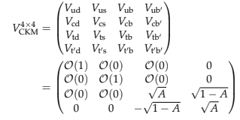
Decay of t’ quark
Extending CKM matrix
https://doi.org/10.48550/arXiv.1209.1062

Slide 4
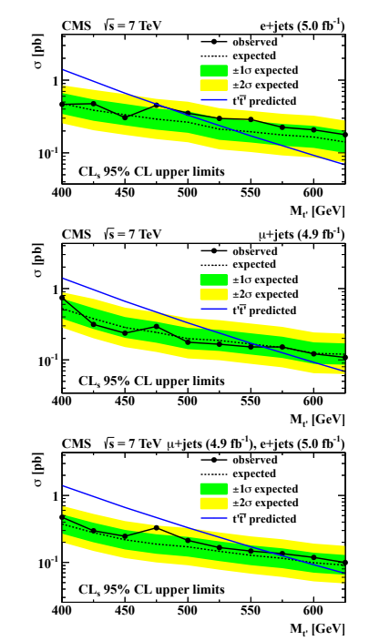
https://doi.org/10.48550/arXiv.1209.1062

Slide 5
Higgs Boson Discovery

Slide 6
Vector-like Quarks

Slide 7
Leptons and Neutrinos

