Slide 1
An analysis of CERN’s search for the gluino
By Marcus Tomlinson

Slide 2
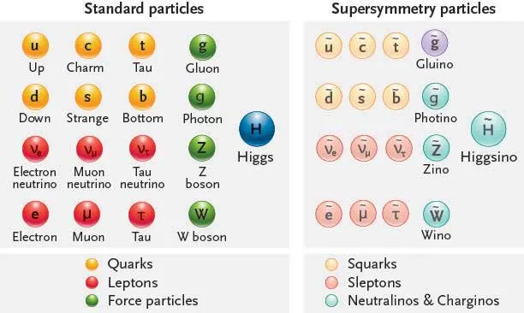
What is supersymmetry?
Standard model needs extension to higher energies
Most corrections mess with Higgs mass
Supersymmetry adds particles via Fermion-Boson symmetry

Slide 3
What is the gluino?
Supersymmetric counterpart to Gluon
Spin-1/2
Strongly interacting
Colour octet
Massive

Slide 4
Why the gluino?
Most supersymmetric states may mix
Superpartners would not directly correspond to single standard model particles
Gluino can’t mix, colour octet has unsuitable quantum numbers for other composition
Should produce recognisable decays
Mass within LHC capabilities

Slide 5
Where not to look?
Theoretical models limit mass below 3 TeV
Cross sections measured for processes that could produce gluino of certain mass
If total cross section attributable to existing processes, exclude gluinos of that mass
CMS at LHC has established lower limit of 1TeV, upper of 2TeV

Slide 6
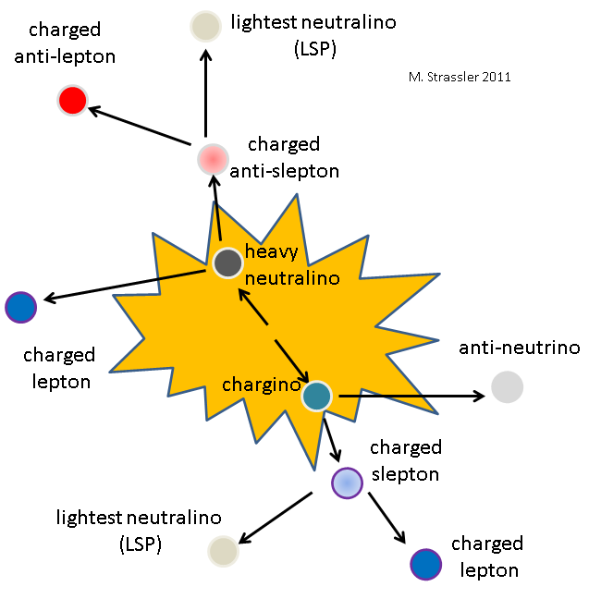
Collider signatures (1)
Gluinos should have unique decay modes
Some decays can produce multiple leptons with the same sign, not seen in standard model
Such a signature would be strong evidence for gluinos
Could also decay

Slide 7
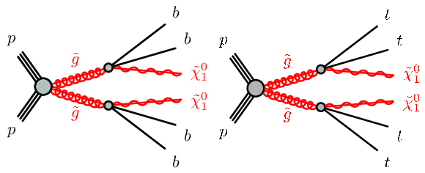
Collider signatures (2)
Gluino pairs could decay to 4 third-generation quarks

Slide 8
Long lived gluinos
Gluinos may not decay within the timescale required to leave detector
LHC “Long lived particle working group” specifically looking for such particles
No candidates currently found
Would likely leave faint tracks, or small energy deposits with no apparent track
Detectors and analysis software being optimised to better identify such signatures in future LHC runs

Slide 9

Does the gluino exist?
Currently no detection of any supersymmetric particles
LHC already has enough energy for gluino
ATLAS and CMS both undergoing detector upgrades, will increase confidence levels for non-detection

