Slide 1
A review of theories and constraints of dark matter
By Harry Rogers

Slide 2
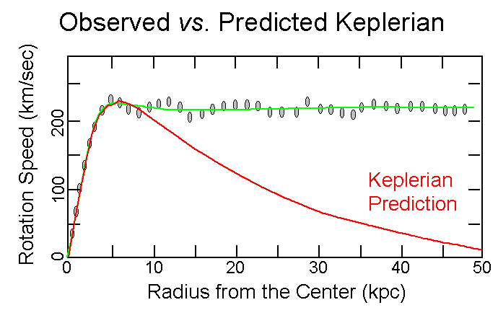
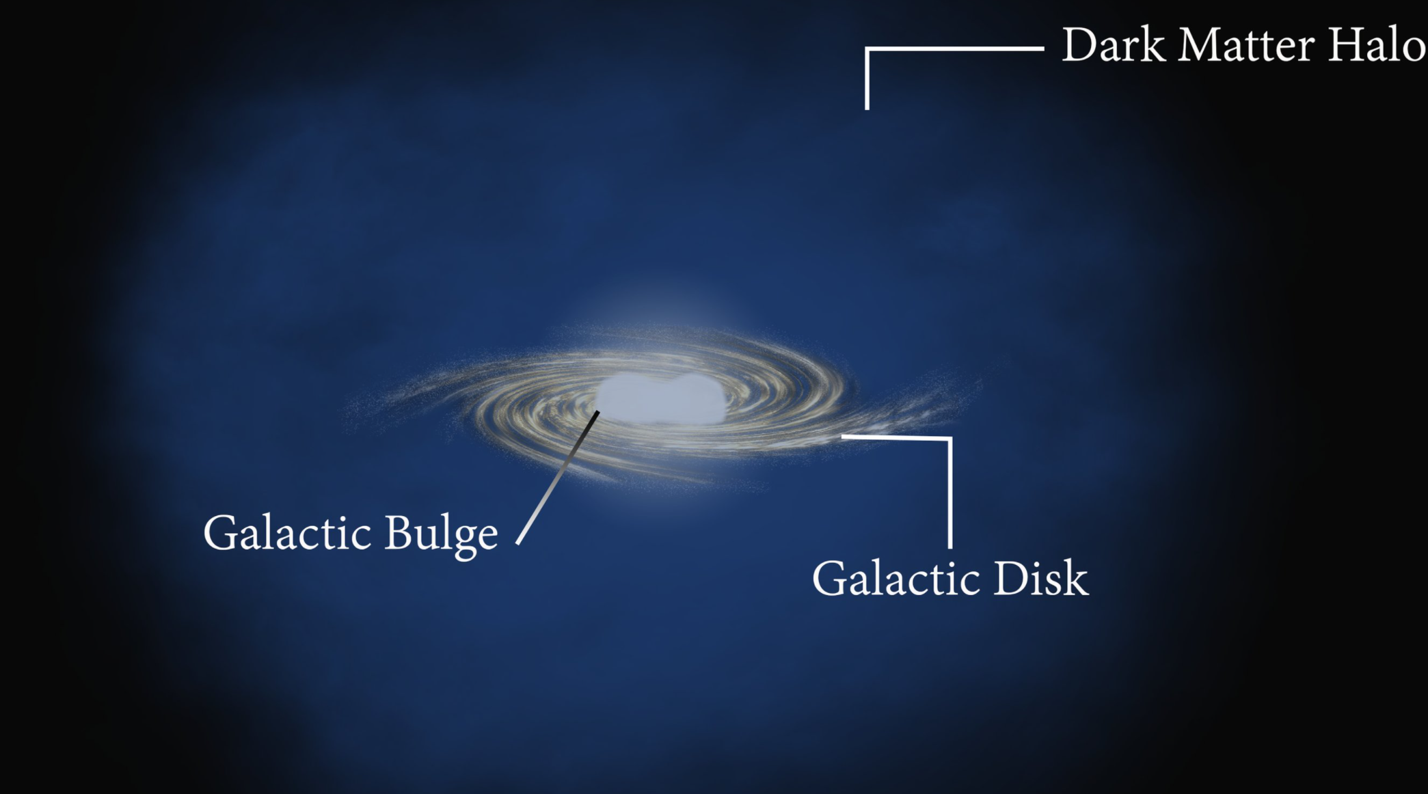
Dark matter
Galaxies do not contain enough matter.
To account for observations, large amount of mass in a large halo around the galaxy.
Estimated that 85% of the total mass in the universe.

Slide 3
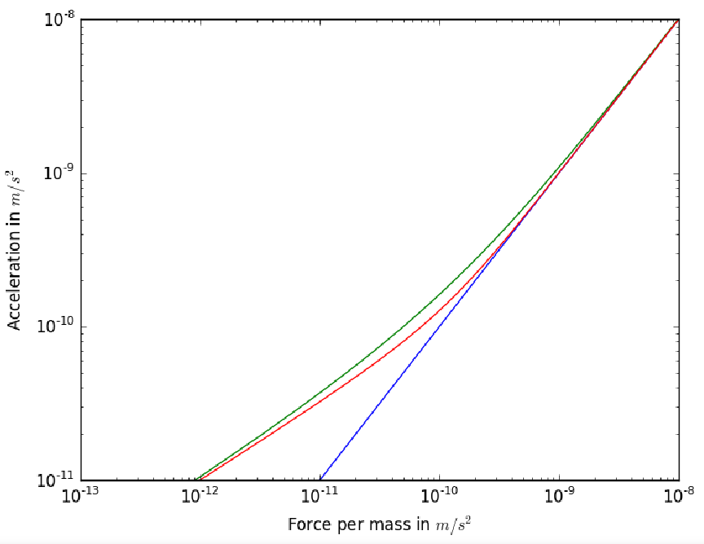
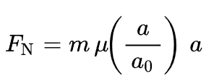
MOND
Modified Newtonian Dynamics
No longer linear acceleration at very low accelerations.
Still requires extra mass, cold gas clouds, dim stars.

Slide 4
Primordial black holes
Formed in the first second after the big bang.
Not generated from stars, can be of any mass.
Cannot be detected by hot accretion disk.
Can be viewed through gravitational lensing.

Slide 5
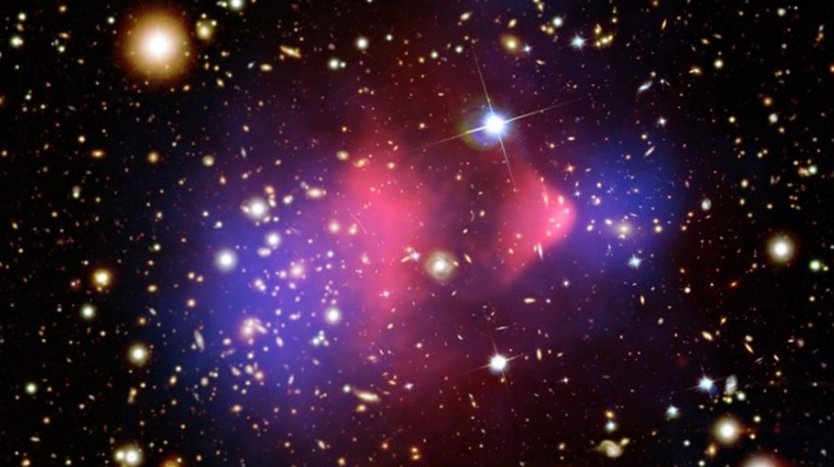
Bullet Cluster
Two galaxy clusters colliding.
Measured centre of masses in blue.
Measured location of hot gas in red.
Centre of mass of visible matter and true centre of mass differ with certainty of 8 sigma.

Slide 6
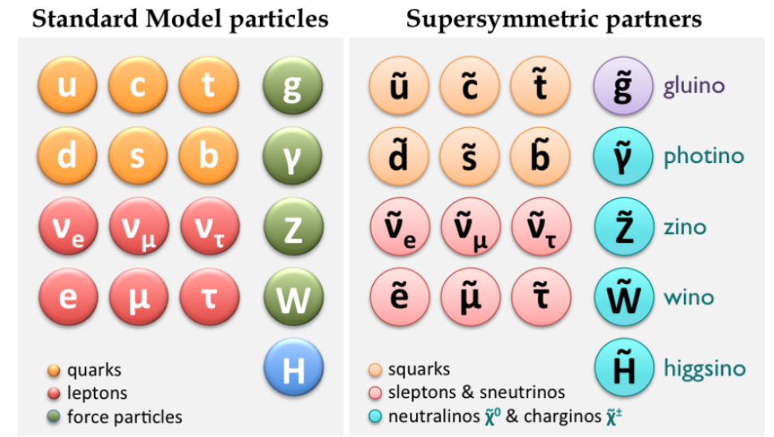
WIMPS and SUSY
Weakly interacting massive particles.
Supersymmetry, a natural extension to standard model, introduces neutralino, ideal candidate for a WIMP.
Solution to further problems in particle physics.
LHC has probed up to 125GeV, requires “unnatural” corrections.

