Slide 1
Momentum Mappings as Tools in QCD Precision
Tom Ben-Ami
Supervisor: Prof. Alexander Mitov

Slide 2
Why do we need to be more Precise?
To keep up with increasingly precise measurements from LHC and later generations
To find new discrepancies between the standard model and the real world

Slide 3
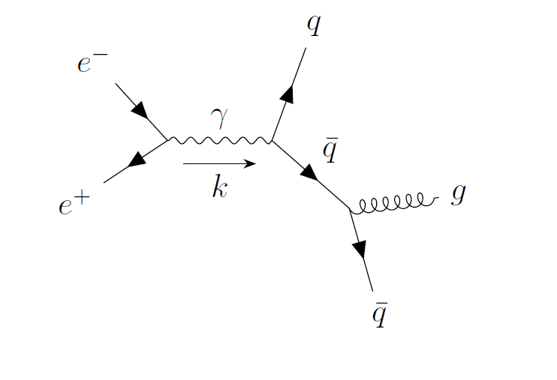
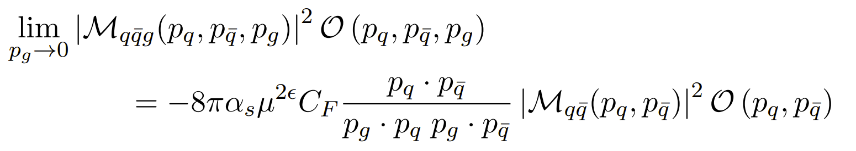
IR Divergences
Divergences due to (massless) contributions with vanishing momentum
$$e^{+}e^{−}→q \overline{q}g$$

Slide 4
KLN Theorem
Kinoshita–Lee–Nauenberg
“under certain general conditions such singularities do not appear”
These singularities are fundamentally removable
But how do we do this in practice?

Slide 5
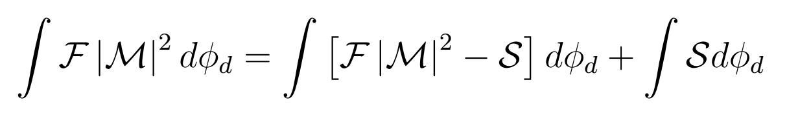
Subtraction Schemes
Counterterm
Original Divergent Matrix element
Notes:
subtraction methods are the standard approach. Real-emission corrections, which exhibit IRC divergences when integrated over phase space, are made integrable by the addition of suitable counterterms. These counterterms exhibit the same divergent behaviour as real-emission matrix elements, but are typically much simpler functions of the kinematics. This permits to integrate them in dimensional regularisation, expose their singularities as poles in the regulator and cancel them against the IRC poles of the virtual loop corrections - as predicted by the KLN theorem.

Slide 6
Subtraction Schemes (2)
Current popular approach for solving these divergences
More easily generalised for higher orders
Is good today for a lot of NLO systems
Relatively reliable and efficient
But how do we find these counterterms?
How do we generalise to higher orders?

Slide 7
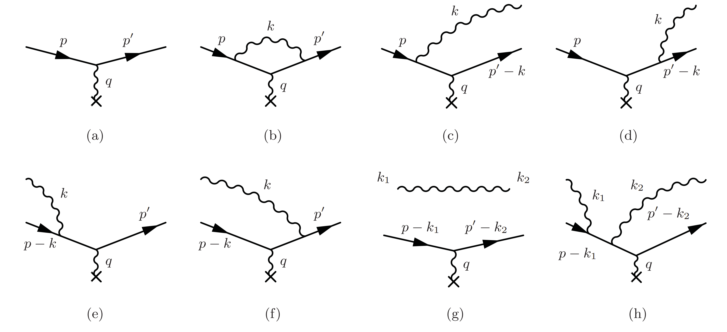
NLO to NNLO, (to N^{N}LO?)
Increase in number of soft divergences that may ‘pop up’
Harder to compute today, even at the NNLO scale
+
+
…
LO
NLO
NNLO

Slide 8
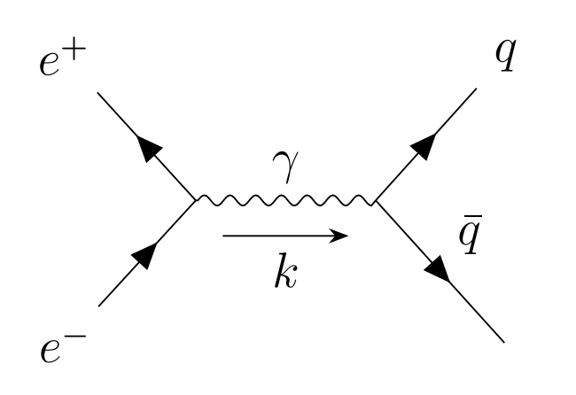
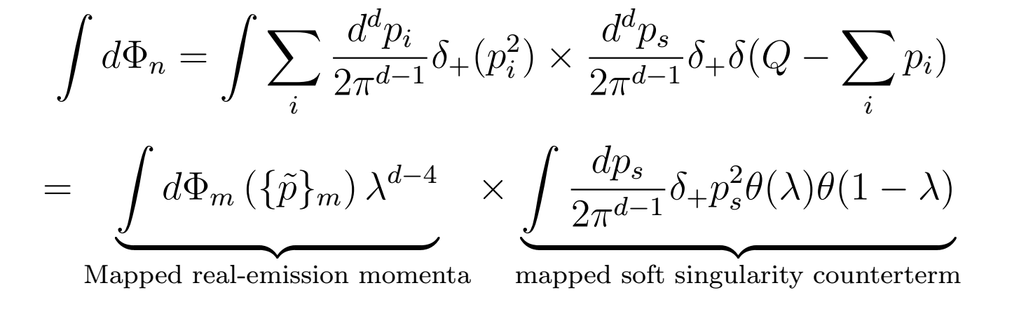

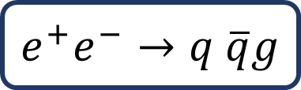
The Momentum Map
$$e^{+}e^{−}→q \overline{q}g$$
We map the momenta into the real emission:
  $$\left\{p_{q},p_{\overline{q}},p_{g}\right\}↦\{\tilde{p_{q}}, \tilde{p_{\overline{q}}}\}$$

Slide 9
The Momentum Map
Improvement from NLO to higher dimensions
A good tool to factorise the system’s phase space, and extract the counterterms
Has the potential to be generalisable, which is important for going beyond NNLO
Today mainly utilised in a very system specific way

Slide 10
The Momentum Map
Outlook to the future
Generalising these schemes – how to go about it
Investigate the properties required of these mappings
Setting up a more structured method of using these mappings

