Slide 1
A Brief Overview of Einstein-Cartan Gravity

Slide 2
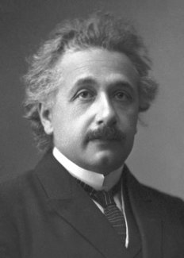
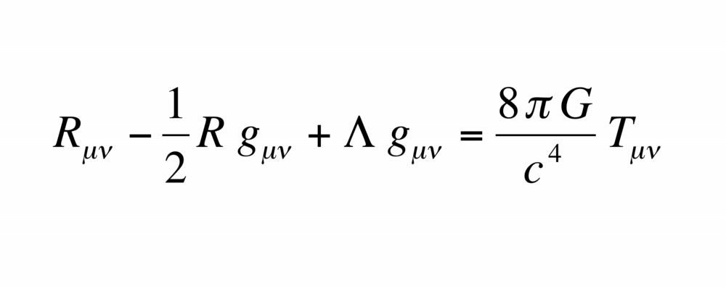


General Relativity
General Relativity is a classical field theory built on the foundation of the equivalence principle.
Gravity is considered a geometric property of spacetime.
We expect that, locally, the laws of physics should be the same.
In this formulation, we operate under the idea that the torsion should be:$T_{μν}^{λ}=Γ_{μν}^{λ}−Γ_{νμ}^{λ}$
Albert Einstein
$$S_{EH}=\frac{1}{16π}\int{d^{4}x}\sqrt{−g}(R−2Λ)$$

Slide 3
There’s something amiss with GR
The current formulation of General Relativity is incompatible with our other working models of the universe.
GR is non-renormalizable.
Singularities arise in the case of Black Holes.
GR does not allow itself to be coupled to spinors.

Slide 4
So why gauge gravity?
Our current Standard Model is constructed from gauge theories.
Gauge theories in themselves have local invariance built into them.
It makes sense!

Slide 5
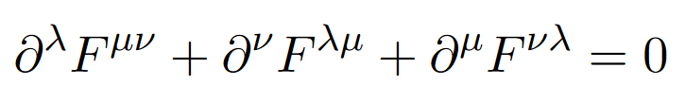

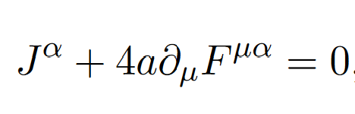
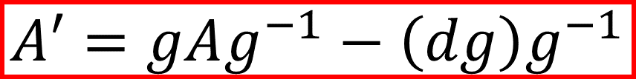
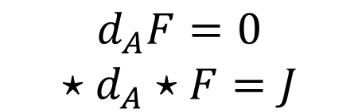
Gauge Field Theories
First three steps for building a Yang-Mills (YM) gauge theory:
  Pick a Manifold
  Pick a Gauge Group
  Pick a representation
The fundamental physical field in YM theories is the Connection
The connection is subsequently used to define the curvature
The YM equations constrain the curvature
$$d_{A}F=0$$
$$⋆d_{A}⋆F=J$$
$$A′=gAg^{−1}−\left(dg\right)g^{−1}$$

Slide 6
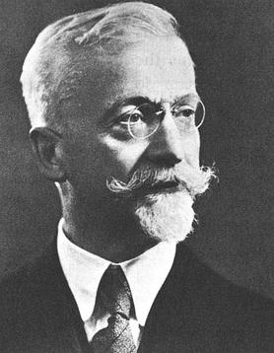

A leap towards Einstein-Cartan
Construct a local orthonormal frame and consider how it transforms as we move through the manifold.
We adopt a vielbein formulation to make calculations more straightforward.
This can be done by asserting that we can write the metric as:
$$g_{μν}=η_{ab}e_{μ}^{a}e_{ν}^{b}$$
Where the components $e_{μ}^{a}$ form an NxN invertible matrix.
But what are vielbeins?
Élie Cartan

Slide 7
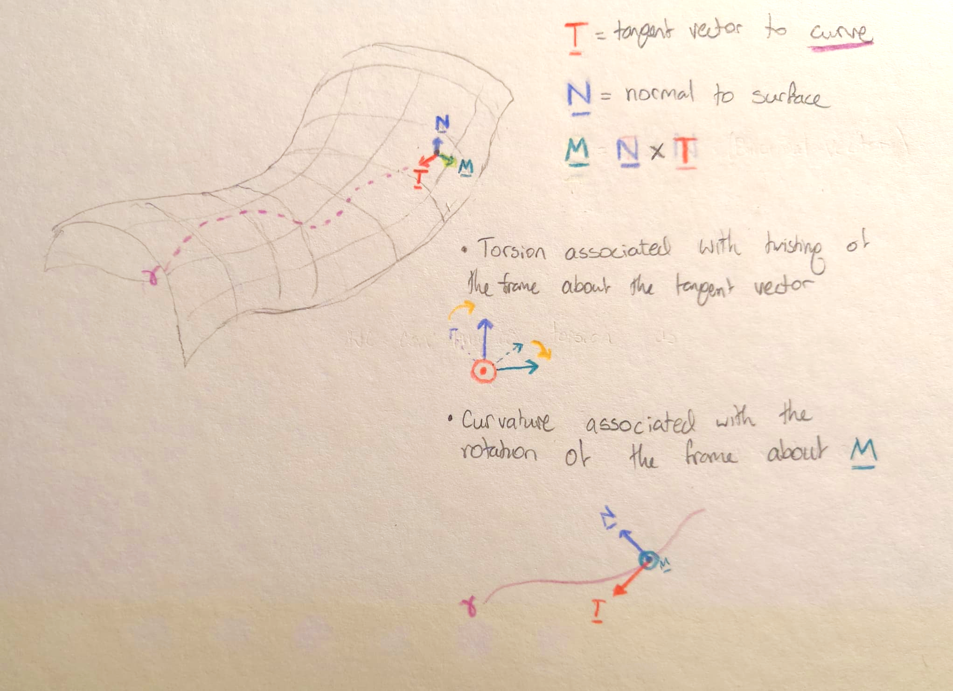

Slide 8

Establishing Connections
We can package the vielbeins into a 1-form: $e^{a}=e_{μ}^{a}{dx}^{μ}$
These objects transform as scalars under a general coordinate transformation
(world indices (Greek) contracted)
This invariance is helpful as we only need to consider transformations on the Lorentz indices (Latin)
Now, consider an infinitesimal Lorentz Transformation:
$Λ_{b}^{a}≈δ_{b}^{a}+{λω}_{b}^{a}$ to first order in λ
Recall from Relativity (Part II):
$$η_{ab}Λ_{c}^{a}Λ_{d}^{b}=η_{cd}$$
$$η_{ab}{(δ}_{c}^{a}+{λω}_{c}^{a}){(δ}_{d}^{b}+{λω}_{d}^{b})=η_{cd}$$
$$η_{ab}ω_{c}^{a}+{η_{cb}ω}_{d}^{b}=0$$
$$ω_{ab}={−ω}_{ba}$$

Slide 9

Establishing Connections cont’d
We expect, as we move infinitesimally on a curved manifold in spacetime, that our co-moving frame will undergo a Lorentz transform. As such, we expect the change in our vielbeins to be given by:
$de^{a}=−ω_{b}^{a}∧e^{b}$ (*)
Since we are in Minkowski space, we can say that each set of vielbeins can be related to another via a Lorentz transformation:
$$e^{a}=Λ_{b}^{a}{e′}^{b}$$
But how then, should ω transform to preserve (*)?
$$d(Λ_{b}^{a}{e^{′}}^{b})=−ω_{b}^{a}∧(Λ_{b}^{a}{e^{′}}^{b})$$
$$\left(dΛ_{b}^{a}\right){e^{′}}^{b}+Λ_{b}^{a}d{e^{′}}^{b}=−ω_{b}^{a}∧Λ_{b}^{a}{e^{′}}^{b}$$
$$\left(dΛ_{b}^{a}\right){e^{′}}^{b}+Λ_{b}^{a}\left(−{ω^{′}}_{b}^{a}∧{e^{′}}^{b}\right)=−ω_{b}^{a}∧Λ_{b}^{a}{e^{′}}^{b}$$
$ω=Λω^{′}Λ^{−1}−(dΛ)Λ^{−1}$ (suppressing indices)

Slide 10

A pattern emerges!
$$ω′=ΛωΛ^{−1}−(dΛ)Λ^{−1}$$
$$A′=gAg^{−1}−\left(dg\right)g^{−1}$$

Slide 11

So what?
This was a lot of work but what have we actually done?
Firstly, by direct comparison to YM connections, we have now developed a connection term:
$$A′=gAg^{−1}−\left(dg\right)g^{−1}$$
$$ω′=ΛωΛ^{−1}−(dΛ)Λ^{−1}$$
Secondly, we have reduced the size of our G-bundle for four-dimensional spacetime from GL(4,$ℝ$) to the Lorentz Group SO(1,3) (compactness is a problem though…)
Thirdly, By relaxing the restriction of no torsion, we can couple spinors to gravity! (covered more extensively by Mattia Varrone)

Slide 12


Pushing Forward
You may remember earlier that I mentioned that gauge theories are built up purely from their connections.
We haven’t quite been able to do that here since we still have lingering vielbeins
Ultimately we combine both the spin connection and the vielbeins to form a new connection (Poincaré Gauge Theory)
The resulting action looks very similar to Yang-Mills actions
However, due to the hyperbolic nature of spacetime, we still can’t deal with gravity as we have in the past with our other gauge theories.
Unfortunately, we still cannot quantise gravity, but exploring variant formulations of General Relativity is certainly a good place to start to get a gauge of the situation…
$$S_{EH}=\frac{1}{16π}\int{d^{4}x}\sqrt{−g}(R−2Λ)$$
$$S_{EC}=\frac{1}{32π}\int{ε_{abcd}e^{a}∧e^{b}∧(R_{ω}^{cd}−\frac{Λ}{6}e^{c}∧e^{d})}$$

Slide 13
Thank You

Slide 14

A stumble into differential forms
We call the object $A=A_{μ}{dx}^{μ}$ a 1-form which transforms thusly:
$A=A_{μ}{dx}^{μ}$= $A_{μ}\frac{∂xμ}{∂x′ν}{dx′}^{μ}$
We can extend this idea to k-forms:
$$H={\frac{1}{k!}H}_{{μ_{1}μ_{2}…μ}_{k}}{dx}^{μ_{1}}∧{dx}^{μ_{2}}∧…∧{dx}^{μ_{k}}$$
Where the exterior product $"∧"$is defined via the following axioms:
Bilinearity: $u∧\left(av+bw\right)=a\left(u∧v\right)+b(u∧w)$
Anticommutativity: $u∧v=−v∧u$
Alternativity: $u∧u=0$ $∀a,b∈ℝ;u,v,w∈V$
More generally we can say:
$${dx}^{σ(1)}∧{dx}^{σ\left(2\right)}∧…∧{dx}^{σ\left(k\right)}=sgn(σ){dx}^{1}∧{dx}^{2}∧…∧{dx}^{k}$$

Slide 15

A stumble into differential forms cont’d
We are (perhaps unknowingly) already familiar with the action of the exterior derivative on a scalar function:
$df=\frac{∂f}{∂x^{j}}dx^{j}$ (0-forms)
We now extend the definition of the exterior derivative as an operation which takes a k-form $ω∈Ω^{k}$ to k+1-forms $ω∈Ω^{k+1}$ via the following axioms:
$d\left(α∧β\right)=\left(dα\right)∧β+{\left(−1\right)}^{p}α∧(dβ)$ $α∈Ω^{p}; β∈Ω^{q}$
$d∘d=0$
$d(cω)=cdω$ $c∈ℝ;ω∈Ω^{p}$
So taking $H={\frac{1}{k!}H}_{{μ_{1}μ_{2}…μ}_{k}}{dx}^{μ_{1}}∧{dx}^{μ_{2}}∧…∧{dx}^{μ_{k}}$
$$dH={\frac{1}{k!}∂_{ν}H}_{{μ_{1}μ_{2}…μ}_{k}}{dx^{ν}∧dx}^{μ_{1}}∧{dx}^{μ_{2}}∧…∧{dx}^{μ_{k}}$$

Slide 16
A stumble into differential forms cont’d
We are (perhaps unknowingly) already familiar with the action of the exterior derivative on a scalar function:
$df=\frac{∂f}{∂x^{j}}dx^{j}$ (0-forms)
We now extend the definition of the exterior derivative as an operation which takes a k-form $ω∈Ω^{k}$ to k+1-forms $ω∈Ω^{k+1}$ via the following axioms:
$d\left(α∧β\right)=\left(dα\right)∧β+{\left(−1\right)}^{p}α∧(dβ)$ $α∈Ω^{p}; β∈Ω^{q}$
$d∘d=0$
$d(cω)=cdω$ $c∈ℝ;ω∈Ω^{p}$
So taking $H={\frac{1}{k!}H}_{{μ_{1}μ_{2}…μ}_{k}}{dx}^{μ_{1}}∧{dx}^{μ_{2}}∧…∧{dx}^{μ_{k}}$
$$dH={\frac{1}{k!}∂_{ν}H}_{{μ_{1}μ_{2}…μ}_{k}}{dx^{ν}∧dx}^{μ_{1}}∧{dx}^{μ_{2}}∧…∧{dx}^{μ_{k}}$$

Slide 17

Connecting Connections
Is there a way to return to the familiar Levi-Civita Connection from the spin connection?
$$∇X=∇_{μ}X^{ν}{dx}^{μ}⊗∂_{ν}=∇_{μ}X^{a}{dx}^{μ}⊗e_{a}$$
$${(∂}_{μ}X^{ν}+Γ_{μλ}^{ν}X^{λ}){dx}^{μ}⊗∂_{ν}={\{∂}_{μ}X^{a}+{ω_{c}^{a}}_{μ}X^{c}\}{dx}^{μ}⊗e_{a}$$
$={\{∂}_{μ}X^{a}+{{(ω}_{c}^{a})}_{μ}X^{c}\}{dx}^{μ}⊗{e_{a}}^{ν}∂_{ν}$
$={{(e}_{a})}^{ν}\{∂_{μ}{[(e^{a})}_{ρ}X^{ρ}]+{{(ω}_{c}^{a})}_{μ}X^{c}\}{dx}^{μ}⊗∂_{ν}$
$={{(e}_{a})}^{ν}\{\left(∂_{μ}X^{ρ}\right){\left(e^{a}\right)}_{ρ}{+(∂}_{μ}{\left(e^{a}\right)}_{ρ})X^{ρ}+{{(ω}_{c}^{a})}_{μ}X^{c}\}{dx}^{μ}⊗∂_{ν}$
$$=[\left(∂_{μ}X^{ν}\right){+{{(e}_{a})}^{ν}(∂}_{μ}{\left(e^{a}\right)}_{ρ})X^{ρ}+{{{(e}_{a})}^{ν}{ {{(e}^{c})}_{λ}(ω}_{c}^{a})}_{μ}X^{λ}]{dx}^{μ}⊗∂_{ν}$$
By direct comparison:
$${{(ω}_{b}^{a})}_{μ}={(e^{a})}_{ν}{{(e}_{b})}^{λ}Γ_{μλ}^{ν}−{{(e}_{b})}^{λ}∂_{μ}{(e^{a})}_{λ}$$

Slide 18

Torsion
Earlier, we discussed the idea of an infinitesimal change in the vielbein via the equation:
$$de^{a}+ω_{b}^{a}∧e^{b}=0$$
However, this only considers the change in the vielbeins due to curvature. What if we consider an additional variation arising from torsion?
We write:
$$T^{a}=D_{ω}e^{a}=de^{a}+ω_{b}^{a}∧e^{b}$$
Plugging in ${{(ω}_{b}^{a})}_{μ}={(e^{a})}_{ν}{{(e}_{b})}^{λ}Γ_{μλ}^{ν}−{{(e}_{b})}^{λ}∂_{μ}{(e^{a})}_{λ}$ we retrieve the familiar torsion relation:
$$T_{μν}^{λ}=Γ_{μν}^{λ}−Γ_{νμ}^{λ}$$
Which we set to zero in the Einstein-Hilbert formation.
It is worth noting that in regions with vanishing torsion, Einstein-Hilbert and Einstein Cartan are essentially equivalent. The difference is that one relies purely on the metric whereas the other relies on the connection and vielbeins.

