Slide 1
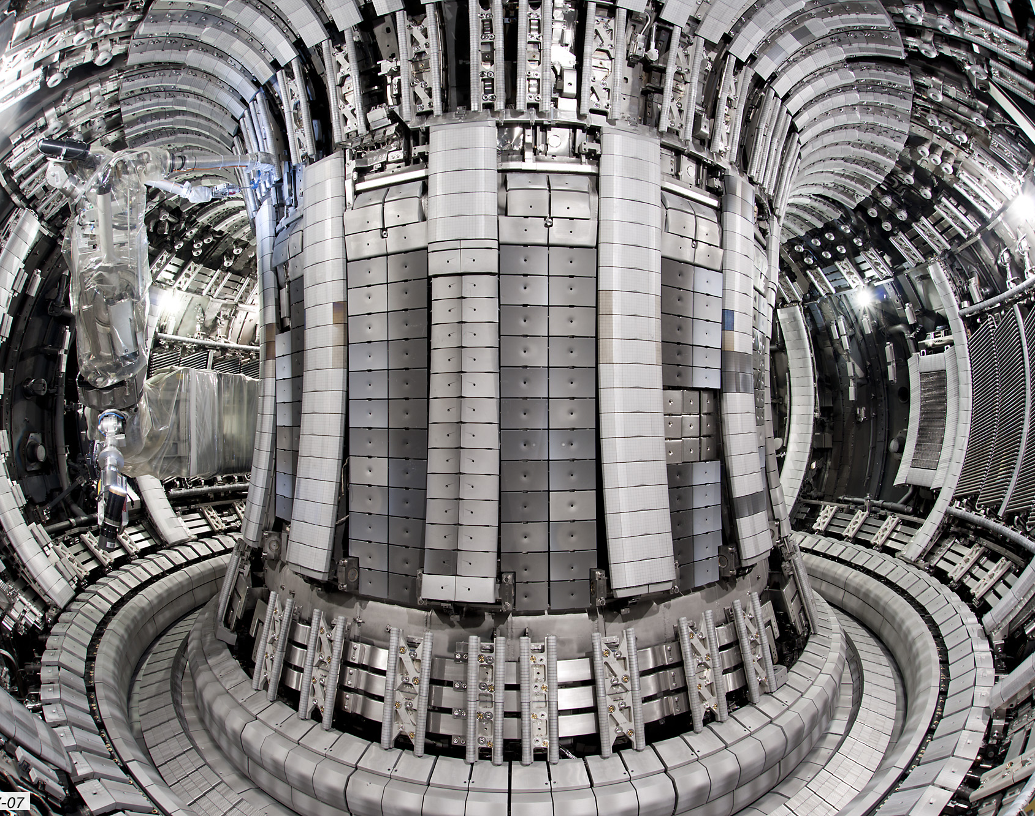
Dominant technical challenges for Magnetic Confinement Fusion
What is the status of research?

Slide 2
Why is fusion important?

Slide 3
Fusion’s advantages
The research leads to a greater understanding of plasma science, which in turn could provide:
Compact particle accelerators for imaging and cancer treatments
New materials
Fundamental knowledge about the creation of the solar system
Provides a sustainable source of energy
Low land use
Carbon free
Low, manageable waste
Reliable baseload
Safe (no runaway, chain events)
Notes:
Energy density is a big issue as population densities are so large.
It has an incredibly high yield

Slide 4
What are the challenges

Slide 5
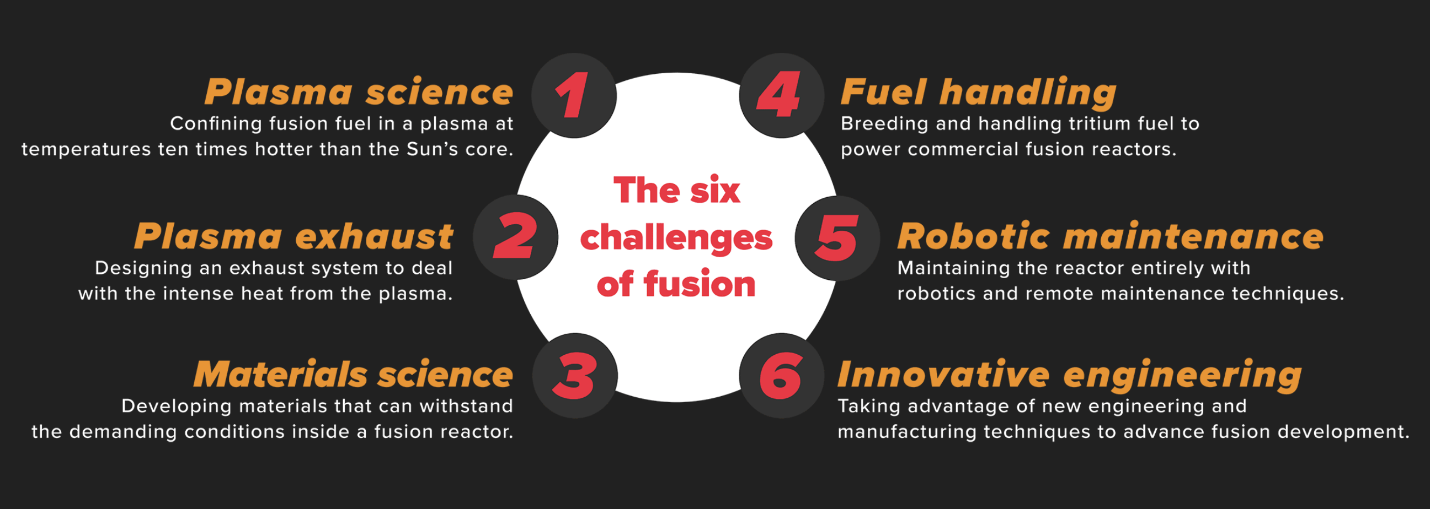
Culham Centre for Fusion Energy
Highlight 6 main challenges for fusion

Slide 6
European Research Roadmap to the Realisation of Fusion Energy
Highlight 9 main challenges for commercially viable fusion
Plasma regimes of operation
Heat-exhaust systems
Neutron tolerant materials
Tritium self-sufficiency
Stellarator
Implementation of the intrinsic
Safety features of fusion
Integrated DEMO design and
system development
Competitive cost of electricity
Recent gate review
Notes:
EUROfusion takes a staged approach to designing DEMO, with industry-standard review practises including a gate review process. Each project phase is reviewed by a panel of independent experts before the project can advance to the next phase
I will discuss those that are common to both and that focus more on the physics of nuclear fusion. Last three are very important but have less of a physical underpinning so I will be focussing on these three.

Slide 7
How Fusion works
Notes:
There a multiple routes for fusion

Slide 8
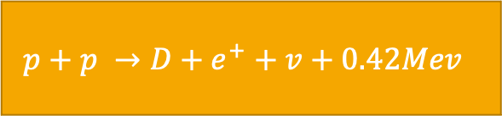
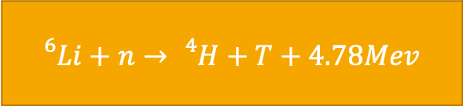
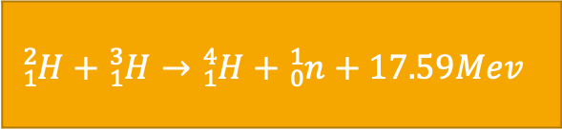
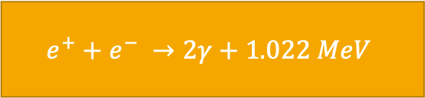
The Sun’s Fusion vs Our Fusion
The Sun
Our Fusion
$$p+p →D+e^{+}+v+0.42Mev$$
$${}_{1}^{2}H+{}_{1}^{3}H→{}_{1}^{4}H+{}_{0}^{1}n+17.59Mev$$
$$e^{+}+e^{−} →2γ+1.022 MeV$$
$${}_{}^{6}{Li}+n→{}_{}^{4}H+T+4.78Mev$$
Notes:
On earth is easiest to do DT reaction because proton cycle is based on the weak interaction ; ‘low reaction cross-section makes it impossible to use for any practical application on Earth’

Slide 9
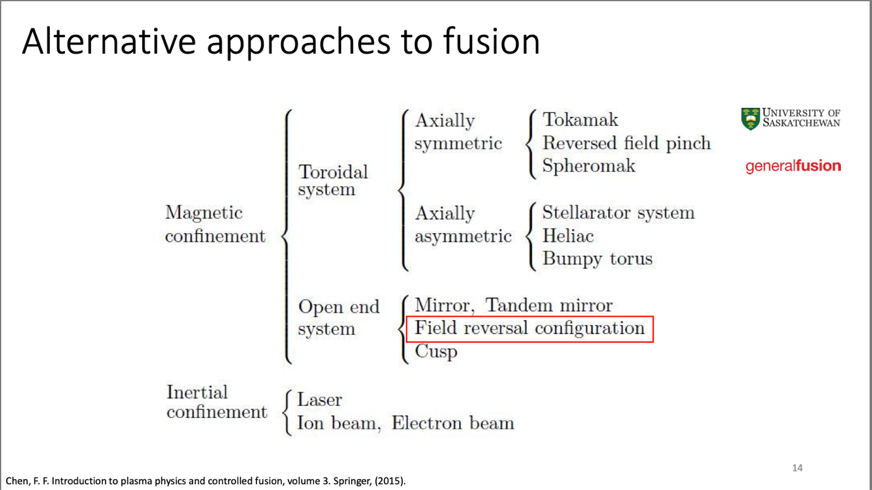
Approaches to Fusion

Slide 10
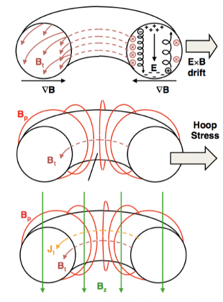
Tokamaks
1. End Loss
Loop container back on itself
2. Particle Drift
Introduce current to produce poloidal field
3. Plasma Expansion
Vertical field
Notes:
In a toroidal field, particles drift due to the varying magnetic field line density, leading to charge separation. Hence use a transformer circuit to induce a current in the plasma and hence a poloidal field
plasma toroidal geometry generates a force that tends to expand the plasma itself outward along the major radius
Auxillary heating used to get the plasma to 50-200 million degrees - 10x hotter than sun

Slide 11
Plasma scenario

Slide 12
Why is it difficult?
Processes in magnetized plasma span a huge range of spatial and temporal scales
Langmuir plasma oscillations ~0.1 ns
Slow global diffusion ~10s.
Some dynamics with strong coupling between large and small spatial scales
Instabilities vary in scale.
MHD instabilities – large scale instabilities predicted by classical theory.
Plasma disruption i.e. termination
Turbulence
Reduces the efficiency of the process
Instabilities
Notes:
Extreme scenarios of any physical theory tests both our understanding of said theory and it’s own validity. The extreme environments of tokamaks are no different.
Different scales require different theories – e.g. in optics where we go from using ray theory to quantum optics.
Add to this that the behaviours of different scales in plasma are also coupled, so you require a means of bridging these transitions between difference theories.

Slide 13
Heat Exhaust Systems

Slide 14
Divertors
Impurities
Cool the plasma
Heat
Protect the walls of the tokamak
Notes:
deleterious effect on heat confinement, as the high-Z atoms have a large number of bound electrons prior to entering the plasma, and upon entering the plasma the ionization process removes energy from the plasma, while the subsequent recombination process radiates away energy in the form of electromagnetic radiation.
positioned at the intersection of magnetic field lines where particle bombardment will be particularly intense in ITER. As the high-energy plasma particles strike the vertical targets, their kinetic energy is transformed into heat and the heat is removed by active water cooling.
Near edge we see a hot gradient – explosive instabilities (a burst of energy). Every time this happened the heat and energy throws heat against the floor (like a solar flare).
Each time this happens it throws a lot of potential energy and throws it against the wall – damage.
Solution? Find a way to release energy at edge while keeping centre hot.
Trying to optimise these and work out which configuration works best

Slide 15
Materials

Slide 16
Materials damage in tokamaks
Materials endure extreme fluxes of :
  heat,
  energetic particles
  deuterium and/or tritium
  high energy neutrons (10¹⁸ -10²⁰ nm-²s⁻¹), leading to:
All the above leading to:
  melting damage
  erosion
  tritium or deuterium embedding leading to deformation of materials
Also have high magnetic fields, leading to
  creep
  cyclic fatigue
Atomistic scale events can affect mesoscale features, which leads to difficulty as models differ depending on the scale of the problem
Notes:
(sacrificial surfaces)
, because they determine the long lifetime of the plant
Have to feed atomistical models of dislocations and how they interact + multi-dislocation dynamics into a representative mesoscale and the macroscale model. Then account that this is needed for various materials and their joints is a challenge.

Slide 17
To conclude
Importance
Sustainable solution to energy crisis
Challenges
Commercialisation – cost efficient
Implementation
Physics + engineering
Plasma scenario
Large scale range and need to control instabilities
Heat Exhaust system
Divertor system – protects the tokamak components and improves efficiency
Materials
Scale of theories again is a difficult, as well as the many ways in which the materials are damaged
Future?
ITER – international effort with Russia, China, Europe, USA …
DEMO – European effort
Private sector funding – Fusion Industry Association has had ~ $1 billion in the past 10 years
Stellarators

