Slide 1
Muon Colliders
Brendan Ng

Slide 2
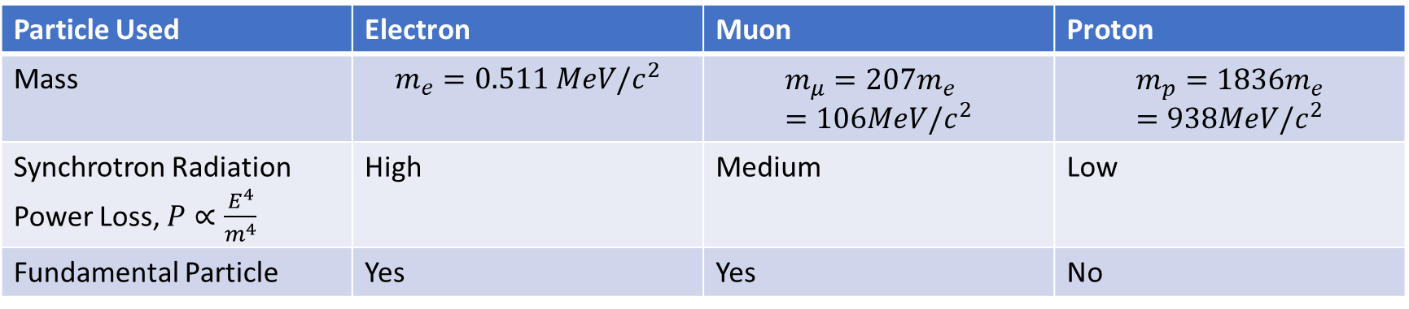
Motivation
Particle Used | Electron | Muon | Proton
Mass | $$m_{e}=0.511 MeV/c^{2}$$ | $$m_{μ}=207m_{e}=106MeV/c^{2}$$ | $$m_{p}=1836m_{e}=938MeV/c^{2}$$
Synchrotron Radiation Power Loss, $P∝\frac{E^{4}}{m^{4}}$ | High | Medium | Low
Fundamental Particle | Yes | Yes | No
Notes:
Beyond the standard model
Midway between hadrons and e- e+ colliders
pp colliders as proxy for hadron colliders
Synchrotron Radiation means same accelerator technologies can be used (superconducting magnets and Rf cavities)
Fundamental particle means full energy available for collisions unlike protons which consist of quarks and gluons

Slide 3
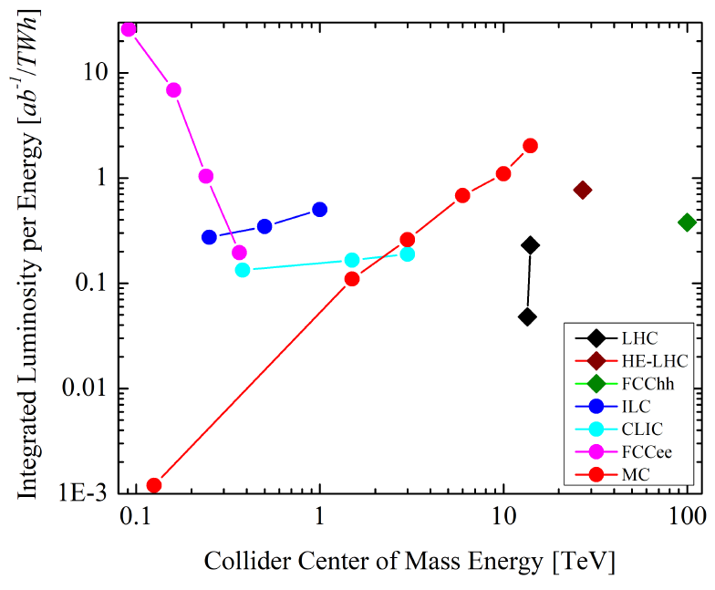
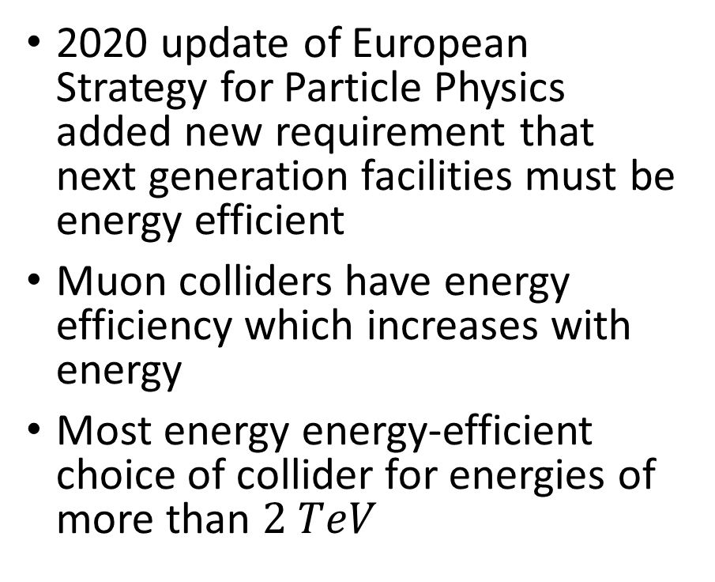
2020 update of European Strategy for Particle Physics added new requirement that next generation facilities must be energy efficient
Muon colliders have energy efficiency which increases with energy
Most energy energy-efficient choice of collider for energies of more than $2 TeV$

Slide 4
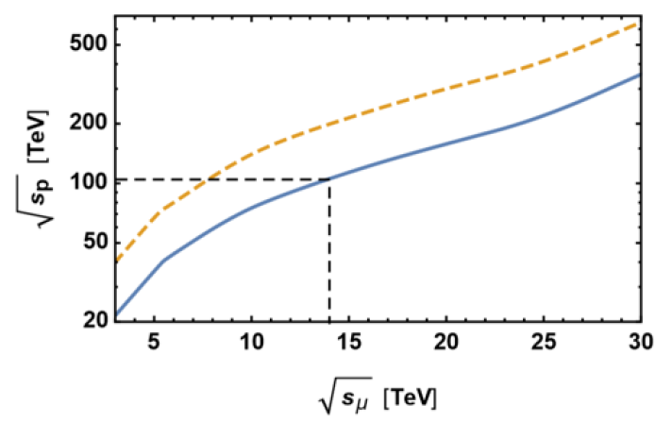
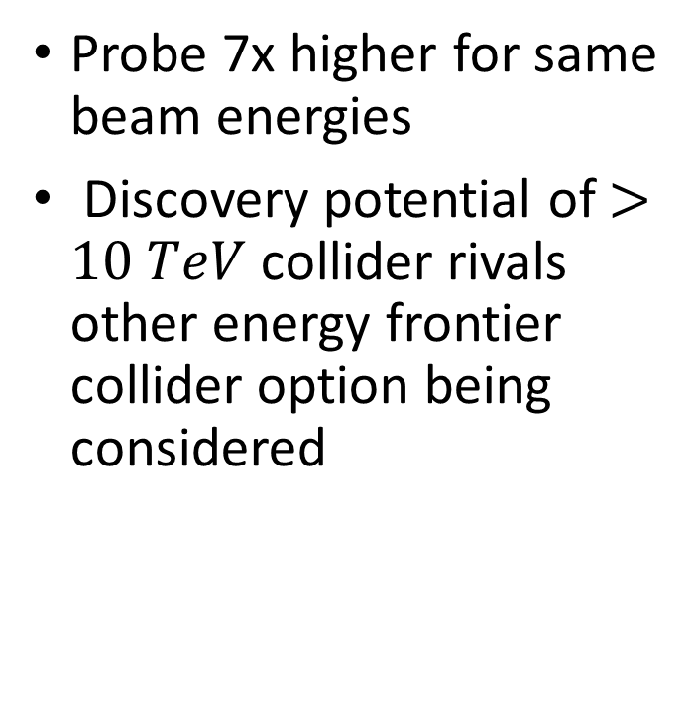
Probe 7x higher for same beam energies
Discovery potential of $>10 TeV$ collider rivals other energy frontier collider option being considered
Notes:
Blue line has QCD enhancement of production rate at a proton-proton colllider

Slide 5
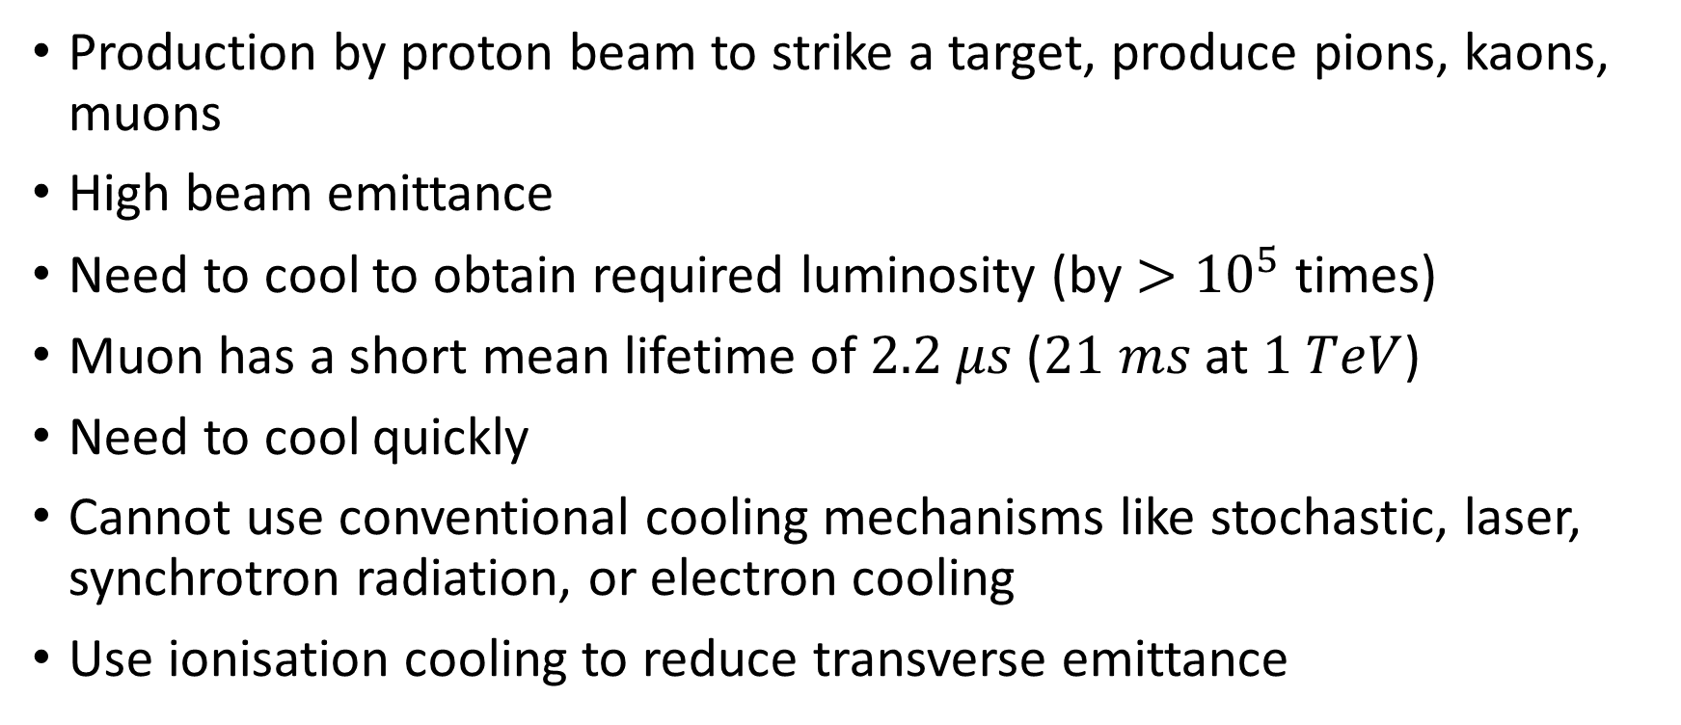
Challenge
Production by proton beam to strike a target, produce pions, kaons, muons
High beam emittance
Need to cool to obtain required luminosity (by $>{10}^{5}$ times)
Muon has a short mean lifetime of $2.2 μs$ ($21 ms$ at $1 TeV$)
Need to cool quickly
Cannot use conventional cooling mechanisms like stochastic, laser, synchrotron radiation, or electron cooling
Use ionisation cooling to reduce transverse emittance
Notes:
First time unstable particles used in collider
Pions and kaons decay to muons
Emittance is 6D phase space density (spread)
Cooling draws parallels from kinetic theory

Slide 6
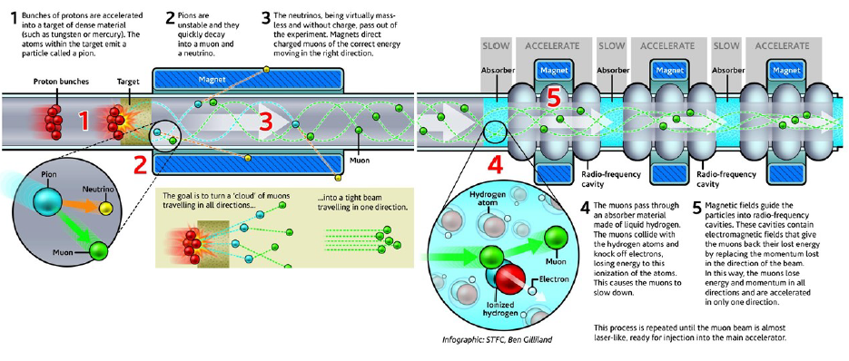
Cooling
Muon Ionisation Cooling Experiment (MICE)

Slide 7
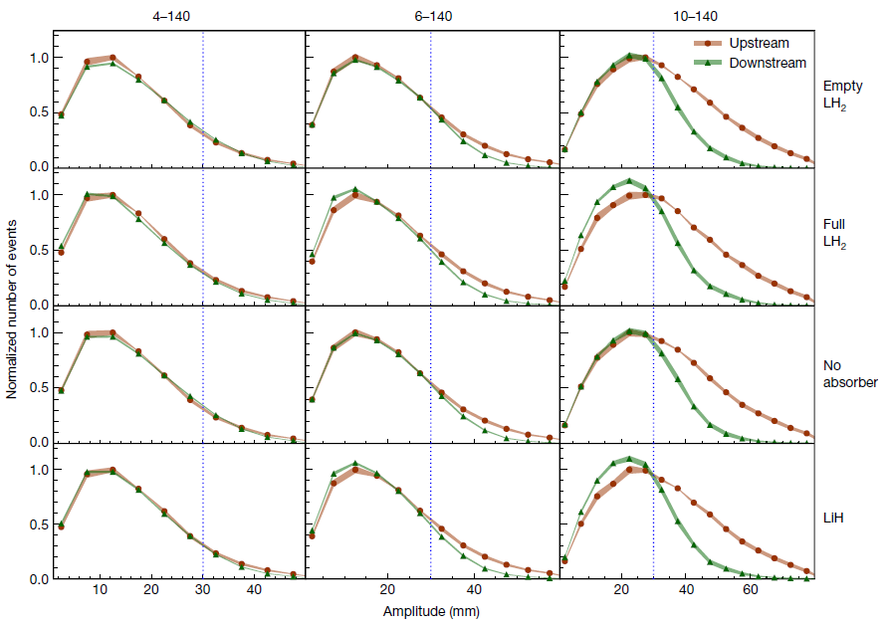
Notes:
Normalised rms emittance
Dotted line is beam scraping
Obtained substantial cooling effect $O\left(10\%\right)$ reduction in emittance of 140 $MeV/c$ momentum beam
Magnitude of cooling in line with simulation, validating muon collider designs which rely on such simulations

Slide 8
Alternative: Producing Cool Muons
Annihilate electrons and positrons just above the muon-antimuon threshold
Produced relatively cool muon beams

Slide 9
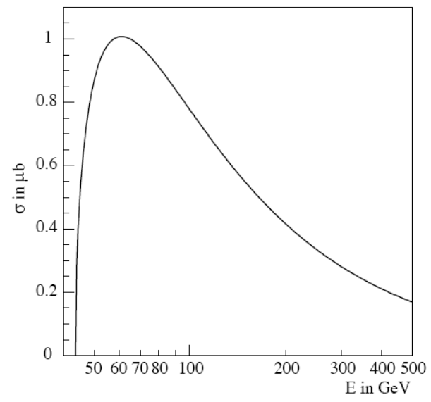
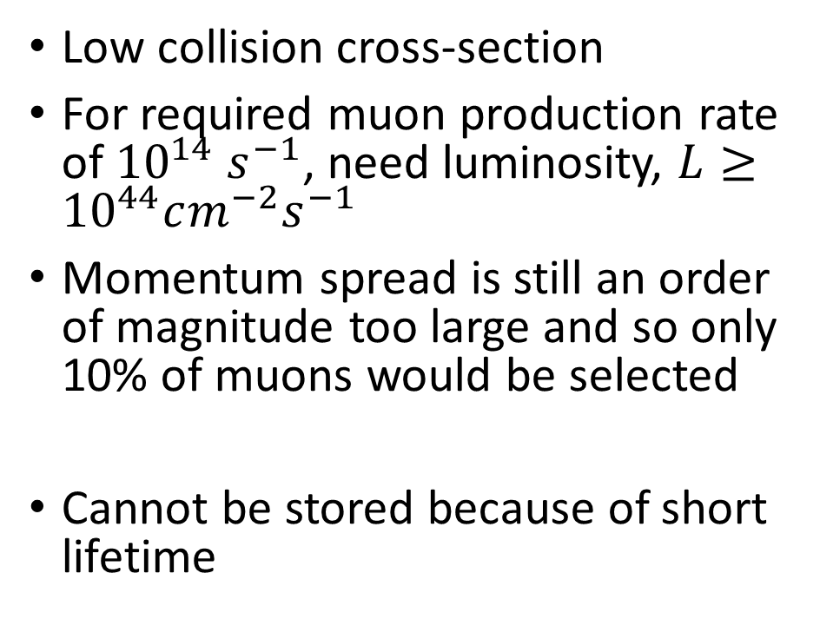
Challenge
Low collision cross-section
For required muon production rate of ${10}^{14} s^{−1}$, need luminosity, $L≥{10}^{44}cm^{−2}s^{−1}$
Momentum spread is still an order of magnitude too large and so only 10% of muons would be selected
Cannot be stored because of short lifetime
Notes:
Graph shows muon production cross-section
Collision of e+e- on fixed target
Muons nearly at rest in CoM frame at threshold of 43.7 GeV
c.f. LHC design luminosity of 10^34
Too high power dissipation (not in line with ESPP’s requirement)
Momentum selection giving an even lower production cross-section

Slide 10
Conclusion
Competitive and promising option for an energy frontier collider

Slide 11
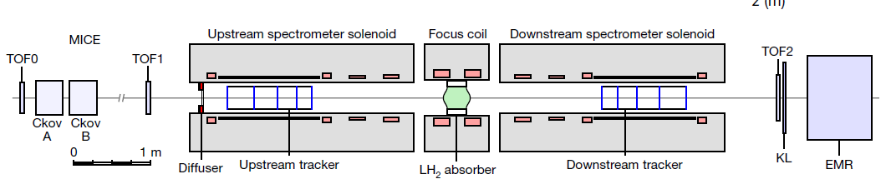

Slide 12
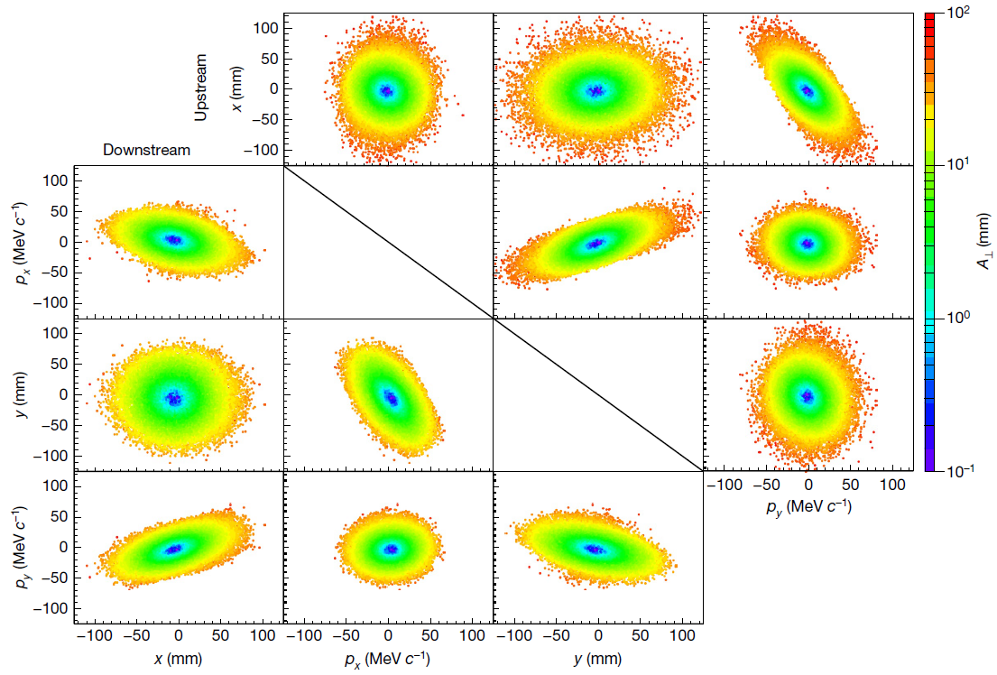

Slide 13
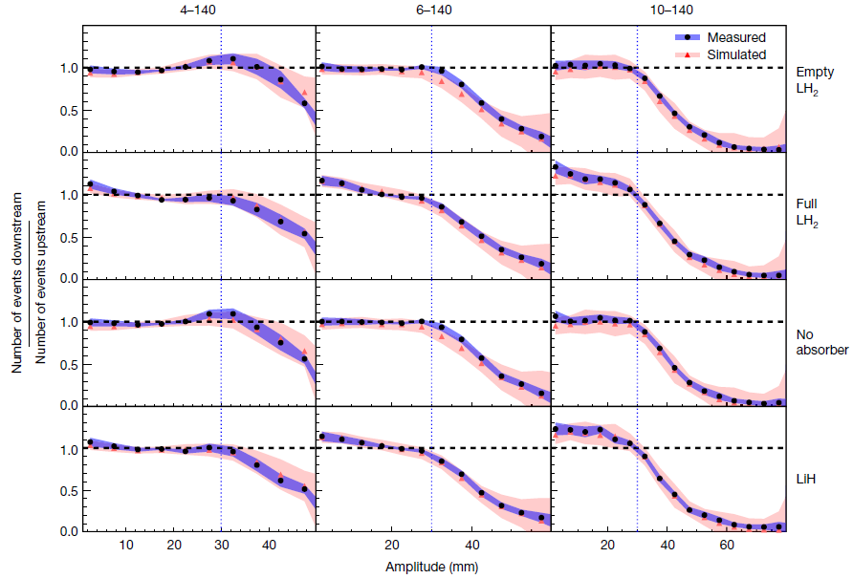

Slide 14

Other Challenges
RF systems to accelerate beam rapidly before beam decays
$10T$ to $15T$ dipole magnets to keep collider ring as small as possible so can maximise number of collisions before muon decay

Slide 15
Development of energy-frontier muon collider would also benefit other efforts in the field, e.g. magnets for proton-proton colliders

