Slide 1
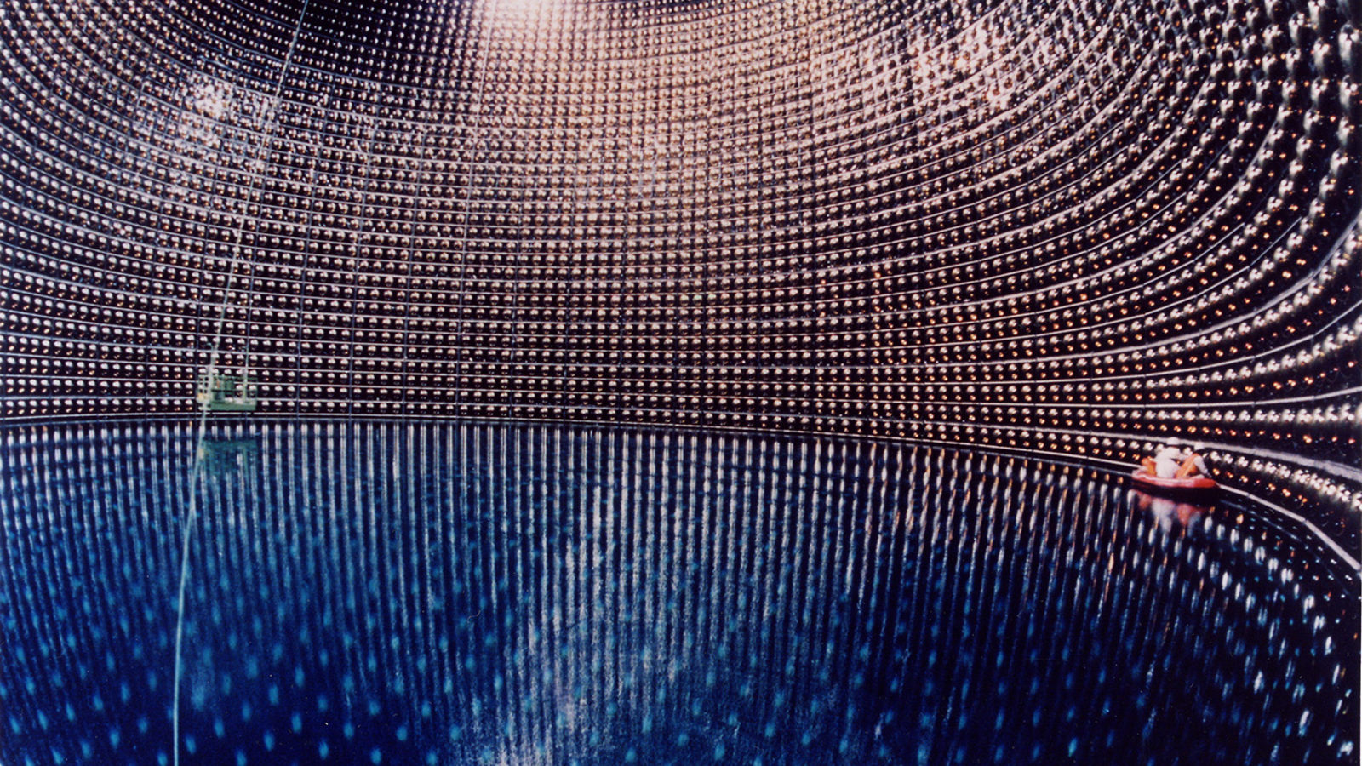
Neutrino Oscillation Experiments
Martha Laundy-Blair
Homerton College
Super Kamiokande Neutrino Detector

Slide 2
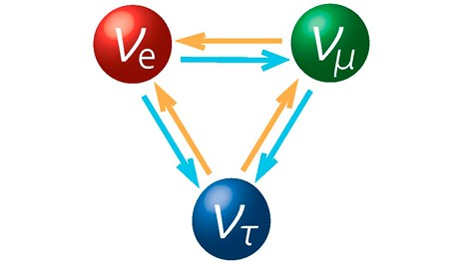
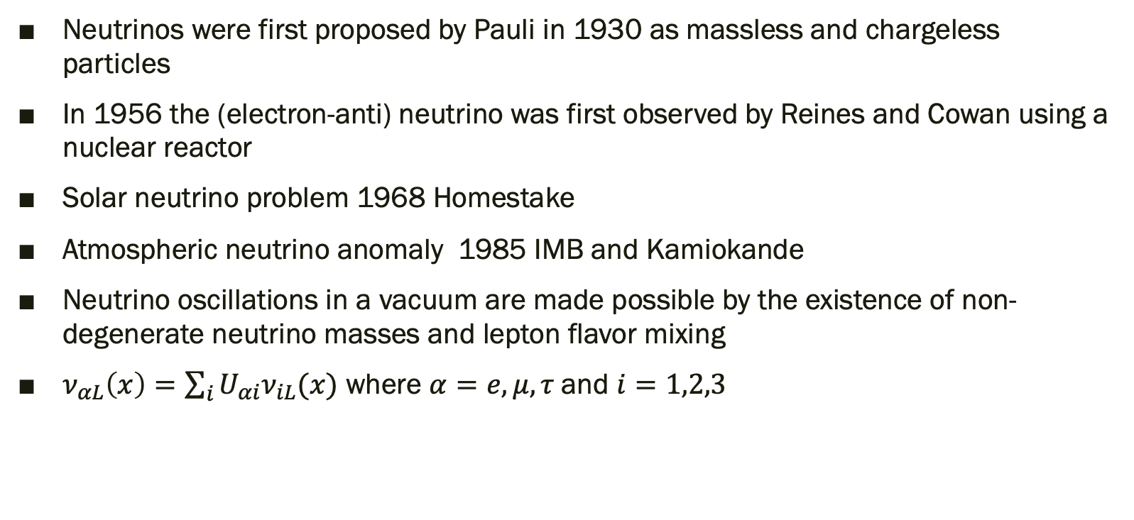
What are neutrino oscillations?
Neutrinos were first proposed by Pauli in 1930 as massless and chargeless particles
In 1956 the (electron-anti) neutrino was first observed by Reines and Cowan using a nuclear reactor
Solar neutrino problem 1968 Homestake
Atmospheric neutrino anomaly 1985 IMB and Kamiokande
Neutrino oscillations in a vacuum are made possible by the existence of non-degenerate neutrino masses and lepton flavor mixing
$ν_{αL}\left(x\right)=\sum_{i}{U_{αi}ν_{iL}(x)}$ where $α=e,μ,τ$and $i=1,2,3$

Slide 3
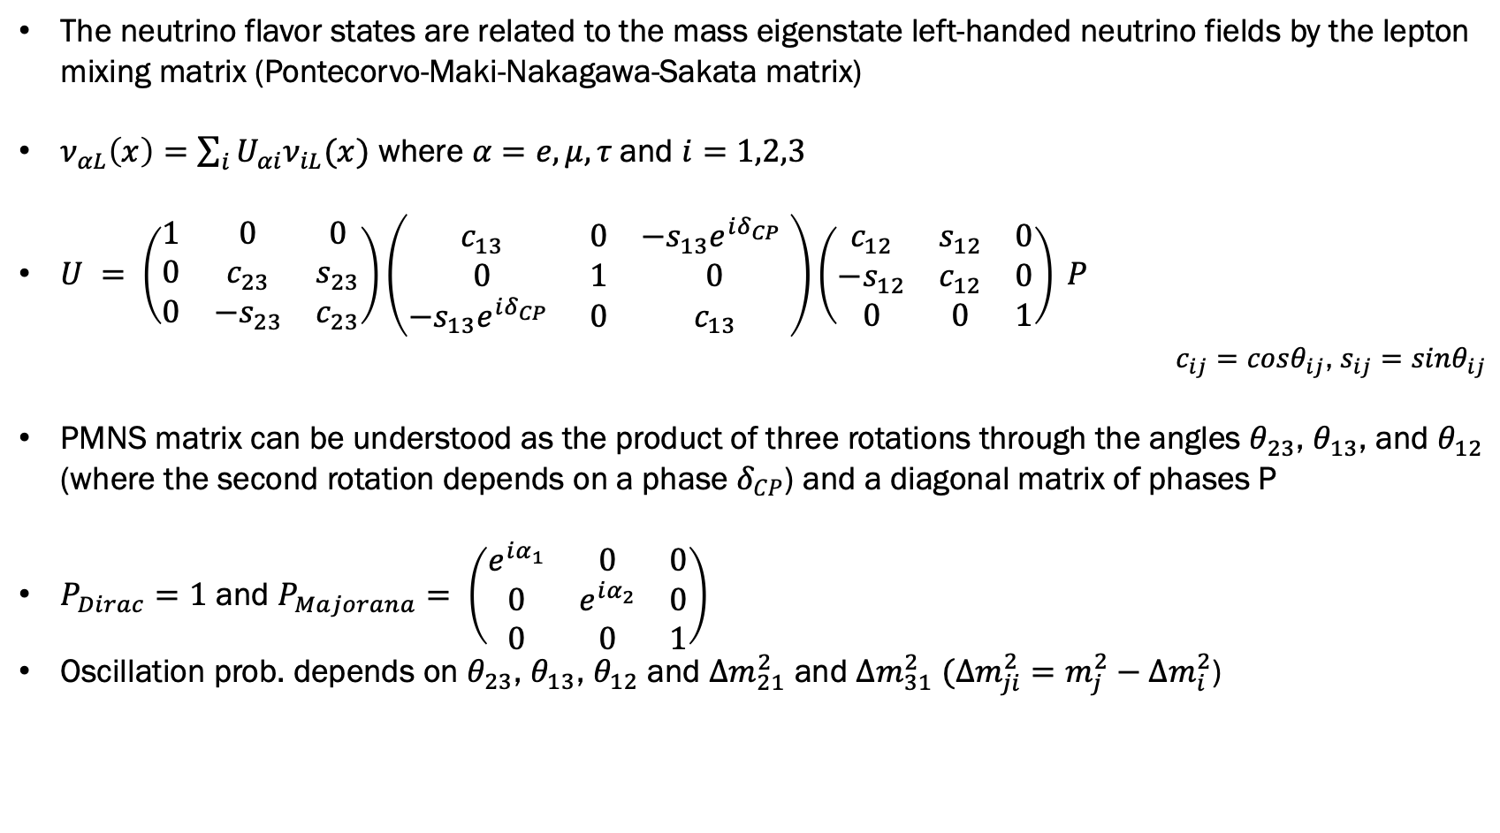

Three Flavor Mixing
C. Giganti, S. Lavignac, and M. Zito, “Neutrino oscillations: the rise of the PMNS paradigm,” 2017.
The neutrino flavor states are related to the mass eigenstate left-handed neutrino fields by the lepton mixing matrix (Pontecorvo-Maki-Nakagawa-Sakata matrix)
$ν_{αL}\left(x\right)=\sum_{i}{U_{αi}ν_{iL}(x)}$ where $α=e,μ,τ$and $i=1,2,3$
$U = \left(\begin{matrix}1 & 0 & 0 \\ 0 & c_{23} & s_{23} \\ 0 & −s_{23} & c_{23}\end{matrix}\right)\left(\begin{matrix}c_{13} & 0 & −s_{13}e^{iδ_{CP} } \\ 0 & 1 & 0 \\ −s_{13}e^{iδ_{CP} } & 0 & c_{13}\end{matrix}\right)\left(\begin{matrix}c_{12} & s_{12} & 0 \\ −s_{12} & c_{12} & 0 \\ 0 & 0 & 1\end{matrix}\right) P$
$c_{ij}=cosθ_{ij}$, $s_{ij}=sinθ_{ij}$
PMNS matrix can be understood as the product of three rotations through the angles $θ_{23}$, $θ_{13}$, and $θ_{12}$ (where the second rotation depends on a phase $δ_{CP}$) and a diagonal matrix of phases P
$P_{Dirac}=1$ and $P_{Majorana}= \left(\begin{matrix}e^{iα_{1}} & 0 & 0 \\ 0 & e^{iα_{2}} & 0 \\ 0 & 0 & 1\end{matrix}\right)$
Oscillation prob. depends on $θ_{23}$, $θ_{13}$, $θ_{12}$ and $∆m_{21}^{2}$ and $∆m_{31}^{2}$ $(∆m_{ji}^{2}=m_{j}^{2}−∆m_{i}^{2}$)
$θ_{ij}∈[0,\frac{π}{2}$] and $δ_{CP}∈[0,\text{2}π\text{]}$

Slide 4
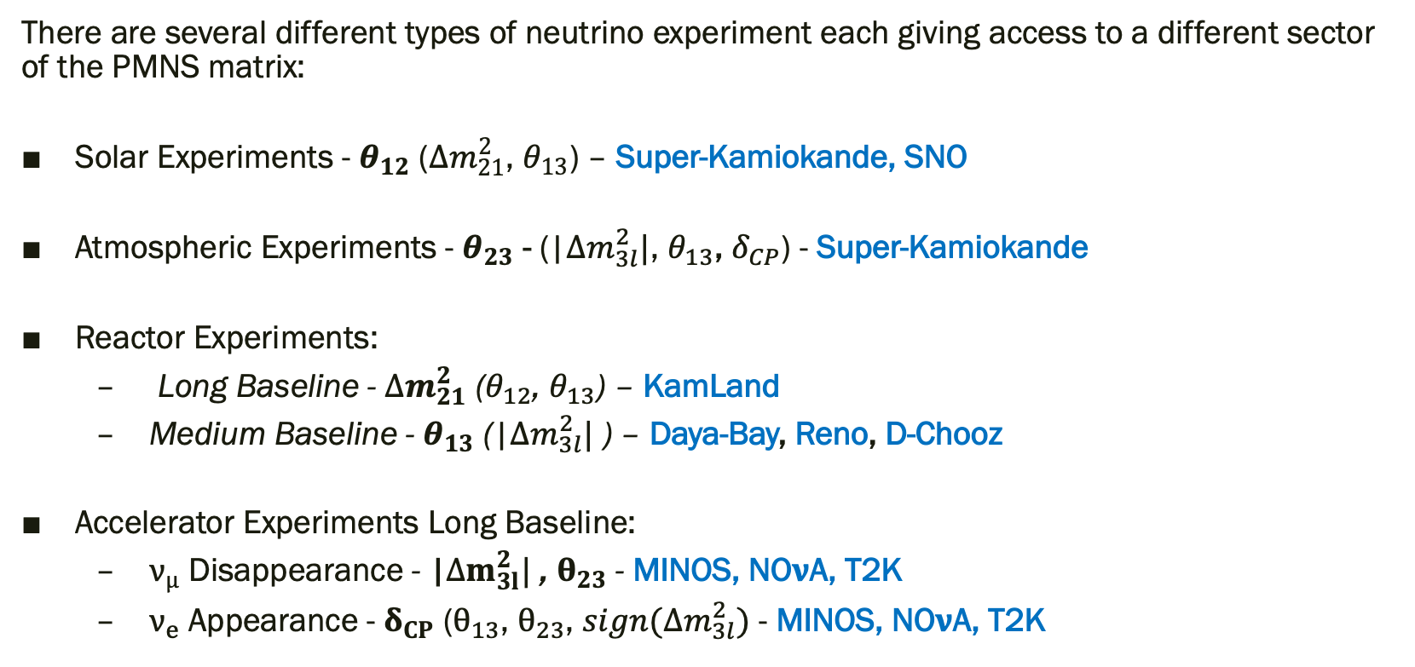
Types of Experiment
M. C. Gonzalez-Garcia, M. Maltoni, and T. Schwetz, “Nuclear Physics B Global Analyses of Neutrino Oscillation Experiments,” 2015. Accessed: Mar. 13, 2021. [Online]. Available: www.elsevier.com/locate/procedia.
There are several different types of neutrino experiment each giving access to a different sector of the PMNS matrix:
Solar Experiments - $θ_{12}$ (${∆m}_{21}^{2}$, $θ_{13}$) – Super-Kamiokande, SNO
Atmospheric Experiments - $θ_{23}$ - (|${∆m}_{3l}^{2}|$, $θ_{13}$, $δ_{CP}$) - Super-Kamiokande
Reactor Experiments:
  Long Baseline - ${∆m}_{21}^{2}$ ($θ_{12}$, $θ_{13}$) – KamLand
  Medium Baseline - $θ_{13}$ (|${∆m}_{3l}^{2}|$ ) – Daya-Bay, Reno, D-Chooz
Accelerator Experiments Long Baseline:
  $ν_{μ}$ Disappearance - |${∆m}_{3l}^{2}|$ , $θ_{23}$ - MINOS, NO$ν$A, T2K
  $ν_{e}$ Appearance - $δ_{CP}$ ($θ_{13}$, $θ_{23}$, $sign(∆m_{3l}^{2})$ - MINOS, NO$ν$A, T2K

Slide 5
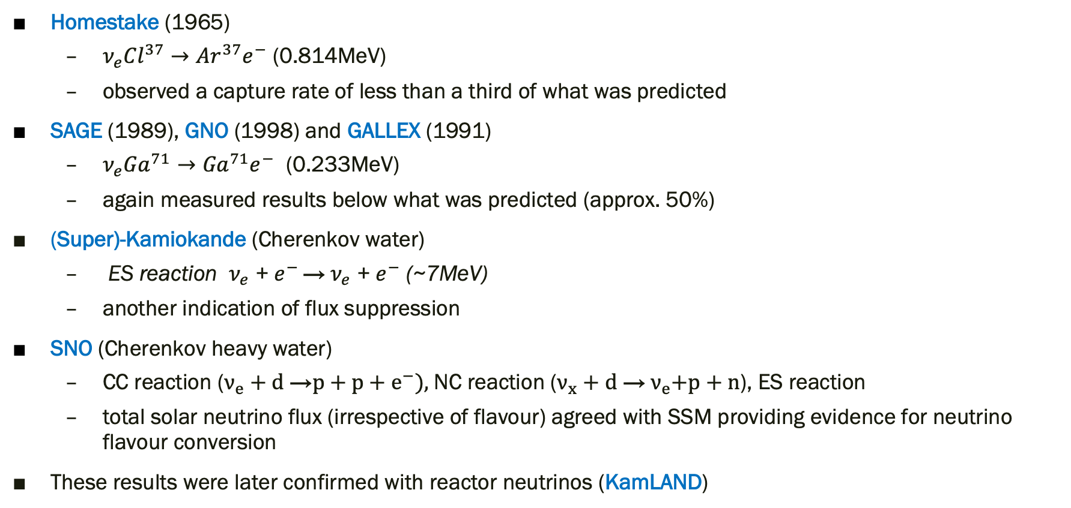
Solar Neutrino Experiments
C. Giganti, S. Lavignac, and M. Zito, “Neutrino oscillations: the rise of the PMNS paradigm,” 2017
Homestake (1965)
  $ν_{e}{Cl}^{37}→{Ar}^{37}e^{−}$ (0.814MeV)
  observed a capture rate of less than a third of what was predicted
SAGE (1989), GNO (1998) and GALLEX (1991)
  $ν_{e}{Ga}^{71}→{Ga}^{71}e^{−}$ (0.233MeV)
  again measured results below what was predicted (approx. 50%)
(Super)-Kamiokande (Cherenkov water)
  ES reaction $ν_{e}$ + $e^{− }$→${ ν}_{e}$ + $e^{−}$ (~7MeV)
  another indication of flux suppression
SNO (Cherenkov heavy water)
  CC reaction ($ν_{e}+d$ →$p+p+e^{−}),$NC reaction ($ν_{x}+d$ →${ ν}_{e}+p+n$), ES reaction
  total solar neutrino flux (irrespective of flavour) agreed with SSM providing evidence for neutrino flavour conversion
These results were later confirmed with reactor neutrinos (KamLAND)

Slide 6
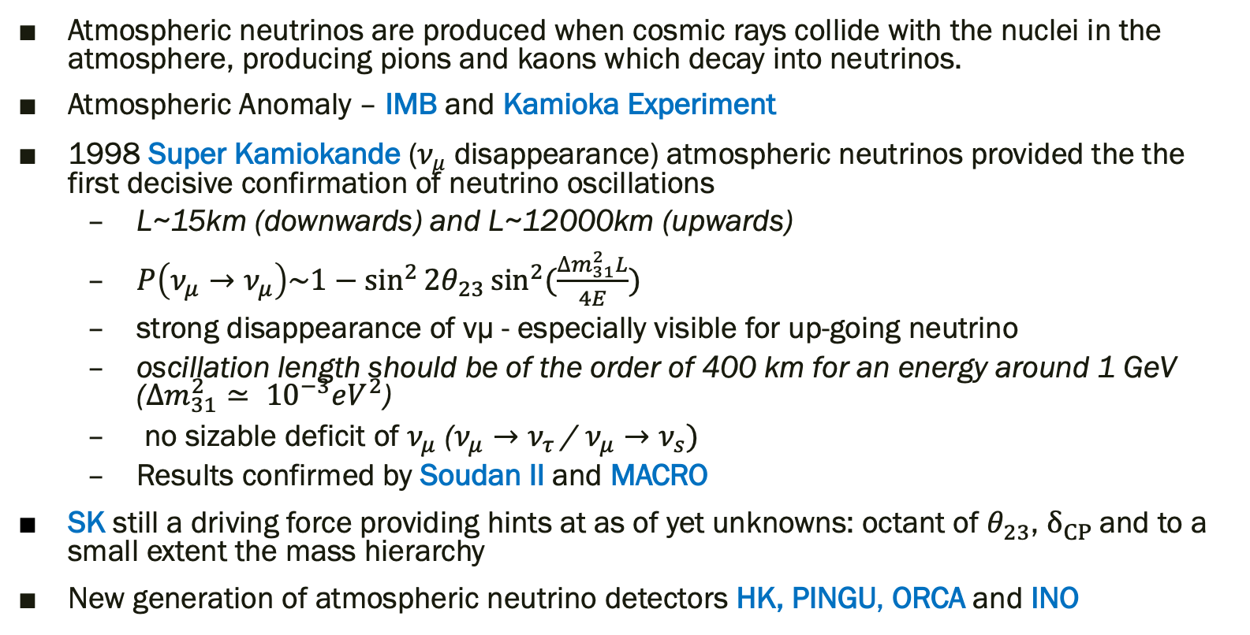
Atmospheric Neutrino Experiments
J. G. Learned, “The Atmospheric Neutrino Anomaly: Muon Neutrino Disappearance,” 2000.
S. Choubey, “Atmospheric Neutrinos: Status and Prospects,” 2016
Atmospheric neutrinos are produced when cosmic rays collide with the nuclei in the atmosphere, producing pions and kaons which decay into neutrinos.
Atmospheric Anomaly – IMB and Kamioka Experiment
1998 Super Kamiokande ($ν_{μ}$ disappearance) atmospheric neutrinos provided the the first decisive confirmation of neutrino oscillations
  L~15km (downwards) and L~12000km (upwards)
  $P\left(ν_{μ}→ν_{μ}\right)\sim 1−\sin^{2}{2θ_{23}}\sin^{2}(\frac{∆m_{31}^{2}L}{4E})$
  strong disappearance of νμ - especially visible for up-going neutrino
  oscillation length should be of the order of 400 km for an energy around 1 GeV
  ($∆m_{31}^{2}≃ {10}^{−3}eV^{2}$)
  no sizable deficit of $ν_{μ}$ ($ν_{μ}→ν_{τ}$ / $ν_{μ}→ν_{s})$
  Results confirmed by Soudan II and MACRO
SK still a driving force providing hints at as of yet unknowns: octant of $θ_{23}$, $δ_{CP}$and to a small extent the mass hierarchy
New generation of atmospheric neutrino detectors HK, PINGU, ORCA and INO

Slide 7
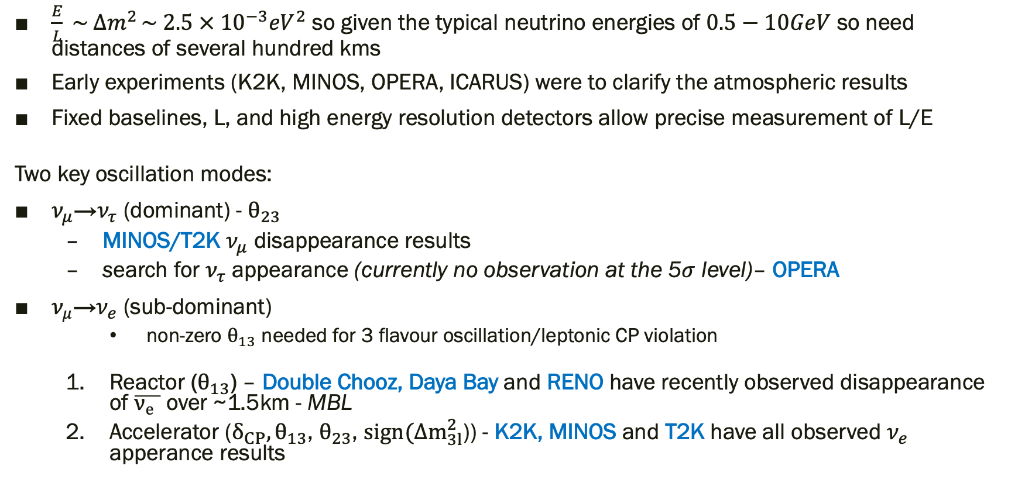
Long Baseline Experiments
G. J. Feldman, J. Hartnell, and T. Kobayashi, “Long-baseline neutrino oscillation experiments,” Advances in High Energy Physics, vol. 2013. Hindawi Publishing Corporation, p. 30, 2013, doi: 10.1155/2013/475749.
$\frac{E}{L} \sim ∆m^{2 }\sim 2.5 × {10}^{−3}{eV}^{2}$ so given the typical neutrino energies of $0.5−10GeV$ so need distances of several hundred kms
Early experiments (K2K, MINOS, OPERA, ICARUS) were to clarify the atmospheric results
Fixed baselines, L, and high energy resolution detectors allow precise measurement of L/E
Two key oscillation modes:
$ν_{μ}$→$ν_{τ}$ (dominant) - $θ_{23}$
  MINOS/T2K $ν_{μ}$ disappearance results
  search for $ν_{τ}$ appearance (currently no observation at the 5$σ$ level)– OPERA
$ν_{μ}$→$ν_{e}$ (sub-dominant)
    non-zero $θ_{13}$ needed for 3 flavour oscillation/leptonic CP violation
  Reactor ($θ_{13}$) – Double Chooz, Daya Bay and RENO have recently observed disappearance of $\overline{ν_{e} }$ over ~1.5km - MBL
  Accelerator ($δ_{CP}, θ_{13}$, $θ_{23}$, $sign(∆m_{3l}^{2}$)) - K2K, MINOS and T2K have all observed $ν_{e}$ apperance results

Slide 8
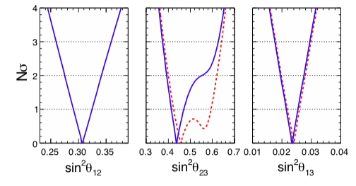
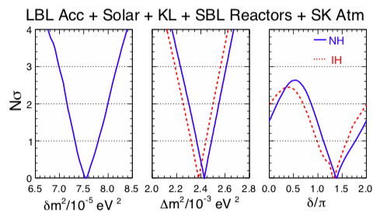
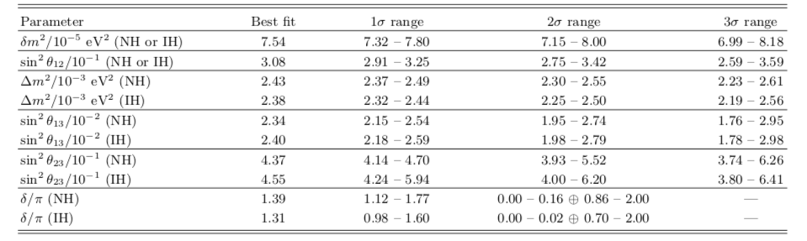
Global Fits
F. Capozzi, G. L. Fogli, E. Lisi, A. Marrone, D. Montanino, and A. Palazzo, “Status of three-neutrino oscillation parameters, circa 2013,” 2014.

Slide 9
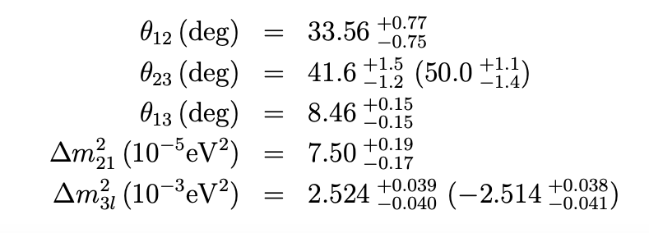
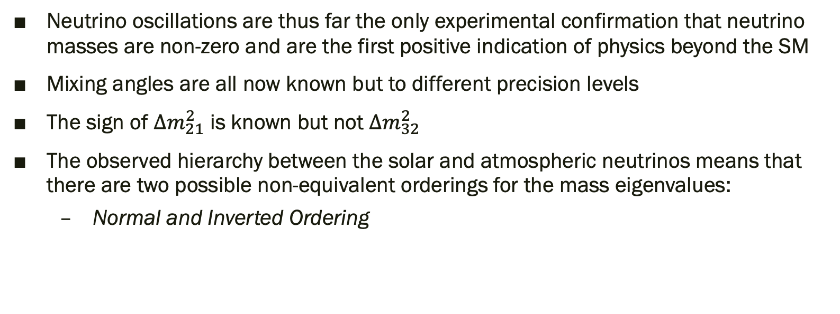

Where are we now?
C. Giganti, S. Lavignac, and M. Zito, “Neutrino oscillations: the rise of the PMNS paradigm,” 2017
Neutrino oscillations are thus far the only experimental confirmation that neutrino masses are non-zero and are the first positive indication of physics beyond the SM
Mixing angles are all now known but to different precision levels
The sign of $∆m_{21}^{2}$ is known but not $∆m_{32}^{2}$
The observed hierarchy between the solar and atmospheric neutrinos means that there are two possible non-equivalent orderings for the mass eigenvalues:
  Normal and Inverted Ordering
$$∆m_{21}^{2}≪(∆m_{31}^{2}≈∆m_{31}^{2}>0)$$
$$∆m_{21}^{2}≪−\left(∆m_{31}^{2}≈∆m_{32}^{2}>0\right)$$
Notation: $∆m_{32}^{2}$ with l=1 for NO and l=2 for IO

Slide 10

Key Questions for the Future
M. C. Gonzalez-Garcia, M. Maltoni, and T. Schwetz, “Global analyses of neutrino oscillation experiments,” Nucl. Phys. B, vol. 908, pp. 199–217, Jul. 2016, doi: 10.1016/j.nuclphysb.2016.02.033.
F. Capozzi, E. Lisi, A. Marrone, and A. Palazzo, “Current unknowns in the three neutrino framework,” Prog. Part. Nucl. Phys., vol. 102, pp. 48–72, Apr. 2018, doi: 10.1016/j.ppnp.2018.05.005.
What is the value of $δ_{CP}?$
What is the octant of $θ_{23 }$? How does it differ from the maximal value of $\frac{π}{2}$?
Is the mass hierarchy normal or inverted?
Sterile neutrinos?
  Some anomalous results cannot be explained in the current 3 flavor framework
  Eg. LSND/MiniBooNE/SAGE/GALLEX
  Can be explained by additional neutrino states
  Sterile neutrinos interact only through gravity (not weak)
Are neutrinos Majorana or Dirac particles?

