Slide 1
Are quarks and leptons fundamental?
Ahmed Elgaziari

Slide 2
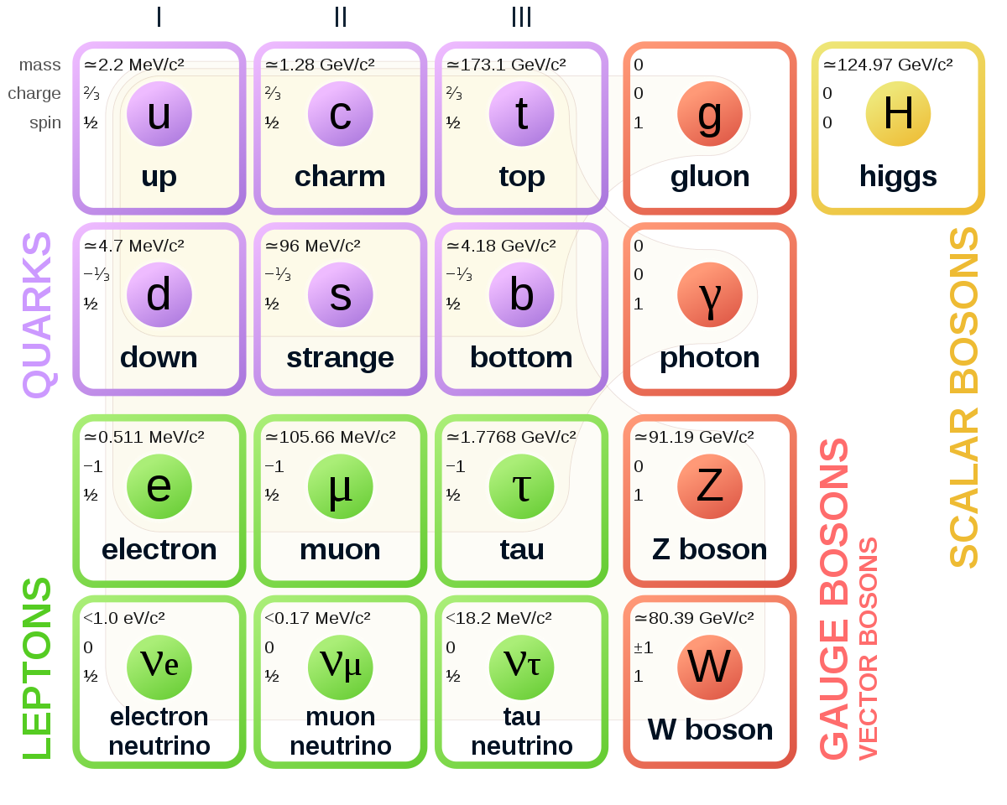
The need for A new STANDARD MODEL
Flavours and Generations have no explanation
Particles and antiparticles
Relative charges of quarks and leptons

Slide 3
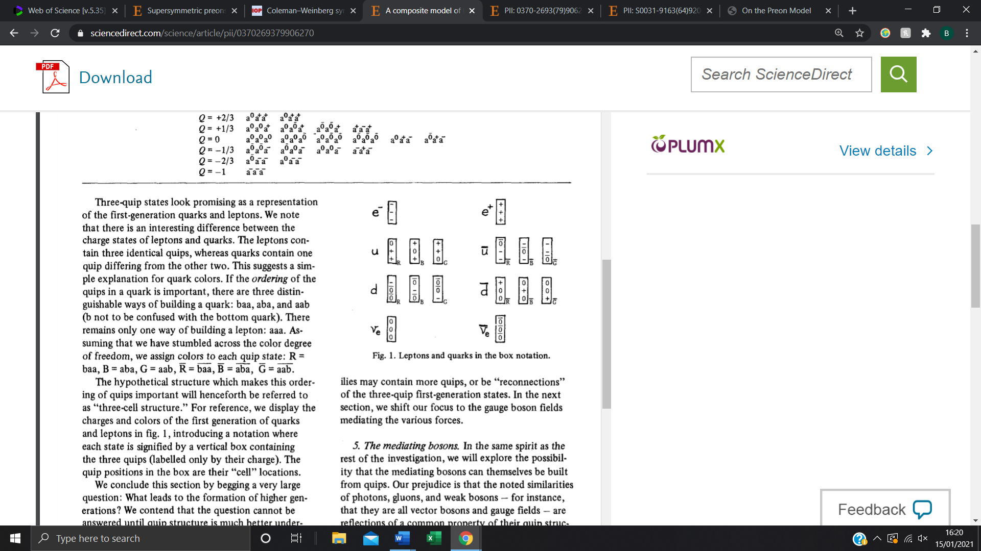
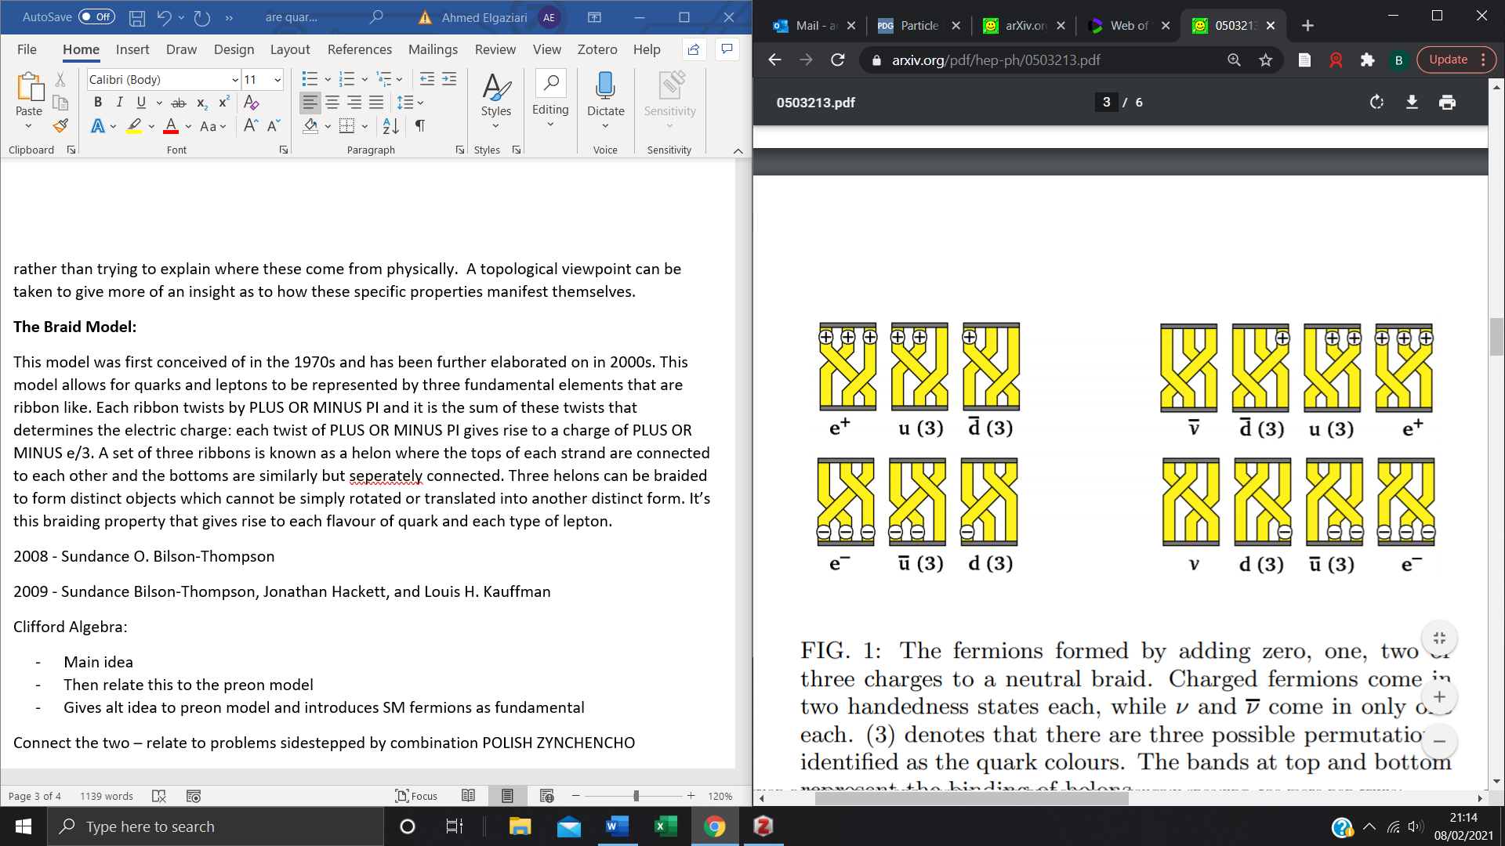
Harari-Shupe model
Charged e/3 preons form leptons and quarks
Permutations give colour
Helon Model
Ribbons/tweedles twist to give charge
Braids form distinct particles
Gives a physical reasoning to particle properties

Slide 4
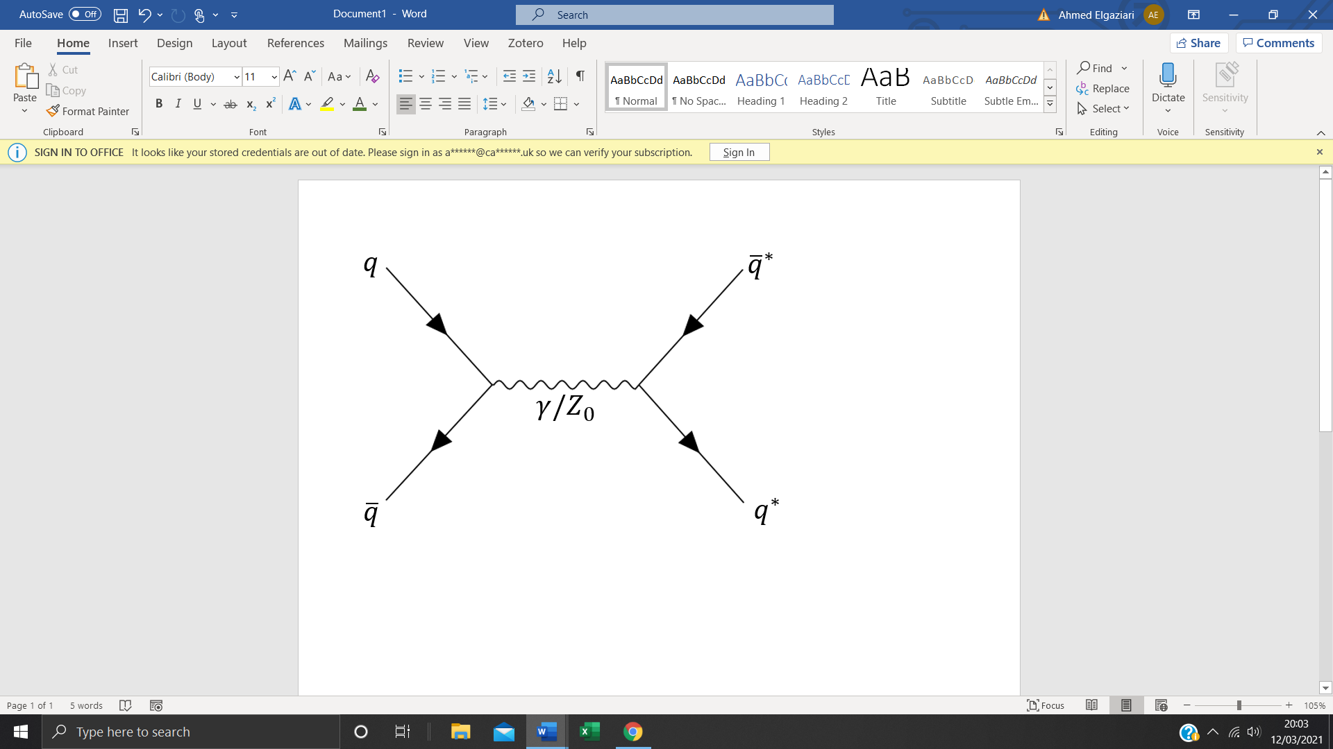
Searching for compositeness
Excited quarks and leptons – similar to excited atoms, emits radiation

Slide 5
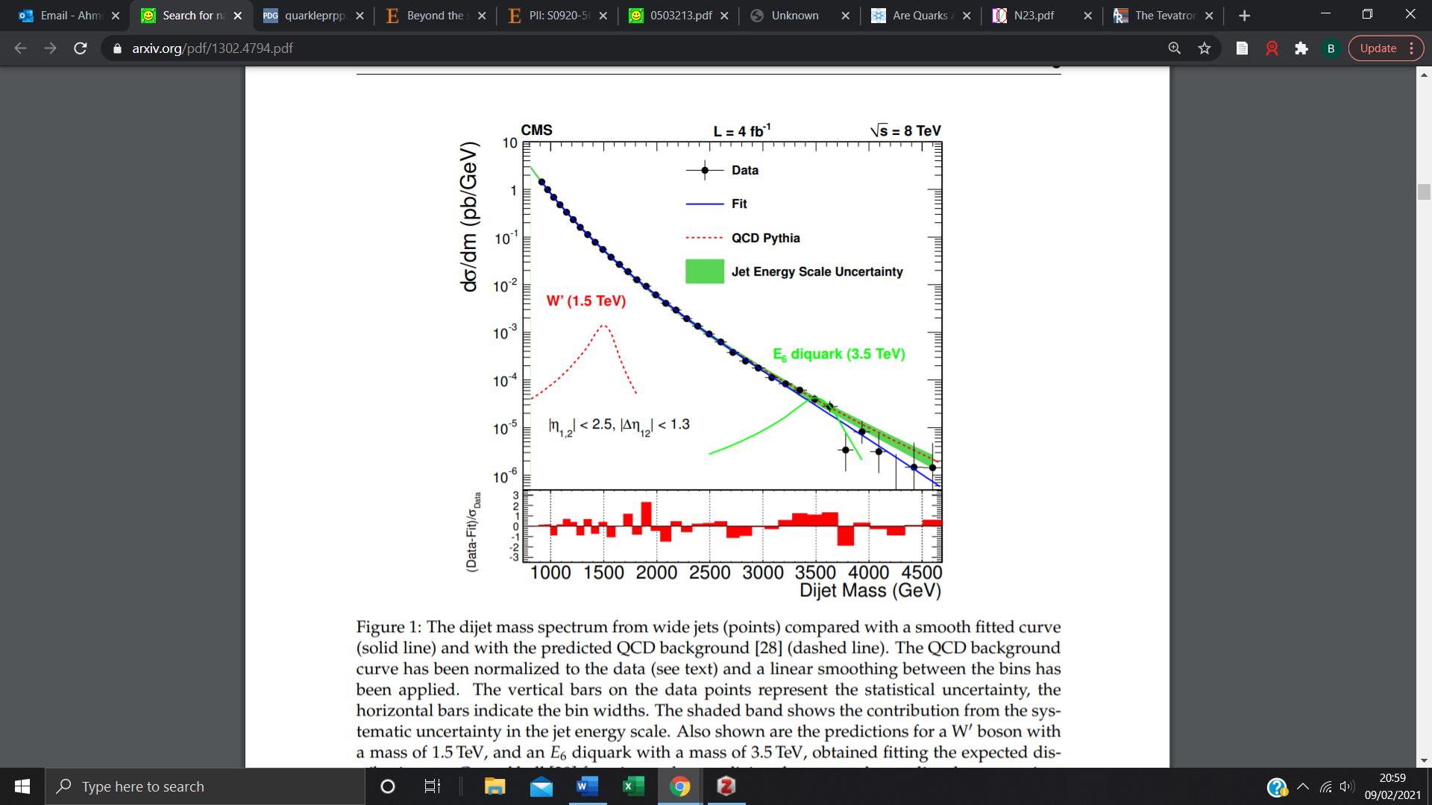
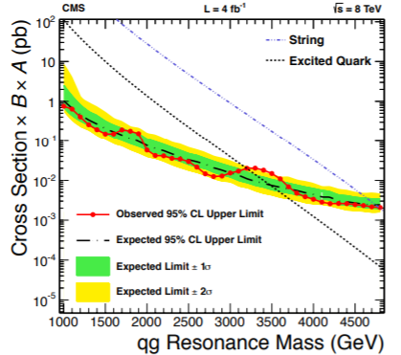
CMS experiment

Slide 6
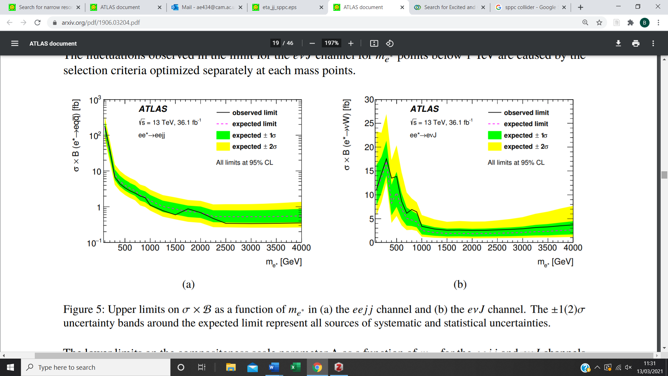
Other Experiments
Pre 2010 - D0 experiments
Atlas experiments - 2015/16
Dilepton Resonances – 2015/16

Slide 7
Conclusions
Are quarks and leptons fundamental? Maybe.
Higher energy colliders – probe preons

