Slide 1
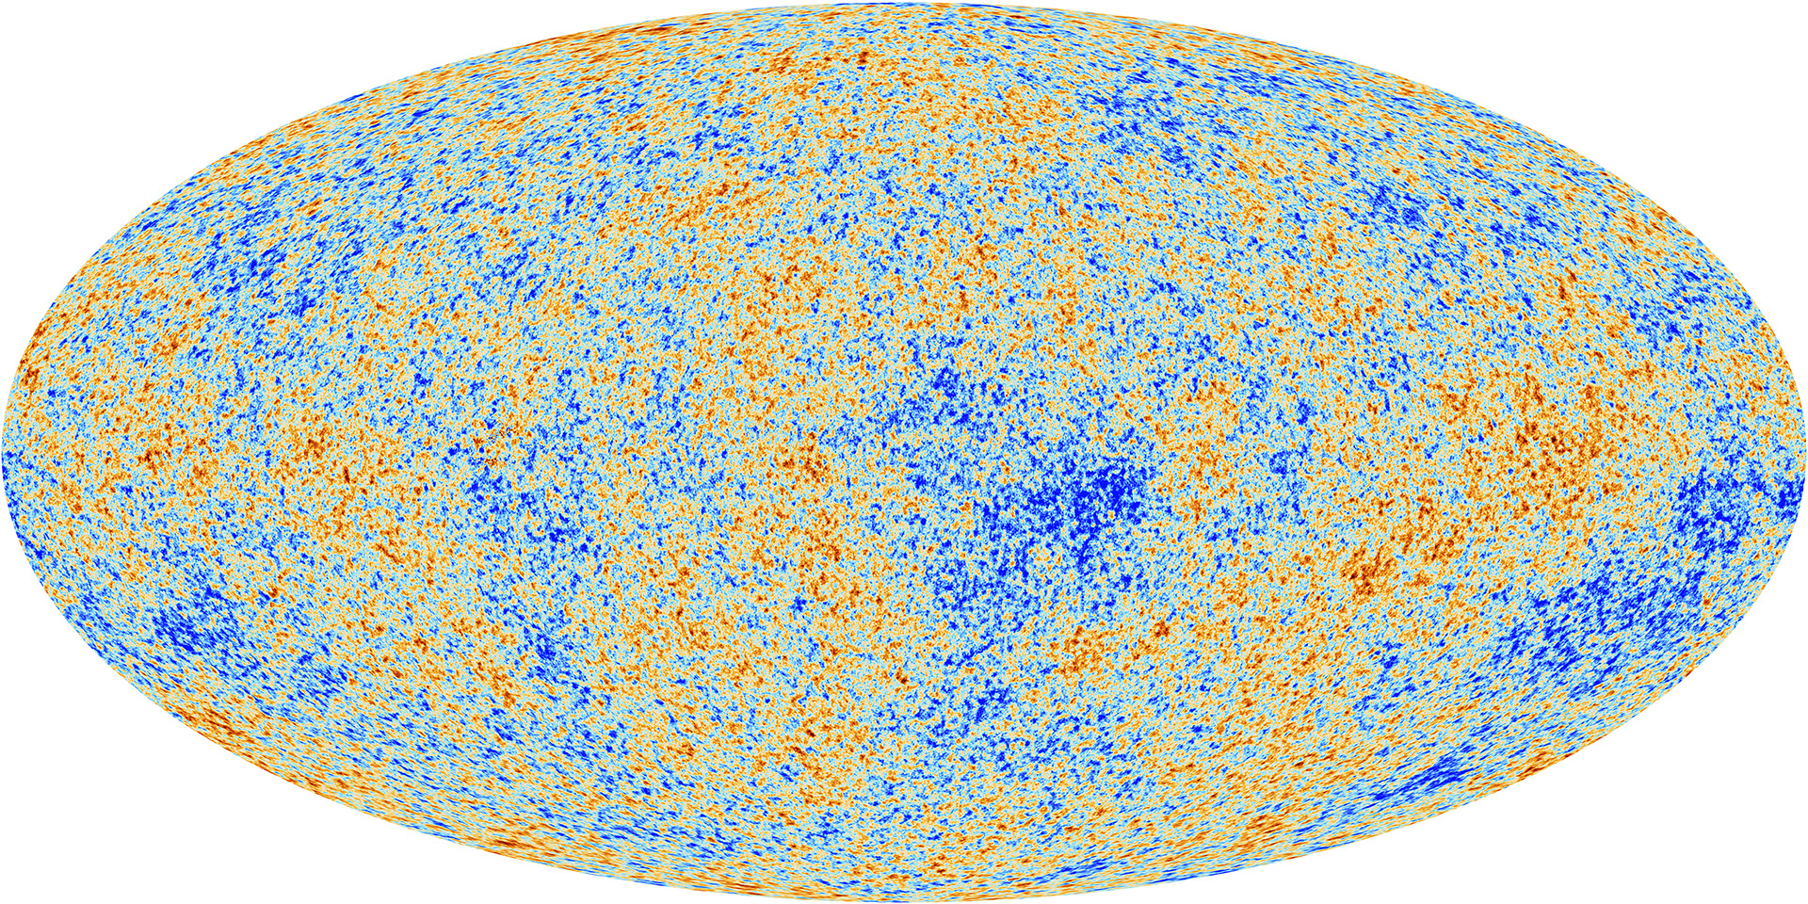
Measuring the Cosmic Microwave Background
Presentation by Oliver Normand
Supervised by Dr Tina Potter

Slide 2
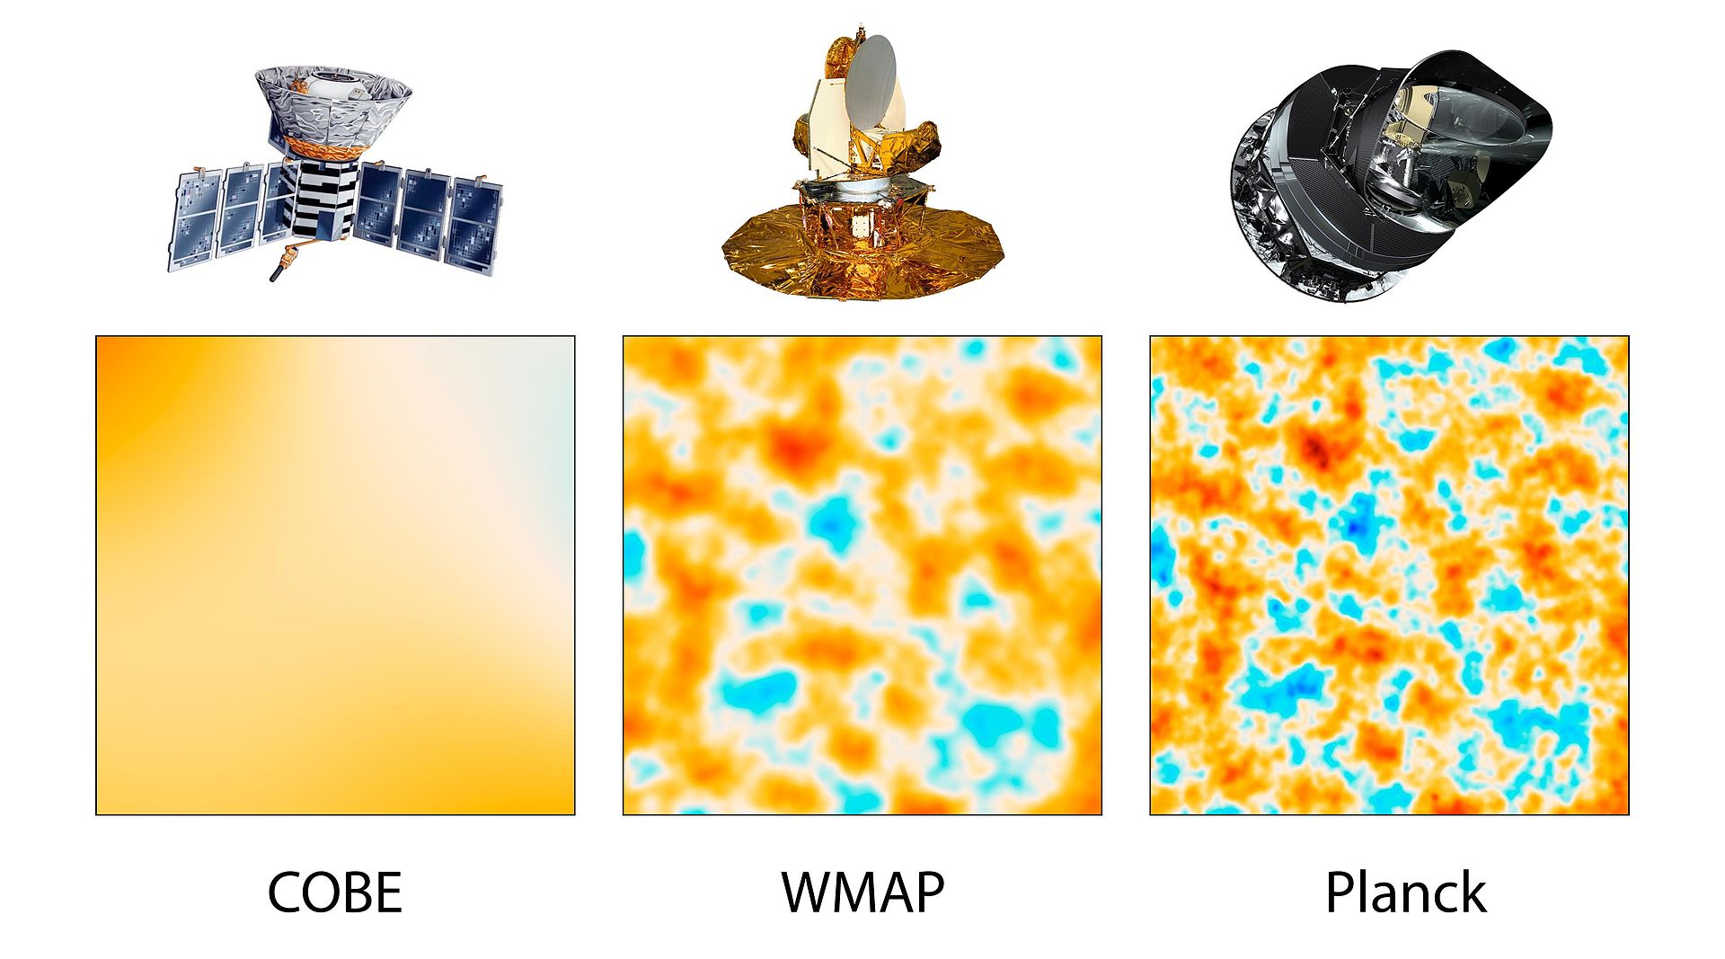
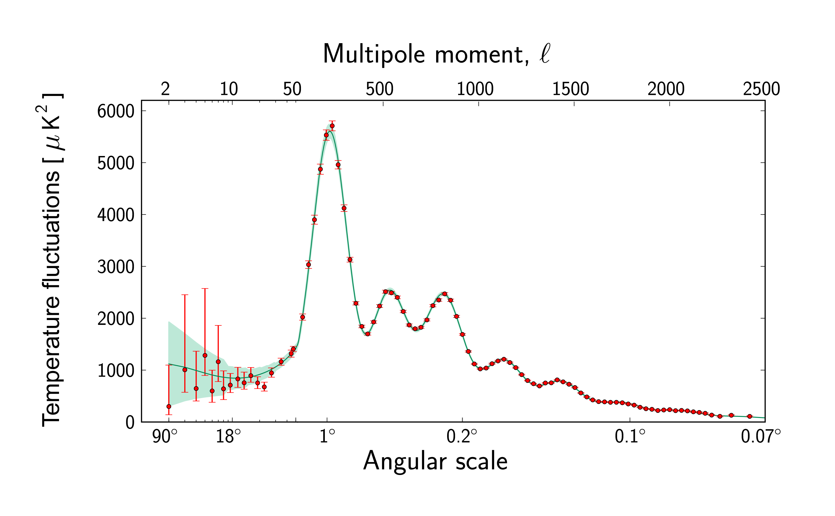
A Very Short Introduction to the CMB
CMB is the relic radiation of the big bang
It has an almost totally homogeneous temperature of 2.7K across the sky.
Experiments have measured the CMB with increasing resolution since the 1990s.
Extract information from the CMB is via its statistical properties, expressing the CMB signal in terms of the spherical harmonics.
Fixsen et al 2009
CMB Power Spectrum

Slide 3
CMB and Inflation
Cosmology requires inflation to overcome a number of key issues
Horizon Problem isotropy on scales larger than causally connected regions
Flatness Problem density of matter precisely that required for flat universe
Inhomogeneities in the CMB are amplifications of quantum fluctuations
Planck Collaboration has placed tight constraints on inflationary models
2013 ruled out scale invariance at 5σ
2015 excluded simpler models of inflation, suggested quadratic potential
2018 universe consistent with spatial flatness to 0.4% at 95% CL
favoured slow-roll models of inflation with concave potentials

Slide 4
Primary Anisotropies
Present at the layer of last scattering
Layer of Last Scattering refers to the region at which photons decoupled from baryons in the early universe, as neutral matter could now form.
Before last scattering photons were tightly coupled to baryons
After last scattering they travelled throughout the universe as it evolved
Their observations can tell us much about the universe at these times.
Baryon Acoustic Oscillations result from balance of gravitational attraction and repulsive radiation pressure of photons. They provide many constraints.
Sound Horizon
DM Annihilation
Baryon Density
Boomerang

Slide 5
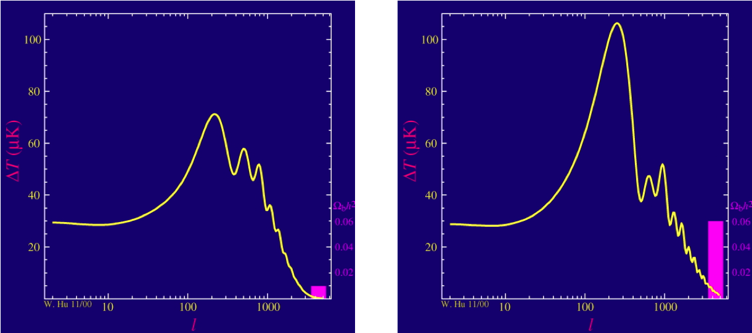
Baryon Loading
Power spectrum changes with baryon density
Wayne Hu CMB Tutorials

Slide 6
Secondary Anisotropies
Introduced along the line of sight of the photons
Able to reconstruct the Lensing Potential by observing B-mode polarisation.
Consistency between lensing constraints and ΛCDM demonstrated at 40σ
Lensing data constrains the summed neutrino mass of 0.23eV at 95% CL.
Planck 2018 Results: Gravitational Lensing
Lesgourgues & Pastor 2014
All sky CMB lensing potential from Planck 2015 results

Slide 7
Tensions and Physics Beyond ΛCDM
Planck generally consistent with other surveys of the CMB, interesting tensions when we compare with other sources.
Sound Horizon
Measurements from CMB in mild tension with those from BOSS
Cosmic Birefringence Angle, β
Non-zero measurements would indicate the presence of parity violating physics.
Using Planck polarisation data, β=0 has been excluded at 2.4σ.
Hubble Constant at low redshift
CMB data prefers a lower value of H0 compared to local measurements.
Most recent paper indicate a 4.4σ discrepancy.
Indications that dark matter and dark energy could resolve these tensions.
Agathe et al 2019
Blomqvist et al 2019
Minami & Komatsu 2020
Riess et al 2019
Valentino et al 2020

Slide 8
Questions and Comments?

