Slide 1
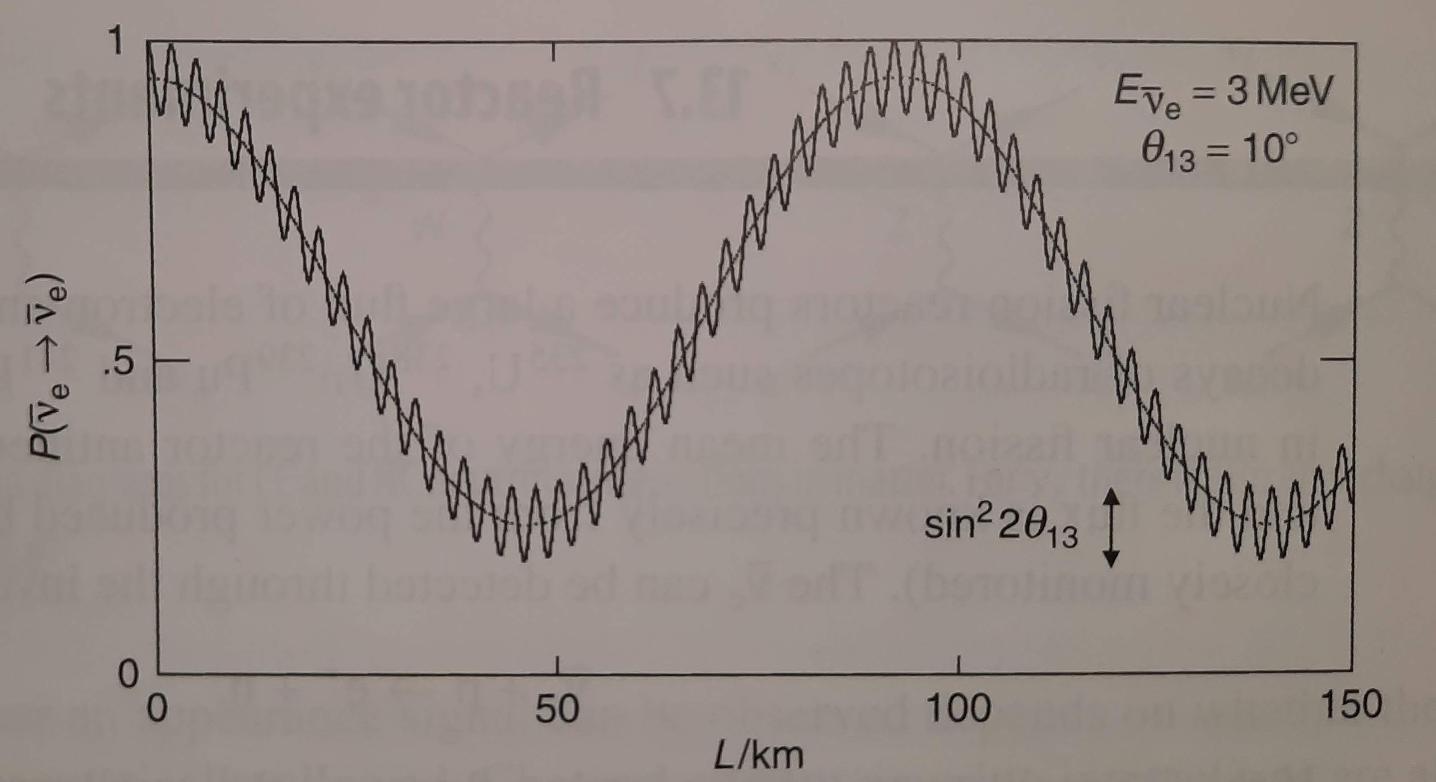
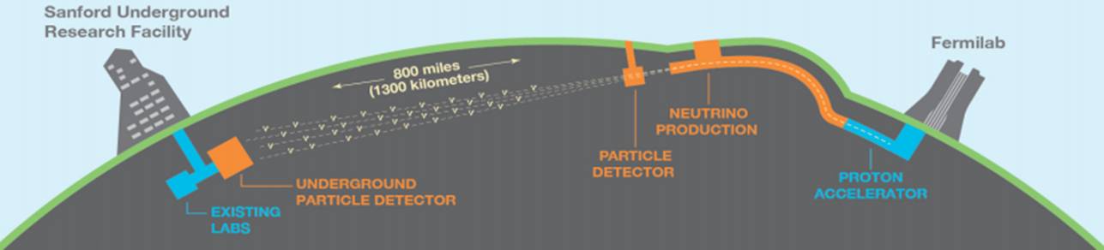
Neutrino Oscillation Experiments
James Quigley

Slide 2
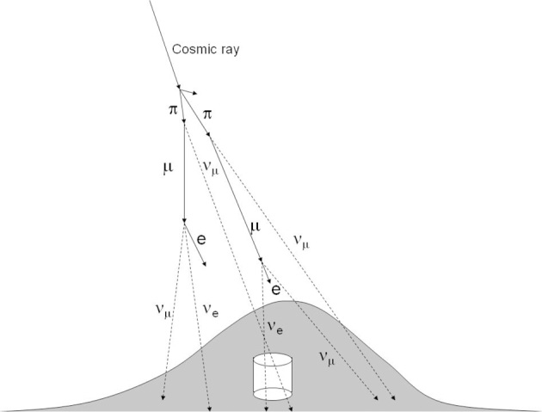
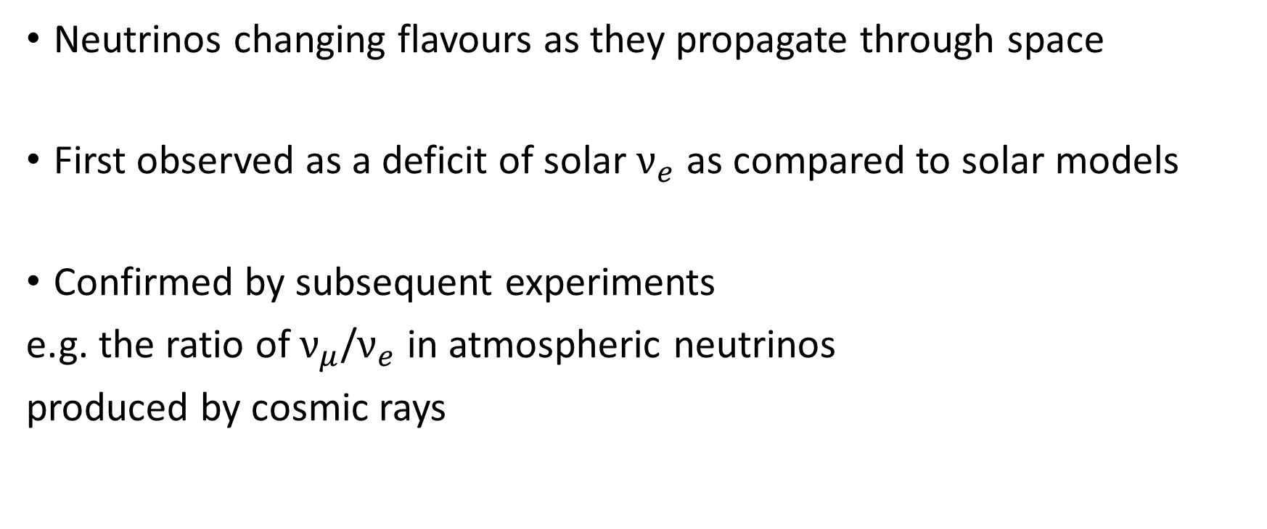
What are neutrino oscillations?
Neutrinos changing flavours as they propagate through space
First observed as a deficit of solar $ν_{e}$ as compared to solar models
Confirmed by subsequent experiments
e.g. the ratio of $ν_{μ}$/$ν_{e}$ in atmospheric neutrinos
produced by cosmic rays
Takaaki Kajita in the Proceedings of the Japan Academy, Series B, Physical and Biological Sciences (10.2183/pjab.86.303)

Slide 3
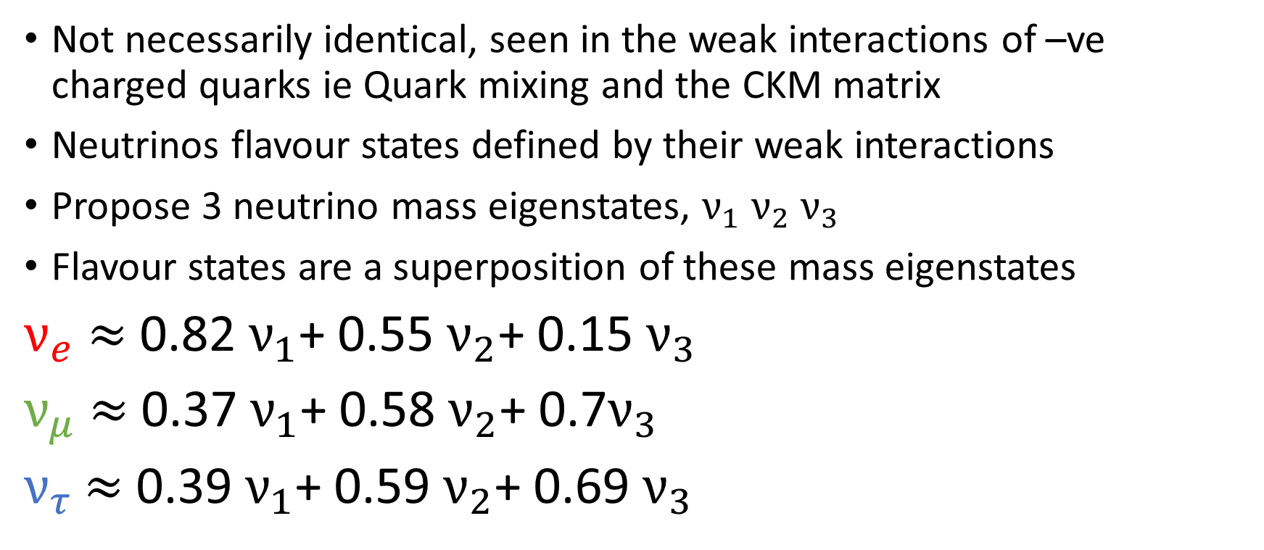
Weak flavour states vs mass eigenstates
Not necessarily identical, seen in the weak interactions of –ve charged quarks ie Quark mixing and the CKM matrix
Neutrinos flavour states defined by their weak interactions
Propose 3 neutrino mass eigenstates, $ν_{1}$ $ν_{2}$ $ν_{3}$
Flavour states are a superposition of these mass eigenstates
$ν_{e}$ $≈$ 0.82 $ν_{1}$+ 0.55 $ν_{2}$+ 0.15 $ν_{3}$
$ν_{μ}$ $≈$ 0.37 $ν_{1}$+ 0.58 $ν_{2}$+ 0.7$ν_{3}$
$ν_{τ}$ $≈$ 0.39 $ν_{1}$+ 0.59 $ν_{2}$+ 0.69 $ν_{3}$

Slide 4
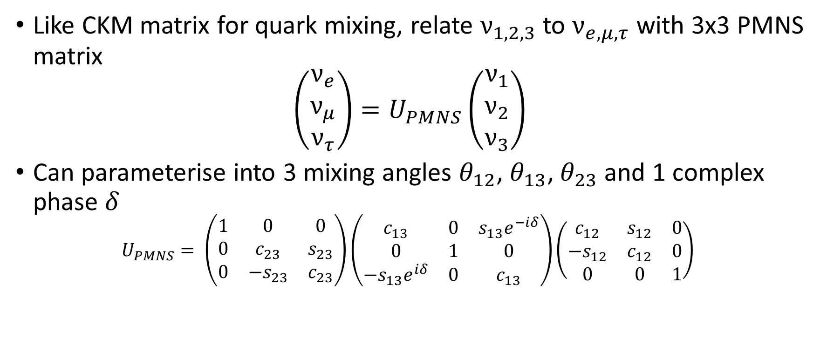
PMNS Matrix
Like CKM matrix for quark mixing, relate $ν_{1,2,3}$ to $ν_{e,μ,τ}$ with 3x3 PMNS matrix
$$\left(\begin{matrix}ν_{e} \\ ν_{μ} \\ ν_{τ}\end{matrix}\right)=U_{PMNS}\left(\begin{matrix}ν_{1} \\ ν_{2} \\ ν_{3}\end{matrix}\right)$$
Can parameterise into 3 mixing angles $θ_{12}$, $θ_{13}$, $θ_{23}$and 1 complex phase $δ$
$$U_{PMNS}= \left(\begin{matrix}1 & 0 & 0 \\ 0 & c_{23} & s_{23} \\ 0 & {−s}_{23} & c_{23}\end{matrix}\right)\left(\begin{matrix}c_{13} & 0 & s_{13}e^{−iδ} \\ 0 & 1 & 0 \\ {−s}_{13}e^{iδ} & 0 & c_{13}\end{matrix}\right)\left(\begin{matrix}c_{12} & s_{12} & 0 \\ {−s}_{12} & c_{12} & 0 \\ 0 & 0 & 1\end{matrix}\right)$$

Slide 5
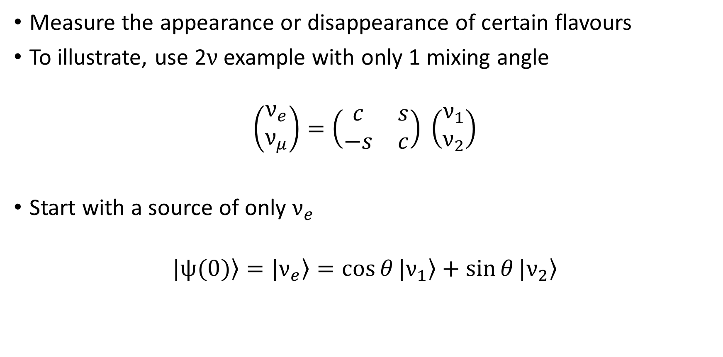
Measuring the oscillations
Measure the appearance or disappearance of certain flavours
To illustrate, use 2$ν$ example with only 1 mixing angle
$$\left(\begin{matrix}ν_{e} \\ ν_{μ}\end{matrix}\right)=\left(\begin{matrix}c & s \\ −s & c\end{matrix}\right) \left(\begin{matrix}ν_{1} \\ ν_{2}\end{matrix}\right)$$
Start with a source of only $ν_{e}$
$$\left.|ψ(0)\right\rangle =\left.|ν_{e}\right\rangle =\cos{θ}|\left.ν_{1}\right\rangle +\sin{θ}|\left.ν_{2}\right\rangle$$

Slide 6
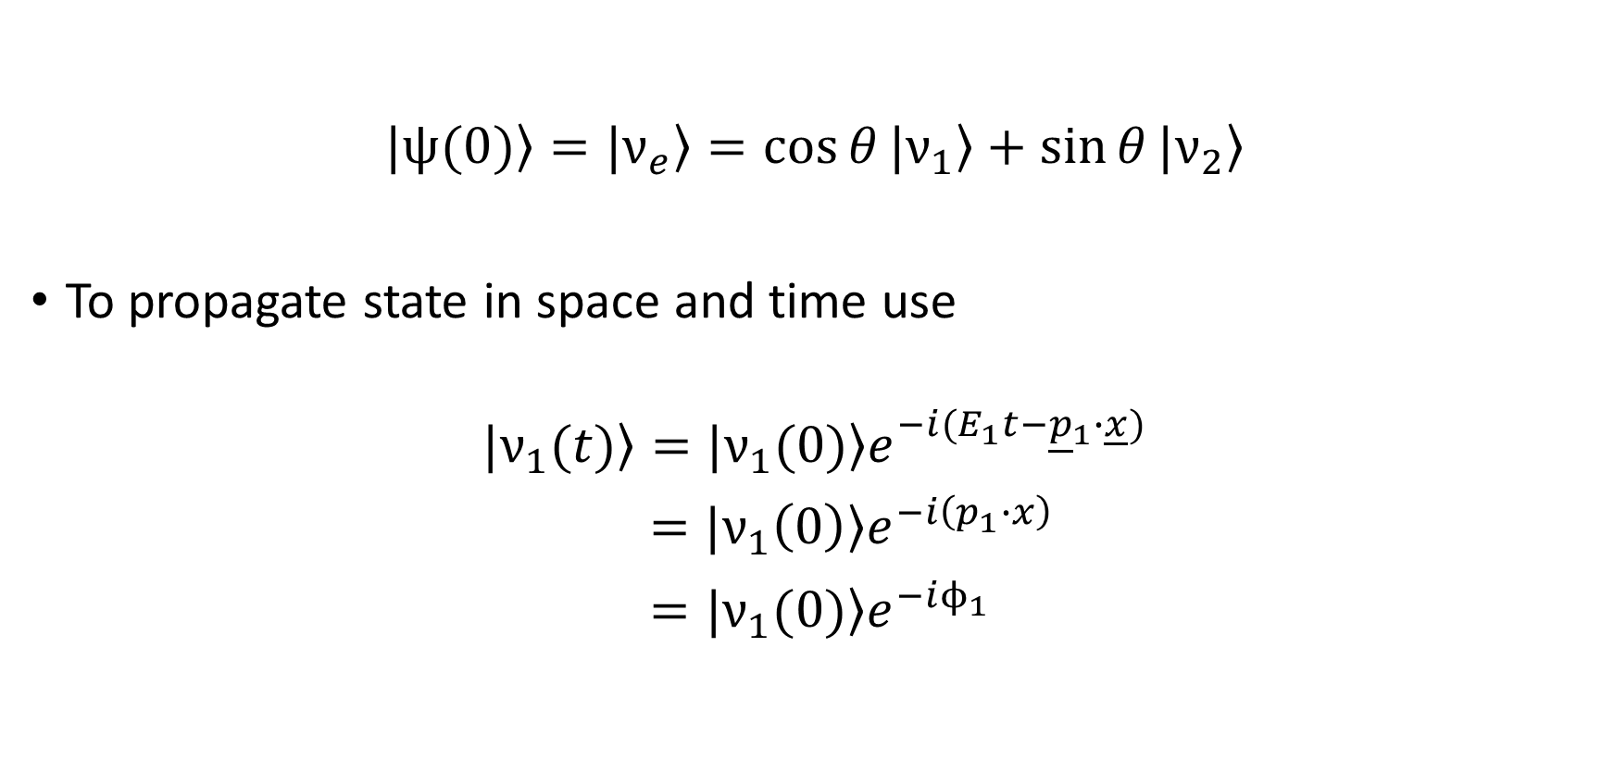
Measuring the oscillations
$$\left.|ψ(0)\right\rangle =\left.|ν_{e}\right\rangle =\cos{θ}|\left.ν_{1}\right\rangle +\sin{θ}|\left.ν_{2}\right\rangle$$
To propagate state in space and time use
$$|\left.ν_{1}(t)\right\rangle =|\left.ν_{1}(0)\right\rangle e^{−i(E_{1}t−{\underline{p}}_{1}∙\underline{x})}$$
$=|\left.ν_{1}\left(0\right)\right\rangle e^{−i\left(p_{1}∙x\right)}$
$=|\left.ν_{1}(0)\right\rangle e^{−iϕ_{1}}$

Slide 7
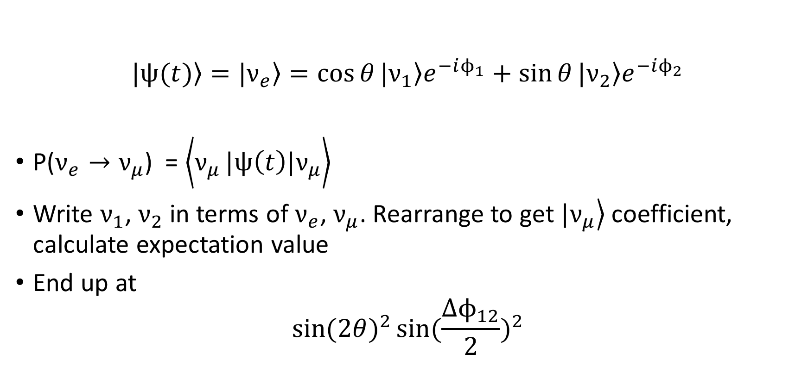
Measuring the oscillations
$$\left.|ψ(t)\right\rangle =\left.|ν_{e}\right\rangle =\cos{θ}|\left.ν_{1}\right\rangle e^{−iϕ_{1}}+\sin{θ}|\left.ν_{2}\right\rangle e^{−iϕ_{2}}$$
P($ν_{e}→ν_{μ}$) = $\left.\left\langle ν_{μ}\right.|ψ\left(t\right)|ν_{μ}\right\rangle$
Write $ν_{1}$, $ν_{2}$ in terms of $ν_{e}$, $ν_{μ}$. Rearrange to get $\left.|ν_{μ}\right\rangle$ coefficient, calculate expectation value
End up at
$${\sin{(2θ})}^{2}{\sin{(\frac{{∆ϕ}_{12}}{2})}}^{2}$$

Slide 8
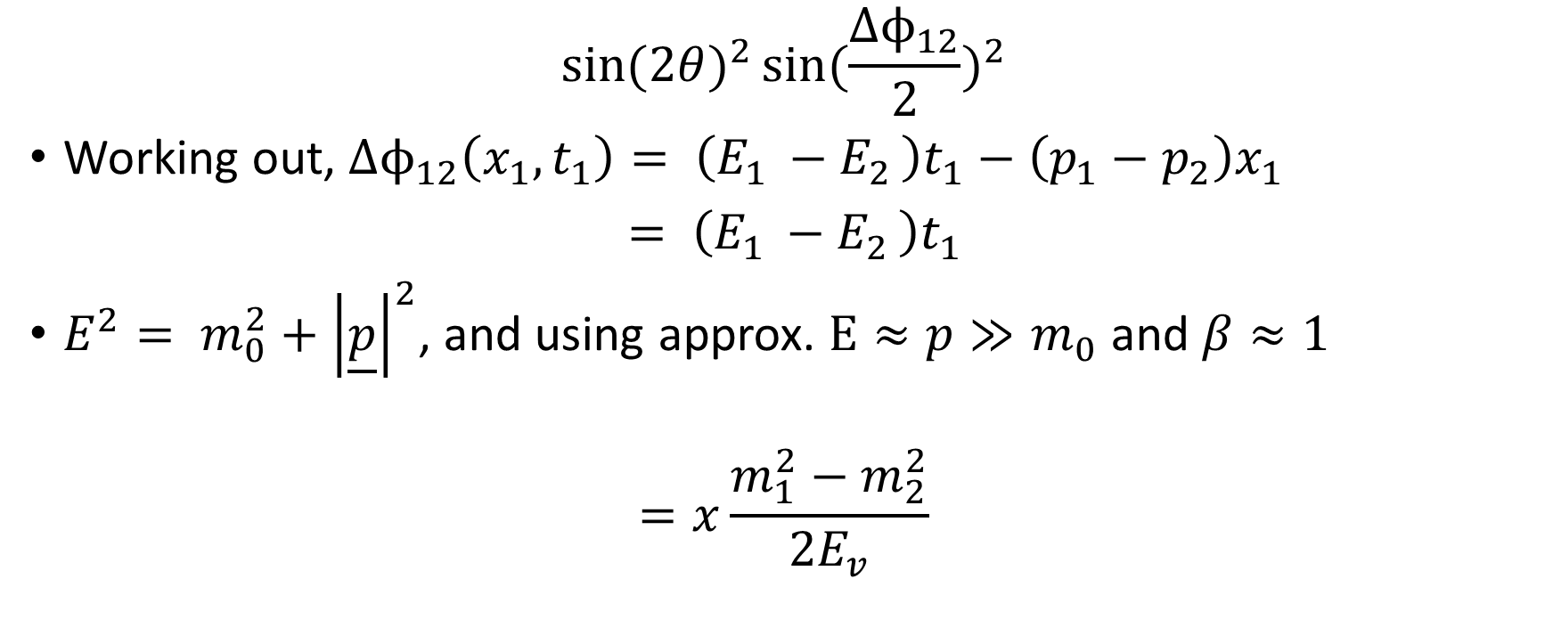
Measuring the oscillations
$${\sin{(2θ})}^{2}{\sin{(\frac{{∆ϕ}_{12}}{2})}}^{2}$$
Working out, $∆ϕ_{12}\left(x_{1},t_{1}\right)= \left(E_{1 }−E_{2 }\right)t_{1}−\left(p_{1}−p_{2}\right)x_{1}$
$= \left(E_{1 }−E_{2 }\right)t_{1}$
$E^{2}= m_{0}^{2}+{\left|\underline{p}\right|}^{2}$, and using approx. $E≈p≫m_{0}$ and $β≈1$
$$=x\frac{m_{1}^{2}−m_{2}^{2}}{2E_{v}}$$

Slide 9

Measuring the oscillations
P($ν_{e}→ν_{μ}$) $={\sin{(2θ})}^{2}{\sin{(x\frac{m_{1}^{2}−m_{2}^{2}}{4E_{v}})}}^{2}$
Similar for 3$ν$ model but 3 mixing angles, 2 mass differences and 1 complex phase $e^{iδ}$ (allows CP violation)

Slide 10
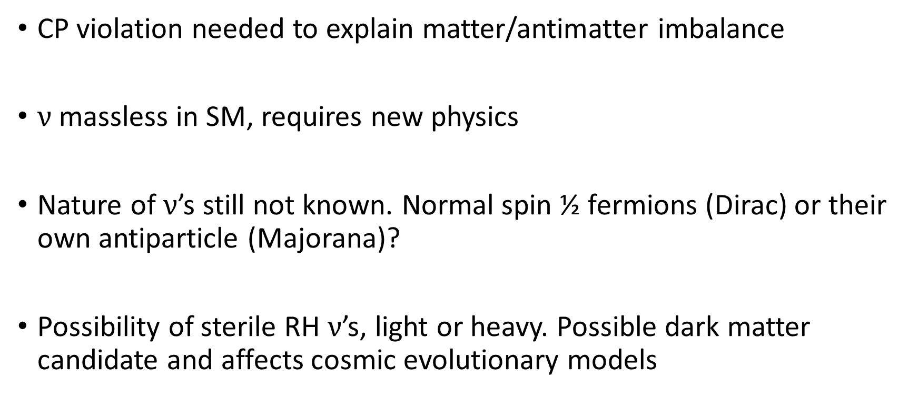
Why is this important/worth measuring?
CP violation needed to explain matter/antimatter imbalance
$ν$ massless in SM, requires new physics
Nature of $ν$’s still not known. Normal spin ½ fermions (Dirac) or their own antiparticle (Majorana)?
Possibility of sterile RH $ν$’s, light or heavy. Possible dark matter candidate and affects cosmic evolutionary models

Slide 11
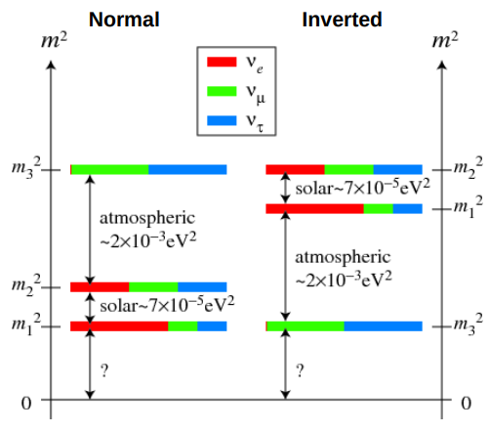
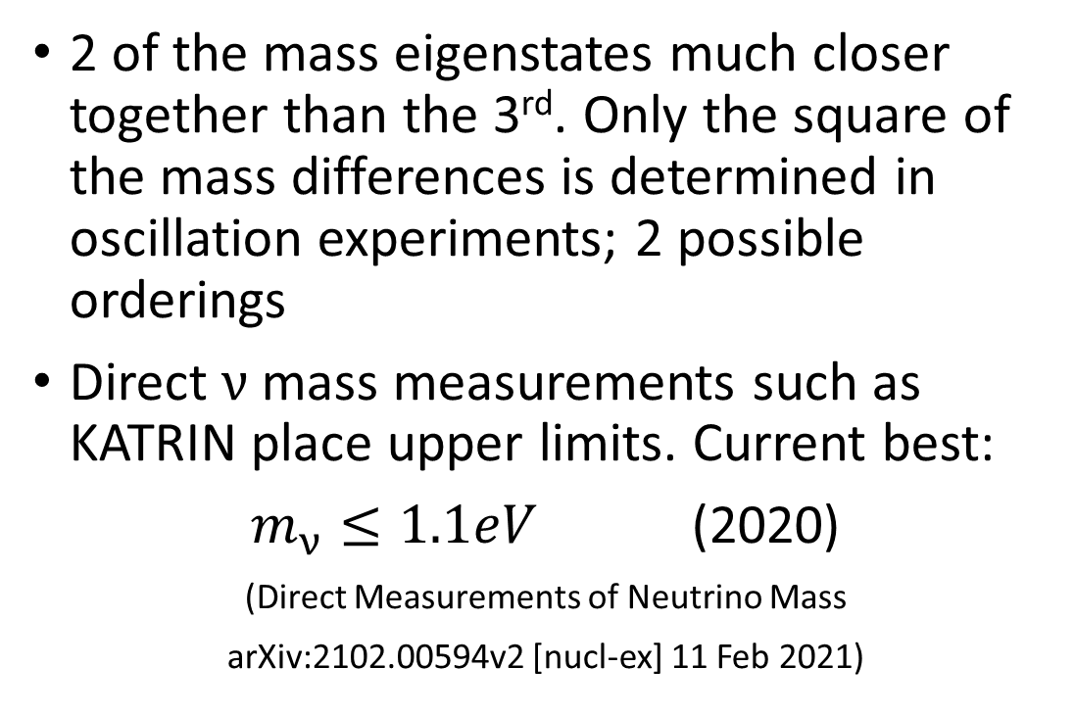
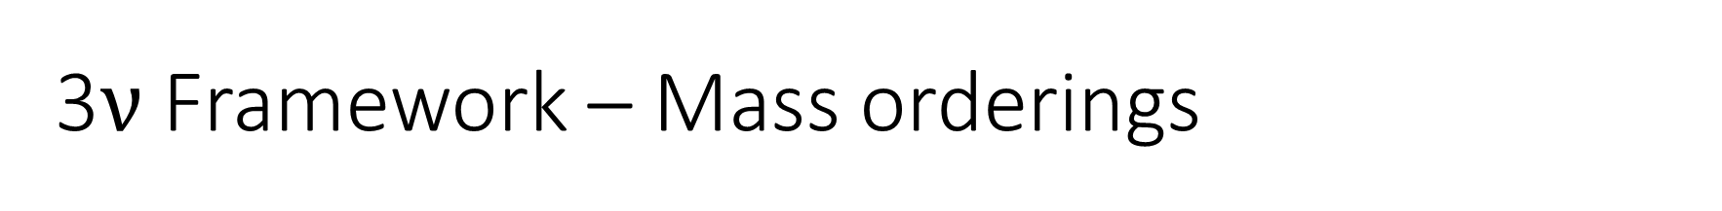
3$ν$ Framework – Mass orderings
2 of the mass eigenstates much closer together than the 3rd. Only the square of the mass differences is determined in oscillation experiments; 2 possible orderings
Direct $ν$ mass measurements such as KATRIN place upper limits. Current best:
$m_{ν}≤1.1eV$ (2020)
(Direct Measurements of Neutrino Mass
arXiv:2102.00594v2 [nucl-ex] 11 Feb 2021)

Slide 12
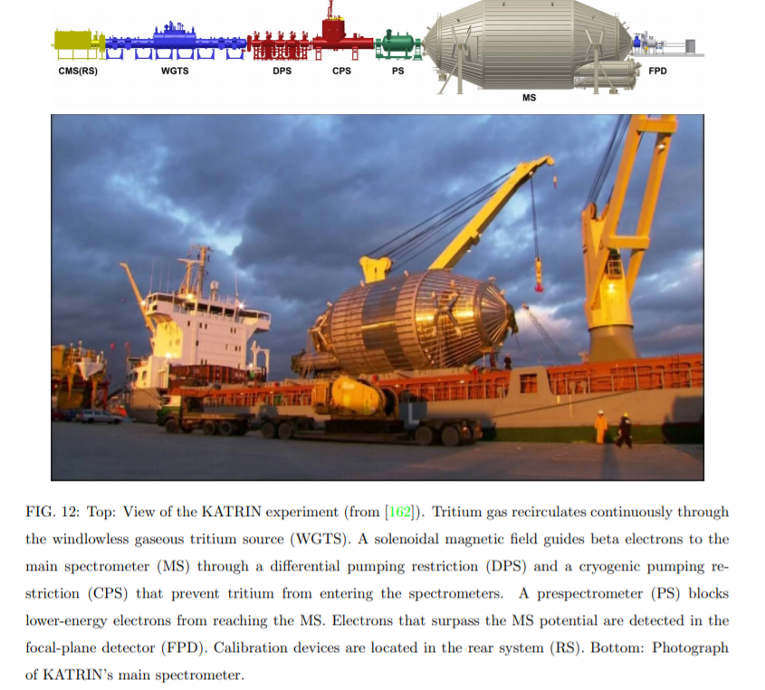

Slide 13
Experiment Types
Solar
- SNO, Borexino, KamLAND
Atmospheric
- SK, IceCube
Reactor
- Daya Bay, KamLAND (only LBL reactor exp)
Long-Baseline
- MINOS, T2K, OPERA, DUNE

Slide 14
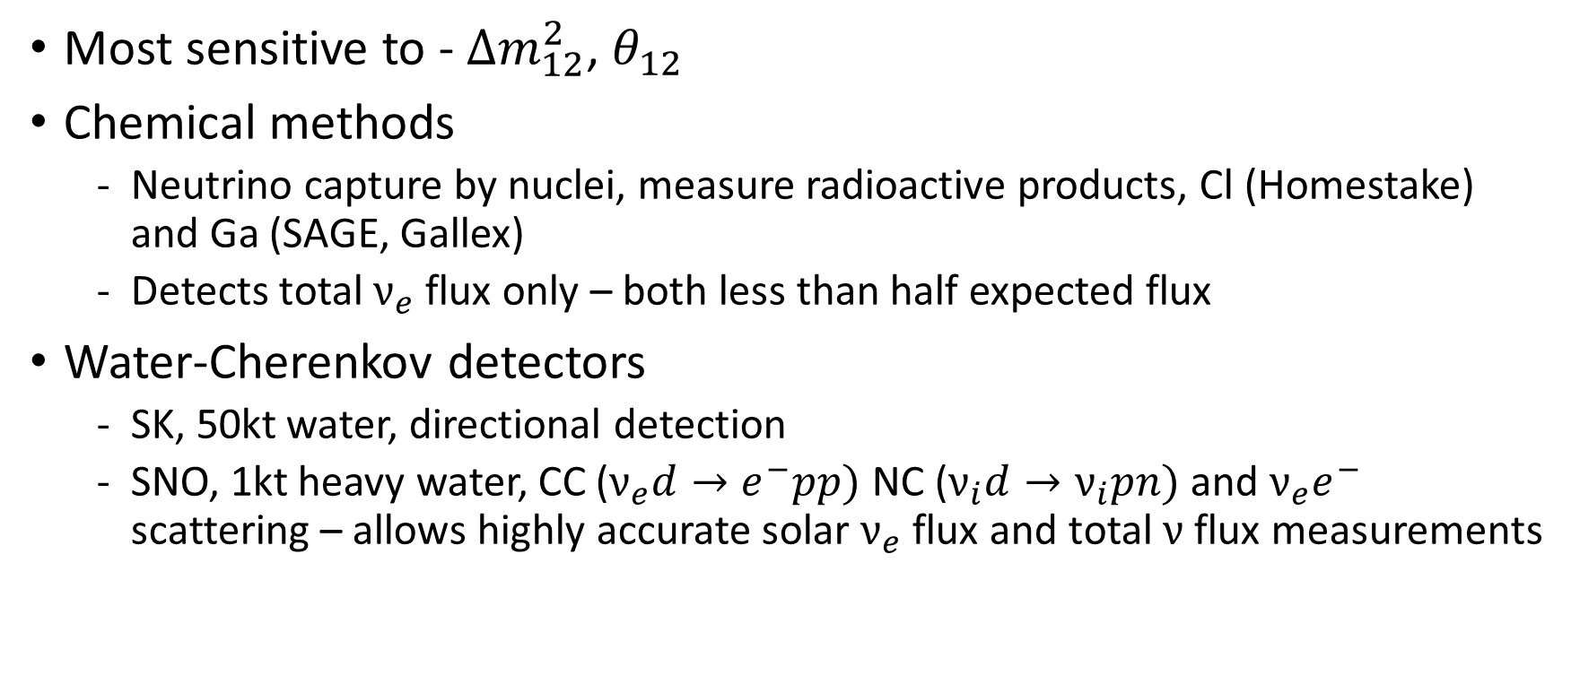
Solar
Most sensitive to - $∆m_{12}^{2}$, $θ_{12}$
Chemical methods
  Neutrino capture by nuclei, measure radioactive products, Cl (Homestake) and Ga (SAGE, Gallex)
  Detects total $ν_{e}$flux only – both less than half expected flux
Water-Cherenkov detectors
  SK, 50kt water, directional detection
  SNO, 1kt heavy water, CC ($ν_{e}d→e^{−}pp)$ NC ($ν_{i}d→ν_{i}pn)$ and $ν_{e}e^{−}$ scattering – allows highly accurate solar $ν_{e}$ flux and total $ν$ flux measurements

Slide 15
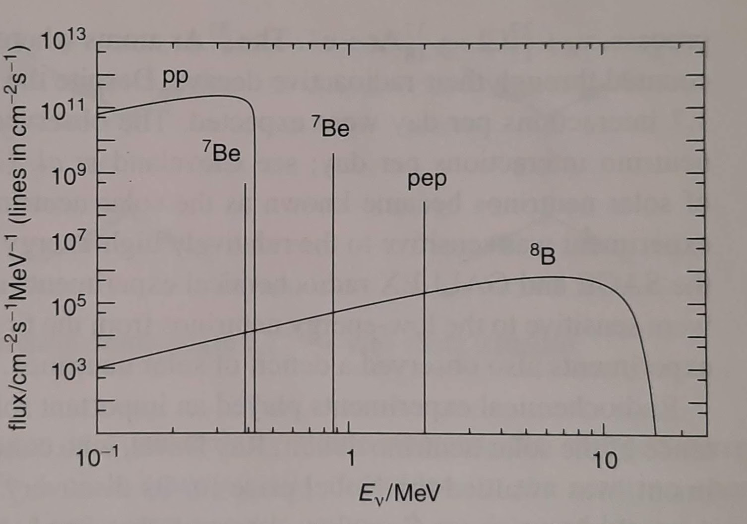
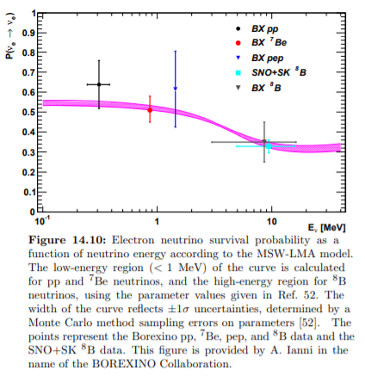

Solar
Source: Mark Thomson – Modern Particle Physics
Most sensitive to - $∆m_{12}^{2}$ , $θ_{12}$
Liquid Scintillator
  Borexino and KamLAND, far lower energy detection threshold allows detection of $ν$’s from Be fusion processes
  KamLAND allowed tests of $∆m_{12}^{2}$ down to $\sim {10}^{−5}eV^{2}$, confirmed current large mixing angle solution to >5σ
Source: Review of Particle Physics, Particle Data Group, C. Patrignani(Bologna U. and INFN, Bologna) et al. (Oct 3, 2016)

Slide 16

Accelerator Long-baseline
Most sensitive to - $∆m_{32}^{2}$, $θ_{23}$ (on axis), $θ_{13}$ or $δ$ (off-axis)
Advantages – Control over source $ν$’s, near and far detectors, fixed distance but variable energy
Can also use detectors for solar/atmospheric experiments

Slide 17
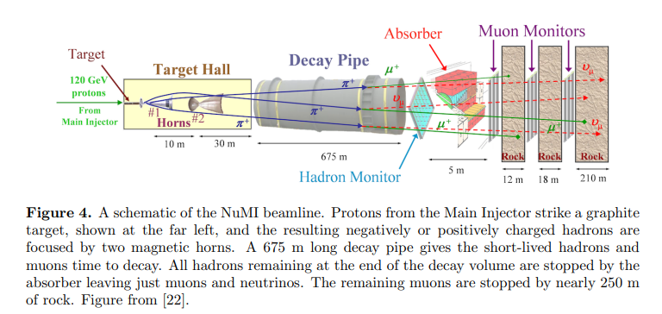
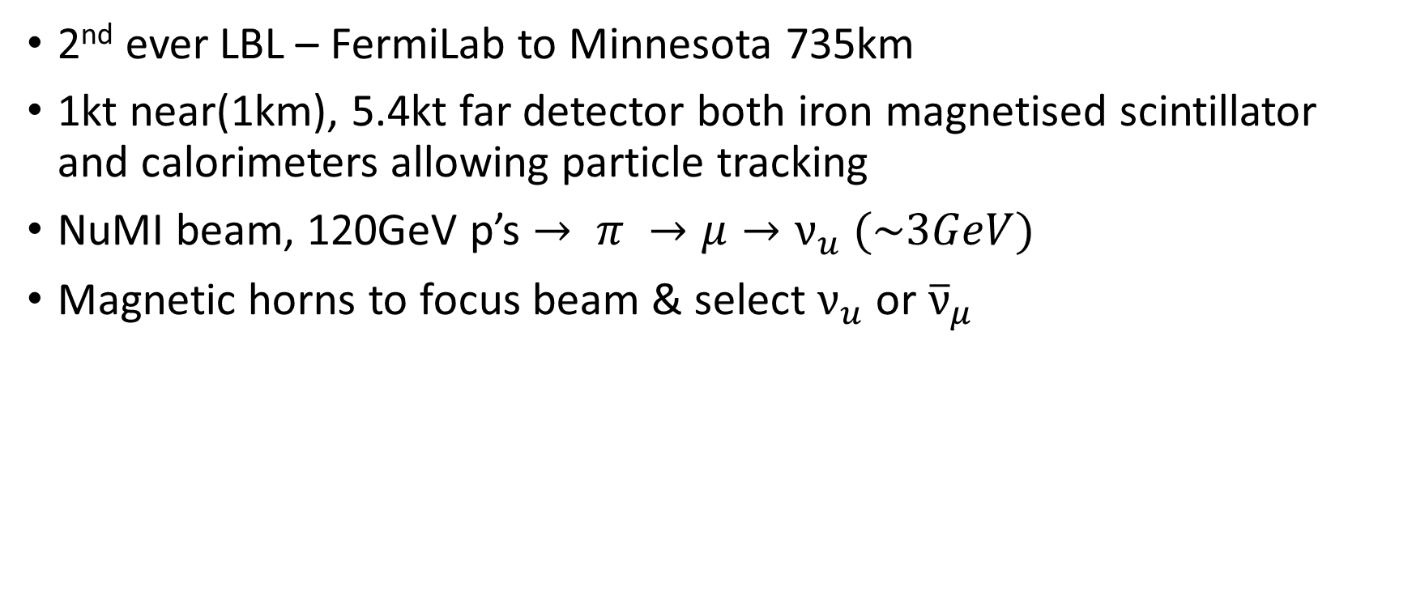
MINOS (2005-2012)
2nd ever LBL – FermiLab to Minnesota 735km
1kt near(1km), 5.4kt far detector both iron magnetised scintillator and calorimeters allowing particle tracking
NuMI beam, 120GeV p’s $→ π →μ→ν_{u} (\sim 3GeV)$
Magnetic horns to focus beam & select $ν_{u}$ or ${\overline{ν}}_{μ}$

Slide 18
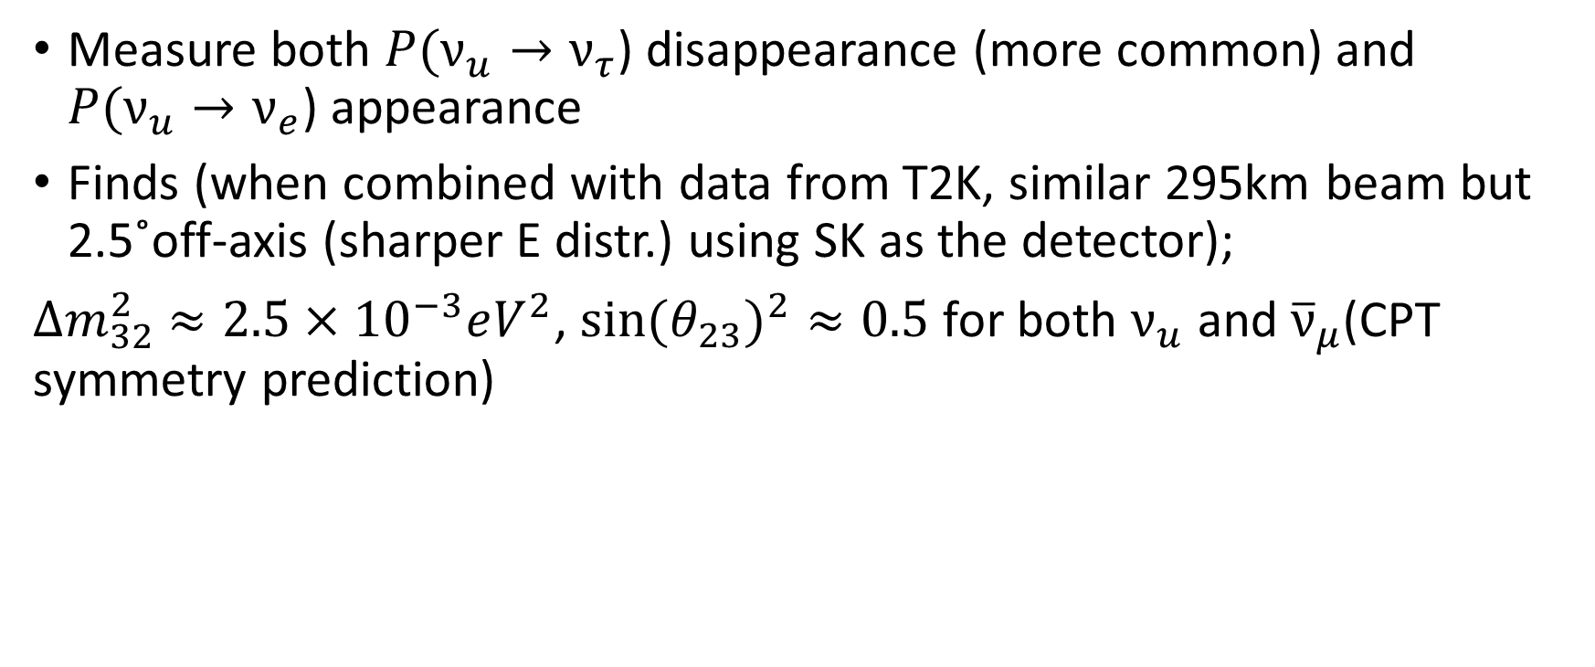
MINOS (2005-2012)
Measure both $P(ν_{u}→ν_{τ}$) disappearance (more common) and $P(ν_{u}→ν_{e}$) appearance
Finds (when combined with data from T2K, similar 295km beam but 2.5˚off-axis (sharper E distr.) using SK as the detector);
$∆m_{32}^{2}$ $≈2.5×{10}^{−3}eV^{2}$, $sin(θ_{23})^{2}≈0.5$ for both $ν_{u}$ and ${\overline{ν}}_{μ}$(CPT symmetry prediction)

Slide 19
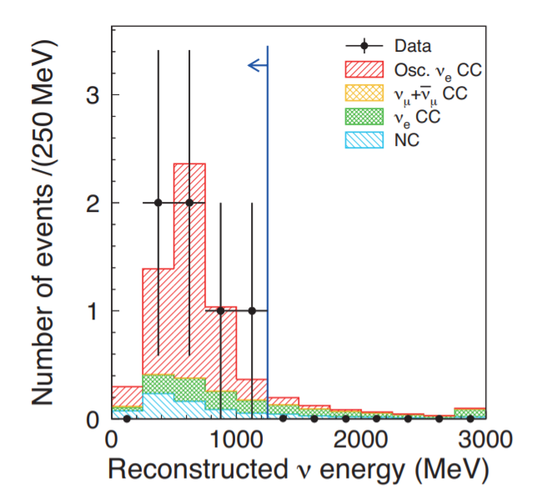
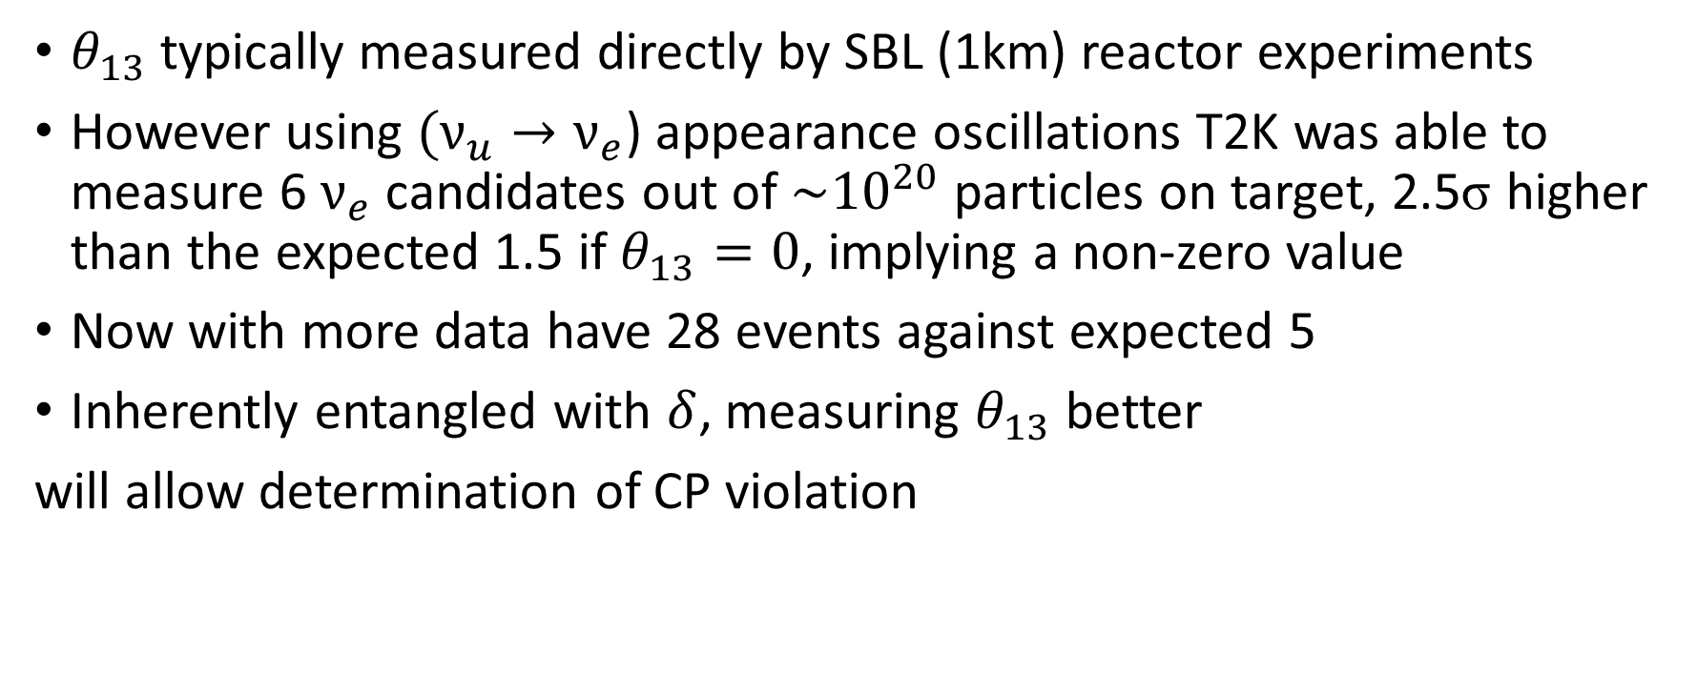
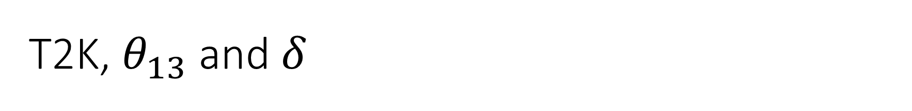
T2K, $θ_{13}$ and $δ$
$θ_{13}$ typically measured directly by SBL (1km) reactor experiments
However using $(ν_{u}→ν_{e}$) appearance oscillations T2K was able to measure 6 $ν_{e}$ candidates out of $\sim {10}^{20}$ particles on target, 2.5σ higher than the expected 1.5 if $θ_{13}=0$, implying a non-zero value
Now with more data have 28 events against expected 5
Inherently entangled with $δ$, measuring $θ_{13}$ better
will allow determination of CP violation

Slide 20
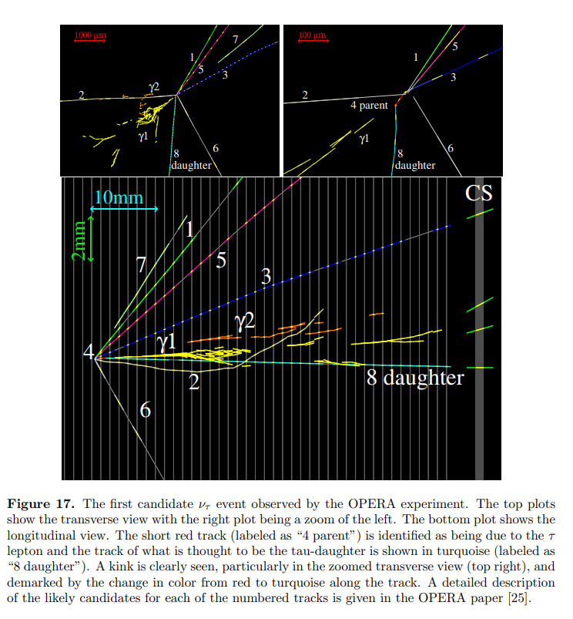
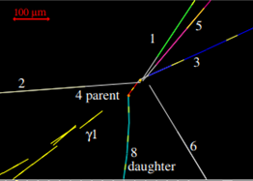


OPERA (CERN) and $(ν_{u}→ν_{τ}$)
Measuring $ν_{τ}$appearance, requires high beam energy (>3.5GeV) to allow $τ^{−}$ production
5 candidate events discovered as of July 2015

Slide 21


Future Accelerator Exp.’s - DUNE
1300km, >10kt liquid argon far detector
Aims to measure $δ$ to high precision, test CP violation
Determine mass ordering through the sign of $∆m_{31}^{2}$

Slide 22
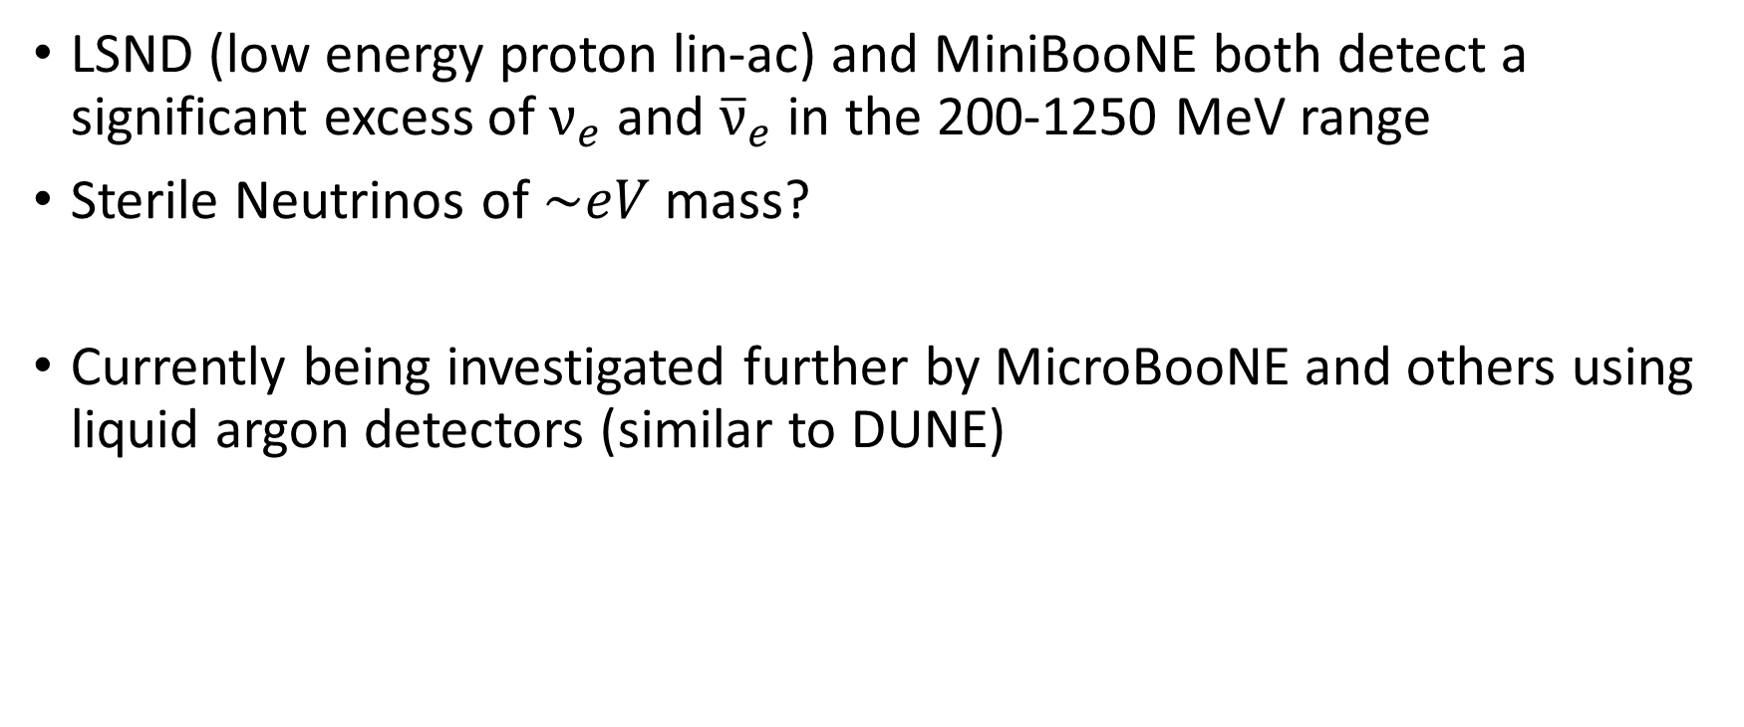
Short Baseline (<1km) – Low Energy Excess
LSND (low energy proton lin-ac) and MiniBooNE both detect a significant excess of $ν_{e}$ and ${\overline{ν}}_{e}$ in the 200-1250 MeV range
Sterile Neutrinos of $\sim eV$ mass?
Currently being investigated further by MicroBooNE and others using liquid argon detectors (similar to DUNE)

Slide 23
Thank you for listening

