Slide 1
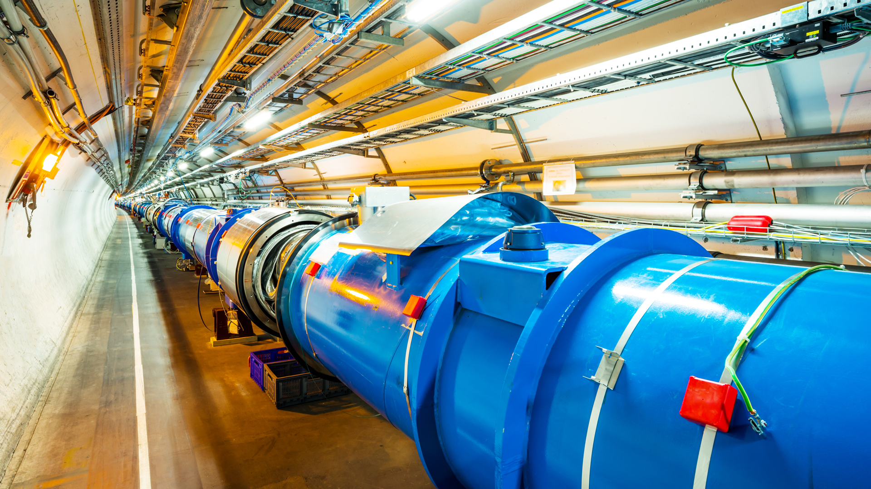
The Search for Supersymmetry
A Research Review

Slide 2
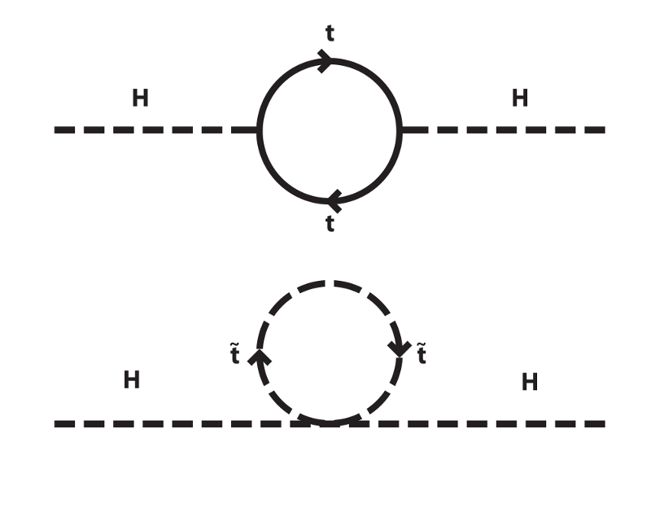
Why Supersymmetry?
The Hierarchy Problem:
  Loop corrections to the Higgs squared mass parameter suggest that the Higgs mass should be much larger than it is.
  Opposite quantum corrections for fermions and bosons.
  If each fermion has a bosonic superpartner and vice versa, loop corrections cancel out.
Dark Matter:
  Prediction of an electrically neutral, stable LSP (lightest neutralino) which presents a likely candidate for dark matter.

Slide 3
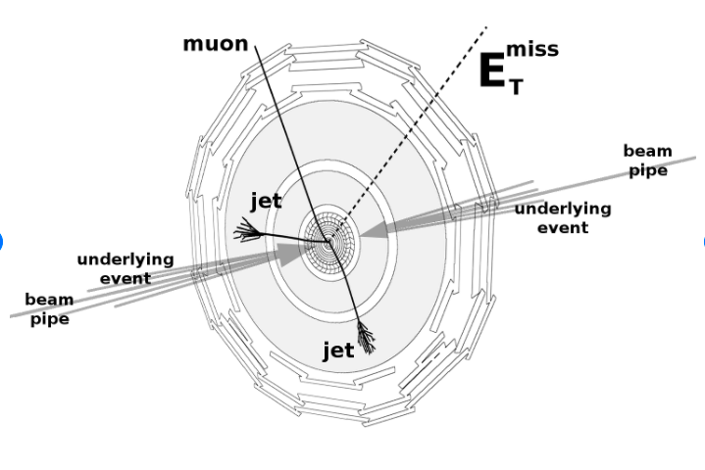
Stop Production
Specific search:
  Top squark/stop pairs in final states with one lepton, jets, and missing transverse momentum in 𝒑 𝒑 collisions at √ 𝒔 = 13 TeV
Key Papers:
  ATLAS, Dec 2020
  CMS, May 2020
Stop production and detection at the LHC
  Stops could be the most likely SUSY particles to be first discovered at the LHC since we expect them to be relatively light.
  Single lepton + jets + E_{T}^{miss} final states could have a large rate from various stop production modes and backgrounds can be reduced.

Slide 4
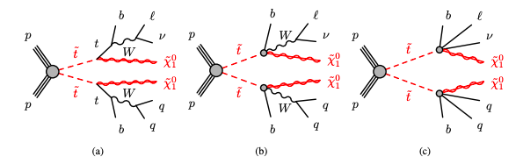
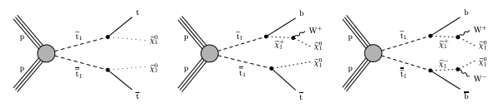
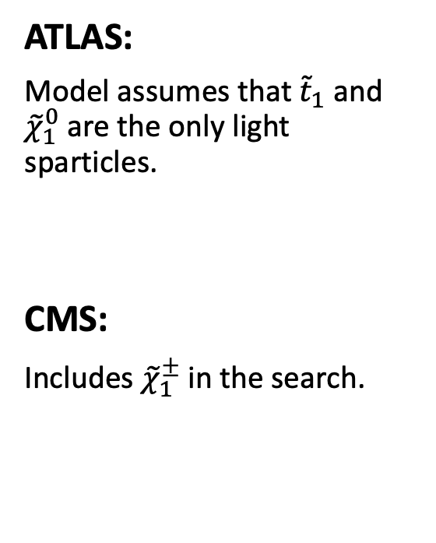
Targeted Simplified Models
ATLAS:
Model assumes that ${\tilde{t}}_{1}$ and ${\tilde{χ}}_{1}^{0}$ are the only light sparticles.
CMS:
Includes ${\tilde{χ}}_{1}^{±}$ in the search.

Slide 5

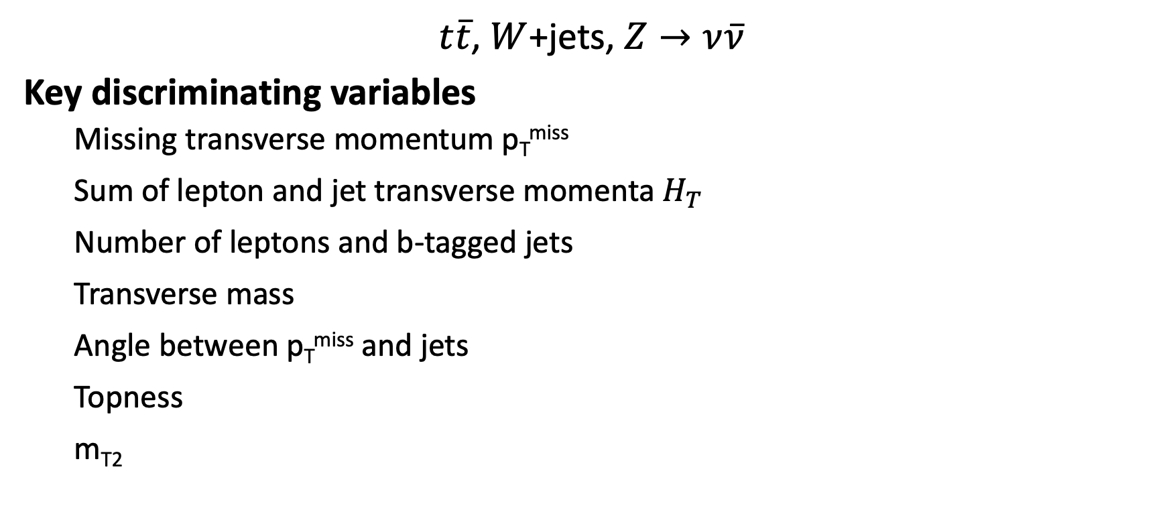
SM Backgrounds
$t\overline{t}$, $W$+jets, $Z→ν\overline{ν}$
Key discriminating variables
  Missing transverse momentum p_{T}^{miss}
  Sum of lepton and jet transverse momenta $H_{T}$
  Number of leptons and b-tagged jets
  Transverse mass
  Angle between p_{T}^{miss} and jets
  Topness
  m_{T2}

Slide 6
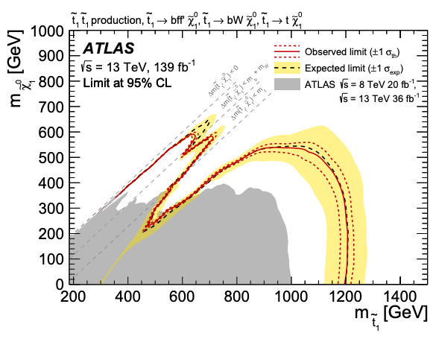
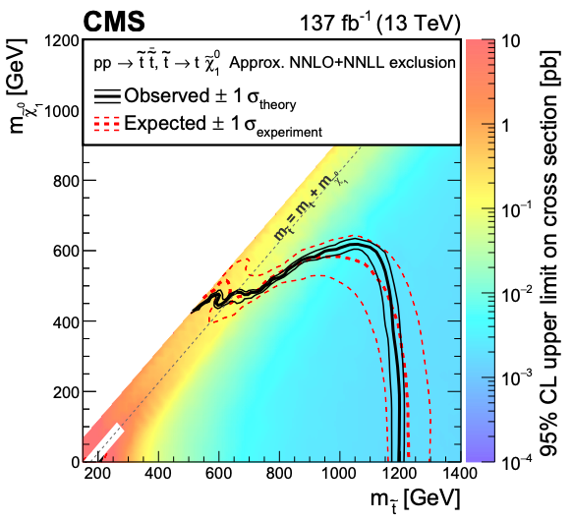
Exclusion Limits

Slide 7
References (so far)
The ATLAS Collaboration, Search for new phenomena with top quark pairs in final states with one lepton, jets, and missing transverse momentum in 𝒑 𝒑 collisions at √ 𝒔 = 13 TeV with the ATLAS detector. arXiv:2012.03799v1 [hep-ex] 7 Dec 2020
The CMS Collaboration, Search for direct top squark pair production in events with one lepton, jets, and missing transverse momentum at 13 TeV with the CMS experiment. arXiv:1912.08887v2 [hep-ex] 18 May 2020
Stephen P. Martin, A Supersymmetry Primer. arXiv:hep-ph/9709356v7, 27 Jan 2016

