Slide 1
Digital Quantum Simulation of the Schwinger Model
Introduction to Quantum Simulation
Work done in this field – Schwinger model
Why use a quantum simulator for this model?
Further developments and conclusion
Stefan Mihalcea

Slide 2
1. Introduction to Quantum Simulation
Simulating physics using a computer has been done for a very long time. However, simulating a quantum mechanical system is much more difficult.
The main difficulty lies in the huge amount of computing storage and power needed to deal with the exponentially growing number of parameters that describe such a system. Feynman showed 40 years ago that quantum simulations cannot be done using a classical Turing machine.
Thus, we started to think about building quantum computers. A quantum computer is an ensemble of universal quantum gates that can act on well-defined qubits. Currently, the largest such computer has only 65 qubits, which is not enough to simulate general systems. However, we can create other simple devices that mimic the behaviour seen in a quantum system and can be used for a specific task.

Slide 3

2. Work done in this field – Schwinger model
The goal is to evaluate the vacuum expectation value of the fermionic mass operator for both the massive and massless cases. The general idea is to take the 1+1 dimensional Schwinger model and couple a Dirac fermion. The system is described by the following Lagrangian:
The work is done using the lattice model and and the steps are mostly to evaluate the vacuum state of the Hamiltonian, impose the Gauss law and in the end re-express the system in terms of spin operators.
In the end the Hamiltonian becomes:

Slide 4
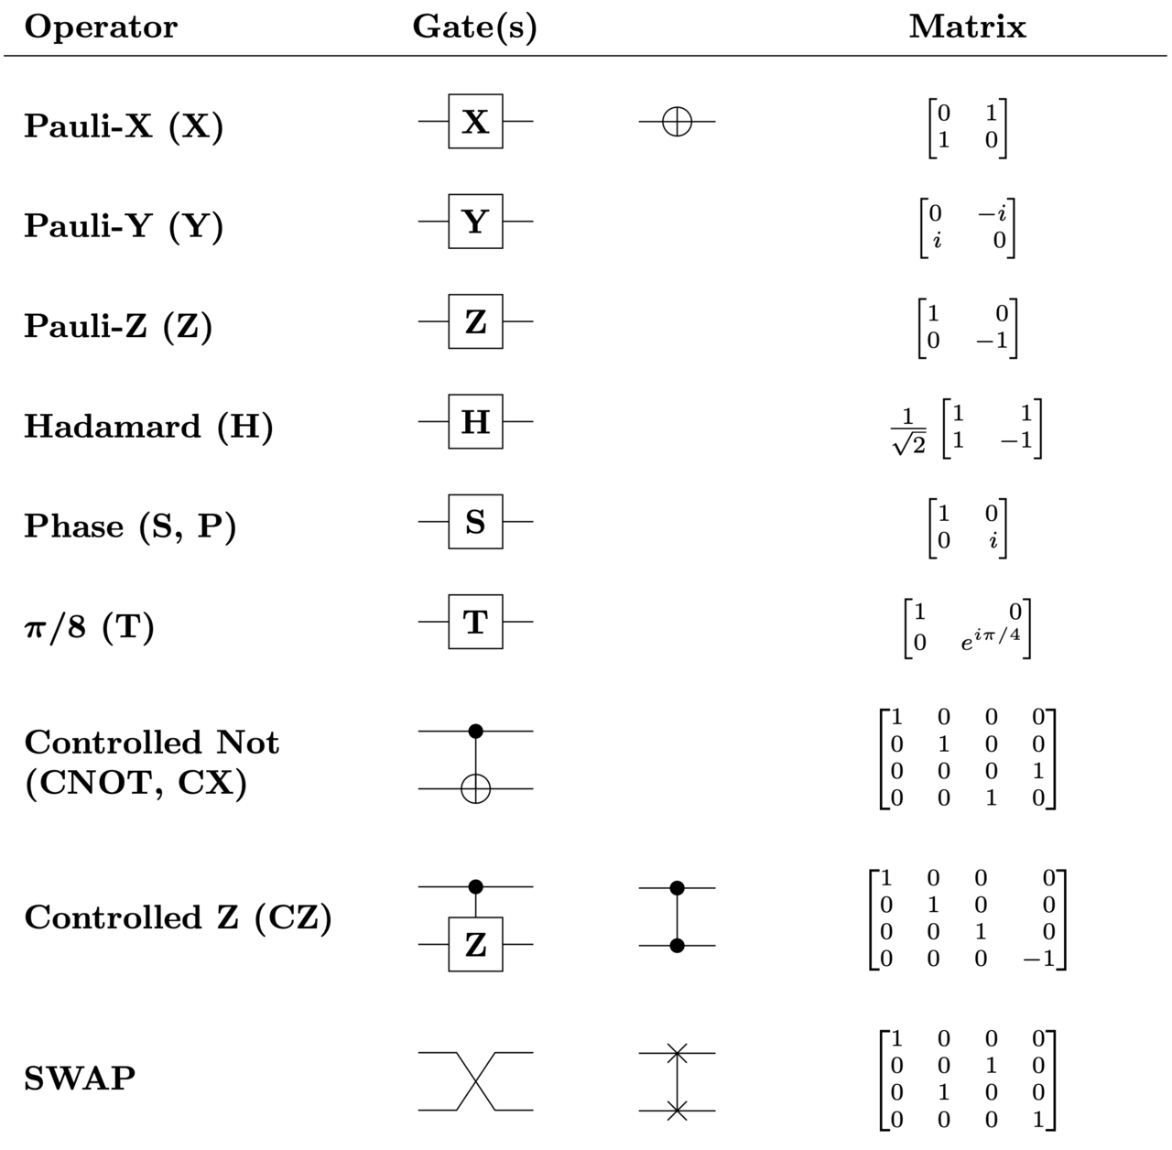
Common quantum logic gates by name, circuit name and the corresponding unitary matrices (source: Wikipedia)

Slide 5
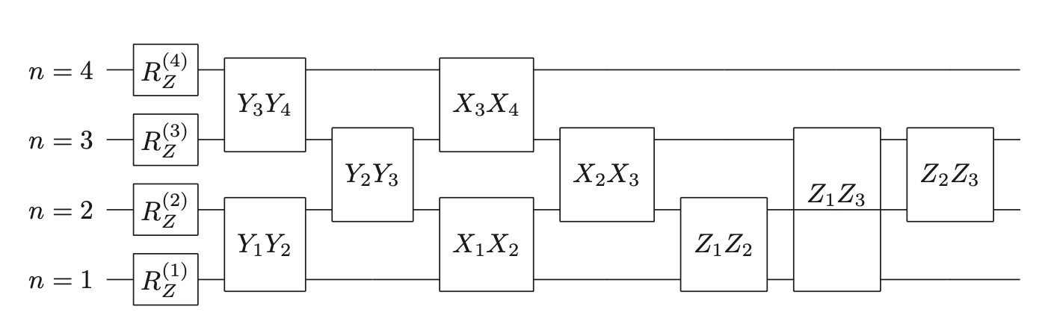
Implementation of time evolution operator with lattice size N=4 for the Schwinger model (source: Digital Quantum Simulation of the Schwinger Model with Topological Term via Adiabatic State Preparation)

Slide 6
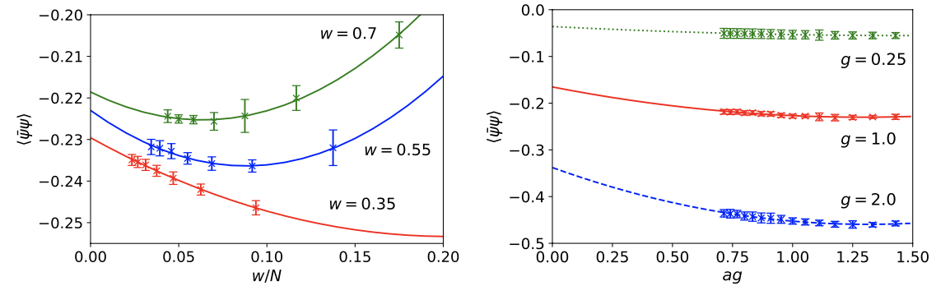
3. Why use a quantum simulator for this model?
QFT can be solved by performing numerical integration methods such as Monte-Carlo, by generating some weights and create samples from a PD:
What if x is imaginary? Then we need a quantum simulator.
For the Schwinger model the steps were described in the previous slide.

Slide 7
4. Further developments and conclusion
This example represents a quantum simulation, this is different from a quantum computer.
There is still plenty of room for development. A method such as the one presented here has the potential to be applied to other theories. For instance, most QFT require the preparation of a true ground state.
There are very fast advances in the field of QS with applications in complex systems such as atoms in optical lattices, superconducting circuits or trapped ions.
Physicists can say with certainty that QS will profoundly impact future research, allowing the study of systems which are currently beyond experimental research.

