Slide 1
Anomalies in Quantum Field Theory
Chong Kai En
Wolfson College

Slide 2
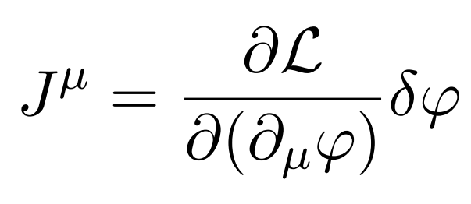
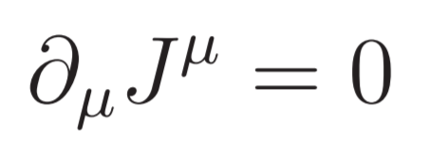


Symmetries and Noether’s Theorem
Noether’s Theorem tells us that for every continuous symmetry of the Lagrangian:
there is a conserved quantity,
$$ψ→ψ+ δψ$$
$$δℒ=0$$

Slide 3
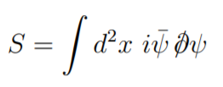
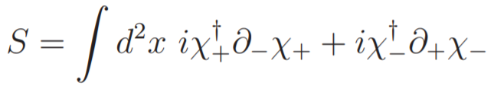
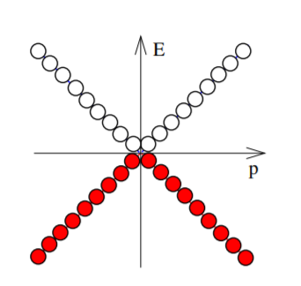
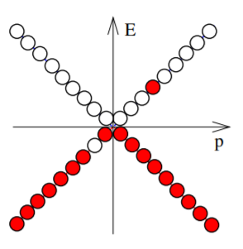
The Chiral Anomaly
In 1+1 dimensions, the action for massless Dirac fermions can be written as:
Expect n₋ and n₊ to be individually conserved
Vacuum
Excited

Slide 4
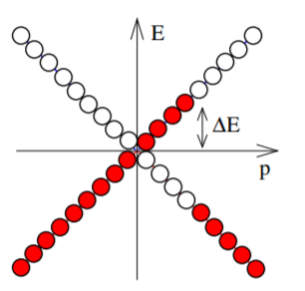

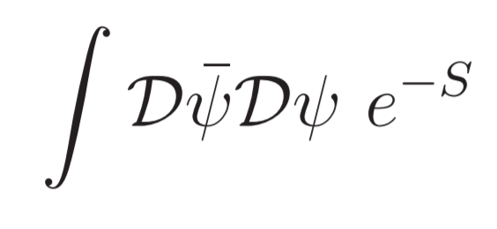
The Chiral Anomaly
But if we switch on an electric field for some time, we get:
We need to consider the path integral:

Slide 5
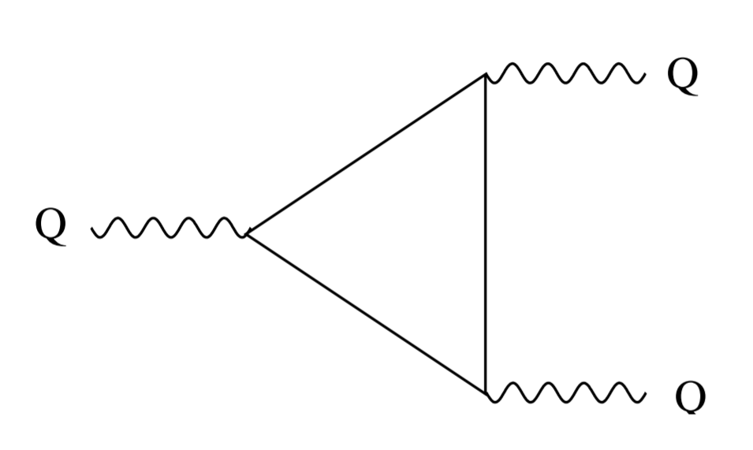
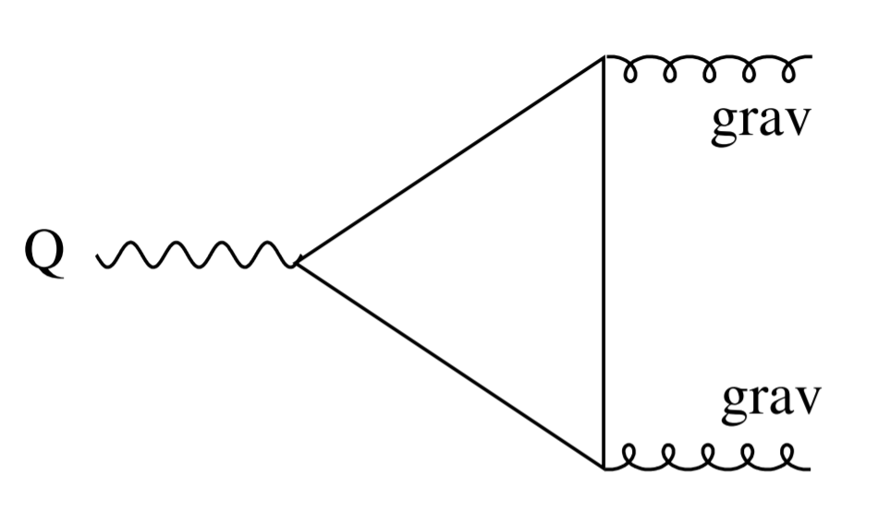
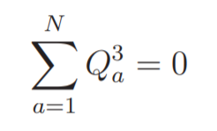
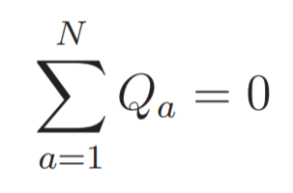
(Abelian) Chiral Gauge Anomalies
Anomalies in gauge symmetries render theory mathematically inconsistent
Arise from one-loop Feynman diagrams → Triangle diagrams in 3+1 dimensions

Slide 6

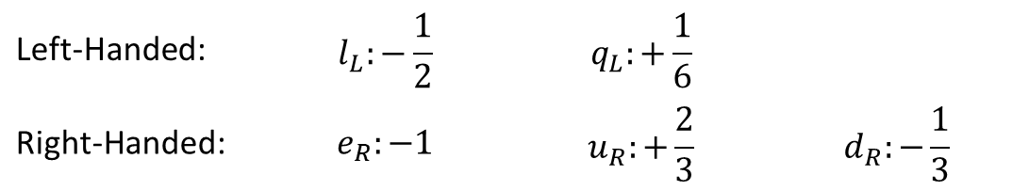
Anomaly Cancellation
Standard Model:
and others…
Left-Handed: | $$l_{L}:−\frac{1}{2}$$ | $$q_{L}:+\frac{1}{6}$$
Right-Handed: | $$e_{R}:−1$$ | $$u_{R}:+\frac{2}{3}$$ | $$d_{R}:−\frac{1}{3}$$

Slide 7
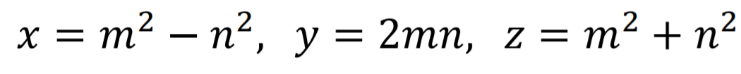
Finding new theories
All Pythagorean triples can be generated using the formula:
Once some solutions have been found, others can be generated using geometric methods in higher-dimensional space
  E.g. using the special properties of a unique solution (double point of quadratic and cubic equations)
  E.g. For U(1) anomaly equations – method of chords

