Slide 1
Anomalous Muon Magnetic Moment: Hadron Vacuum Polarization
yz610 Sel Yuchen Zhou Selwyn
Supervised by Dr. Bipasha Chakraborty

Slide 2
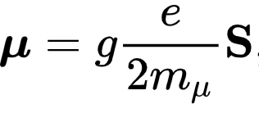
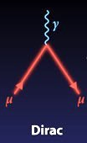
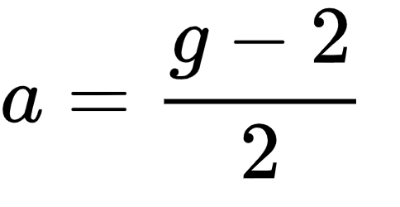
What is aµ?
Recall from PNP course, magnetic moment of muon can be written as:
This result is derived from Dirac equation, and it corresponds to the lowest order Feynman diagram (no loop). For muon, g=2.
However, quantum field theory predicts loop corrections. These loops will contribute to µ hence g is found to deviate from 2.
aµ is defined as the fractional deviation from 2, namely:

Slide 3
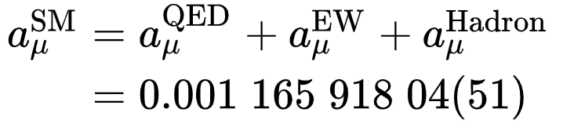
Which loops contribute to aµ?
Standard model: QED, Electroweak, Hadrons (QCD)
A theoretical prediction from C. Patrignani et al, (Particle Data Group), Chinese Physics C, 40, 100001 (2016)
Test SM by experimentally determine aµ and compare with theoretical prediction.
3-4 σ?!
Theory
Experiment
(What is going on?)
Improve QCD contribution prediction
(what my review is about)
Fermilab, J-PARC

Slide 4
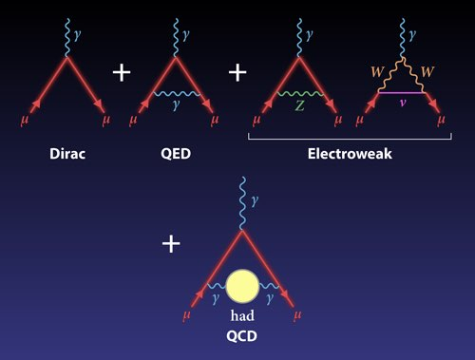
Why is HVP important?
(Fermilab)
Hadron vacuum polarization (HVP)
Hadron light by light scattering
(HLbL)

Slide 5
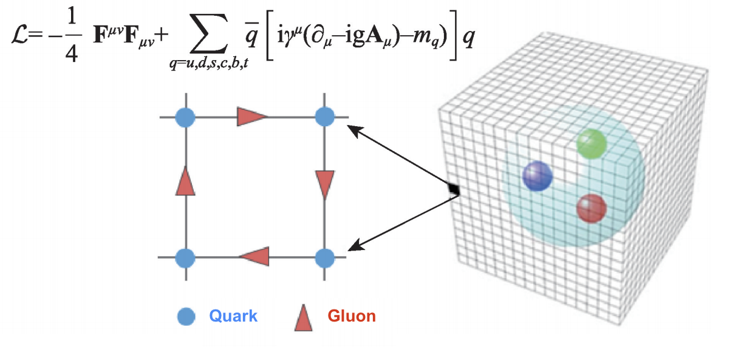
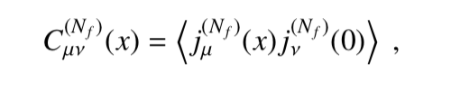



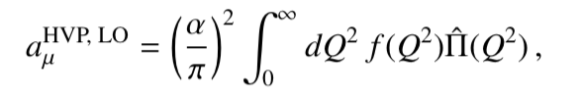
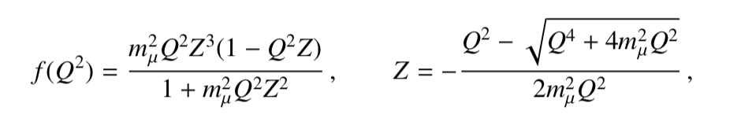
So, lattice QCD!
Recipe for computing aµ
Step 1: EM current correlator
  Step 2: 3+1 dimension Fourier Transform to obtain Vacuum Polarisation Tensor (and apply symmetry)
  Step 3: Integrate to obtain leading order HVP contribution
Lattice point 3+1 dimension
Currently 64³×128
Computed on supercomputer
where:

Slide 6
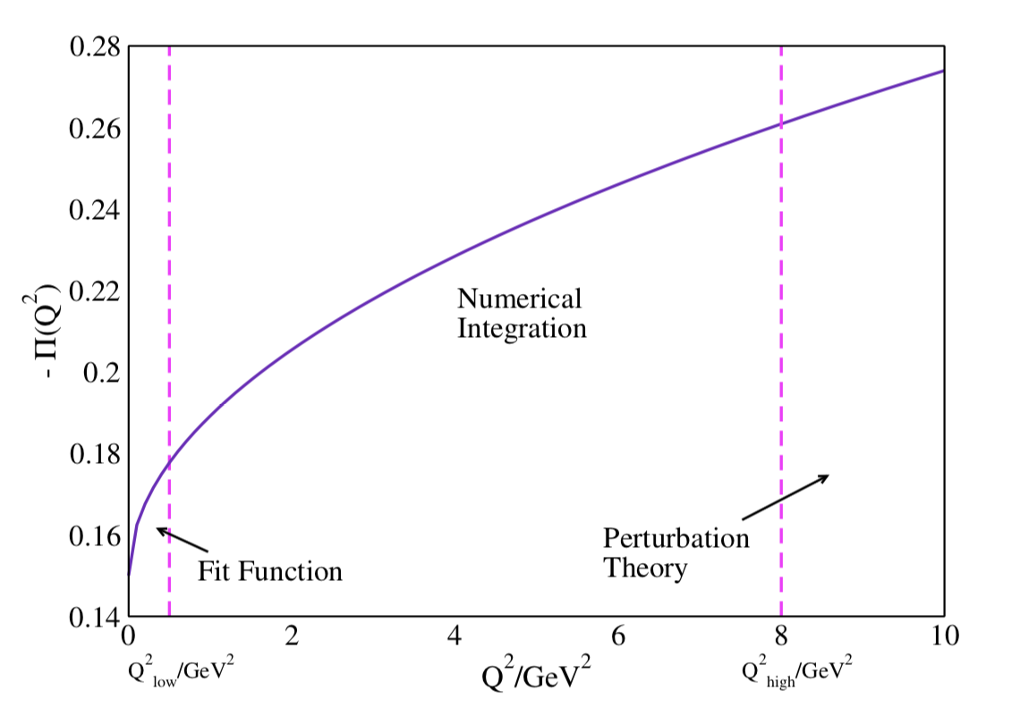
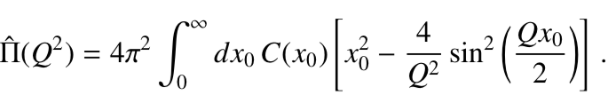
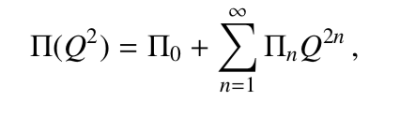
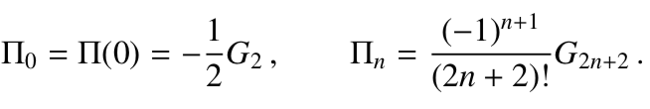
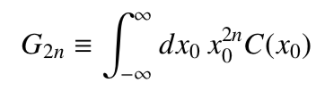
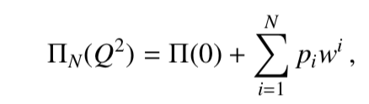
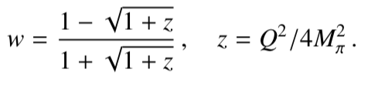
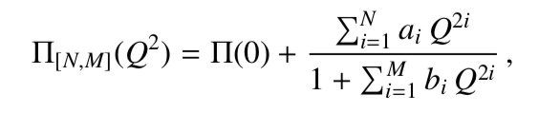
Different methods of calculating ∏(Q²)
**Hybrid Method**
Time-momentum Representation (TMR)
Time moment:
where
Conformal Polynomials
Padé function:

Slide 7
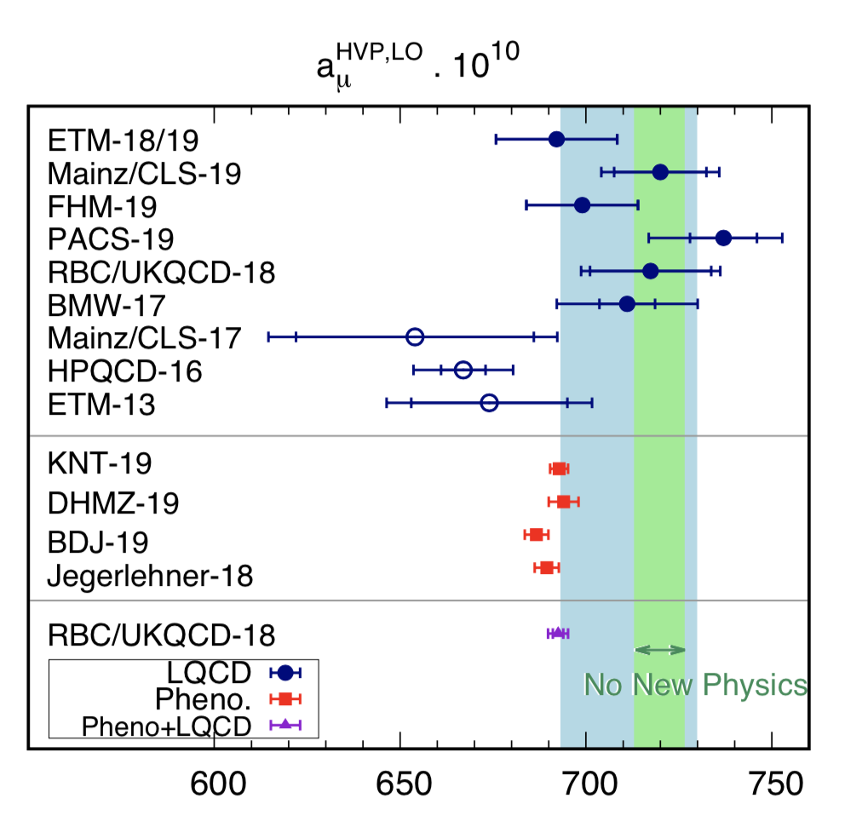
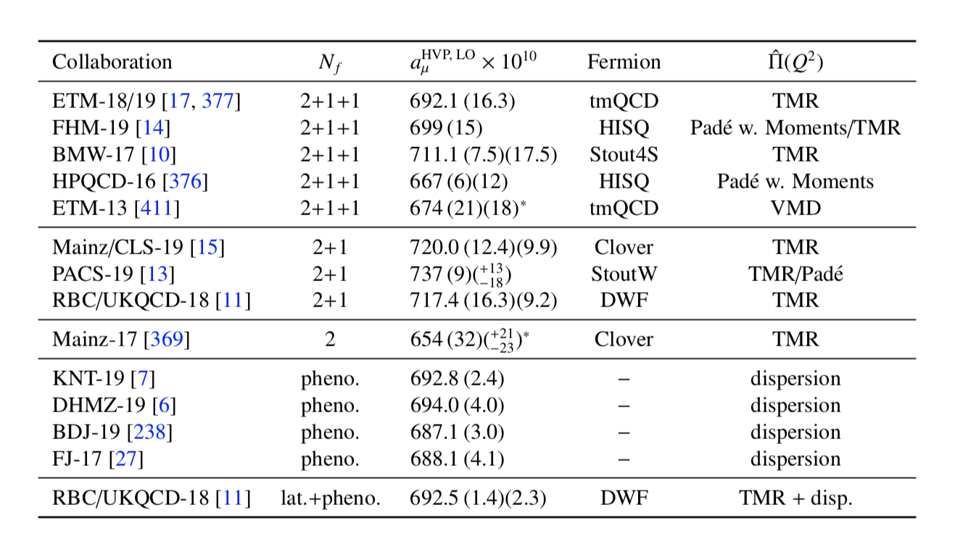
Result Comparison:
Lattice QCD vs. Phenomenology Result
(Padé, moment, TMR, etc)
(Dispersion method in different channels)

Slide 8
Reference
Pictures:
Y. Chen et al. “Lattice QCD in China”. In: Modern Physics, 2020, 32(1): pp. 36-44.
Roberts, B. Lee. “Zeroing in on the Muon's Magnetism.” Physics, American Physical Society, 25 June 2018, physics.aps.org/articles/v11/65.
T. Aoyama et al. “The anomalous magnetic moment of the muon in the Standard Model”. In: Phys. Rept. 887 (2020), pp. 1–166. doi: 10.1016/j.physrep.2020.07.006. arXiv:2006.04822 [hep-ph].
Formula and Graphs:
T. Aoyama et al. “The anomalous magnetic moment of the muon in the Standard Model”. In: Phys. Rept. 887 (2020), pp. 1–166. doi: 10.1016/j.physrep.2020.07.006. arXiv:2006.04822 [hep-ph].

