Slide 1
What can we learn from gravitational waves?
URSZULA KOMOROWSKA
King’s college

Slide 2
Sections:
Introduction – what is a gravitational wave?
Brief history
Outline of derivation and most important properties
How LIGO observed black holes merger
Gravitational waves astronomy and proposed further research
Conclusions

Slide 3
Explaining gravitational waves
Wikipedia: Gravitational waves are disturbances in the curvature of spacetime, generated by accelerated masses, that propagate as waves outward from their source at the speed of light.
They cause a change in metric which are assumed (rightfully) to be small, such that it is feasible to solve Einstein’s field equations in linearised form.
They possess all properites that we would expect a wave to have, most importantly they obey inverse square law.

Slide 4
How did we get here? A long search for gravitational waves
Possibility of their existence first showed by Einstein after he published general theory of relativity in 1915.
However, soon he started opposing the idea. In 1936 together with Nathan Rosen submitted a paper to Physical Review claiming that allowing for gravitational waves propagation leads to singularity in field equations. The fact that it would be just a coordinate singularity was suggested during the peer review.
Chapel Hill conference in 1956. First ’GR’ conference.
After the conference search for gravitational waves became more intense. First attempt to measure graviational waves by Joseph Weber in 1969.
Finally, success of LIGO in 2015.

Slide 5



Mathematics of GW
Solve this:
Knowing that:
Result:
Each component of perturbed metric obeys wave equation with a source (analogy to electromagnetism).

Slide 6

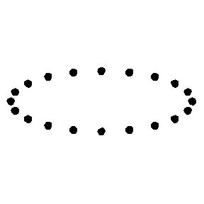
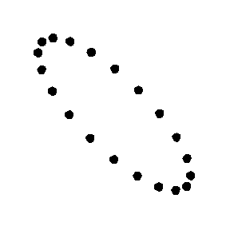
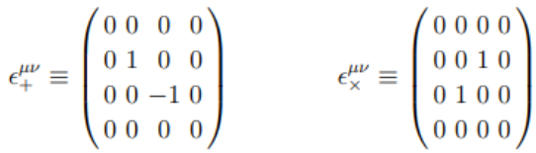
Most important properties:
Energy is carried away from the source and it propagates with the same rate as it is being extracted.
After considering all symmetries of the system it turns out that the most general solution is of the form:
with unit polarisation tensors:
Picture 1. Plus polarisation.
Picture 2. Cross polarisation
3. Metric perturbation decreases with distance like 1/r and rough estimate of h scale is:

Slide 7
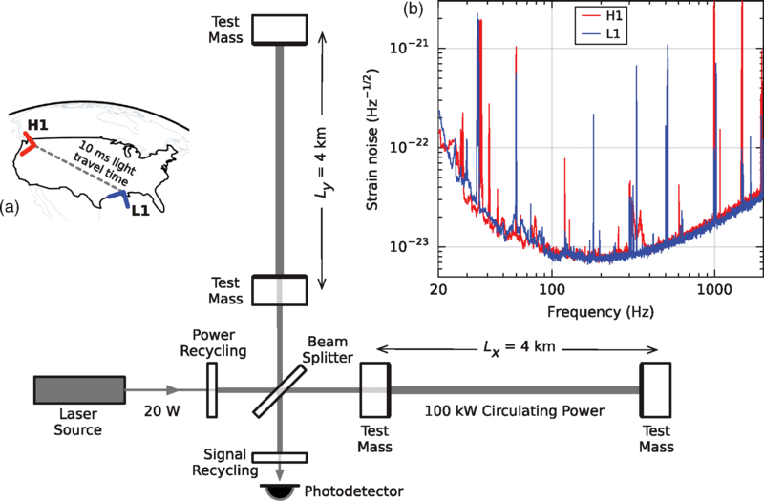
The story behind LIGO
The core idea is to use two distant interferometers, localized in Hanford, Washington and in Livingston, Louisiana.
Picture 3: Simplified scheme of the LIGO interferometer.

Slide 8
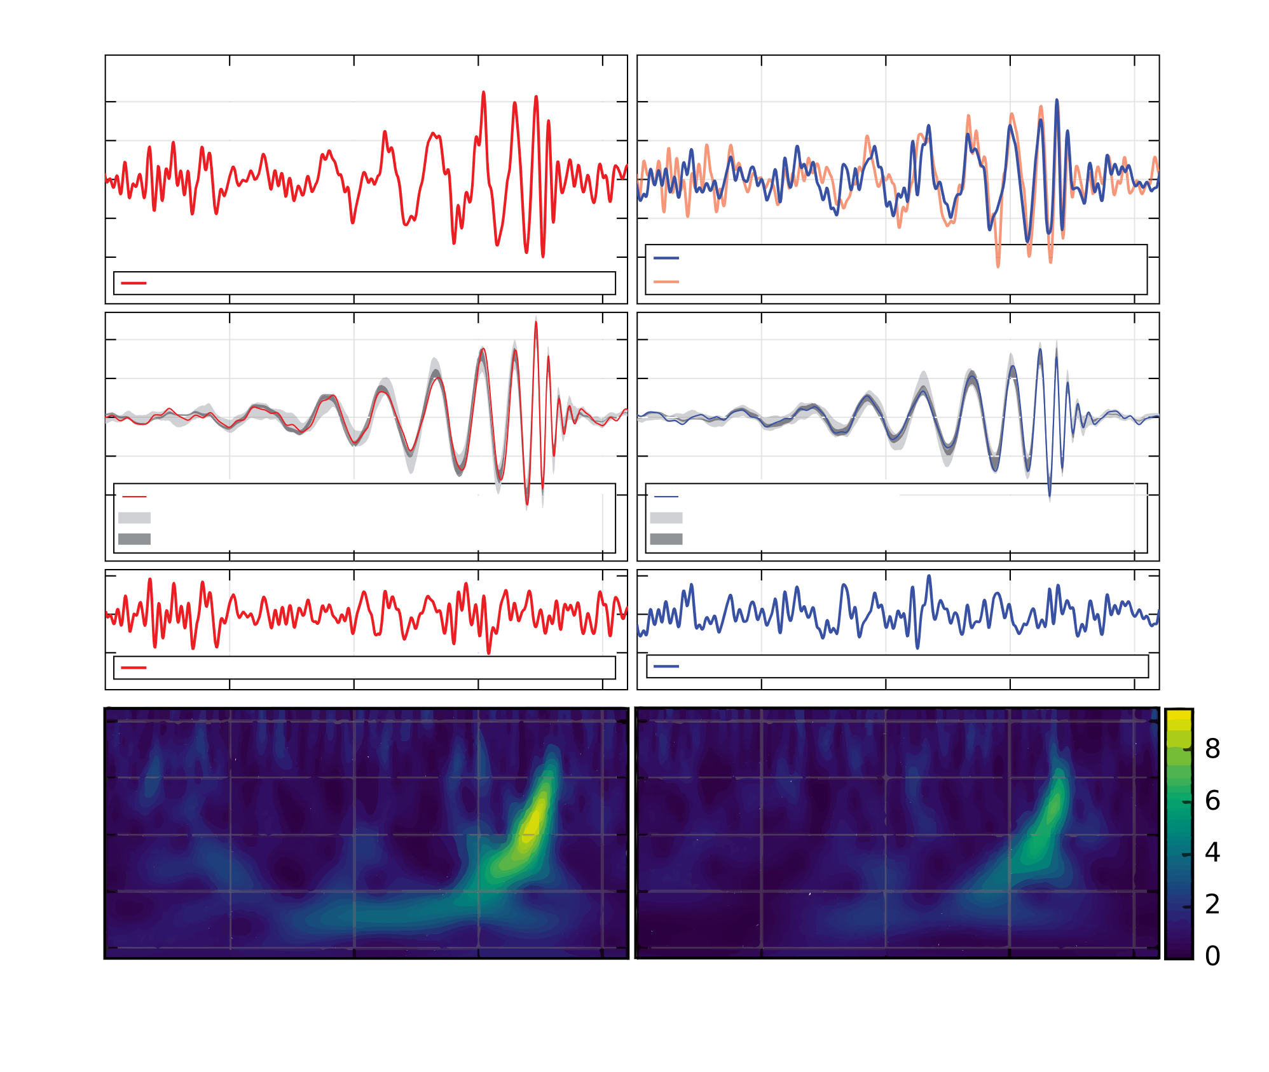

LIGO results:
Using this remarkable technology allowed for the detection of the event GW150914. Scientists observed the merger of two black holes as well as inferred their masses: initial were 36+5 -4 and 29+4 -4 and final mass was 62+4 -4 solar masses.
What exactly did they do and see? Very simiplified approach:
Assume that in the beginning black holes have non-relativistc speeds
Apply Kepler’s third law
Equate energy radiatef (from GR) and loss of orbital energy
Result: expression relating frequency of gravitational wave and ’chirp’ mass:
Picture 4: Gravitational waves signal detected in LIGO.

Slide 9
Gravitational waves astronomy and further research
New possibilites for multi-messenger astronomy. In 2017, the teams in LIGO and Virgo detectors announced passage of a GW. Shortly after that, the combined global efforts resulted in recording the electromagnetic counterpart in radiation. It was the first time, when both EM waves and GW were observed.
There are plans of constructing more advanced, underground laser interferometer with increased arm length to 10km with even better sensitivity – The Einstein Telescope.
One of the most important examples of the gravitational wave astronomy is using GW to resolve a ’Hubble tension’. Currently, the values of Hubble constant are 73 km/s/Mpc for ‘late universe’ techniques and 67.7 km/s/Mpc for ‘early universe’. Even though with better technologies available the measurement uncertainties have decreased, range of obtained values have not.
In 2018 researchers simulated a universe where binary neutron stars mergers have their EM counterparts and showed it is possible to calculate H with fractional uncertainty 2%.

Slide 10
Conclusions
After nearly a century of scientific dissent, first detection of gravitational waves happened in LIGO in 2015.
There are two types of polarisation of GW, each leading to oscillation in coordinate distance. This property is exploited in interferometers.
GW are a good source of information about previously inaccessible parts of the universe.
Popularity of multi-messenger astronomy is growing.
Even more precise experiments can be conducted by The Einstein Telescope once it is build.
Thank you for your attention

