Slide 1
EXPLORING THE ZOO OF DARK MATTER CANDIDATES
Vasu Prasad

Slide 2
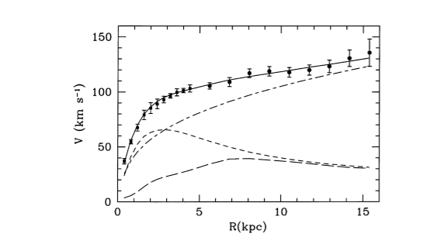
THE CASE FOR DARK MATTER
Galactic rotation curves
Notes:
Rotation curve of M33, a nearby dwarf spiral galaxy
Top line: observations from hydrogen 21-cm line
2nd line: contribution from dark matter halo
3rd line: contribution from stellar disc
4th line: contribution from gas
Source: https://academic.oup.com/mnras/article/311/2/441/965167

Slide 3
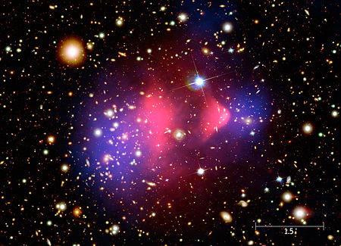
THE CASE FOR DARK MATTER
Gravitational lensing
Microlensing
Dark galaxies
Notes:
Image: Bullet Cluster, source: https://en.wikipedia.org/wiki/Bullet_Cluster

Slide 4
THE ΛCDM MODEL
Dark matter is cold (non-relativistic) and non-baryonic
Λ: cosmological constant
Very good at explaining large-scale structure of Universe
Notes:
See RH neutrinos, dark matter section for decent explanation

Slide 5
STERILE NEUTRINOS
Hypothetical right-handed neutrinos
Neutrino oscillations show that neutrinos have mass
Sterile neutrino could explain neutrino mass
More massive than active neutrinos
Notes:
What to say:
Ordinary neutrinos too fast, not massive enough
Neutrinos originally thought to be massless, but oscillate so can’t be – SNs may be required to give neutrinos mass
More massive due to see-saw mechanism

Slide 6
STERILE NEUTRINOS: DETECTION ATTEMPTS
Liquid Scintillator Neutrino Detector (2001): neutrino oscillation possibly corresponding to fourth neutrino mass
MiniBooNE (2018): neutrino oscillations hint at sterile neutrino detection
IceCube (2020): no evidence of eV-scale sterile neutrino

Slide 7
WEAKLY INTERACTING MASSIVE PARTICLES
Hypothetical particles interacting only via weak force and gravity
WIMP miracle: self-annihilation cross-section of 100 GeV electroweak particles matches that of DM
Supersymmetry provides popular candidate (neutralino)

Slide 8
WIMP DETECTION ATTEMPTS
Direct detection: searches for signal from WIMP collision with atomic nucleus
Indirect detection: searches for decay products of astrophysical WIMPs
LHC searches for production of WIMPs in high-energy collisions

Slide 9
AXIONS
Strong CP problem: QCD permits violation of CP symmetry, but has not been observed
Axion was postulated to resolve this problem
Very light, but could constitute cold dark matter
Detection attempts: searching for axions converting to photons

Slide 10
SUMMARY
Three DM candidates:
  Sterile neutrinos
  WIMPS
  Axions
  Thank you for listening!

