Slide 1
Dark matter detection via Higgs Boson interactions
Jacob Cutts
Sidney Sussex College

Slide 2
Introduction
The Higgs
2HDM
Dark matter
Higgs as a portal to dark matter
2HDM + scalar mediator
Conclusion

Slide 3
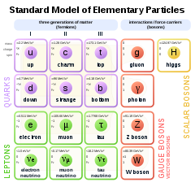
Introduction- Higgs Boson SM
Higgs field is an energy field
  Mass manifestation energy coupling with the field
  Same Field gives mass to fermions and bosons
  Explain Boson mass without breaking gauge theory
Excitation of the field produce the Higgs Boson
High energy PP collisions to produce the Higgs
Discovered in 2012
M_{h} ≈ 125GeV

Slide 4
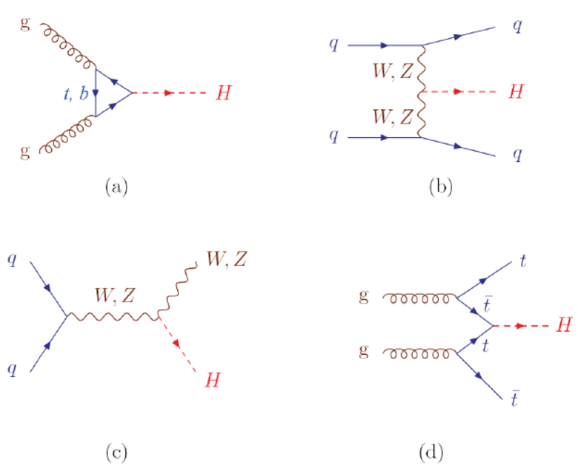
Introduction- Higgs Boson Feynamn diagrams
Gluon-fusion (ggF)
Vector Boson Fusion (VBF)
Higgs-strahlung (VH)
Top fusion (ttH + tH)

Slide 5
Introduction- 2HDM
Constraints of SM Higgs:
  Decay into DM will have an upper bound of M_DM < M_H /2
Two-Higgs-doublet model (2HDM) introduces a second doublet V(φ₁,φ₂)
  Includes 5 scalar states
  Model types determine coupling to which φ.
  2 parameters α(mixing angle) and β(related to VEV)
Additional scalars give more signatures
Alignment limits where we expect h or H to map to the observed Higgs Boson.
H(heavy), h(light) | CP-Even scalar
A | CP-Odd pseudo scalar
H± | Charged pair

Slide 6
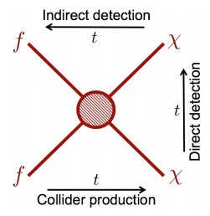
Introduction- Dark matter
Dark matter does not interact with EM field(Non-luminous)
Weak interaction (at most) with SM particles
Evidence of gravitational interactions
Indirect detection
  Galaxy cluster eg.Bullet cluster
  CMB anisotropy
High energy particle collisions (at LHC)
WIMPs
Dark matter discovery will change SM

Slide 7
Higgs Boson as a portal
Higgs field interactions induce mass
Can hypothesise the Higgs boson interacts with DM
Z
p
Z
p
Z
Z
χ
H
χ
p
H
p
χ
χ
VH Invisible Higgs decay
VH Invisible (virtual) Higgs decay
P’
p
V
χ
H
p
V
χ
P’
VBF invisible Higgs decay

Slide 8
Higgs Boson as a portal
Introduce fewest DoF
Works with SM Higgs
Limited to M_dm < M_h /2
Missing momentum
  Expect 0 transverse momentum
  Add up transverse momentum ≠ 0 → DM!
  Difficult in longitudinal direction don’t know momentum of constituents

Slide 9
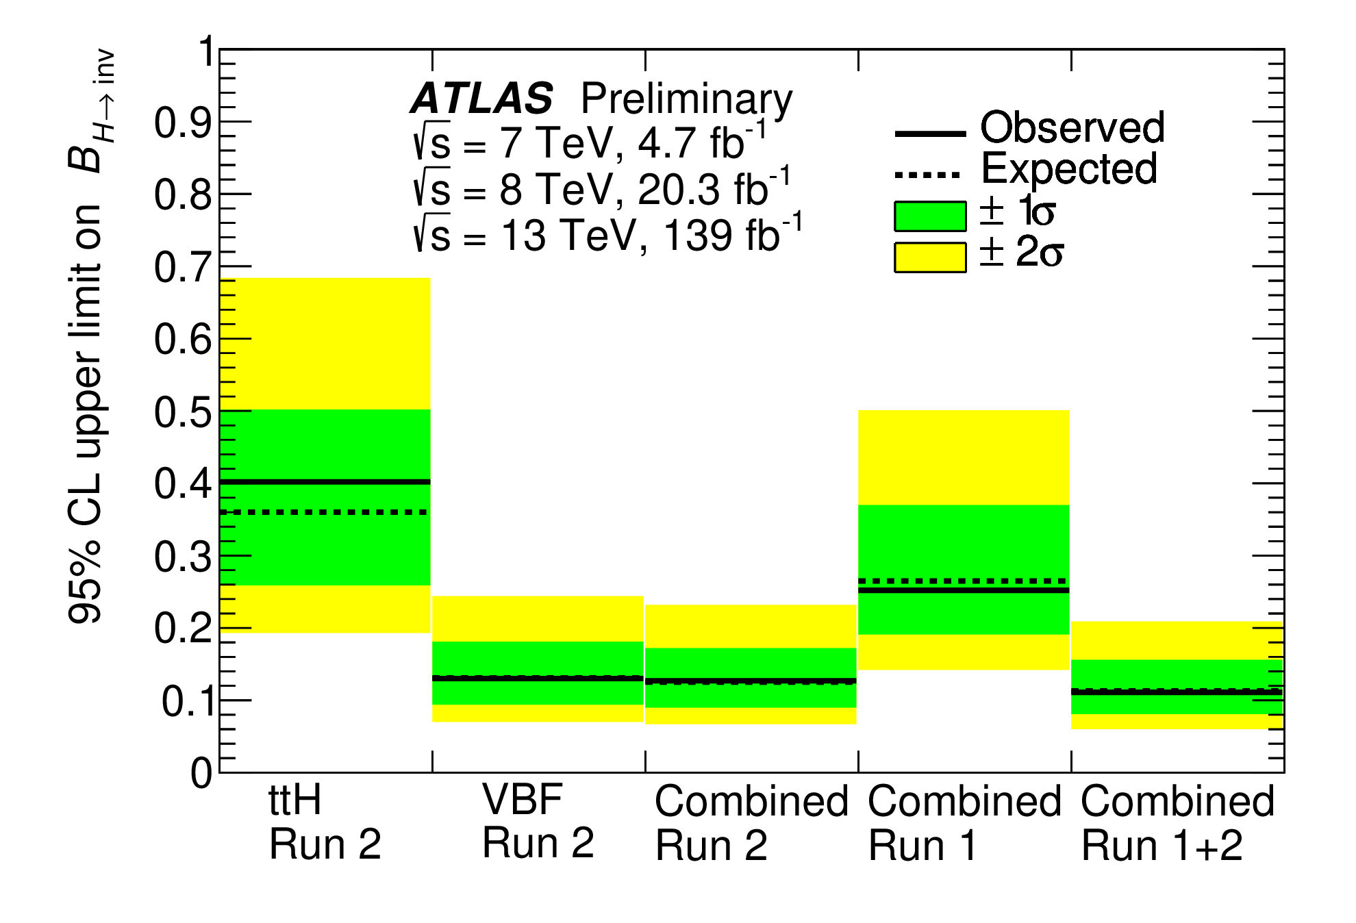
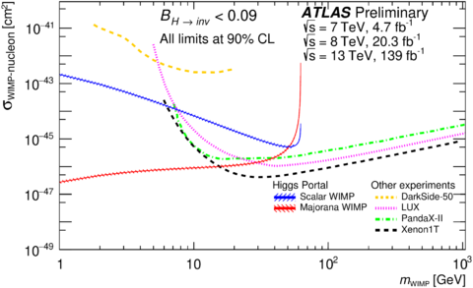
Higgs Boson as a portal- VBF
Upper limit on combined B_{inv} = 0.11±0.04 (95% CL) (October 2020)
Upper limits on WIMP cross section
(October 2020)
Branching fration based on the number of events
Asymtote 125/2 GeV

Slide 10
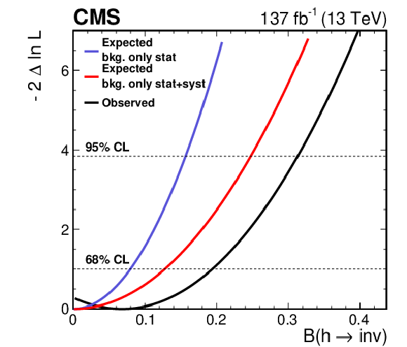
Higgs Boson as a portal- VH
Negative log-likelihood of branching fraction of H → χ (August 2020)
B_{inv} < 0.3 (95% CL)
Less data points larger uncertainty range

Slide 11
Higgs Boson as a portal
VH vs VBF results
  Larger uncertainty VH
    VBF striking signature (easier to detect)
    B_{z→ee} = B_{z→ee} = 3% Hence limited data for VH
    σ_{VBF} = 2 σ_{VH}
From branching fraction we can infer partial width
  Use Fermis golden rule to predict density of states and matrix elements
Introduced minimum DoF so can infer cross section of DM candidate

Slide 12
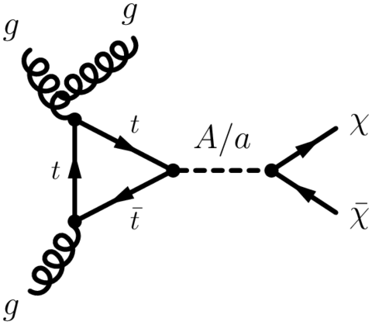
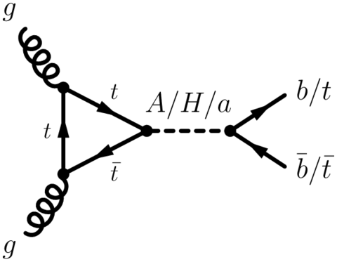
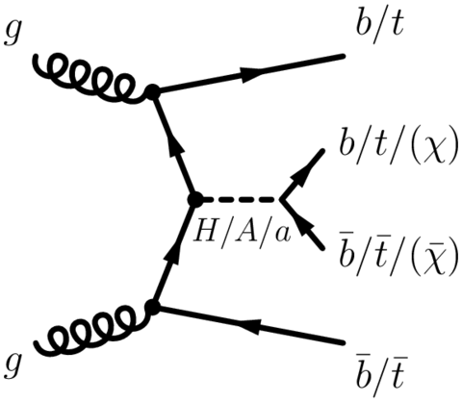
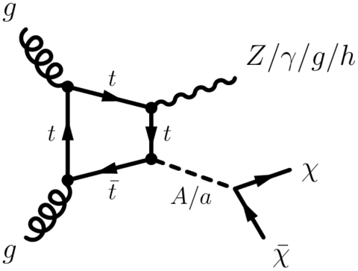
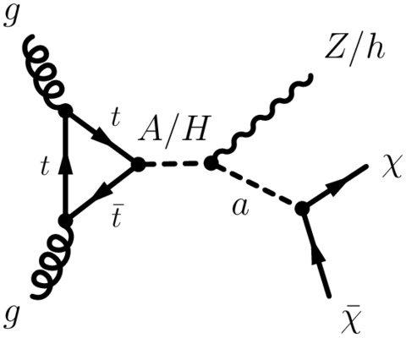
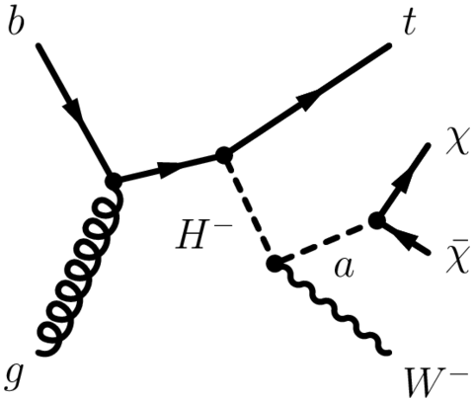
2HDM + scalar mediator

Slide 13
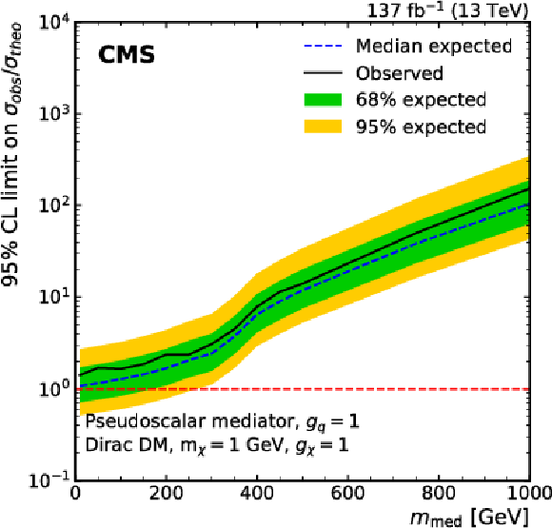
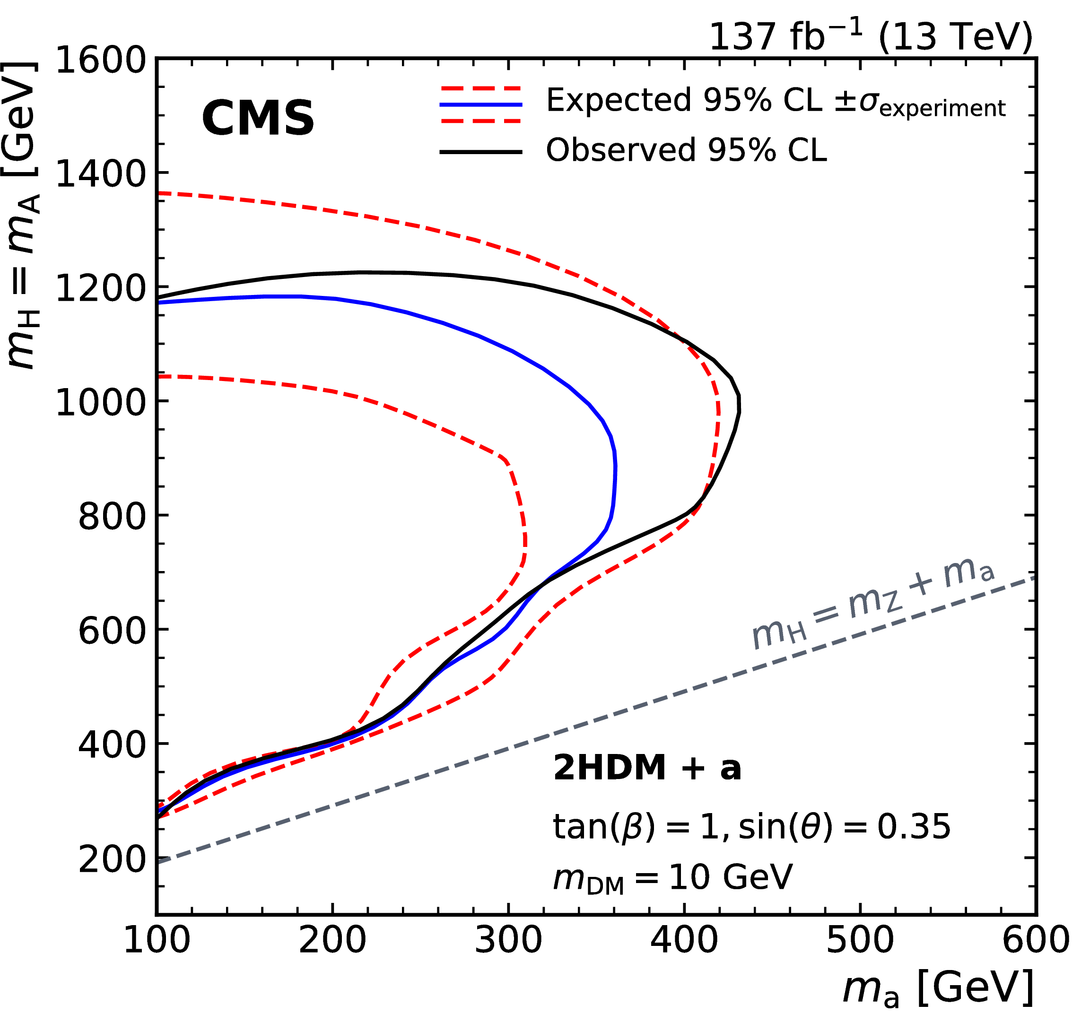
2HDM + scalar mediator
95% limit on mediator cross section
(August 2020)
95% upper limit on mediator mass
(August 2020)

Slide 14
2HDM + scalar mediator
Introduced 5 new DoF compared to SM
Fixed many parameters to calculate M_{a}
More exotic signatures
Access to E > M_{h} but higher energies have few data points.
  More uncertainty

Slide 15
Conclusion
Difficult detecting absence rather than a presence
  Can only conclude upper limits
Require higher energy collisions for greater accuracy at large masses
Draw different conclusions from the same data

Slide 16
Conclusion
Discussed models are simplified models
  Add minimal DoF
Complete models
  Susy – believed 2HDM effective theory at low energy
Modified gravity theories
Discovery are dark matter will have significant effects across all of Physics

