Slide 1
Hunting Dark Matter Using the Higgs Boson as a Probe
Lucas Strange

Slide 2
Dark Matter
What is it?
-The existence of dark matter is well established from astrophysical observations [1]
-Galaxy rotation curves→ large amount of unseen matter present in galaxies (otherwise they would fly apart)
-All our observations that give strong evidence for dark matter require it to only interact with gravity (WIMPs are a good dark matter candidate)
Why do I care?
-Makes up 85% of matter [2]
-No good SM candidate (neutrinos, our closest bet, wouldn’t fit)
-Follows naturally from new physics (SUSY and neutralino)

Slide 3
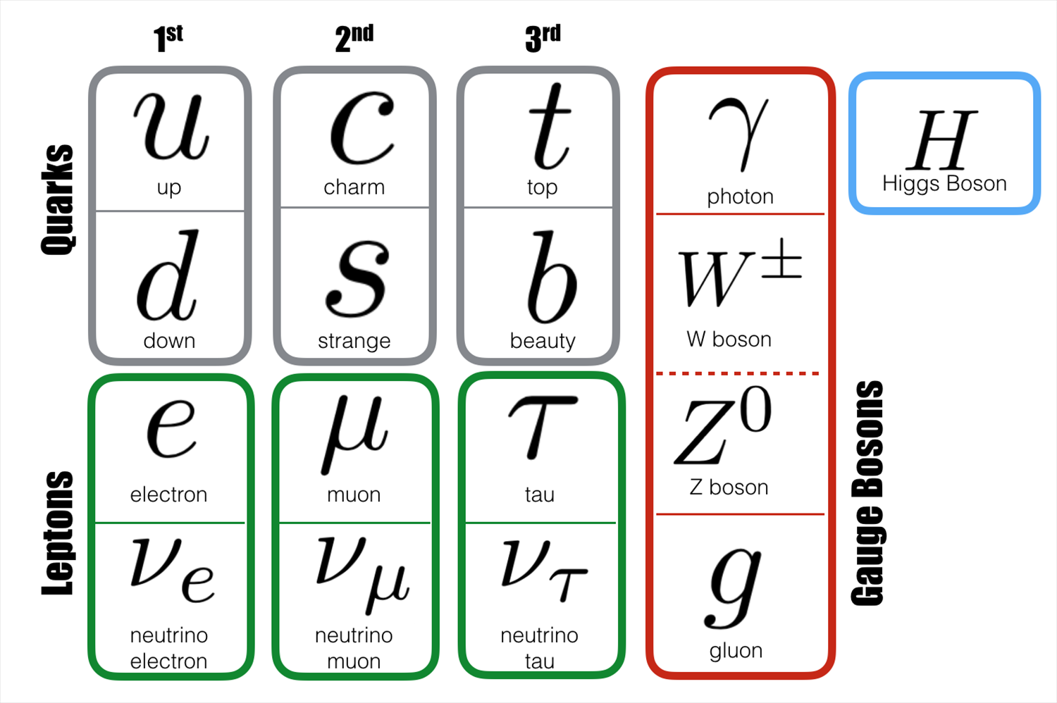

How can the Higgs help?
Dark matter interacts with gravity…
DM

Slide 4
How can the Higgs help?
-We expect the Higgs boson to couples to dark matter
-We look for the Higgs boson producing dark matter→ invisible Higgs decays
-This appears as missing transverse momentum
-Aren’t invisible Higgs decays a standard model process?
-H →ZZ* →4v | Branching ratio of 0.12% [3]
-Several beyond SM scenarios allow for value of ~10%
-We look for an excess of events over SM expectations

Slide 5
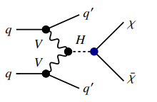
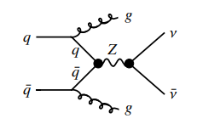
Where should we look?
-Most sensitive channel is vector boson fusion (VBF)
-Other processes such as gluon fusion have a larger cross section, but VBF has a unique signature that we can search for
-Signal is characterised by two jets with a wide separation in pseudorapidity and missing transverse momentum from the invisible Higgs decay
Figure 1: A VBF process [3]
Figure 1: A SM background process [3]

Slide 6
Results
-From a VBF search, “No significant excess of events over the expected background from known Standard Model processes were found” [2]
-In same search, an upper limit of 0.13, with a 95% confidence level, is set on the BR for invisible Higgs decay [3]
-This BR limit is related to a limit on the spin-independent WIMP–nucleon cross section
-Statistical combinations of various search es have lead to a BR limit of 0.11 [4]

Slide 7
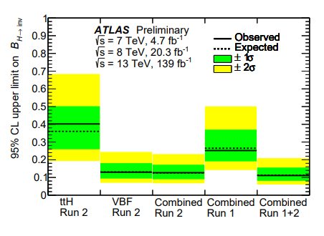
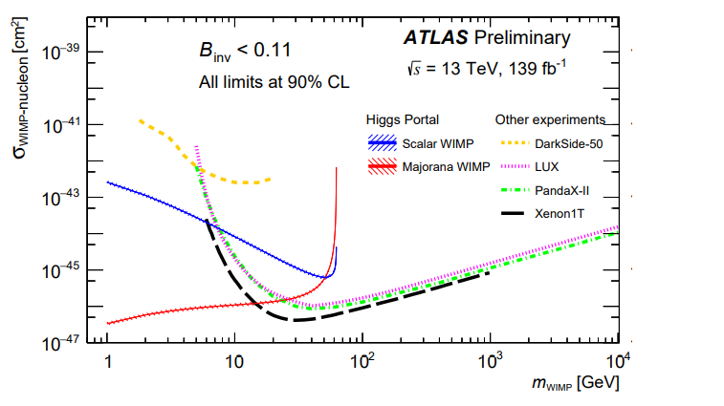
Figure 3: The observed and expected upper limits on BR of invisible Higgs decays from direct searches [4]
Figure 4: Comparison of the BR upper limits at 90% CL from direct detection experiments on the spin-independent WIMP-nucleon scattering cross-section, as a function of the WIMP mass [3]

Slide 8
Outlook
-How can we improve current experiments and reduce uncertainties?
-How will new upgrades at LHC affect future results?
-Given these constraints, where should we next look for dark matter?
-What further upgrades might be needed, can the LHC reach new physics?
-What signal would we need to see at LHC to confirm dark matter?
-What if we don’t find any dark matter? What would explain phenomena in galaxies etc.

Slide 9
References
[1] G. Bertone and D. Hooper, “History of dark matter”, Rev. Mod. Phys. 90 (2018) 045002,
Doi: 10.1103/RevModPhys.90.045002, arXiv: 1605.04909.
[2] ATLAS Collaboration, 21st April 2020, “Probing dark matter with the Higgs boson”, https://atlas.cern/updates/briefing/probing-dark-matter-higgs-boson
[3] ATLAS Collaboration, “Search for invisible Higgs boson decays with vector boson fusion signatures with the ATLAS detector using an integrated luminosity of 139 fb−1”, ATLAS-CONF-2020-008, 2020, https://cds.cern.ch/record/2715447
[4] ATLAS Collaboration, “Combination of searches for invisible Higgs boson decays with the ATLAS EXPERIMENT” , ATLAS-CONF-2020-052

