Slide 1
LHC Constraints on Dark Matter
Aleksandar Atanasov, aa2092

Slide 2
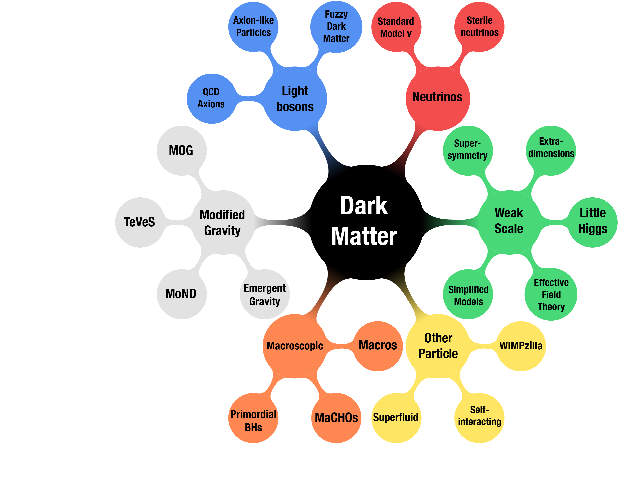
Dark Matter – what is it?
(Many hypotheses-none confirmed.)
Axions/Axion-like Particles
Sterile Neutrinos
WIMPs (BSM)
  Supersymmetry
  Rich Dark sector models
(Image: G. Bertone and T. M. P. Tait)

Slide 3
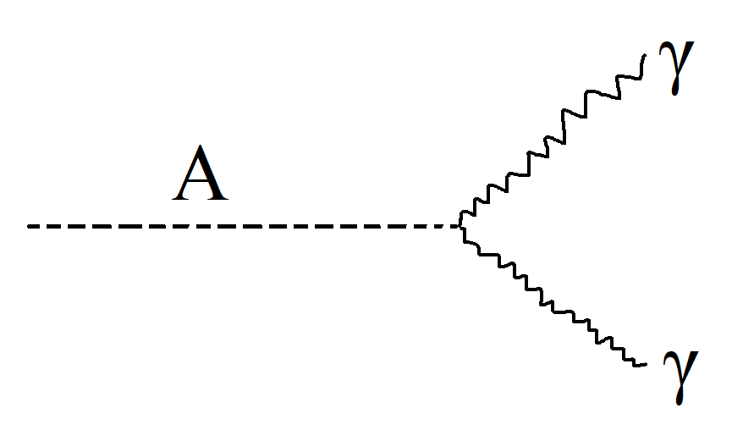
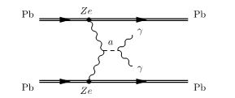
Looking for Axions & Axion-like particles ALP
Provide a solution to CP problem
Light – look for Diphoton States excess (γγ) events in CMS/ATLAS
Produced by pp→a or from Z/h decays [1] or heavy ion collisions [2]
Best we can do is bounds on possible mass between 10-65 GeV [1]
(image from [2])

Slide 4
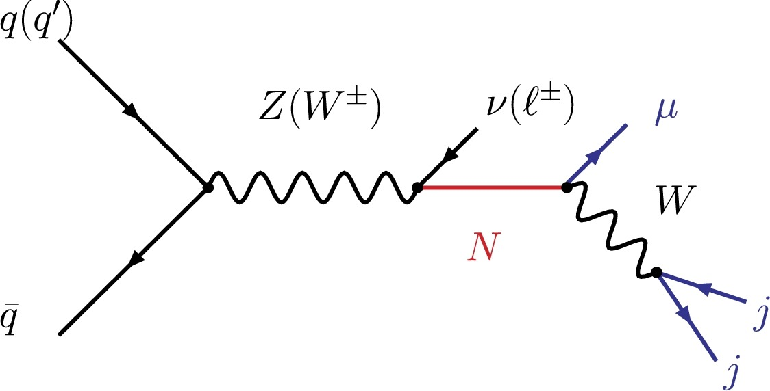
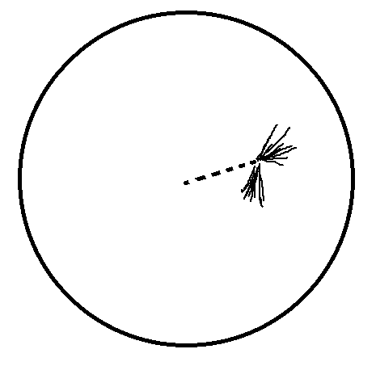
Sterile Neutrinos
No SM interaction(RH).
Neutrino-mixing → oscillation
Looking for displaced vertex, Heavy Sterile Neutrino decays in LHCb (m<m_{W})
Sadly non-observation just gives a constraint on neutrino mixing in the 4.5-10 GeV mass range [3] – mixing constrained down to ~3x10⁻⁶
(image from [3])
A gratuitous non-artist’s impression of a displaced vertex

Slide 5
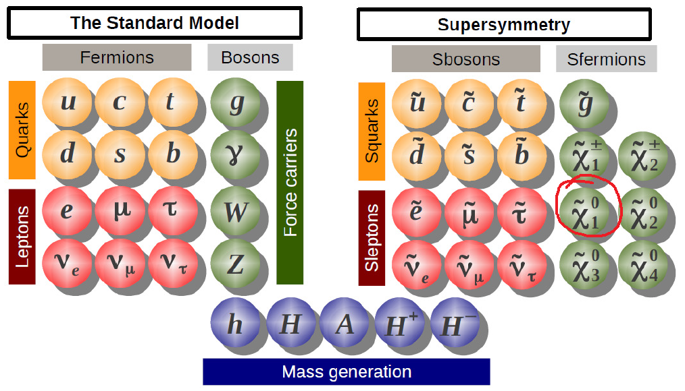
WIMPs (SUSY and other Richer models)
(image from [4])

Slide 6
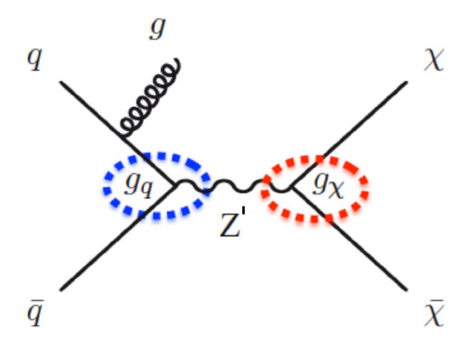
Missing Momentum WIMP searches
Mono-X events:
Mono-jet
mono-γ
mono-Z
mono-Top
Mono-Higgs
h weakly coupled to light quarks → suppressed simple mono-x regime – couples to mediator
tt + DM
Non-observations again – constraints on mediator mass/WIMP (χ) mass
Mono-jet event [5]

Slide 7
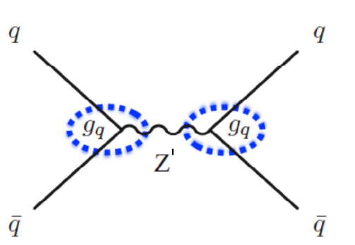
Direct resonance search for mediator
Much like Higgs discovery – except non-discoveries again – restraints on coupling of Dark sector mediator to SM quarks
Focused on dijet searches for lower uncertainty in event distinction and clasiffication
Mediator resonance event[5]

Slide 8
References
1. A. Mariotti, R. Diego, S. Fillippo, T. Kohsaku, New LHC bound on low-massdiphoton resonances, Phys. Letters, (2018) [arXiv:1710.01743]
2. Simon Knapen, Tongyan Lin, Hou Keong Lou, Tom Melia, LHC limits on axion-like particles from heavy-ion collisions, arXiv:1709.07110 [hep-ph]
3. Stefan Antuschab,Eros Cazzatoa, Oliver Fischera, Sterile neutrino searches via displaced vertices at LHCb, https://doi.org/10.1016/j.physletb.2017.09.057
4 Tina Potter’s Particle and Nuclear Physics Course for University of Cambridge Part II Physics https://www.hep.phy.cam.ac.uk/~chpotter/particleandnuclearphysics/mainpage.html
5. N. Trevisani (ATLAS, CMS), Universe 4, 11, 131 (2018).

