Slide 1
LHC Constraints On Dark Matter
Peng Wang

Slide 2
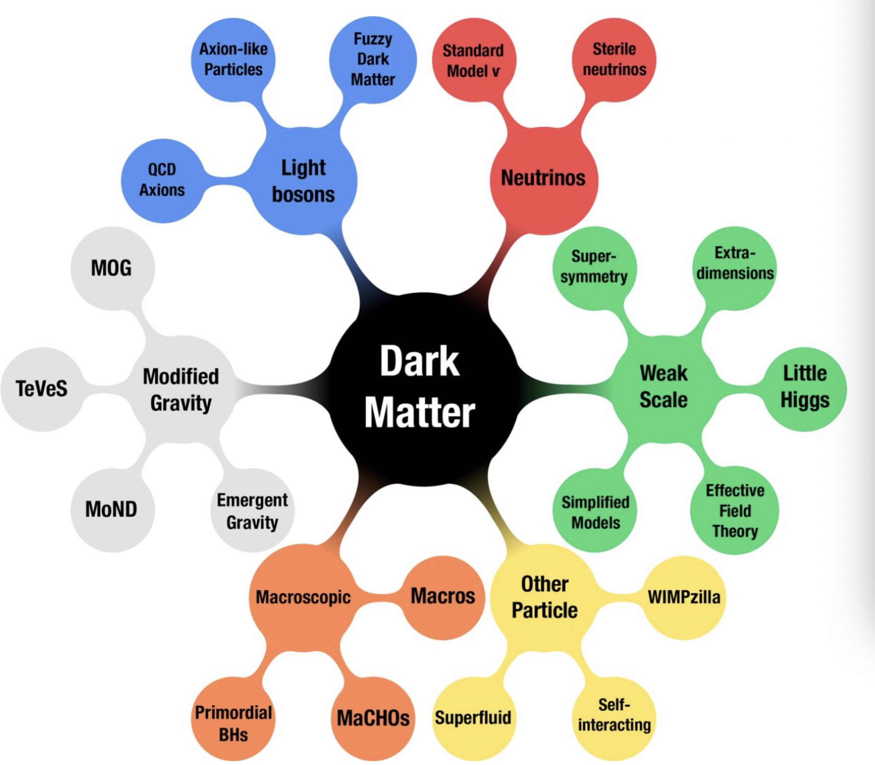
Dark Matter (DM) Candidates
-LHC looks for Weakly Interacting Massive Particles (WIMPs)
- WIMPs are neutral, stable particles , density was determined by the constraint that they were in thermal equilibrium at some time in the early universe .
https://scitechdaily.com/the-large-hadron-collider-is-breaking-new-ground-in-the-search-for-dark-matter/
Notes:
WIMPs are neutral, stable particles whose number density was determined by the constraint that they were in thermal equilibrium at some time in the early universe

Slide 3
DM Detection
Proton-proton collision
Looking for a missing-transverse Energy
  Mono-X and Dijet experiments
  Supersymmetry (SUSY) guided experiments
This project focuses on the SUSY guided constraints
Notes:
WIMPs do not interact neither electromagnetically nor strongly with matter, hence do not leave a trace in detectors like neutrinos. However, they can be detected through the balance of energy/momentum measured in various detector components – missing energy.

Slide 4
SUSY-Supersymmetry Models
Relates particles with the same strong, weak and electromagnetic quantum numbers and with spins differing by ½ unit.
R-parity: SM particles(+1), SUSY particles(-1)
  R-parity conserving models: predicts LSP (lightest supersymmetric particle)
  R-parity violating models also possible.

Slide 5
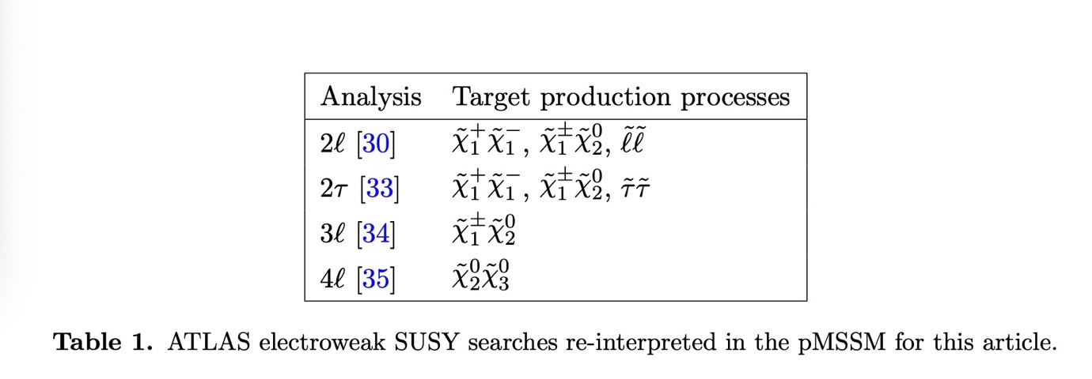
ATLAS Interpretation of Run-1 Data
Run 1: centre-of-mass energy of 8TeV and an integrated luminosity of 20.3 fb-1
Electroweak SUSY productions are considered
570 599 models generated in the initial likelihood scan
Notes:
Use

Slide 6
ATLAS Interpretation of Run-1 Data
Analysis involves using the EWKH model
This model consists of a 5-D parameter space.
Find the exclusion region in 2-D parameter space, while maximise the likelihood function for the remaining parameters.
95% confidence level

Slide 7
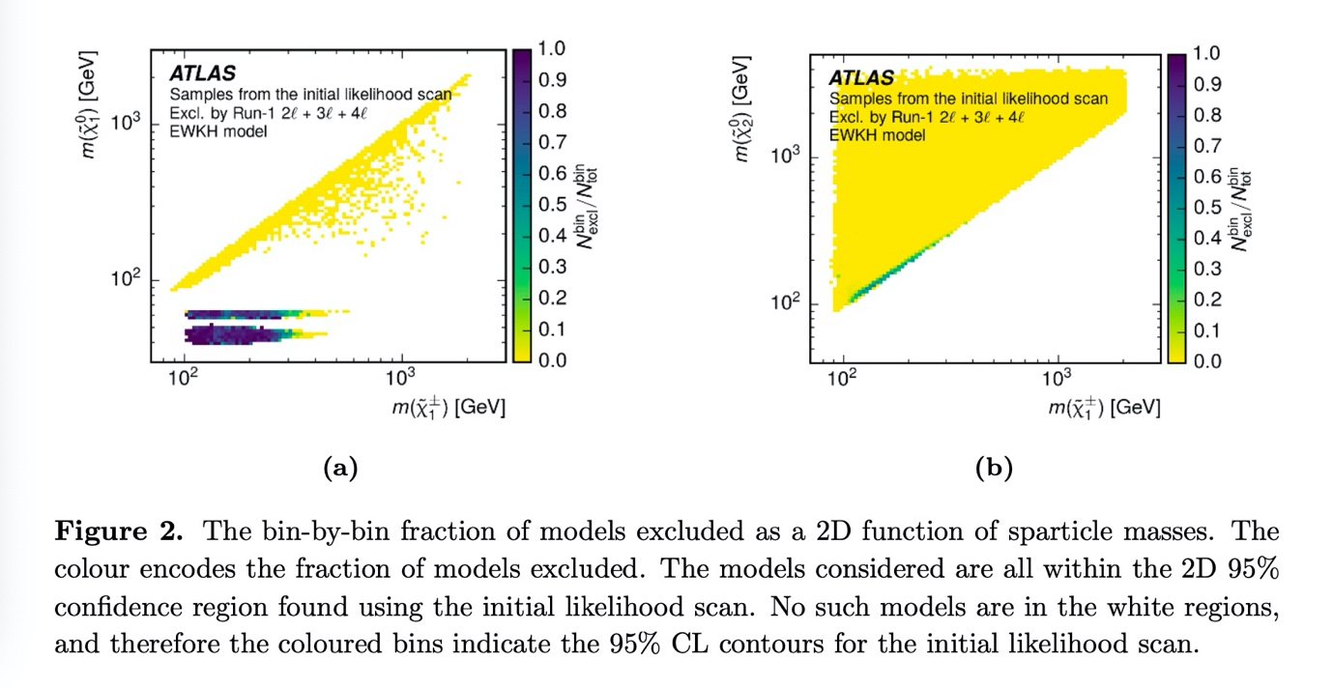
ATLAS Interpretation of Run-1 Data

