Slide 1
Probing Dark Matter with Long-Lived Particles
Research Review
Xy Wang 2021

Slide 2
General Background
Standard Model - Exists Problems
Gauge Hierarchy Problem
Baryon Asymmetry
Existence of Dark Matter
Beyond the Standard Model proposed which predict new observable particles
Collider Search for Long-Lived Particles: New Frontier
Dark Matter
Existence: Cosmic Abundance of Dark Matter
Arises from various mechanisms
Some of them predict Long-Lived Particles with specific detector signatures

Slide 3
Review Emphasis
A summary that compares and contrasts various models that give Dark Particle(s) AND Long-Lived Particles based on
The predicted Long-Lived Particle Candidate Decay Widths(stability), which can be
Detection Methods, i.e. direct/indirect detection, which depends on the charge etc. of the LLP
Predicted detector Signature that depends on the specific model’s implementation of Dark Matter Production mechanism
A summary of made attempts of LLP search and current experiment constraints

Slide 4
Review Structure
Introduction (300)
Background Theory (500)
Review of Theories (4000)
Review of Experiment Searches Performed (5000)
Future Research Perspectives (500)
Conclusion (200)

Slide 5
Comparison of Mechanisms
Freeze-in
Asymmetric DM
Co-annihilating DM
…
Which can be found in various models
SUSY
WIMP
…
Model parameters that determine the current DM relic abundance also determines the properties of the associated LLP
The predicted life-time of the LLP varies quite a lot

Slide 6
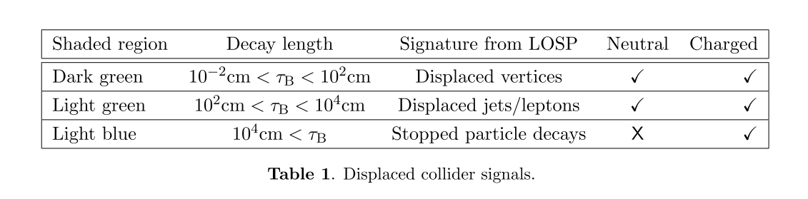
Summary tables, what they will look like
﻿10.1088/1475-7516/2015/12/024

Slide 7
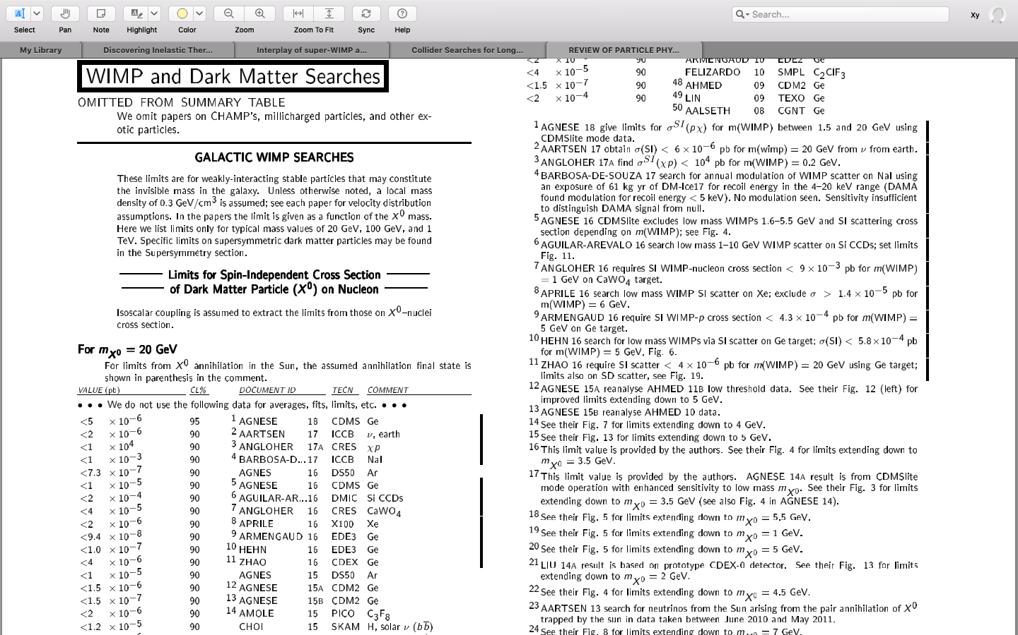
Example:
﻿Limits for Spin-Independent Cross Section of Dark Matter Particle (X ) on Nucleon
﻿10.1103/PhysRevD.98.030001

Slide 8
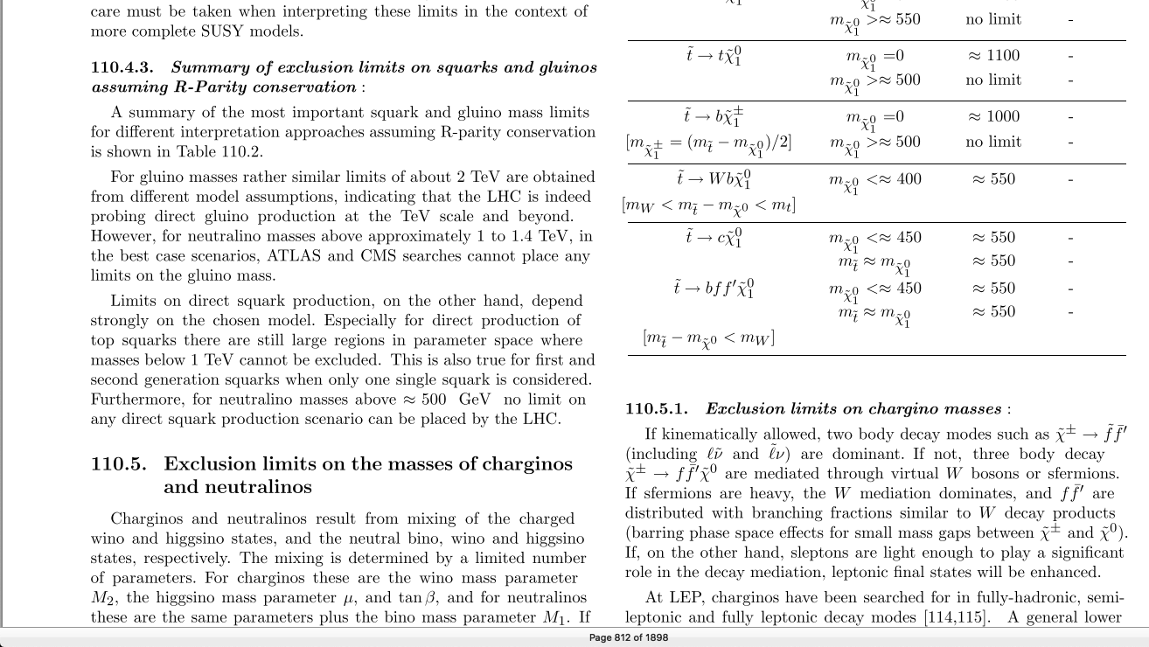
Example: Exclusion of neutralino mass, squark mass…etc.
﻿10.1103/PhysRevD.98.030001

Slide 9
Thank You

