Slide 1
Exploring the dark sector using long-lived particles
The achievements and potential of Displaced Vertex analysis in searching for LLPs
Milo Eyre-Morgan

Slide 2

Selecting a focus
Signal types
Models
Detectors
An image of the housing for the ATLAS detector at CERN
This Photo by Unknown Author is licensed under CC BY-SA-NC

Slide 3
Selecting a focus
The Displaced Vertex is unusual in the Standard Model, making it a good search candidate with low background
Searches chosen to be model comparable and somewhat complementary
2015 CMS dilepton decay search implemented results as a function of model acceptance
2018 ATLAS search utilised the Muon Spectrometer, thus accessing longer lifetimes, and searched for LLPs decaying hadronically

Slide 4
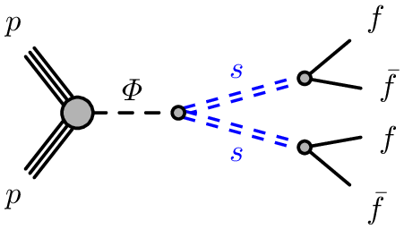
Creating a displaced vertex
A Feynman diagram for the production of two fermionic displaced vertices via a scalar mediator Φ, which produces two LLPs (copyright ATLAS Collaboration)

Slide 5
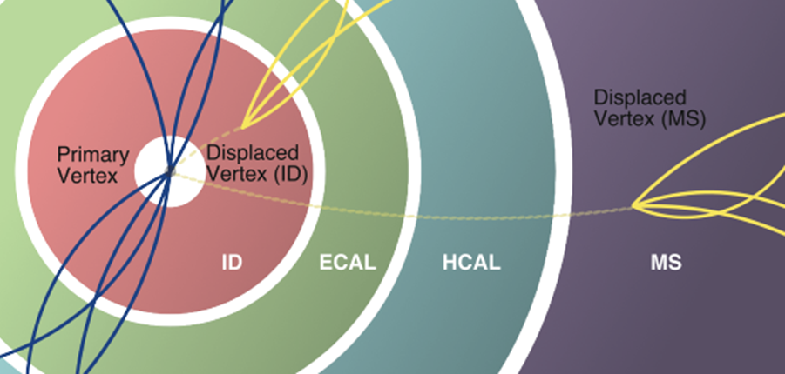
Measuring a displaced vertex
A vertex found to have a large displacement from the interaction point relative to the uncertainty in its position
Multiple tracks in vertex determination lead to typically low uncertainties
What counts as large?
A diagram of a typical detector, showing a displaced vertex signal in both the ID and MS (copyright Lee et al)

Slide 6
Searches
CMS (2015) considers a long-lived scalar boson produced by a Beyond Standard Model Higgs, and R-parity violating SUSY with long-lived neutralinos
ATLAS (2018) considers a weakly Higgs-coupled long-lived scalar boson and R-parity conserving SUSY with a long-lived singlino produced via gluino decay
A third model (Higgs portal baryogenesis) is considered in ATLAS (2018), but due to the length of the review I have opted to not consider it

Slide 7
Search Methods
Compare expected background and signal levels from model simulations with real data
Simulation rates depend on signal requirements and cuts
Null result provides upper limits on production cross-sections impacted by the error in the data collection and in the predicted signal rates
Limits found at 95% confidence level by Bayesian analysis

Slide 8
Results so far
In both searches, scalar boson models have weakest limits of order 100fb. These are for the lower masses of scalar boson considered. Best case limits are single or tens of femtobarns
CMS SUSY analysis finds limits on cross-sections of around 5fb for all cases except for low mass (120 GeV) squarks, which has upper limits of around 50fb for all neutralino masses
ATLAS SUSY analysis had its strongest limits for lower masses of gluino and lifetimes around 1m. Best limits of order E-5 (in terms of the SUSY production cross-section)

Slide 9
Gaps
Low masses have the worst limits for scalar boson models. Lighter decay products can be highly boosted (Bernreuther et al) and may not be correctly associated with the correct vertex, leading to lighter vertices being systematically discarded
10-100 GeV range is significant so covering this is important
Lifetimes: CMS used mostly the ID so was best at centimetre scale, while the ATLAS search used the MS and did best at lifetimes of metre scale

Slide 10
Moving Forwards
Mass Ranges
Lifetime Ranges
Relaxed cuts could cover the 10-100 GeV scale, but would increase background - this may not be an issue for some models e.g. sterile neutrinos (Cottin et al)
New experiments will have access to higher mass ranges (e.g. HL-LHC, order of magnitude greater integrated luminosity)
Dedicated DV trigger
MATHUSLA, a surface detector, could reach lifetimes up to E7 metres and be dedicated to Displaced Vertex detection.
ANUBIS would be installed in an ATLAS installation shaft (cost-effective)
Has similar lifetime improvements to MATHUSLA but has particular value in the range of 1-100m

Slide 11
Bibliography
CERN. 2013. “New results indicate that new particle is a Higgs boson.” CERN. URL: https://home.cern/news/news/physics/new-results-indicate-new-particle-higgs-boson.
Lee, Lawrence; Christian Ohm; Abner Soffer; and Tien-Tien Yu. 2018. “Collider Searches for Long-Lived Particles Beyond the Standard Model.” Progress in Particle and Nuclear Physics, doi:10.1016/j.ppnp.2019.02.006.
ATLAS Collaboration. 2019. “Search for long-lived particles produced in pp collisions at √s=13 TeV that decay into displaced hadronic jets in the ATLAS muon spectrometer.” Physical Review D 99, no. 5 (March). doi:10.1103/PhysRevD.99.052005.
CMS Collaboration. 2015. “Search for long-lived particles that decay into final states containing two electrons or two muons in proton-proton collisions at √s=8 TeV.” Physical Review D 91, no. 5 (March). doi:10.1103/PhysRevD.91.052012.
ATLAS Outreach. 2010. “ATLAS Fact Sheet.” CERN Document Server. URL: http://cds.cern.ch/record/1457044/files/ATLAS%20fact%20sheet.pdf.
CMS Collaboration. 2015. “Search for long-lived neutral particles decaying to quark-antiquark pairs in proton-proton collisions at √ s = 8 TeV.” Physical Review D 91, no. 1 (January). doi:10.1103/PhysRevD.91.012007.
Bernreuther et al. 2020. “On the challenges of searching for GeV-scale long-lived particles at the LHC”. Prepared for submission to JHEP. URL: https://arxiv.org/abs/2011.06604v1
Cottin, Giovanna; Helo, Juan Carlos; and Hirsch, Martin. 2018. “Searches for light sterile neutrinos with multitrack displaced vertices”. Physical Review D 97, no. 5 (March). doi:10.1103/PhysRevD.97.055025.
Gershtein, Yuri; Knapen, Simon; and Redigolo, Diego. 2020. “Probing naturally light singlets with a displaced vertex trigger”. URL: https://arxiv.org/abs/2012.07864v1
Alpigiani et al. 2018. “A Letter of Intent for MATHUSLA: a dedicated displaced vertex detector above ATLAS or CMS”. URL: https://arxiv.org/abs/1811.00927v1
Bauer, Martin; Brandt, Oleg; Lee, Lawrence; and Ohm, Christian. 2018. “ANUBIS: Proposal to search for long-lived neutral particles in CERN service shafts”. Submitted to Physical Review Letters. URL: https://arxiv.org/abs/1909.13022

Slide 12
Questions?

