Slide 1
Higgs Physics at The International Linear Collider

Slide 2
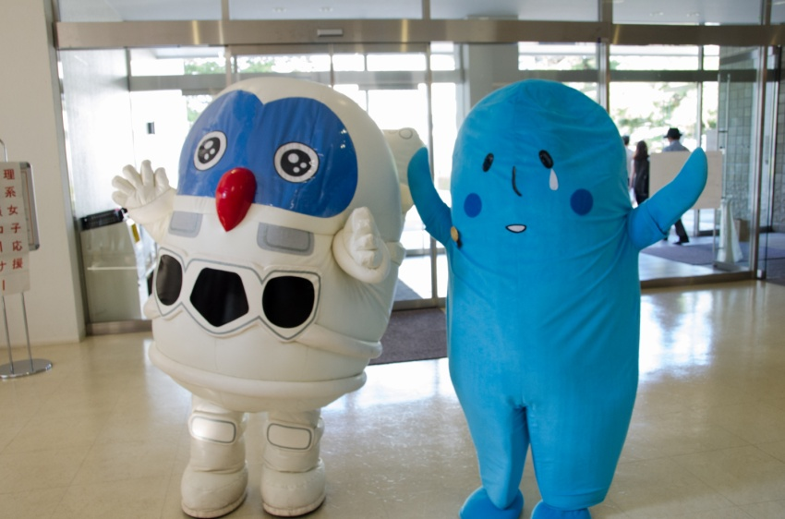
WHY do we need new experiments?
WHAT do we need from them?
HOW will the ILC achieve these?
Higgs-Kun and anonymous

Slide 3
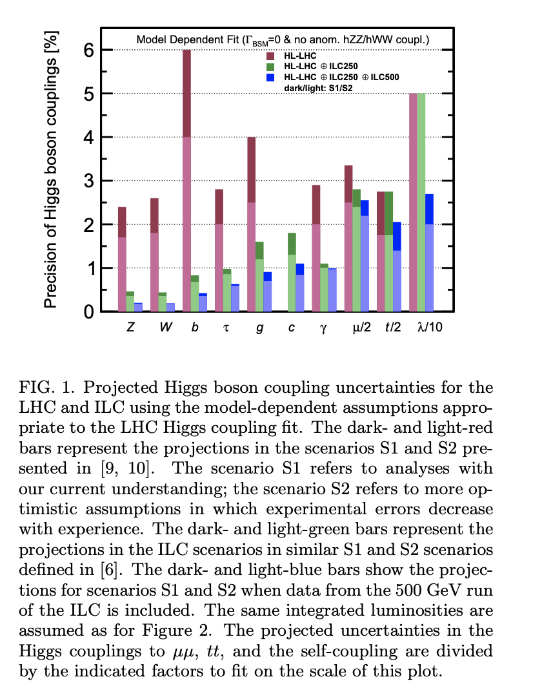
Limitations of LHC
Apart from decay into two photons and four charged leptons
  Narrow resonance
Cannot distinguish from standard model background events
https://arxiv.org/pdf/1901.09829.pdf

Slide 4

What the ILC Wants
Determine Higgs boson couplings, model independently
  EFT coefficients
  High precision
  Beam polarization
High energies
  Coupling to the top quark to 2% accuracy
More detailed studies of Higgs decays

Slide 5





Who you gonna call??????
HIGGS BUSTERS

Slide 6
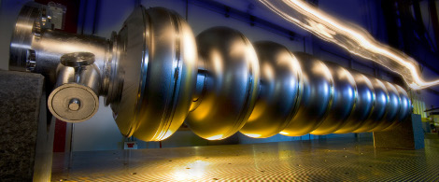
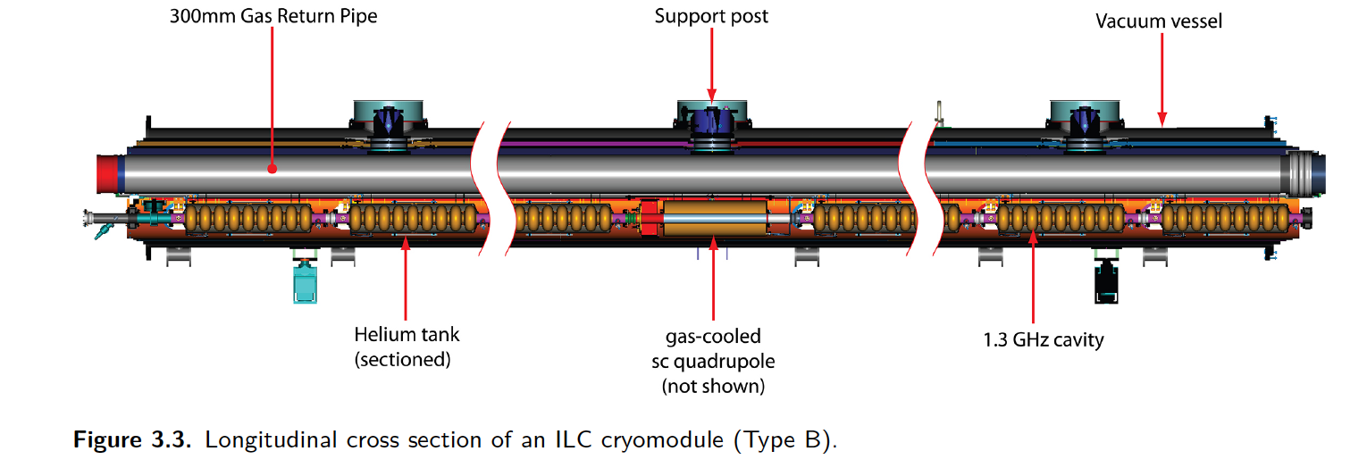
Superconducting Radio Frequency Cavities
Each hollow structure has an electric field.
  Its voltage changes from plus to minus with a radio frequency.
Extremely small loss of energy
  Smaller synchrotron radiation
  High acceleration

Slide 7
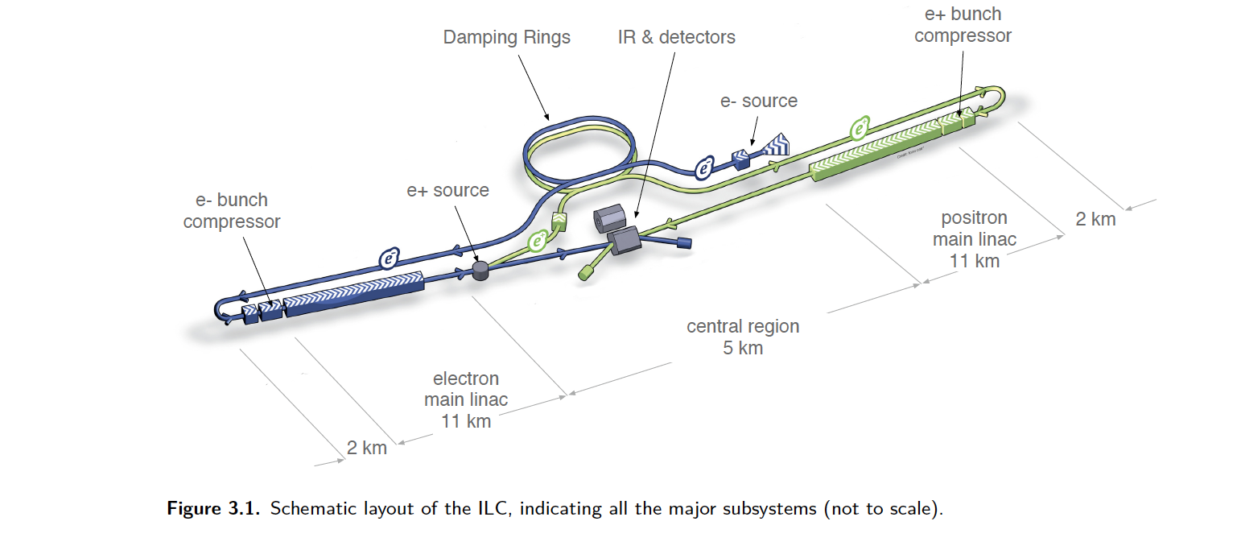
Beam Polarization
Ti:Sapphire Laser
Make them spin 0, to make it more likely to get a Higgs
Positrons 30%, electrons 80% polarized
Photocathode with strained GaAs/ GaAsP supperlattice structure
90% polarized electrons

Slide 8
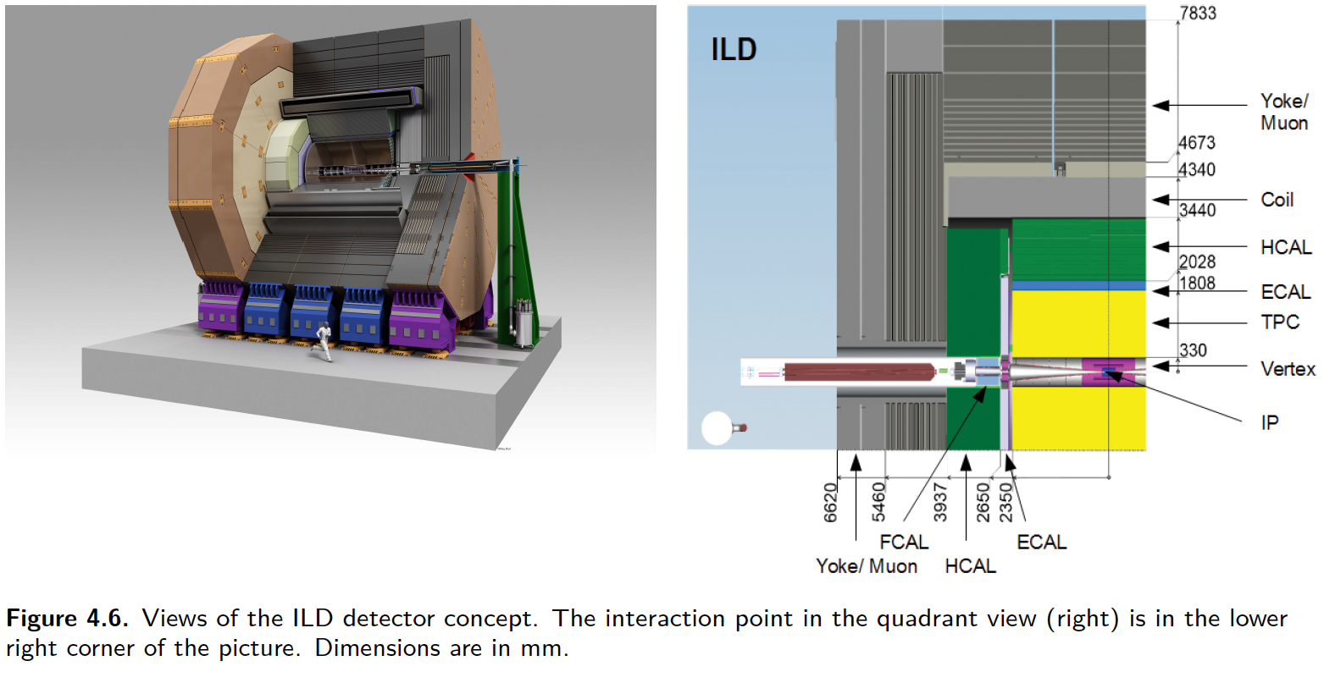
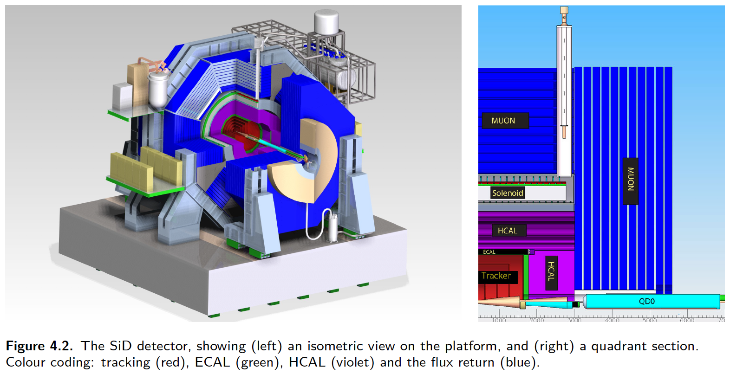
Detectors
Push-pull mode
Few other particles
ILD
  optimise the particle-flow resolution by making the detector large, thus separating charged and neutral particles
SiD
  All-silicon solution, like LHC, cheaper
  compensates by using a higher central magnetic field (5T)

