Slide 1
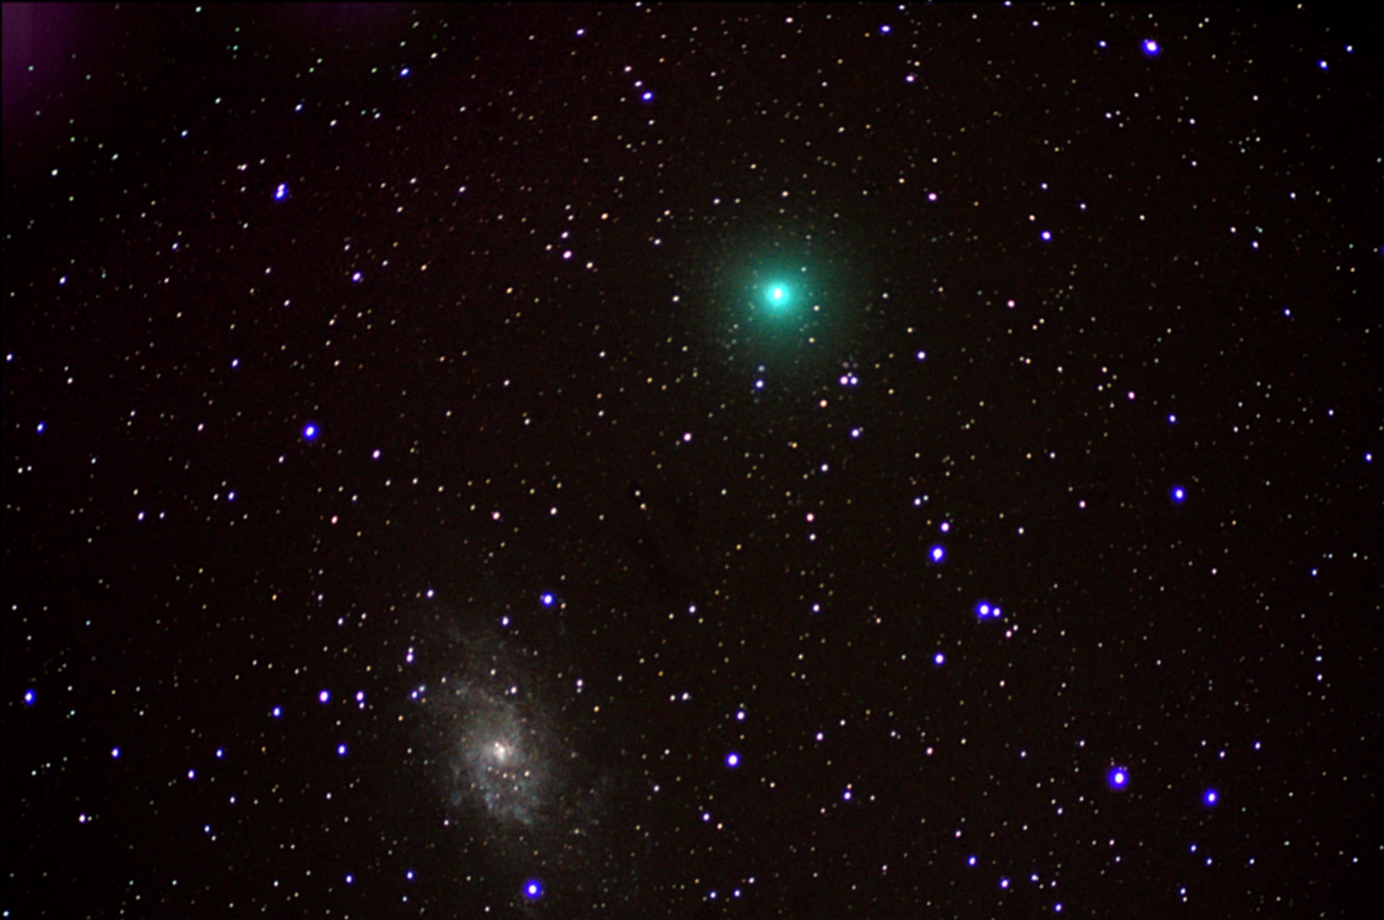

Tests of Lorentz and CPT Violation with
Neutrino Oscillation Experiments
Teppei Katori
Queen Mary University of London
Cavendish HEP seminar, Univ. Cambridge, Cambridge, UK, Nov. 11, 2014

Slide 2
Tests of Lorentz and CPT Violation with
Neutrino Oscillation Experiments
Teppei Katori
Queen Mary University of London
Cavendish HEP seminar, Univ. Cambridge, Cambridge, UK, Nov. 11, 2014

Slide 3
Tests of Lorentz and CPT Violation with
Neutrino Oscillation Experiments
outline
1. Spontaneous Lorentz symmetry breaking
2. What is Lorentz and CPT violation?
3. Modern test of Lorentz violation
4. Lorentz violating neutrino oscillations
5. Test for Lorentz violation with MiniBooNE data
6. Test for Lorentz violation with Double Chooz data
7. Double Chooz spectrum fit analysis
8. Extra-terrestrial neutrinos
9. Conclusion
Teppei Katori
Queen Mary University of London
Cavendish HEP seminar, Univ. Cambridge, Cambridge, UK, Nov. 11, 2014

Slide 4
1. Spontaneous Lorentz symmetry breaking
2. What is Lorentz and CPT violation?
3. Modern test of Lorentz violation
4. Lorentz violating neutrino oscillation
5. Test for Lorentz violation with MiniBooNE data
6. Test for Lorentz violation with Double Chooz data
7. Double Chooz spectrum fit
8. Extra-terrestrial neutrinos
9. Conclusion

Slide 5
1. Spontaneous Lorentz symmetry breaking (SLSB)
Every fundamental symmetry needs to be tested, including Lorentz symmetry.
After the recognition of theoretical processes that create Lorentz violation, testing Lorentz invariance becomes very exciting
Lorentz and CPT violation has been shown to occur in Planck scale theories, including:
- string theory
- noncommutative field theory
- quantum loop gravity
- extra dimensions
- etc
However, it is very difficult to build a self-consistent theory with Lorentz violation...

Slide 6
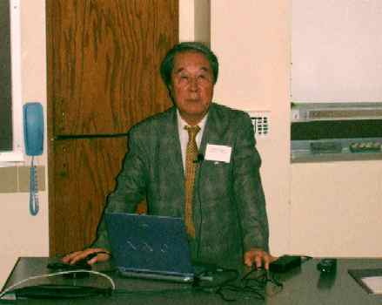
1. Spontaneous Lorentz symmetry breaking (SLSB)
Every fundamental symmetry needs to be tested, including Lorentz symmetry.
After the recognition of theoretical processes that create Lorentz violation, testing Lorentz invariance becomes very exciting
Lorentz and CPT violation has been shown to occur in Planck scale theories, including:
- string theory
- noncommutative field theory
- quantum loop gravity
- extra dimensions
- etc
However, it is very difficult to build a self-consistent theory with Lorentz violation...
Spontaneous Symmetry Breaking (SSB)!
Y. Nambu
(Nobel prize winner 2008),
picture taken from CPT04 at Bloomington, IN

Slide 7
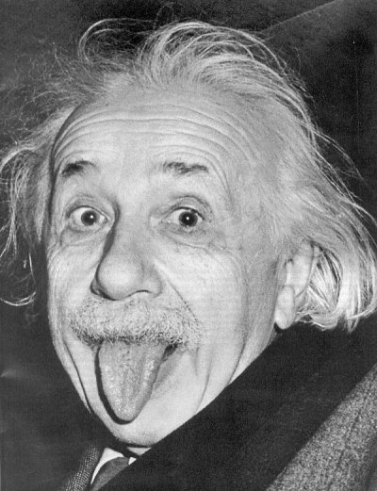
1. Spontaneous Lorentz symmetry breaking (SLSB)
vacuum Lagrangian for fermion
e.g.) SSB of scalar field in Standard Model (SM)
- If the scalar field has Mexican hat potential
SSB
φ

Slide 8
1. Spontaneous Lorentz symmetry breaking (SLSB)
vacuum Lagrangian for fermion
e.g.) SSB of scalar field in Standard Model (SM)
- If the scalar field has Mexican hat potential
φ
SSB
φ
Particle acquires mass term!

Slide 9
1. Spontaneous Lorentz symmetry breaking (SLSB)
Kostelecký and Samuel
PRD39(1989)683
vacuum Lagrangian for fermion
e.g.) SSB of scalar field in Standard Model (SM)
- If the scalar field has Mexican hat potential
e.g.) SLSB in string field theory
- There are many Lorentz vector fields
- If any of vector field has Mexican hat potential
φ
SSB
φ
φ
SLSB
a^{μ}

Slide 10
1. Spontaneous Lorentz symmetry breaking (SLSB)
Kostelecký and Samuel
PRD39(1989)683
vacuum Lagrangian for fermion
e.g.) SSB of scalar field in Standard Model (SM)
- If the scalar field has Mexican hat potential
e.g.) SLSB in string field theory
- There are many Lorentz vector fields
- If any of vector field has Mexican hat potential
φ
SSB
φ
φ
a^{μ}
SLSB
Lorentz symmetry is spontaneously broken!
a^{μ}

Slide 11
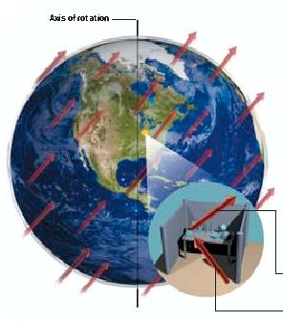

1. Spontaneous Lorentz symmetry breaking
Test of Lorentz violation is to find the coupling of these background fields and ordinary fields (electrons, muons, neutrinos, etc); then the physical quantities may depend on the rotation of the earth (sidereal time dependence).
background fields of the universe
vacuum Lagrangian for fermion
Scientific American (Sept. 2004)
PM 6:00
AM 6:00

Slide 12
1. Spontaneous Lorentz symmetry breaking
Test of Lorentz violation is to find the coupling of these background fields and ordinary fields (electrons, muons, neutrinos, etc); then the physical quantities may depend on the rotation of the earth (sidereal time dependence).
Sidereal time dependence
The smoking gun of Lorentz violation is the sidereal time dependence of the observables.
Solar time: 24h 00m 00.0s
sidereal time: 23h 56m 04.1s
Sidereal time dependent physics is often smeared out in solar time distribution
→ Maybe we have some evidence of Lorentz violation but we just didn’t notice?!
Target scale
Since it is Planck scale physics, either >10¹⁹GeV or <10⁻¹⁹GeV is the interesting region. >10¹⁹GeV is not possible (LHC is 10⁴GeV), but <10⁻¹⁹GeV is possible.
background fields of the universe
vacuum Lagrangian for fermion

Slide 13
1. Spontaneous Lorentz symmetry breaking
2. What is Lorentz and CPT violation?
3. Modern test of Lorentz violation
4. Lorentz violating neutrino oscillation
5. Test for Lorentz violation with MiniBooNE data
6. Test for Lorentz violation with Double Chooz data
7. Double Chooz spectrum fit
8. Extra-terrestrial neutrinos
9. Conclusion

Slide 14
2. What is Lorentz violation?
y
x

Slide 15
2. What is Lorentz violation?
hypothetical background vector field
moving particle
Einstein
(observer)
y
x

Slide 16
2. What is Lorentz violation?
Under the particle Lorentz transformation:
y
x

Slide 17
2. What is Lorentz violation?
Under the particle Lorentz transformation:
Lorentz violation is observable when a particle is moving in the fixed coordinate space
y
Lorentz violation!
x
Notes:
particle motion depends on direction

Slide 18
2. What is Lorentz violation?
Under the particle Lorentz transformation:
Under the observer Lorentz transformation:
Lorentz violation is observable when a particle is moving in the fixed coordinate space
y
y
x
x

Slide 19
2. What is Lorentz violation?
Under the particle Lorentz transformation:
Under the observer Lorentz transformation:
Lorentz violation is observable when a particle is moving in the fixed coordinate space
y
y
x
x

Slide 20
2. What is Lorentz violation?
Under the particle Lorentz transformation:
Under the observer Lorentz transformation:
Lorentz violation cannot be generated by observers motion (coordinate transformation is unbroken)
all observers agree for all observations
Lorentz violation is observable when a particle is moving in the fixed coordinate space
y
y
x
x
Notes:
Lorentz violating effect in one frame is conserved in other frame

Slide 21
2. What is CPT violation?
CPT symmetry is the invariance under the CPT transformation
C: charge conjugation
P: parity transformation
T: time reversal

Slide 22
2. What is CPT violation?
CPT phase = (-1)^{n}
n = # Lorentz indices
CPT symmetry is the invariance under the CPT transformation
CPT is the perfect symmetry of the Standard Model, due to CPT theorem
CPT-even
CPT-odd
QED
Weak
QCD

Slide 23
2. What is CPT violation?
CPT phase = (-1)^{n}
n = # Lorentz indices
CPT symmetry is the invariance under the CPT transformation
CPT is the perfect symmetry of the Standard Model, due to CPT theorem
CPT-even
CPT-odd
QED
Weak
QCD
Lorentz violation
CPT-odd Lorentz violating coefficients (odd number Lorentz indices, e.g., a^{μ} , g^{λμν} )
CPT-even Lorentz violating coefficients (even number Lorentz indices, e.g., c^{μν} , κ^{αβμν} )

Slide 24
2. CPT violation implies Lorentz violation
Greenberg, PRL(2002)231602
Lorentz invariance
Lorentz invariance of quantum field theory
CPT
CPT violation implies Lorentz violation in interactive quantum field theory.
t
t
Lorentz invariance
Lorentz invariance
causality
x
x

Slide 25
1. Spontaneous Lorentz symmetry breaking
2. What is Lorentz and CPT violation?
3. Modern test of Lorentz violation
4. Lorentz violating neutrino oscillation
5. Test for Lorentz violation with MiniBooNE data
6. Test for Lorentz violation with Double Chooz data
7. Double Chooz spectrum fit
8. Extra-terrestrial neutrinos
9. Conclusion

Slide 26
3. Test of Lorentz violation
Lorentz violation is realized as a coupling of particle fields and background fields, so the basic strategy to find Lorentz violation is:
(1) choose the coordinate system
(2) write down the Lagrangian, including Lorentz-violating terms under the formalism
(3) write down the observables using this Lagrangian

Slide 27
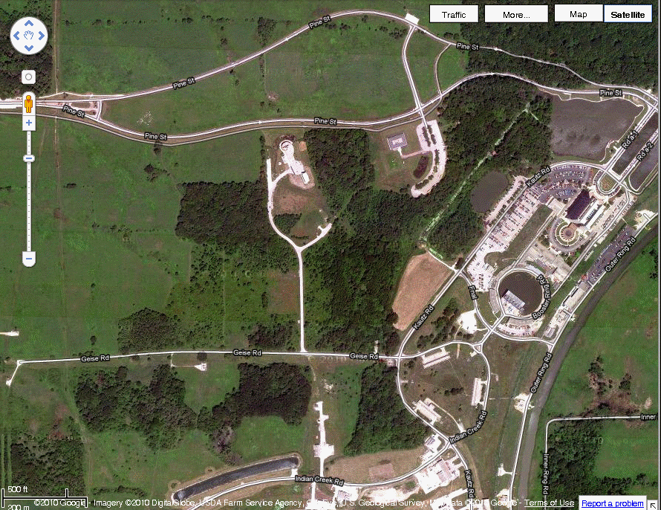
3. Test of Lorentz violation
Lorentz violation is realized as a coupling of particle fields and background fields, so the basic strategy to find Lorentz violation is:
(1) choose the coordinate system
(2) write down the Lagrangian, including Lorentz-violating terms under the formalism
(3) write down the observables using this Lagrangian
- Neutrino beamline is described in Sun-centred coordinates
Z
Vernal equinox
Fermilab Google© map
Winter
solstice
Earth
MiniBooNE
Sun
Y
541m
Summer
solstice
MI12
X
Autumn equinox
MiniBooNE beamline
Notes:
MiniBooNE experiment at Fermilab which I will discuss later

Slide 28
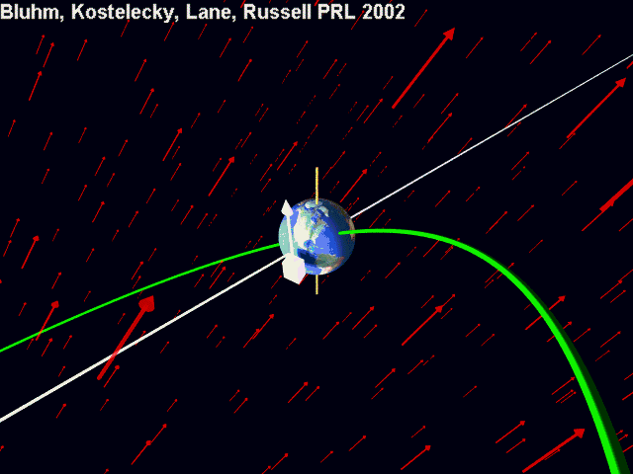

Slide 29
3. Test of Lorentz violation
Kostelecký and Mewes
PRD69(2004)016005
Lorentz violation is realized as a coupling of particle fields and background fields, so the basic strategy to find Lorentz violation is:
(1) choose the coordinate system
(2) write down the Lagrangian, including Lorentz-violating terms under the formalism
(3) write down the observables using this Lagrangian
Standard Model Extension (SME) is the standard formalism for the general search for Lorentz violation. SME is a minimum extension of QFT with Particle Lorentz violation
SME Lagrangian in neutrino sector
SME coefficients

Slide 30
3. Test of Lorentz violation
Kostelecký and Mewes
PRD69(2004)016005
Lorentz violation is realized as a coupling of particle fields and background fields, so the basic strategy to find Lorentz violation is:
(1) choose the coordinate system
(2) write down the Lagrangian, including Lorentz-violating terms under the formalism
(3) write down the observables using this Lagrangian
Standard Model Extension (SME) is the standard formalism for the general search for Lorentz violation. SME is a minimum extension of QFT with Particle Lorentz violation
SME Lagrangian in neutrino sector
SME coefficients
CPT odd
CPT even

Slide 31
3. Test of Lorentz violation
Kostelecký and Mewes
PRD70(2004)076002
Lorentz violation is realized as a coupling of particle fields and background fields, so the basic strategy to find Lorentz violation is:
(1) choose the coordinate system
(2) write down the Lagrangian, including Lorentz-violating terms under the formalism
(3) write down the observables using this Lagrangian
Various physics are predicted under SME, but among them, the smoking gun of Lorentz violation is the sidereal time dependence of the observables
solar time: 24h 00m 00.0s
sidereal time: 23h 56m 04.1s
Lorentz-violating neutrino oscillation probability for short-baseline experiments
sidereal frequency
sidereal time

Slide 32
3. Test of Lorentz violation
Kostelecký and Mewes
PRD70(2004)076002
Lorentz violation is realized as a coupling of particle fields and background fields, so the basic strategy to find Lorentz violation is:
(1) choose the coordinate system
(2) write down the Lagrangian, including Lorentz-violating terms under the formalism
(3) write down the observables using this Lagrangian
Various physics are predicted under SME, but among them, the smoking gun of Lorentz violation is the sidereal time dependence of the observables
solar time: 24h 00m 00.0s
sidereal time: 23h 56m 04.1s
Lorentz-violating neutrino oscillation probability for short-baseline experiments
Sidereal variation analysis for short baseline neutrino oscillation is 5-parameter fitting problem
sidereal frequency
sidereal time
time independent amplitude sidereal time dependent amplitude

Slide 33
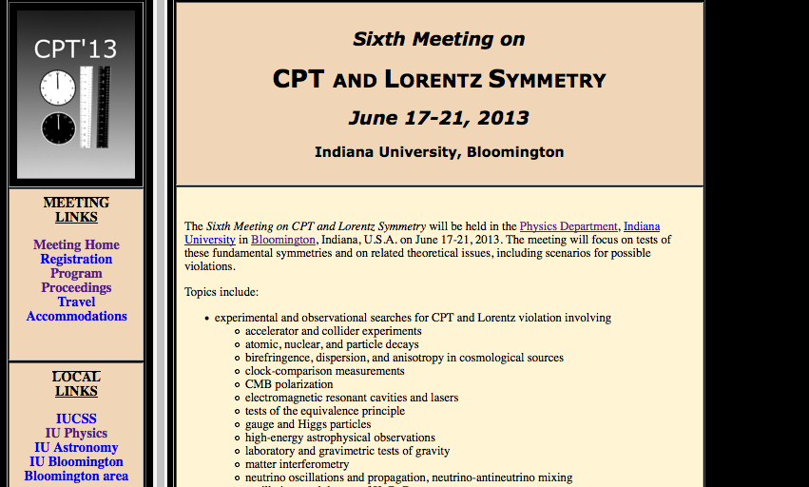
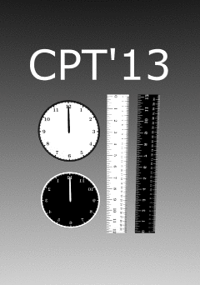
3. Modern tests of Lorentz violation
The latest meeting was in June 2013
http://www.physics.indiana.edu/~kostelec/faq.html
Notes:
We took the first group photo

Slide 34
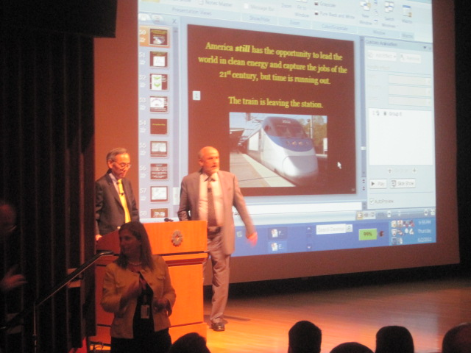
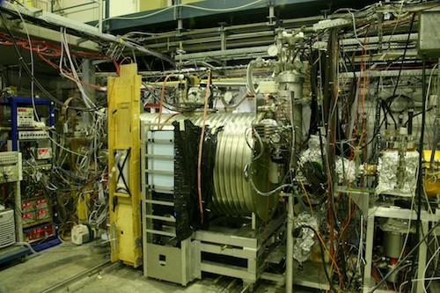
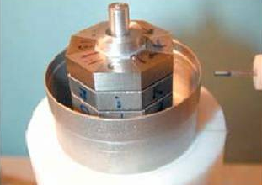
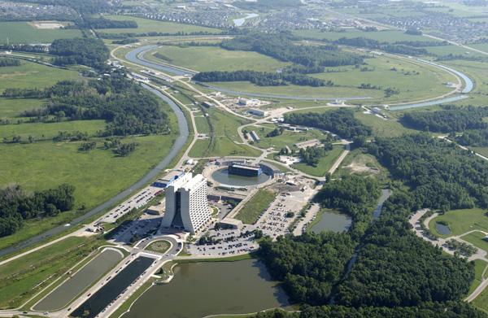
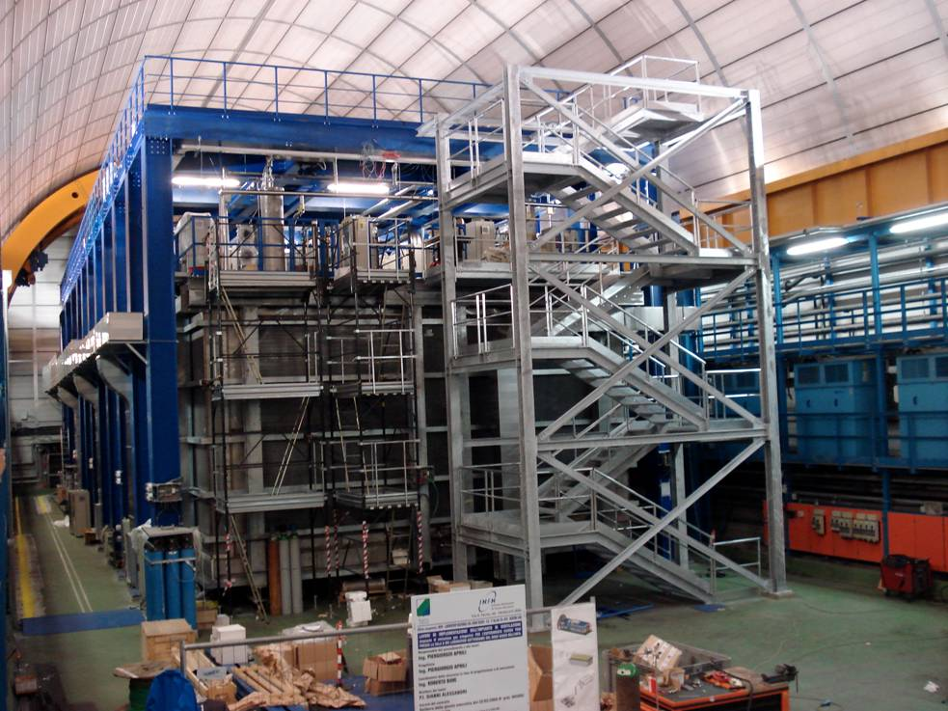
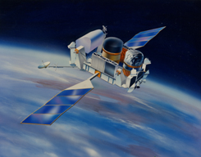
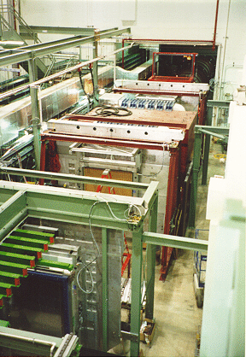
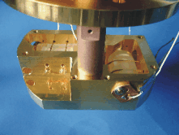
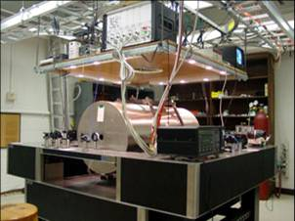
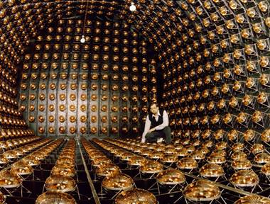
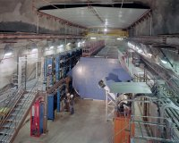
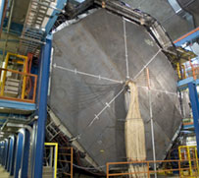
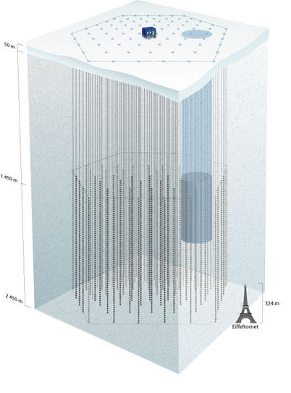
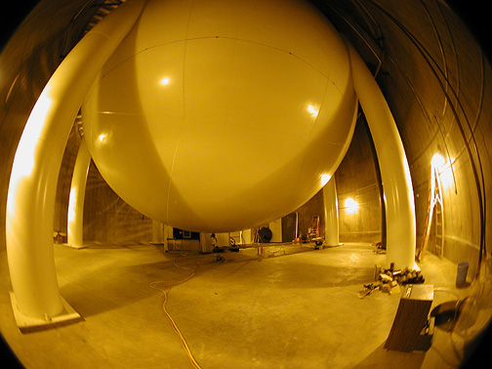

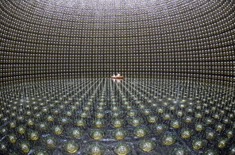
3. Modern tests of Lorentz violation
Atomic Interferometer
(a,c)^{n,p,e} <10⁻⁶
CERN Antiproton Decelerator
(M_{p}-M_{p})/M_{p}<10⁻⁸
Spin torsion pendulum
b_{e}<10⁻³⁰ GeV
Tevatron and LEP
-5.8x10⁻¹²<κ_{tr}-4/3c_{e}⁰⁰<1.2x10⁻¹¹
The latest meeting was in June 2013
Steven Chu
http://www.physics.indiana.edu/~kostelec/faq.html
Topics:
experimental and observational searches for CPT and Lorentz violation involving
  accelerator and collider experiments
  atomic, nuclear, and particle decays
  birefringence, dispersion, and anisotropy in cosmological sources
  clock-comparison measurements
  CMB polarization
  electromagnetic resonant cavities and lasers
  tests of the equivalence principle
  gauge and Higgs particles
  high-energy astrophysical observations
  laboratory and gravimetric tests of gravity
  matter interferometry
  neutrino oscillations and propagation, neutrino-antineutrino mixing
  oscillations and decays of K, B, D mesons
  particle-antiparticle comparisons
  post-newtonian gravity in the solar system and beyond
  second- and third-generation particles
  sidereal and annual time variations, compass asymmetries
  space-based missions
  spectroscopy of hydrogen and antihydrogen
  spin-polarized matter
  time-of-flight measurements
theoretical and phenomenological studies of CPT and Lorentz violation involving
  physical effects at the level of the Standard Model, General Relativity, and beyond
  origins and mechanisms for violations
  classical and quantum field theory, particle physics, classical and quantum gravity, string theory
  mathematical foundations, Finsler geometry
Nature419(2002)456
PRL97(2006)021603
PRL102(2009)170402
PRL106(2011)151102
Neutrino TOF
(v-c)/c <10⁻⁵
GRB vacuum birefringence
κ_{e+}, κ_{o-}<10⁻³⁷
KTeV/KLOE (strange)
Δa_{K}<10⁻²² GeV
FOCUS (charm)
Δa_{D}<10⁻¹⁶ GeV
BaBar/Belle (bottom)
Δm_{B}/m_{B}<10⁻¹⁴
Limits from all these experiments >50 page tables!
Rev.Mod.Phys.83(2011)11
ArXiv:0801.0287v6
PRD76(2007)072005
JHEP11(2012)049
PRL97(2006)140401
Test of Lorentz invariance with neutrino oscillation is very interesting, because neutrinos are the least known standard model particles!
Double gas maser
b_{n}(rotation)<10⁻³³GeV
b_{n}(boost)<10⁻²⁷GeV
Cryogenic optical resonator
Δc/c<10⁻¹⁶
LSND MINOS ND MINOS FD IceCube MiniBooNE Double Chooz Super-Kamiokande
PRD72(2005)076004 PRL101(2008)151601 PRL105(2010)151601 PRD82(2010)112003 PLB718(2013)1303 PRD86(2013)112009 ArXiv:1410.4267
PLB556(2003)7
PRL100(2008)131802
PRL105(2010)151604
PRL107(2010)171604
PRL99(2007)050401
Notes:
Chu’s paper is 2011 (when he is DOE secretary)
meson oscillation is the only way to test Lorentz violation for second and third generation quarks

Slide 35
1. Spontaneous Lorentz symmetry breaking
2. What is Lorentz and CPT violation?
3. Modern test of Lorentz violation
4. Lorentz violating neutrino oscillation
5. Test for Lorentz violation with MiniBooNE data
6. Test for Lorentz violation with Double Chooz data
7. Double Chooz spectrum fit
8. Extra-terrestrial neutrinos
9. Conclusion

Slide 36

4. Neutrinos
Neutrinos in the standard model
The standard model describes 6 quarks and 6 leptons and 3 types of force carriers.
Neutrinos are special because,
1. they only interact with weak nuclear force.
2. interaction eigenstate is not Hamiltonian eigenstate (propagation eigenstate). Thus propagation of neutrinos changes their species, called neutrino oscillation.
ν_{μ}
μ
ν_{μ}
ν_{μ}
W
Z
d
u
u
u
Charged Current
(CC) interaction
“W-boson exchange”
Neutral Current
(NC) interaction
“Z-boson exchange”

Slide 37
4. Neutrino oscillations, natural interferometers
Neutrino oscillation is an interference experiment (cf. double slit experiment)
light source
slits
screen
ν₁
ν₂
interference pattern
For double slit experiment, if path ν₁ and path ν₂ have different length, they have different phase rotations and it causes interference.

Slide 38
4. Neutrino oscillations, natural interferometers
Neutrino oscillation is an interference experiment (cf. double slit experiment)
ν_{μ}
ν_{μ}
If 2 neutrino Hamiltonian eigenstates, ν₁ and ν₂, have different phase rotation, they cause quantum interference.

Slide 39
4. Neutrino oscillations, natural interferometers
Neutrino oscillation is an interference experiment (cf. double slit experiment)
ν_{μ}
U_{μ1}
ν₁
U_{e1}∗
ν₂
ν_{μ}
ν₂
ν₁
If 2 neutrino Hamiltonian eigenstates, ν₁ and ν₂, have different phase rotation, they cause quantum interference.
If ν₁ and ν₂, have different mass, they have different velocity, so thus different phase rotation.

Slide 40
4. Neutrino oscillations, natural interferometers
Neutrino oscillation is an interference experiment (cf. double slit experiment)
ν_{e}
ν_{e}
ν_{e}
ν_{μ}
U_{μ1}
ν₁
U_{e1}∗
ν₂
ν_{μ}
ν_{e}
If 2 neutrino Hamiltonian eigenstates, ν₁ and ν₂, have different phase rotation, they cause quantum interference.
If ν₁ and ν₂, have different mass, they have different velocity, so thus different phase rotation.
The detection may be different flavor (neutrino oscillations).

Slide 41
4. Lorentz violation with neutrino oscillation
Neutrino oscillation is an interference experiment (cf. double slit experiment)
ν_{μ}
ν_{μ}
If 2 neutrino Hamiltonian eigenstates, ν₁ and ν₂, have different phase rotation, they cause quantum interference.

Slide 42
4. Lorentz violation with neutrino oscillation
Neutrino oscillation is an interference experiment (cf. double slit experiment)
ν_{μ}
U_{μ1}
ν₁
U_{e1}∗
ν₂
ν_{μ}
ν₂
ν₁
If 2 neutrino Hamiltonian eigenstates, ν₁ and ν₂, have different phase rotation, they cause quantum interference.
If ν₁ and ν₂, have different coupling with Lorentz violating field, neutrinos also oscillate.
The sensitivity of neutrino oscillation is comparable the target scale of Lorentz violation (<10⁻¹⁹GeV).

Slide 43
4. Lorentz violation with neutrino oscillation
Neutrino oscillation is an interference experiment (cf. double slit experiment)
ν_{μ}
ν_{μ}
ν_{μ}
ν_{e}
ν_{e}
ν_{e}
ν_{μ}
U_{μ1}
ν₁
U_{μ1}∗
U_{e1}∗
ν₂
ν_{μ}
ν_{μ}
ν_{e}
If 2 neutrino Hamiltonian eigenstates, ν₁ and ν₂, have different phase rotation, they cause quantum interference.
If ν₁ and ν₂, have different coupling with Lorentz violating field, neutrinos also oscillate.
The sensitivity of neutrino oscillation is comparable the target scale of Lorentz violation (<10⁻¹⁹GeV).
If neutrino oscillation is caused by Lorentz violation, interference pattern (oscillation probability) may have sidereal time dependence.

Slide 44
1. Spontaneous Lorentz symmetry breaking
2. What is Lorentz and CPT violation?
3. Modern test of Lorentz violation
4. Lorentz violating neutrino oscillation
5. Test for Lorentz violation with MiniBooNE data
6. Test for Lorentz violation with Double Chooz data
7. Double Chooz spectrum fit
8. Extra-terrestrial neutrinos
9. Conclusion

Slide 45
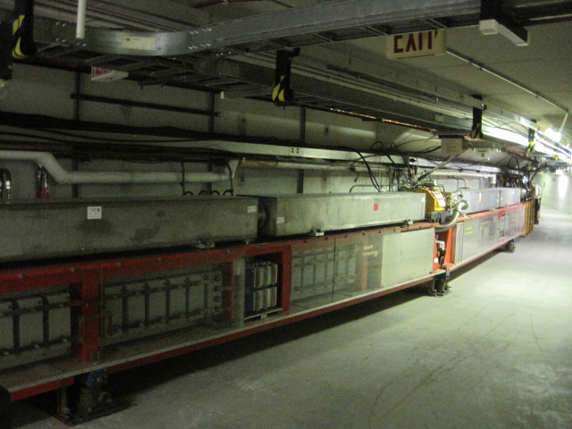
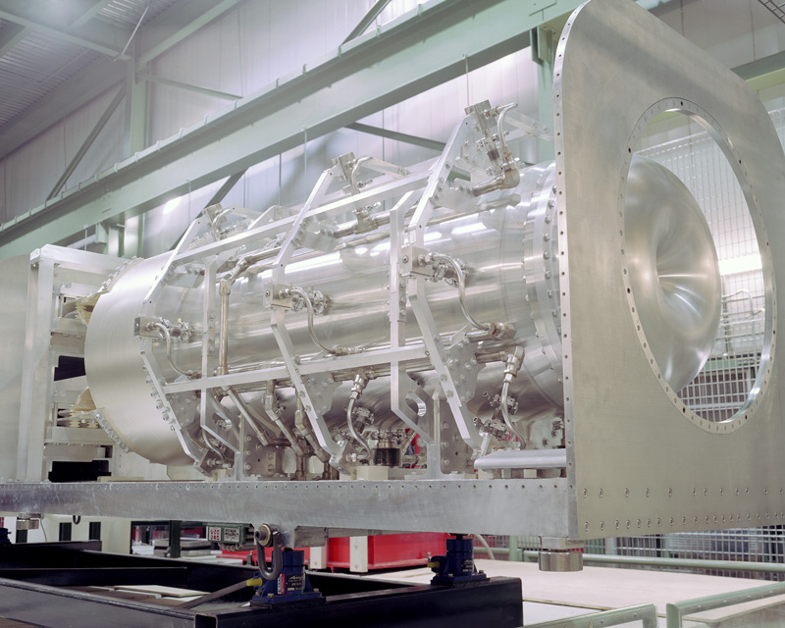
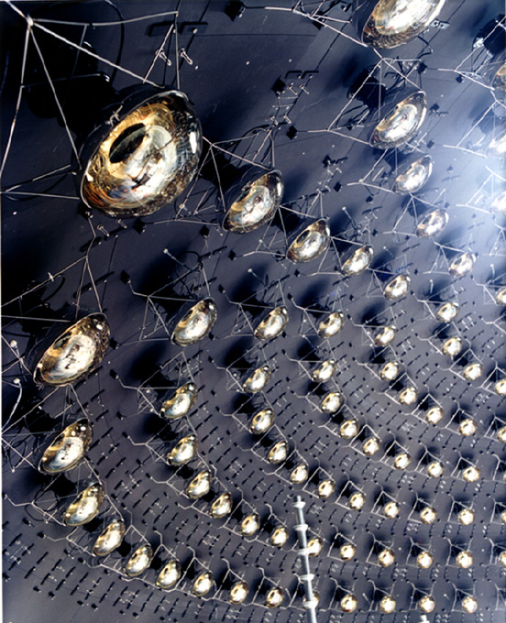
5. MiniBooNE experiment
MiniBooNE collaboration,
PRD79(2009)072002
NIM.A599(2009)28
MiniBooNE is a short-baseline neutrino oscillation experiment at Fermilab.
Booster Neutrino Beamline (BNB) creates ~800(600)MeV neutrino(anti-neutrino) by pion decay-in-flight. Cherenkov radiation from the charged leptons are observed by MiniBooNE Cherenkov detector to reconstruct neutrino energy.
FNAL Booster
Magnetic focusing horn
MiniBooNE detector
~520m
primary beam
secondary beam
tertiary beam
(8 GeV protons)
(1-2 GeV pions)
(800 MeV ν_{μ} , 600 MeV anti-ν_{μ})
1280 of 8” PMT

Slide 46
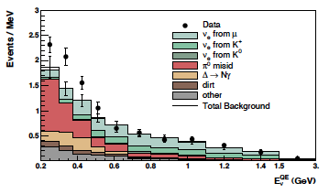
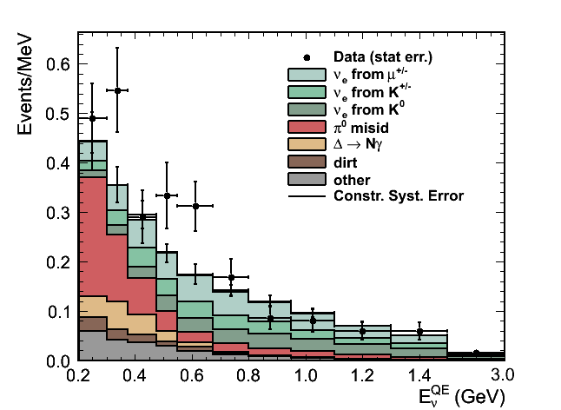
5. MiniBooNE experiment
MiniBooNE collaboration,
PRL102(2009)101802,
PRL105(2010)181801
MiniBooNE is a short-baseline neutrino oscillation experiment at Fermilab.
Neutrino mode analysis: MiniBooNE saw the 3.0σ excess at low energy region
Antineutrino mode analysis: MiniBooNE saw the 1.4σ excess at low and high energy region
MiniBooNE low E ν_{e} excess
MiniBooNE anti-ν_{e} excess
475MeV
475MeV
low energy high energy
low energy high energy
These excesses are not predicted by neutrino Standard Model (νSM), therefor it might sterile neutrino or other new physics, such as Lorentz violation
→ Oscillation candidate events may have sidereal time dependence!

Slide 47
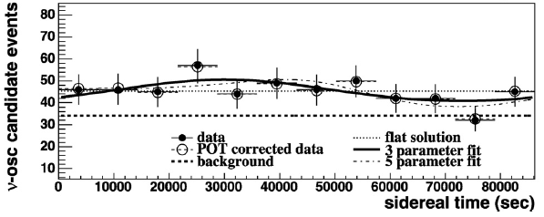
5. Lorentz violation with MiniBooNE neutrino data
MiniBooNE collaboration,
PLB718(2013)1303
MiniBooNE is a short-baseline neutrino oscillation experiment at Fermilab.
Neutrino mode analysis: MiniBooNE saw the 3.0σ excess at low energy region
Antineutrino mode analysis: MiniBooNE saw the 1.4σ excess at low and high energy region
Neutrino mode
Electron neutrino candidate data prefer sidereal time independent solution (flat)

Slide 48
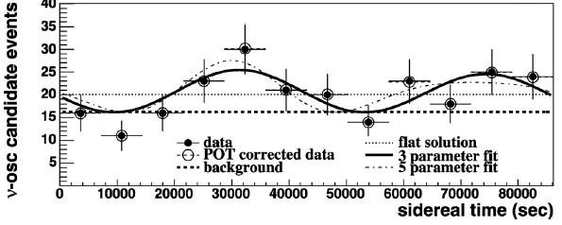
5. Lorentz violation with MiniBooNE neutrino data
MiniBooNE collaboration,
PLB718(2013)1303
MiniBooNE is a short-baseline neutrino oscillation experiment at Fermilab.
Neutrino mode analysis: MiniBooNE saw the 3.0σ excess at low energy region
Antineutrino mode analysis: MiniBooNE saw the 1.4σ excess at low and high energy region
Neutrino mode
Electron neutrino candidate data prefer sidereal time independent solution (flat)
Electron antineutrino candidate data prefer sidereal time dependent solution, however statistical significance is marginal
We find no evidence of Lorentz violation
Antineutrino mode

Slide 49
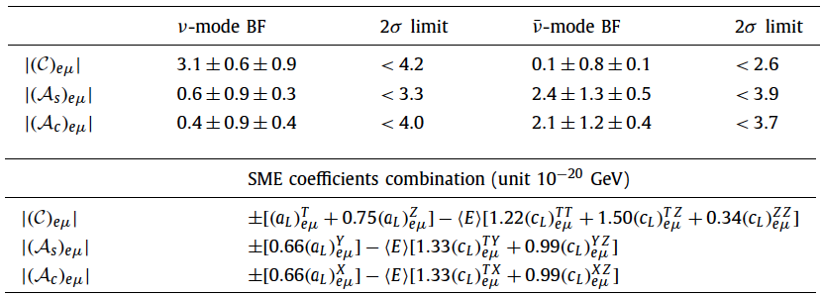
5. Lorentz violation with MiniBooNE neutrino data
MiniBooNE collaboration,
PLB718(2013)1303
MiniBooNE is a short-baseline neutrino oscillation experiment at Fermilab.
Neutrino mode analysis: MiniBooNE saw the 3.0σ excess at low energy region
Antineutrino mode analysis: MiniBooNE saw the 1.4σ excess at low and high energy region
Since we find no evidence of Lorentz violation, we set limits on the combination SME coefficients.

Slide 50
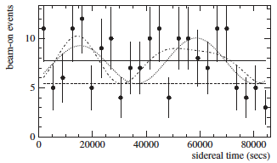
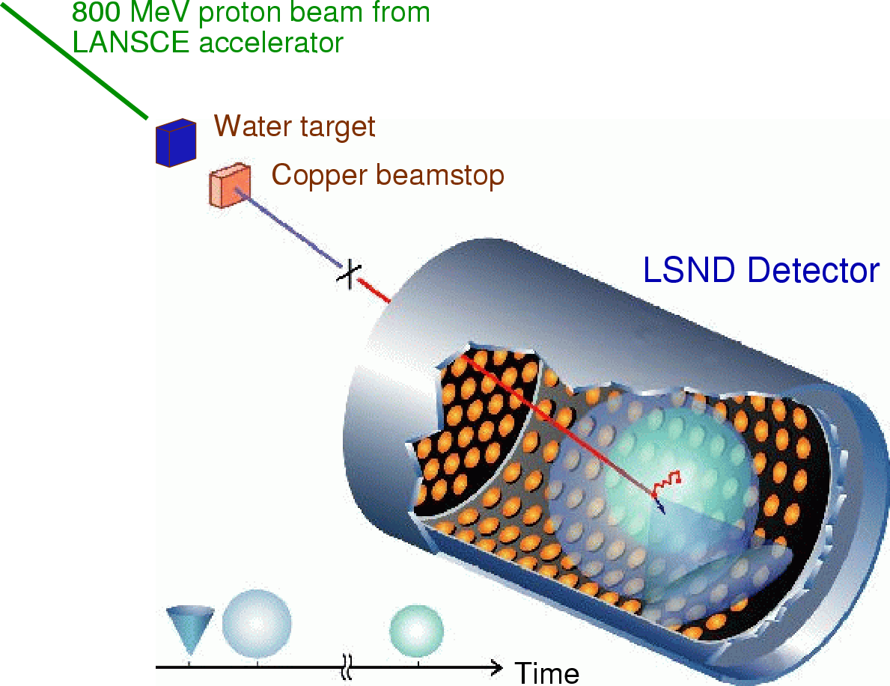
5. Summary of results
LSND collaboration,
PRD72(2005)076004
LSND experiment
LSND is a short-baseline neutrino oscillation experiment at Los Alamos.
LSND saw the 3.8σ excess of electron antineutrinos from muon antineutrino beam; since this excess is not understood by neutrino Standard Model, it might be new physics
Data is consistent with flat solution, but sidereal time solution is not excluded.
LSND oscillation candidate sidereal time distribution
L/E~30m/30MeV~1
data
flat solution
3-parameter fit
5-parameter fit
~10⁻¹⁹ GeV CPT-odd or ~10⁻¹⁷ CPT-even Lorentz violation could be the solution of LSND excess

Slide 51
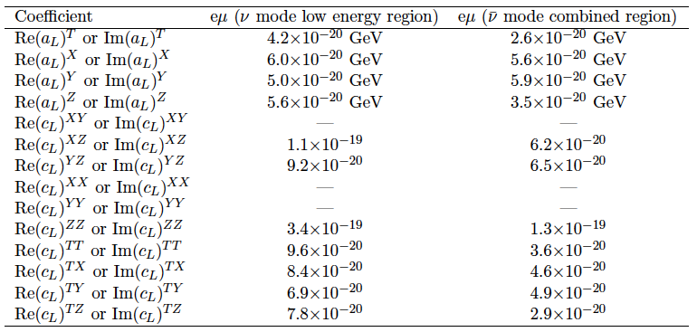
5. Summary of results
TK,
MPLA27(2012)1230024
Since we find no evidence of Lorentz violation from MiniBooNE analysis, we set limits on the SME coefficients.
These limits exclude SME values to explain LSND data, therefore there is no simple Lorentz violation motivated scenario to accommodate LSND and MiniBooNE results simultaneously
Notes:
By the way now we have twice more data for antineutrino so I am thinking update of this analysis.

Slide 52
1. Spontaneous Lorentz symmetry breaking
2. What is Lorentz and CPT violation?
3. Modern test of Lorentz violation
4. Lorentz violating neutrino oscillation
5. Test for Lorentz violation with MiniBooNE data
6. Test for Lorentz violation with Double Chooz data
7. Double Chooz spectrum fit
8. Extra-terrestrial neutrinos
9. Conclusion

Slide 53
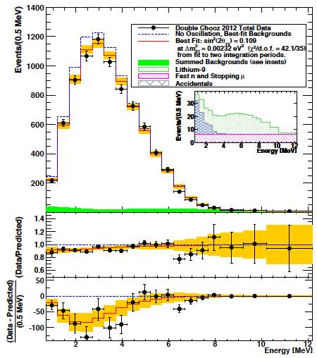
6. Double Chooz experiment
Double Chooz collaboration, PRL108(2012)131801
DayaBay collaboration, PRL108(2012)171803
RENO collaboration, PRL108(2012)191802
Reactor electron antineutrino disappearance
- Double Chooz, DayaBay and RENO experiments observed disappearance signals
Double Chooz reactor neutrino candidate
Notes:
Say I am invited for Double Chooz analysis

Slide 54
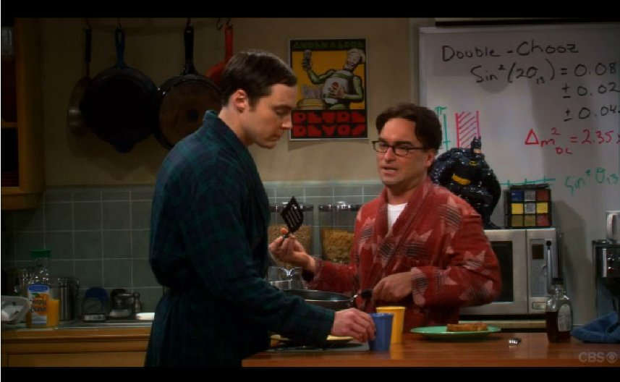
6. Double Chooz experiment
Reactor electron antineutrino disappearance
- Double Chooz, DayaBay and RENO experiments observed disappearance signals
Double Chooz reactor neutrino candidate
The Big Bang Theory (CBS)
Notes:
Say I am invited for Double Chooz analysis

Slide 55
6. Double Chooz experiment
Reactor electron antineutrino disappearance
- Double Chooz, DayaBay and RENO experiments observed disappearance signals
This small disappearance may have sidereal time dependence?
Double Chooz reactor neutrino candidate
The Big Bang Theory (CBS)
Leonard: What do you think about the latest Double Chooz result?
Sheldon: I think this is Lorentz violation..., check sidereal time dependence
Notes:
Say I am invited for Double Chooz analysis

Slide 56
6. Double Chooz experiment
Double Chooz collaboration,
paper in preparation
So far, we have set limits on
1. ν_{e}↔ν_{μ} channel: LSND, MiniBooNE, MINOS (<10⁻²⁰ GeV)
2. ν_{μ}↔ν_{τ} channel: MINOS, IceCube (<10⁻²³ GeV)
The last untested channel is ν_{e}↔ν_{τ}
It is possible to limit ν_{e}↔ν_{τ} channel from reactor ν_{e} disappearance experiment
P(ν_{e}↔ν_{e}) = 1 - P(ν_{e}↔ν_{μ}) - P(ν_{e}↔ν_{τ}) ~ 1 – P(ν_{e}↔ν_{τ})
The Big Bang Theory (CBS)
Leonard: What do you think about the latest Double Chooz result?
Sheldon: I think this is Lorentz violation..., check sidereal time dependence
Notes:
Say I am invited for Double Chooz analysis

Slide 57
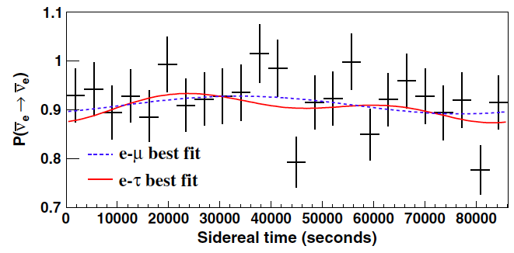
6. Double Chooz experiment
Double Chooz collaboration,
PRD86(2012)112009
So far, we have set limits on
1. ν_{e}↔ν_{μ} channel: LSND, MiniBooNE, MINOS (<10⁻²⁰ GeV)
2. ν_{μ}↔ν_{τ} channel: MINOS, IceCube (<10⁻²³ GeV)
The last untested channel is ν_{e}↔ν_{τ}
It is possible to limit ν_{e}↔ν_{τ} channel from reactor ν_{e} disappearance experiment
P(ν_{e}↔ν_{e}) = 1 - P(ν_{e}↔ν_{μ}) - P(ν_{e}↔ν_{τ}) ~ 1 – P(ν_{e}↔ν_{τ})
Double Chooz reactor neutrino data/prediction ratio
Small disappearance signal prefers sidereal time independent solution (flat)
We set limits in the e-τ sector for the first time; ν_{e}↔ν_{τ} (<10⁻²⁰ GeV)
Notes:
Say I am invited for Double Chooz analysis

Slide 58
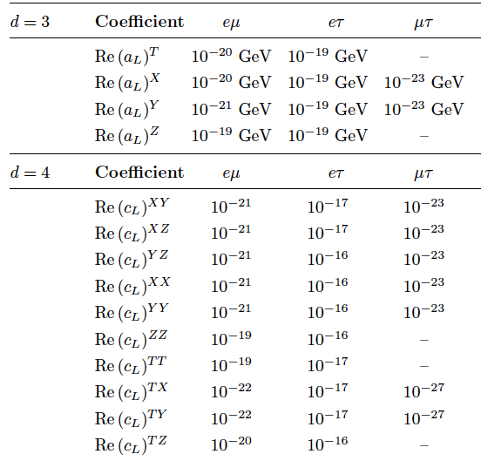
6. Double Chooz experiment
Kostelecký and Russel
Rev.Mod.Phys.83(2011)11
ArXiv:0801.0287v6
MiniBooNE Double Chooz IceCube
MINOS ND MINOS FD
By this work, Lorentz violation is tested with all neutrino channels
Chance to see the Lorentz violation in terrestrial neutrino experiments will be very small
Recently, Super-Kamiokande collaboration published significantly better limits
arXiv:1410.4267
Notes:
Say I am invited for Double Chooz analysis

Slide 59
1. Spontaneous Lorentz symmetry breaking
2. What is Lorentz and CPT violation?
3. Modern test of Lorentz violation
4. Lorentz violating neutrino oscillation
5. Test for Lorentz violation with MiniBooNE data
6. Test for Lorentz violation with Double Chooz data
7. Double Chooz spectrum fit
8. Extra-terrestrial neutrinos
9. Conclusion

Slide 60
7. Massive Lorentz-violating model
Díaz, Kostelecký, Mewes
PRD80(2009)076007
Double Chooz oscillation signal has no sidereal time dependence.
By assuming main source of neutrino oscillation is neutrino mass, we can study perturbation terms to find secondary effect to cause oscillations.
In this way, we can access to different types of Lorentz violation
massive neutrino oscillation Lorentz violating neutrino oscillation
Notes:
Say I am invited for Double Chooz analysis

Slide 61
7. Anomalous energy spectrum
Díaz, Kostelecký, Mewes
PRD80(2009)076007
Sidereal variation is one of many predicted phenomena of Lorentz violating neutrino oscillations.
Lorentz violation predicts unexpected energy dependence of neutrino oscillations from standard neutrino mass oscillations.
Effective Hamiltonian for
neutrino oscillation
This is very useful to differentiate 2 effects:
- massive neutrino oscillation
- sidereal time independent Lorentz violating neutrino oscillation
Double Chooz released its energy spectrum (with full error matrix). We use this to test time independent Lorentz violating neutrino oscillation.
massive neutrino oscillation Lorentz violating neutrino oscillation
Notes:
Say I am invited for Double Chooz analysis

Slide 62
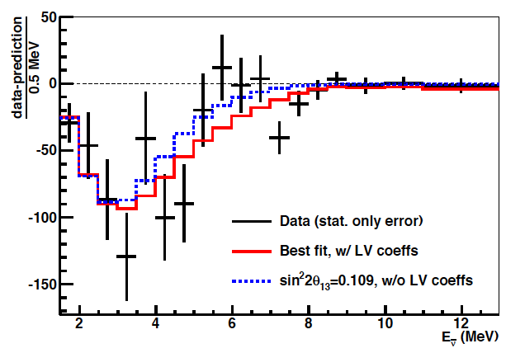
7. Double Chooz spectrum fit
Díaz, TK, Spitz, Conrad
PLB727(2013)412
Neutrino-Antineutrino oscillation
- Most of neutrino-neutrino oscillation channels are constraint from past analyses
- Here, we focus to test neutrino-antineutrino oscillation
ex) anti-ν_{e}→ν_{e} oscillation fit with Double Chooz data
These fits provide first limits on neutrino-antineutrino time independent Lorentz violating coefficients
Notes:
Say I am invited for Double Chooz analysis

Slide 63
1. Spontaneous Lorentz symmetry breaking
2. What is Lorentz and CPT violation?
3. Modern test of Lorentz violation
4. Lorentz violating neutrino oscillation
5. Test for Lorentz violation with MiniBooNE data
6. Test for Lorentz violation with Double Chooz data
7. Double Chooz spectrum fit
8. Extra-terrestrial neutrinos
9. Conclusion

Slide 64
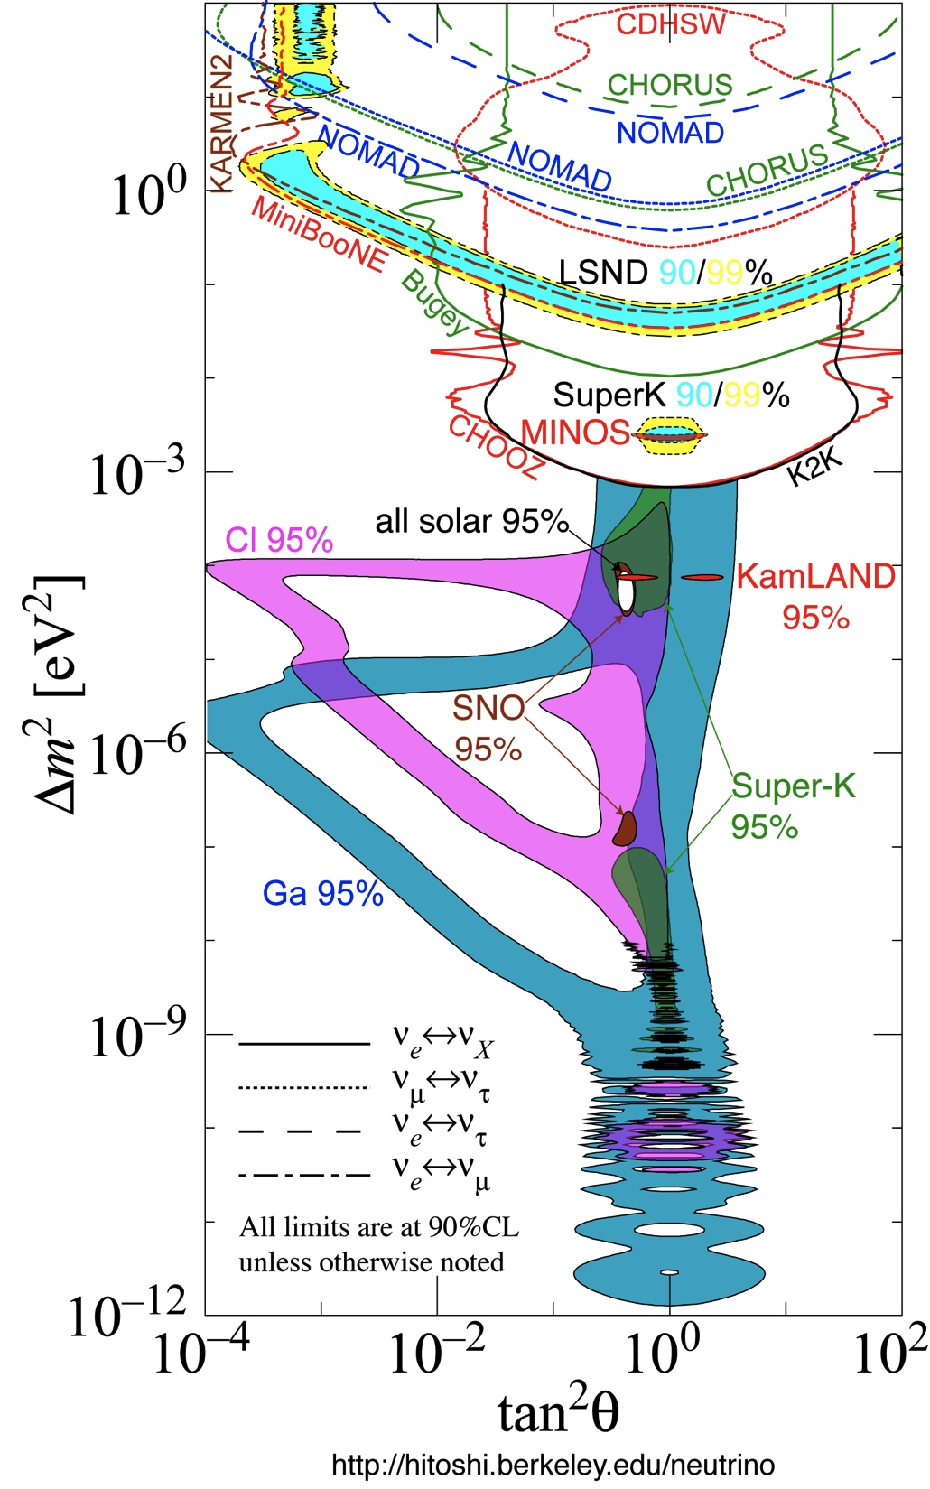
8. Neutrino standard Model (νSM)
This is the world data of neutrino oscillation
It looks majority of region is either accepted (positive signals) or excluded
But this is model dependent diagram, because it assumes neutrino mass as phase, and mass mixing matrix elements as amplitude of neutrino oscillations
What is model independent diagram look like?

Slide 65
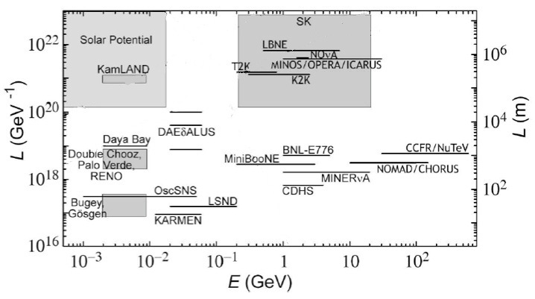
8. Lorentz violation with neutrino oscillation
Kostelecký and Mewes
PRD69(2004)016005
Model independent neutrino oscillation data is the function of neutrino energy and baseline.

Slide 66
8. Lorentz violation with neutrino oscillation
Kostelecký and Mewes
PRD69(2004)016005
Model independent neutrino oscillation data is the function of neutrino energy and baseline.
accelerator neutrino
long baseline
reactor neutrino
short baseline reactor signal
MiniBooNE excesses
LSND signal

Slide 67
8. Lorentz violation with neutrino oscillation
Kostelecký and Mewes
PRD69(2004)016005
Model independent neutrino oscillation data is the function of neutrino energy and baseline.
Δm²_{atm}
accelerator neutrino
Δm²
long baseline
reactor neutrino
short baseline reactor signal
MiniBooNE excesses
LSND signal

Slide 68
8. Lorentz violation with neutrino oscillation
Kostelecký and Mewes
PRD69(2004)016005
?
?
Model independent neutrino oscillation data is the function of neutrino energy and baseline.
Δm²_{atm}
accelerator neutrino
Δm²
long baseline
reactor neutrino
short baseline reactor signal
MiniBooNE excesses
LSND signal

Slide 69
8. Lorentz violation with neutrino oscillation
Kostelecký and Mewes
PRD69(2004)016005
extra galactic
neutrino potential
?
1Mpc(~Andromeda)
?
Δm²
reactor neutrino
Δm²_{atm}
accelerator neutrino
TeV neutrino potential
1TeV

Slide 70
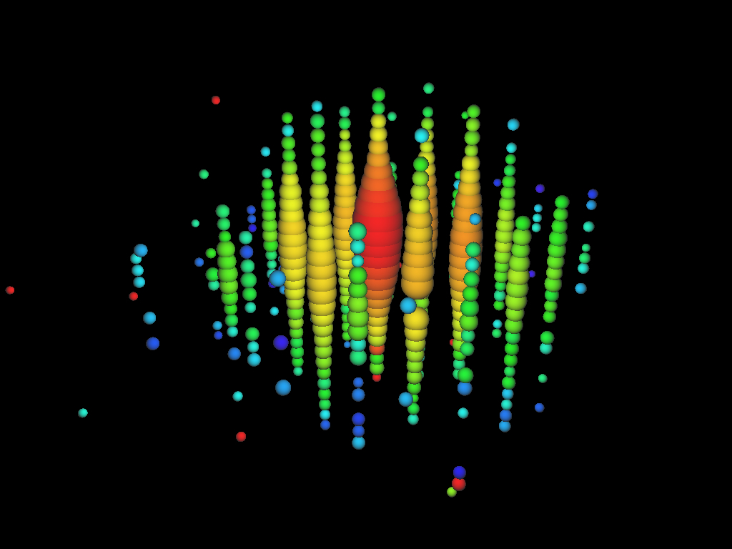
8. Lorentz violation with neutrino oscillation
Kostelecký and Mewes
PRD69(2004)016005
extra galactic
neutrino potential
?
1Mpc(~Andromeda)
?
IceCube collaboration
PRL111(2013)021103
Δm²
reactor neutrino
Δm²_{atm}
accelerator neutrino
TeV neutrino potential
1TeV

Slide 71

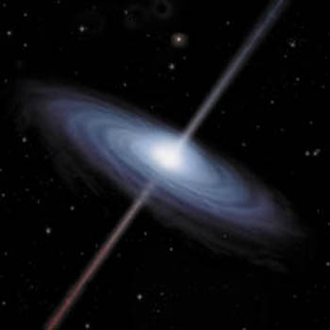
8. Lorentz violation with extra-terrestrial neutrinos
Diaz, Kostelecký, Mewes
PRD85(2013)096005;89(2014)043005
Combination of longer baseline and higher energy makes extra-terrestrial neutrino to be the most sensitive source of fundamental physics.
Vaccum Cherenkov radiation
Vacuum decoherence
etc
cf) The most sensitive test of Planck scale physics is vacuum birefringence of polarized GRB

Slide 72
Conclusion
Lorentz and CPT violation has been shown to occur in Planck-scale theories.
There is a world wide effort to test Lorentz violation with various state-of-the-art technologies.
LSND and MiniBooNE data suggest Lorentz violation is an interesting solution to neutrino oscillation.
MiniBooNE sets limits on Lorentz violation on ν_{μ}→ν_{e} oscillation coefficients. These limits together with MINOS exclude simple Lorentz violation motivated scenario to explain LSND anomaly.
MiniBooNE, LSND, MINOS, IceCube, and Double Chooz, Super-Kamiokande set stringent limits on Lorentz violation in neutrino sector in terrestrial level.
Extra-terrestrial neutrinos from IceCube are one of the most sensitive tool to test fundamental physics, such as Lorentz violation.
Thank you for your attention!

Slide 73
backup

Slide 74
2. Comment: Is there preferred frame?
As we see, all observers are related with observer’s Lorentz transformation, so there is no special “preferred” frame (all observer’s are consistent)
But there is a frame where universe looks isotropic even with a Lorentz violating vector field. You may call that is the “preferred frame”, and people often speculate the frame where CMB looks isotropic is such a frame (called “CMB frame”).
However, we are not on CMB frame (e.g., dipole term of WMAP is nonzero), so we expect anisotropy by lab experiments even CMB frame is the preferred frame.

Slide 75
5. MiniBooNE experiment
MiniBooNE collaboration,
PRL102(2009)101802,
PRL105(2010)181801
MiniBooNE is a short-baseline neutrino oscillation experiment at Fermilab.
Neutrino mode analysis: MiniBooNE saw the 3.0σ excess at low energy region
Antineutrino mode analysis: MiniBooNE saw the 1.4σ excess at low and high energy region
MiniBooNE low E ν_{e} excess
MiniBooNE anti-ν_{e} excess
475MeV
intrinsic
intrinsic
475MeV
misID
misID
low energy high energy
low energy high energy
Intrinsic background errors are constraint from MiniBooNE data
Data driven corrections are applied to MisID backgrounds

Slide 76
5. MiniBooNE experiment
MiniBooNE collaboration,
PRL102(2009)101802,
PRL105(2010)181801
MiniBooNE is a short-baseline neutrino oscillation experiment at Fermilab.
Neutrino mode analysis: MiniBooNE saw the 3.0σ excess at low energy region
Antineutrino mode analysis: MiniBooNE saw the 1.4σ excess at low and high energy region
MiniBooNE low E ν_{e} excess
MiniBooNE anti-ν_{e} excess
475MeV
475MeV
low energy high energy
low energy high energy
These excesses are not predicted by neutrino Standard Model (νSM), therefor it might sterile neutrino or other new physics, such as Lorentz violation
→ Oscillation candidate events may have sidereal time dependence!

Slide 77
6. Lorentz violation with MiniBooNE
Kostelecký and Mewes
PRD70(2004)076002
Sidereal variation of neutrino oscillation probability for MiniBooNE (5 parameters)
Expression of 5 observables (14 SME parameters)
coordinate dependent direction vector (depends on the latitude of FNAL, location of BNB and MiniBooNE detector)
Notes:
You can at most find 5 constraint for 14 free parameters

Slide 78
8. Superluminal neutrinos
OPERA collaboration,
ArXiv:1109.4897
OPERA
v(neutrino) = c + (2.37±0.32) × 10⁻⁵ c
= c + (16±2) × 10³ mph
It is fascinating result, but...
- time of flight is kinematic test (less sensitive than neutrino oscillations)
- no indication of Lorentz violation from any neutrino oscillation experiments
- superluminal neutrino is unstable (vacuum Cherenkov radiation)
- pion phase space is limited to create such neutrinos
- SN1987A neutrinos provide severe limit to superluminal neutrinos
- etc...
It is very difficult to interpret superluminal neutrinos at OPERA by Lorentz violation within field theory approach.
ArXiv:1109.6562
ArXiv:1109.6630
PRL58(1987)1490

