Slide 1

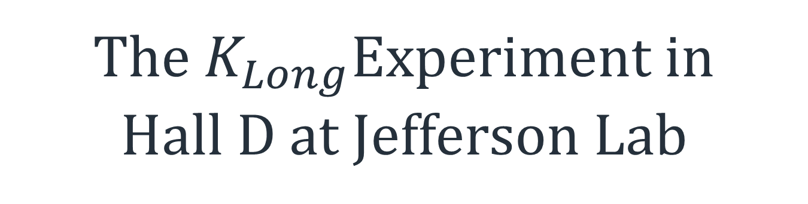
The $K_{Long}$Experiment in
Hall D at Jefferson Lab
arXiv:2008.08215v3
KLF proposal 2020
Stuart Fegan (Slides from Mikhail Bashkanov)

Slide 2
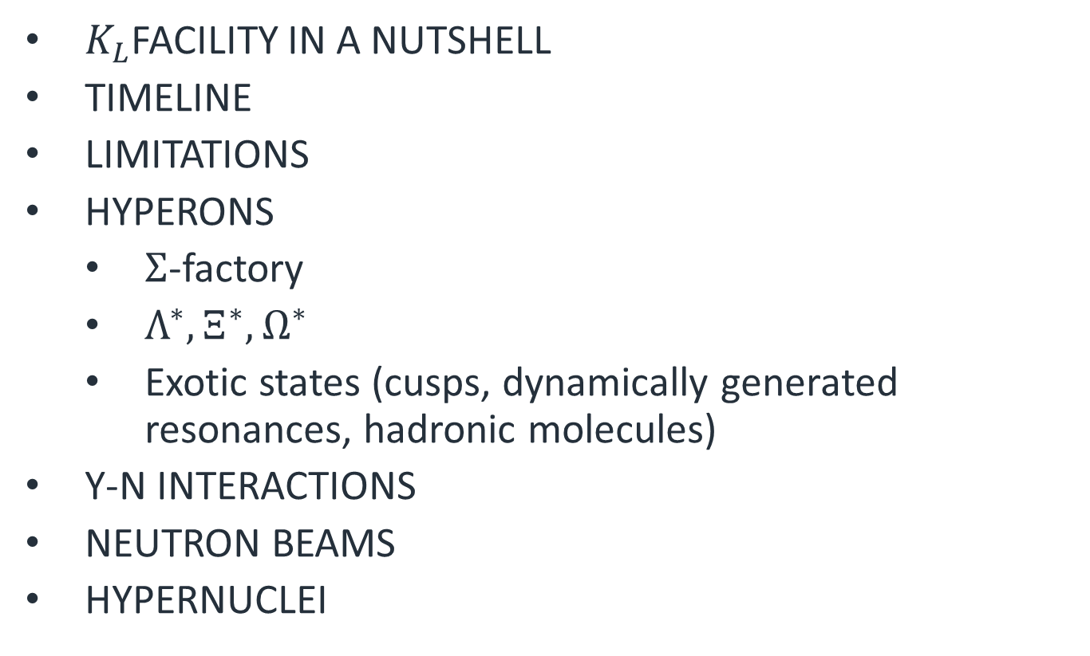
Outlook
$K_{L}$Facility in a Nutshell
Timeline
Limitations
Hyperons
  $Σ$-factory
  $Λ^{∗},Ξ^{∗},Ω^{∗}$
  Exotic states (cusps, dynamically generated resonances, hadronic molecules)
Y-N interactions
Neutron beams
Hypernuclei
2

Slide 3
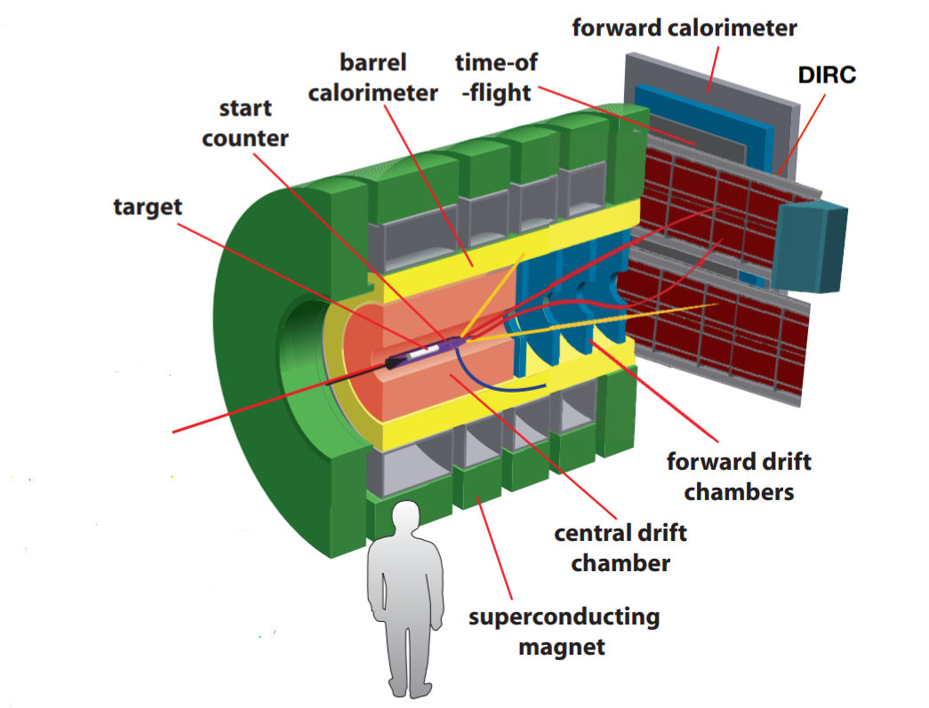
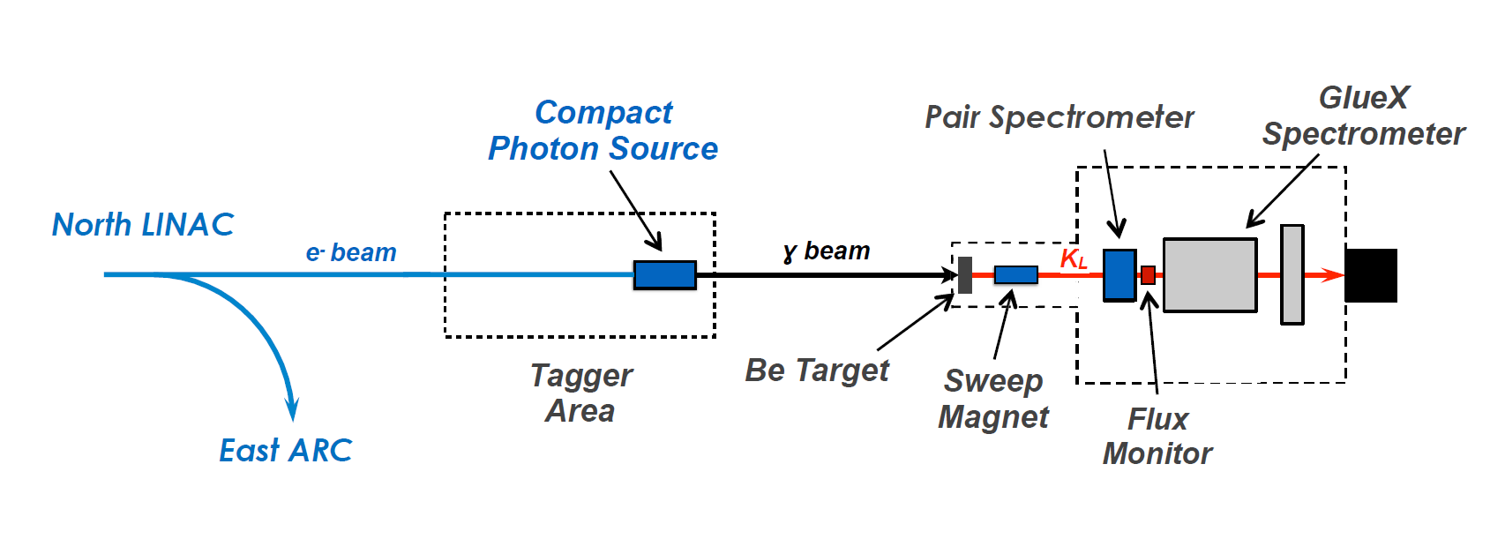
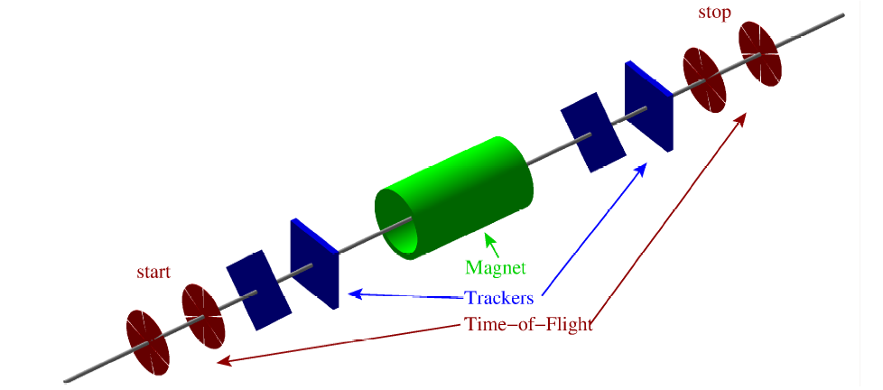
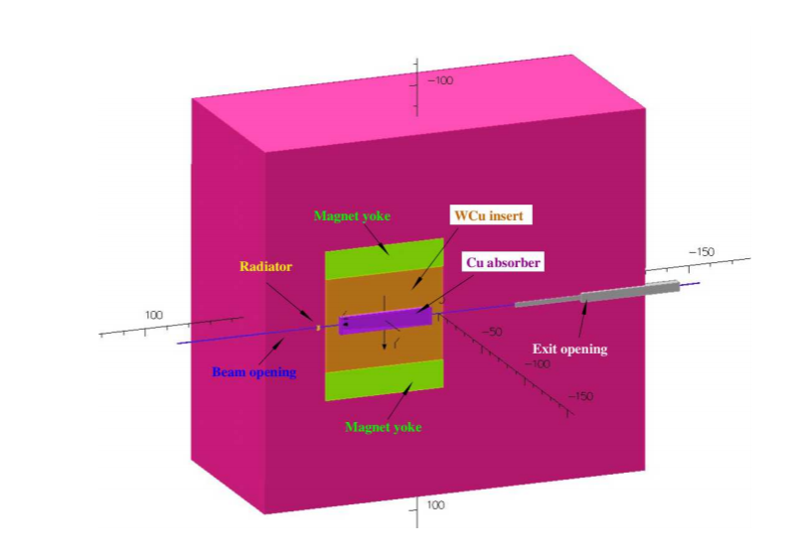
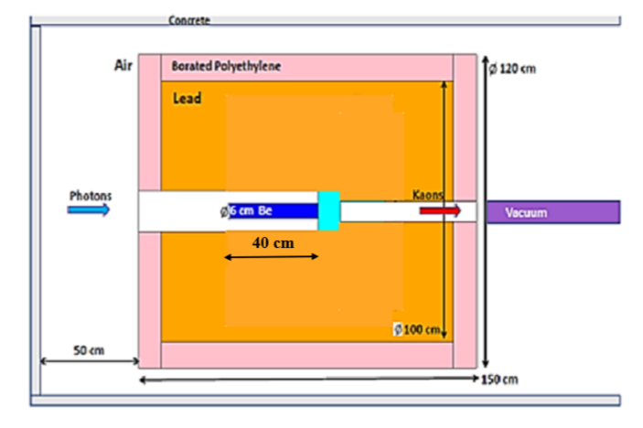

KLF
I=5$μA$
3

Slide 4
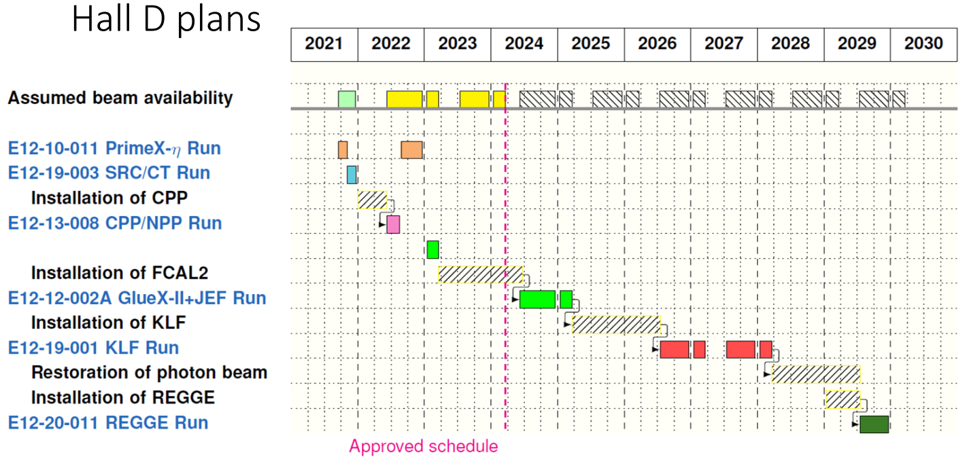
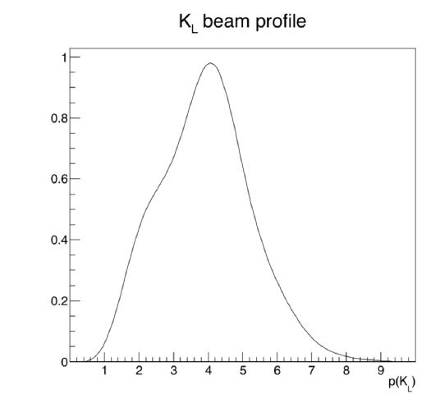
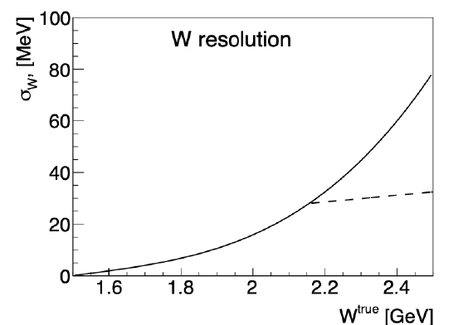
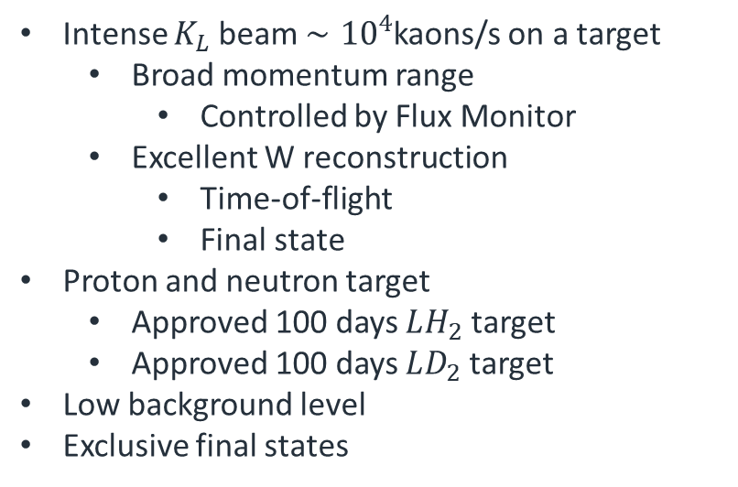
Intense $K_{L}$ beam $∼{10}^{4}$kaons/s on a target
  Broad momentum range
    Controlled by Flux Monitor
  Excellent W reconstruction
    Time-of-flight
    Final state
Proton and neutron target
  Approved 100 days $LH_{2}$target
  Approved 100 days $LD_{2}$target
Low background level
Exclusive final states
ToF
Final State
4

Slide 5

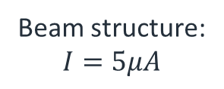


KLF
Be target
cryo target
$$Λ$$
$$K_{L}$$
$$π^{+}$$
24m time-of -flight
Beam structure:
$$I=5μA$$
64ns
5

Slide 6
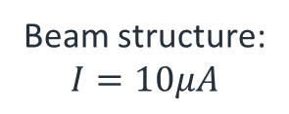
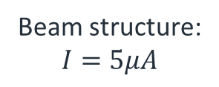
KLF
Be target
cryo target
$$Λ$$
$$K_{L}$$
$$π^{+}$$
24m time-of -flight
Beam structure:
$$I=5μA$$
64ns
Beam structure:
$$I=5μA$$
128ns
Beam structure:
$$I=10μA$$
64ns
6

Slide 7
Compact photon source
~100 tons
7

Slide 8
Hyperons

Slide 9
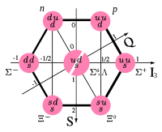
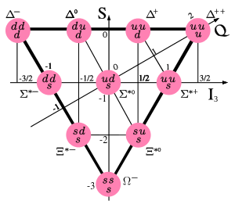
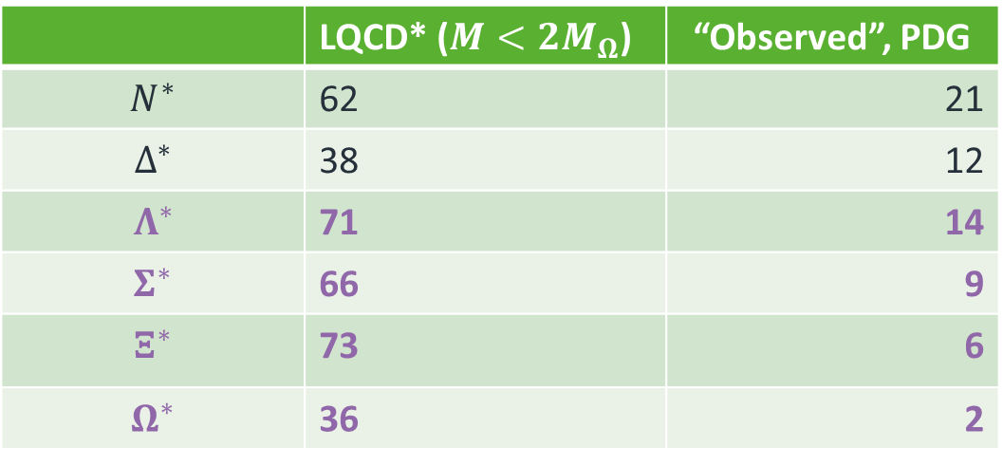
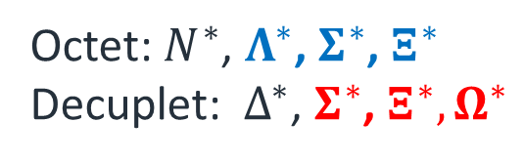
Hyperons
Octet: $N^{∗}$, $Λ^{∗}$, $Σ^{∗}$, $Ξ^{∗}$
Decuplet: $Δ^{∗}$, $Σ^{∗}$, $Ξ^{∗}, Ω^{∗}$
 | LQCD* ($M<2M_{Ω}$) | “Observed”, PDG
$$N^{∗}$$ | 62 | 21
$$Δ^{∗}$$ | 38 | 12
$$Λ^{∗}$$ | 71 | 14
$$Σ^{∗}$$ | 66 | 9
$$Ξ^{∗}$$ | 73 | 6
$$Ω^{∗}$$ | 36 | 2
*R.G. Edwards et al, Phys.Rev.D 87 (2013) 5, 054506
9

Slide 10
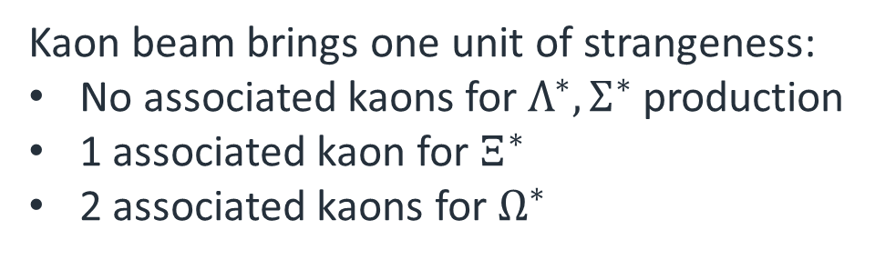
Theory limitations
Kaon beam brings one unit of strangeness:
No associated kaons for $Λ^{∗},Σ^{∗}$ production
1 associated kaon for $Ξ^{∗}$
2 associated kaons for $Ω^{∗}$
Good
Acceptable
Simplified,
model dependent analysis only
10

Slide 11








Strange beams?
$$K_{L}$$
$$Σ^{∗}$$
$$K^{+}$$
$$K$$
$$N$$
$$Ξ^{∗}$$
Direct $Σ^{∗}$ production
$$Λ$$
11

Slide 12











Strange beams?
$$K_{L}$$
$$Σ^{∗}$$
$$K^{+}$$
$$K$$
$$N$$
$$Ξ^{∗}$$
Direct $Σ^{∗}$ production
$$Λ$$
$$π^{+}$$
$$γ$$
$$π^{−}$$
$$K^{0}$$
$$N^{∗}$$
$$Σ^{∗}$$
$$K^{+}$$
Associated production
$$K$$
$$N$$
$$Ξ^{∗}$$
$$Λ$$
12

Slide 13
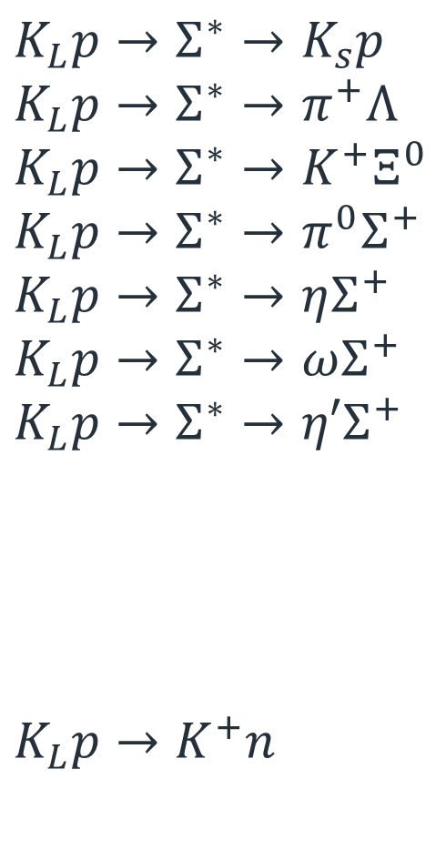

Sigma factory
$$K_{L}p→Σ^{∗}→K_{s}p$$
$$K_{L}p→Σ^{∗}→π^{+}Λ$$
$$K_{L}p→Σ^{∗}→K^{+}Ξ^{0}$$
$$K_{L}p→Σ^{∗}→π^{0}Σ^{+}$$
$$K_{L}p→Σ^{∗}→ηΣ^{+}$$
$$K_{L}p→Σ^{∗}→ωΣ^{+}$$
$$K_{L}p→Σ^{∗}→η′Σ^{+}$$
$$K_{L}p→K^{+}n$$
2 Body Final state
Pure $Σ^{∗}$ channels
Self-polarising observables
Non-resonant background
13

Slide 14
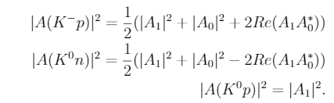
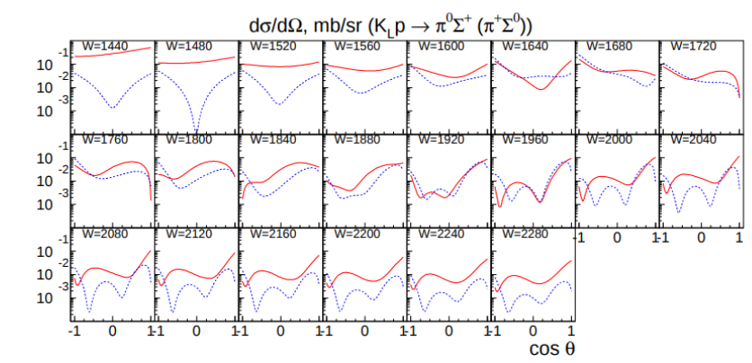

New findings: $πΛ/πΣ$
Isospin amplitudes
arXiv:2008.08215v3
KLF proposal 2020
14

Slide 15
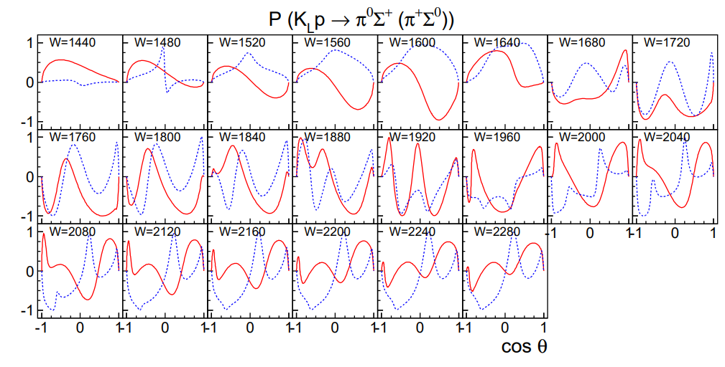
New findings: $πΛ/πΣ$
Isospin amplitudes
Recoil asymmetry
15

Slide 16
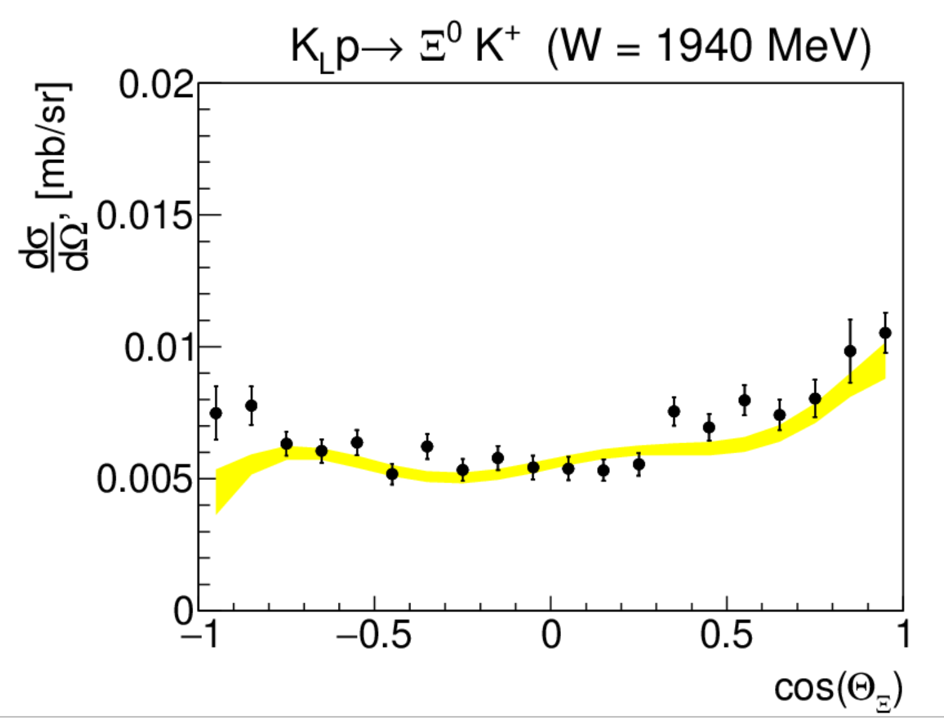
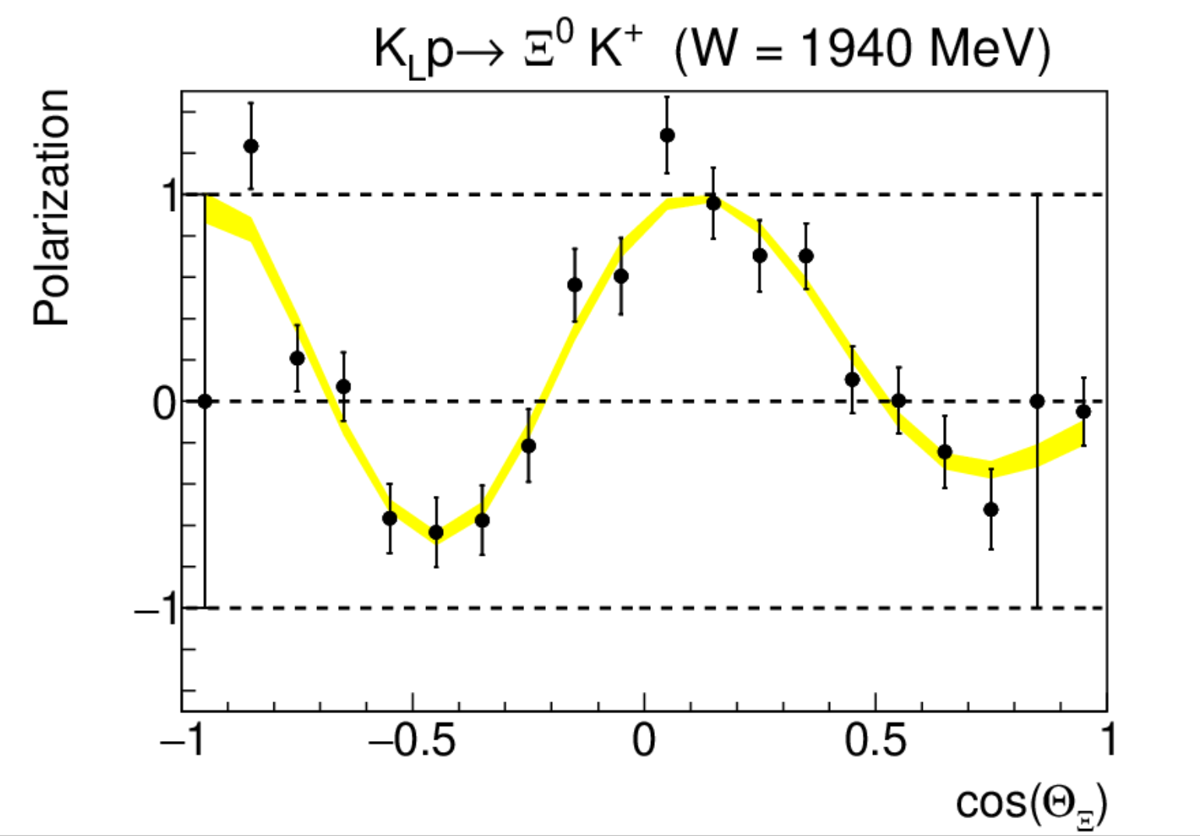
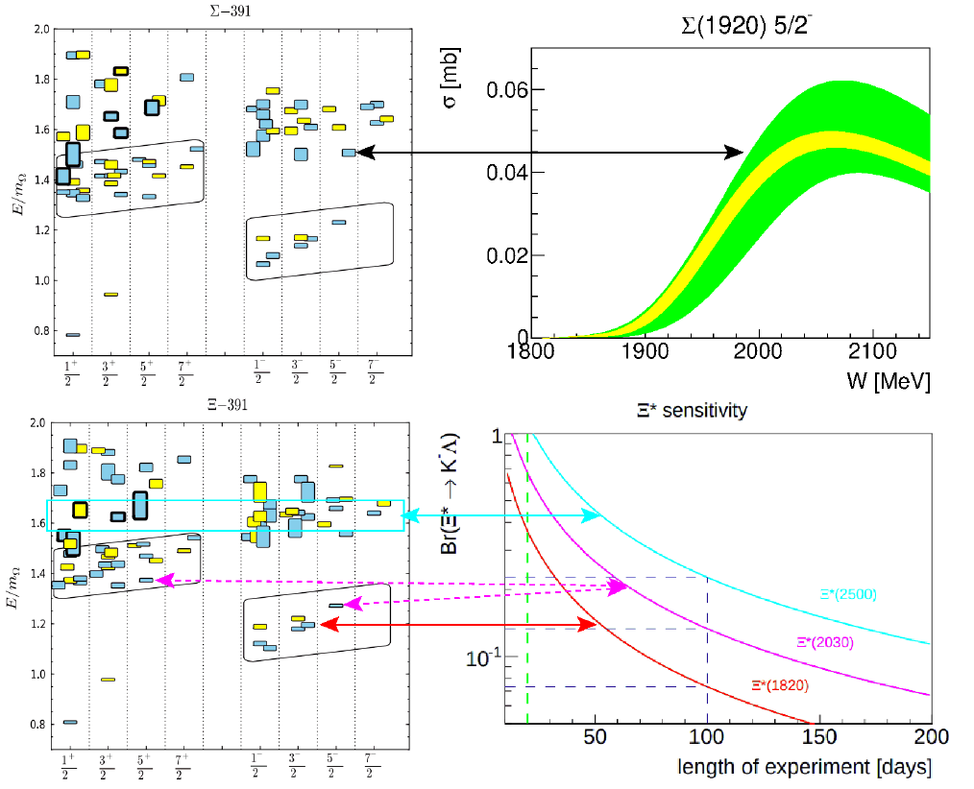

Expected results
$$K_{L}p→K^{+}Ξ^{0}$$
20 days
100 days
16

Slide 17








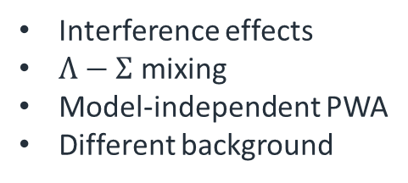




Excited $Λ^{∗}$
$$π^{+}$$
$$K_{L}$$
$$K^{+}$$
Associated production
$$p$$
$$Λ^{∗}$$
$$Ξ^{−}$$
$$K_{L}$$
$$Λ^{∗}$$
$$K^{+}$$
Direct formation
$$n$$
$$Ξ^{−}$$
Interference effects
$Λ−Σ$ mixing
Model-independent PWA
Different background
17

Slide 18

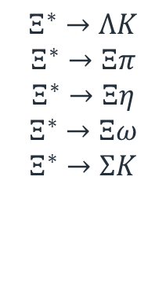

Excited $Ξ^{∗}$ in associated production
$$K^{+}$$
$$K_{L}$$
$$Ξ^{∗}→ΛK$$
$$Ξ^{∗}→Ξπ$$
$$Ξ^{∗}→Ξη$$
$$Ξ^{∗}→Ξω$$
$$Ξ^{∗}→ΣK$$
$$K$$
$$N$$
$$Ξ^{∗}$$
$$Λ$$
$$K_{L}n→K^{+}Ξ^{−}→K^{+}ΛK^{−}$$
18

Slide 19
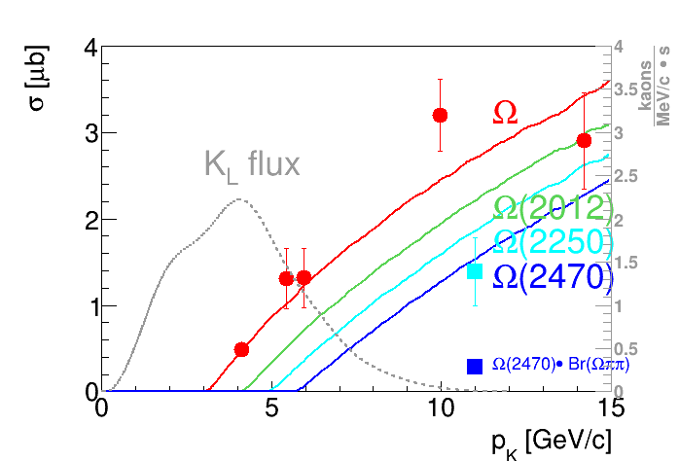
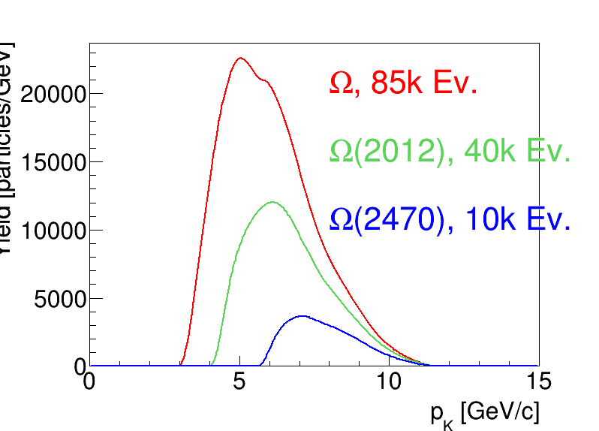





Excited $Ω^{∗}$ in associated production
$$K^{+}$$
$$K_{L}$$
$$K^{+}$$
$$N$$
$$Ω$$
$$Ξ^{∗}$$
Expected Yield
$$\overline{K}p→Ω^{∗}X$$
19

Slide 20
Why Strangeness?

Slide 21
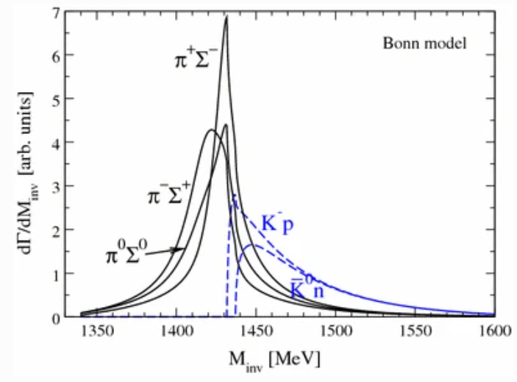
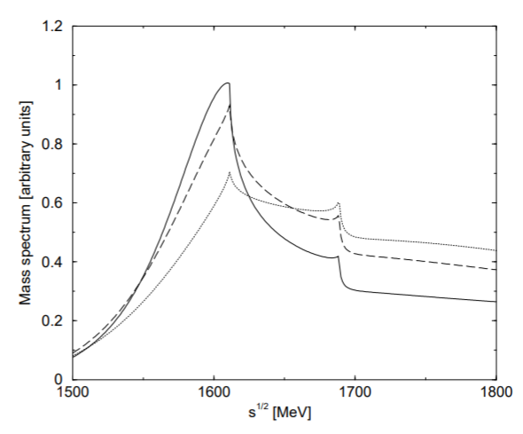



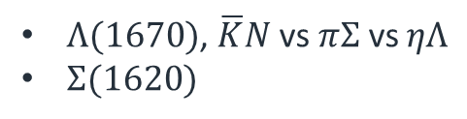

Molecules and cusps
$$Λ_{b}→J/ψΛ(1405)$$
Many thresholds
  Cusps
  Molecules
  Dynamic resonances
$Λ(1670)$, $\overline{K}N$vs $πΣ$ vs $ηΛ$
$Σ(1620)$
L. Roca, M. Mai, E. Oset & Ulf-G. Meißner
$$Ξ(1620)$$
States?
Decay channels?
Resolution?
$$Ξπ,Λ\overline{K},Σ\overline{K},Ξη$$
$$M(Ξπ)$$
A. Ramos, E. Oset , C. Bennhold
21

Slide 22
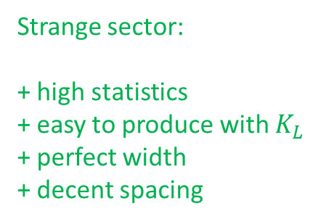
Strangeness is a key
Many thresholds
  Cusps
  Molecules
  Dynamic resonances
Light quark sector:
+ high statistics
+ easy to produce
too broad
too many interferences
Strange sector:
+ high statistics
+ easy to produce with $K_{L}$
+ perfect width
+ decent spacing
Heavy quark sector:
- low statistics
- hard to produce
- too narrow
22

Slide 23
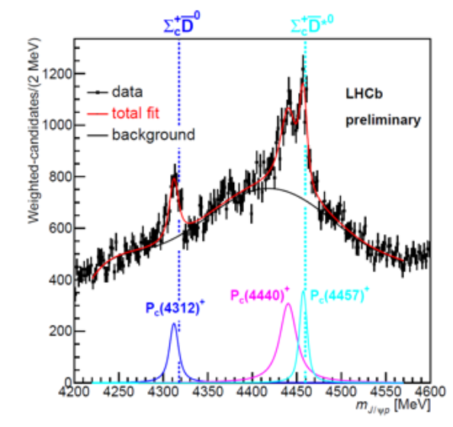




Strangeness is a key
Many thresholds
  Cusps
  Molecules
  Dynamic resonances
$$Λ_{b}→J/ψΛ(1405)$$
L. Roca, M. Mai, E. Oset & Ulf-G. Meißner
$Λ\left(1405\right)↔πΣ/\overline{K}N$-molecule
$P\left(4450\right)↔{\overline{D}}^{∗}Σ_{c}$-molecule
Continuous beam $→$ small systematics
23

Slide 24
KLF spectroscopy
Direct formation
Meson spectroscopy
Associated production
24

Slide 25
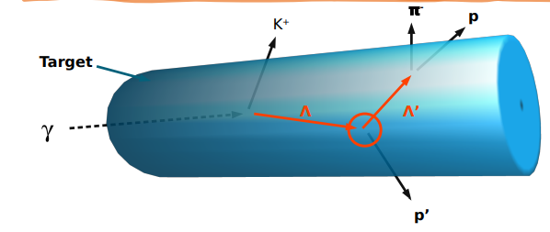
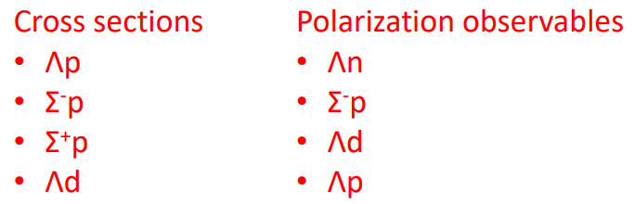
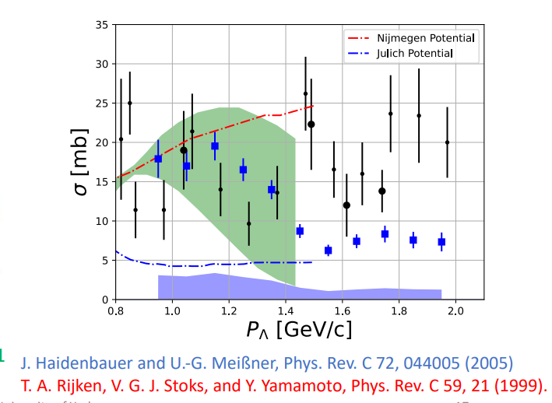
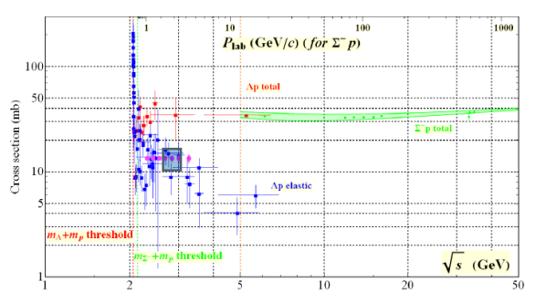
Hyperon-nucleon Scattering
PhysRevLett.127.272303 (2021)
CLAS
KLF
25

Slide 26
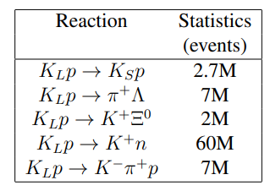
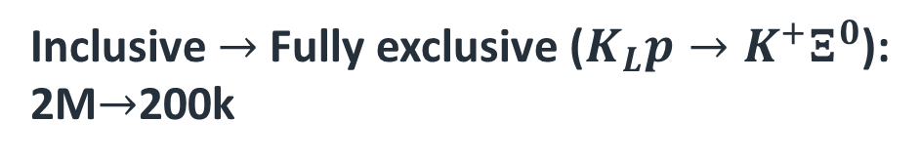
Statistics
Inclusive reconstruction (with background suppression)
Inclusive $→$ Fully exclusive ($K_{L}p→K^{+}Ξ^{0}$):
2M$→$200k
26

Slide 27
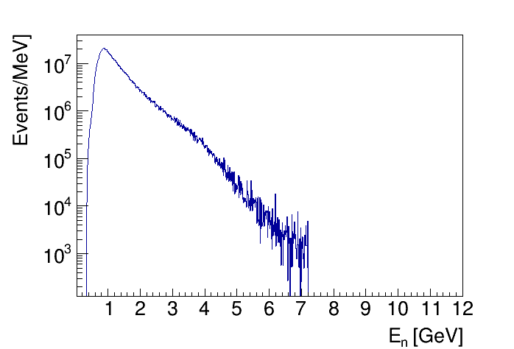
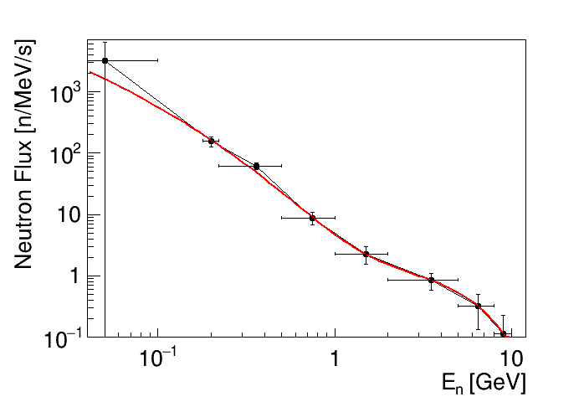
Neutron beam
Neutron induced reactions (hadrons)
Neutron flux
np reaction X-sections from SAID
Low energy Neutron induced reactions-> Nuclear structure
27

Slide 28
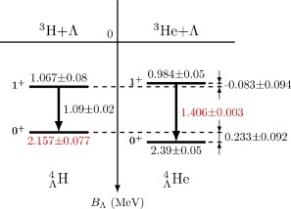
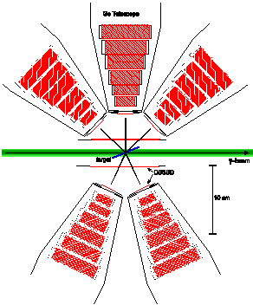


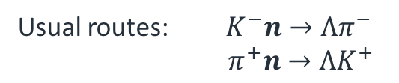
Hypernuclei
Daniel Gazda, Avraham Gal , NPA 954, 161, (2016)
Usual routes: $K^{−}n→Λπ^{−}$
$π^{+}n→ΛK^{+}$
KLF route: $K^{0}p→Λπ^{+}$
Double-strangeness KLF route: $K^{0}p→ΞK^{+}$
28

Slide 29
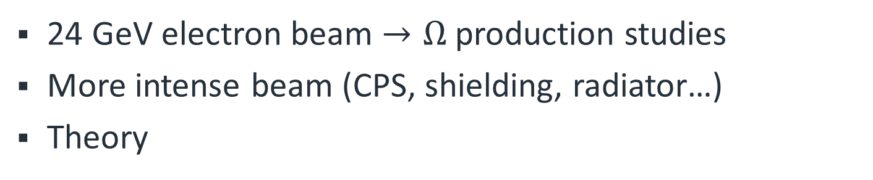
Possible improvements
24 GeV electron beam $→Ω$ production studies
More intense beam (CPS, shielding, radiator…)
Theory
New collaborators welcome!!!
More information at https://wiki.jlab.org/klproject
29

Slide 30
NSTAR2024
York UK
June 17-21st 2024

Slide 31
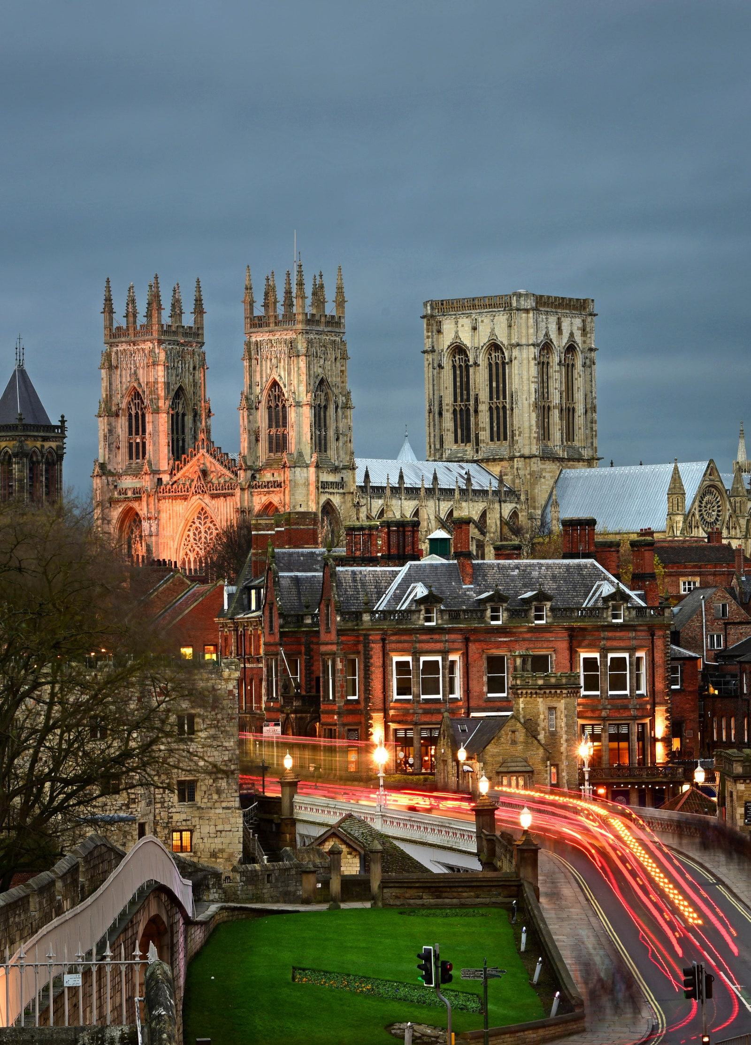
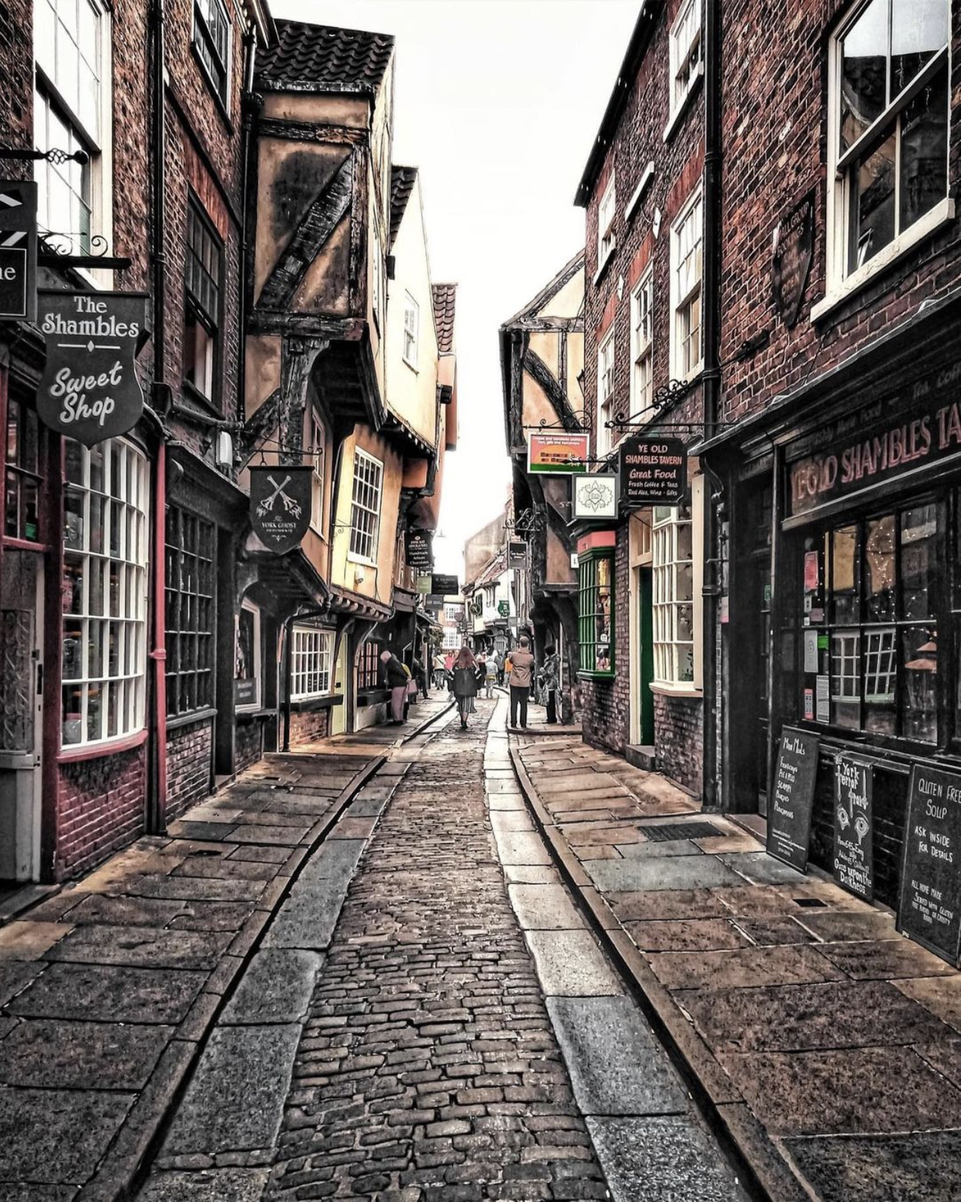


York

