Slide 1

Choices

Slide 2
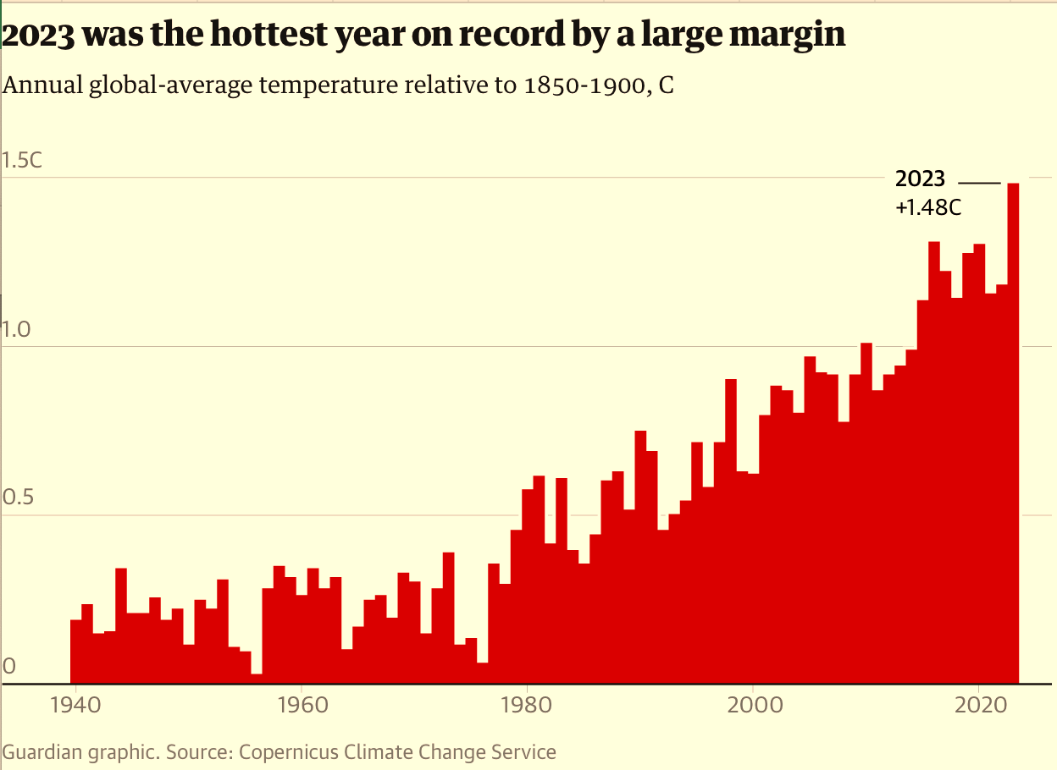

Slide 3
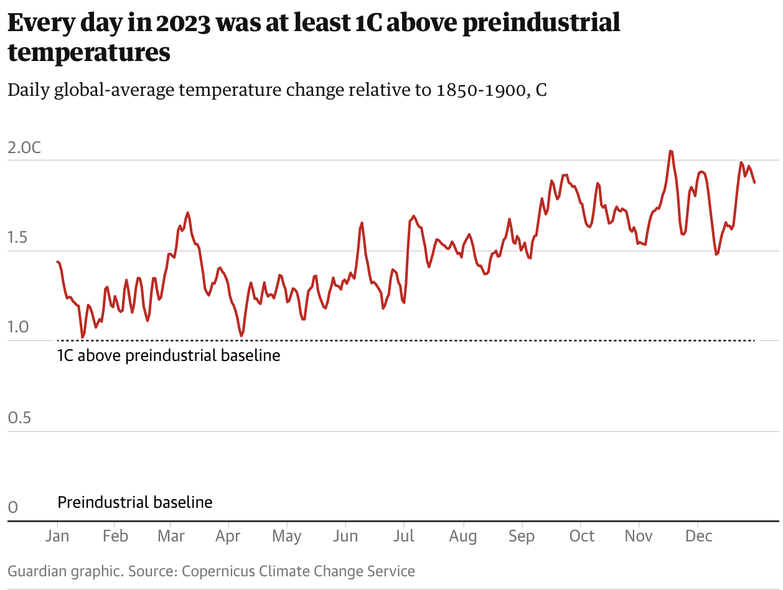

Slide 4
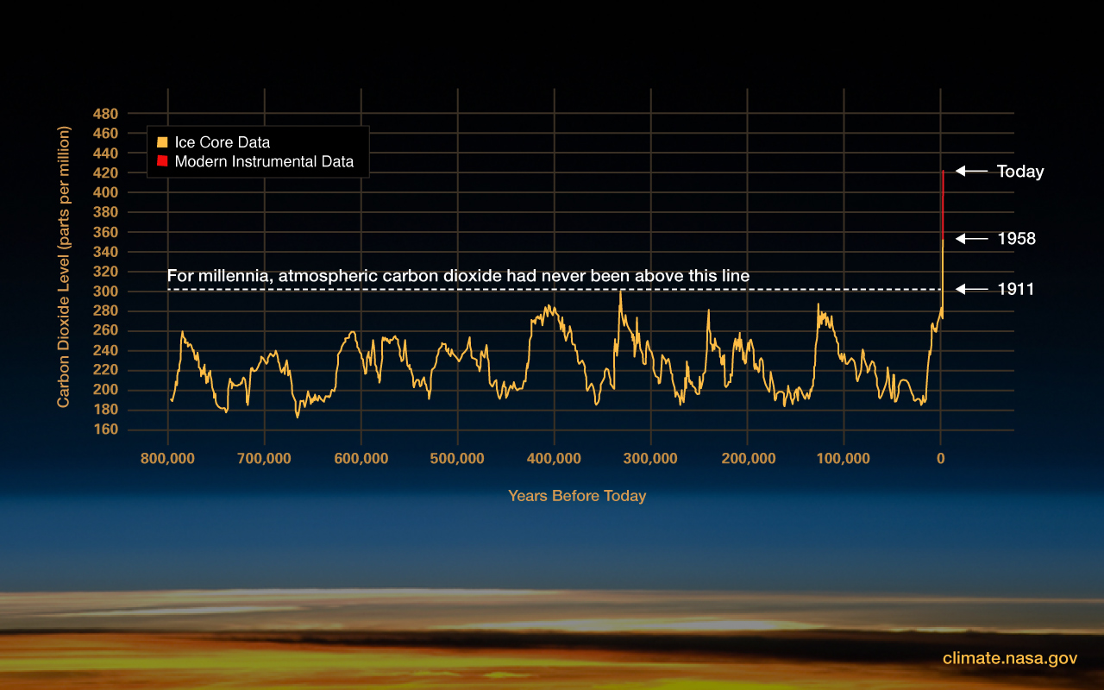
https://climate.nasa.gov/climate_resources/24/graphic-the-relentless-rise-of-carbon-dioxide/

Slide 5
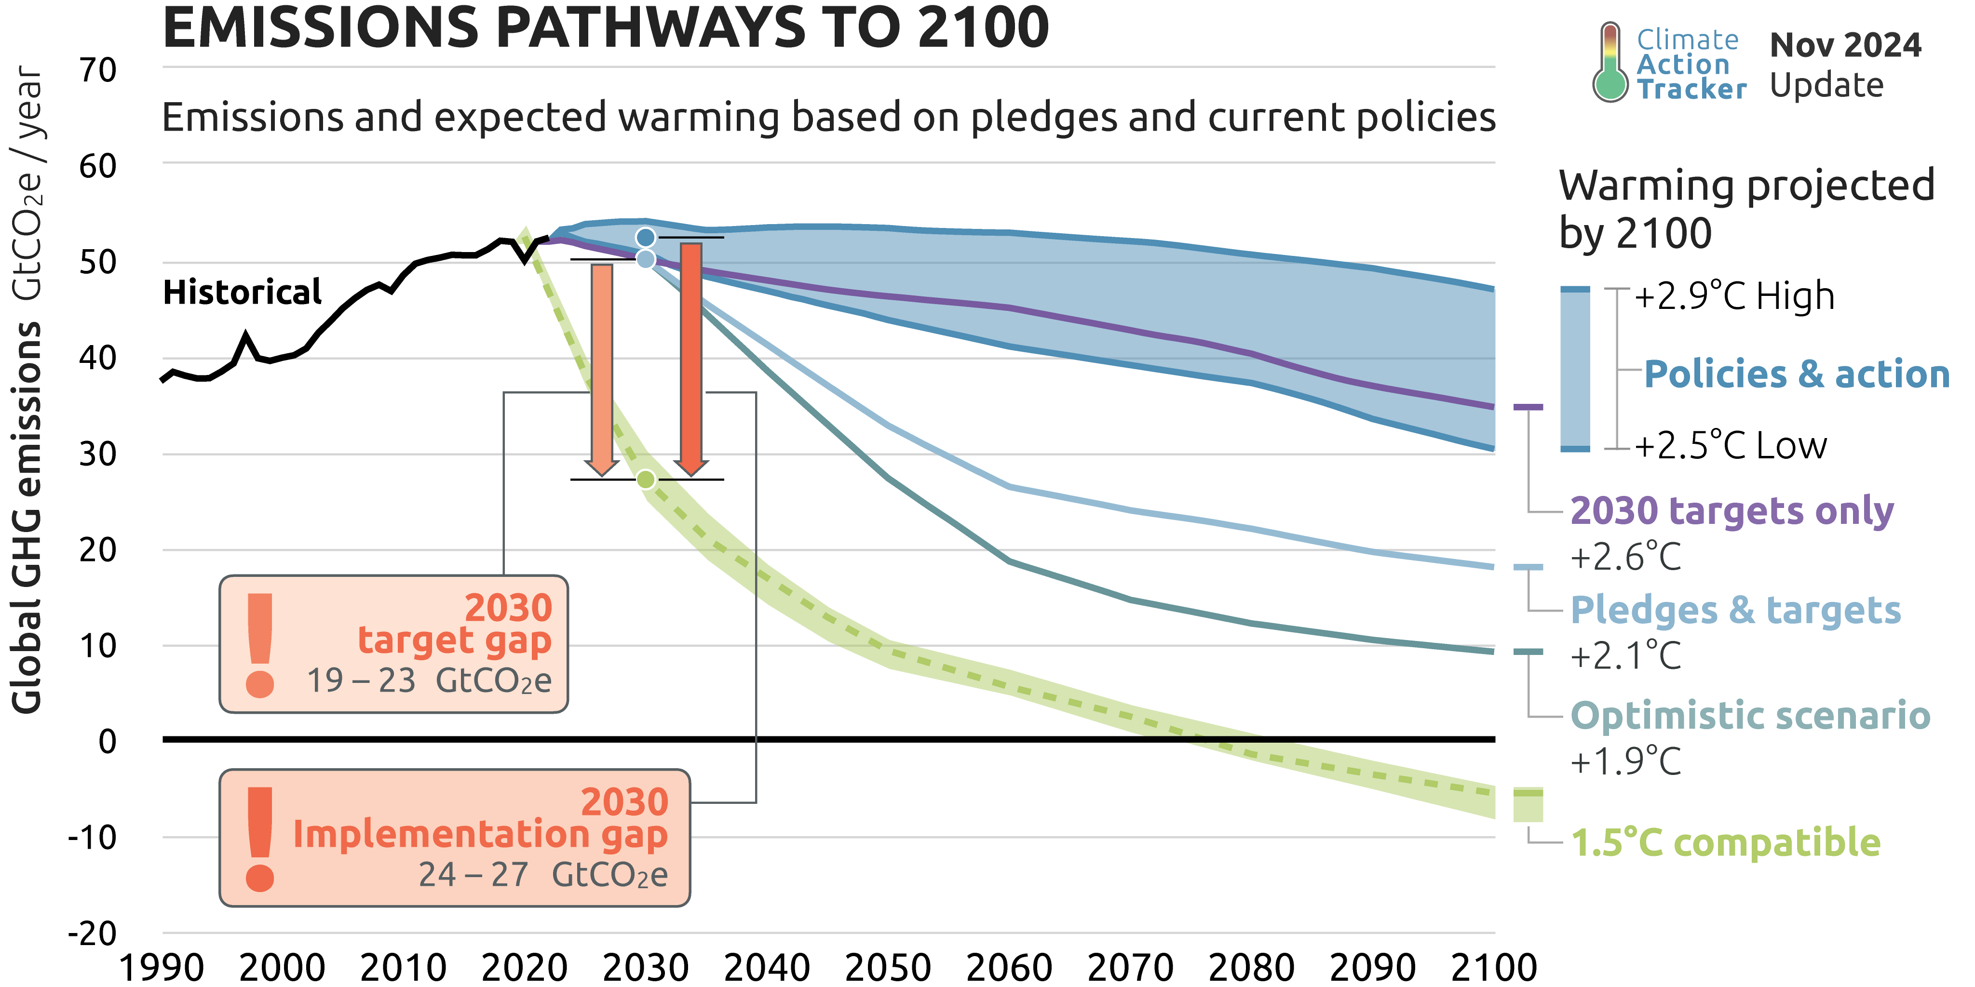
FCC-ee
FCC-hh
https://climateactiontracker.org/global/cat-emissions-gaps/

Slide 6
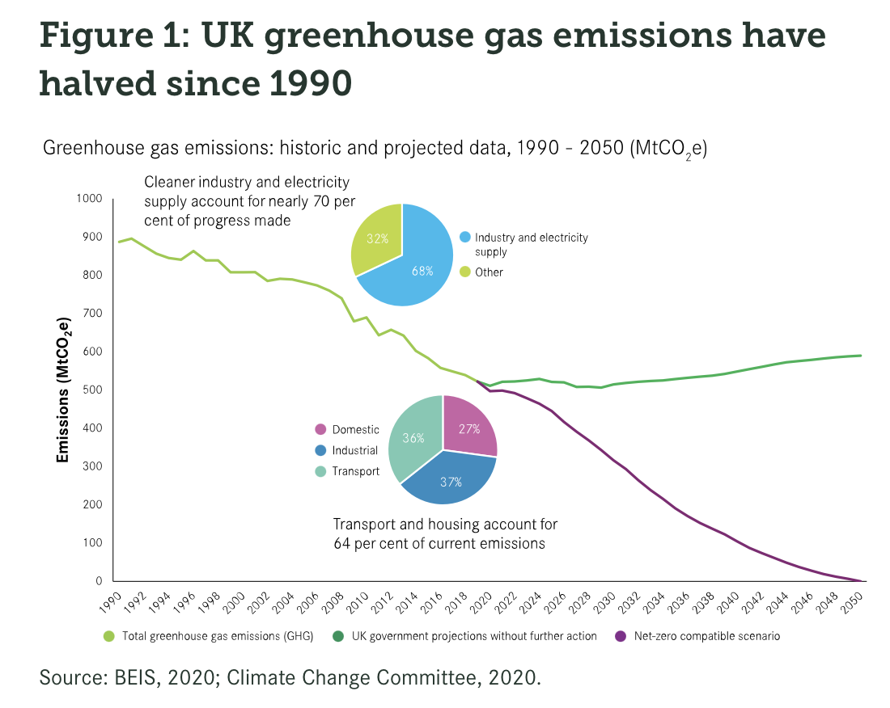
Reduction until now dominated by removing coal from power generation
Heating your home accounts for 18% of the UK greenhouse gas emissions
Notes:
Domestic includes hearting, cooking, other electricity, waste

Slide 7

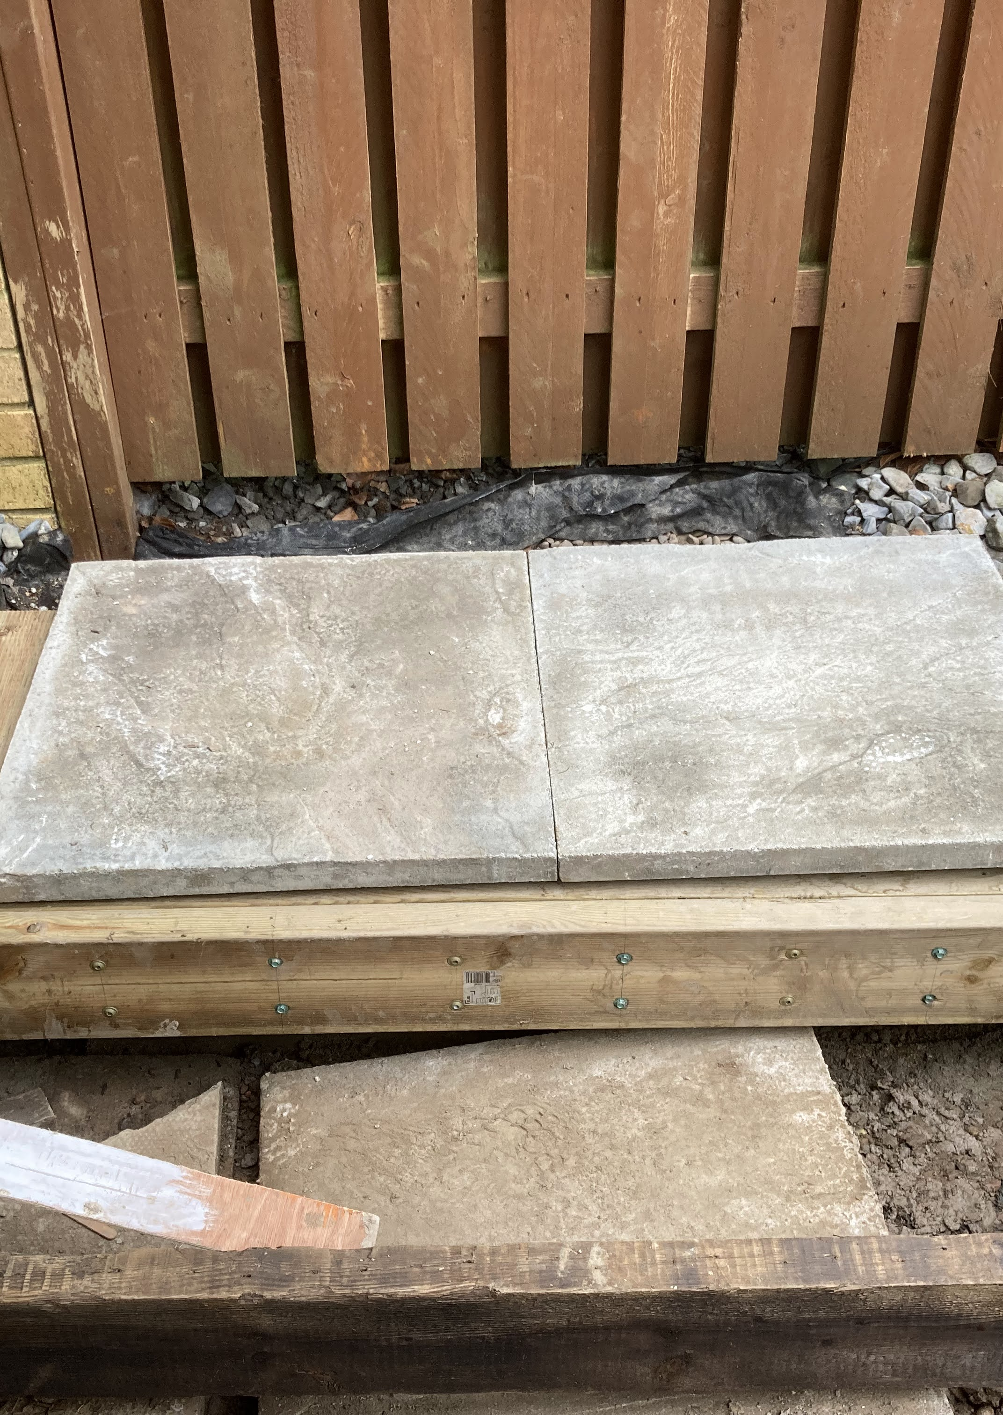


Slide 8

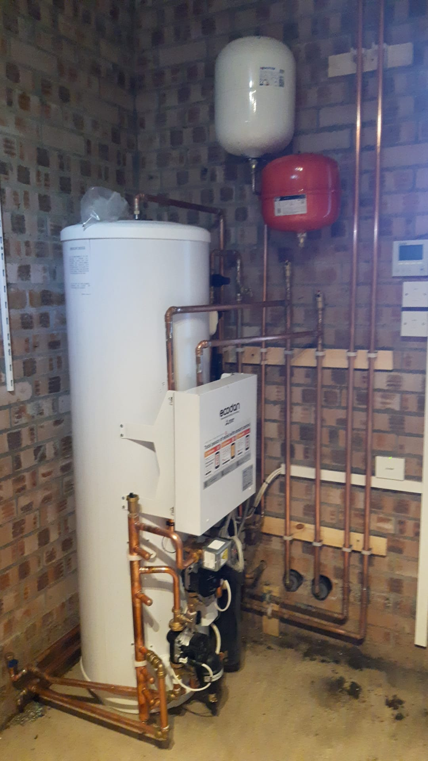
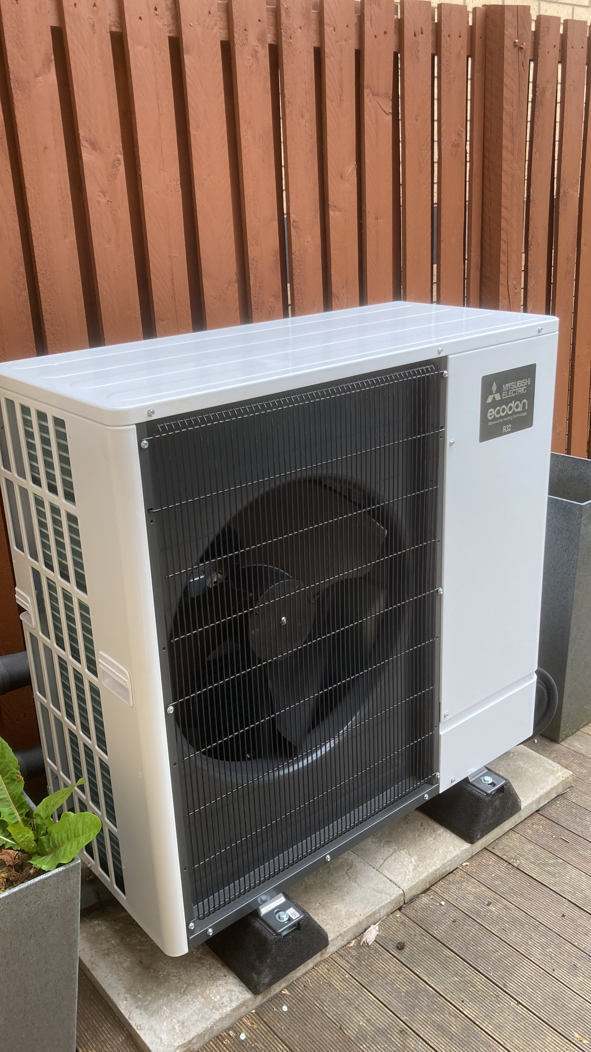

Slide 9
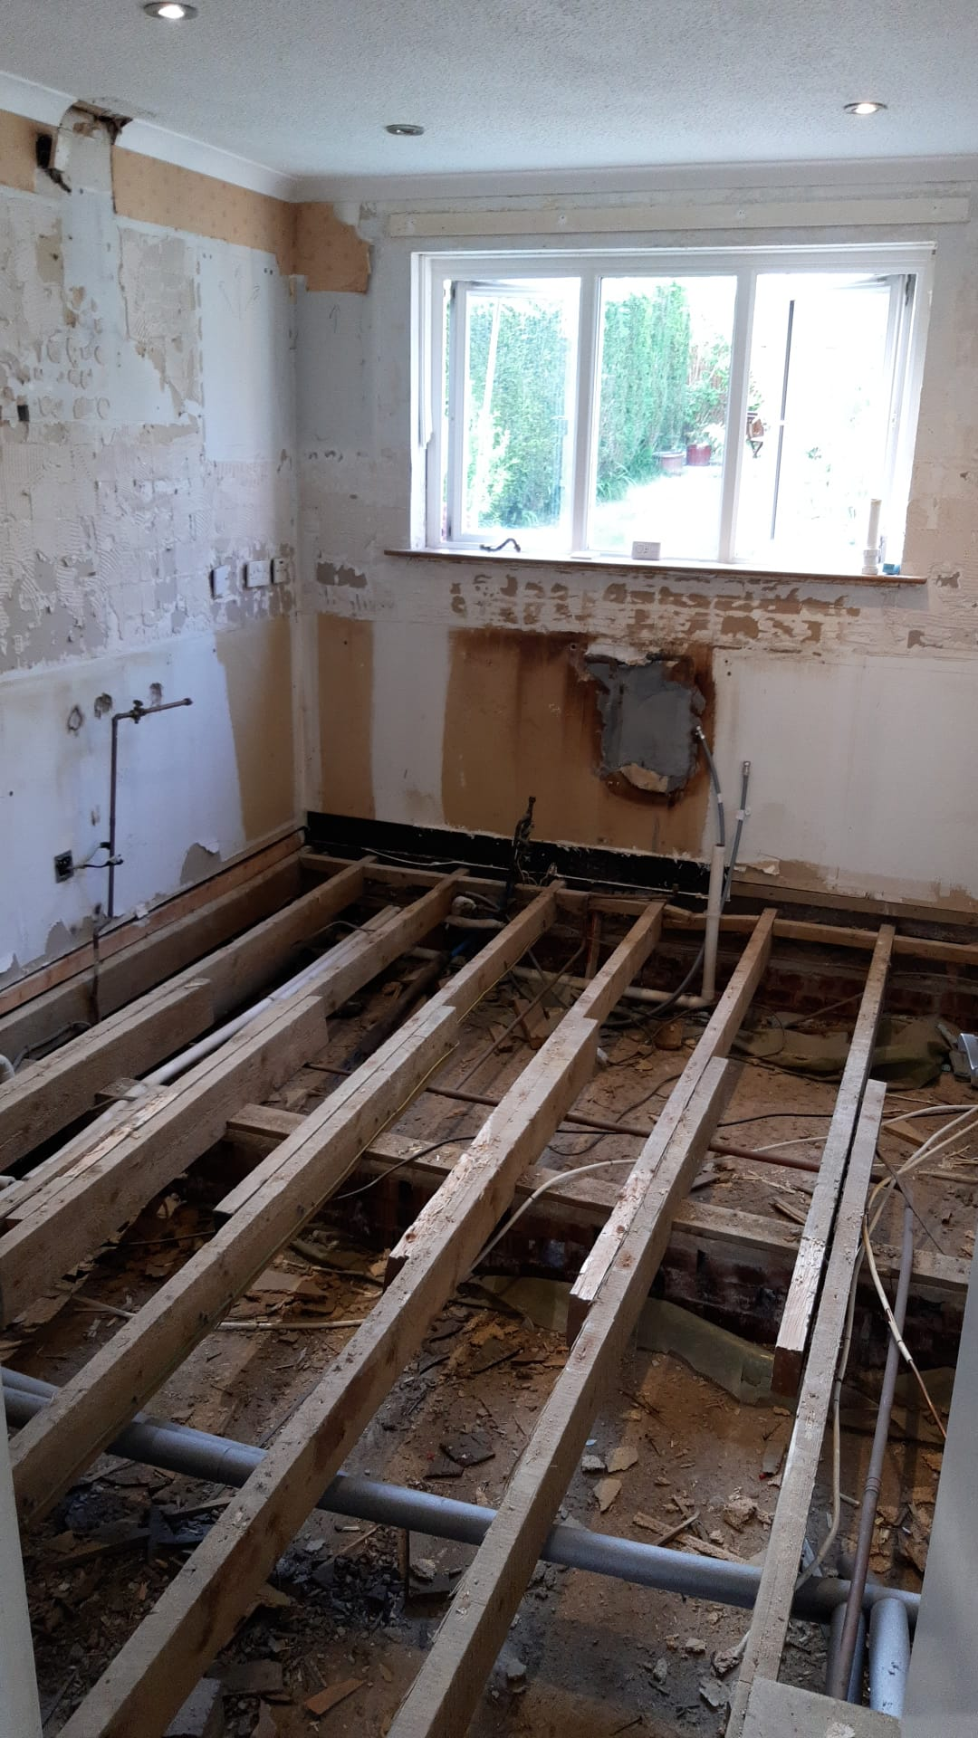
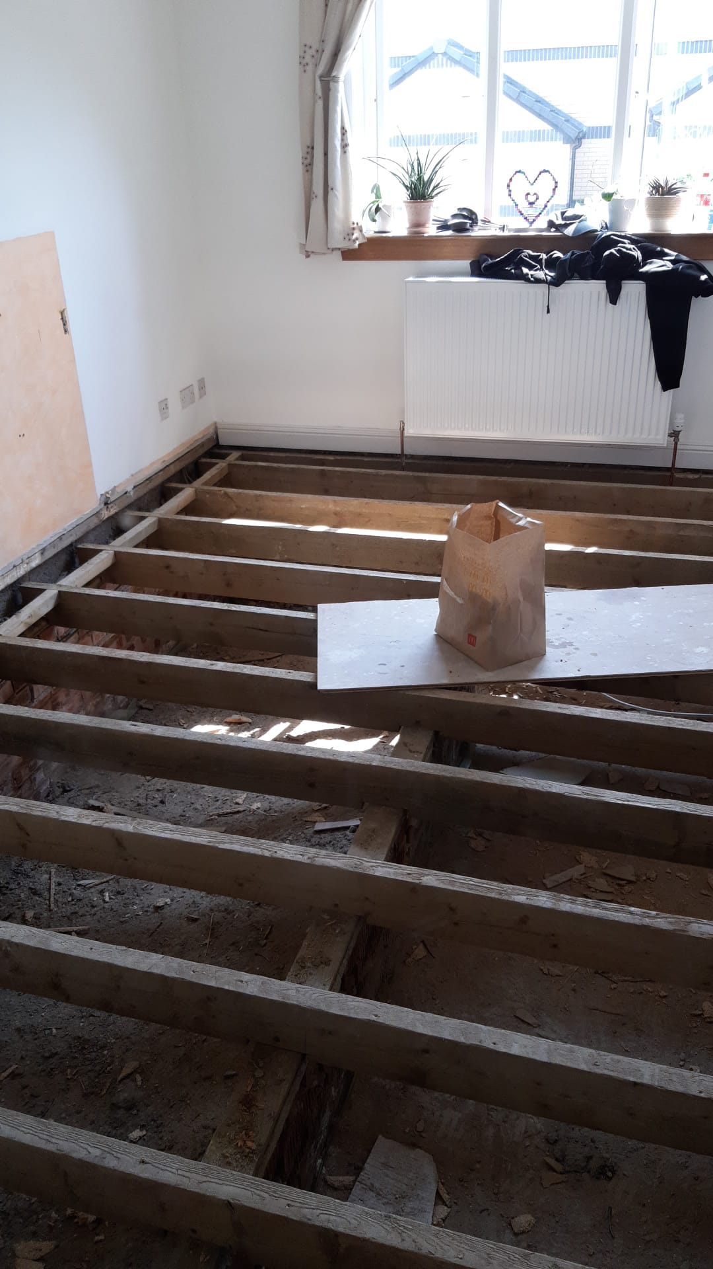
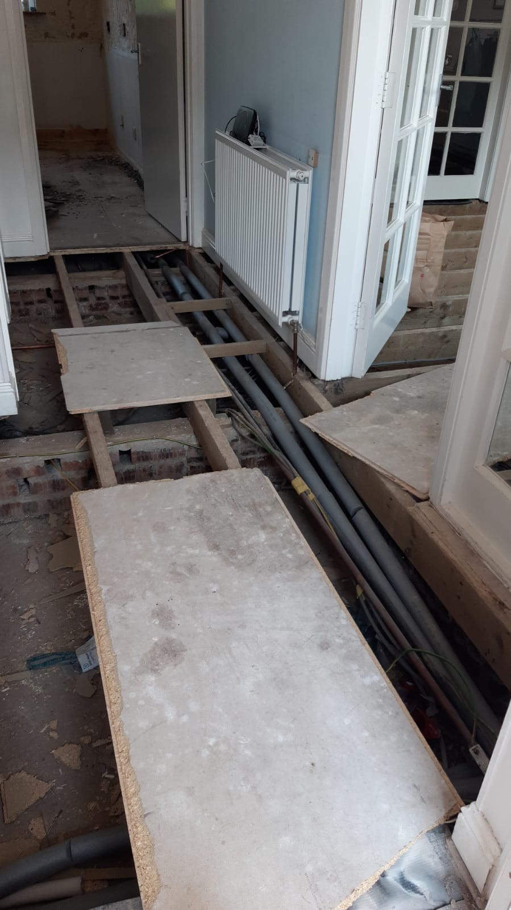

Slide 10
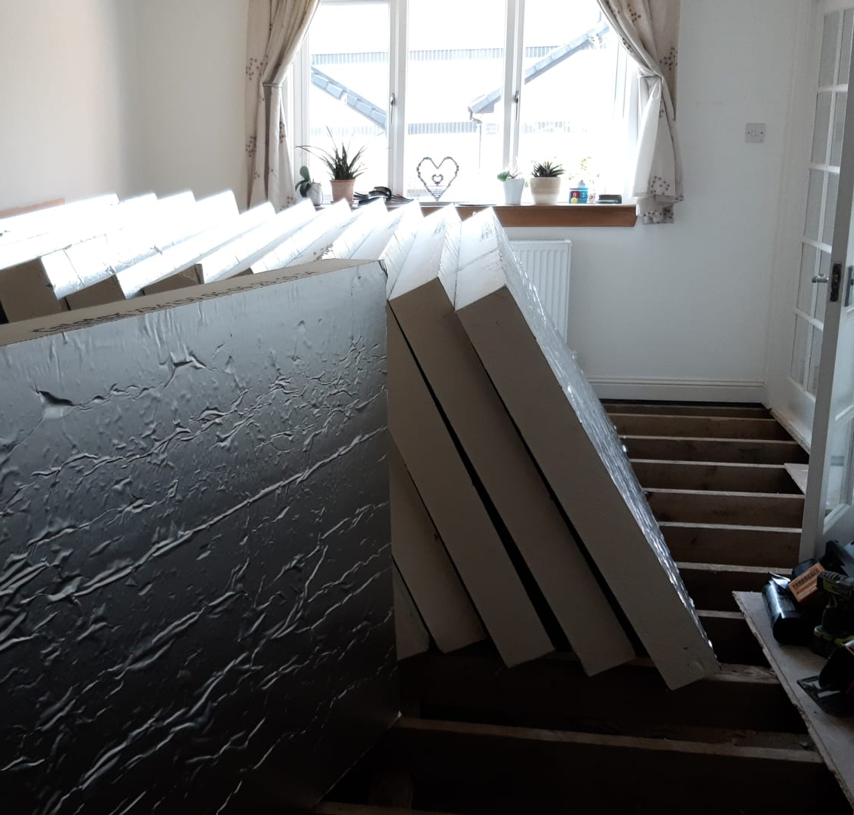
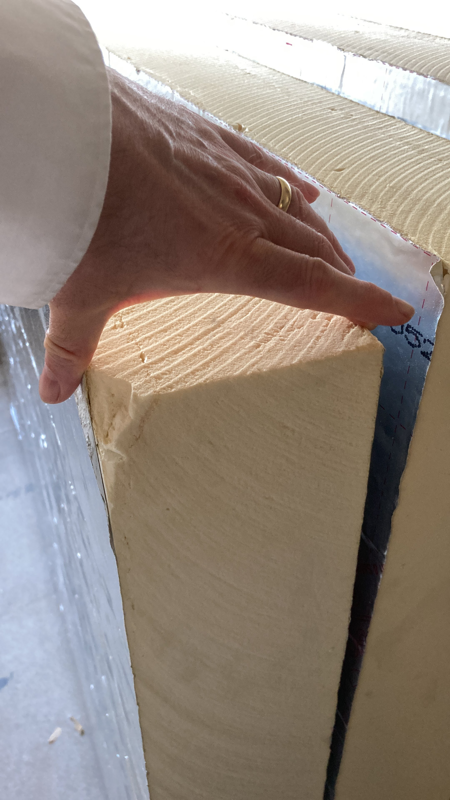
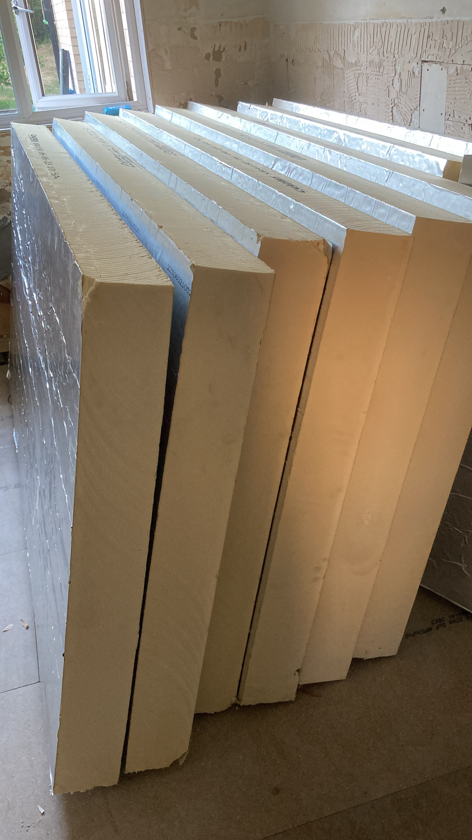

Slide 11
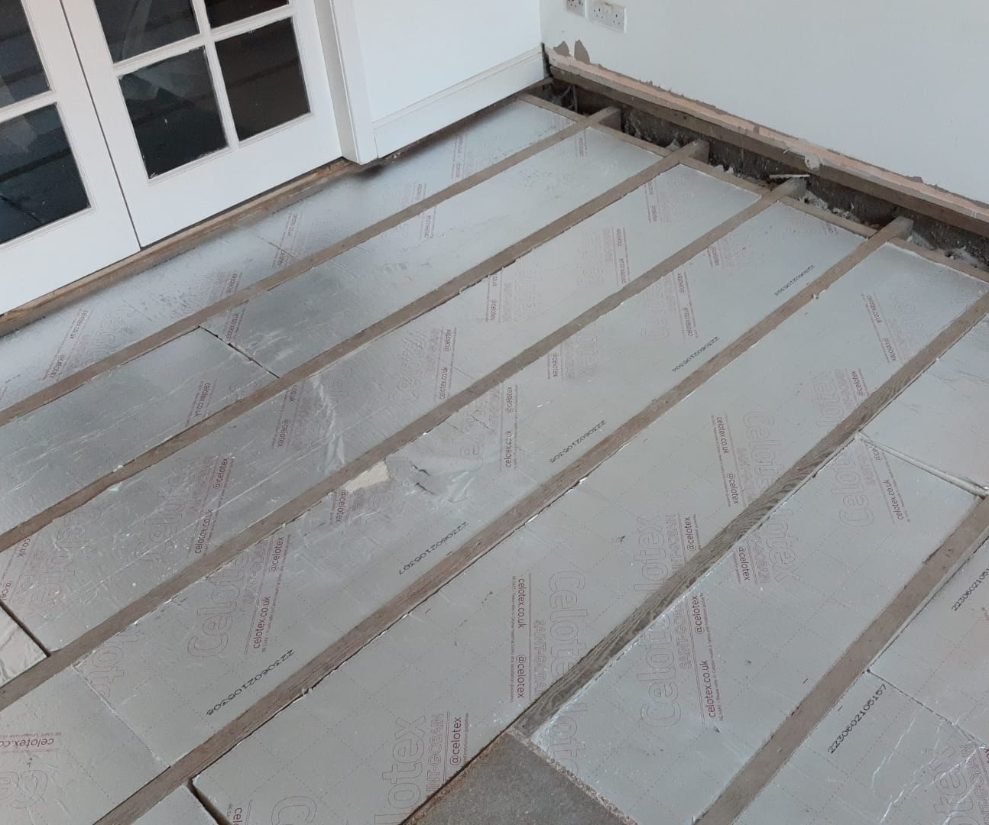
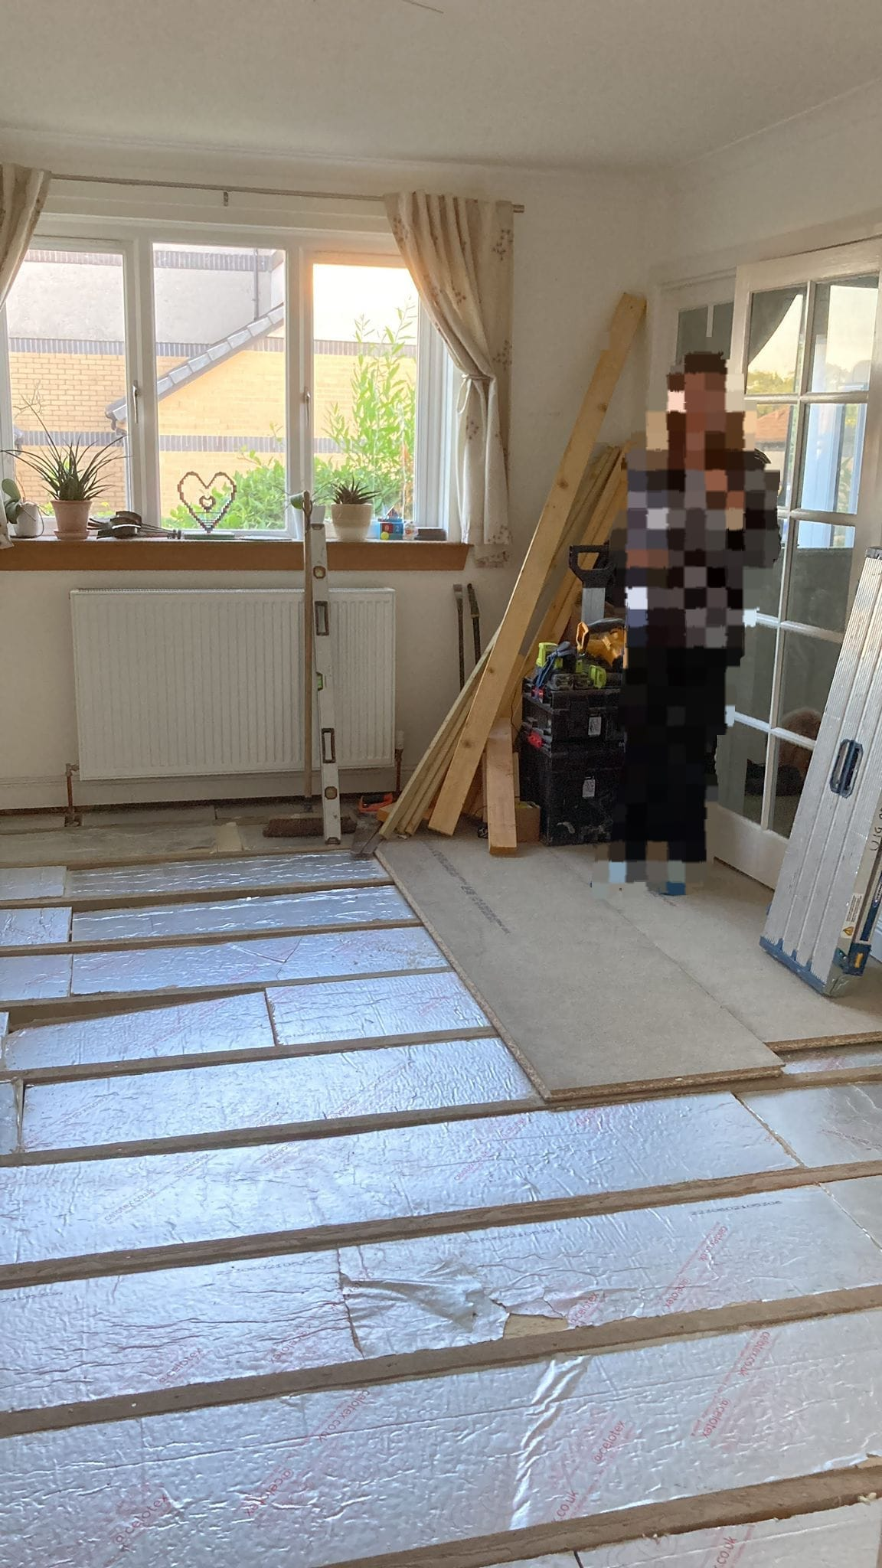

Slide 13
Year | Gas (kWh) | Electricity (kWh) | Total (kWh)
2021-22 | 16100 | 3900 | 20000
2022-23 | 12400 | 3100 | 15500
2023-24 | 0 | 6400 | 6400
Year | Consumed Energy (kWh) | Delivered Energy (kWh) | COP
2023 | 1718 | 5354 | 3.1
2024 | 3661 | 12261 | 3.3
Dec | 108 | 370 | 3.4
Oct | 287 | 1127 | 3.9
14,000 kWh gas = 490 Therms of natural gas
2600 kg CO₂
additional electricity generates 500 kg CO₂¹
2100 kg CO2 saving
Saving equivalent to
  5,400 miles of car driving²
  1.4 people going vegan³
  35 tree saplings growing for 10 years²
https://www.carbonbrief.org/analysis-uk-electricity-from-fossil-fuels-drops-to-lowest-level-since-1957
https://www.epa.gov/energy/greenhouse-gas-equivalencies-calculator
https://www.ucl.ac.uk/news/2022/aug/opinion-which-diet-will-help-save-our-planet-climatarian-flexitarian-vegetarian-or-vegan

Slide 14
Thank you

Slide 15
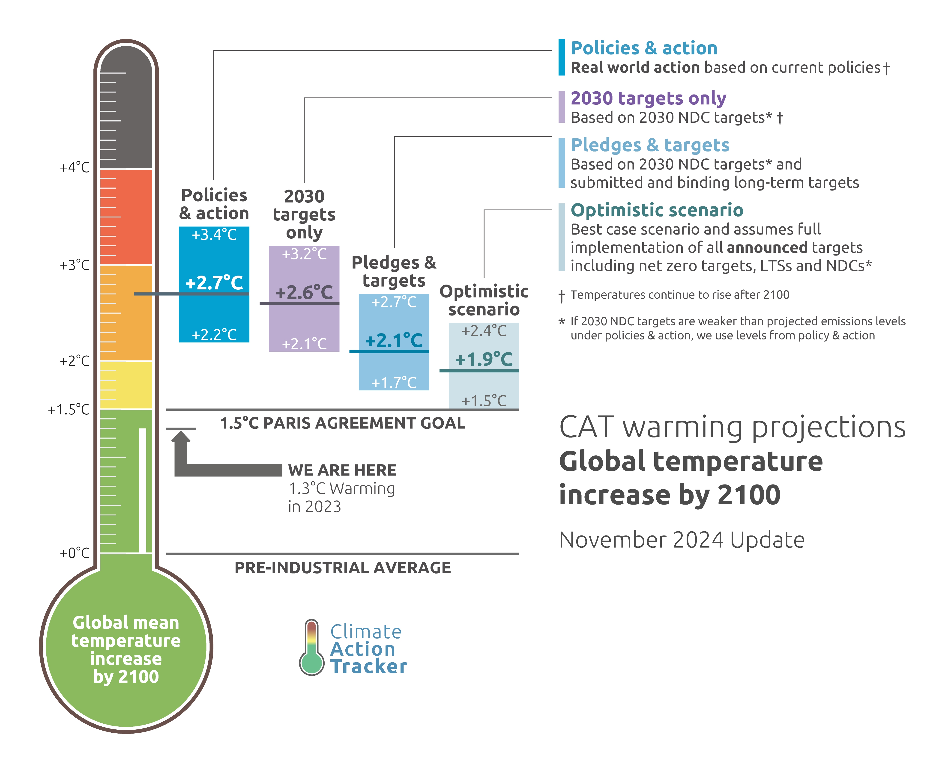
https://climateactiontracker.org/global/cat-thermometer/

