Slide 1
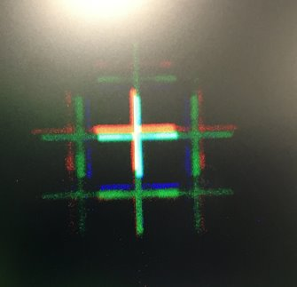
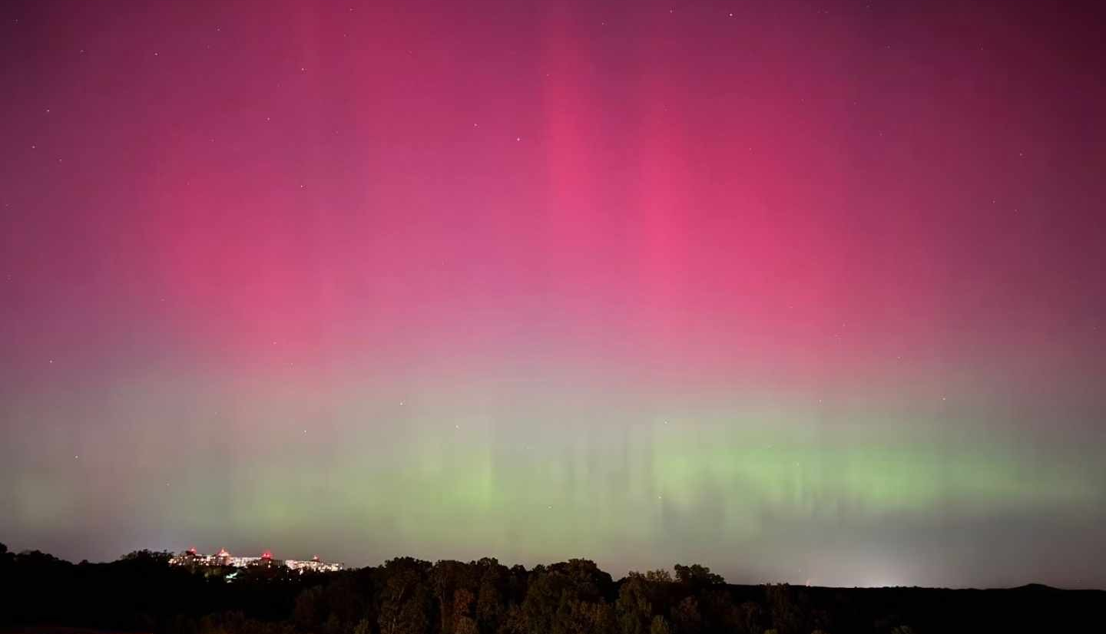
Flip Chip Iridescence & Northen Light
Ruirui Han
10th Oct. 2024

Slide 2
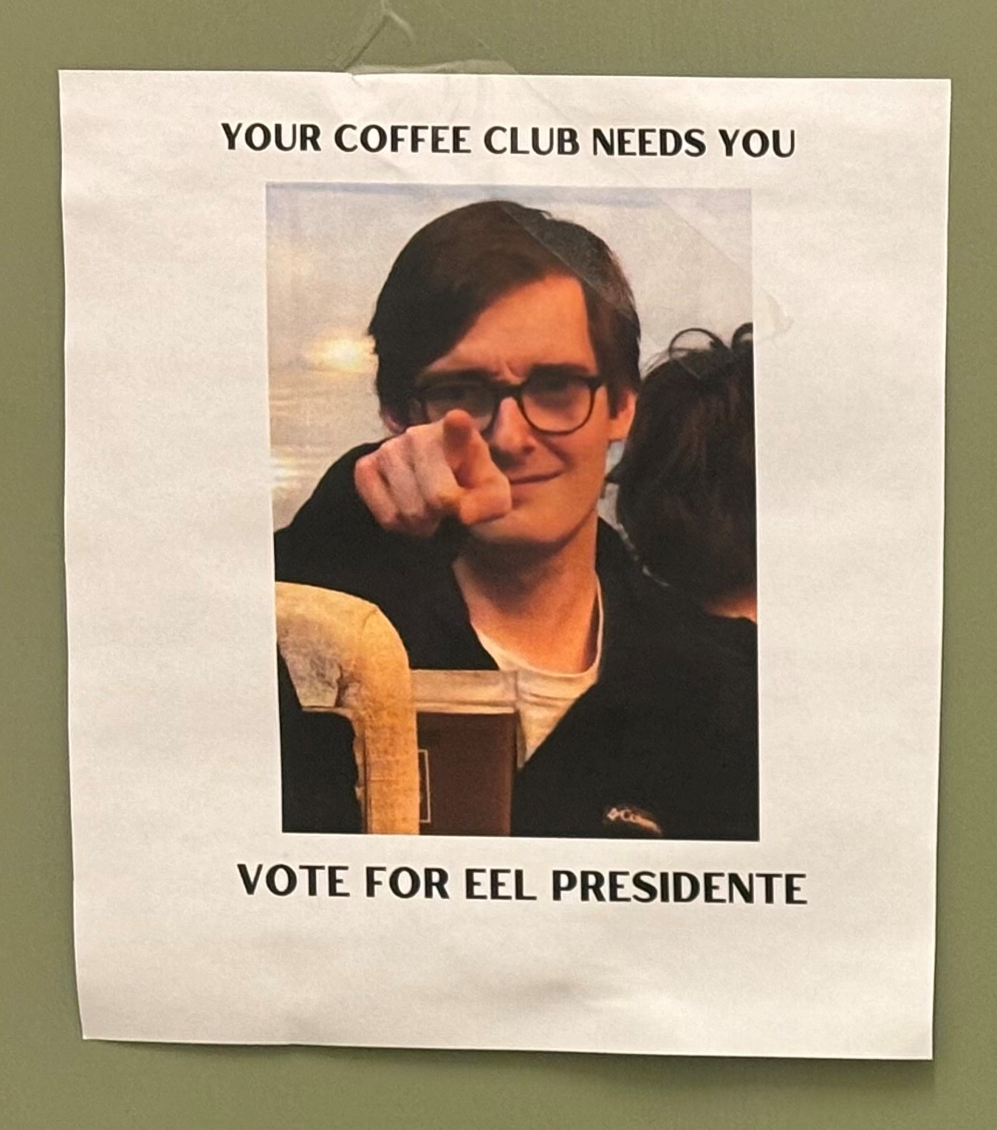
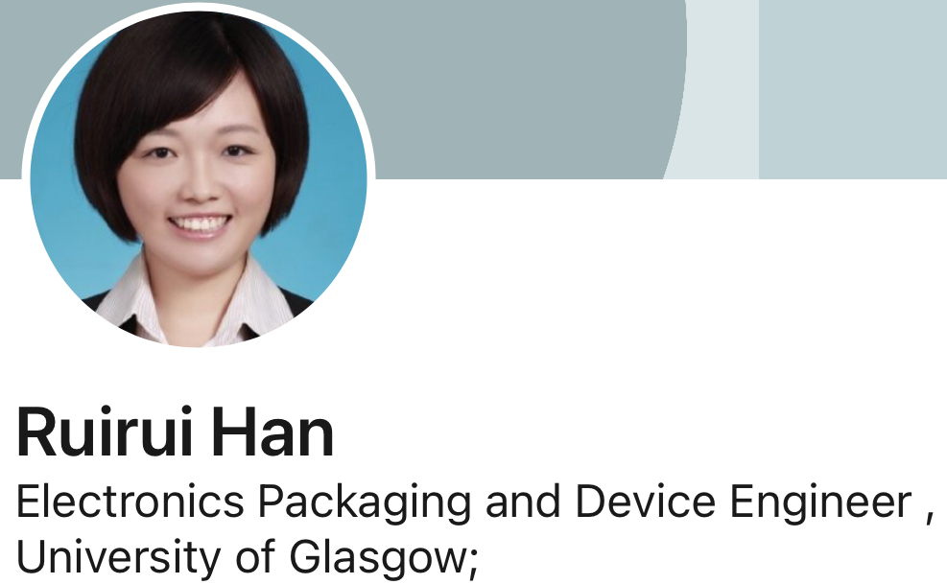
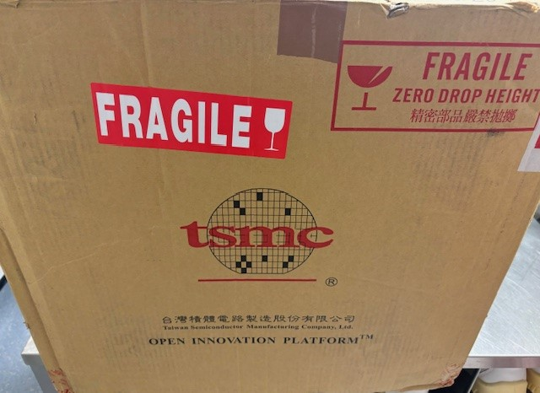
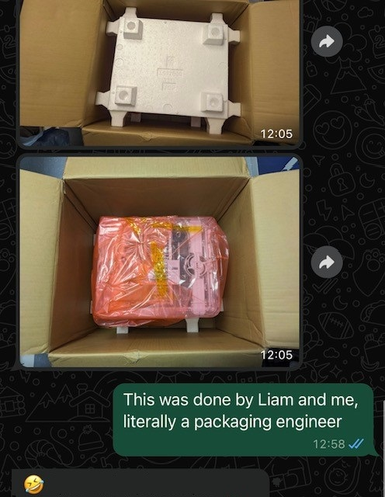
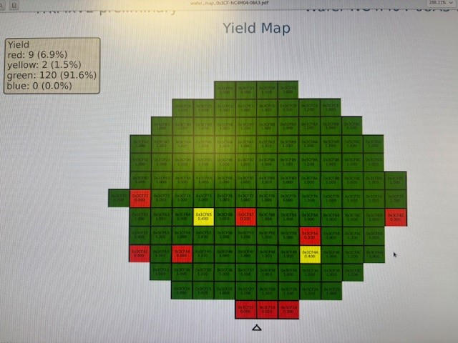
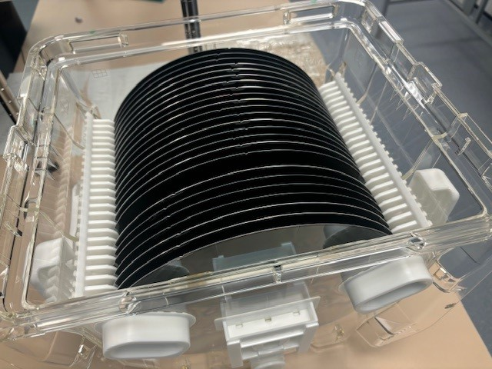
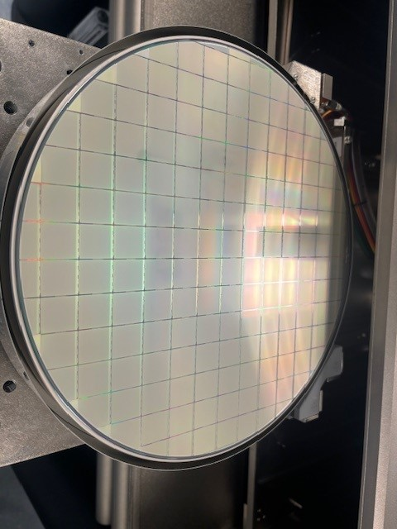
Ruirui pronounced as ‘ Ray-ray’,
sounds like ‘Rory’( BOSS of the coffice)
I don’t drink coffee…
Who am I
“Joe Biden googles himself because he forgets…”
I also google myself because I can’t remember what kind of engineer I am
If an engineer does not drink coffee,
what does she do in the department?
(ATLAS Pixels , LGAD…)
Flip chip process R&D
Sensor characterization
Module radiation testing
Optical and X-ray Metrology
Chip /Wafer probing (so proud)
……
Package wafer foups for shipping
(enhance my profile as a “packaging ”
Engineer)

Slide 3

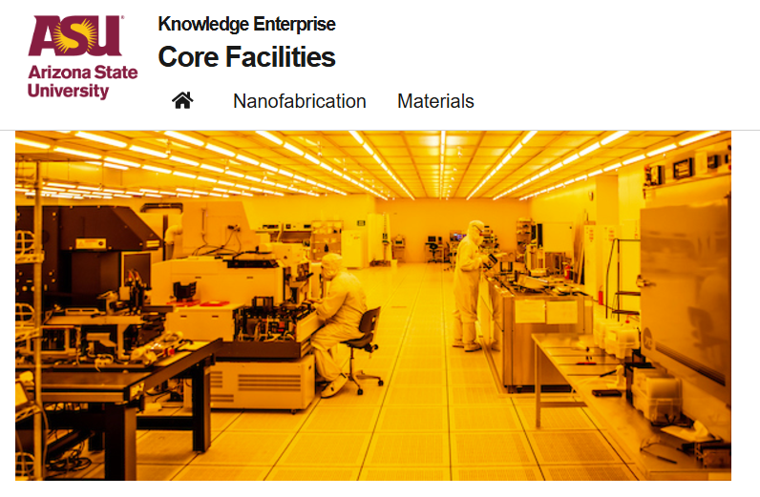
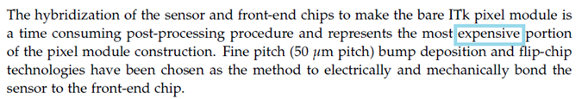
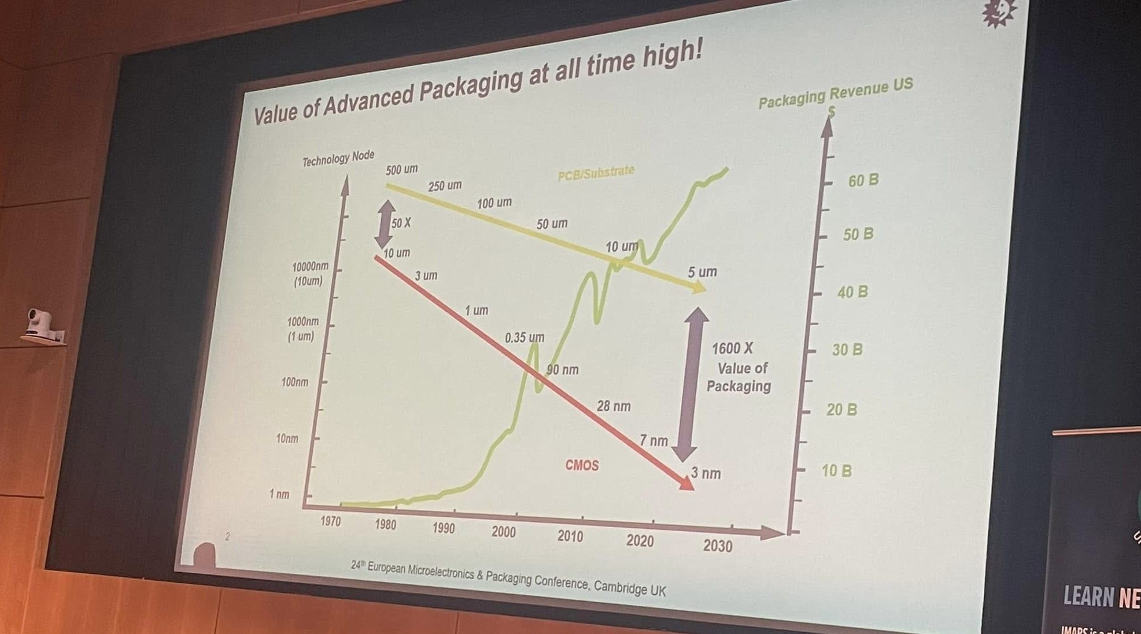
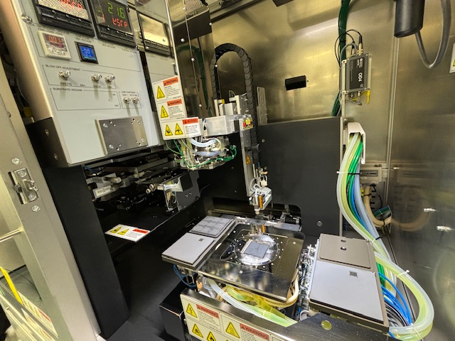
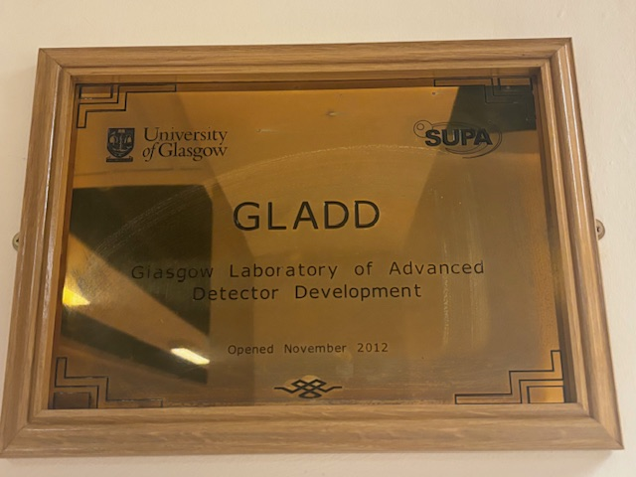
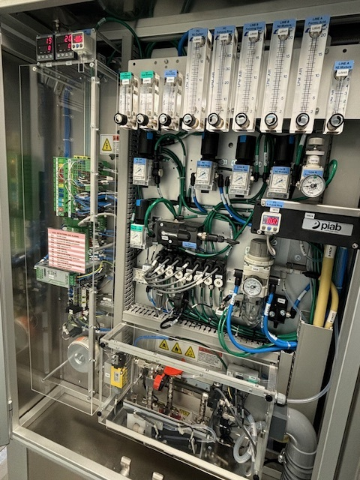
Semiconductor Packaging
Cited from ATLAS Inner Tracker Pixel Detector Technical Design Report 2018
Nanofab— HF, photoresist…can’t be more nasty
Post-fab — packaging, test, assembly …lovely;
flip chip machine…amazing

Slide 4
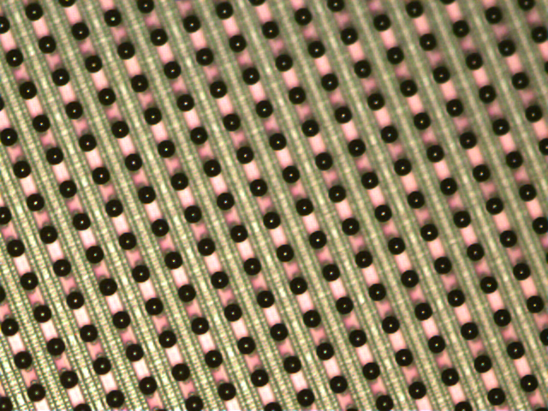
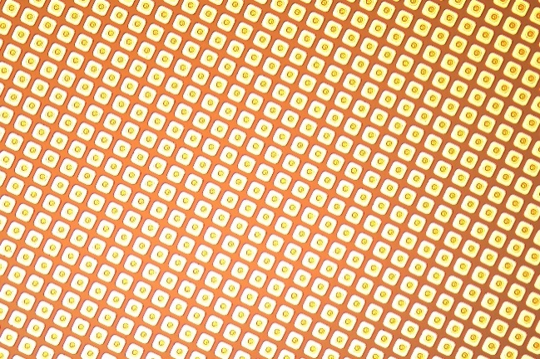
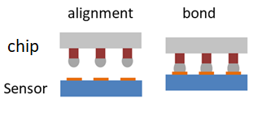
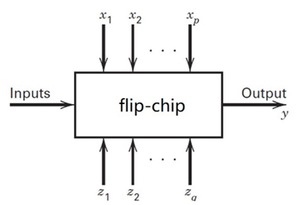
Flip Chip for ATLAS Pixels :definitely challenging
ATLAS pixel IC chip and sensor
Companies /vendors:
costly and giving variable results
Too thin
Too fine/dense
( sensor/chip thickness :150μm
(pitch: 50 μm x 50 μm; matrix of 400x192 pixels)
Controllable factors : bonding temperature, bonding pressure, alignment
temperature, choice of reaction gas , gas phases/duration...
which factors are most influential?
how to set X1,X2…Xp to get the desired results and with smallest variability?
how to set the controllable factors so that the effects of the uncontrollable factors are minimized?
DOE (a statistic method to do experiment ): super high volume of experiment beyond a research lab capacity
Uncontrollable factors: thickness/size of the chips/sensor, bumps material/structure, cleanroom classification...
Best guess…

Slide 5
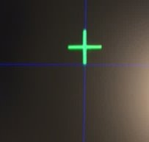
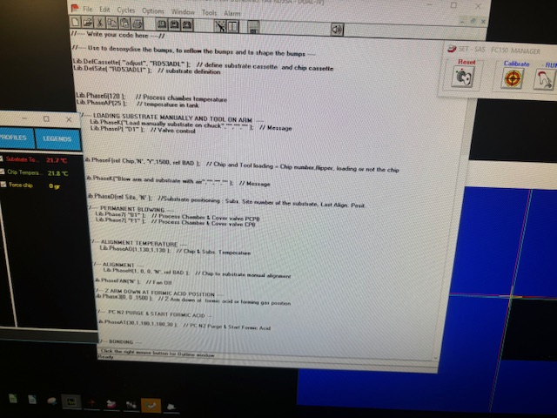
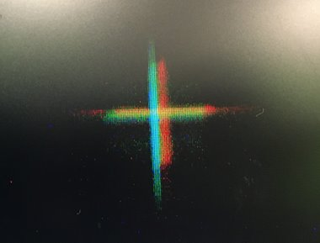
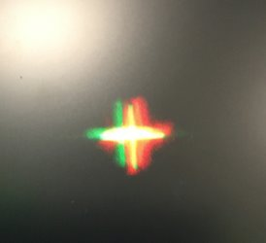
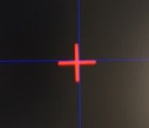
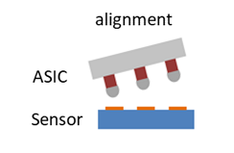

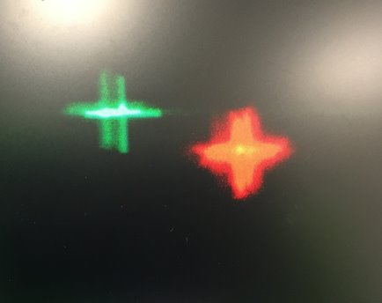
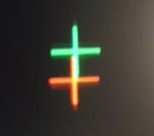
Flip Chip ‘s Iridescence: autocollimation
Parallelism adjusted manually:
hunting nice cross light

Slide 6
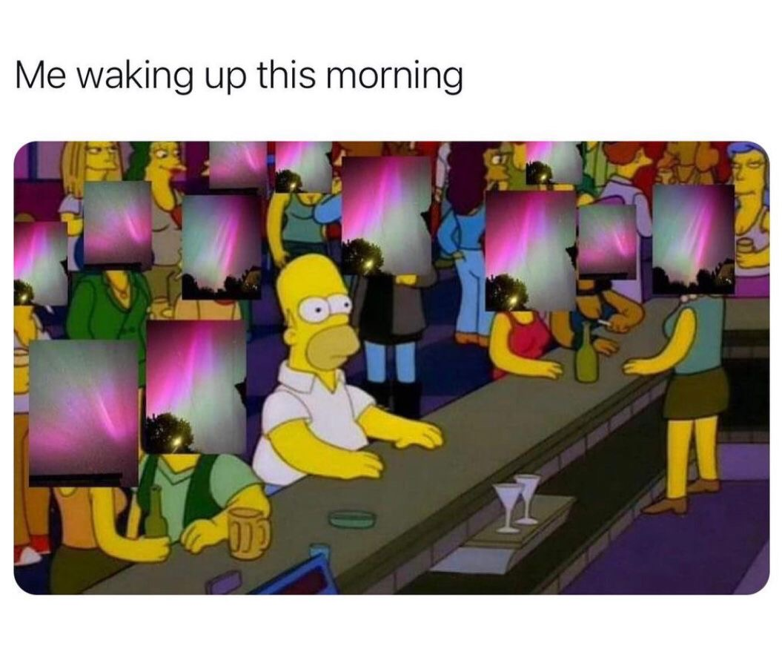
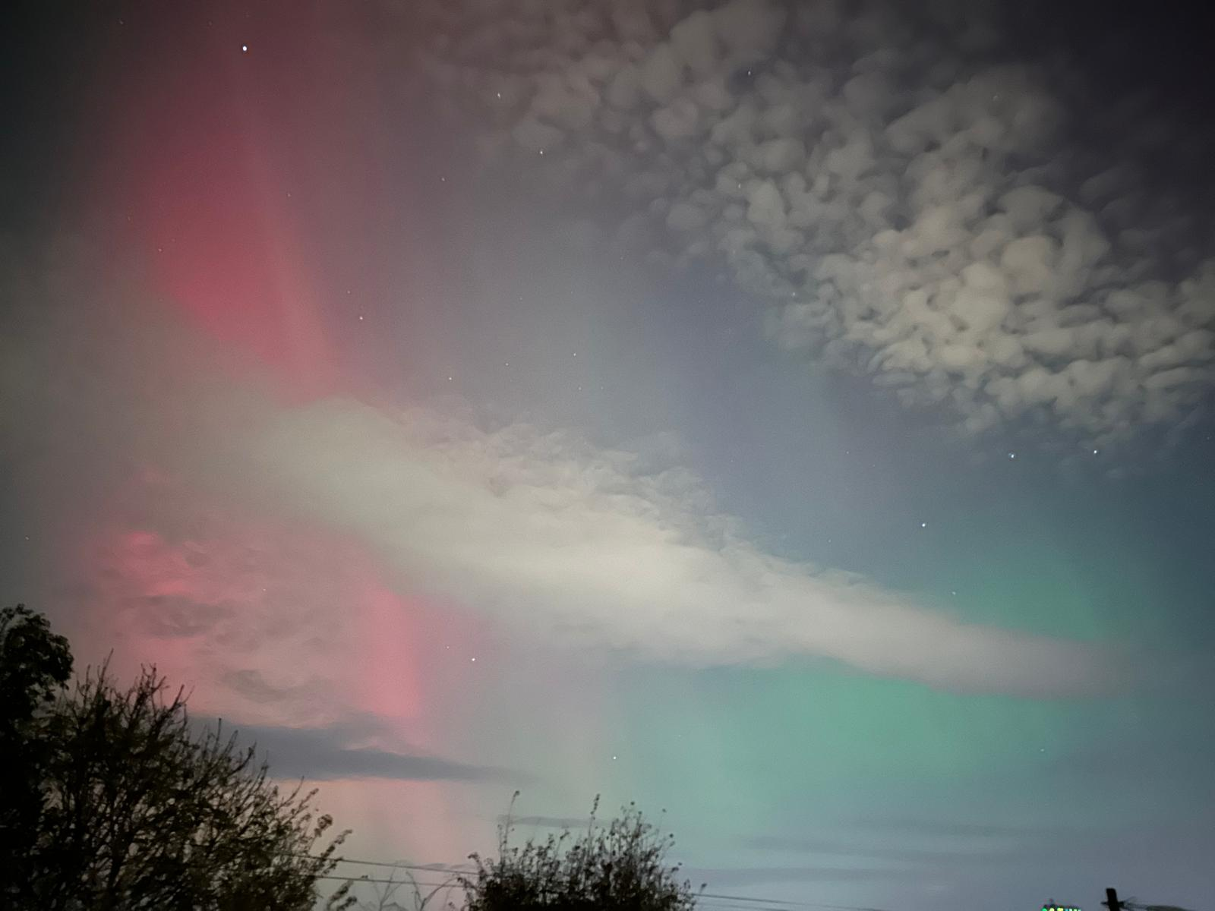
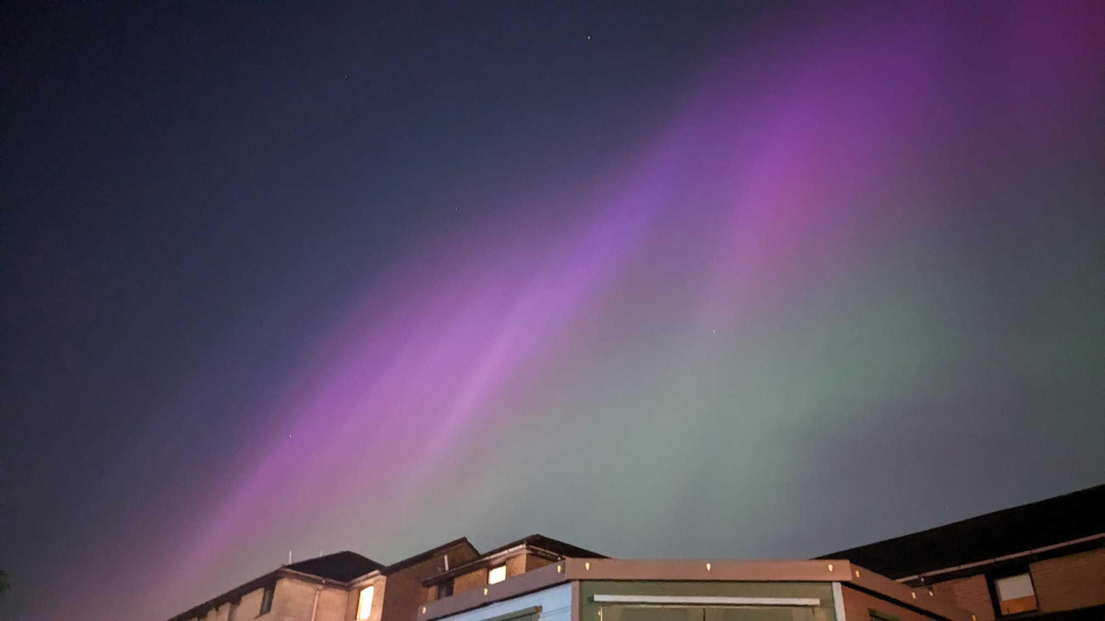
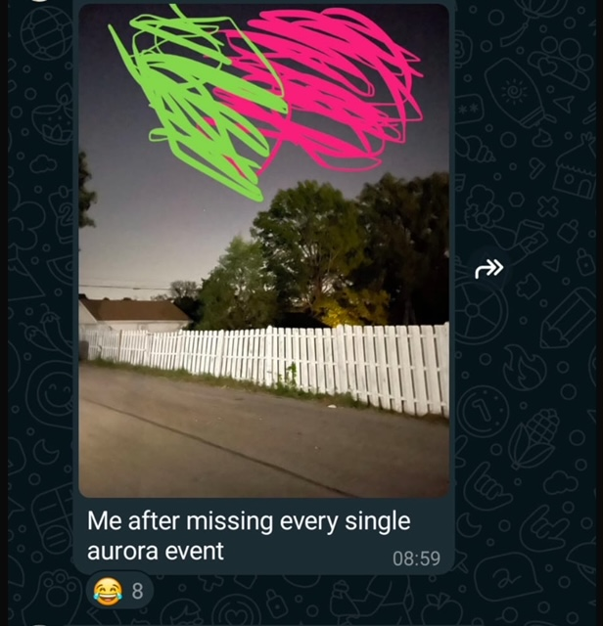
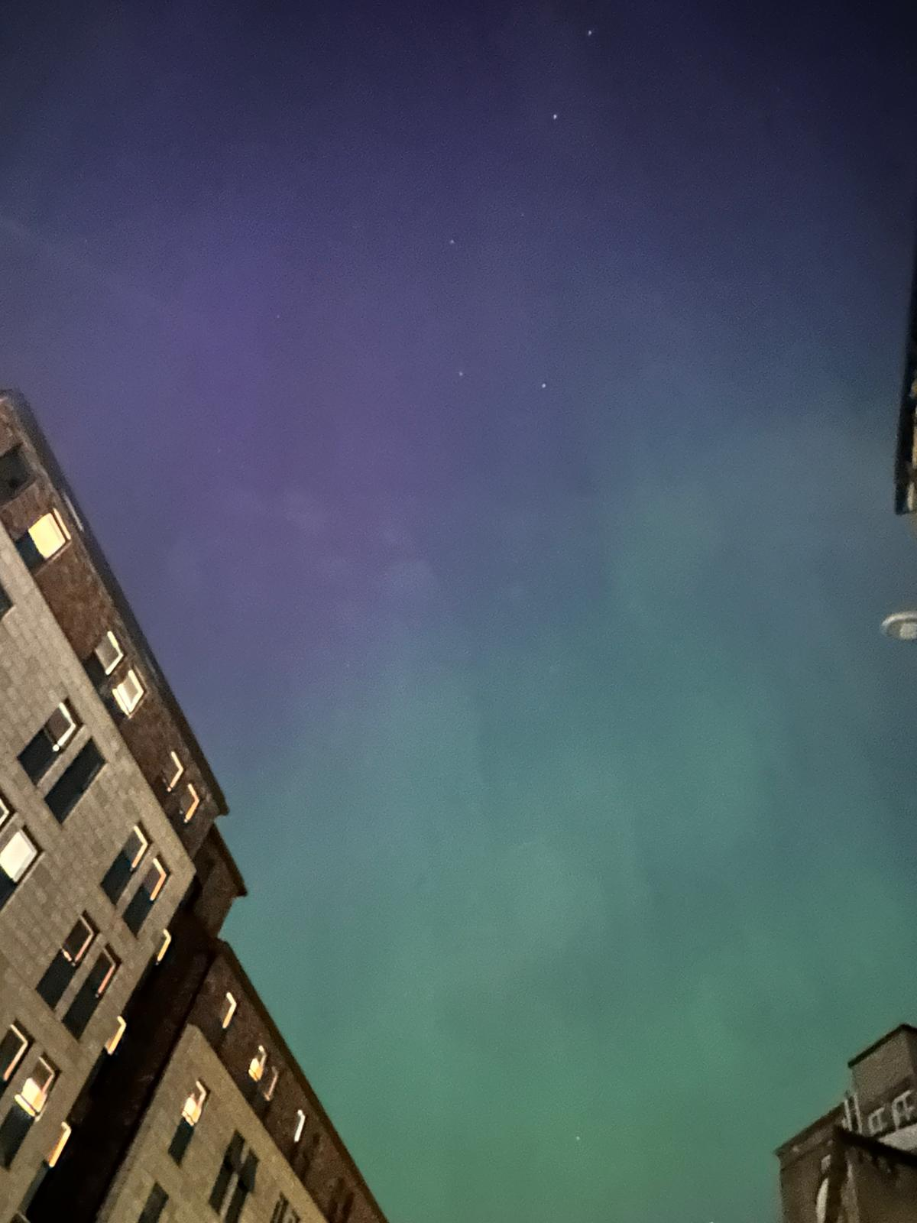
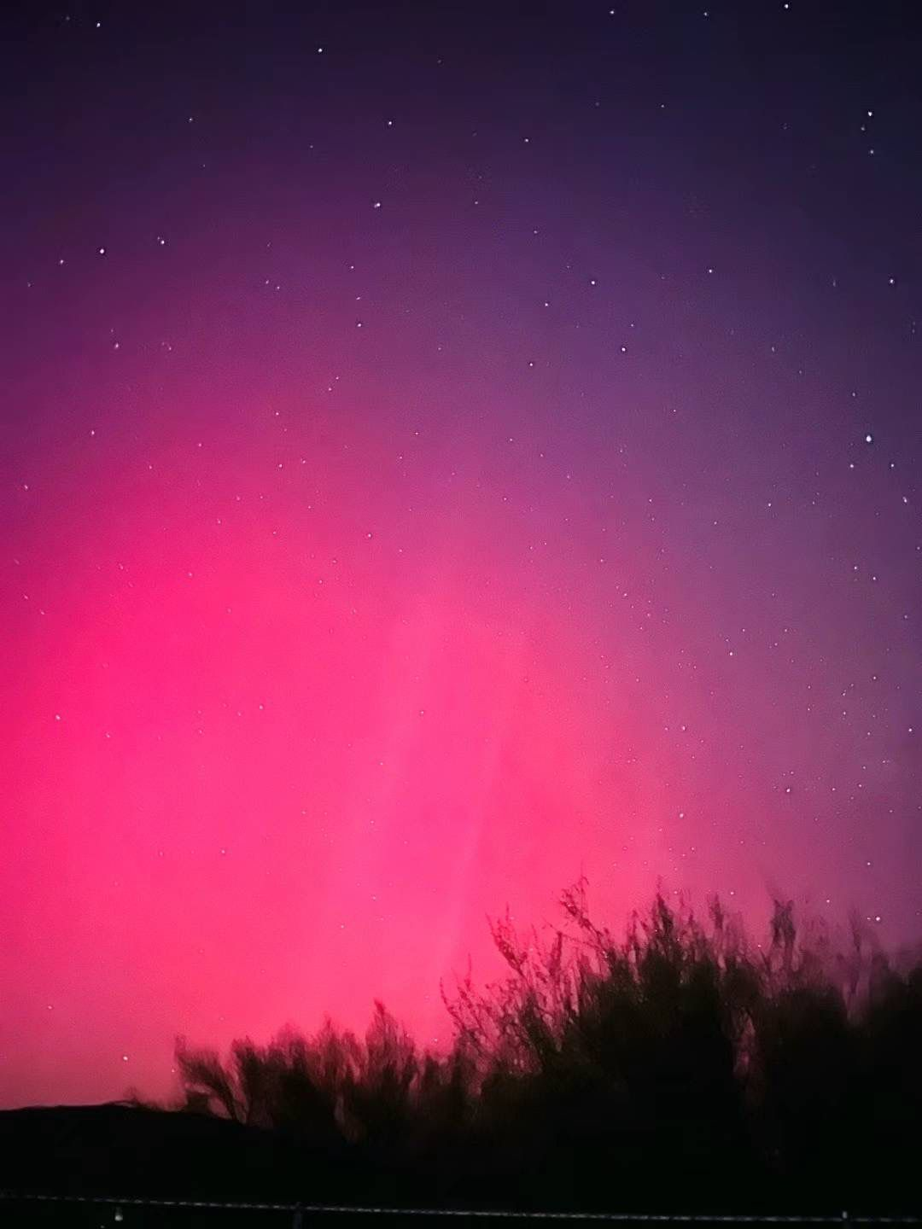
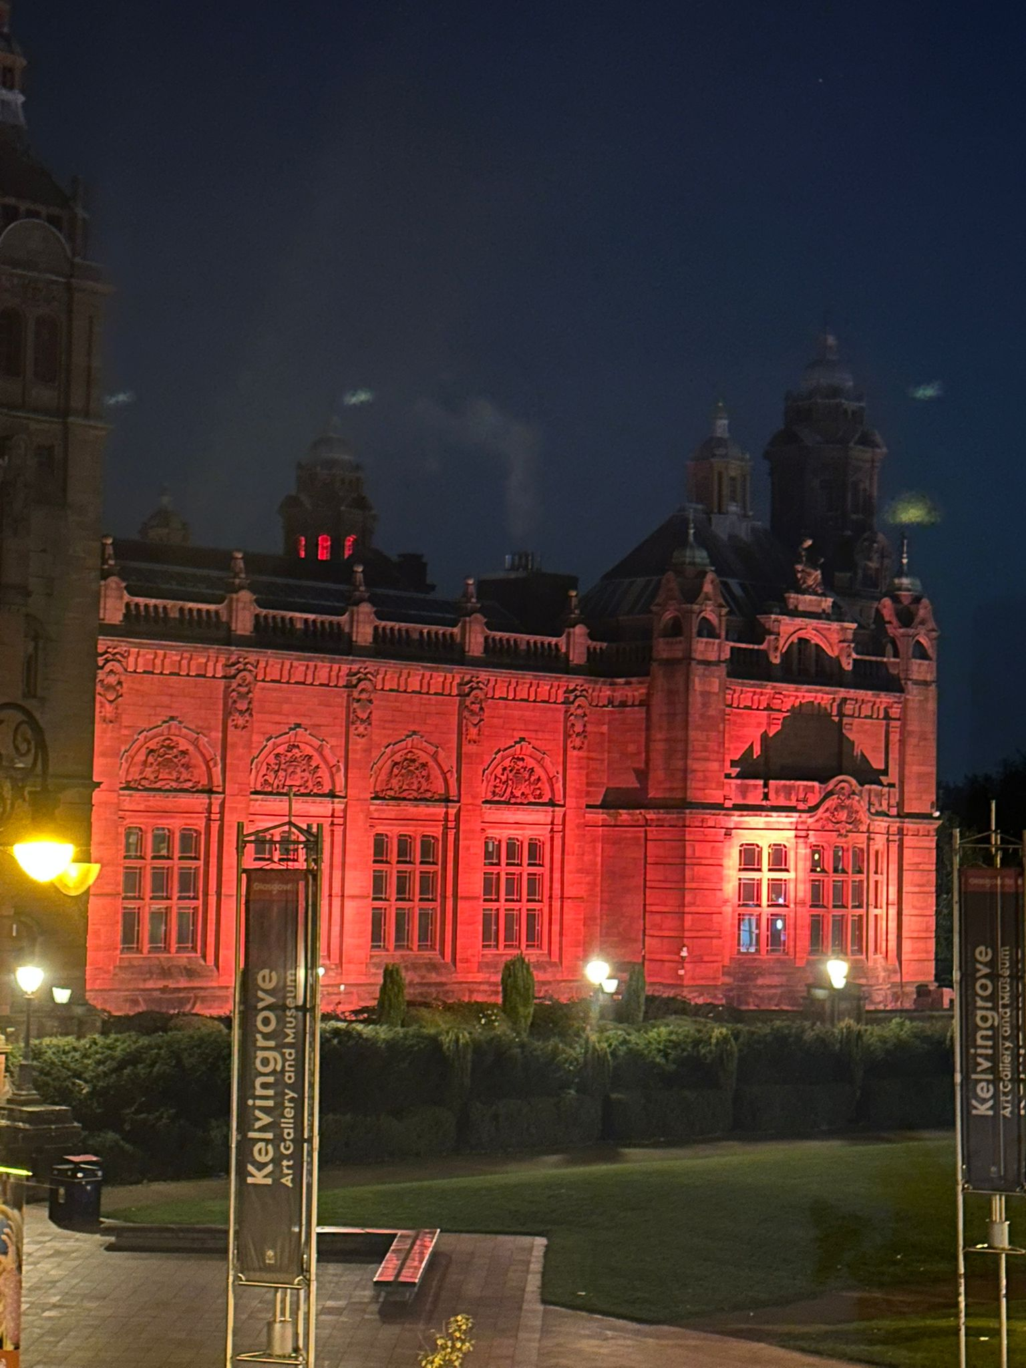
This is me
Northern Light
10~11 May,2024
Sneha’s
Kenny’s
10 ~11Oct,2024
Andy’s (Liam pointed out this is just city light)
Samy’s
In Phoenix

Slide 7
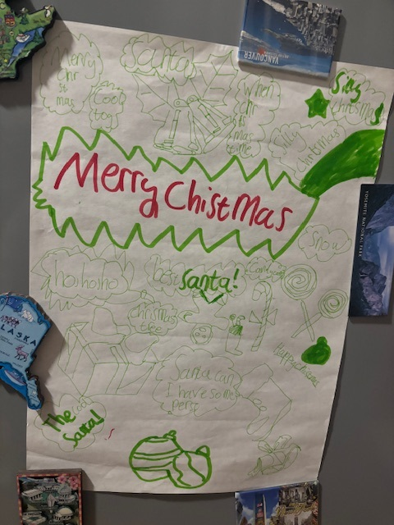
Merry Christmas
…from my 8 years old son, Aaron
mistakes
aging
bold
explore
curious
best wishes

