Slide 1
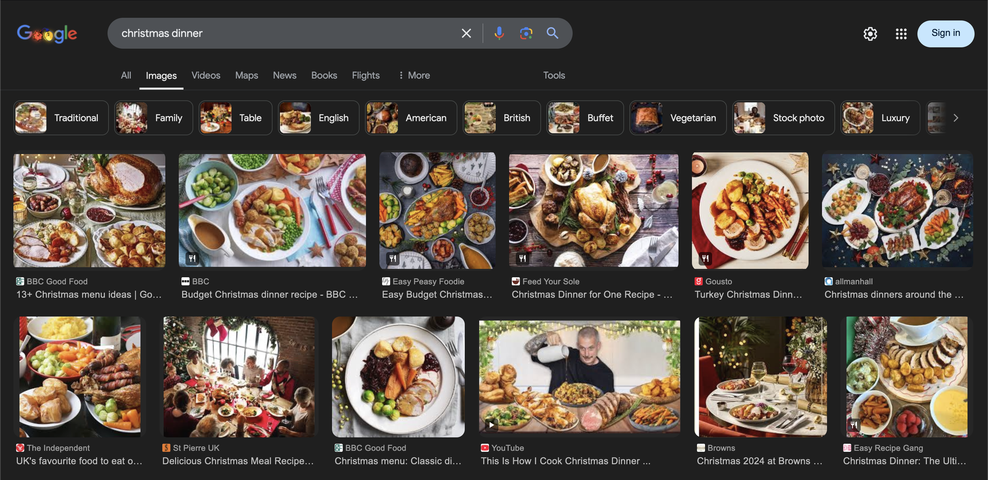
Who am I?
New LHCb & Theory PhD Student
  Working on Lepton Flavour Universality tests at LHCb (measuring the Wilson coefficients in the existing R(D⁺) analysis)
  And doing something(??) related in theory
And why am I dressed as a potato?

Slide 2
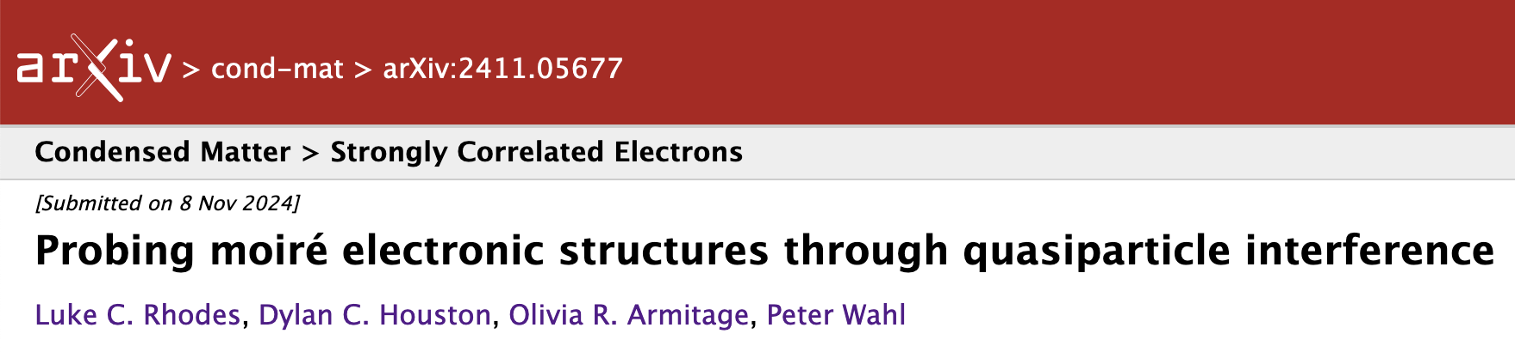
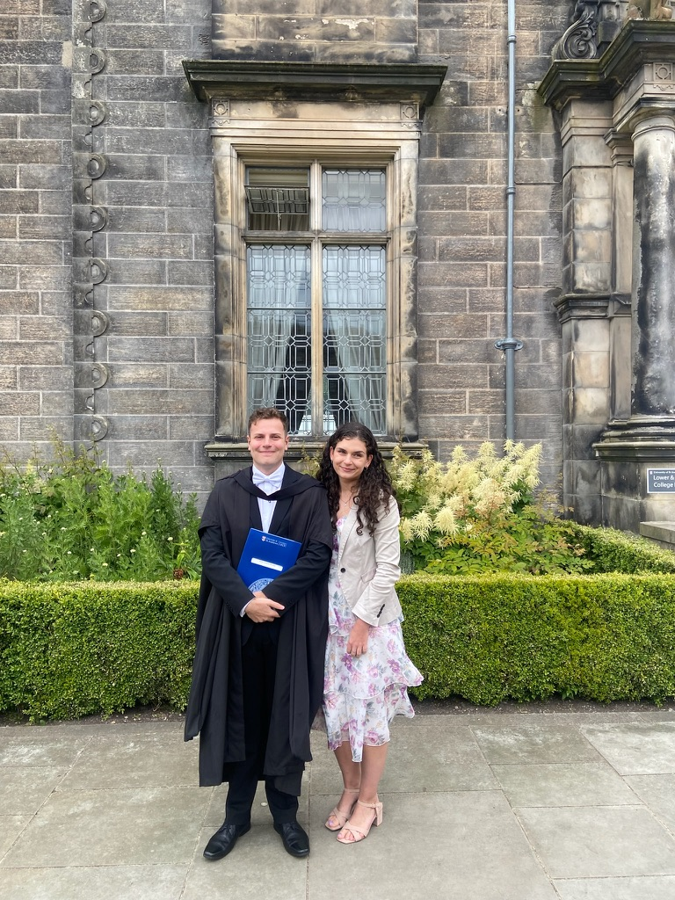
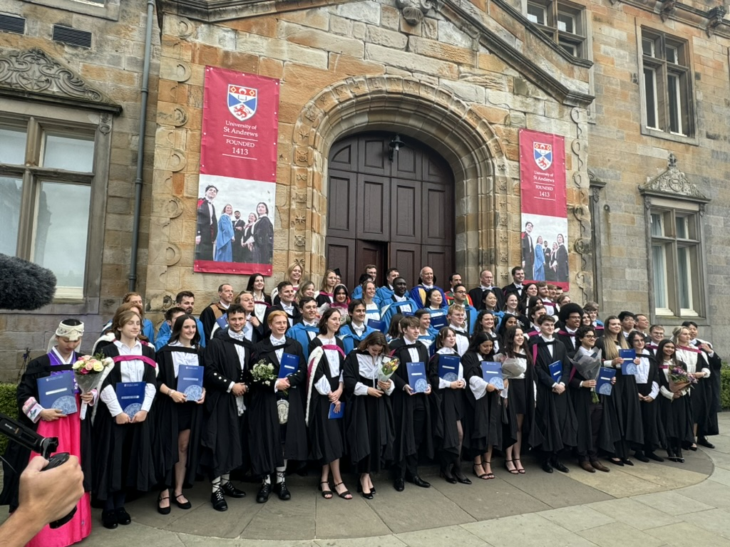
What have I done in 2024?
Finished and graduated from my degree in St Andrews

Slide 3
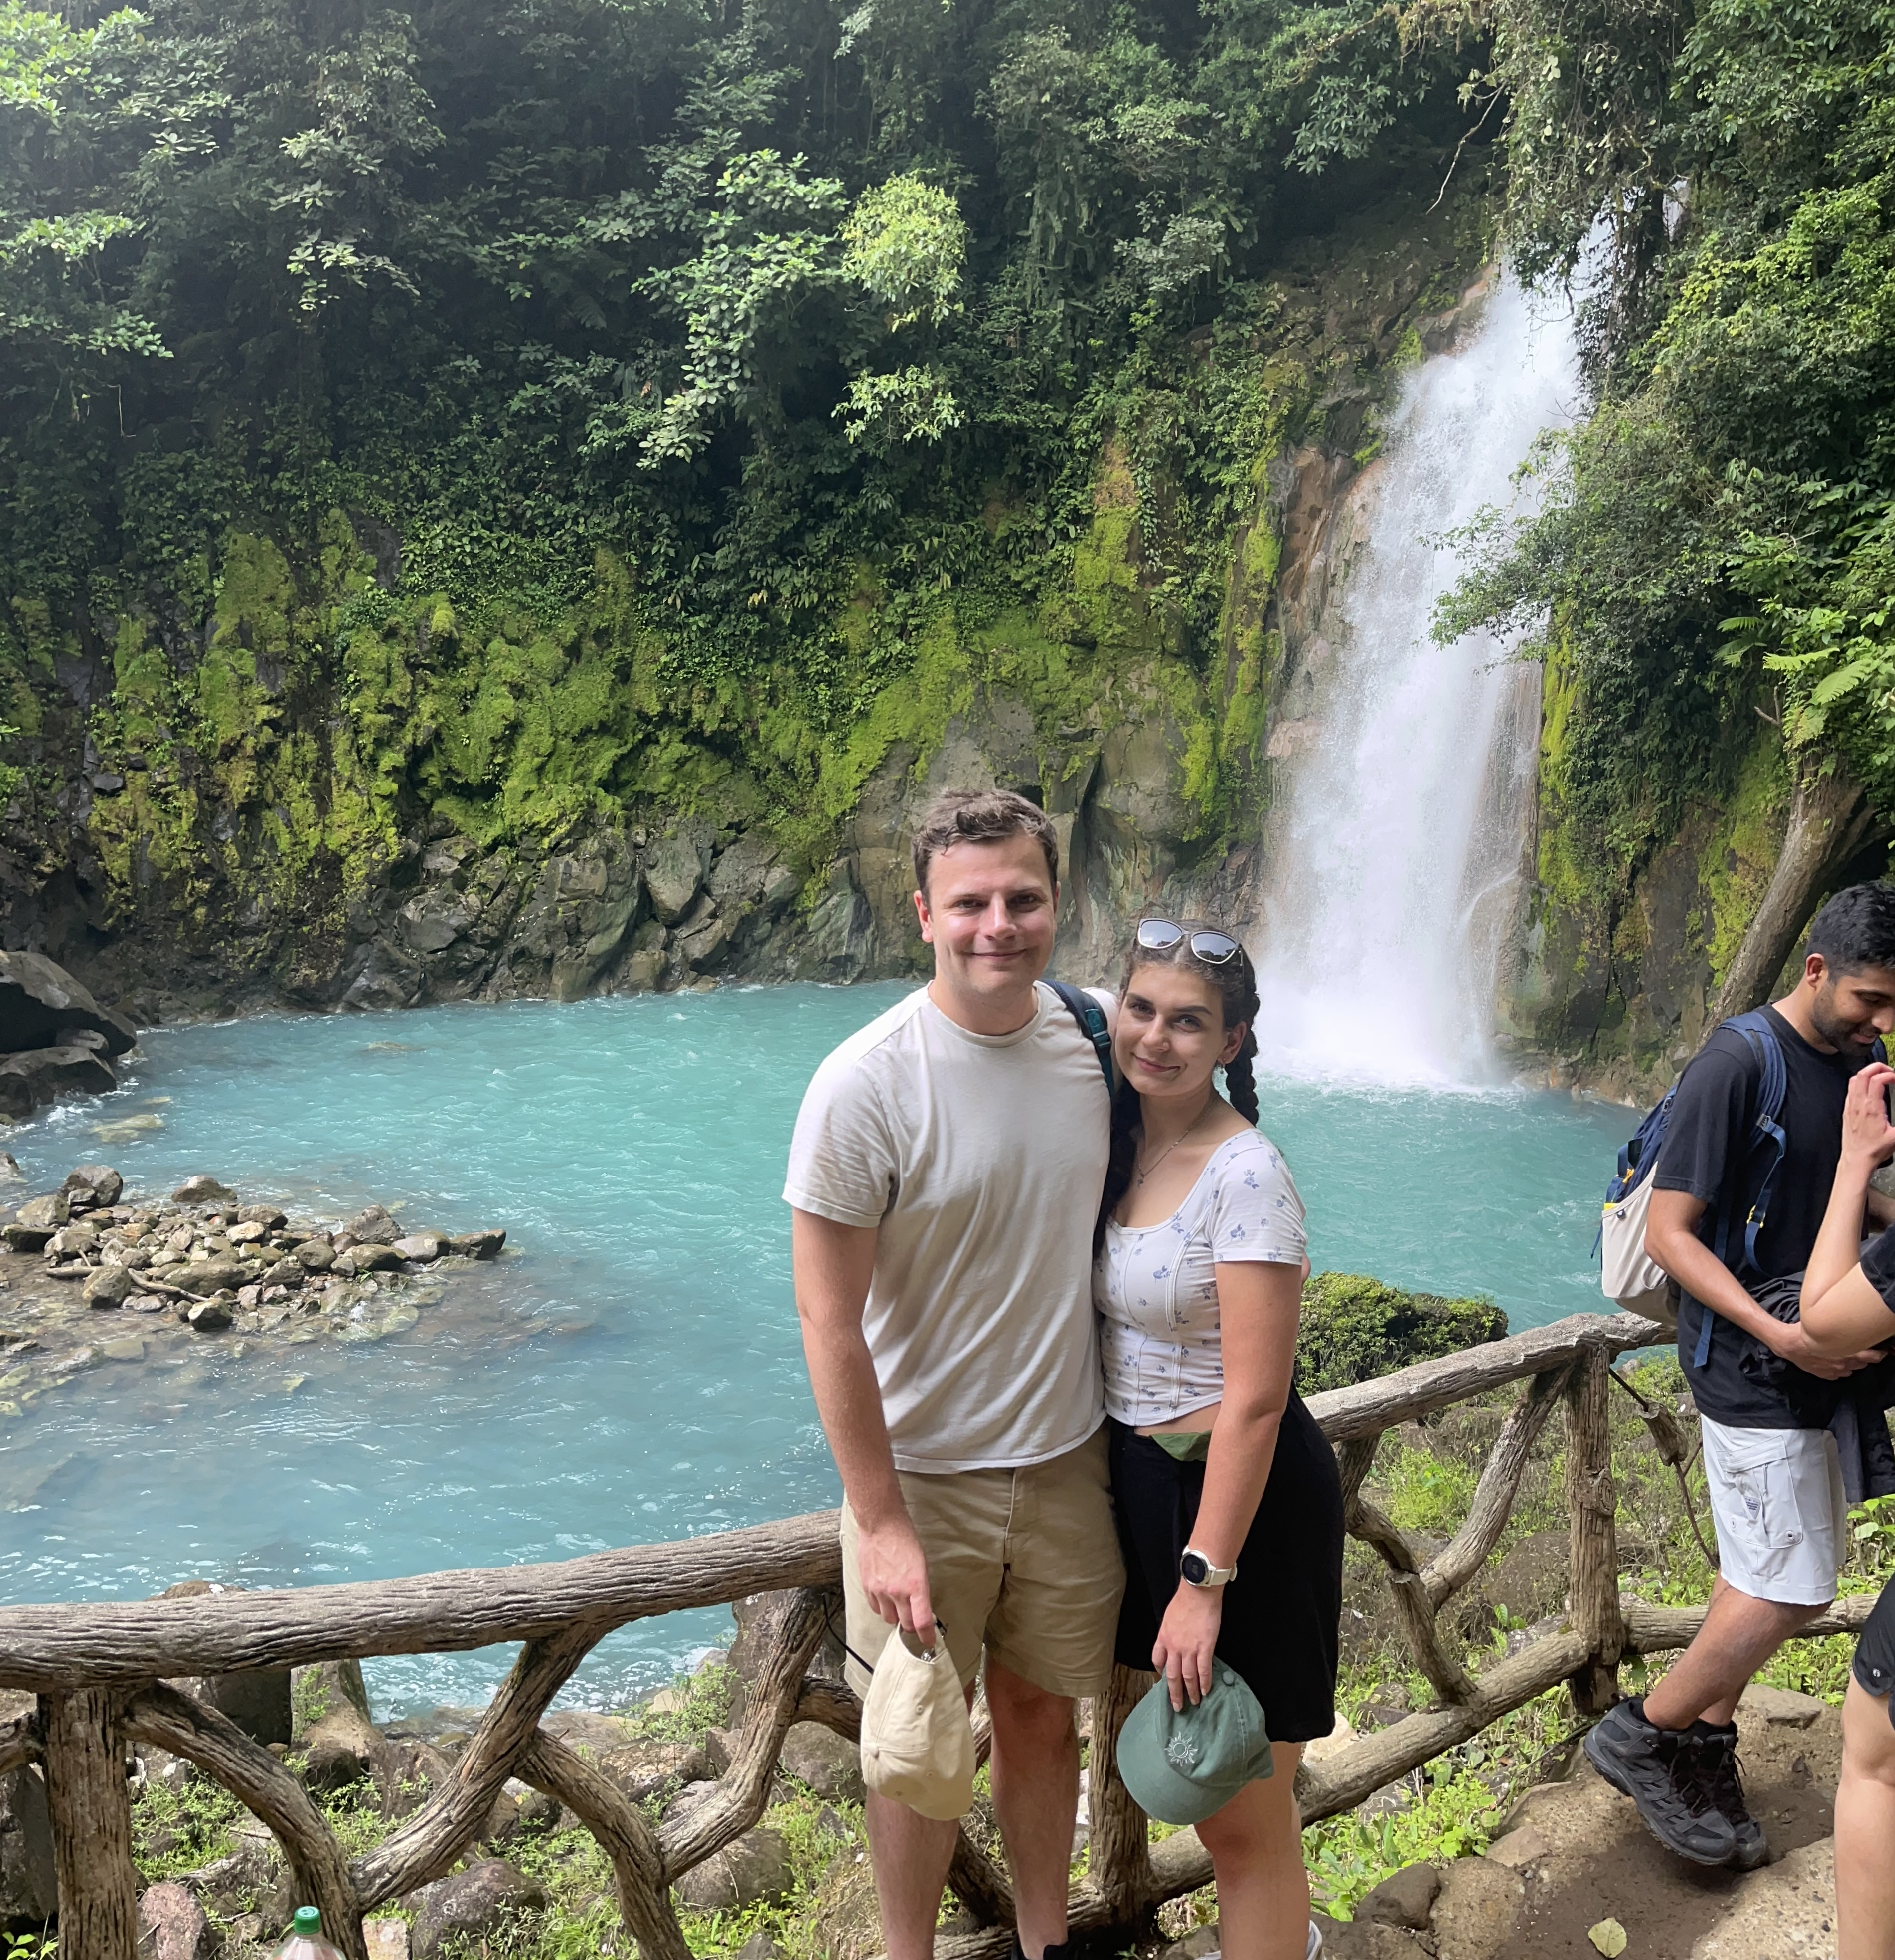
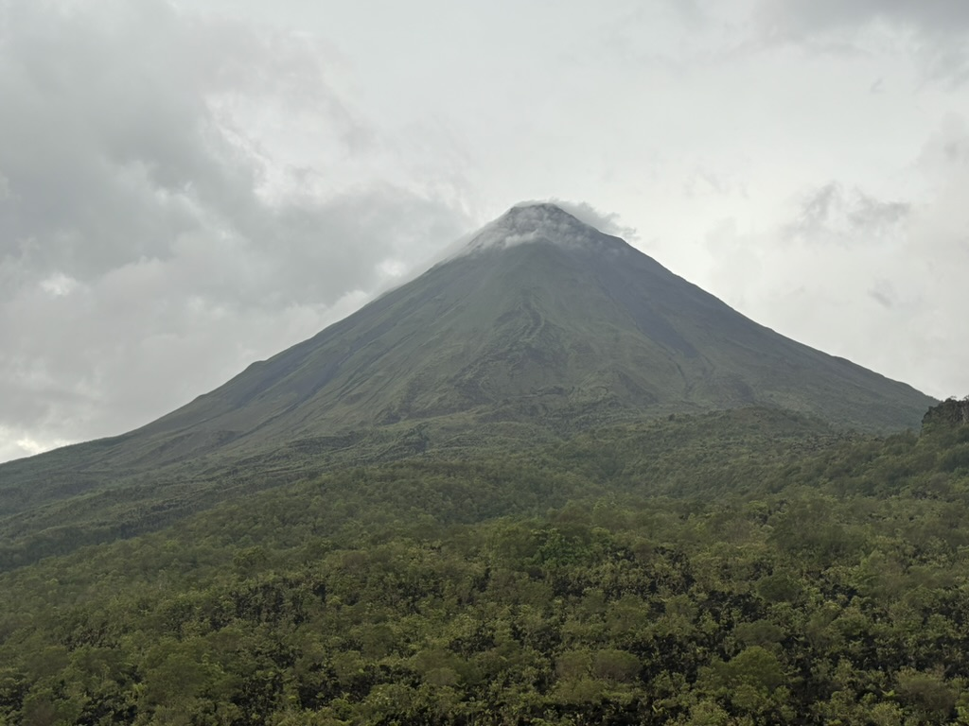
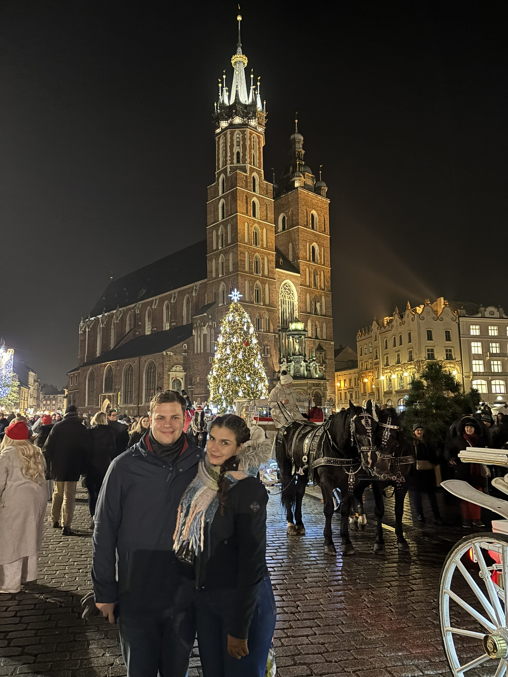
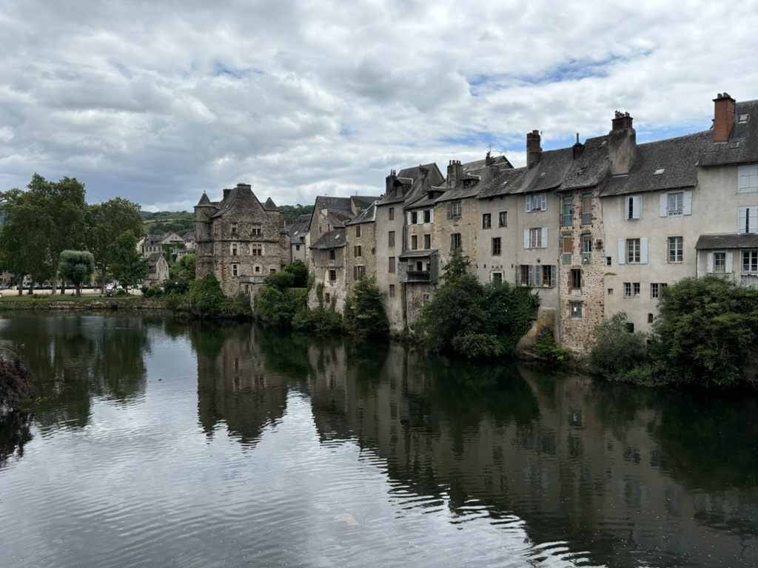
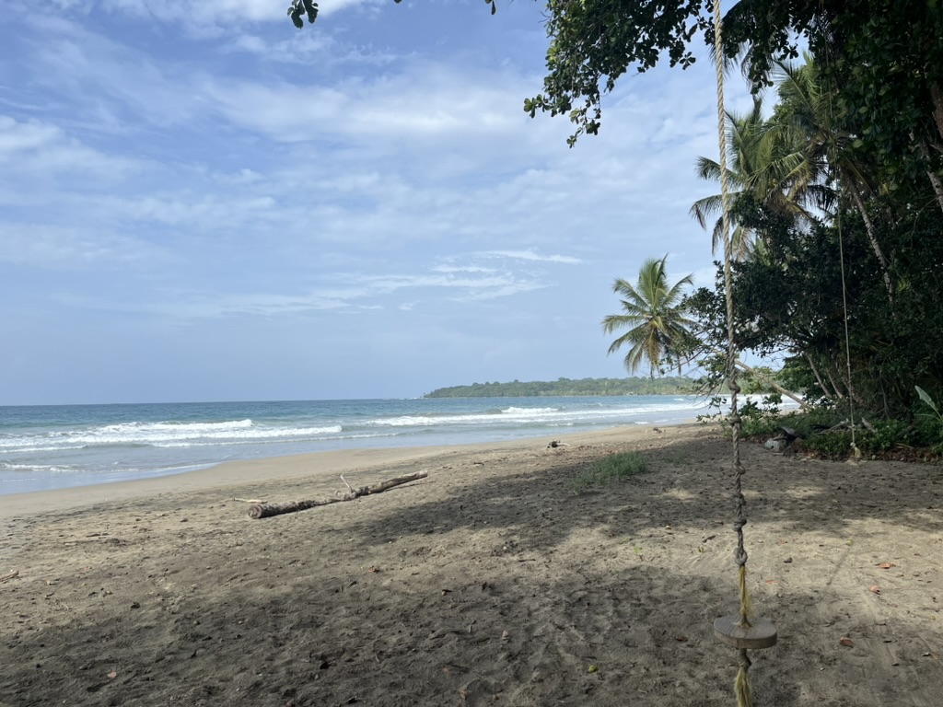
What have I done in 2024?
Visited Costa Rica (in May), South of France (in July) & Poland (yesterday)

Slide 4
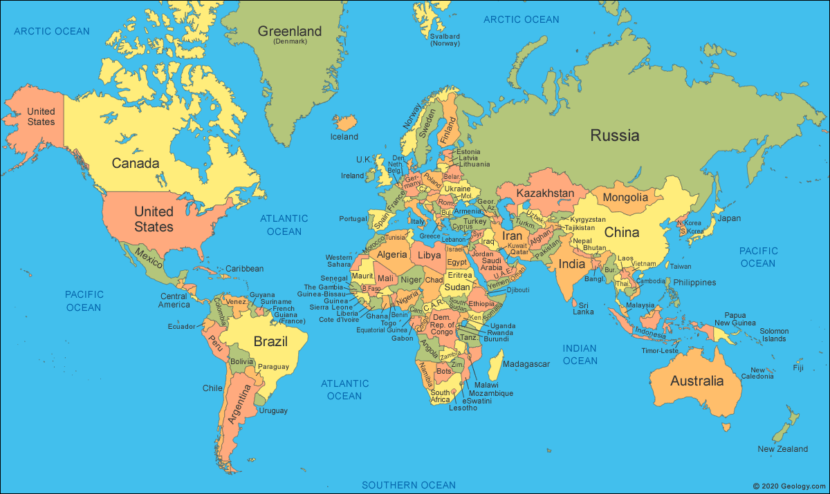
What have I done in 2024?
Been ill in (almost) all of these places
Food Poisoning
(from Christmas market pierogi)
Migraine (once)
MISC Fever (once)
Food Poisoning
(from Chicken Nuggets)

Slide 5
A pattern??
Been ill in (almost) all of these places
Food Poisoning
(from Christmas market pierogi)
Migraine
(2020)
Food Poisoning (from Sainsbury’s sausages before I left (2023))
Migraine (once)
MISC Fever (once)
Food Poisoning
(from Chicken Nuggets)

Slide 6
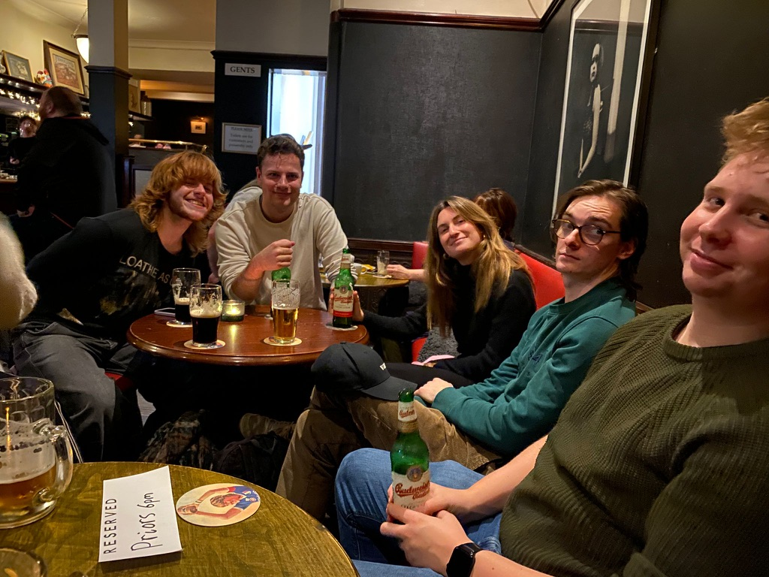
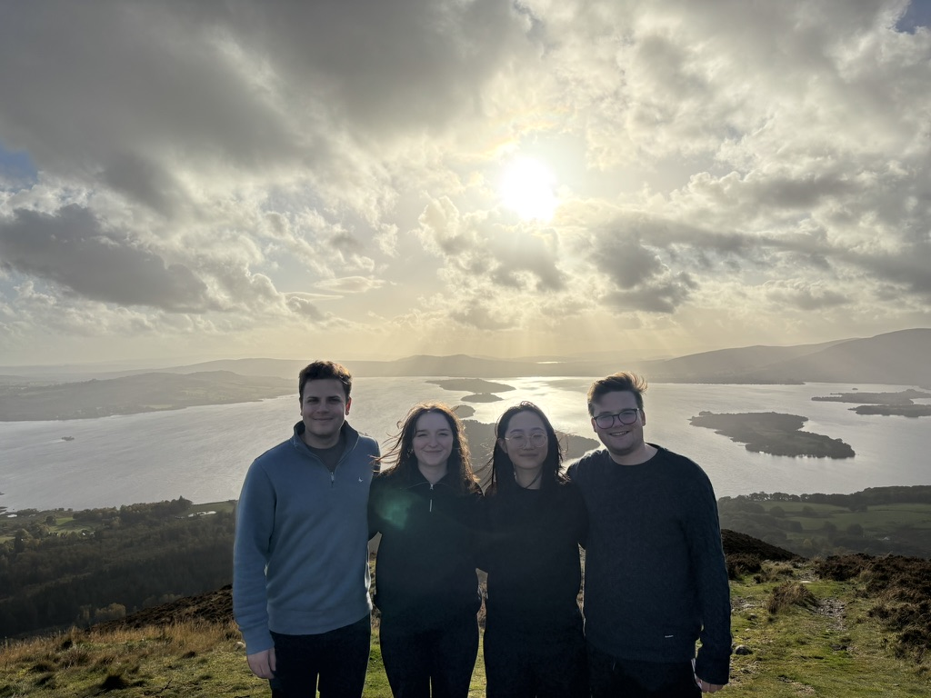
What have I done in 2024?
Moved to Glasgow!
  Living with Kat after 5 years together
  Had old friends visit
  Made some new ones

Slide 7
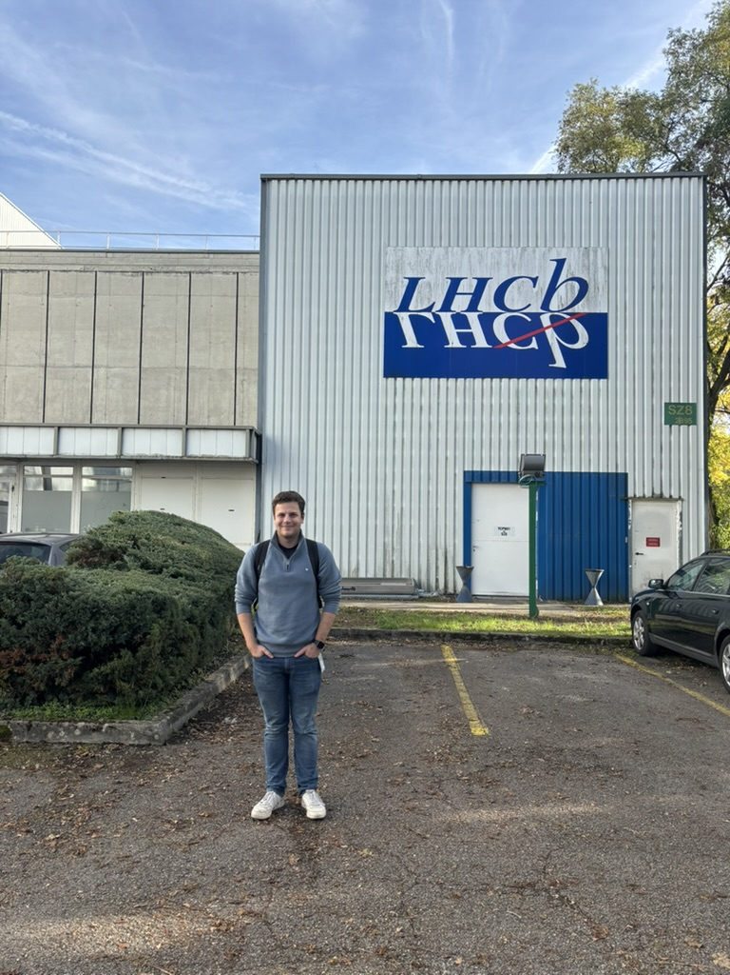
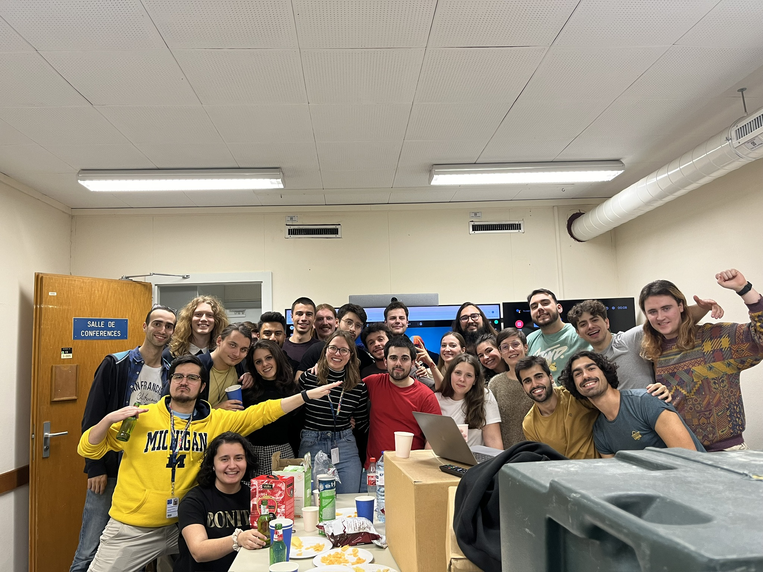
What have I done in 2024?
Been to CERN for LHCb Implications Week & LHCb StarterKit

Slide 8
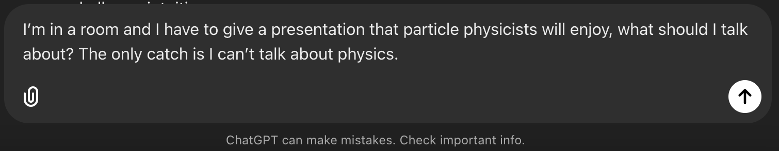




What else should I talk about?
…

Slide 9
What else should I talk about?
…

Slide 10
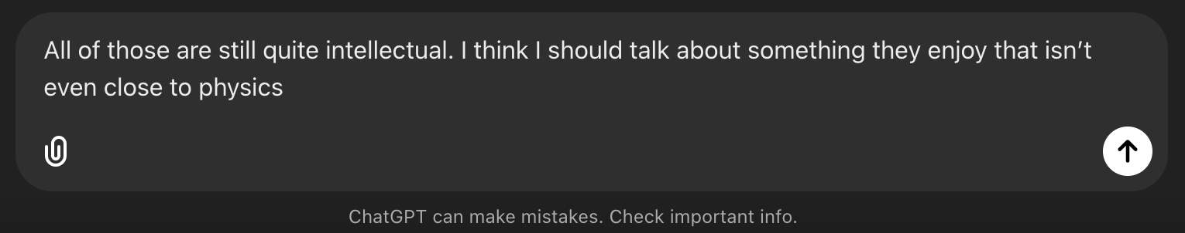





Attempt 2
…

Slide 11
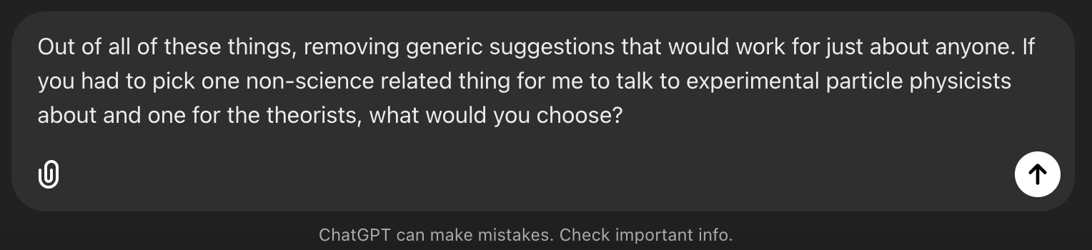
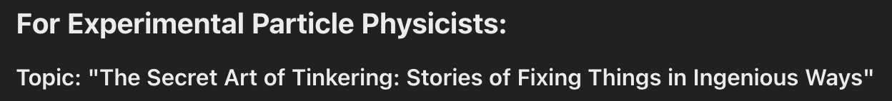
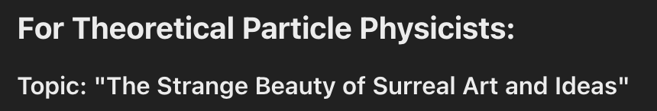
Something less generic?

Slide 12
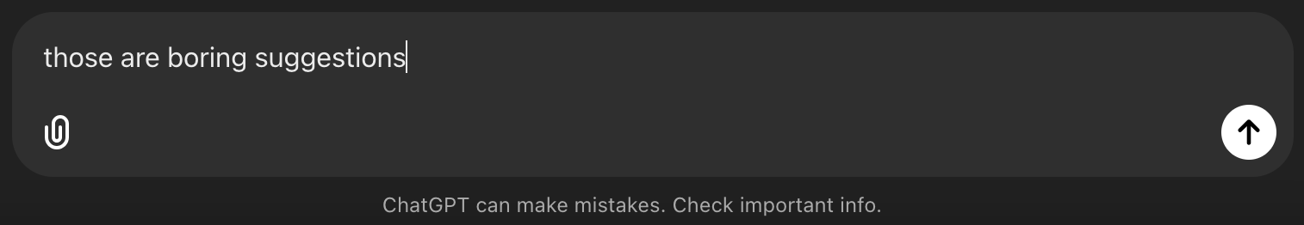
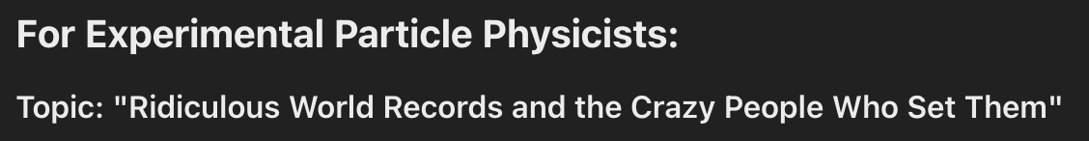
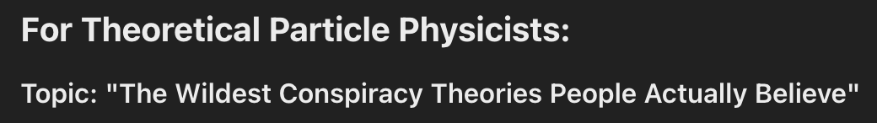
I told it it was boring…

Slide 13
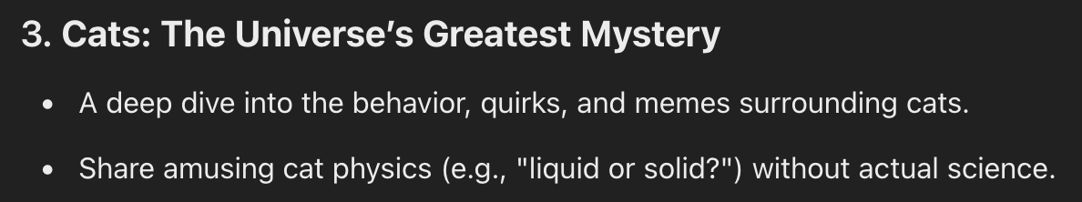
Buried among the other suggestions

Slide 14
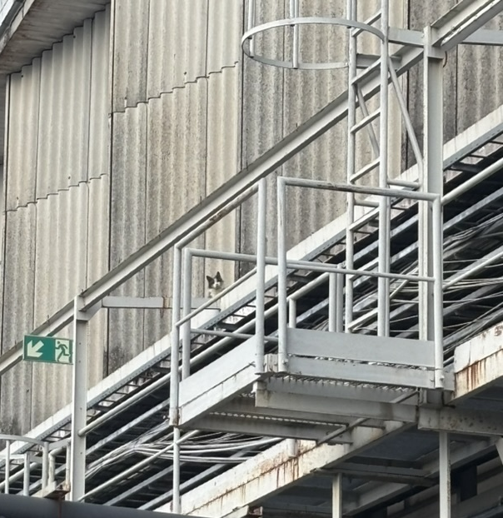
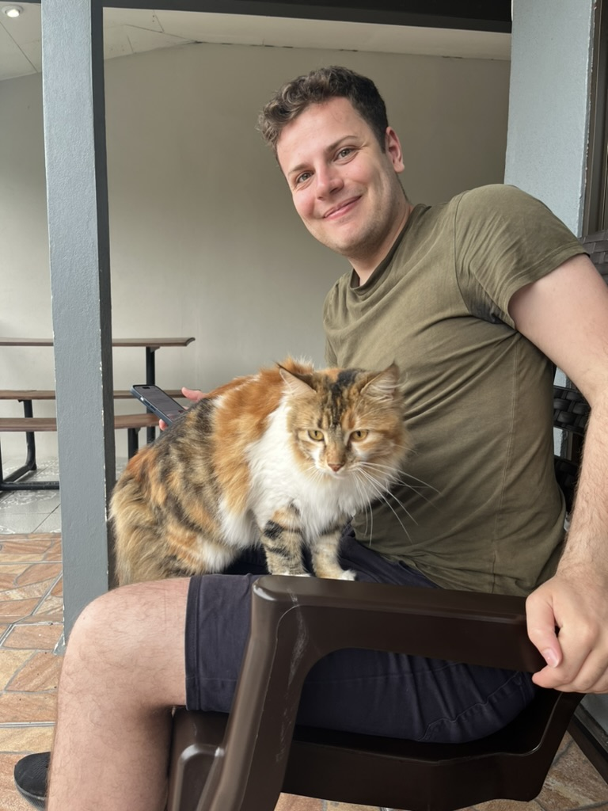
Cats: The Universe’s Greatest Mystery
Cat at LINAC2
Cat in Costa Rica

Slide 15
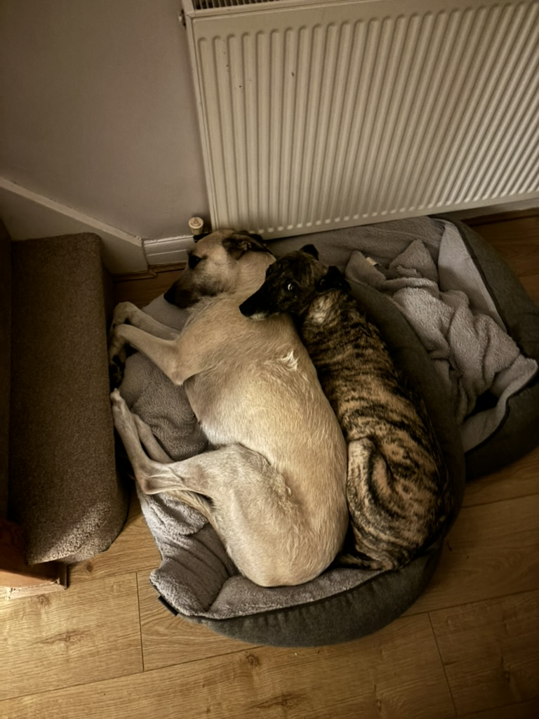
Why use two beds when one works?

