Slide 1

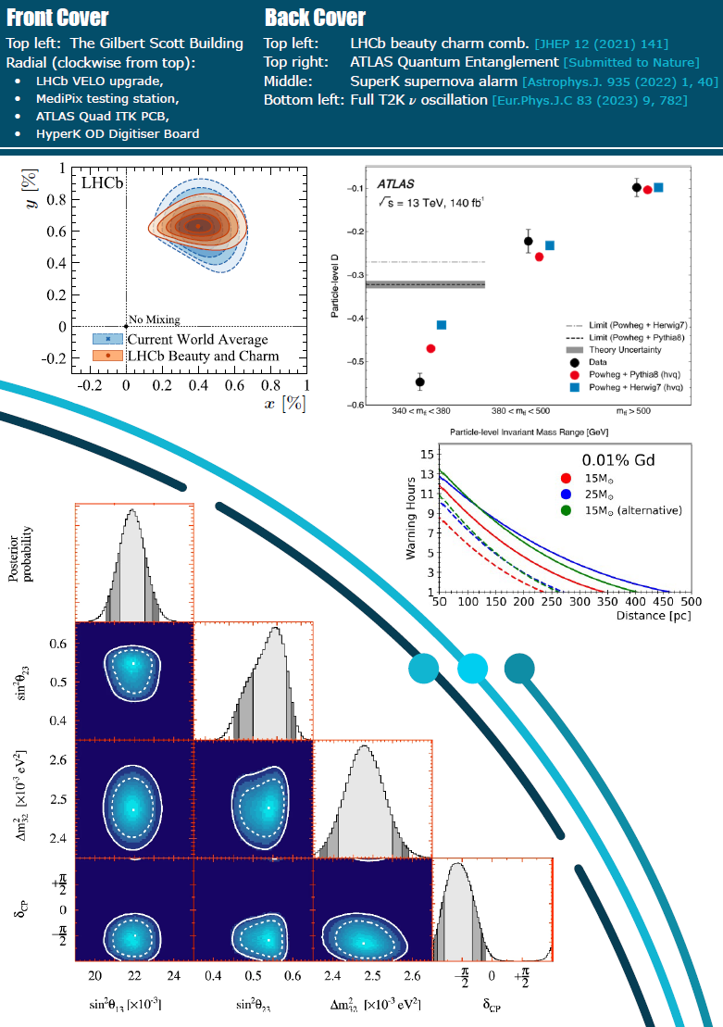

Under the Microscope
again
Building
Back
Better..
for Christmas

Slide 2
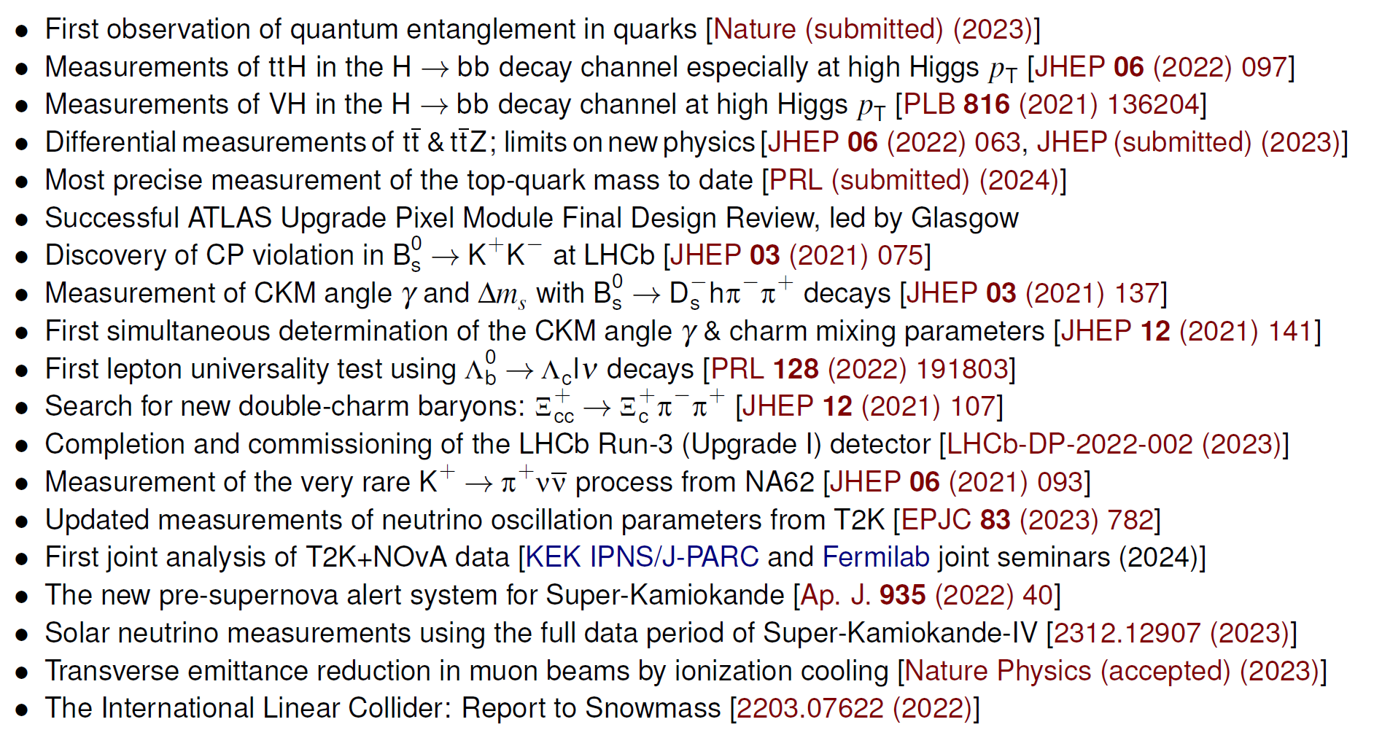
Highlights (January 2021- December 2023 ish)

Slide 3

Providing Direction
Aidan is Project Lead for the 2025-29 CG and will be Research Group Leader from October 2025

Slide 4
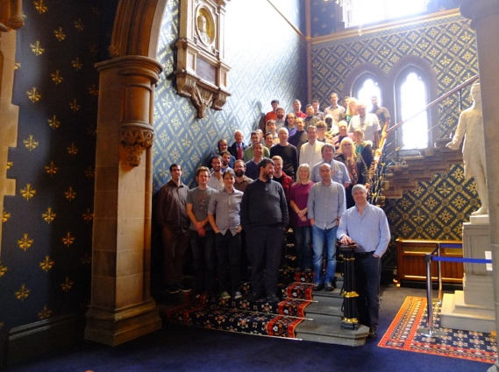

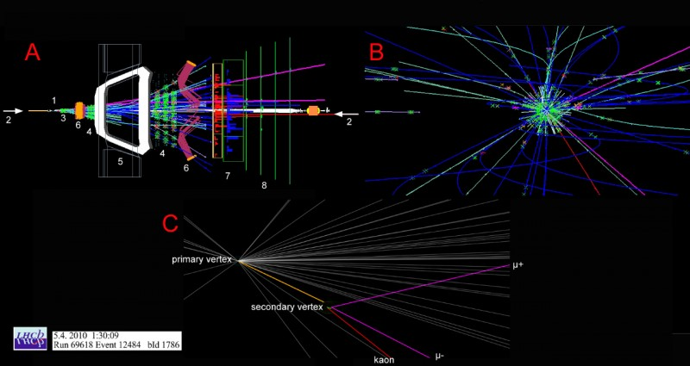
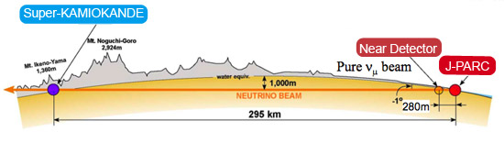
Particle Physics Experiment – build upon existing foundations
Research Group Leader: Tony Doyle → Aidan Robson
10→13 academic staff, 15 → 19 research staff, 2 → 4 electronic engineers,
4 → 6 technicians, 6 computing 2 admin. support, 22 research students
Total support ~£3m/annum (current STFC CG ~£1.8m/annum),
Including a Royal Society Fellow (Jay Howarth),
Including 2 Ernest Rutherford Fellows (Lucia Grillo, Mark Whitehead)
We work on
Higgs, top quark, precision QCD, neutrinos and BSM physics searches
ATLAS, LHCb, NA62 and T2K current experiments
Working towards
Future neutrino (HyperK) and linear (and circular) collider experiments
Development of detector systems esp. ATLAS & LHCb Upgrades
Incorporating Facilities leading to Spinout
Glasgow Laboratory for Advanced Detector Development (GLADD)
Flip-chip bonding and X-ray characterization Facilities
Internal collaboration with Electron Microscopy Facility
spinout of TauProbes (Bates)
Experiments, Computing & Detector Development
  LISA orbit
We lead
UK Deputy HyperK (Soler)
UK GridPP (Britton) inc. £13m Kelvin Data Annex Facility
International ATLAS Pixel Detector Upgrade (Buttar)
International CLICdp Collaboration (Robson)
UK Medipix and flagship Knowledge Exchange (Bates)

Slide 5
Welcome (in particular)
In 2023
In 2024
ATLAS Upgrade RAs:
Katie Walkingshaw-Pass
Md Arif Abdulla Samy, known as “Samy”
ATLAS Upgrade technicians:
Kamil Dulak
Christopher Lickley
Neutrinos (T2K) RA:
Veera Mikola
ATLAS Responsive RAs:
Siyuan Yan
Marcos Miralles Lopez
LHCb Responsive RA
Gary Robertson
Karen Law Admin
Martin Habedank (ATLAS/ORD) RA
Niall McHugh (LHCb) RA
Haythem Elnashar (LHCb) Engineer (starting 13th December)

Slide 6
Outlook
For LHCb we will commit to simulation project leadership, Real-Time Analysis software, and VELO performance monitoring development
We will lead lepton physics at LHCb with lepton universality tests and new physics searches, along with CP violation measurements and spectroscopy in the beauty and charm sectors
We will continue to lead the design, production, and testing of the Hyper-K Outer Detector front-end electronics
For NA62 the group will continue to lead the Monte Carlo production and will extend the data-quality monitoring tools and studies of the upstream background
The group will continue to invest in and promote a world-class detector development activity leading to significant impact in sensor technologies
The next four-year timescale is particularly exciting with the exploitation of the LHC and LHC upgrade construction at a critical stage, and Hyper-K construction due to be completed and first data taken
We are in a major construction phase that requires significant effort, building on the synergies established among our ATLAS, LHCb, and neutrino detector and electronics activities
Glasgow is contributing significant core and project effort for ATLAS
We will make important measurements of the top-quark mass, ttH, tttt and HH and build on our recent quantum entanglement success with further new measurements of quantum information observables in the top and Higgs sectors

