Slide 1
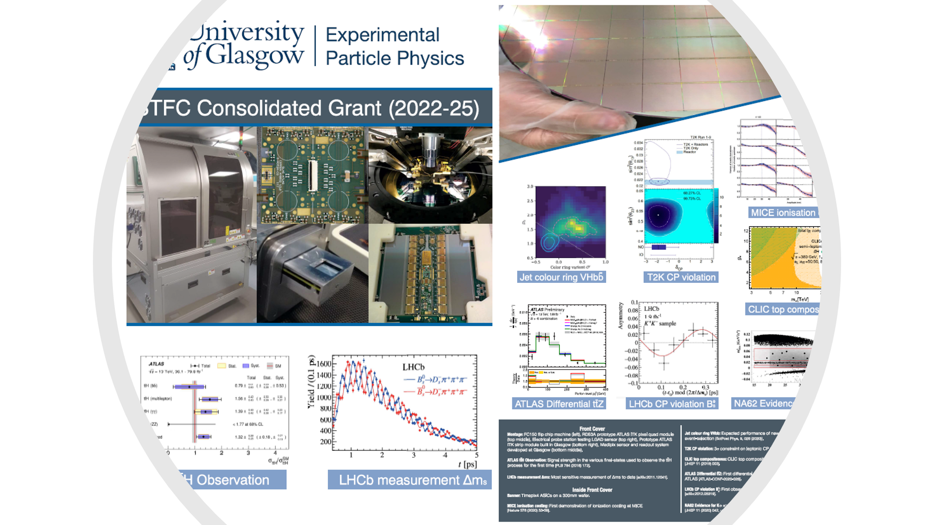
Under the Micro-scope
again
Building
Back
Better..

Slide 2
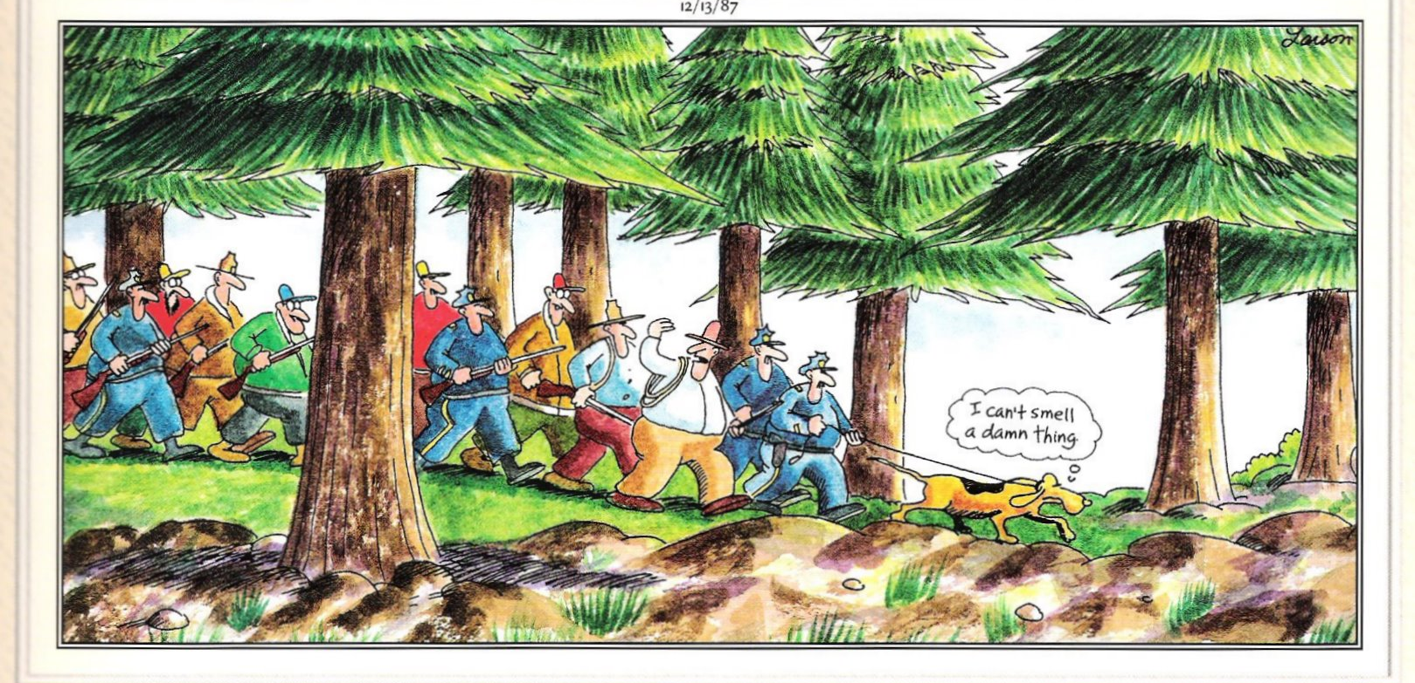
Providing Direction
Aidan is Project Lead for the 2025-29 CG

Slide 3
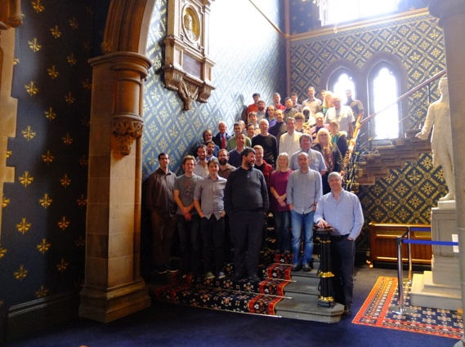

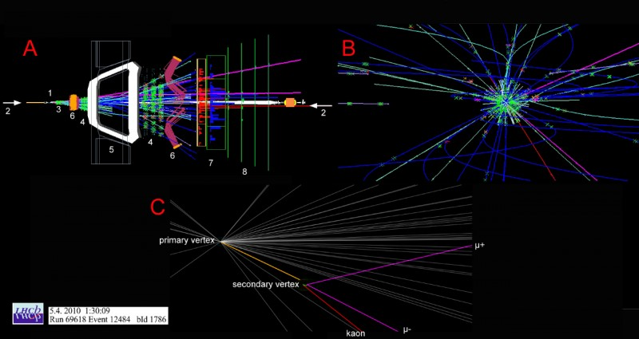
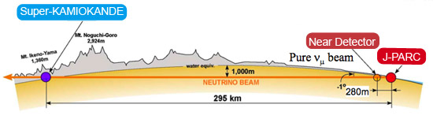
Particle Physics Experiment – build upon existing foundations
Research Group Leader: Tony Doyle
10 academic staff, 15 research staff, 2 electronic engineers, 4 technicians,
6 computing and administrative support staff and 30 research students
Total support ~£3m/annum (current STFC CG ~£1.8m/annum),
Including 3 Royal Society Fellows – new (Howarth), Profs (Buckley, Owen)
Including (this year) 2 Ernest Rutherford Fellows (Grillo, Whitehead)
We work on
Higgs, top quark, precision QCD, neutrinos and BSM physics searches
ATLAS, LHCb, NA62 and T2K experiments
Working towards
Future neutrino (HyperK) and linear (and circular) collider experiments
Development of detector systems esp. ATLAS & LHCb Upgrades
Incorporating Facilities leading to Spinout
Glasgow Laboratory for Advanced Detector Development (GLADD)
Flip-chip bonding and X-ray characterization Facilities
Internal collaboration with Electron Microscopy Facility
spinout of Timepix & Medipix3 detectors and (in 2021) TauProbes (Bates)
Experiments, Computing & Detector Development
  LISA orbit
We lead
UK Deputy HyperK (Soler)
UK GridPP (Britton) inc. £13m Kelvin Data Annex Facility
International ATLAS Pixel Detector Upgrade (Buttar)
International CLICdp Collaboration (Robson)
UK Medipix and flagship Knowledge Exchange (Bates)

Slide 4
Welcome (in particular)
In 2023
In 2024
ATLAS Upgrade RAs:
Katie Walkingshaw-Pass
Md Arif Abdulla Samy, known as “Samy” (starting soon)
ATLAS Upgrade technicians:
Kamil Dulak
Christopher Lickley
Neutrinos (T2K) RA:
Veera Mikola
ATLAS Responsive RAs:
Siyuan Yan
Marcos Miralles Lopez
LHCb Responsive RA
Gary Robertson
ATLAS/ORD RA (2-year post)
LHCb/Upgrade RA (2-year post)
Job adverts released today

Slide 5
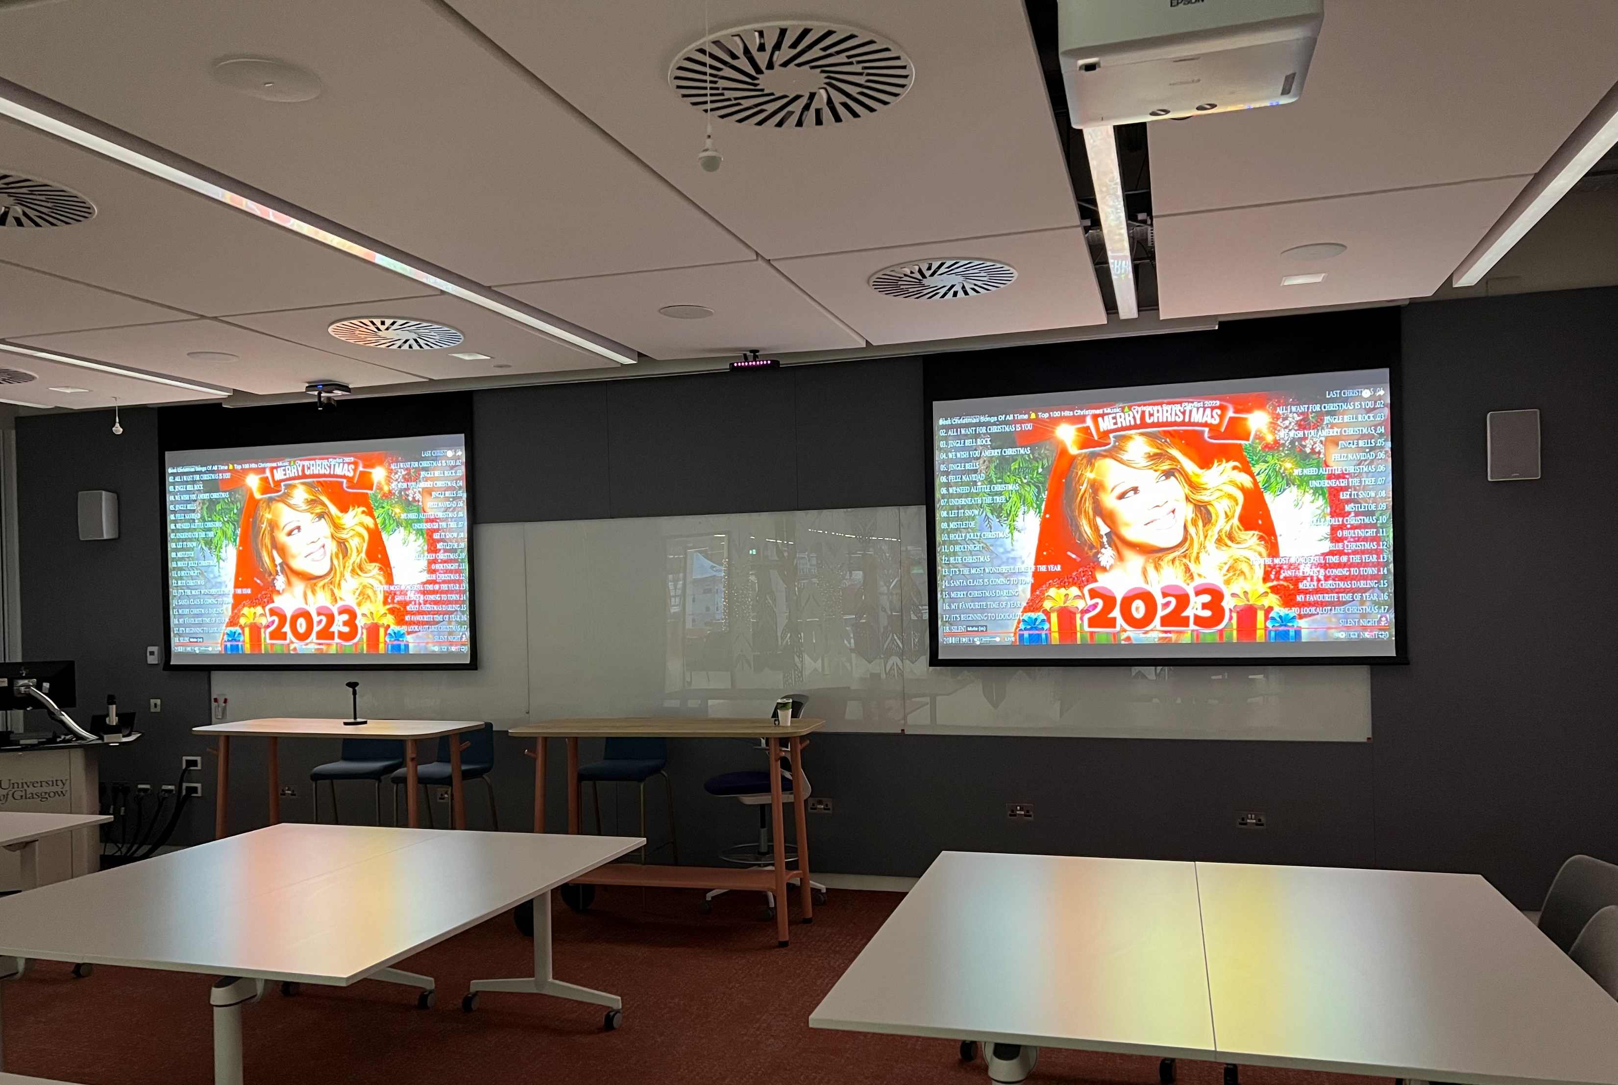
déjà vu
Meeting room last year
But different - Mariah isn’t number 1 this year (depending on which chart you use)

