Slide 1

How the discovery of Cold Noise delayed the production of ATLAS ITk strip tracker modules by a year
AKA FUN WITH LASERS
Andy Blue

Slide 2
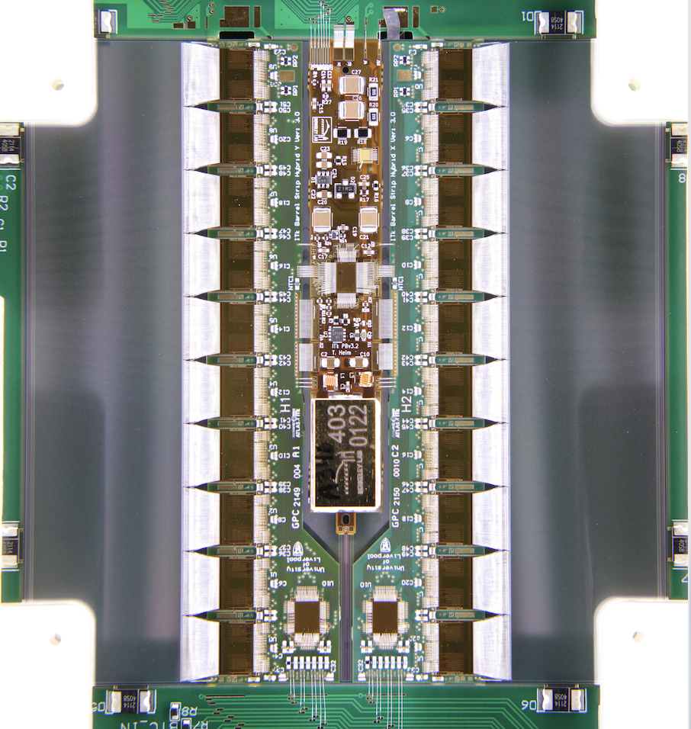
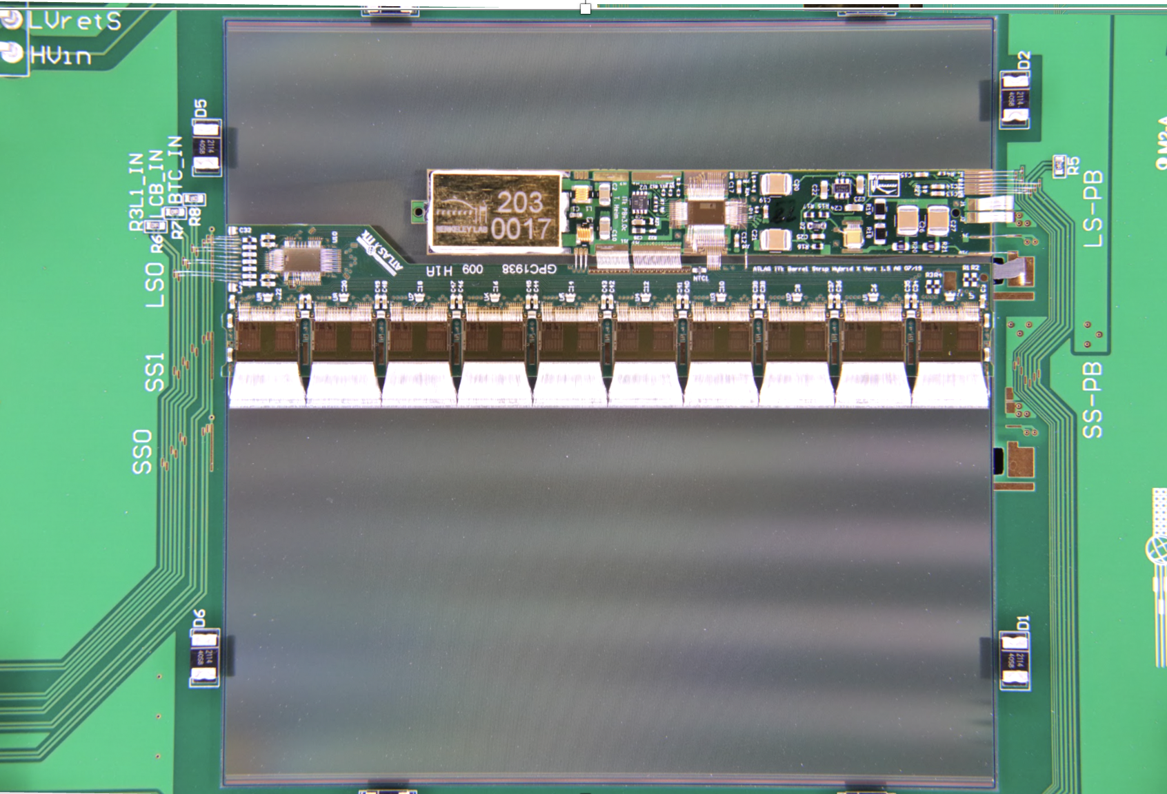
ITk Strip Barrel Modules
Powerboard
Hybrids
Short-strip module
Strip
Strip
Long-strip module
Short-strip module

Slide 3
Cold Noise Observations
Early Observations:
Only appears on the strip rows under the hybrids & PB.
Strip Row 1
Strip Row 4
Strip direction
Short-strip module

Slide 4
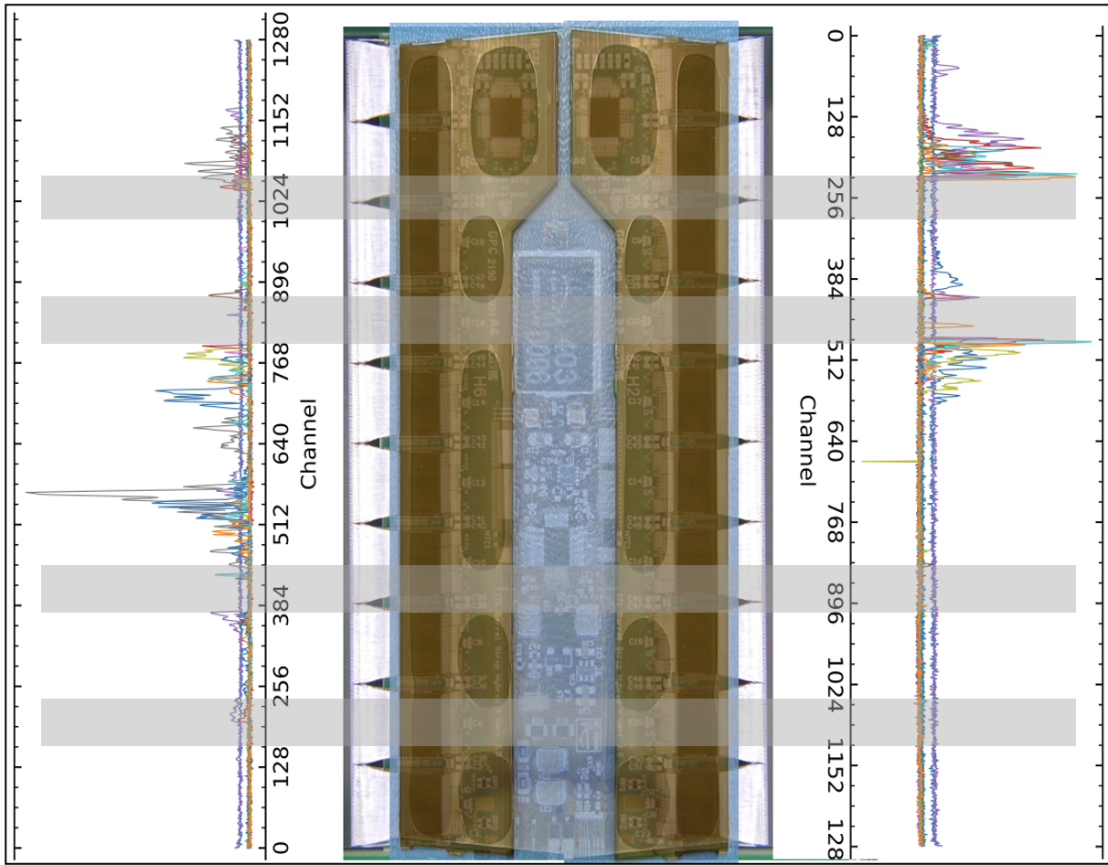
Cold Noise Observations
Early Observations:
Only appears on the strip rows under the hybrids & PB.
Tends to appear in certain regions.
  Correlated with glue under hybrids.
Short-strip module

Slide 5
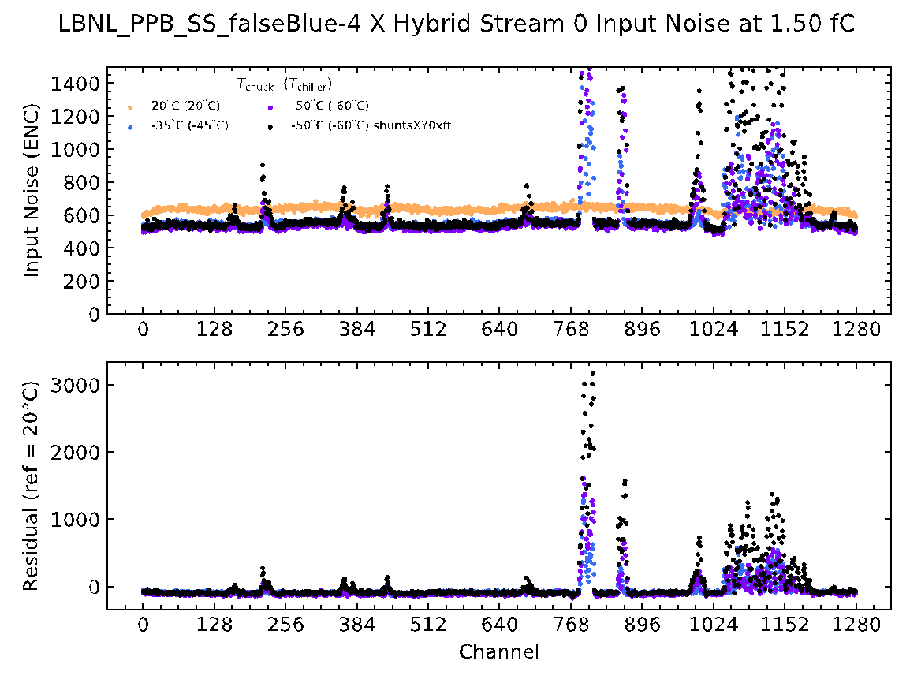
Cold Noise Observations
Early Observations:
Only appears on the strip rows under the hybrids & PB.
Tends to appear in certain regions.
  Correlated with glue under hybrids.
Worsens with load on DC-DC converter.
  Can increase load by shunting current on ABCs.
-50C, shunts on
-50C, shunts off
-35C, shunts off

Slide 6
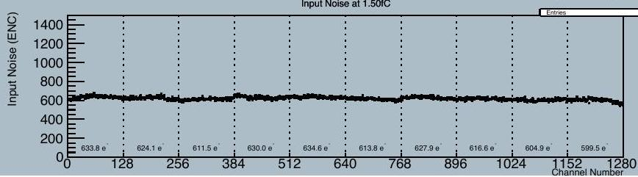
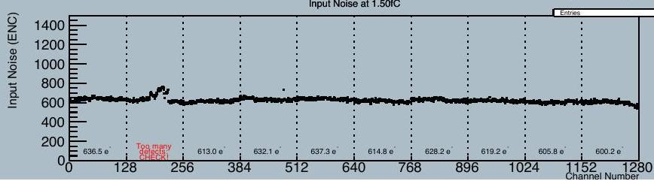
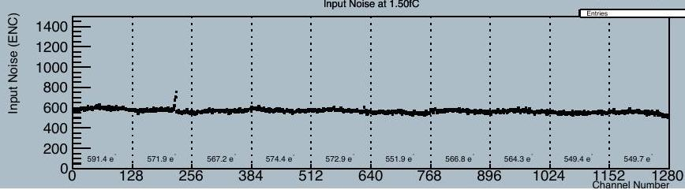
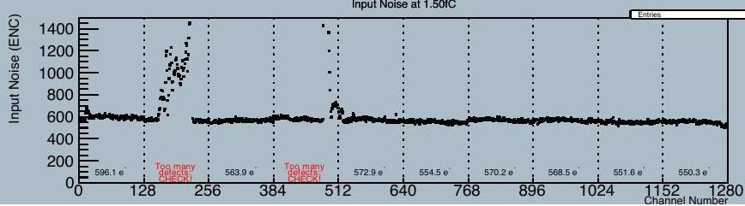
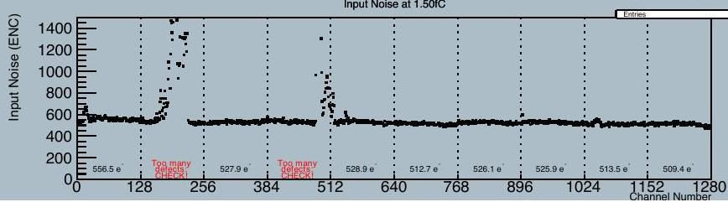
Cold Noise Observations
Early Observations:
Only appears on the strip rows under the hybrids & PB.
Tends to appear in certain regions.
  Correlated with glue under hybrids.
Worsens with load on DC-DC converter.
  Can increase load by shunting current on ABCs.
Noise “freezes-in” during 1st thermal cycle.
  Persists while warming.
  Occasionally have residual “cold” noise at room temp!
1st thermal cycle
+20C
+20C
-10C
-10C
-50C

Slide 7
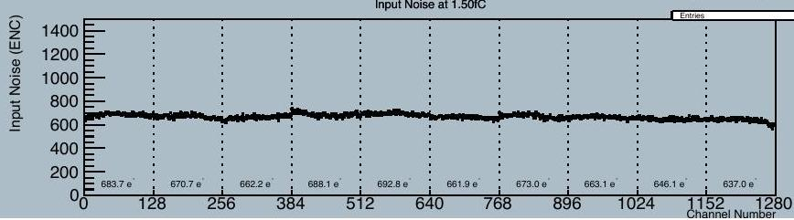
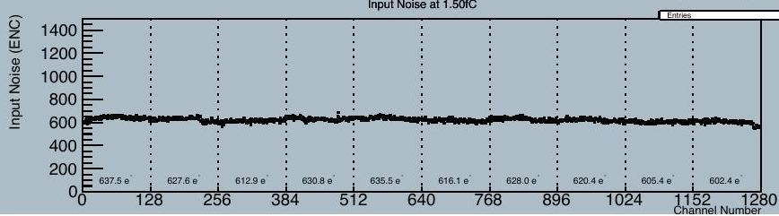
Cold Noise Observations
Early Observations:
Only appears on the strip rows under the hybrids & PB.
Tends to appear in certain regions.
  Correlated with glue under hybrids.
Worsens with load on DC-DC converter.
  Can increase load by shunting current on ABCs.
Noise “freezes-in” during 1st thermal cycle.
  Persists while warming.
  Occasionally have residual “cold” noise at room temp!
    But can “bake-out” by going warmer.
+20C
+40C
+20C
+20C
+20C
Bake-out
+20C

Slide 8
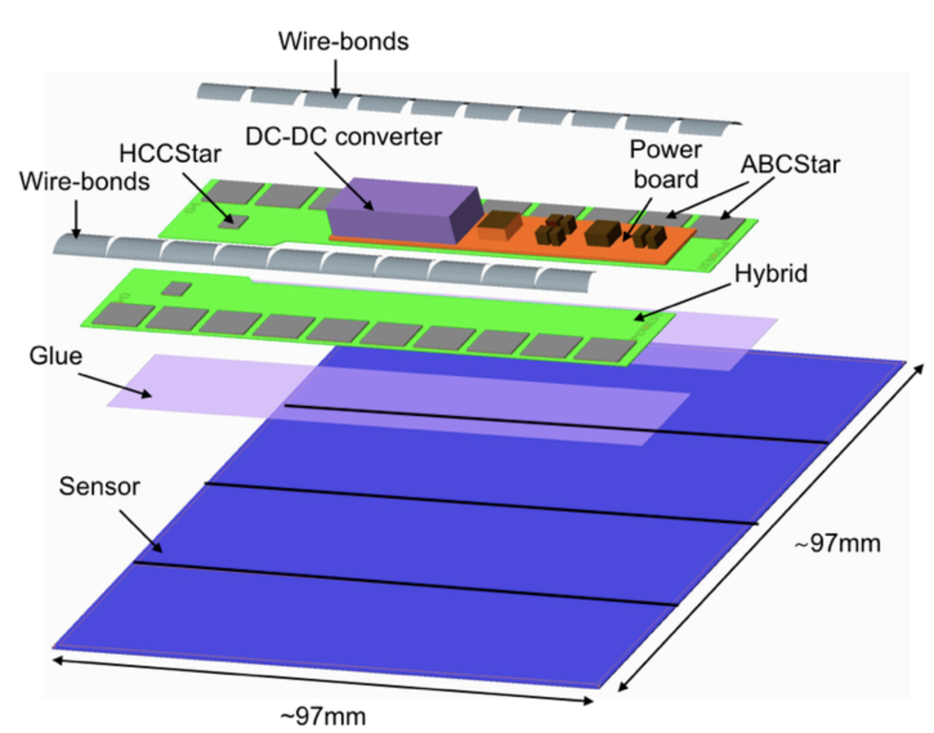
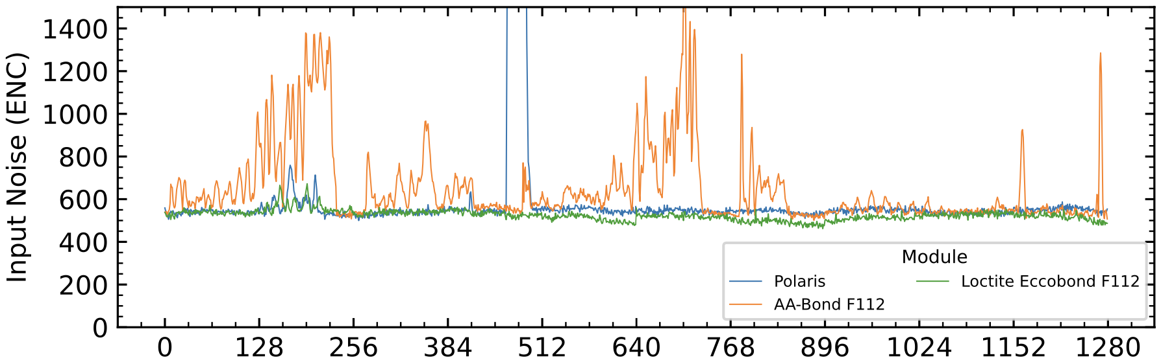
Cold Noise Observations
Early Observations:
Only appears on the strip rows under the hybrids & PB.
Tends to appear in certain regions.
  Correlated with glue under hybrids.
Worsens with load on DC-DC converter.
  Can increase load by shunting current on ABCs.
Noise “freezes-in” during 1st thermal cycle.
  Persists while warming.
  Occasionally have residual “cold” noise at room temp!
    But can “bake-out” by going warmer.
Glue dependence:
Severity varies greatly among “nearly identical” epoxies.
  Unable to correlate with any info in data sheets…
-50C
AA-Bond F112 Eccobond F112 Polaris

Slide 9
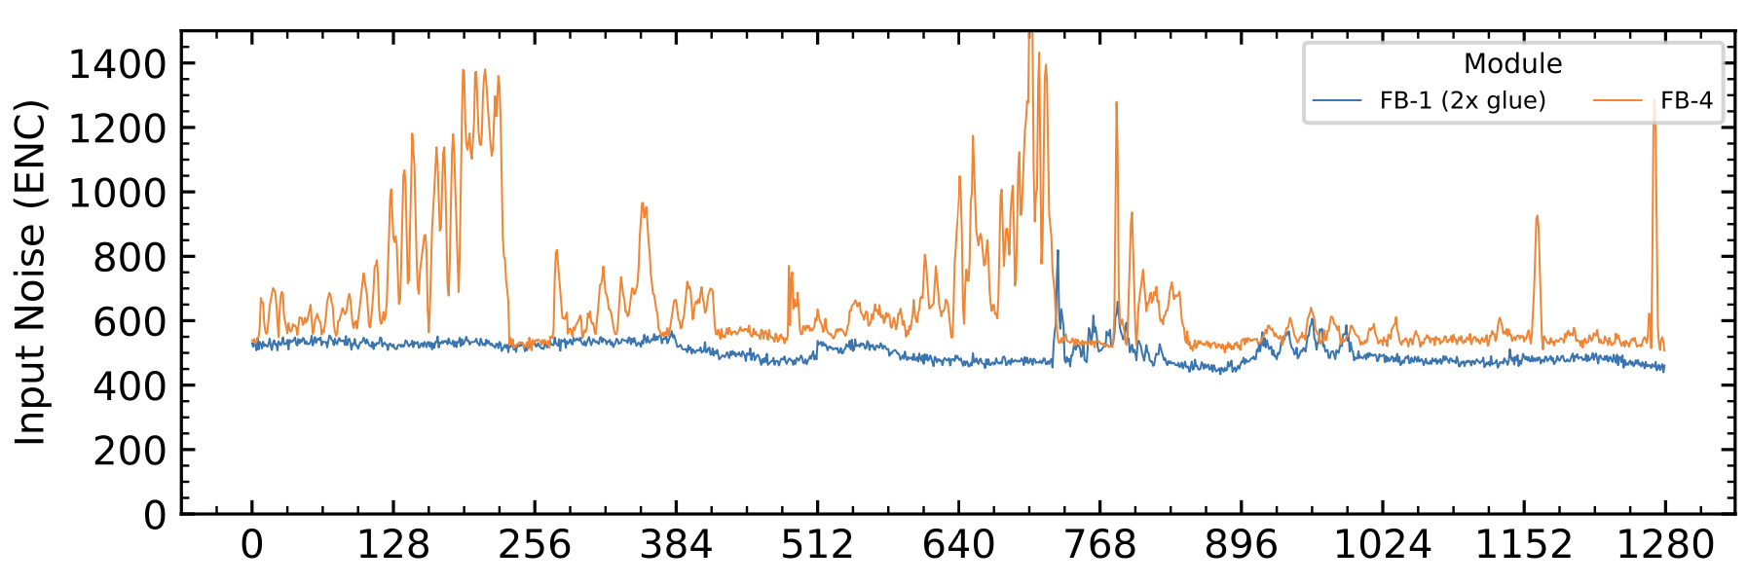
Cold Noise Observations
Early Observations:
Only appears on the strip rows under the hybrids & PB.
Tends to appear in certain regions.
  Correlated with glue under hybrids.
Worsens with load on DC-DC converter.
  Can increase load by shunting current on ABCs.
Noise “freezes-in” during 1st thermal cycle.
  Persists while warming.
  Occasionally have residual “cold” noise at room temp!
    But can “bake-out” by going warmer.
Glue dependence:
Severity varies greatly among “nearly identical” epoxies.
  Unable to correlate with any info in data sheets…
Thicker glue layers under PB and hybrid(s) can reduce CN.
-50C
Nominal glue thickness
Double glue thickness
AA-BOND F112

Slide 10
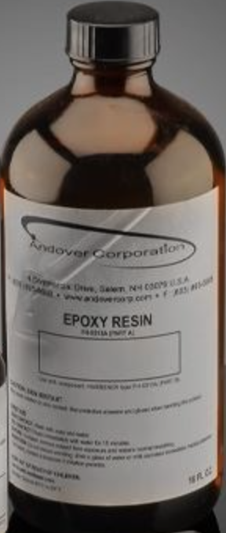
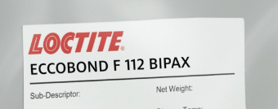
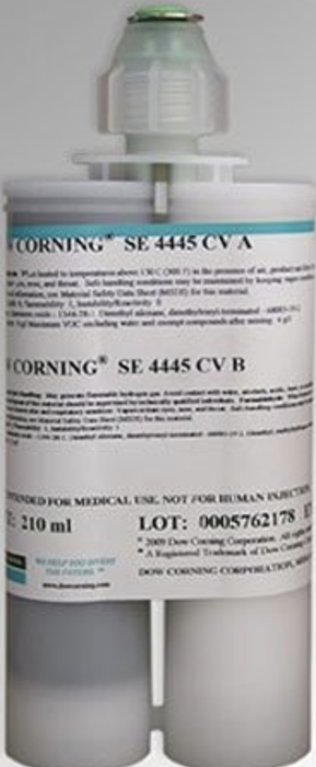
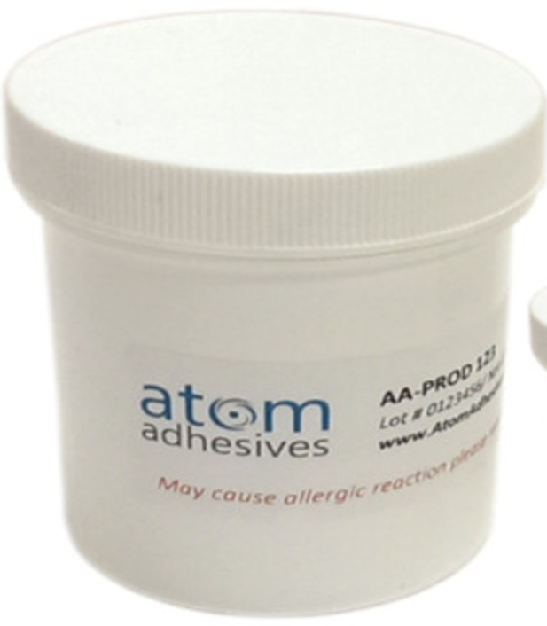
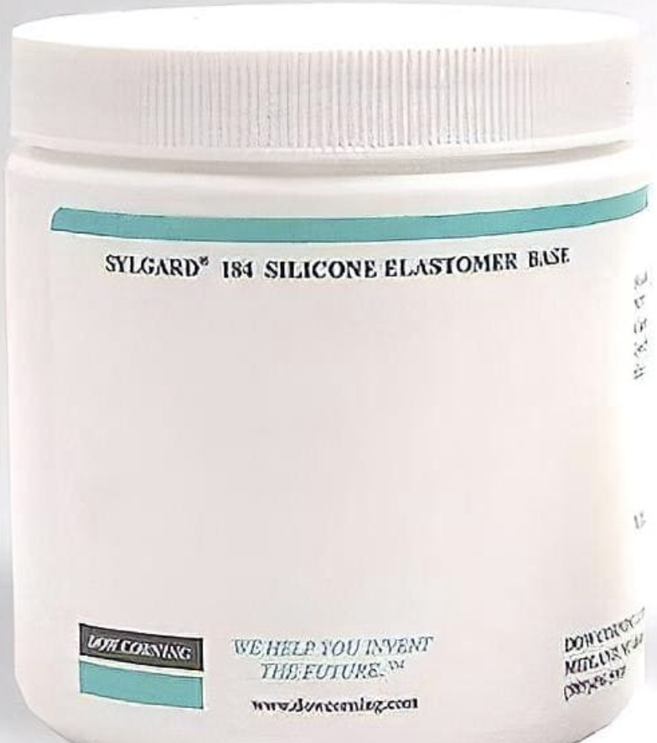
Cold Noise Observations
Early Observations:
Only appears on the strip rows under the hybrids & PB.
Tends to appear in certain regions.
  Correlated with glue under hybrids.
Worsens with load on DC-DC converter.
  Can increase load by shunting current on ABCs.
Noise “freezes-in” during 1st thermal cycle.
  Persists while warming.
  Occasionally have residual “cold” noise at room temp!
    But can “bake-out” by going warmer.
Glue dependence:
Severity varies greatly among “nearly identical” epoxies.
  Unable to correlate with any info in data sheets…
Thicker glue layers under PB and hybrid(s) can reduce CN.
Softer “glues” (Sylgard encapsulant, SE-4445 gel) remove CN.
  Only diagnostic, not suitable for detector.

Slide 11
Finding the source of vibrations

Slide 12
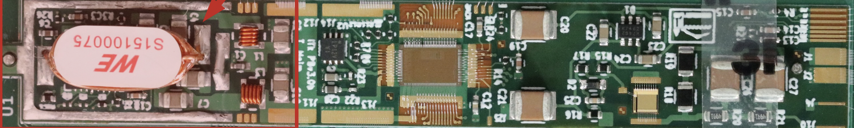
Cold Noise Instigator
Powerboard
HV switch
Buck converter
AMAC
Autonomous Monitor and Control (AMAC)
Powerboard is instigator of Cold Noise
  Powerboard electrically bypassed - CN is removed
“Singing” capacitors known phenomenon when dielectric used in capacitor has piezoelectric effect
  Occurs with a oscillating voltage on capacitors
  Buck converter a potential candidate for singing capacitors

Slide 13
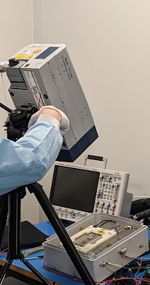

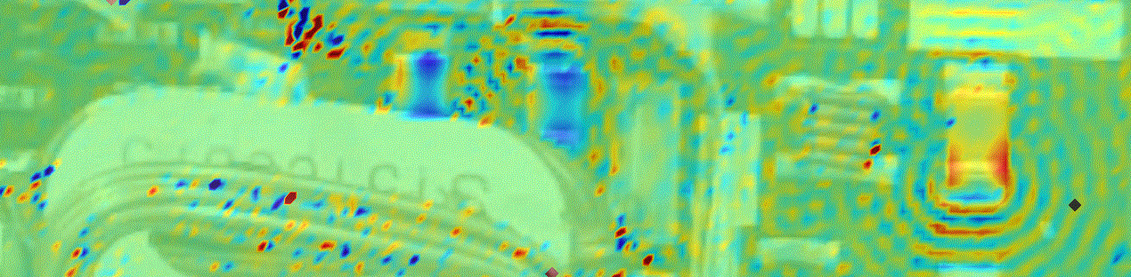
Propagating wave - Vibromoeter
2D scanning vibrometer
Cant remove the source of vibration
Need to understand how vibration is propagating
Use a Vibrometer
  Non-contact measurement
  No mass loading
  Laser spot 40 µm
  Sensitive to MHz range
Upgraded Vibrometer with 2D scanning
  Single point measurements across module
  Stitched together measurements in phase
    Magnetic trigger on buck converter as reference
Capacitor amplitude approx. 1 nm
  Amplitude is dependent on power draw of powerboard
Vibrations propagate across Silicon at same wavelength as calculated ~1.3 mm
The wavelength on the PCB is ~400 µm
CN connected to wavelength in Silicon so interested in scan of back side of module
Module

Slide 14
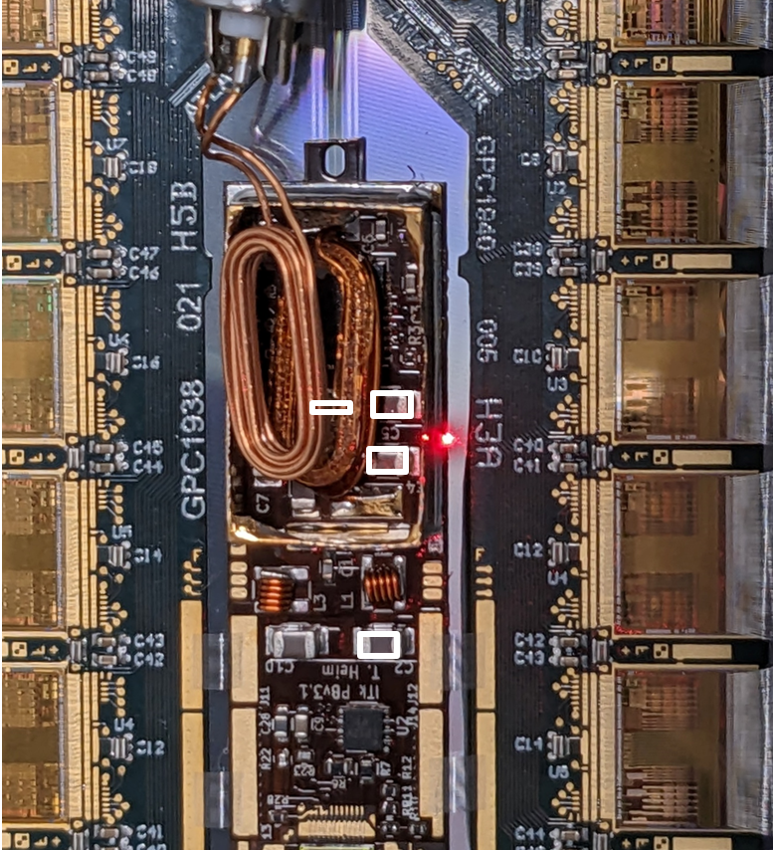
Propagating Wave in Silicon Sensor
10cm
Strip Sensor
2D Scanning vibrometer
Si Strip Sensor
Al backside
Climate Chamber
Propagation across the silicon sensor
Window cut in pcb readout board for module to scan the pack of the sensor
Module powered in climate chamber at -60C
Vibrometer scan through 9 pane window

Slide 15
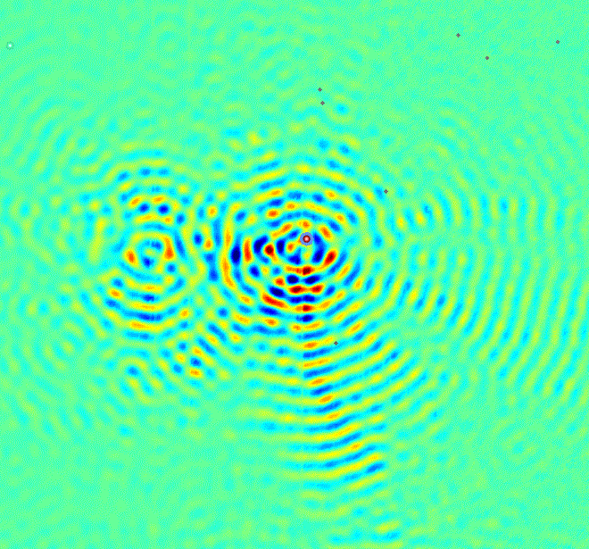
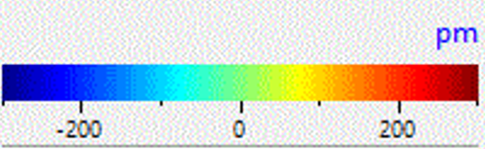
Propagating Wave in Silicon Sensor
Hybrid
Hybrid
Strip Sensor
Si Strip Sensor
Glue
Pattern
(approx.)
Glue
Pattern
(approx.)
Power Board
1cm
Height
Vibrometer scan of Silicon sensor from the back of module while in climate chamber at -60C

Slide 16
Propagating Wave in Silicon Sensor
The glue gaps allow the waves to pass through
The glue under the hybrids dampens the vibrations
There is an interference pattern between the caps
The C2 cap has strong oscillations when at full power
The location of CN readout is not clearly correlated to the wave pattern
Hybrid
Hybrid
CN strips
Glue
Pattern
(approx.)
Glue
Pattern
(approx.)
Power Board
1cm
Height

Slide 17
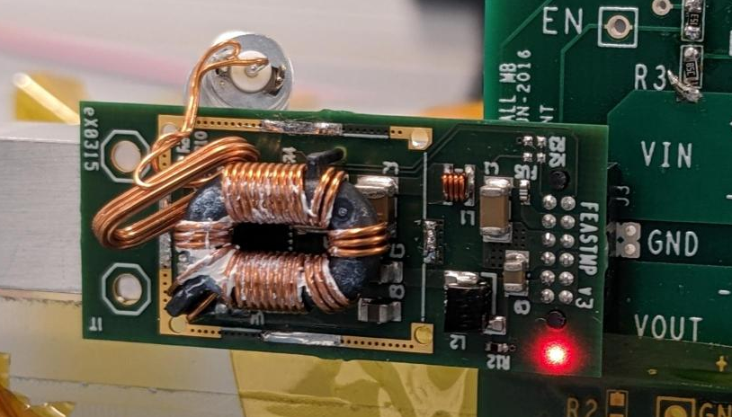
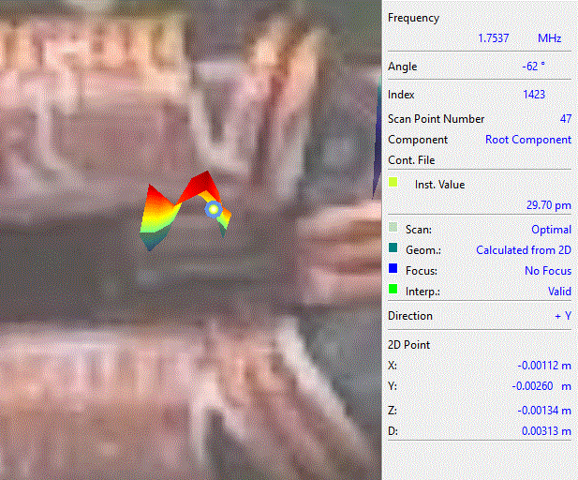
We Are Not Alone
FEAST module is currently in CMS
CERN’s bPOL (on ITk strip module) and FEAST DCDC power converters used in multiple experiments
0.5 nm vibrations seen on both versions
FEAST has been running in CMS operationally for over a year
These capacitor vibrations are the same as our module
Source and scale of vibrations not unique to ATLAS ITk strip
Capacitor vibration

