Slide 1


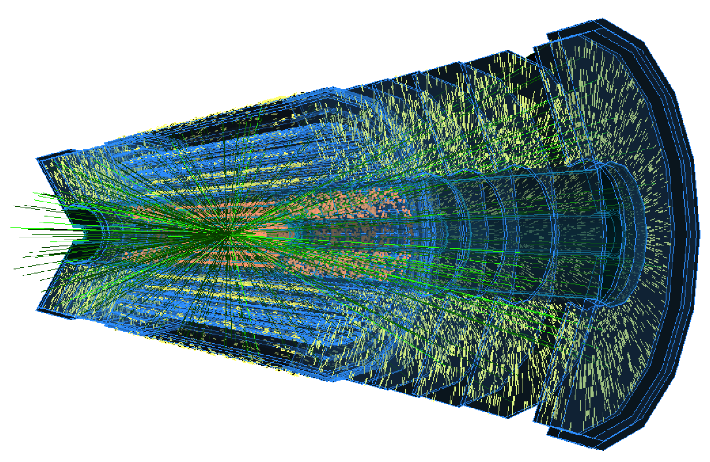
Kenneth Wraight
ITk Production Database Stuff
(Pop Quiz v.92)

Slide 2

2
Released Nov 1992
#1 UK album
ITK PRODUCTION DATA

Slide 3

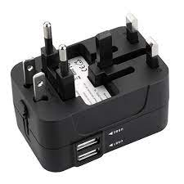

3
ITk Production Database
Scale of ITk production involves large dataset to track progress
~9,500 pixel modules; ~17,000 strip modules
Inter-continental, multi-stage production chain
Common Production Database for all ITk projects
Store data & images for production QA/QC (components x stages x tests)
Functionality: registration, shipping, test upload, reporting
API access allows interface customization
Diverse user profiles: technicians, engineers, RAs, students, academics
Custom interfaces: GUIs, webapps, notebooks, scripts
(Glasgow(ish)) Tools for ITk database interactions
Web applications for upload
Reporting dashboards
Uploading
Reporting

Slide 4

4
Released Nov 1992
#25 UK singles
DES-
… of democratic access to ITk Production database

Slide 5
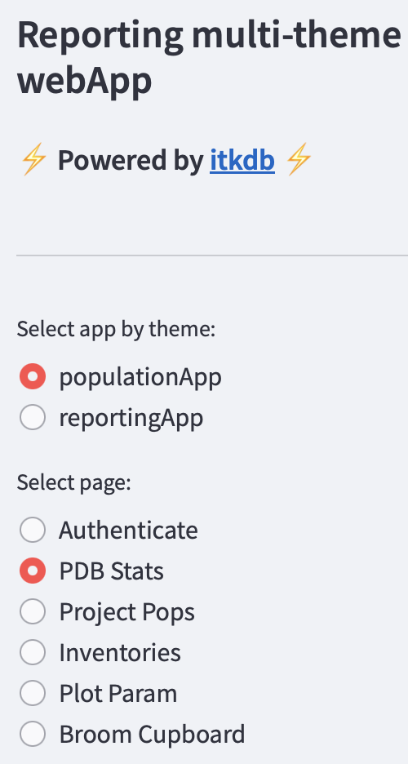
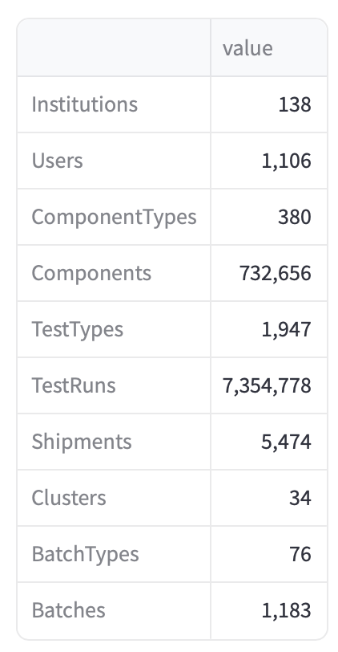
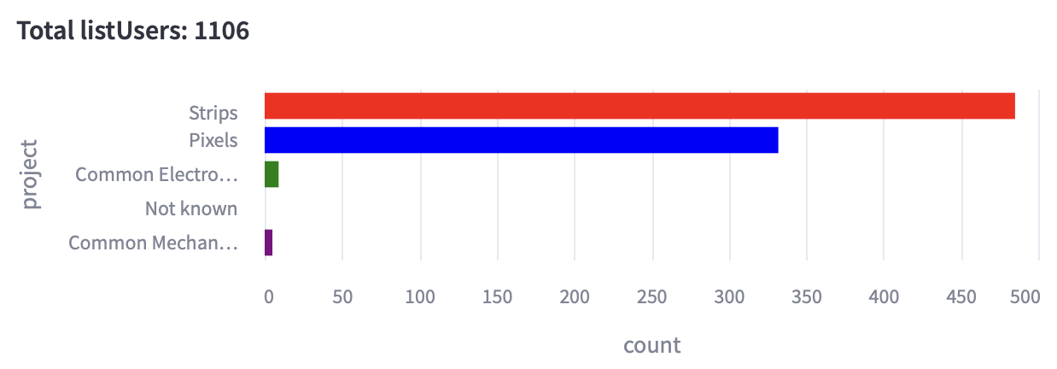
5
PDB Stats
https://itk-pdb-webapps-reporting.web.cern.ch
Overall statistics (12/12/23 UK ~morning)
Database population ongoing:
Central online GUI
API (with documentation!)
Python API wrapper
Custom scripts
Custom webApps
There a lot of stuff and a lot more to come

Slide 6

6
Released Oct 1992
#1 UK album
REPORT GENERATION FOR THE ATLAS ITK COMMUMINTY

Slide 7






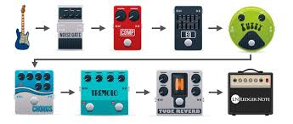


7
Pedal board
Infrastructure built up over past year using several tools
Based on custom python based framework itk-reports
  Including dashboard style reports:
    Pandas
    Altair
    datapane
Script to collect gather report specifications
Containerise (with docker) to run from Cern (OKD)
  Cronjobs to automate frequent generation
Reports stored as html files on eos
Additional automation to collate, link and publish available reports
  Published from Cern: itk-reports-repository

Slide 8
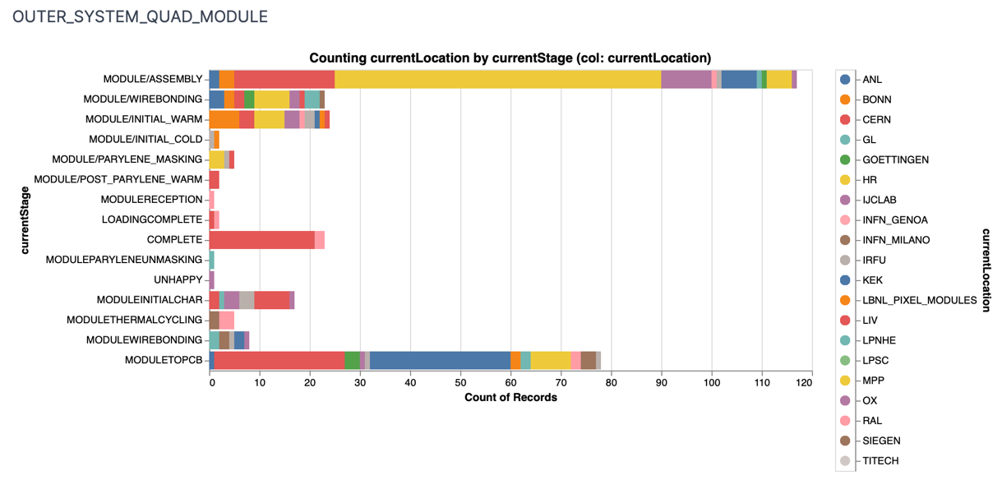
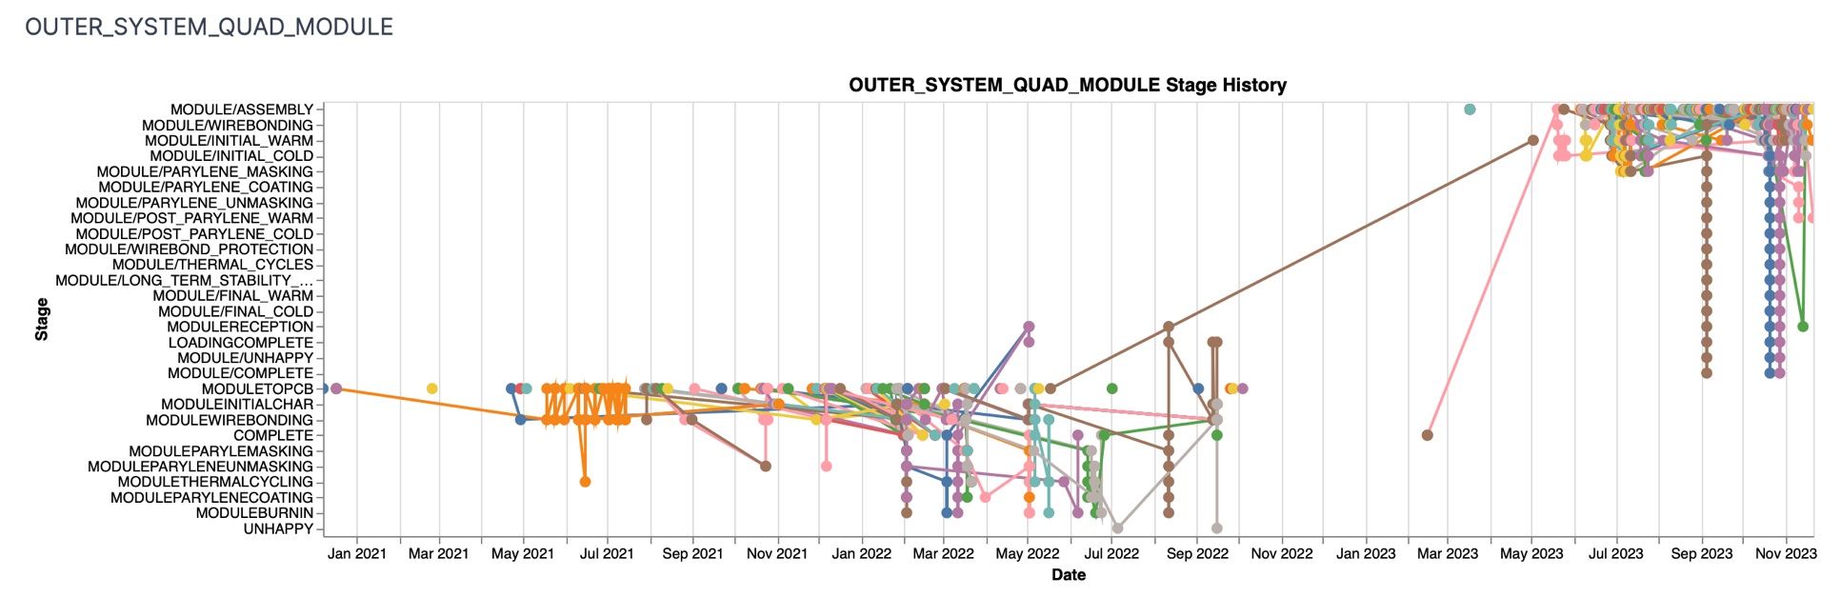
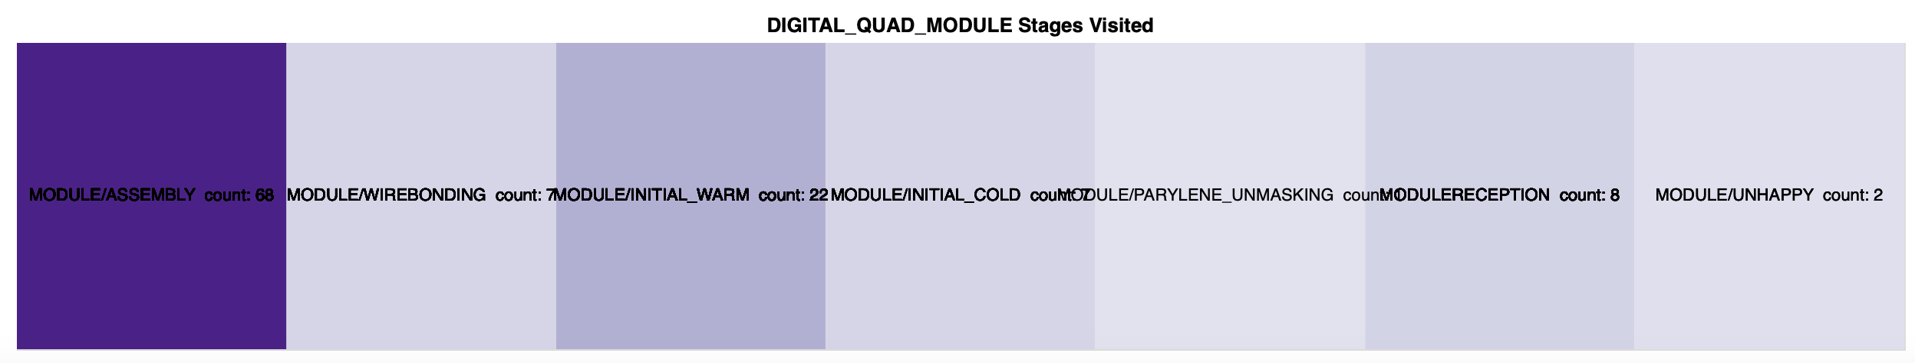
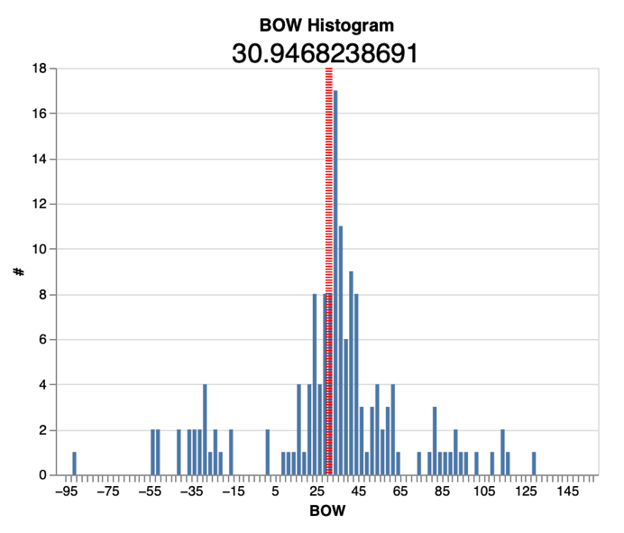
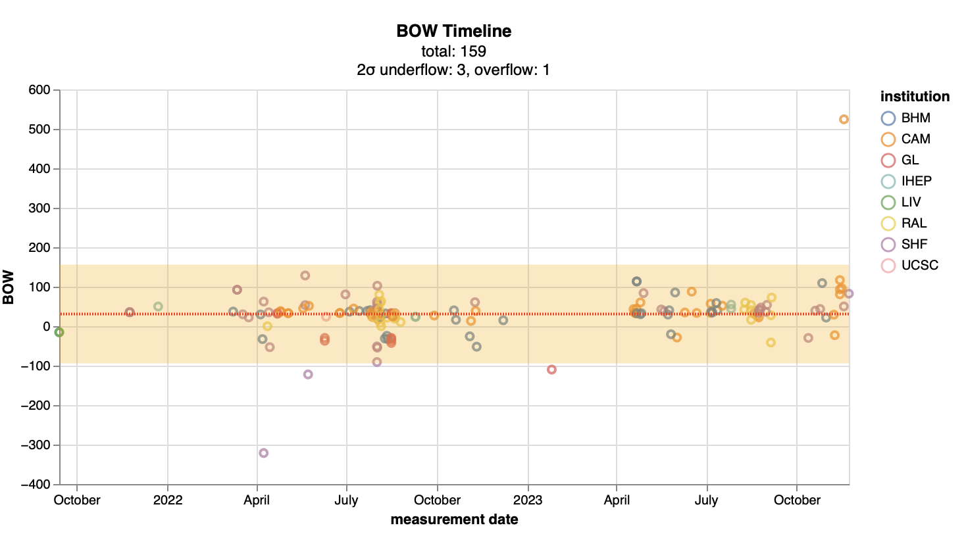
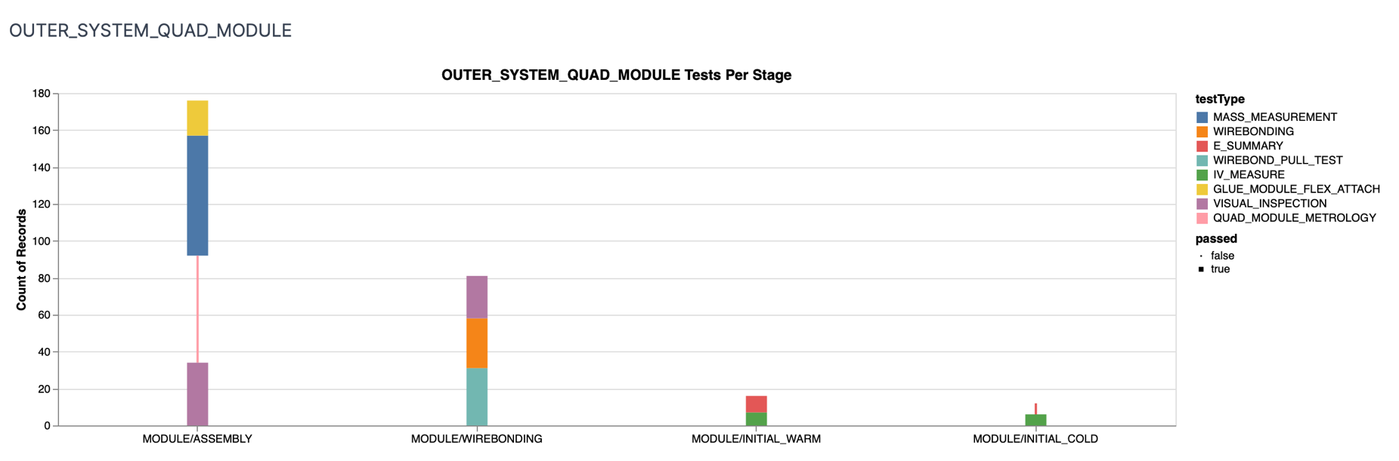
8
Visual Compositions
Per Component type: current location and current stage

Slide 9
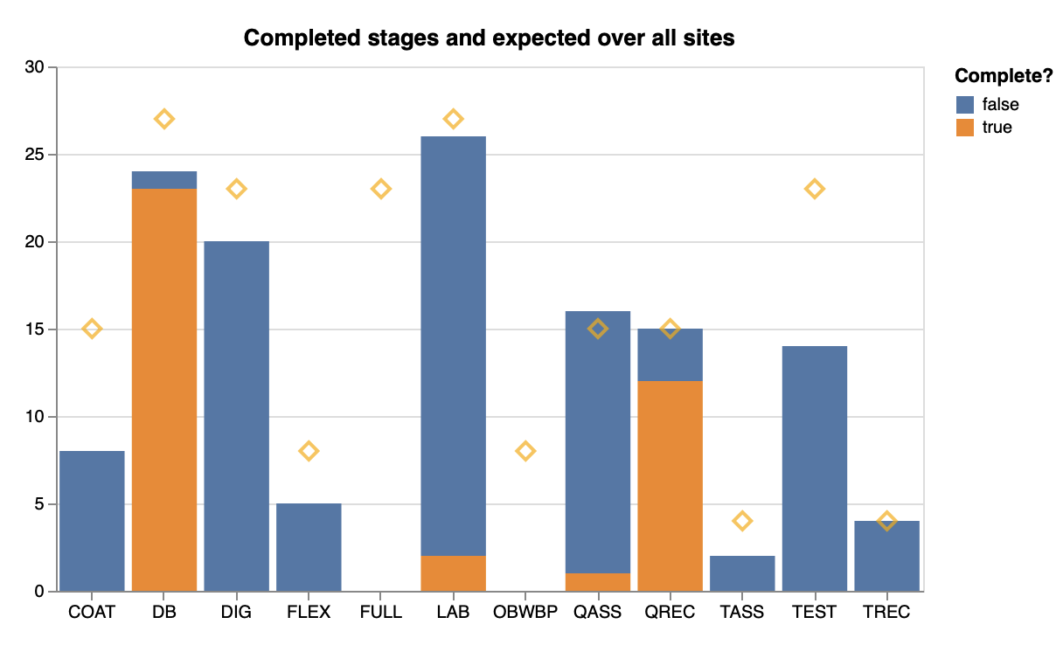
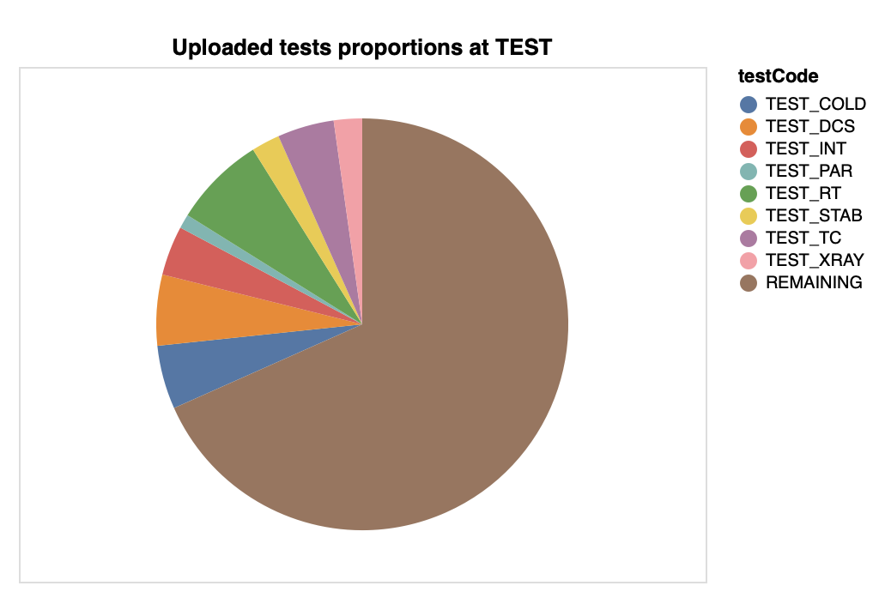
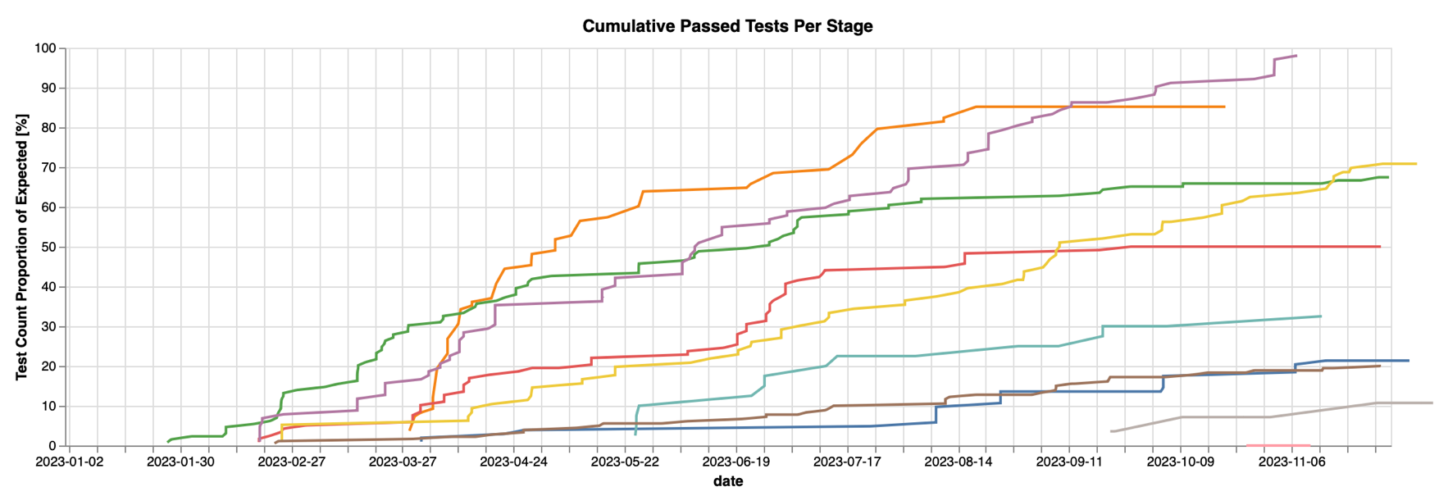
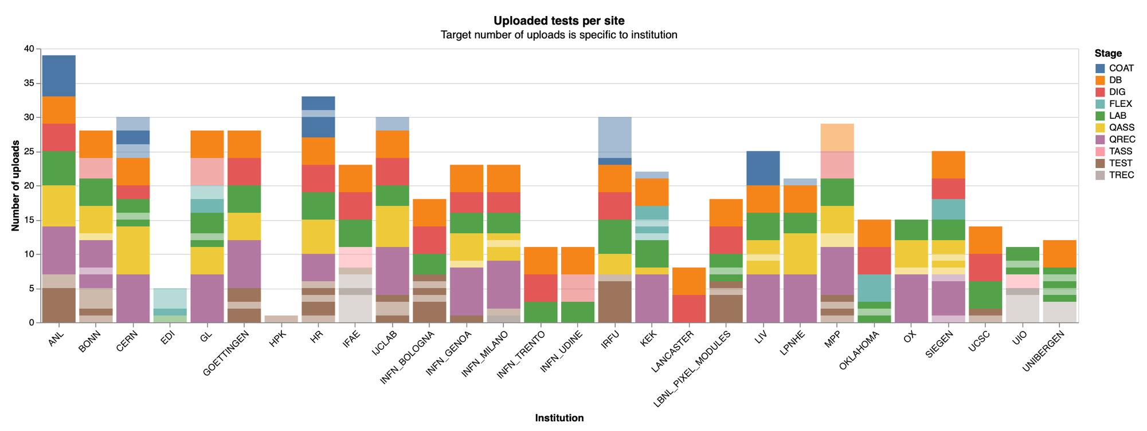
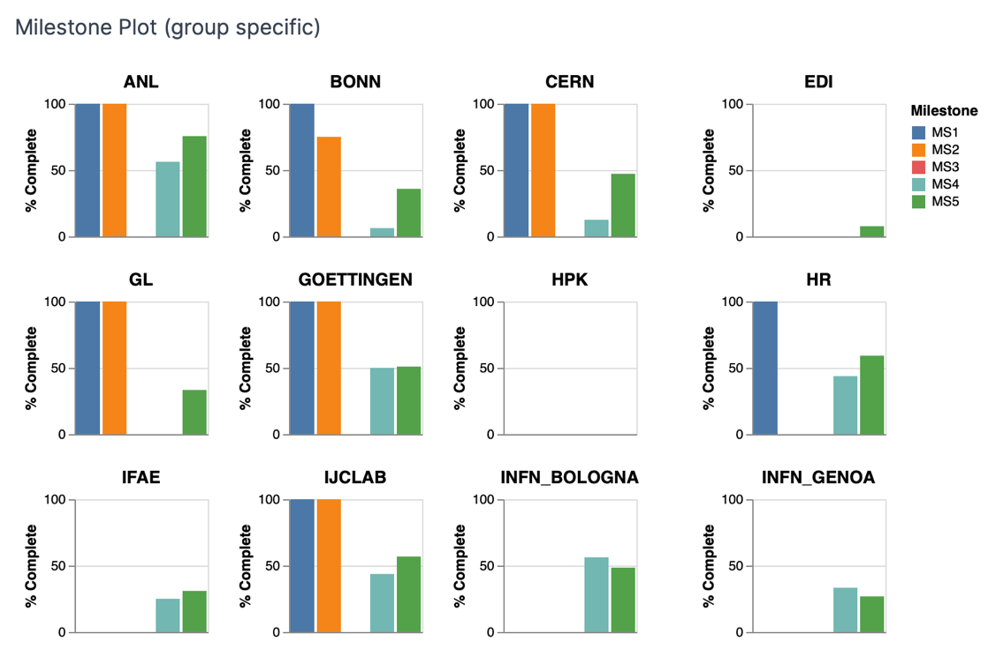
9
More Eye Noises

Slide 10

10
Released summer?
#Unknown
A
Y

Slide 11
11
Summary
On-demand ITk PDB reporting tools:
https://itk-pdb-webapps-reporting.web.cern.ch
Automated ITk PDB reporting:
https://itk-reporting-repository.docs.cern.ch/report_notes/
Based on itk-reports

