Slide 1
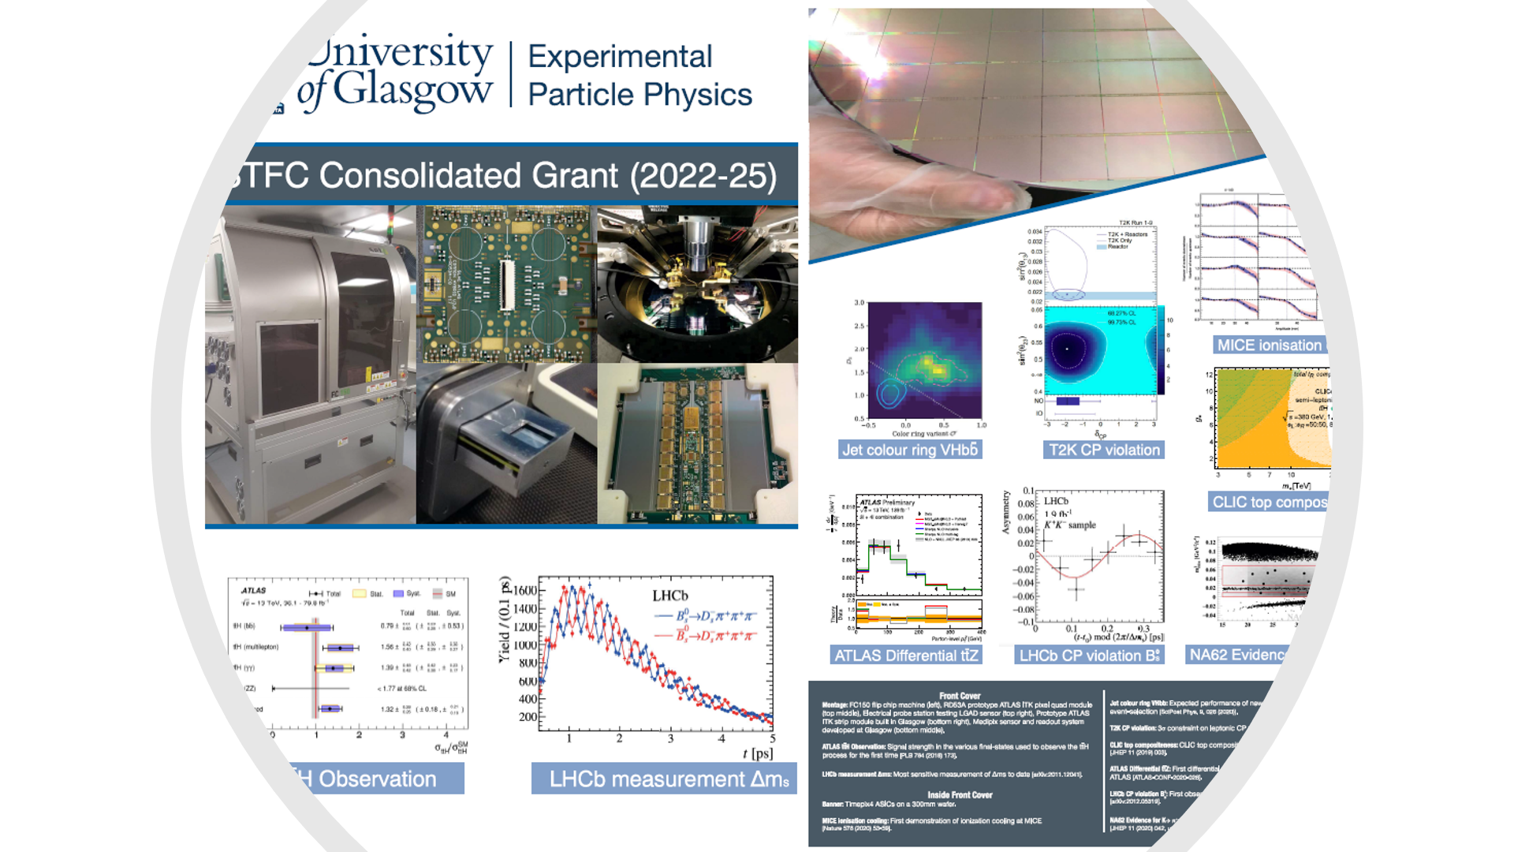
Under the Micro-scope
Building
Back
Better..

Slide 2
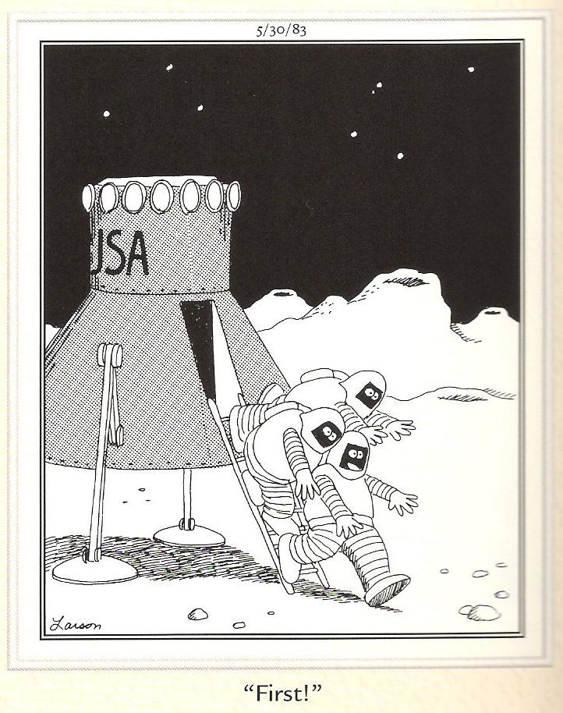
Research Goals
NPE
PPE
Optics
PPT
IGR
SSP
Astro
1st in terms of Funding
  #RAs/academic
  More grant applications
  Improve grant applications
  Recruit best people
  Identify well-funded areas
  Spin-off using prior expertise
1st to Discover
  Publications
  Patents
1st in Research Excellence
  Publications/academic
  Citations/academic
  Indicators of Esteem

Slide 3
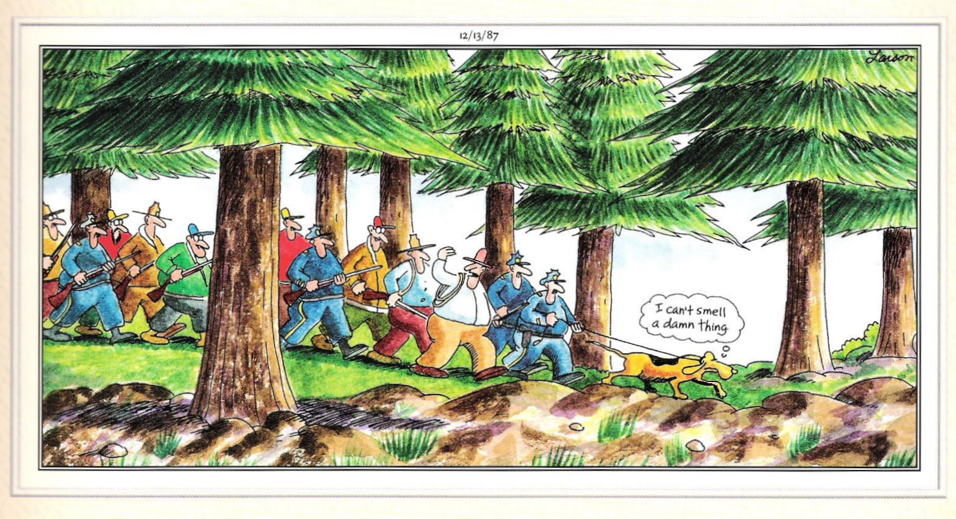
Providing Direction

Slide 4
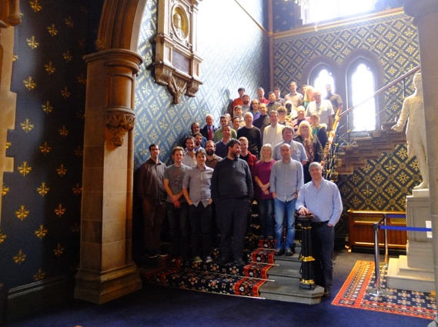

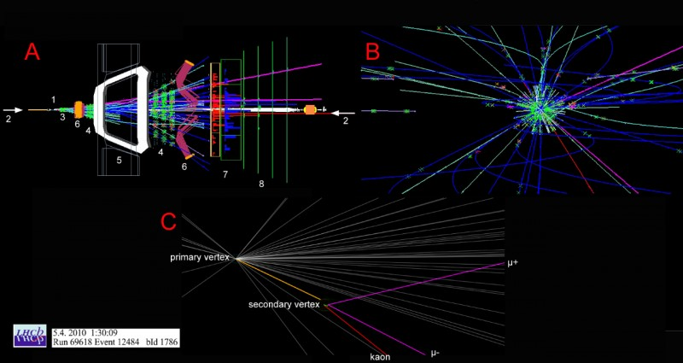
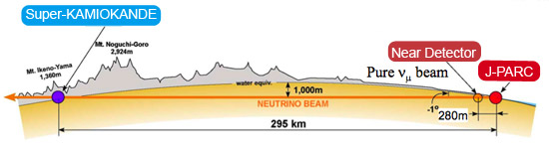
Particle Physics Experiment – build upon existing foundations
Research Group Leader: Tony Doyle
10 academic staff, 15 research staff, 2 electronic engineers, 4 technicians,
6 computing and administrative support staff and 30 research students
Total support ~£3m/annum (current STFC CG ~£1.8m/annum),
Including 3 Royal Society Fellows (Buckley, Howarth, Owen)
Including (this year) 2 Ernest Rutherford Fellows (Grillo, Whitehead)
We work on
Higgs, top quark, precision QCD, neutrinos and BSM physics searches
ATLAS, LHCb, NA62 and T2K experiments
Working towards
Future neutrino (HyperK) and linear (and circular) collider experiments
Development of detector systems esp. ATLAS & LHCb Upgrades
Incorporating Facilities leading to Spinout
Glasgow Laboratory for Advanced Detector Development (GLADD)
Flip-chip bonding and X-ray characterization Facilities
Internal collaboration with Electron Microscopy Facility
spinout of Timepix & Medipix3 detectors and (in 2021) TauProbes (Bates)
Experiments, Computing & Detector Development
  LISA orbit
We lead
UK MICE and Deputy HyperK (Soler)
UK GridPP (Britton) inc. new £13m Kelvin Data Annex Facility
International ATLAS Pixel Detector Upgrade (Buttar)
International CLICdp Collaboration (Robson)
UK Medipix and flagship Knowledge Exchange (O’Shea)

Slide 5
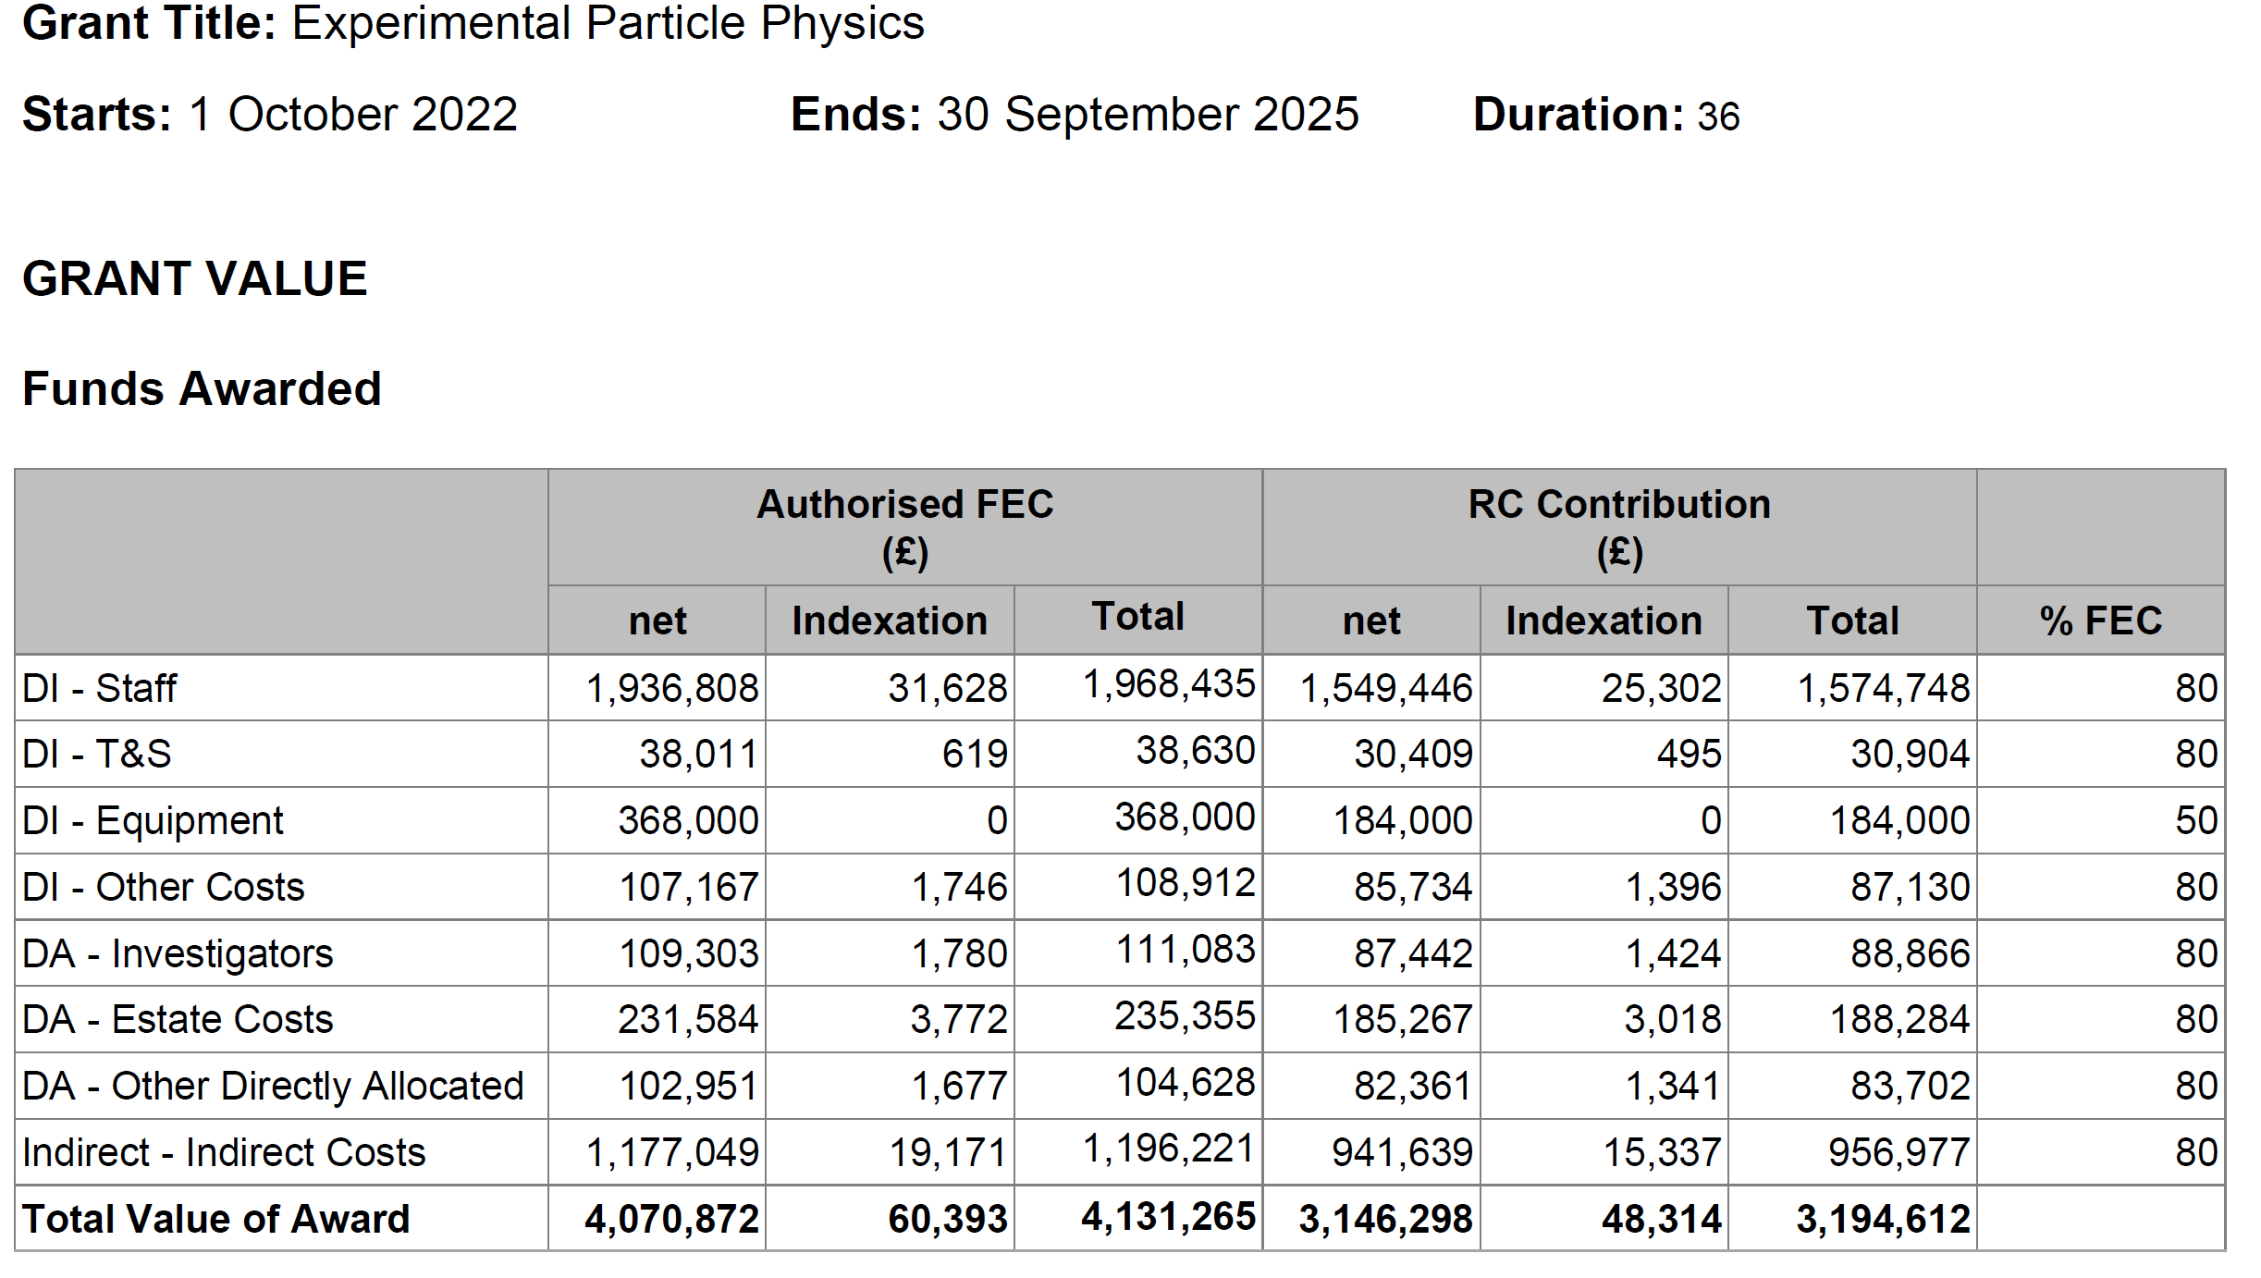
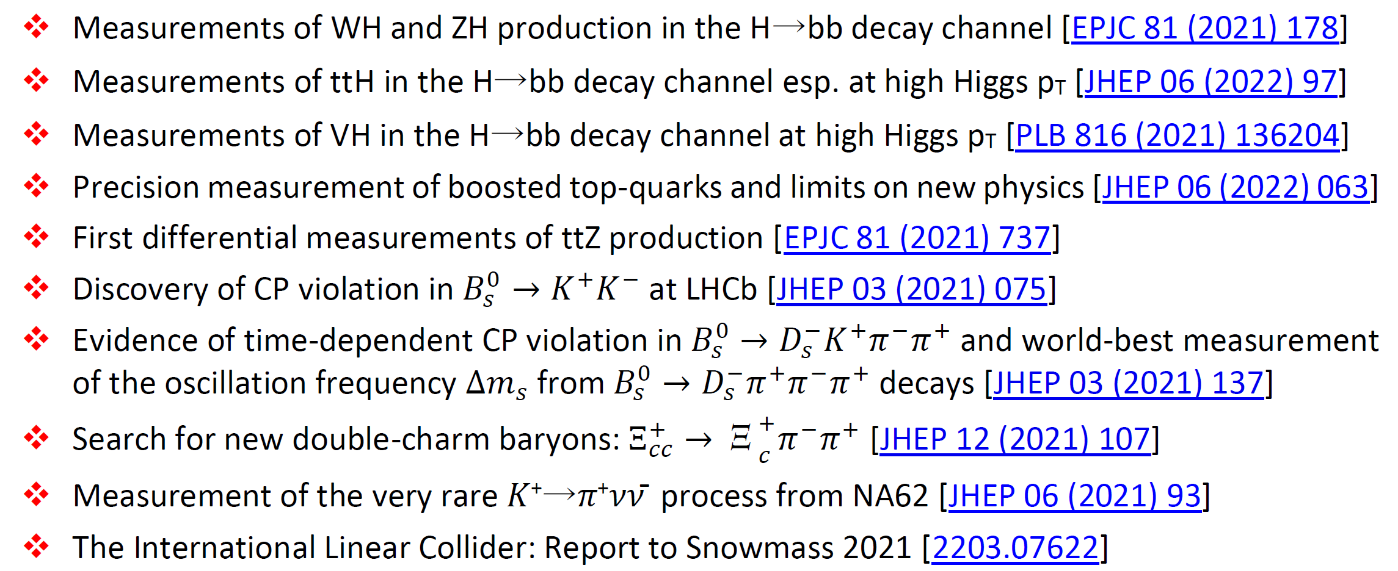
Recent Highlights
Input
Output

Slide 6
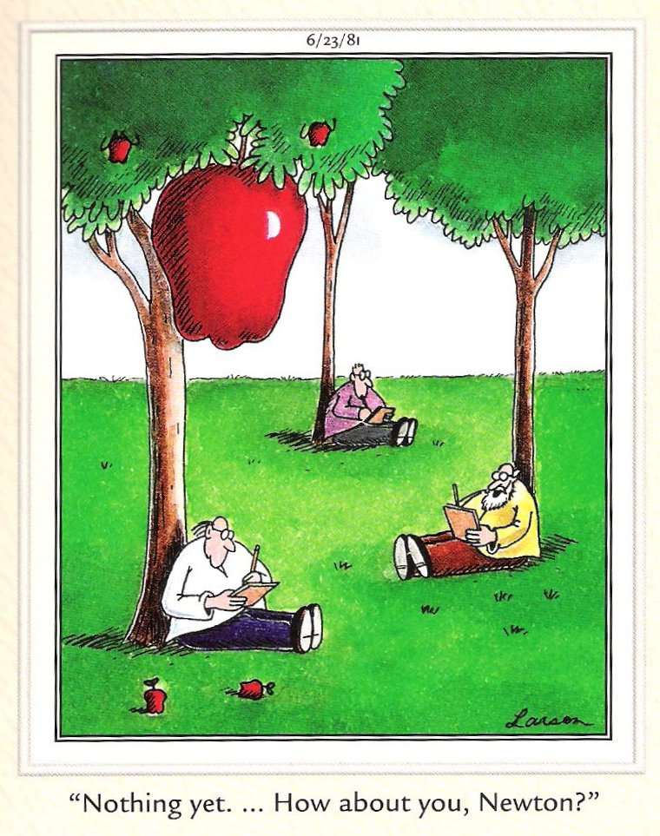
Shared Research Strategy
NPE
PPE
Opt
Dept
PPT
IGR
SSP
Ast
Srategy
Strategy
Strategy
Strategy
Strategy
Strategy
Strategy
Shared Research Strategy
PP
Strategy should always be designed to provide competitive advantage.
Shared research strategy
Starts from good ideas..
.. not a high-level strategy document

Slide 7
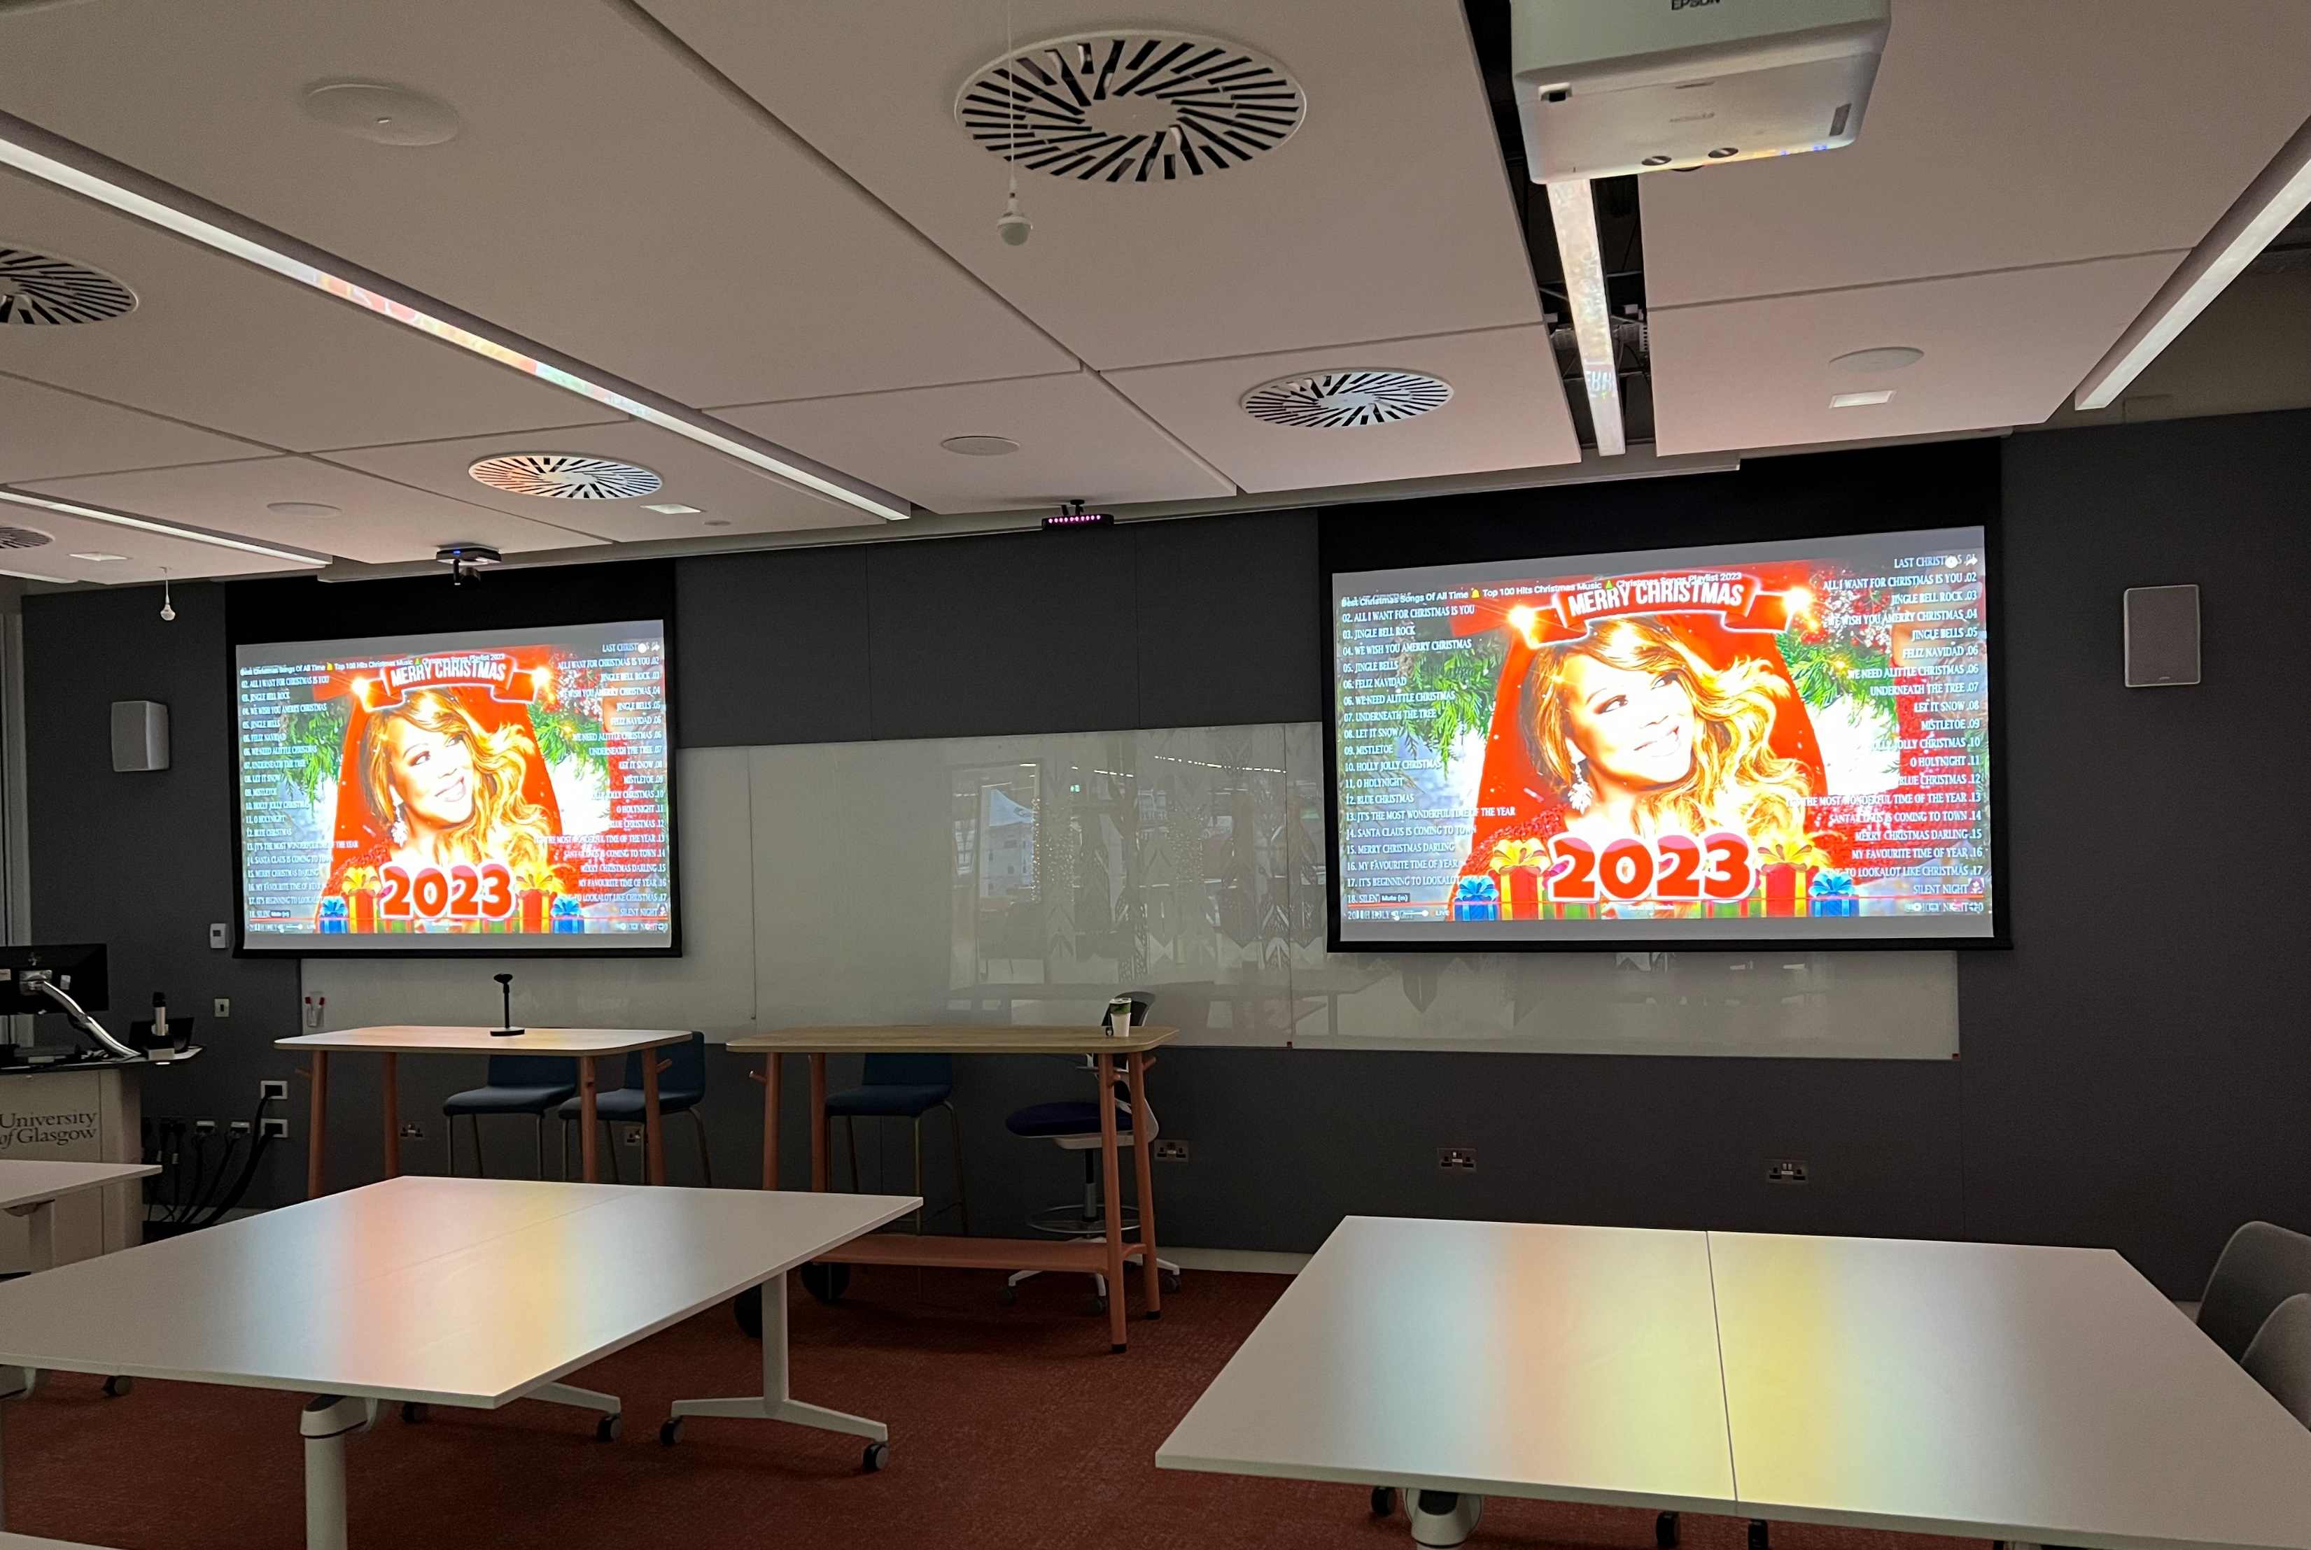
Entanglement Entropy – why we felt disconnected during lockdown and why we don’t live in the Marvel Universe of all the multiverses..

