Slide 1

Why we continue to do this?
What our students have been up to since 2019
Paul Soler, 16 December 2022
PPE PhD student factory in flavour physics since 2019 (9 theses):
  Cameron Dean: Time dependent studies of B->h⁺h'⁻ decays and research and operation for the VELO project at LHCb
  Murdo Traill: Searches for doubly charmed Baryons at LHCb
  George Coombs: Beam-Gas Imaging at the LHCb experiment
  Iain Longstaff (MSc): Hardware prototyping and thermal simulations of strip sensor, and simulation of transmission lines for the LHCb VELO upgrade
  Lauren Douglas: Measurement of the CP violation parameter in ΔY in D⁰ → π⁻ π⁺ π⁻ π⁺ decays
  Dana Bobulska: Doubly charmed baryon searches at the LHCb experiment
  Lai Hin Lam (MSc): Neutrino beam simulations of an extended target in T2K and neutrino interactions in BabyMIND
  David Friday: A time-integrated analysis of B_{d} → π⁺π⁻π⁺π⁻ at LHCb and simulations for Low Gain Avalanche Detectors (LGAD)
  Gavriil Chatzitheodoridis (with Strathclyde): Analysis of multiple Coulomb scattering of muons in liquid hydrogen

Slide 2
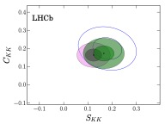
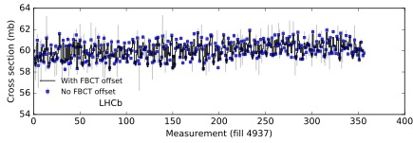
Discovery CP violation in Bs mesons (JHEP 03 (2021) 075)
($B^{0}→π^{+}π^{−},B_{s}^{0}→K^{+}K^{−})$Cameron Dean, Lars Eklund, Michael Alexander, PS
6.7σ
Beam-gas imaging (BGI) luminosity measurement
George Coombs, PS
Preliminary 2016
Currently, there is a re-analysis of all the Run-2 BGI luminosity and first look at Run-3 BGI luminosity by Niall McHugh

Slide 3




Search CP violation in $D^{0}→π^{+}π^{−}π^{+}π^{−}$
Lauren Douglas, Lars Eklund, Michael Alexander, PS
George Coombs, PS
$$D^{0}→K^{−}π^{+}π^{−}π^{+}$$
$D^{0}→π^{−}π^{+}π^{−}π^{+}$ blinded
Search $Ξ_{cc}^{+}→Ξ_{c}^{+}π^{−}π^{+}$
Dana Bobulska, Lars Eklund, Patrick Spradlin, PS
Global significance: 2.9σ
Set upper limits on production:

Slide 4
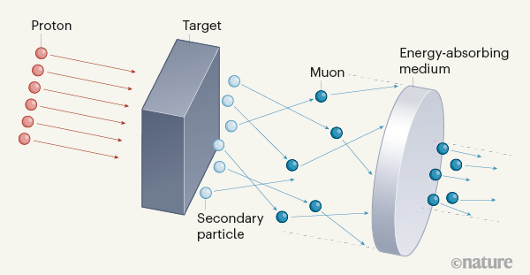
New extended target for T2K and Hyper-K
Lai Hin Lam, Phill Litchfield, Lucas Machado, PS
Extended SiC target
Graphite target
Increases flux by 3% and reduces wrong-sign contamination by 12% ⟹ overall 15% improvement
Multiple scattering muons in LiH and liquid-H₂ (MICE)
Gavriil Chatzitheodoridis, Kevin Ronald (Strathclyde), John Nugent, PS
Ionization cooling
LiH
Phys. Rev. D106, 092003, (2022)
Liquid H₂

Slide 5
What’s in a name?
That which we call a rose by any other name would smell as sweet …
Evolution title thesis by David Friday (Vendredi, Venerdì, Freitag, Piątek, Viernes, Vineri, Vrijdag, Sexta-feira, 金曜日 Kin'yōbi, ….) over time:
  Unemployment Final Edition (pre-May)
  The “little” book on why I’m good at physics (May)
  If I’d wanted to see penguins, I’d have gone to the zoo! (July)
  Turn back, ye have been warned! (July)
  So many amplitudes, so little time (August)
  A charming light at the end of this charmless tunnel (beginning September)
  A charmless and timeless analysis of B_{d} → π⁺π⁻π⁺π⁻ (mid-September)
  A charmless, timeless and tasteless amplitude analysis of B_{d} → π⁺π⁻π⁺π⁻ (end-September)
  A time-integrated analysis of B_{d} → π⁺π⁻π⁺π⁻ at LHCb and simulations for Low Gain Avalanche Detectors (LGAD) - final
(boring but accurate title)

