Slide 1


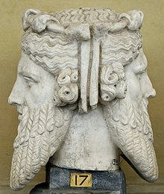
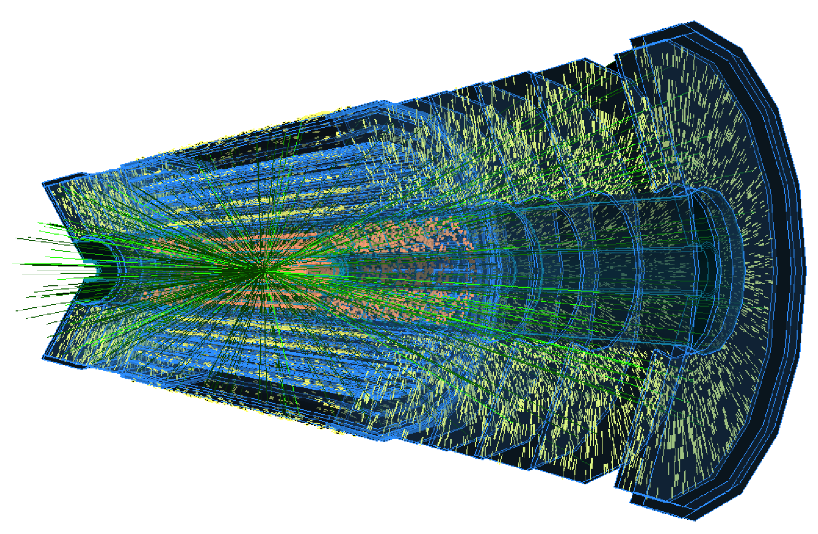
Kenneth Wraight
Oh, my God(s)!
The Janus in Atlas
  The Standard Case
  Case Study: ITk Production Database
  Balance?
  Christmas 2022 talk

Slide 2
2
The Standard Case
The World is Open
Nothing demands a specific way of life – nothing is epistemically given
But for any way of life some local order is required
Some predictability – certainty and safety
Coordination of activity – group effort
Standardisation
Enables productivity in predictable ways through conformity of resources
Stifles creativity and suppresses disruptive change
→ There is a tension between conformity and creativity
Weber’s warning:
The fate of our times is characterized by rationalization and intellectualization and, above all, by the disenchantment of the world.
+ Lesson from the Natural World – a vast, but finite, dataset
Great diversity in how order is achieved

Slide 3
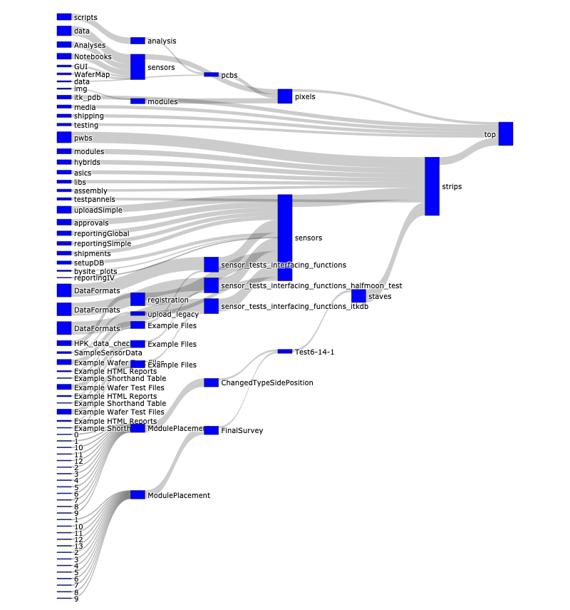

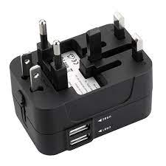

3
Case Study: ITk Production Database
Scale of Atlas Inner Tracker (ITk) production involves large tracking dataset
~9,500 pixel modules; ~17,000 strip modules
Inter-continental, multi-stage production chain
Common Production Database (PDB) for all ITk projects
Store data & images for production QA/QC (components x stages x tests)
Functionality: registration, shipping, test upload, reporting
Many users of the database from difference sub-(sub-(sub-))groups
Diverse user profiles: technicians, engineers, RAs, students, academics
Each solving problems of what to store and how to store it
API (Application Programming Interface) –middle-guy
Standardised upload protocols and data schemas (json)
Custom interfaces: GUIs, webapps, notebooks, scripts and scripts and scripts
Uploading
Reporting

Slide 4
4
Upload Anatomy
PDB API uses a TestRun Schema for uploads - a dictionary in 3 parts:
Header
"component": "..."
"testType": "MODULE_IV_PS_V1"
"institution": "GL"
"runNumber”: "007"
"date": "2022-12-15T13:24:29.281Z"
"passed": true
"problems": false
Properties
Parameters relevant to a test but not the result of a test, e.g.
Instrument or operator of measurement equipment
Temperature and humidity of an IV test (voltage vs. current)
Results
Parameters of interest
Standard
Nested standard +1
(+ file attachments)
(+ comments)

Slide 5
5
A Hundred Flowers Bloom
ITk groups: projects (strips, pixels) and activities (sensors, chips, modules) find various strategies to data-structures
Consequences for data-retrieval, e.g. reporting (more to come)
E.g. Cultural preference - simple
There is no universal distinction of “properties” and “results”
E.g. IV temperature in result (property) for strips (pixels)
E.g. Structural Anarchy - advanced
Tests have various data-structures
Values can be singles, (nested) arrays, (nested) dictionaries, combinations
A couple of highlights:
Strips Metrology: (ordered) list inside dictionary inside a dictionary 😒
Strips Wire bonding: dictionary with keys as numbers and values describing the numbers 😞
…

Slide 6
6
Zoom in: Perverted Dictionary
KEY
:
VALUE
Traditional:
KEY – name of the thing being stored
VALUE – the thing being stored
Novel:
KEY : the thing being stored
VALUE: explanation of the thing
Rejoice in the enchantment of this creative data biosphere! 🤯

Slide 7
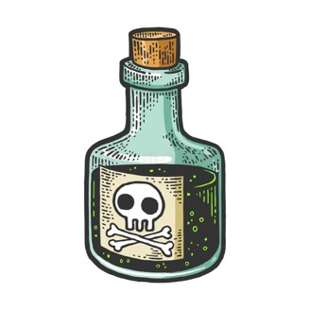
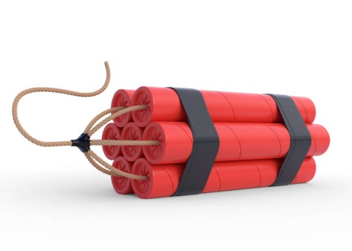
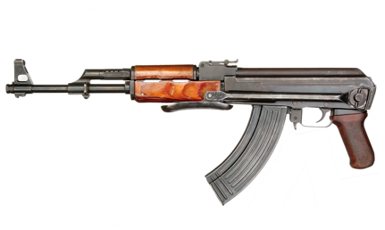
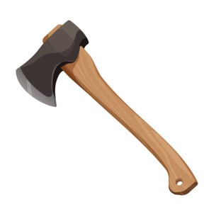
7
Reporting: Revenge of Reason
Reports based on database inputs are desirable
Standard tasks to all groups
Monitor QC/QA of produced components
Monitor production rates
In addition bespoke missions to check correlations
Test-test, part-part, site-site
Retrieving data from the (populated*) Production database takes “wrangling”
Creativity is an obstacle
The number of cat skinning methods must be reckoned with
*another story

Slide 8
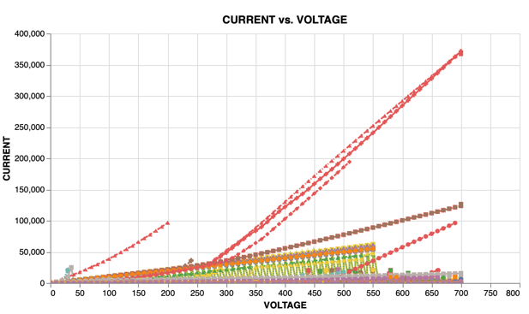
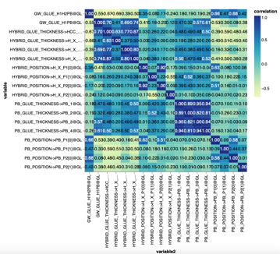
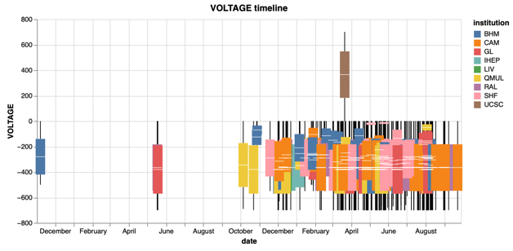
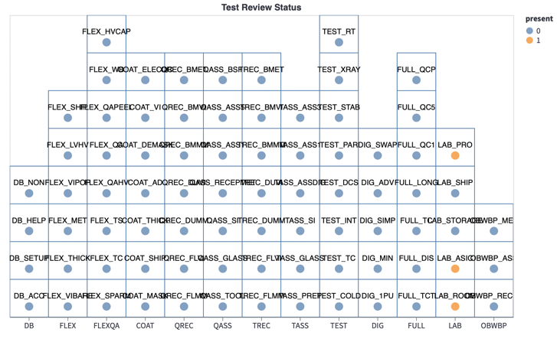
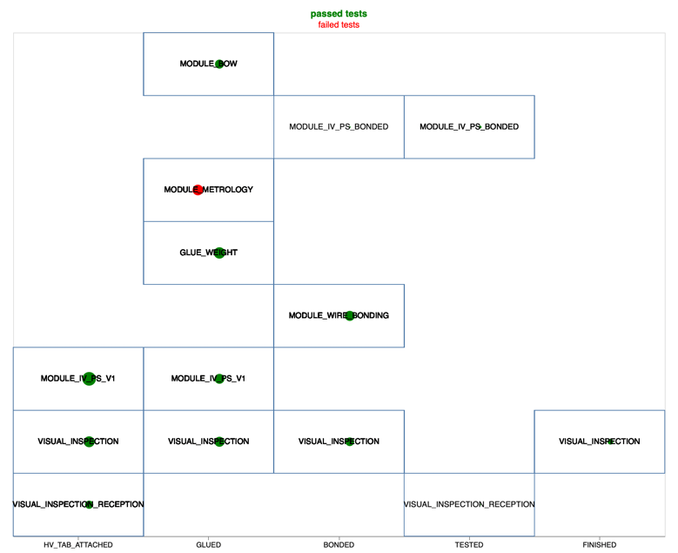
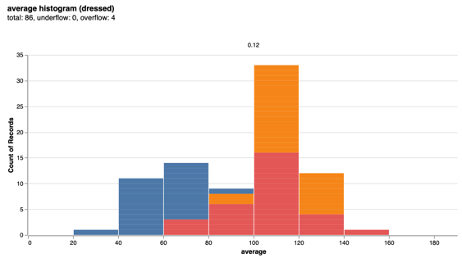
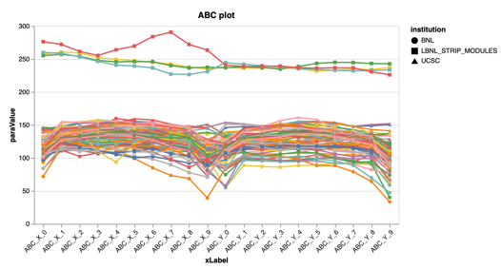
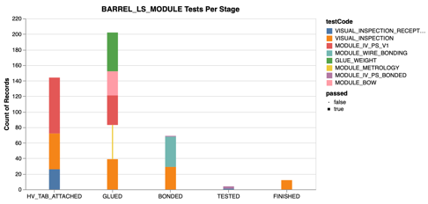
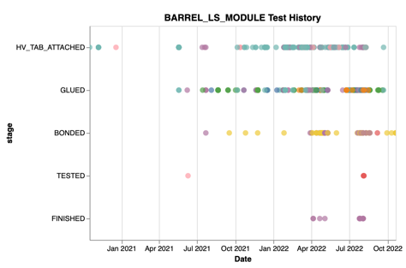
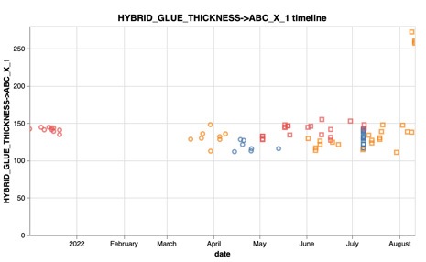
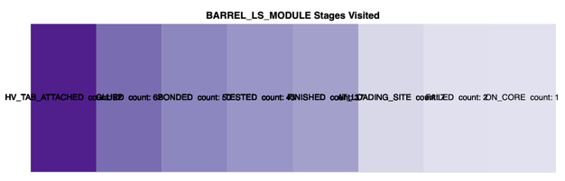
8
Balance?
In the end… or rather, in practice… balance is
an unending battle
Or perhaps better an open door
The draft continues…
weekdays 9* to 5** in room 329b***
* Likely a bit after due to schoolrun
** Probably on again a bit later with
infrequent breaks between due to
work-life balance
*** Home working 2-3 days a week

