Slide 1
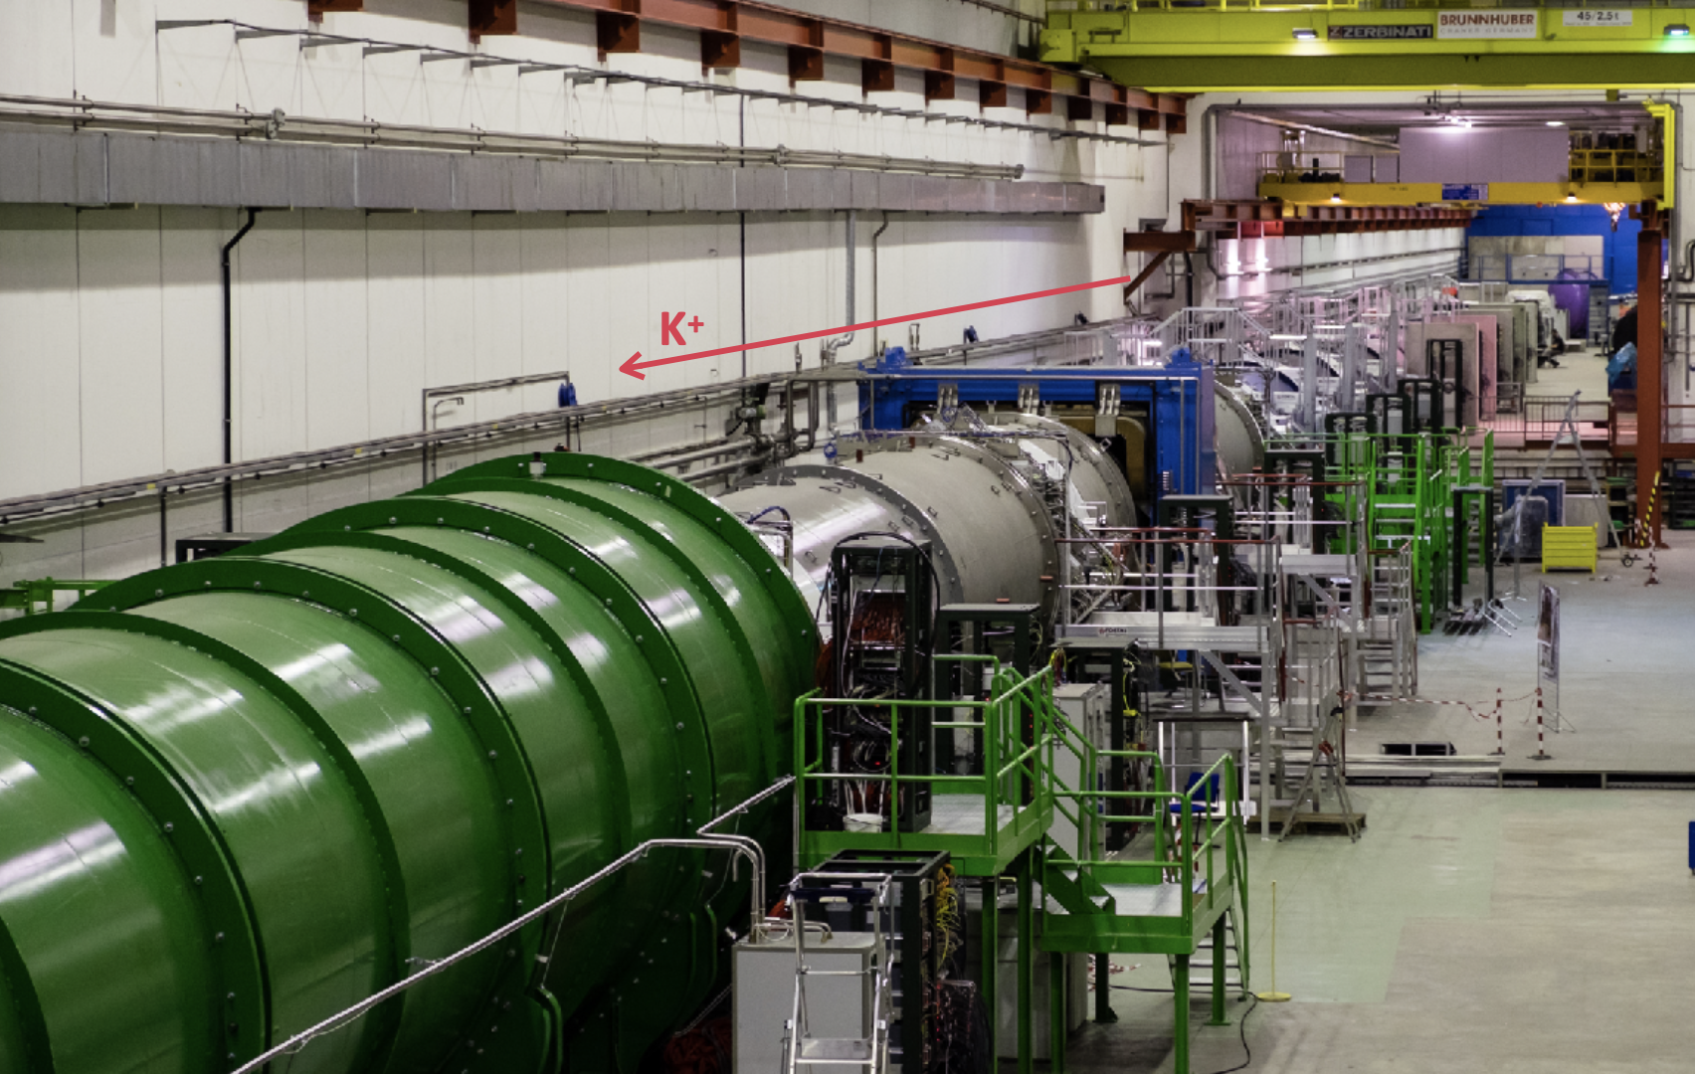
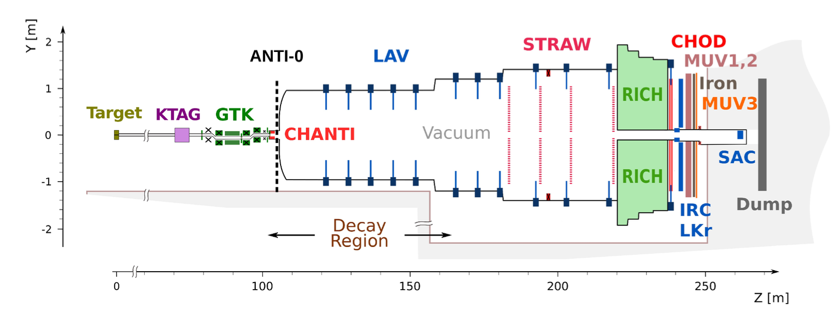
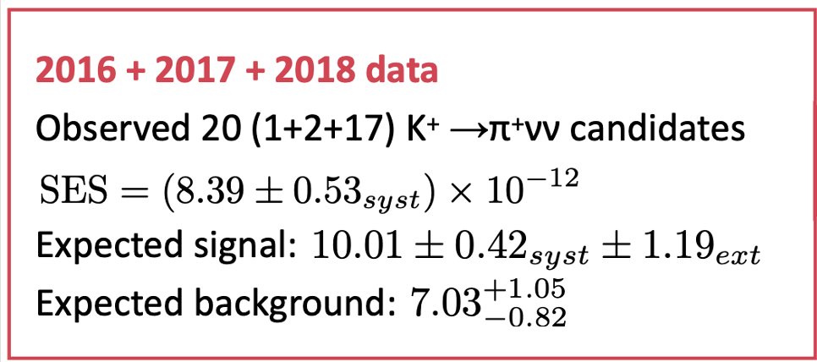
NA62 Overview
Main goal is measurement of K⁺ → π⁺ ν ν
FCNC processes with highest CKM suppression
Theoretically very clean
Hadronic matrix elements can be measured from K_{l3}
Theory predicts: (8.4 ± 1.0) x 10⁻¹¹
In Run1 (2016-2018), experiment measured:

Slide 2
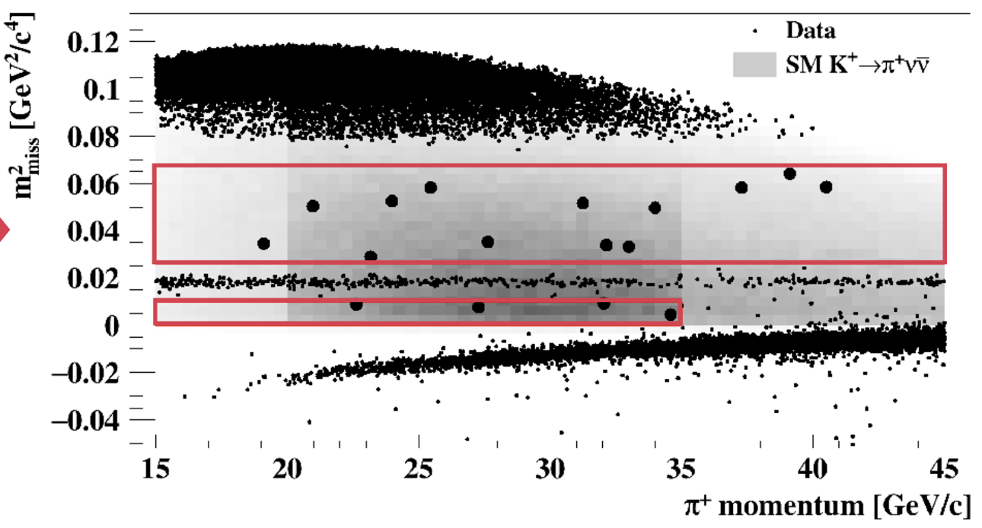
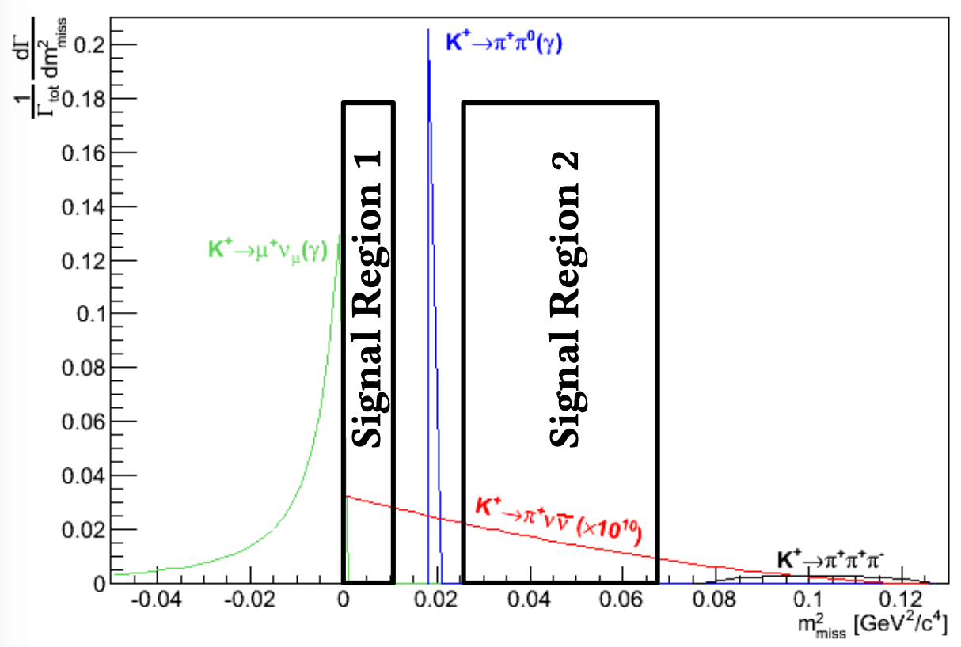
2018 Events

Slide 3
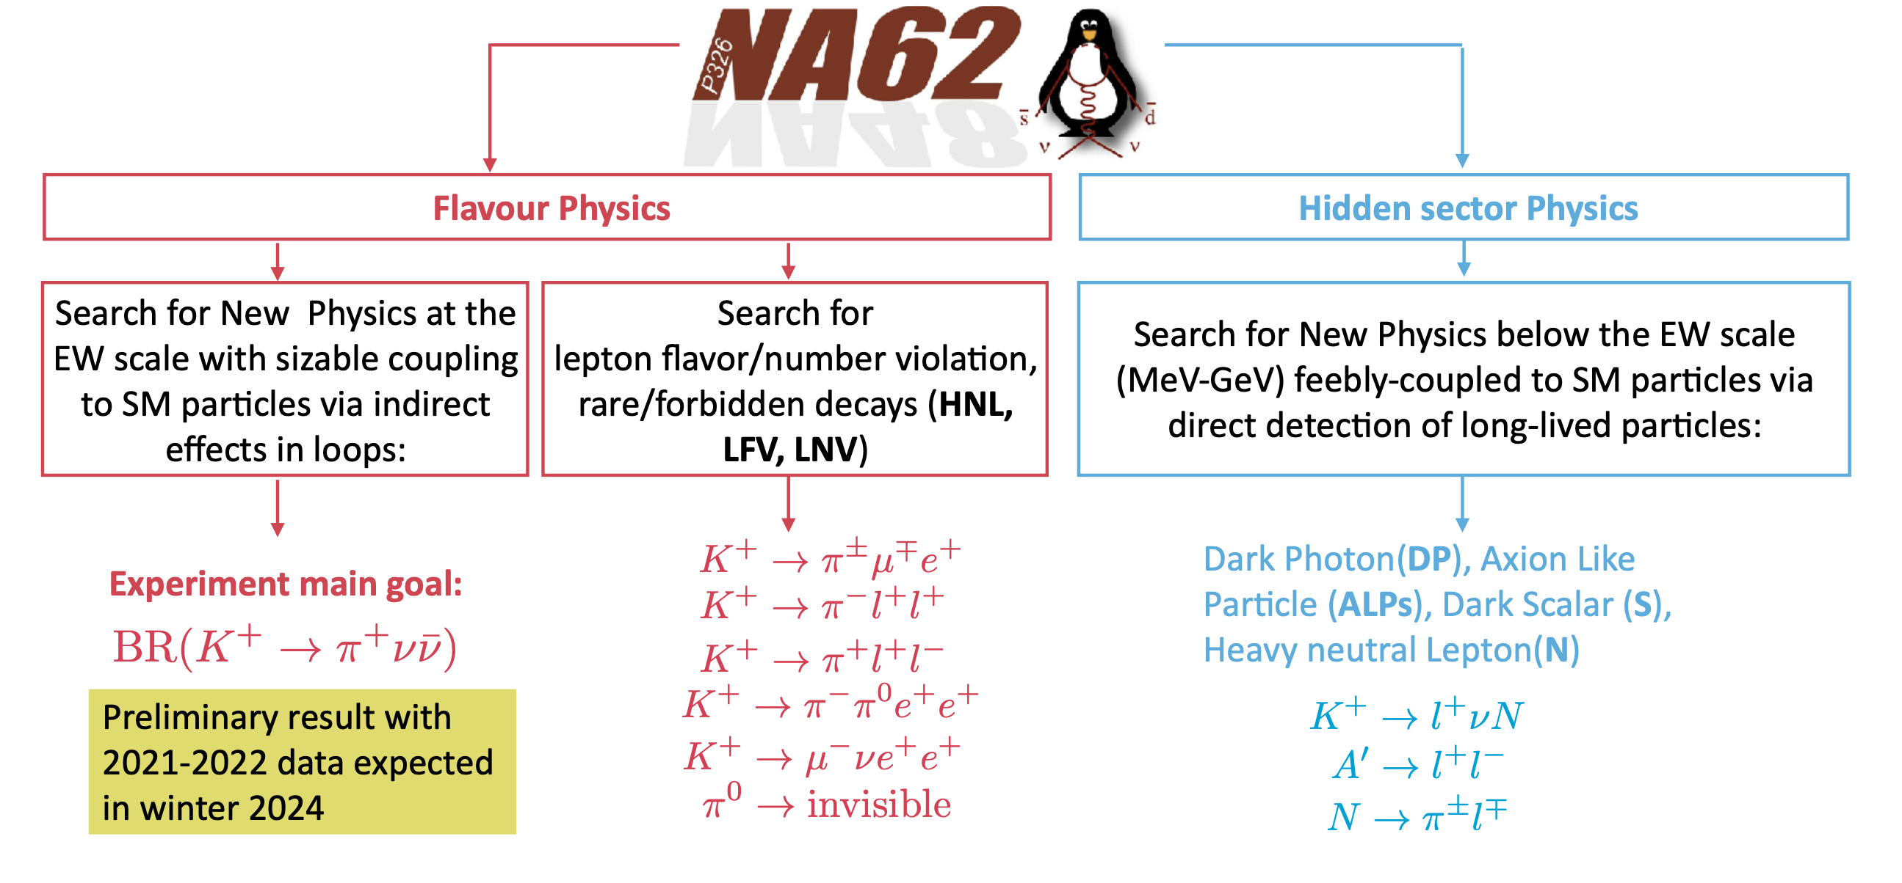
NA62 as a Multi-Purpose Detector
sizeable

Slide 4

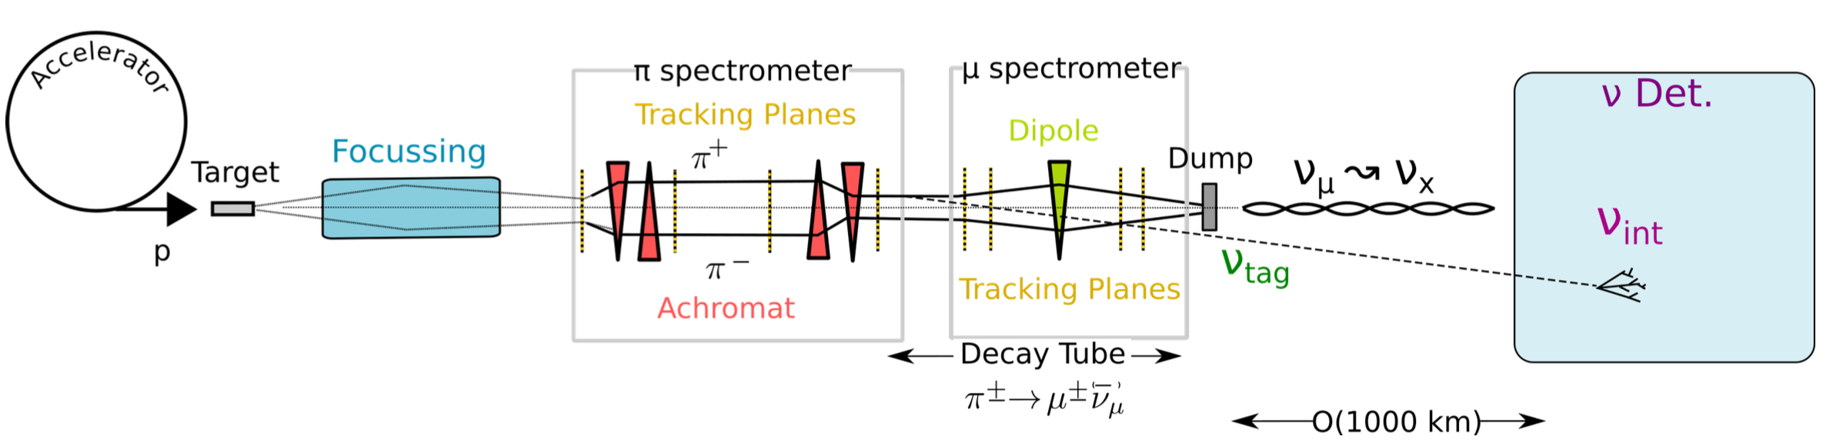
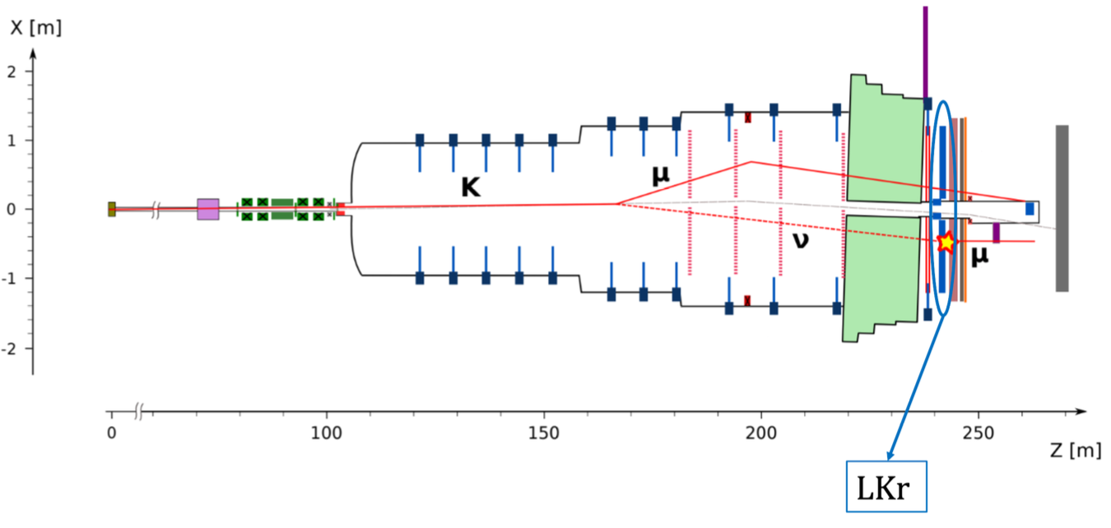
Example: Neutrino Tagging
Neutrino Tagging:
New paradigm for accelerator-based ν experiments.
Kinematically reconstruct each detected ν in association with the decay from which it was produced.
Kinematic constraints give much (15%→ 1%) better energy resolution.
NA62 Proof-of-Principle:
𝐾+ main decay channel: 𝐾⁺ → 𝜇⁺ + 𝜈_{𝜇}
Look for:
  𝐾⁺ in beam spectrometer
  𝜇⁺ in downstream spectrometer
  𝜈 interacting in the EM calorimeter (20 –tons of LKr) via CC-DIS
  𝜈 → shower + 𝜇−

Slide 5
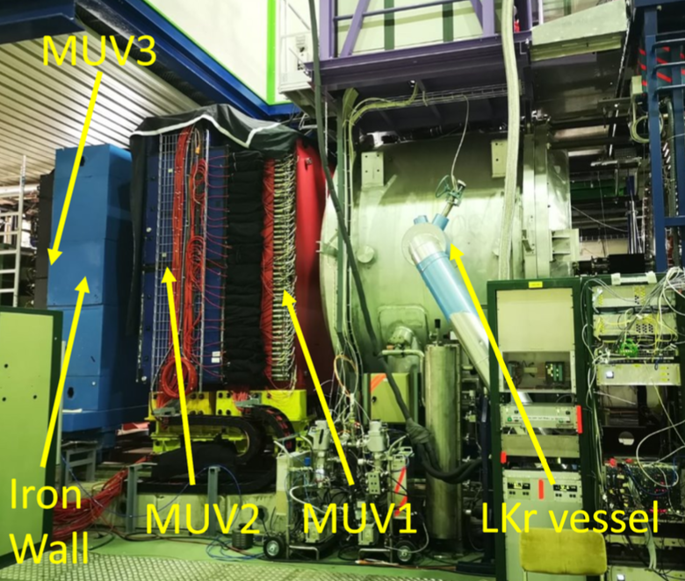
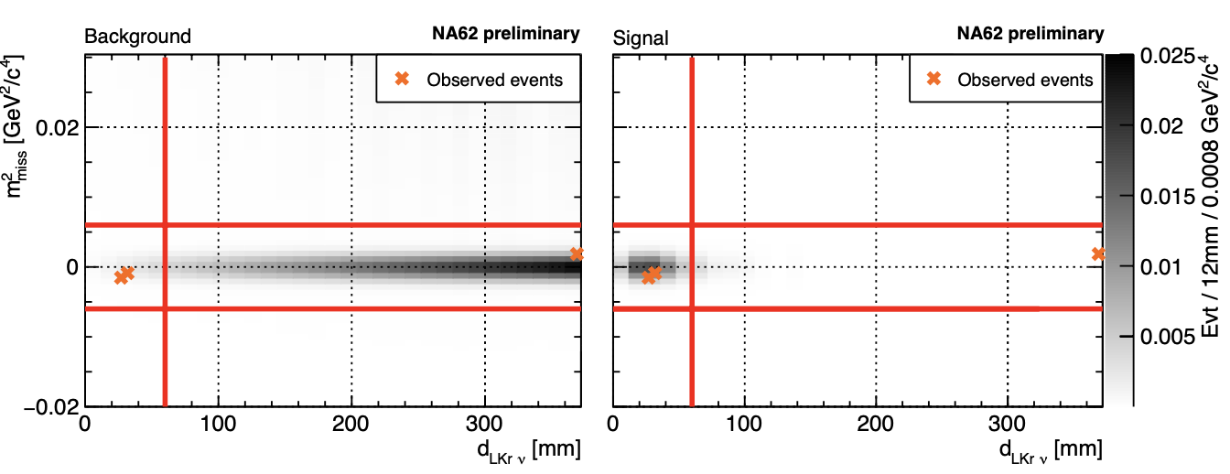
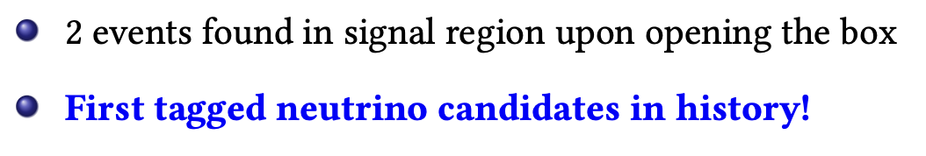
First Tagged Neutrinos (2023)

Slide 6
Glasgow Contributions
It’s all ‘part-time’ and ‘best-effort’. There is no funded effort other than my 10% NA62 on CG.
Dan Protopopescu (GridPP support for non-LHC Experiments)
Ian Skillicorn and Alan Norton (Emeritus)
Recent contributions include:
Grid simulations (Dan’s major responsibility)
Data quality monitoring
Synthetic data
GTK hot pixel monitoring
Beam Quality Indicators

Slide 7
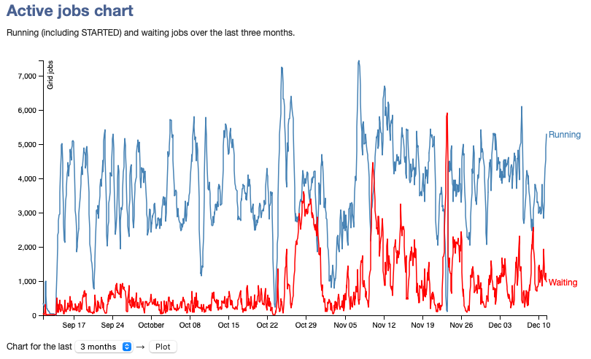
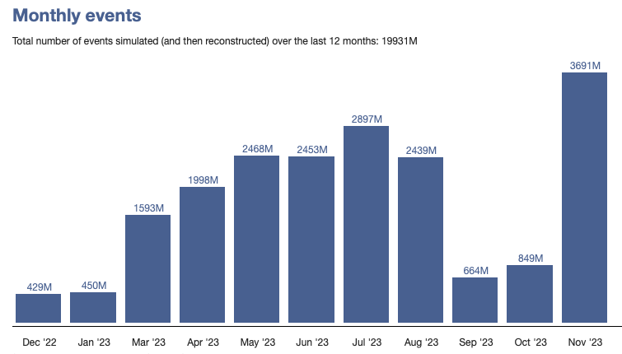
Large Scale Simulations
Custom fully automated grid simulation system, with 99.999% uptime since 2013
NA62 VO supported by 12 sites (9 GridPP, 2 EU, and CERN)
Since 2013, 6.5 PB of data generated which goes to CERN, with a backup tape copy at RAL.
Currently 4.2PB of MC/reco stored at RAL on tape.
20 billion full-sim events in last year or 70 Billion if you include fast simulations
6000 ------------------------------------------------------------------------

Slide 8
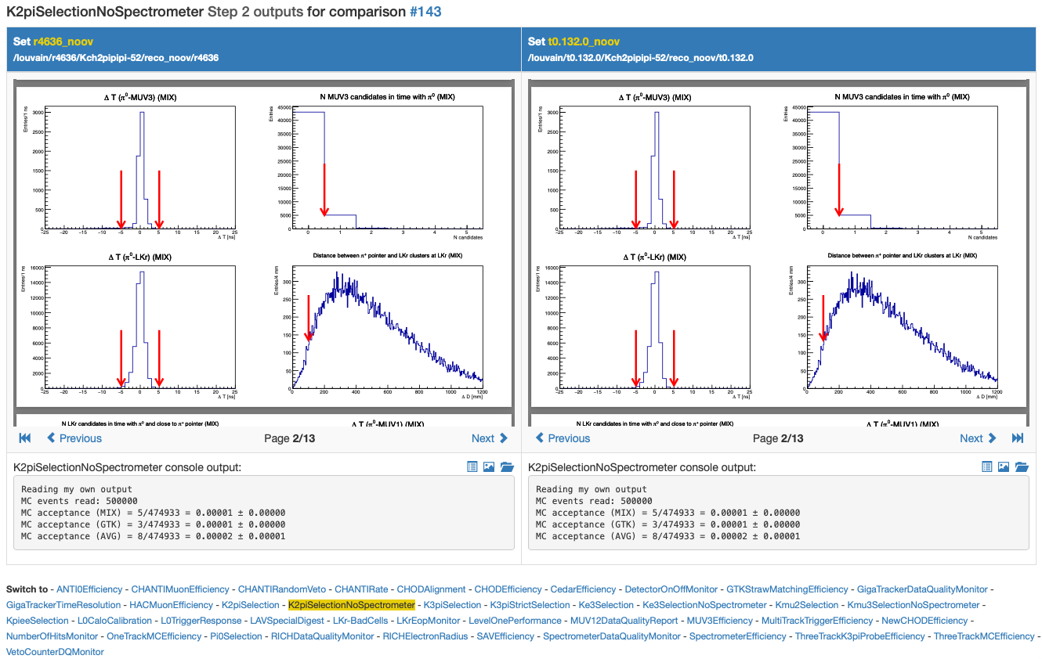
Data Quality monitoring tools
Grew out of some work we did to improve effectiveness of data-quality shifts during lock-down.
Allows MC-MC, Data-Data, and Data-MC comparisons.
System analyses two inputs and displays metrics and plots side-by-side. Users just have to select the datasets via a web UI.
MC – validation Interface

Slide 9
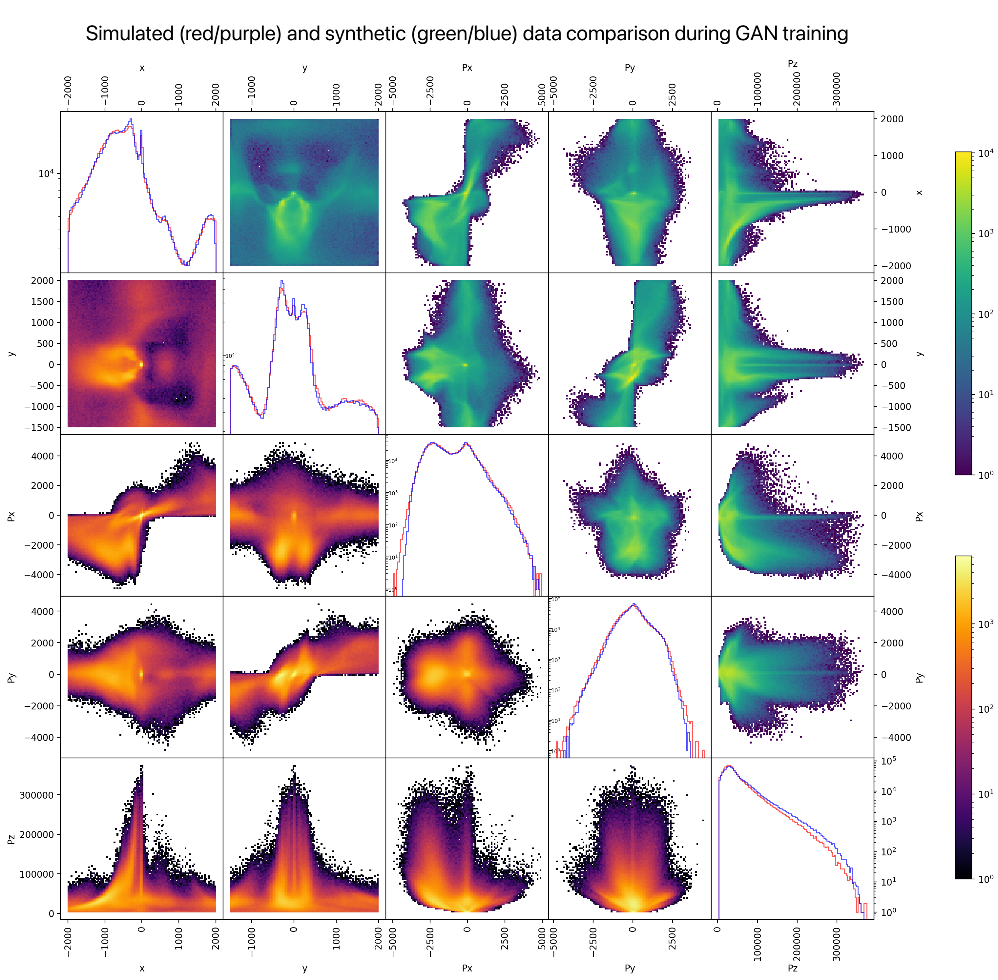
Generating Synthetic Data using a GAN
Biggest issue in Run1 was ‘upstream background’.
This is a beam halo.
Limits physics result.
NA62 simulate this using BDSim but time-consuming.
We developed a Generative Adversarial Network (GAN) trained on BDSim to generate additional data much faster.
Started as a summer student project
New Veto counters in (most of) Run2 have helped.

Slide 10
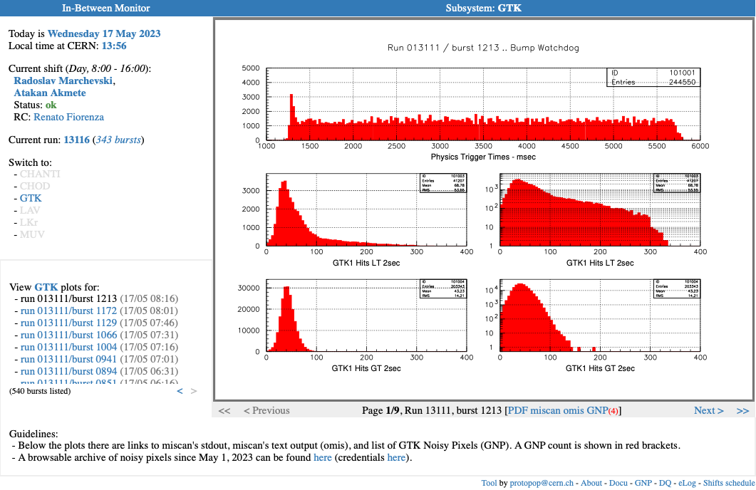
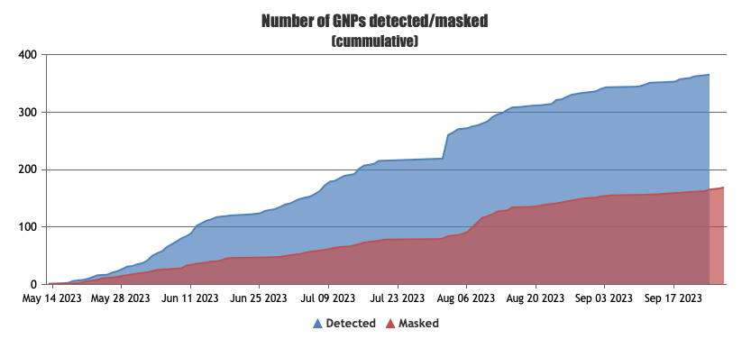
GTK Pixel Monitoring
Developed a system to monitor hot pixels in the Giga-Tracker by analysing raw data bursts; complements info from other online data quality analysers. This information, together with pixel masking info, is held in a database, browsable online.

Slide 11
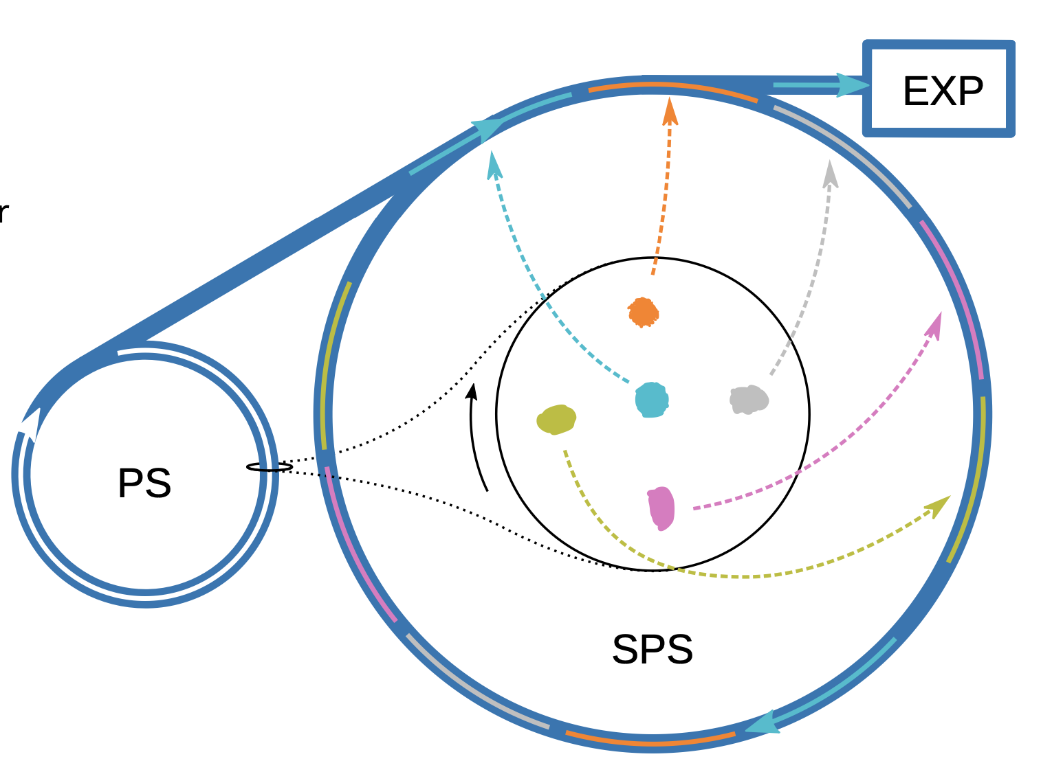
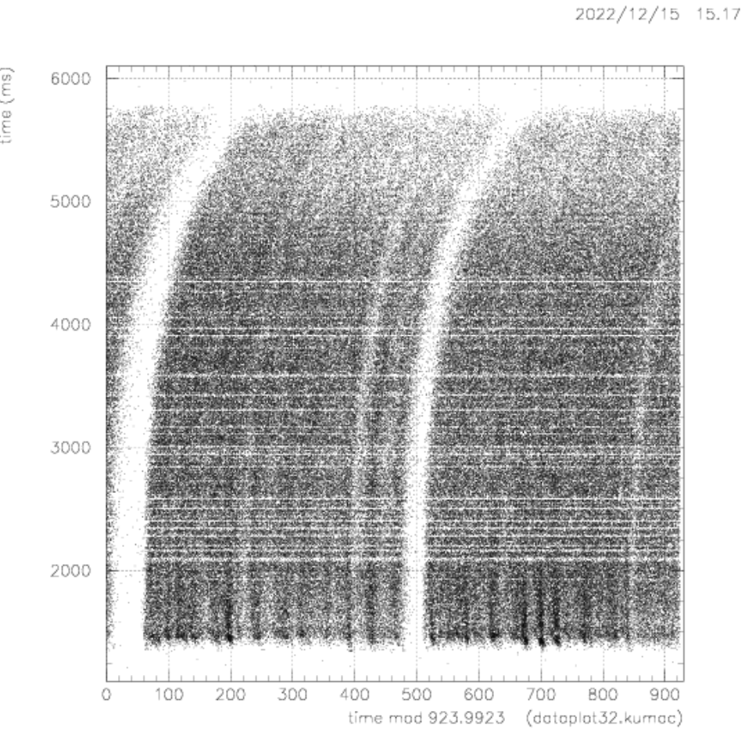
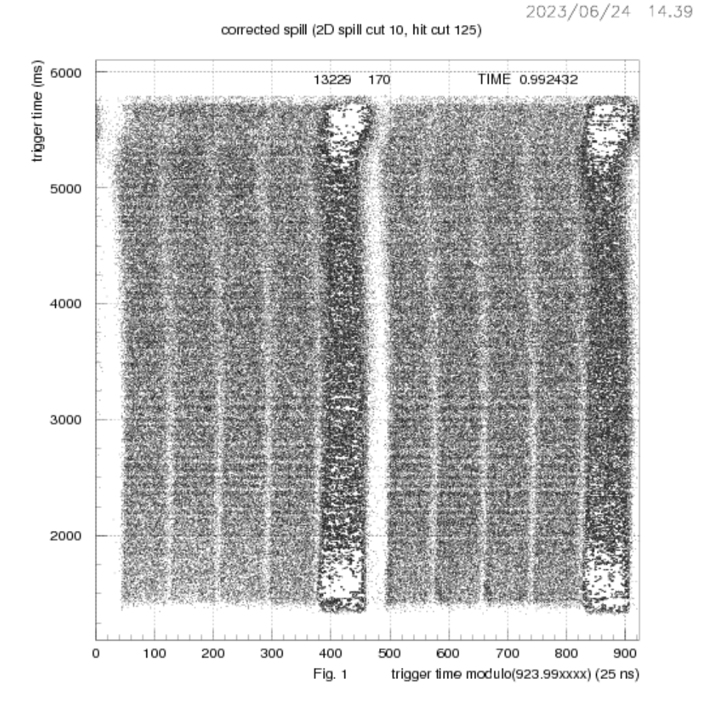
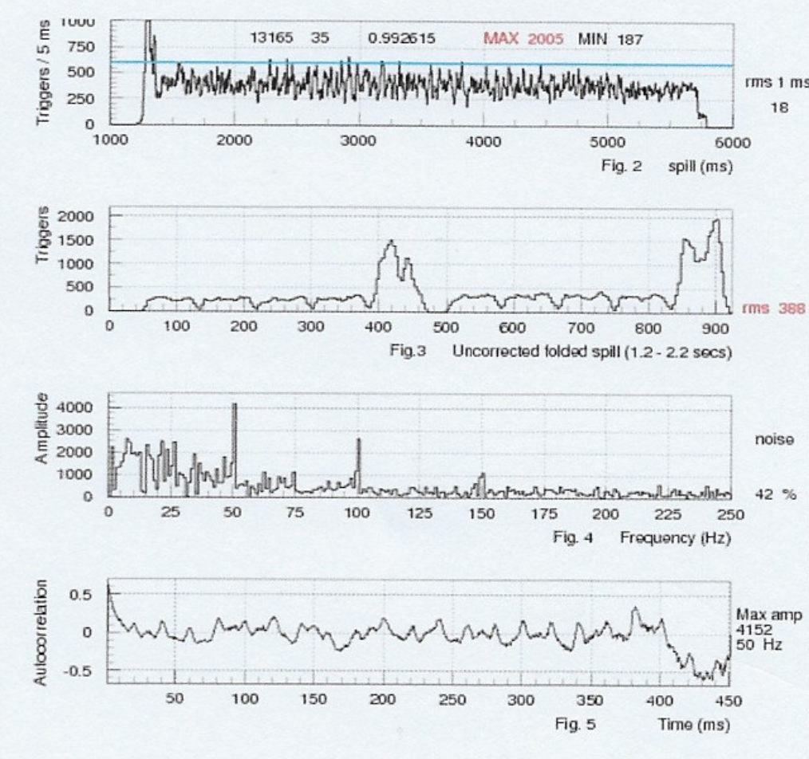
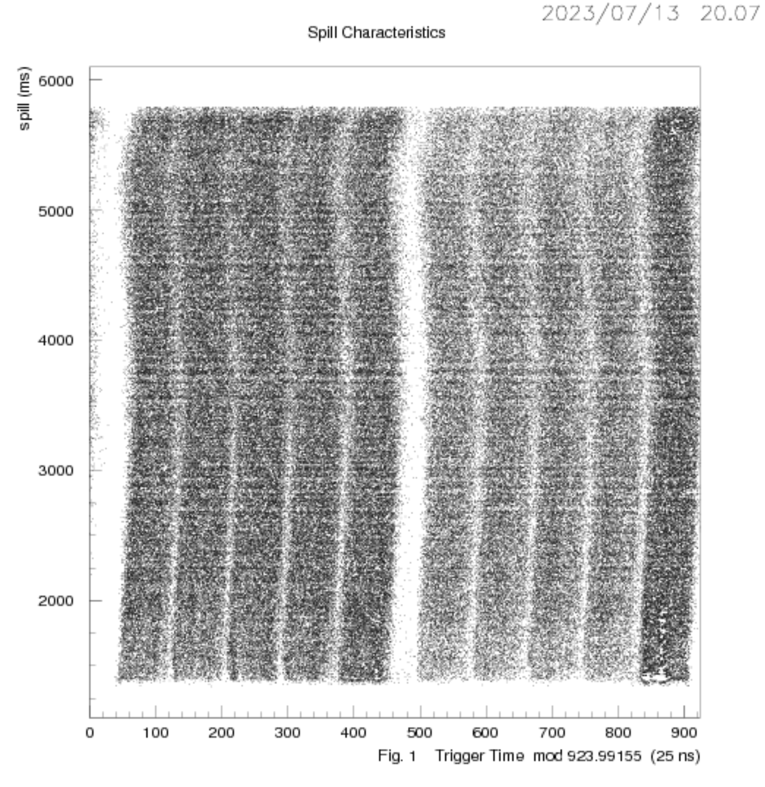
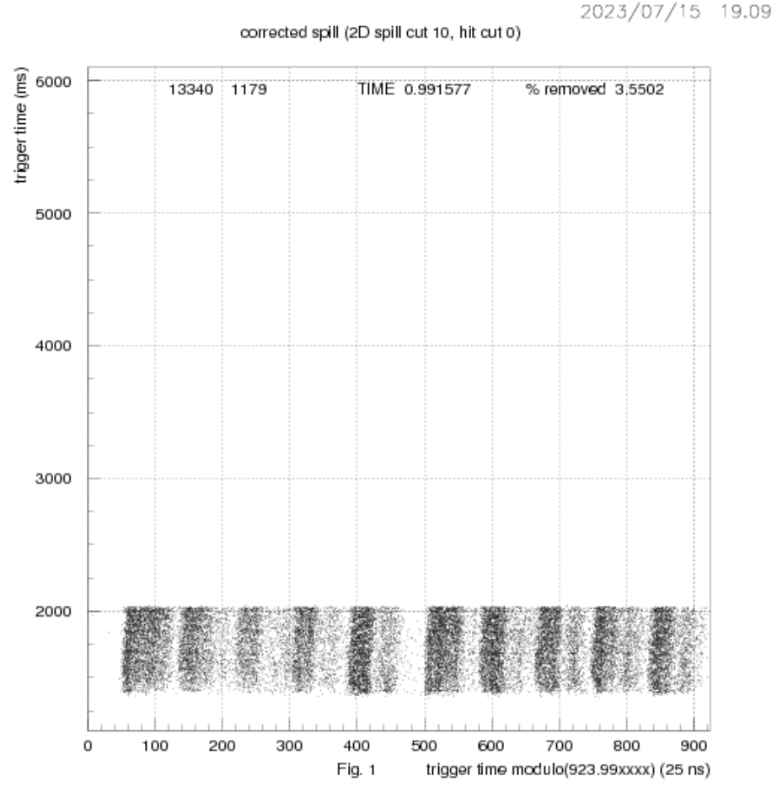
Beam Quality Indicators – BQI
Spill Plots
This shows the timing of NA62 triggers for a single burst
Burst Time [ms]
Max (e.g. ’The Bump’)
Min (unlikely to be a problem in itself).
Harmonics (e.g. 100Hz)
Low frequency ‘Noise’
Local density
Folded Time (Burst Time % 923.99ns) [ns]

Slide 12
Summary
NA62 group at Glasgow is very small.
Our main role is to enable production of the MC simulations that underpins all NA62 physics results.
But we also contribute on a range of technical issues.
Unfortunately, we don’t have the capacity to contribute full-time effort to time-critical physics analyses.
We have tried and failed to get CG funded RA for many years that, in turn, would enable a student and a physics involvement.
Future?
  NA62 takes data till end of Run-3; analysis will take another 2? Years.
  High Intensity Kaon Experiment (HIKE)? Proposal competing with SHIP for NA.

