Slide 1

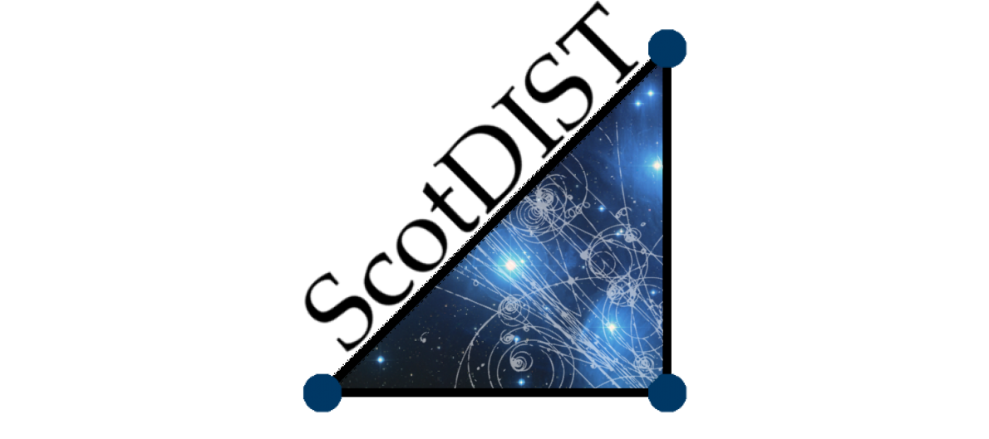

The application of neural networks in observational solar physics
John Armstrong and Lyndsay Fletcher
j.armstrong.2@research.gla.ac.uk

Slide 2
Outline
Motivations
Correcting for atmospheric seeing in flare observations using generative adversarial networks (GANs)
Image-based feature recognition using convolutional neural networks (CNNs)
Future endeavours

Slide 3
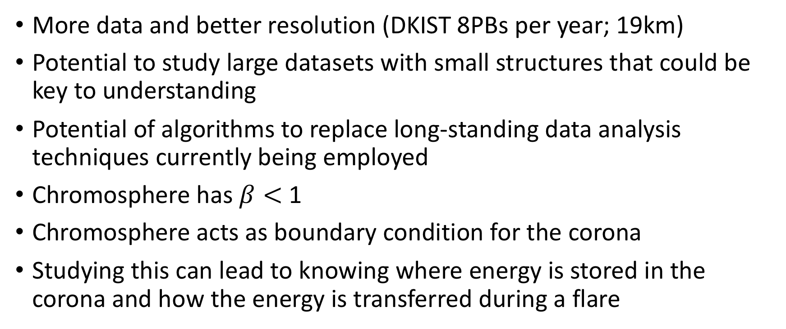
Motivation
More data and better resolution (DKIST 8PBs per year; 19km)
Potential to study large datasets with small structures that could be key to understanding
Potential of algorithms to replace long-standing data analysis techniques currently being employed
Chromosphere has $β<$ 1
Chromosphere acts as boundary condition for the corona
Studying this can lead to knowing where energy is stored in the corona and how the energy is transferred during a flare

Slide 4
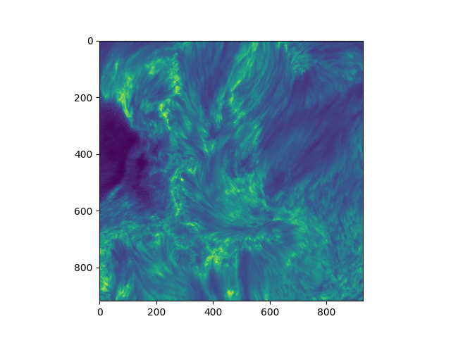
Learning to correct for atmospheric seeing with GANs I
Flares are rare
Any reconstruction that can be done on the data would add value to the observations

Slide 5
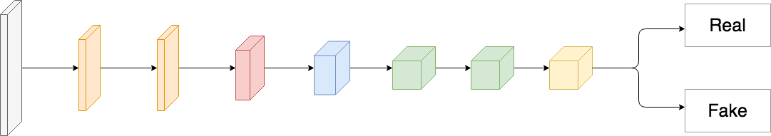
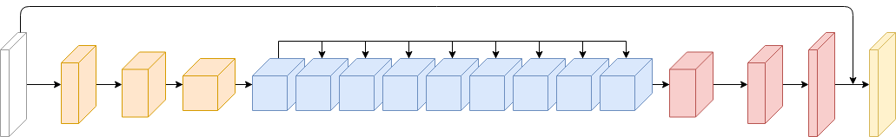
Learning to correct for atmospheric seeing with GANs II

Slide 6
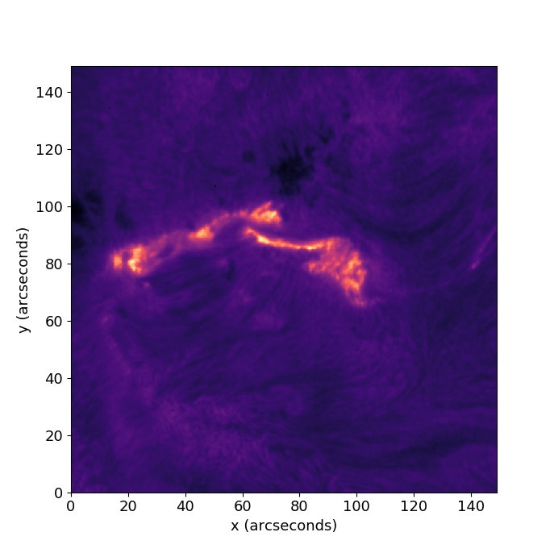
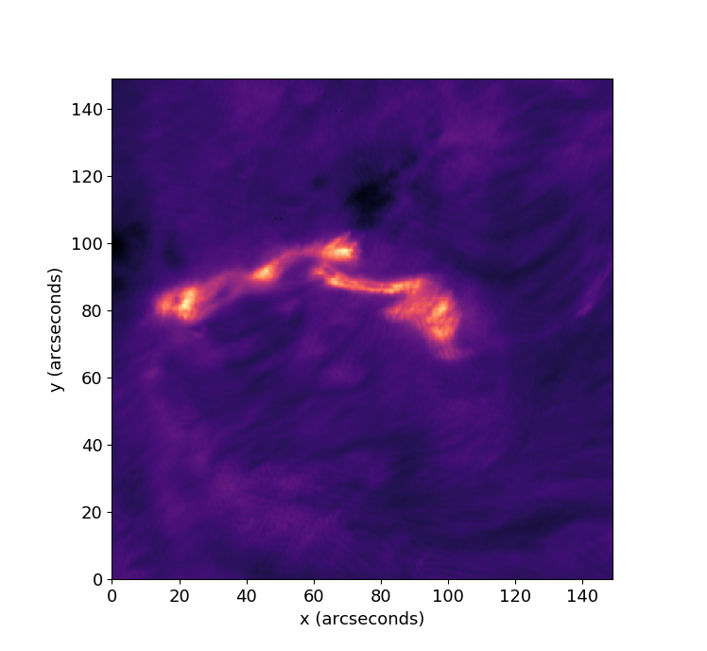
Learning to correct for atmospheric seeing with GANs III

Slide 7
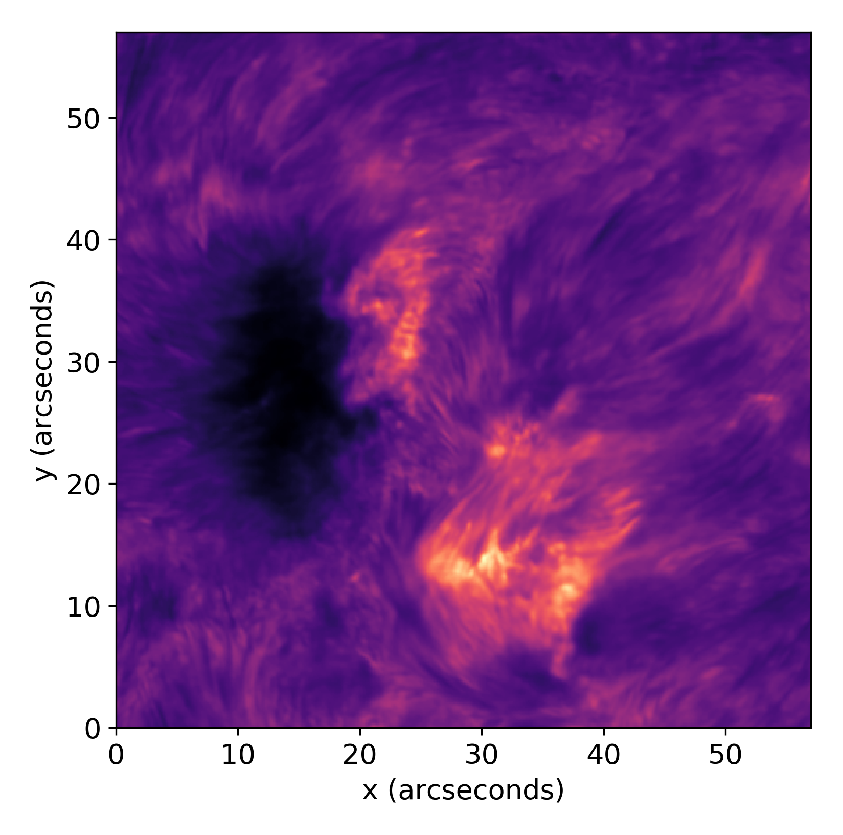
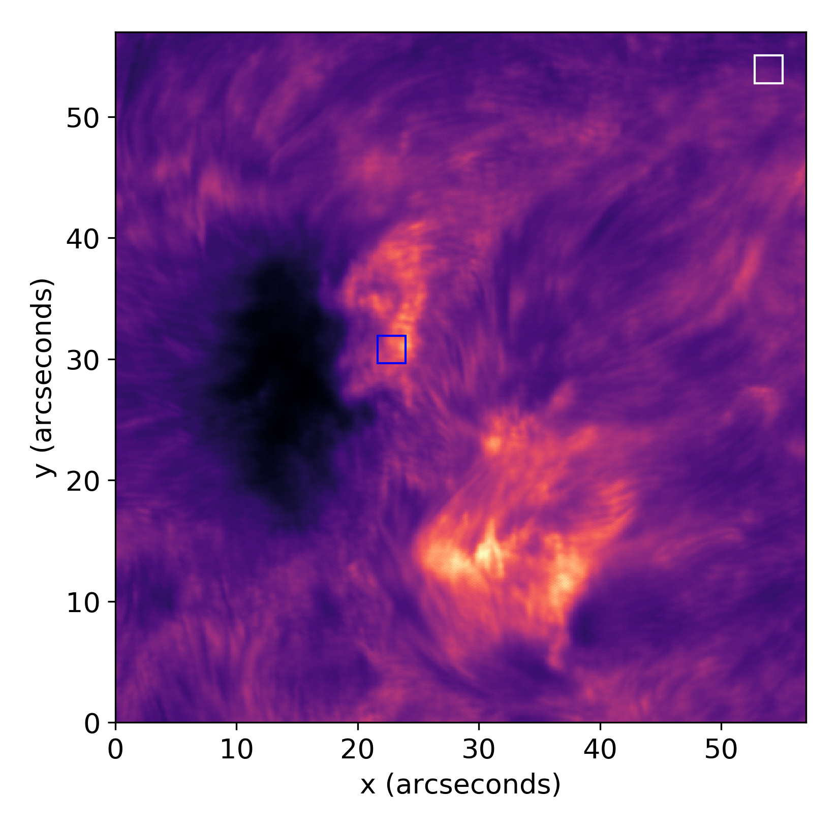
Learning to correct for atmospheric seeing with GANs IV

Slide 8
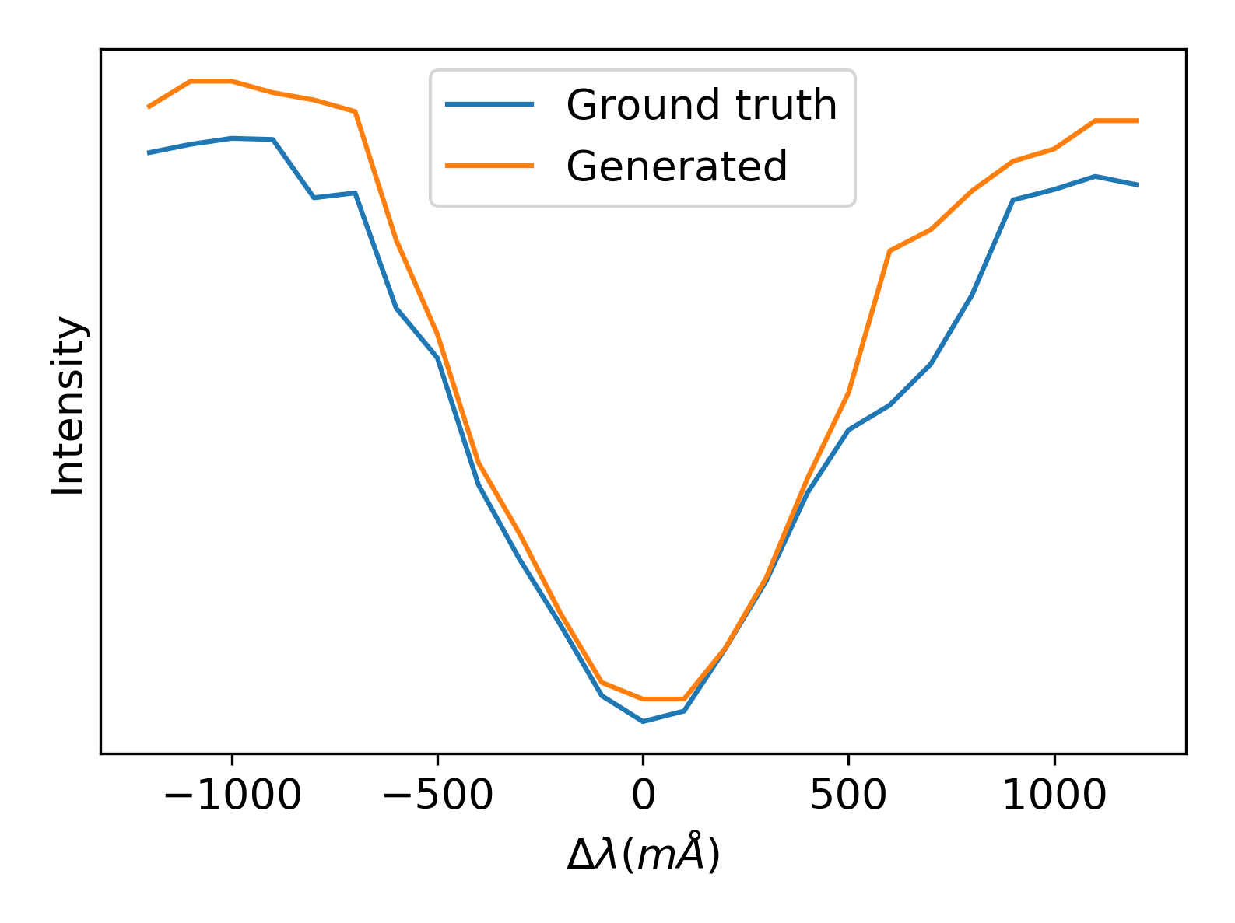
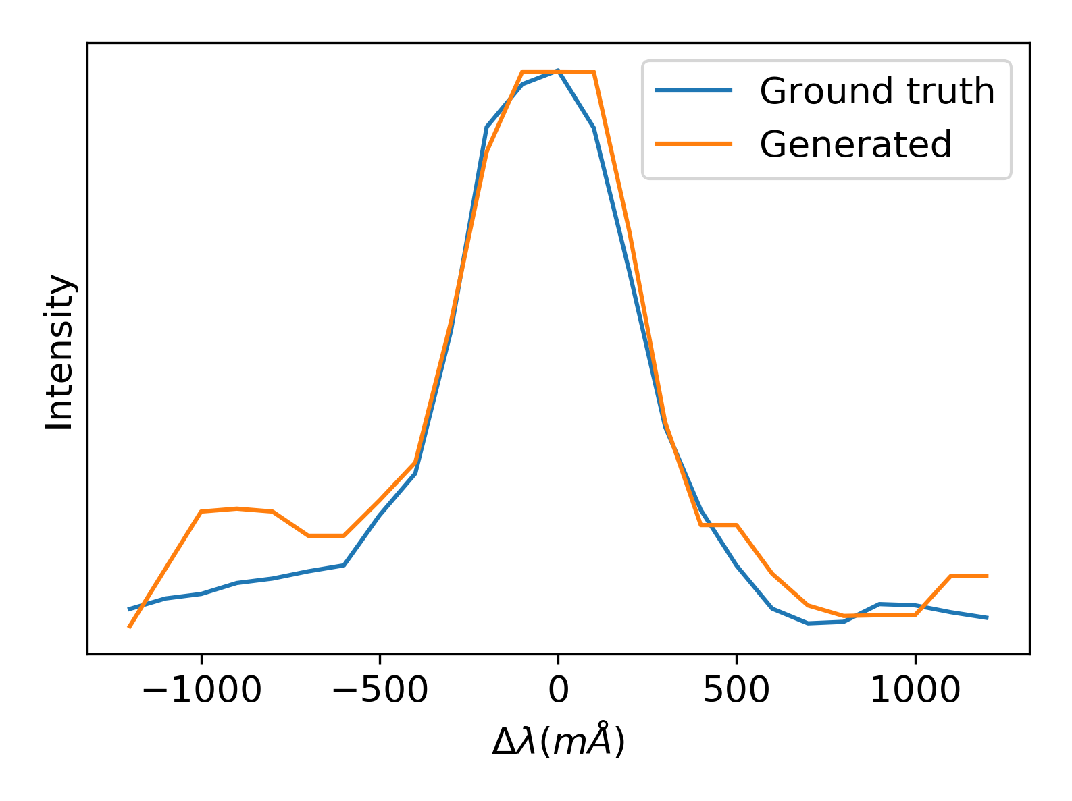
Learning to correct for atmospheric seeing with GANs V

Slide 9
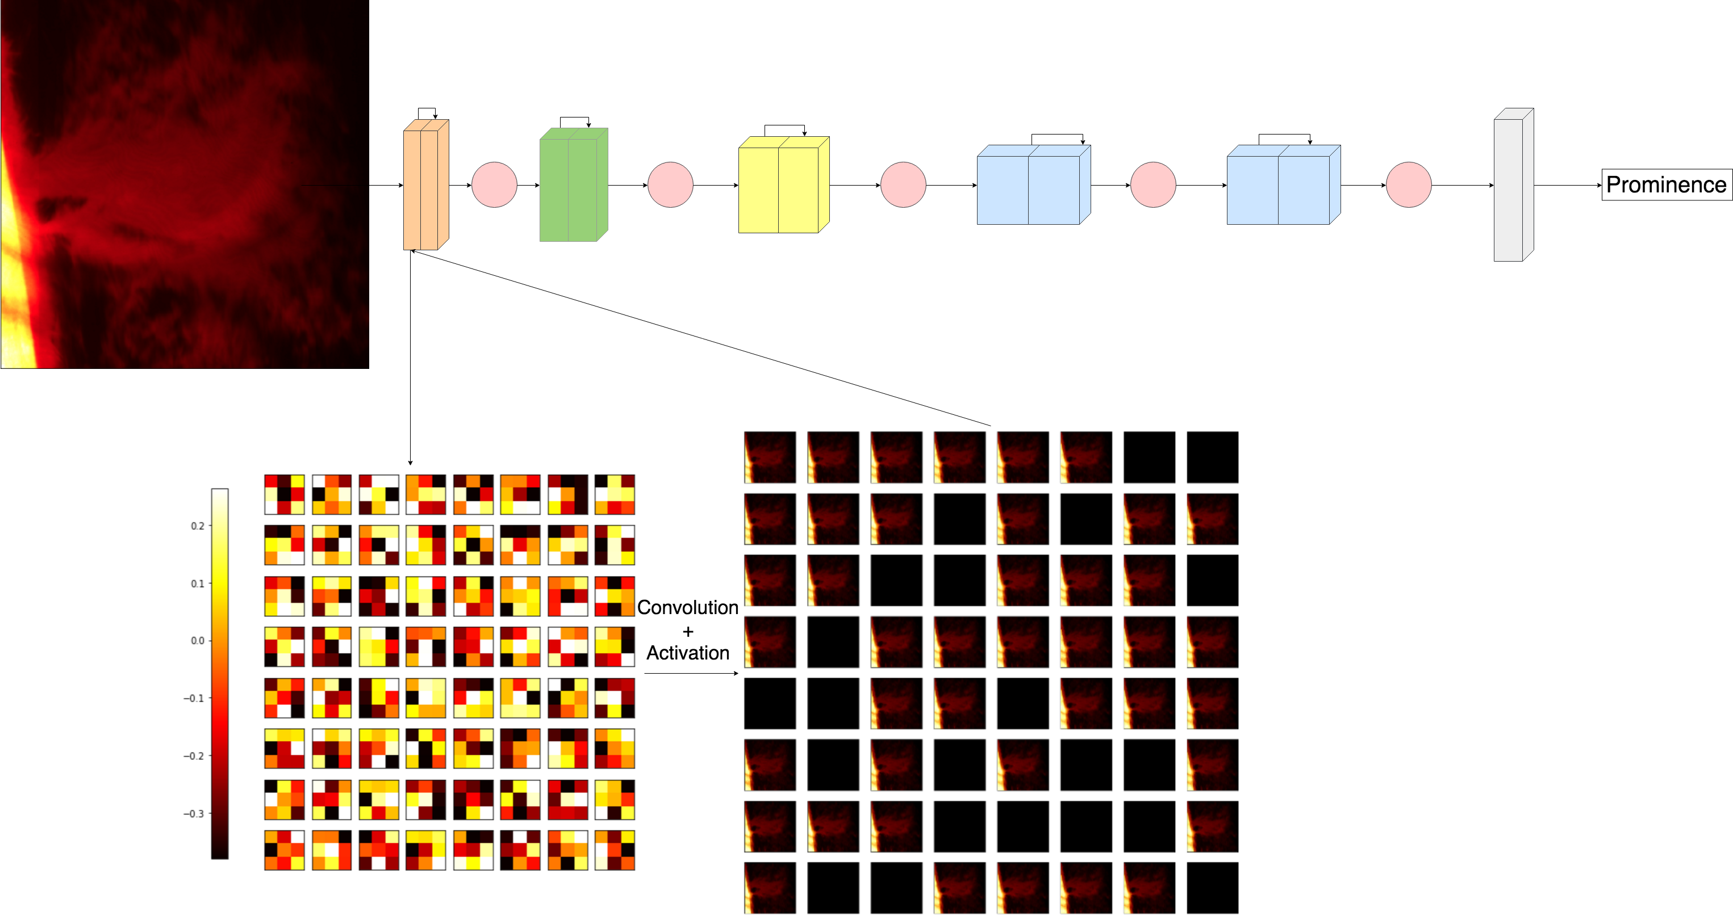

Feature recognition using deep CNNs
99% accuracy
Trained with over 10000 images in H$α$
Useful for dataset reduction and transfer learning (we’ll come back to this later)
Armstrong & Fletcher (in prep)

Slide 10
Future Projects
Use trained GAN and kNN classification of spectral lines (Panos et al. 2018) to generate consistent flare data
Automate spectropolarimetric line inversions to learn about the flaring chromospheric magnetic field
Use automation techniques to constrain flare models for spectroscopic (simulation and data hybrid model) and spectropolarimetric (data model only, simulations hopefully soon) radiation transfer

