Slide 1
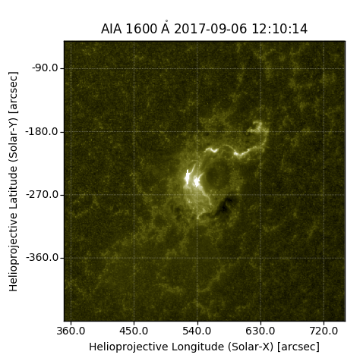
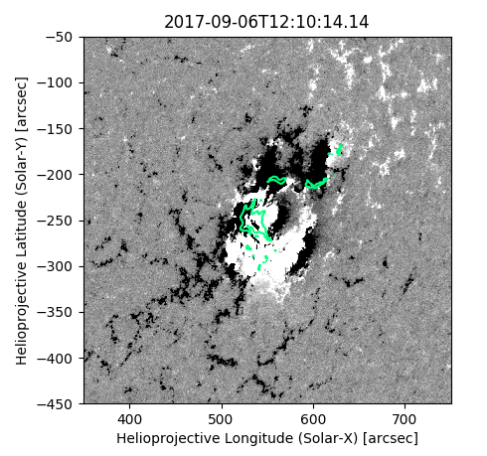
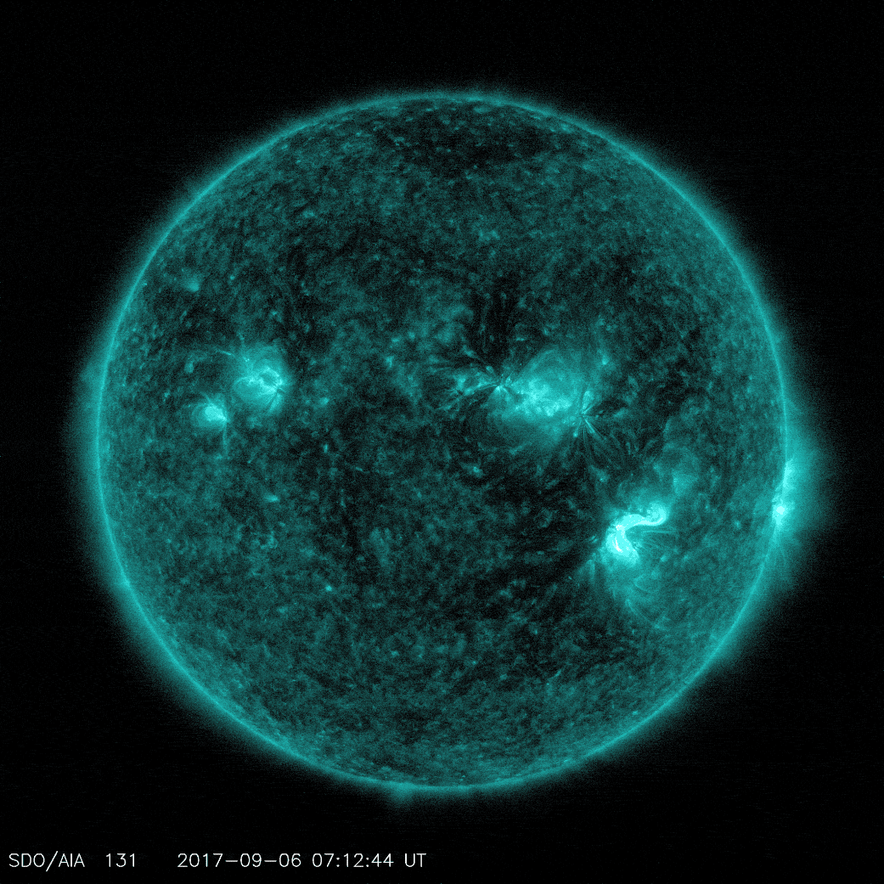
Solar Flare Ribbon Analysis
Teri Love, Clare Parnell University of St Andrews

Slide 2
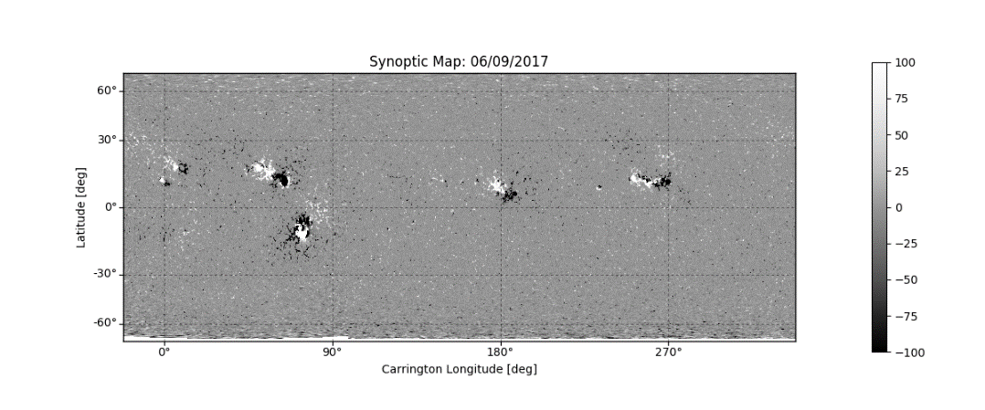
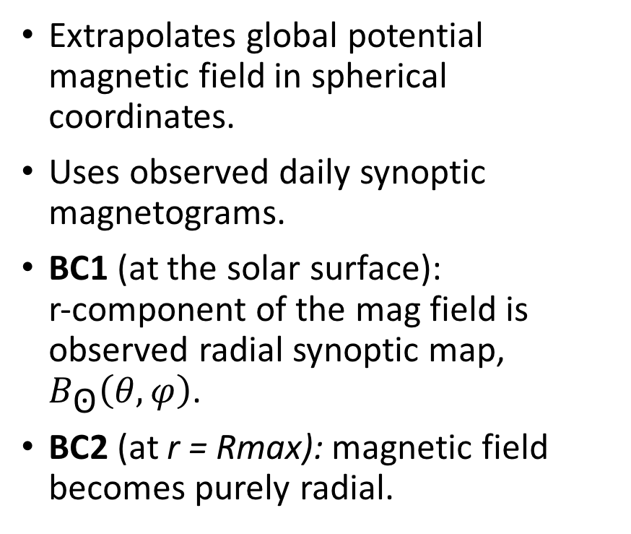
Global Magnetic Field Model: PFSS
(A. van Ballegooijen, 1997) (B. Williams, 2018)
Extrapolates global potential magnetic field in spherical coordinates.
Uses observed daily synoptic magnetograms.
BC1 (at the solar surface): r-component of the mag field is observed radial synoptic map, $B_{\text{ʘ}}\left(θ,φ\right)$.
BC2 (at r = Rmax): magnetic field becomes purely radial.

Slide 3
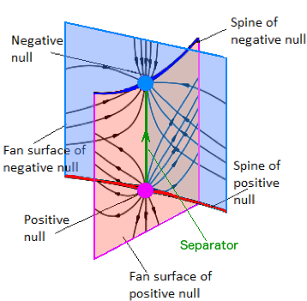
3D Magnetic Skeleton
Nulls: Points where B = 0
Spines: Field-line that points into/out of a positive/negative null. (Defined by the 3rd oppositely signed eigenvalue)
Separatrix Surface Field-lines: Field-lines that are pointing out of/into a positive/negative null.
Separators: Occurs where two or more separatrix surfaces from opposite polarity nulls intersect.
Heliospheric Current Sheet(HCS): Null line, HCS Curtains (traced fieldlines from the null line).
Notes:
Mention Jacobian here??

Slide 4
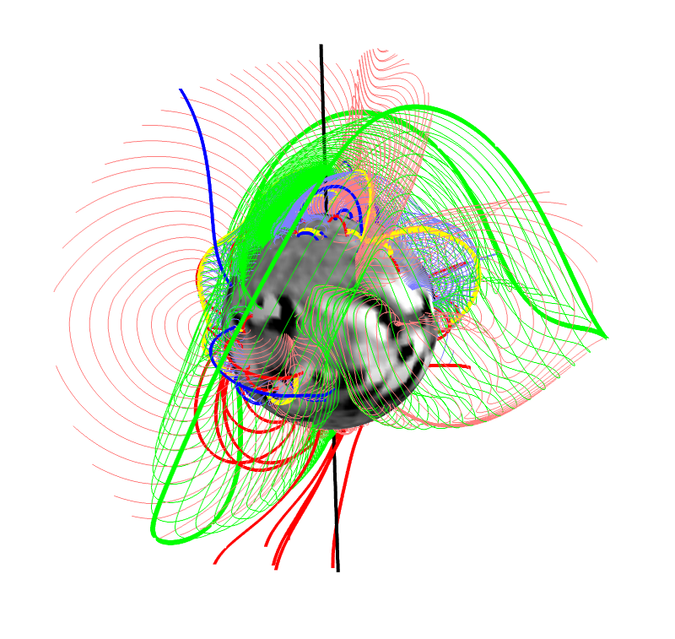
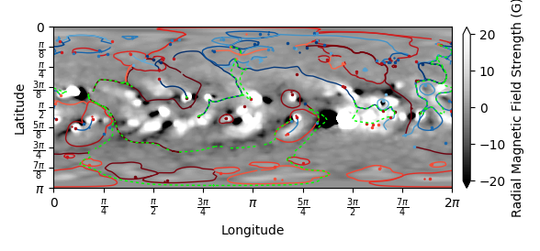
3D Magnetic Skeleton
Topological Feature | Colour | Symbols (3D Model)
Negative Nulls | Blue | Sphere
Positive Nulls | Red | Sphere
Negative Spines | Blue | Line
Positive Spines | Red | Line
Separators | Yellow | Line
HCS | Green | Line
-ve fieldlines | Blue | Line
+ve fieldlines | Red | Line

Slide 5
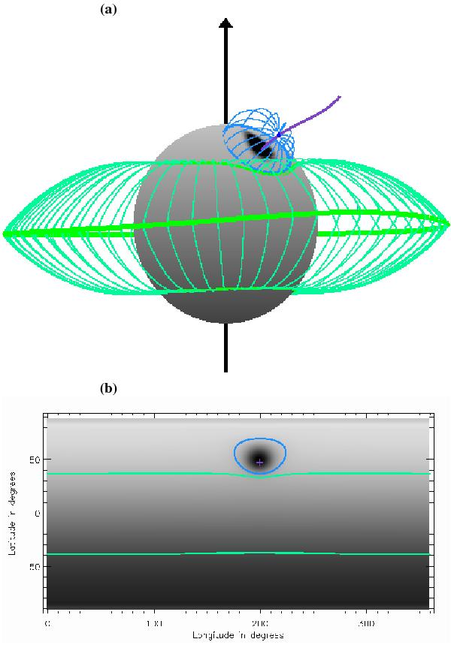
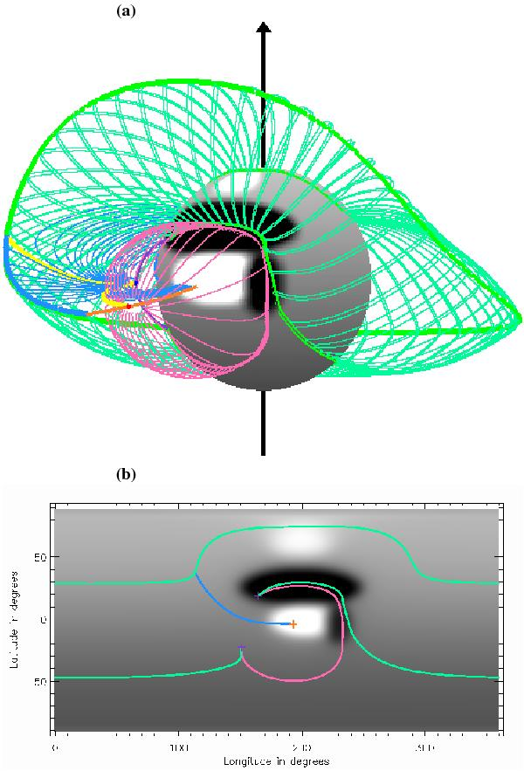
3D Magnetic Skeleton: Structure Types
Separatrix Domes
Made from 1 or more nulls
Can be found within or outside
the HCS.
Separatrix Caves
Doesn’t intersect photosphere
at all points.
Bounded by spines lines of
opposite polarity null.
Has one opening.
Notes:
Domes are the typicla structures that people associate with flaring active regions. Some papers have analysed a single flaring region showing the null-spine topology.

Slide 6
Flares Analysed
Flare Ribbon Database:
Flares that occurred from April 2010 to April 2016 as viewed by SDO.
Flares within 45° of the central meridian.
Excluded events with missing active region numbers in the HEC.
3137 flares
Start/end time, peak X-ray flux, heliographic lat & lon, AR number.
Class | Number of Flares | Percentage %
C | 2870 | 91.5
M | 250 | 8.0
X | 17 | 0.5
Total | 3137 | 100.0
M. Kazachenko et al. (2017)
Notes:
Classification X: > 10^-4 W/m^2 and each after that is 10^-1 smaller

Slide 7
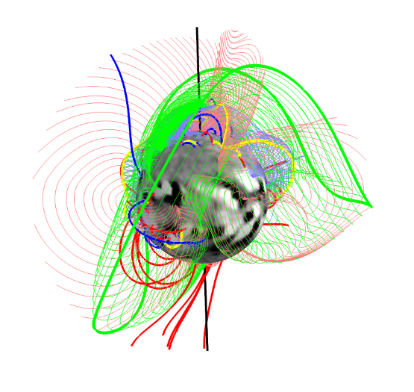
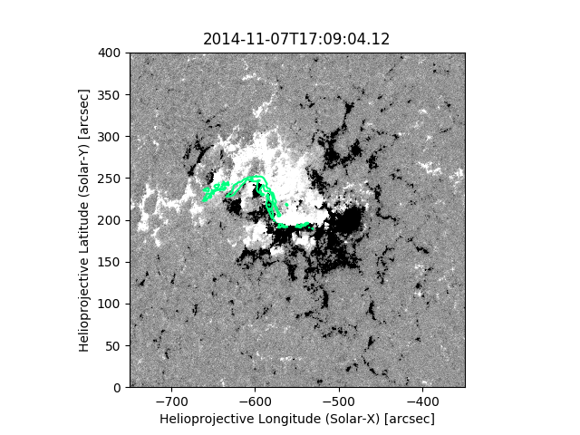
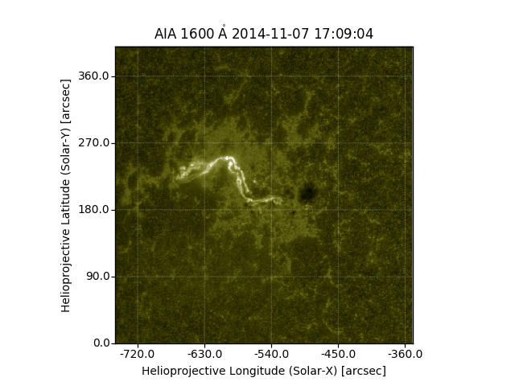
Method
Created potential field using PFSS Model (synoptic maps)
Created 3D magnetic skeleton.
Created surface cut at 1.001 Rʘ
AIA 1600Å (upper photosphere/transition region) and HMI Magnetograms
Compared flare ribbon to topological features found.
1)
2)
3)
5)
4)
Notes:
AIA 1600: Carbon IV: 10^5 K transition region, 10^4 photosphere

Slide 8
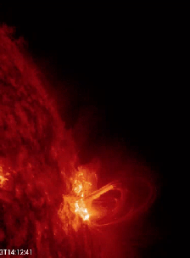
Flares Analysed
15th February 2011
9th March 2011
6th & 7th September 2011
7th March 2012
12th July 2012
8th & 10th November 2013
7th January 2014
29th March 2014
10th September 2014
22nd → 26th October 2014
7th November 2014
20th December 2014
11th March 2015
6th September 2017
Image: NASA
Type of Separatrix Feature | No of Flares | Percentage (%)
Cave | 4 | 28.57
Tunnel | 0 | 0.00
Dome | 9 | 64.29
None | 1 | 7.14

Slide 9
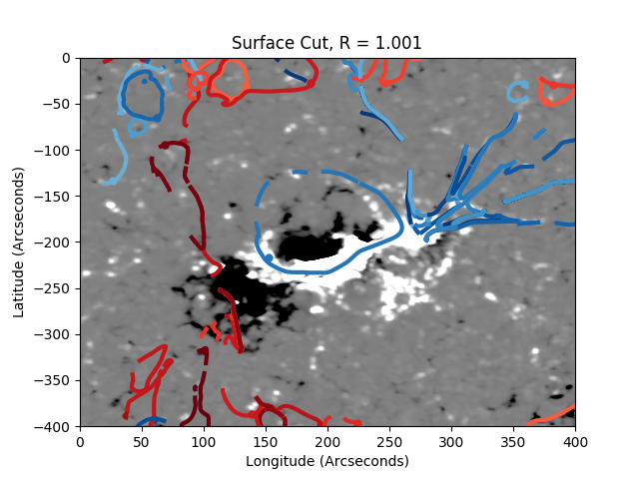
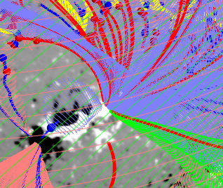
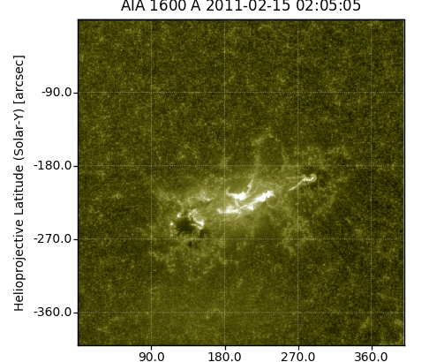
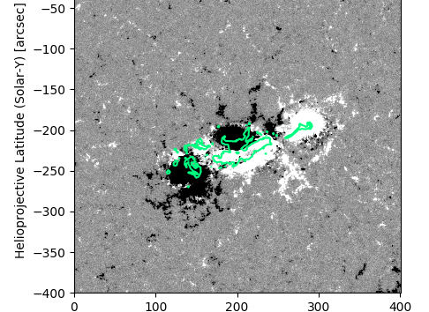
1: X2.2 Flare
15th February 2011

Slide 10
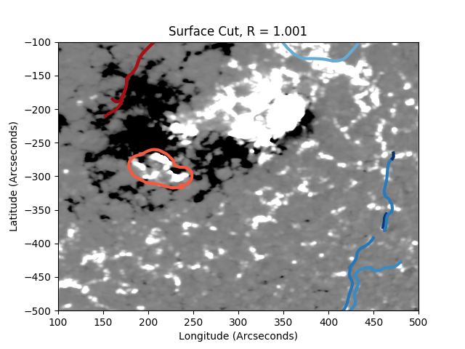
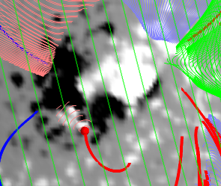
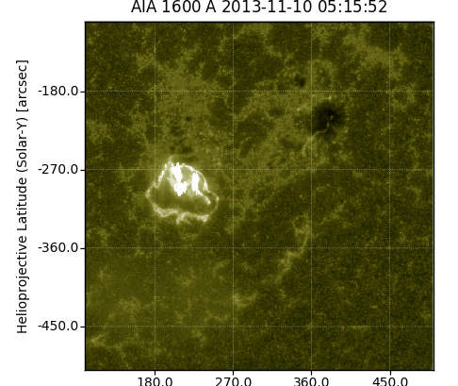
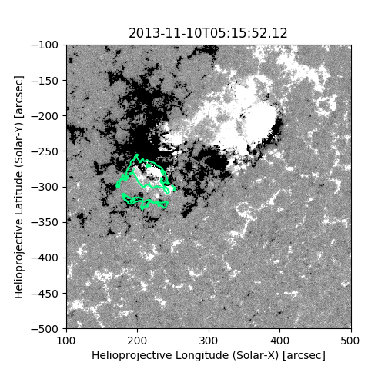
2: X1.1 Flare
10th November 2013

Slide 11
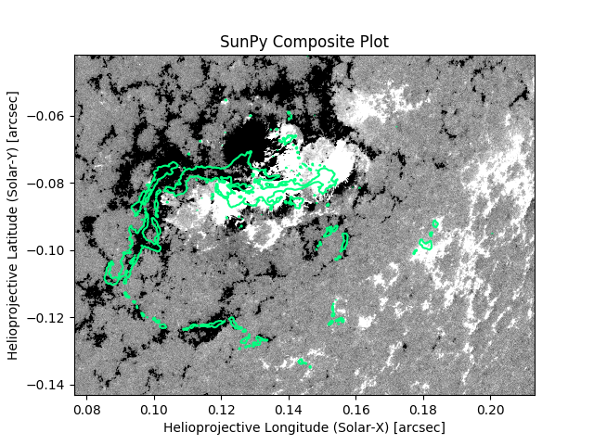
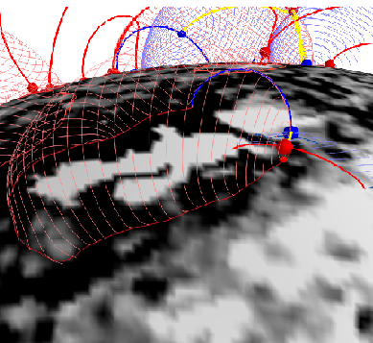
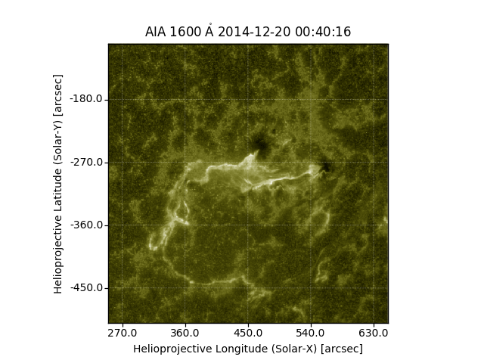
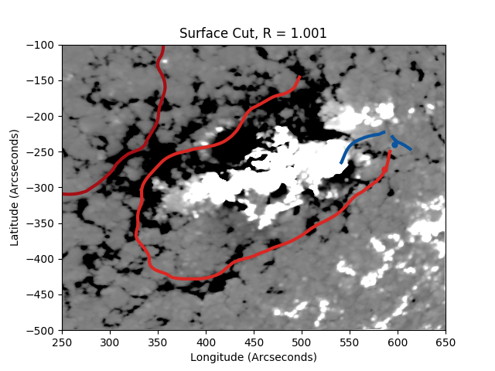
3: X1.8 Flare
20th December 2014

Slide 12
Summary of ARs Analysed
Date | Flare Class | Ribbons Map? | Topological Feature
15/02/11 | X2.2 | Yes | Dome (SN)
09/03/11 | X1.5 | Partial | Dome (SN)
06/09/11 | X2.1 | Yes | Dome (SN)
07/09/11 | X1.8 | Yes | Dome (SN)
07/03/12 | X1.3 | Partial (shape) | Cave
12/07/12 | X1.4 | Partial (shape) | Dome
08/11/13 | X1.1 | Yes | Dome (SN)
10/11/13 | X1.1 | Yes | Dome (SN)
Date | Flare Class | Ribbons Map? | Topological Feature
07/01/14 | X1.2 | Partial (s) | Dome
29/03/14 | X1.0 | Yes | Dome
10/09/14 | X1.6 | No | Dome
22 → 26/10/14 | X1.0 → X3.0 | No | None
07/11/14 | X1.6 | Yes | Dome
20/12/14 | X1.8 | Partial (s) | Cave
11/03/15 | X2.1 | Partial (s) | Cave
06/09/17 | X9.3 | Partial | Cave
Notes:
07/03/12 was one of the regions were more features were found when the disk data was used in the synoptic map. As well as 11/03/15.

Slide 13
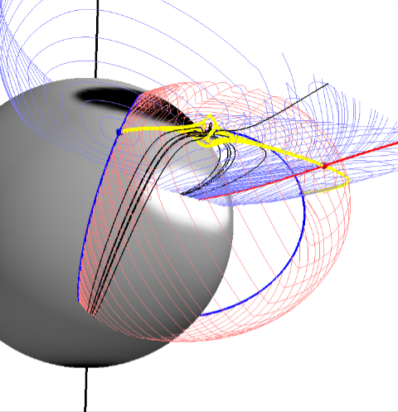
Summary of analysis so far…
Of all 14 ARs analysed approximately 85% were found to have a topological feature that could be partially or fully mapped to the flare ribbon.
Only 1 AR was found to have no features in the region.
Next Steps…
Place a localised current around separators found in the features around the regions and trace field-lines. Do these match the ribbons?
Can we speed up & automate process – allowing us to analyse the 250 M-Class and 2870 C-Class Flares?
Notes:
Loss resolution: In some regions were disk data was replaced the ribbon feature was found.
Final point – many of the regions that didn’t map had features that looked very similar to the ribbon however were not directly over the active region – will these move slightly when a current is introduced??

