Slide 1
Positron Opportunities at Jlab
and a Future EIC
e⁺ @ Jlab, EIC…
Eric Voutier
Institut de Physique Nucléaire
Orsay, France
Physics opportunities
Positron production
Technical opportunities
Positron Working Group
Summary
Workshop on Physics & Engineering Opportunities at the Electron-Iuon Collider
Loch Lomond, October 13-14, 2016

Slide 2
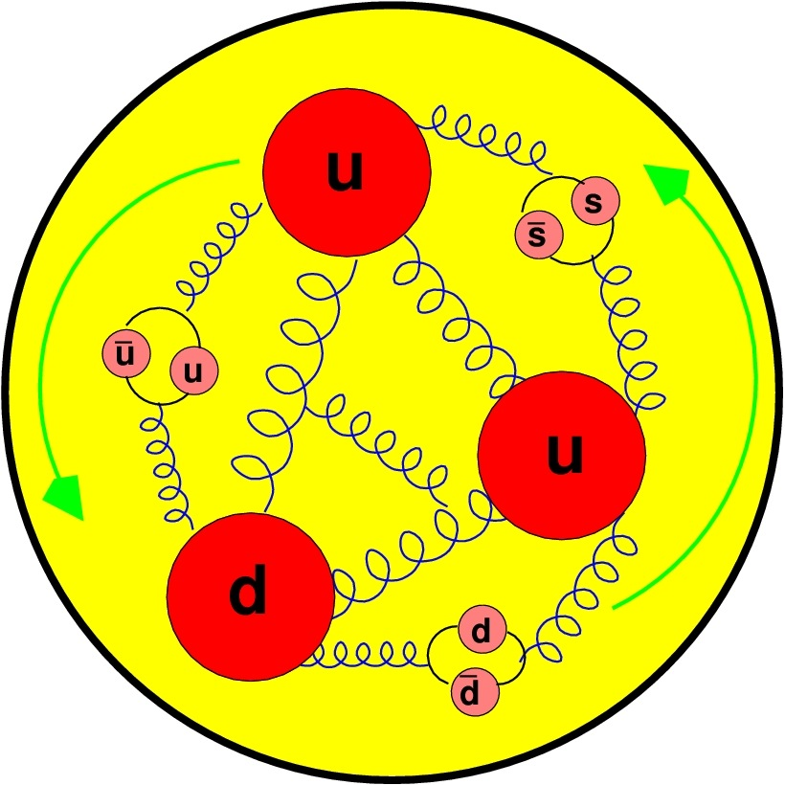
Physics Opportunities
Two-photon physics (U,P)
Generalized parton distributions (U,P)
Deep inelastic scattering (U,P)
Charm production (P)
Search for a U-boson coupling to dark matter (U,P)
Charge conjugation violation to access C_{3q} (U,P)
Positron annihilation spectroscopy (U,P)
Spintronics (P)
Interference
Physics
Charged Current
Physics
Test of the
Standard Model
Positron
Applications
Loch Lomond, October 13-14, 2016
2/26

Slide 3

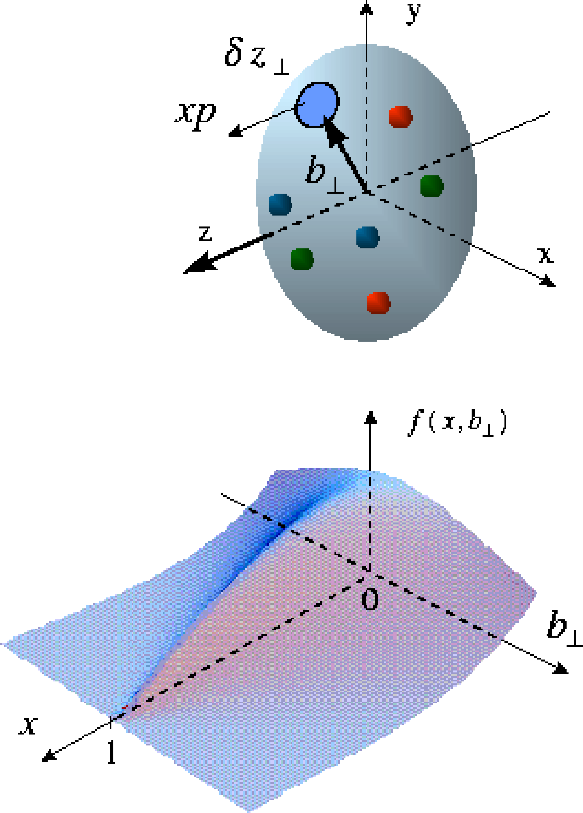
Generalized parton distributions
Eric Voutier
Parton Imaging
GPDs are the appropriate framework to deal with the partonic structure of hadrons and offer the unprecedented possibility to access the spatial distribution of partons.
GPDs = GPDs(Q²,x,ξ,t) whose perpendicular component of the momentum transfer to the nucleon is Fourier conjugate to the transverse position of partons.
GPDs encode the correlations between partons and contain information about the dynamics of the system like the angular momentum or the distribution of the strong forces experienced by quarks and gluons inside hadrons.
X. Ji, PRL 78 (1997) 610 M. Polyakov, PL B555 (2003) 57
M. Burkardt, PRD 62 (2000) 071503 M.Diehl, EPJC 25 (2002) 223
A new light on
hadron structure
GPDs can be interpreted as a 1/Q resolution distribution in the transverse plane of partons with longitudinal momentum x.
Loch Lomond, October 13-14, 2016
3/26

Slide 4
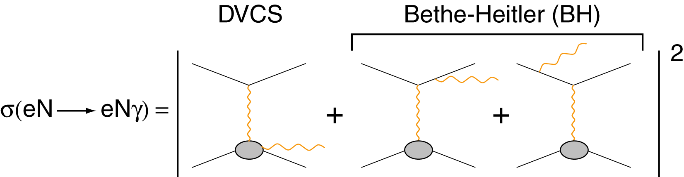
Generalized parton distributions
Eric Voutier
N(e,e′γN) Differential Cross Section
M. Diehl at the CLAS12 European Workshop, Genova, February 25-28, 2009
Additional observables
Electron
observables
Electron & positron
observables
Polarized electrons and positrons allow to separate the
unknown amplitudes of the cross section for electro-production of photons.
Loch Lomond, October 13-14, 2016
4/26

Slide 5
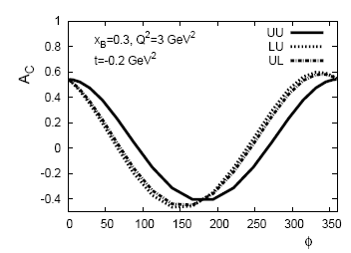
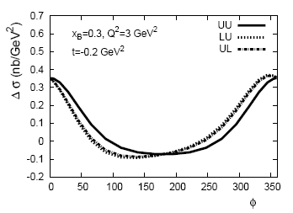
Experimental observables
Eric Voutier
Cross Sections
H. Avakian, V. Burkert, V. Guzey, JPos09, AIP 1160 (2009) 43
Evaluation of experimental observables is performed considering GPD H and E only, within a dual parameterization approach.
Significant differences between polarized and unpolarized lepton beams supports potential benefits of a polarized positron beam.
Loch Lomond, October 13-14, 2016
5/26

Slide 6
Experimental observables
Eric Voutier
Moments
H. Avakian, V. Burkert, V. Guzey, JPos09, AIP 1160 (2009) 43
The sin(φ) moments linked to the imaginary part of the interference amplitude express the important benefit of a polarized positron beam for GPD physics at JLab.
Loch Lomond, October 13-14, 2016
6/26

Slide 7
Experimental observables
Eric Voutier
Projected Data
H. Avakian, V. Burkert, V. Guzey, JPos09, AIP 1160 (2009) 43
Statistics of projected data involves 1000 h data taking time at 11 GeV with e⁻ at 10³⁵ cm⁻².s⁻¹, and e⁺ at 2×10³⁴ cm⁻².s⁻¹ (8 nA, 10 cm LH₂).
High quality data with modest polarized positron beam current
can be achieved, allowing to strictly separate
the interference contribution to the (e,e’γ) process.
Loch Lomond, October 13-14, 2016
7/26

Slide 8
Charged current physics
Eric Voutier
Deep Inelastic Scattering
E. Aschenauer, T. Burton, T. Martin, H. Spiesberger, M. Stratman, arXiv:1309.5327 (2013)
Charge current DIS access quark flavors combination different from those measured with the electromagnetic interaction.
Polarized electron
off protons
Leading order
Direct access to ΔΣ
Polarized positron
off protons
Access to strange polarized PDF free of hadronization ambiguities
Loch Lomond, October 13-14, 2016
8/26

Slide 9
Positron Production
PEPPo technique
Polarized e⁺ @ CEBAF
Polarized e⁺ @ JLEIC
Loch Lomond, October 13-14, 2016
9/26

Slide 10
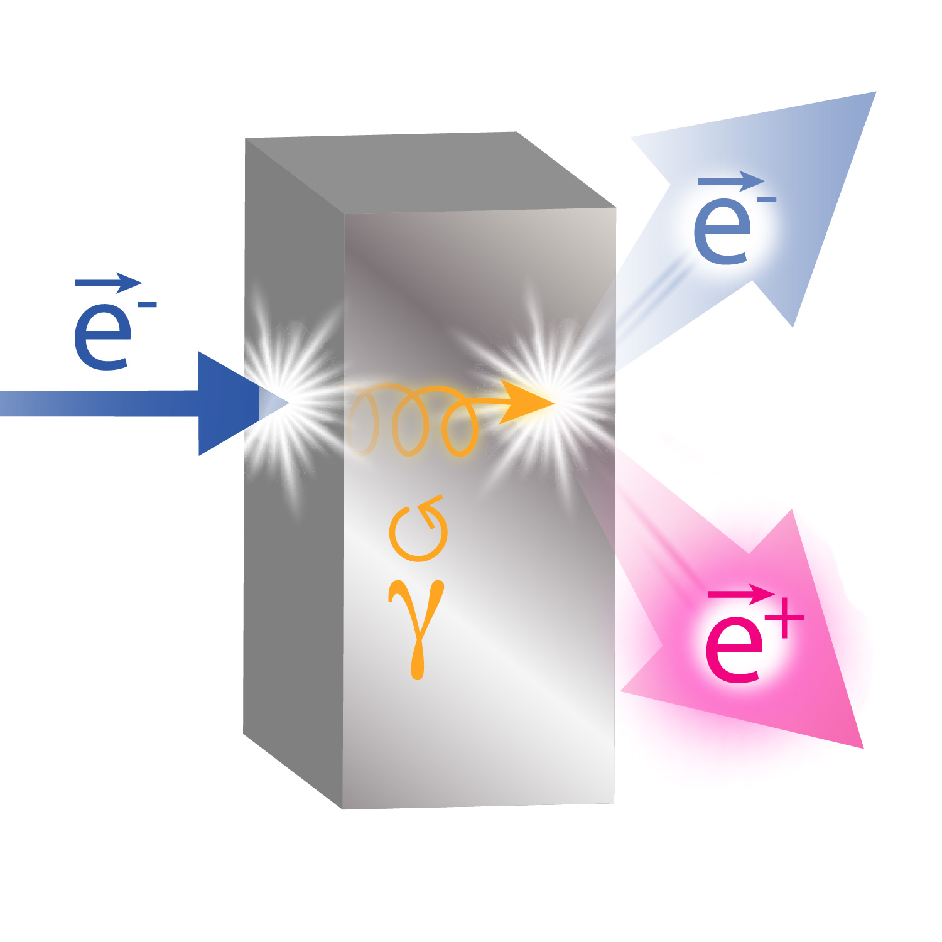
PEPPo technique
Eric Voutier
Electron Polarization Transfer
(PEPPo Collaboration) D. Abbott et al. , Phys. Rev. Lett. 116 (2016) 214801
PEPPo demonstrated efficient polarization transfer from 8.2 MeV/c electrons to positrons, expanding polarized positron capabilities from GeV to MeV accelerators.
e⁻ beam polarization
85.2 ± 0.6 ± 0.7 %
Whenever producing e⁺ from e⁻, polarization is coming for free
if initial electrons are polarized.
Loch Lomond, October 13-14, 2016
10/26

Slide 11
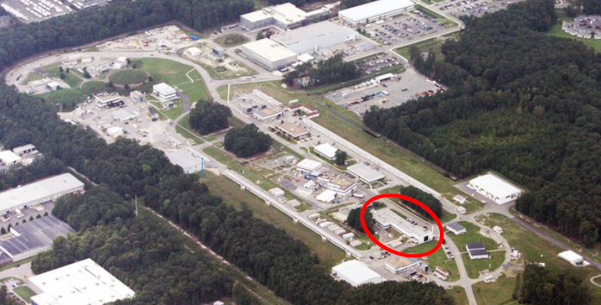
Polarized e⁺ @ CEBAF
Eric Voutier
e⁺ Production Scenarii
CEBAF INJ (10-100 MeV)
LERF (100 MeV)
CEBAF (12 GeV)
Loch Lomond, October 13-14, 2016
11/26

Slide 12
Polarized e⁺ @ CEBAF
Eric Voutier
Basic Characteristics
M. Mazouz (2015)
5mm
11 GeV electrons
Tungsten target
6 GeV (±2‰) positrons
50 μA beam
10 nA beam
80% longitudinal polarization
65% longitudinal polarization
δθ = 17 mrd
3 kW (heat)
High power target (~ 3 kW)
High power beam dump (~ 0.5 MW)
Significant radiation impact
Loch Lomond, October 13-14, 2016
12/26

Slide 13
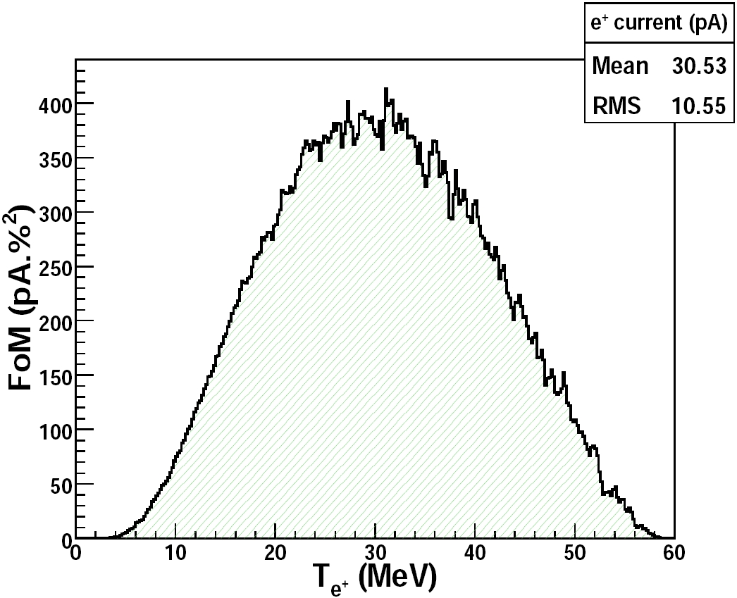

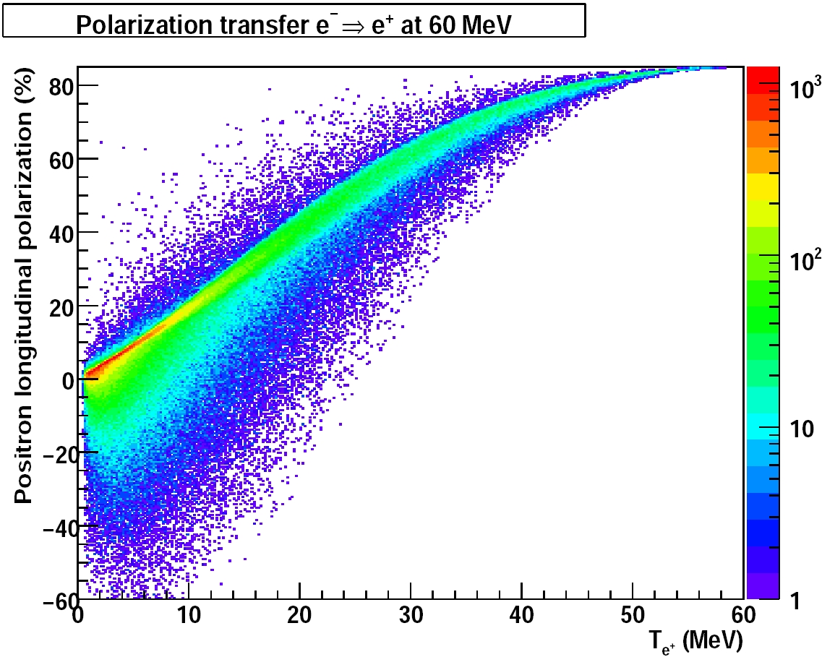
Polarized e⁺ @ CEBAF
Eric Voutier
Figure-of-Merit
R. Dollan, K. Laihem, A. Schälicke, NIM A 559 (2006) 185 J. Dumas, J. Grames, E. Voutier, JPos09, AIP 1160 (2009) 120
J. Dumas, Doctorate Thesis (2011)
The polarization distribution of generated positrons is typical of bremsstrahlung induced pair creation with a production rate dominated by low-energy particles.
Optimum
FoM
Optimum energy
The positron energy at optimum FoM is about half of the electron beam energy.
Loch Lomond, October 13-14, 2016
13/26

Slide 14
Polarized e⁺ @ CEBAF
Eric Voutier
Expected Performances
J. Dumas, Doctorate Thesis (2011)
The optimized FoM at each electron beam energy defined the « operational conditions »; simplistic cuts mimic a capture system and/or an accelerator acceptance, and define the quantitative source performances.
Δp/p = 10% ΔΘ = 10°
In the 100 MeV energy range, one can reasonably expect to optimaly achieve
75% electron polarization transfer and 10⁻⁴-10⁻³ e⁺/e⁻.
Loch Lomond, October 13-14, 2016
14/26

Slide 15
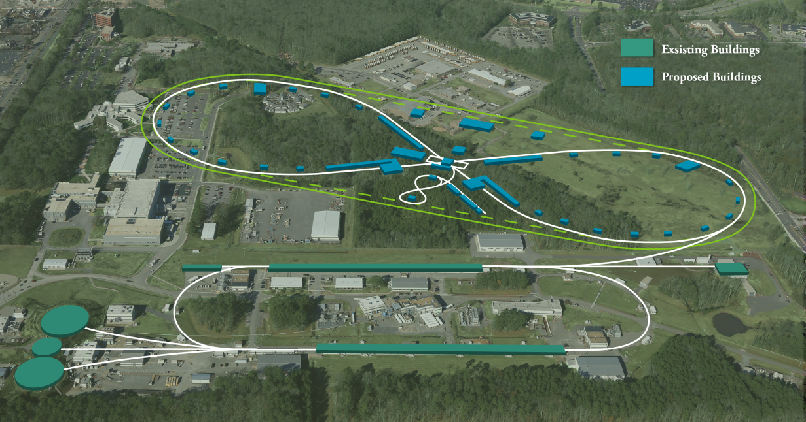
Polarized e⁺ @ JLEIC
Eric Voutier
Design Constraints
A polarized positron injector suitable for JLEIC would deliver
L ≥10³³cm⁻²s⁻¹ P_{e+}≥40%
with a specific pulsed structure.
e⁺
68.1 MHz bunch train, 1.6 us
110 bunches (I = 4.6 uA)
67 fC
×30
…
A low average current (>10 nA) is required for injection into JLEIC with a reasonably short injection time (mn) and a reasonable polarization.
35 μs
1.05 ms
20 ms
~ 50 Hz, I_{ave}= 10.5 nA
Courtesy of Joe Grames
15/26
Loch Lomond, October 13-14, 2016

Slide 16
Polarized e⁺ @ JLEIC
Eric Voutier
Conceptual Design
Polarized
Electron
10 MeV Injector
500-Turn
Accumulator Ring
(22m)
Harmonic
Extraction Ring
(22m)
Positron Conversion/Collection Efficiency ~ 10⁻⁴
Bunch
Management
to CEBAF/JLEIC
10 MeV polarized e⁻
1.33 pC @ 1500 MHz
10 MeV pol e⁻
0.67 nC bunches
@ 1500 MHz
10 MeV polarized e⁻
0.67 nC @ 68.1 MHz
5-7 MeV Polarized e⁺
67 fC @ 68.1 MHz
 | Polarized Electron Source | Accumulator/ Extractor Rings | Electrons at Converter | Polarized Positron Source | R&D Challenge
JLEIC | Ave = 100 μA 1.33 pC @ 1500 MHz 2 mA w/ DF=5% | Ave = 1 A 1500 MHz | Ave = 100 uA 68.1 MHz 44 mA @ DF=0.23% | Ave = 10 nA 68.1 MHz 4.4 uA @ DF = 0.23% | Electron accumulator Harmonic extraction Target: 440 kW peak
CEBAF | Ave = 1-10 mA 4-40 pc @ 250 MHz (cw) | Not Necessary | Ave = 1-10 mA 250 MHz (cw) | Ave = 100 nA - 1 μA 250 MHz (cw) | High-QE photocathode High voltage gun Target: 10-100 kW ave
Courtesy of Fanglei Lin
16/26
Loch Lomond, October 13-14, 2016

Slide 17
Technical Challenges
Polarized electron source
Accumulator ring
Positron production target
Positron capture system
Demonstration experiments
Loch Lomond, October 13-14, 2016
17/26

Slide 18
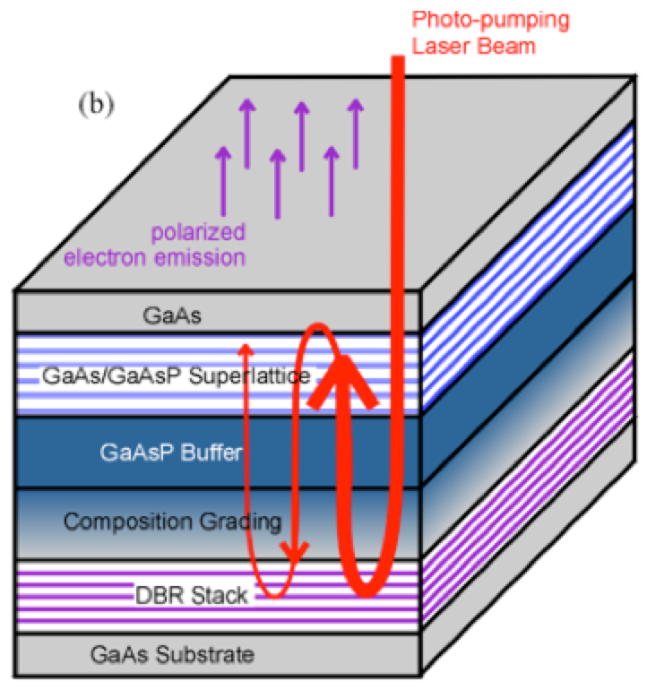
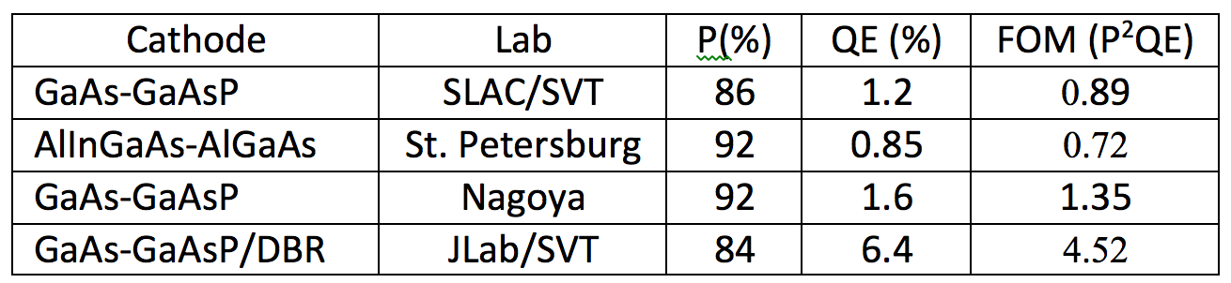
Polarized electron source
Eric Voutier
Photocathode R&D
W. Liu et al. SPIN Conference 2016
Current developments based on the Distributed Bragg Reflector (DBR) technique demonstrated the highest QE & FoM of any reported strained GaAs/GaAsP superlattice photocathode.
Photocathode
DBR
Substrate
@ 776 nm
Courtesy of Joe Grames
18/26
Loch Lomond, October 13-14, 2016

Slide 19
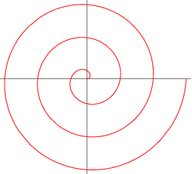
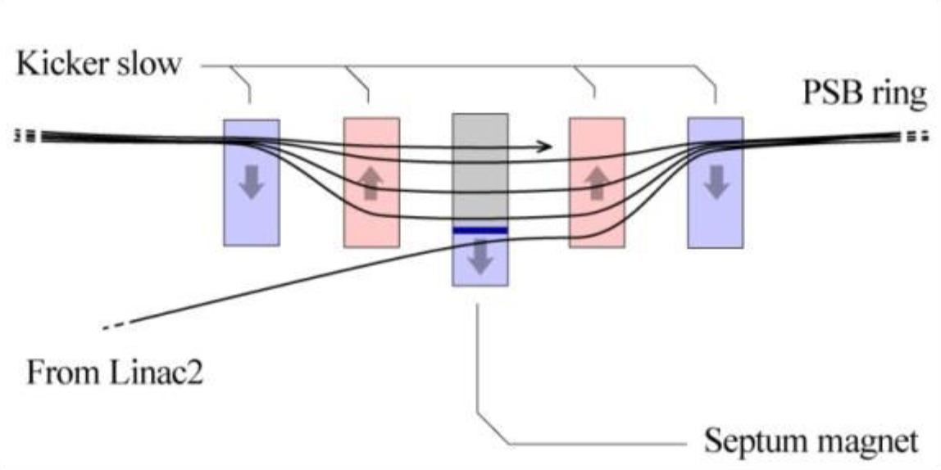
Accumulator ring
Eric Voutier
Multi-Turn Injection
x′
Septum thickness +
bunch width
The concept consists in an orbit bump near a septum which is then slowly reduced as beam being injected (phase-space painting).
The process can simultaneously occur in the longitudinal and vertical dimensions.
CERN’s LEIR has a design for 75-turn injection of Pb⁵⁴⁺. The plan is to push this number to a few hundred to a thousand thanks to low electron emittance.
x
Accumulator ring
Injected beam
Courtesy of Vasiliy Morozov
Loch Lomond, October 13-14, 2016
J. Grames, SPIN 2016 @ UIUC, Sep 26-30 2016
19/26

Slide 20
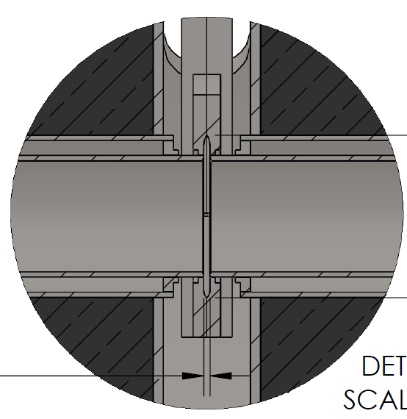
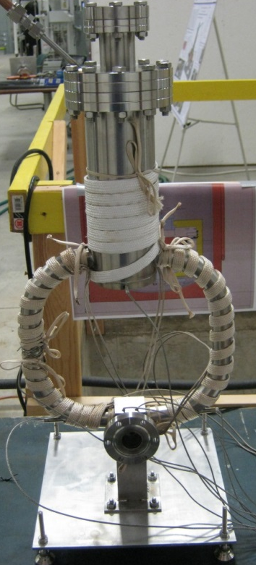
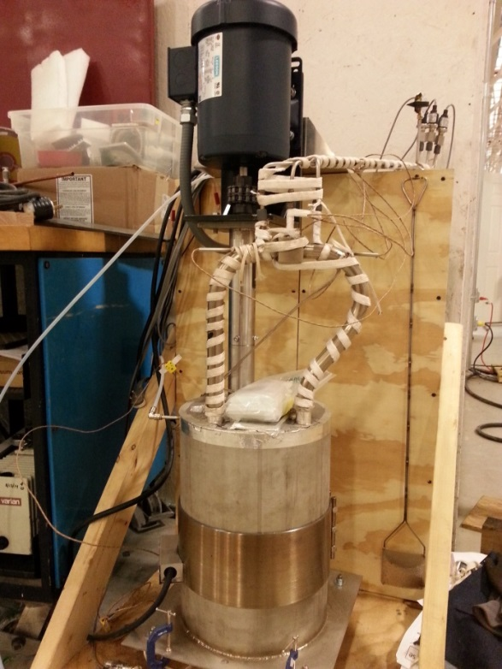
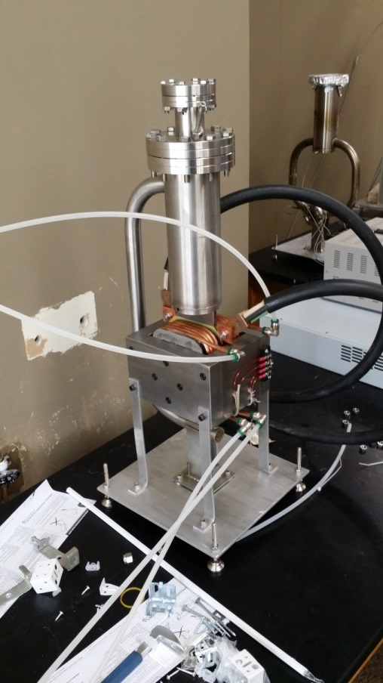

Positron production target
Eric Voutier
High Power Target
Liquid Metal Target – lead-bismuth eutectic (LBE)
  High Z = 82, 83
  Low melting point: 124°C High boiling point: 1670°C
Multiple LBE targets tested on various accelerators
  Natural Circulation
  Mechanical & Electromagnetic Pumping
Approaching 10 kW power level CW
Stainless Steel Windows (0.25mm)
LBE (2mm)
Output (e⁻,e⁺,γ)
Input (e⁻)
Loch Lomond, October 13-14, 2016
Courtesy of James McCarter
20/26

Slide 21
Positron capture system
Eric Voutier
Positron Collection Concept
Quarter Wave Transformer
(QWT) Solenoid
Collimators
e⁻
e⁻
γ
126 MeV
e⁺
24 MeV
W target
Combined Function Magnet
(QD)
A collection efficiency of 3х10⁻⁴ is predicted at the maximum positron production yield, corresponding to a positron energy of 24 MeV.
The resulting beam can then be accelerated without significant loss, and injected into the CEBAF main accelerator section.
S. Golge, PhD Thesis, 2010 (ODU/JLab)
21/26
Loch Lomond, October 13-14, 2016

Slide 22
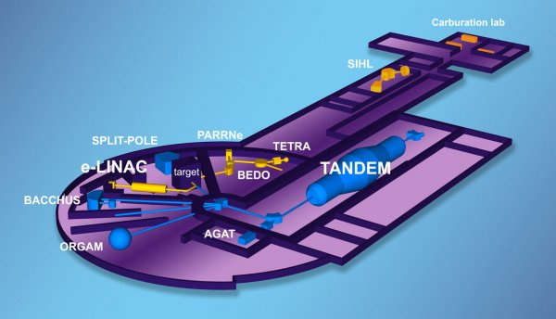
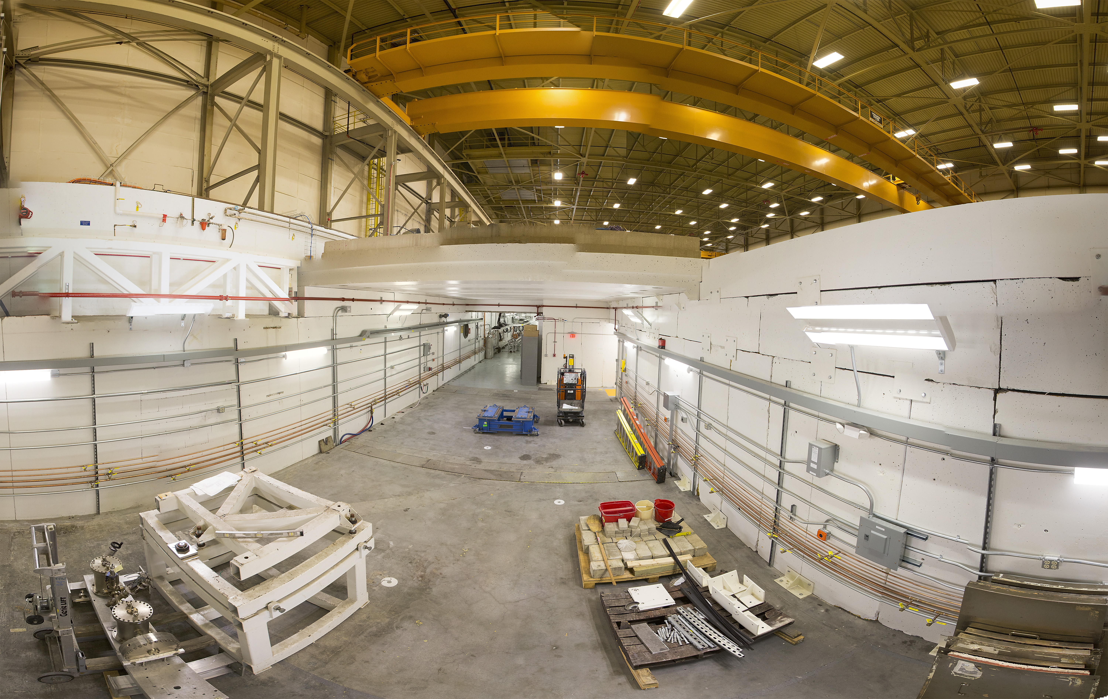
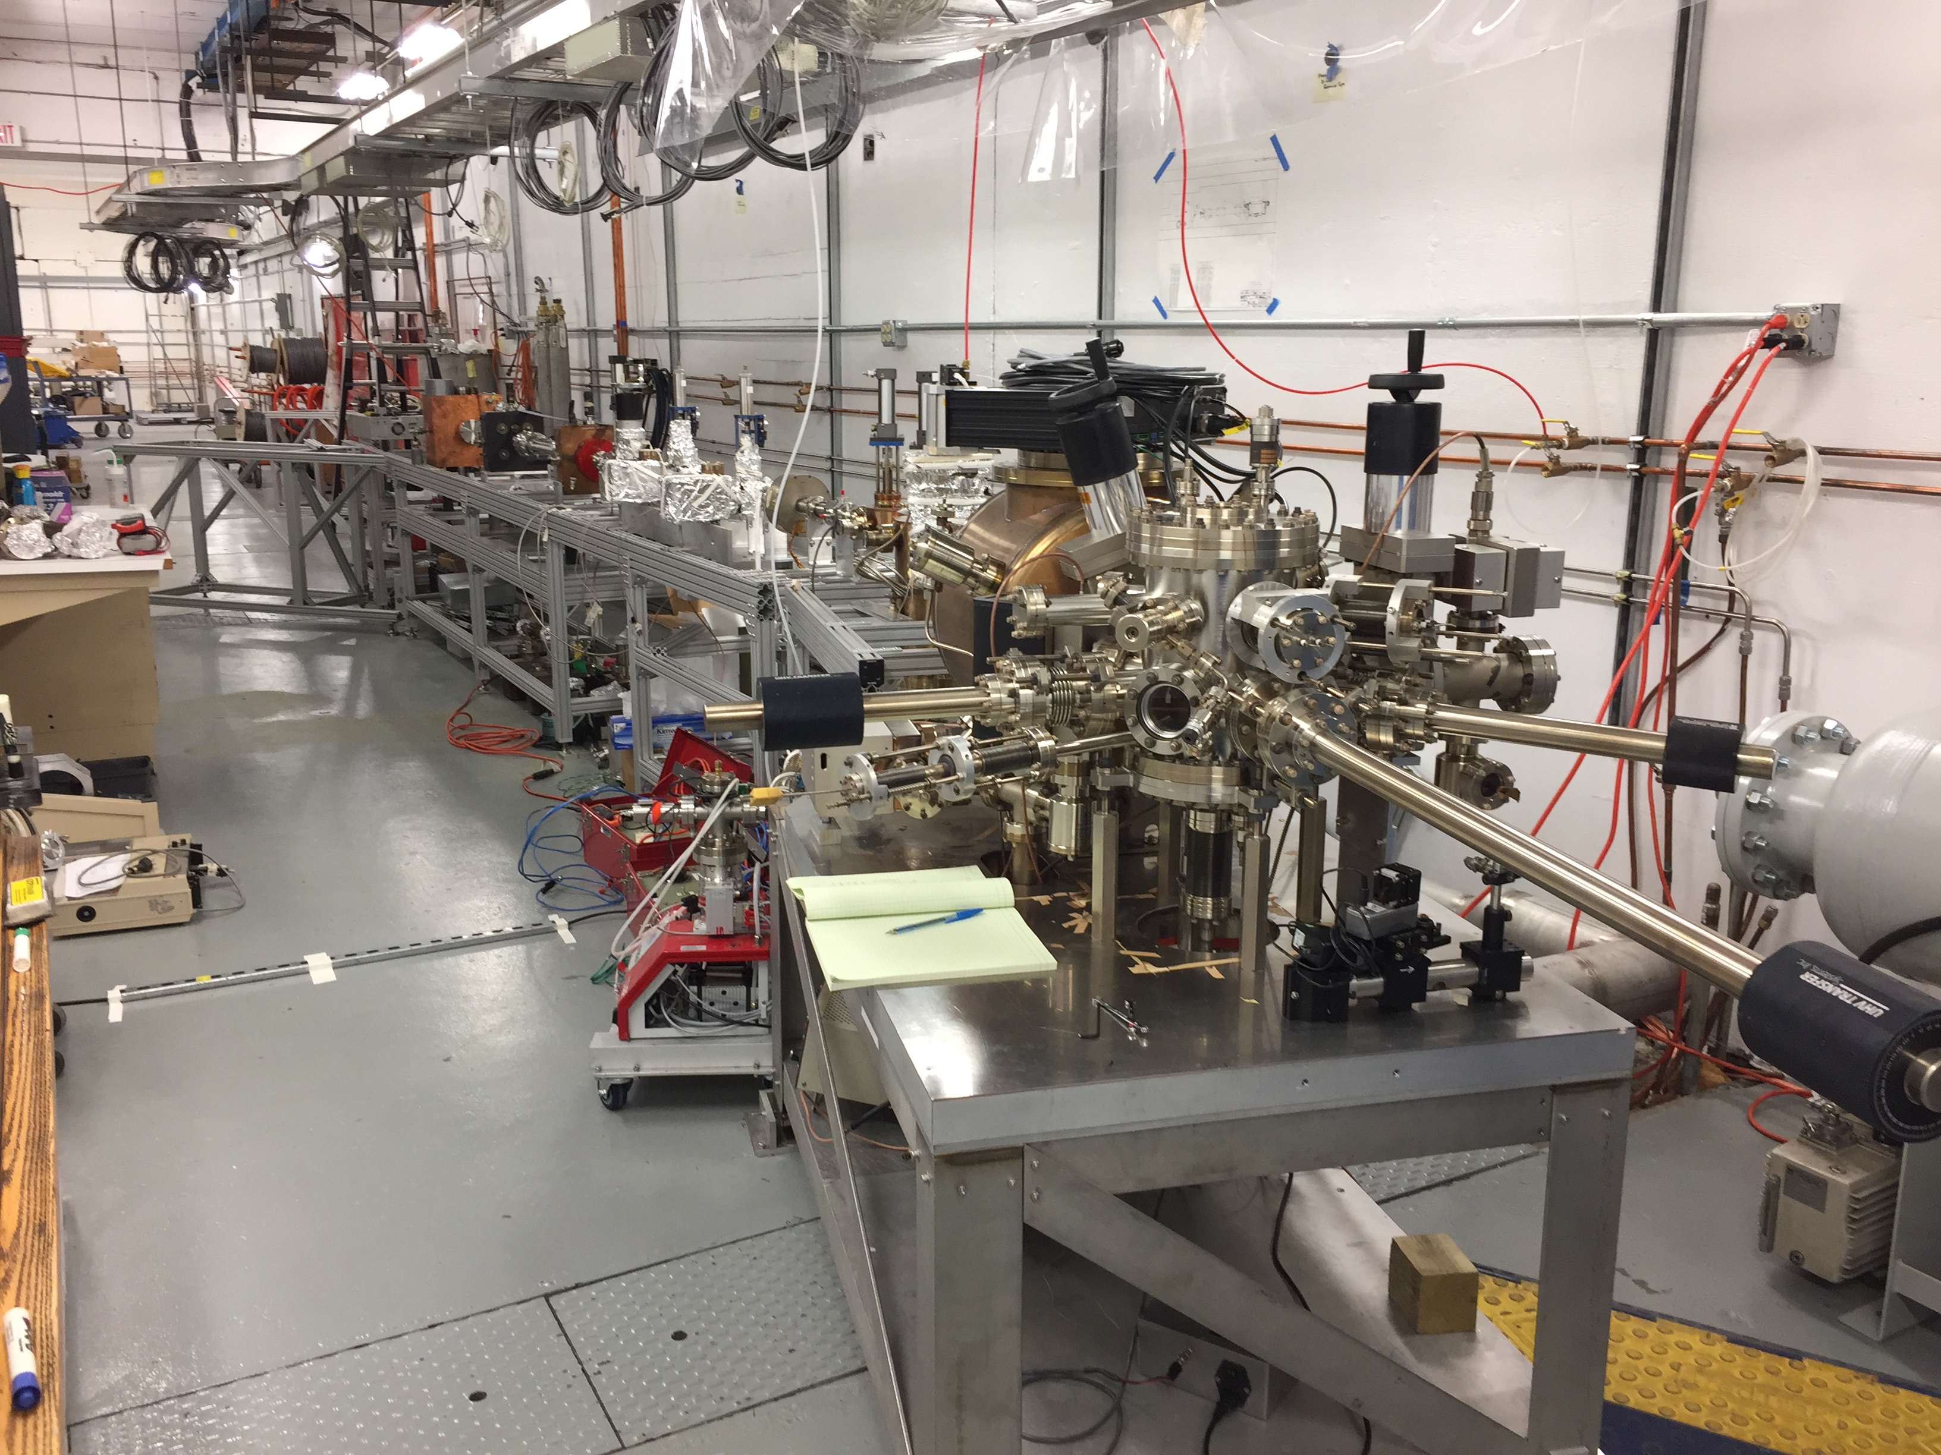
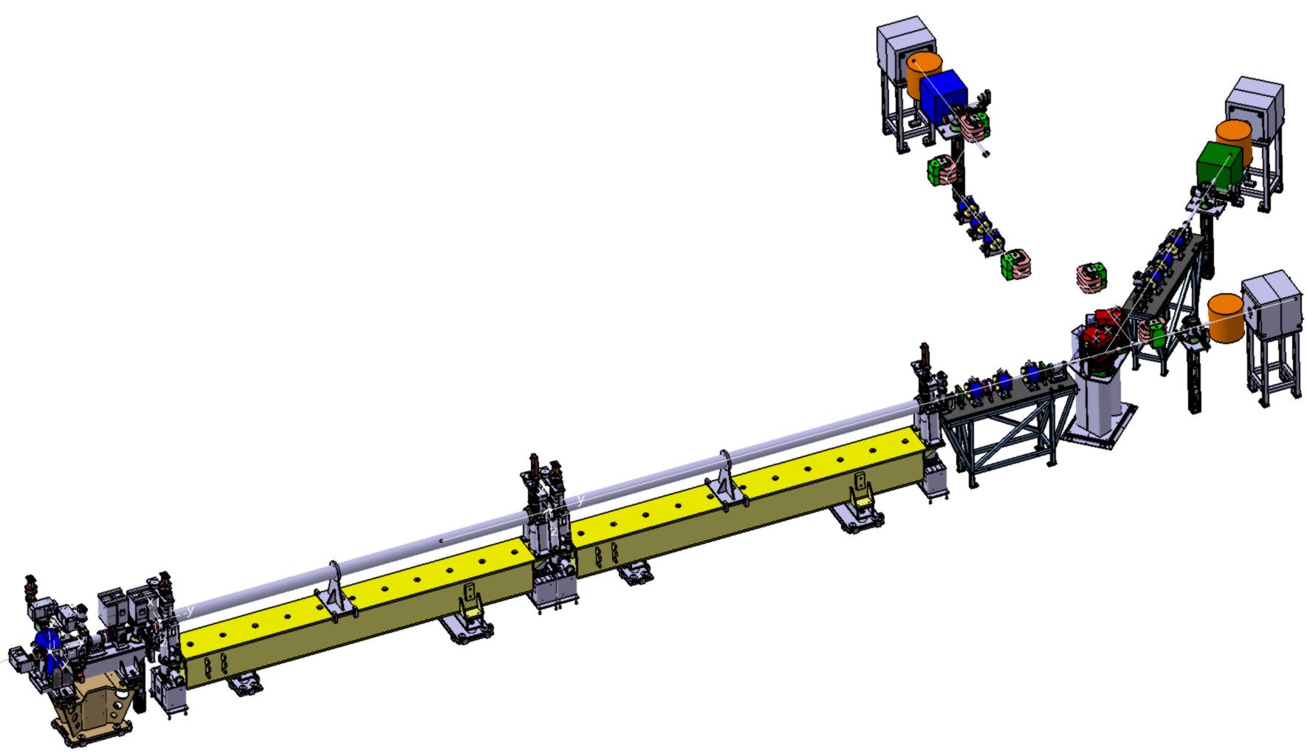
Demonstration experiments
Eric Voutier
Technical Concept Validation
Technical solutions for each component of the positron source must be experimentally evaluated and optimized.
ALTO @ IPN Orsay
10-50 MeV 100 Hz
IUTF @ JLab
5-10 MeV CW
PRAE @ LAL Orsay
30-140 MeV 50 Hz
Loch Lomond, October 13-14, 2016
22/26

Slide 23
Positron Working Group
http://wiki.jlab.org/pwg
pwg@jlab.org
Loch Lomond, October 13-14, 2016
23/26

Slide 24
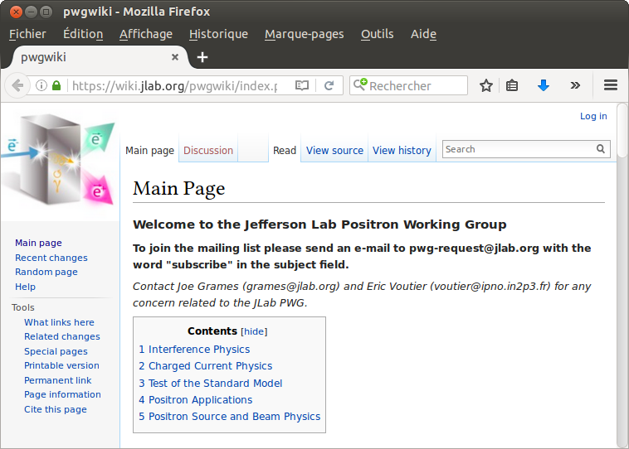
Positron beam at JLab
Eric Voutier
Positron Working Group
A Positron Working Group has been recently created at JLab with the aim of exploring the physics reach and technical requirements for positron experimental program at JLab12 and a future EIC.
Organized in 5 topical sub-groups coordinated by 2 conveners
John Arrington / Charles Hyde
Yulia Furletova / Wally Melnitchouk
Marco Battaglieri / Xiaochao Zheng
Tony Forest / Farida Selim
Joe Grames / Vasiliy Morozov
Loch Lomond, October 13-14, 2016
Joe Grames & Eric Voutier coordinators
24/26

Slide 25
Positron beam at JLab
Eric Voutier
Work Plan
Over the course of 2017, each topical subgroup will hold Working Sessions to revisit and develop their positron physics case in the context of JLab12 and JLEIC.
A final JPos17 Workshop will be hold at Jefferson Lab which proceedings will be the basis for a Positron Physics White Paper to be delivered about the end of 2017.
Please join this effort
by email to Voutier@jlab.org and Grames@jlab.org
Loch Lomond, October 13-14, 2016
25/26

Slide 26

Summary
Eric Voutier
Outlook
The PEPPo technique provides
an efficient and reliable method for producing a polarized positron beam,
particularly adapted to CEBAF.
JLab12, JLEIC
The next step in e⁺ source R&D is
maximizing the beam intensity and the beam quality.
A polarized positron experimental program
at JLab12 and JLEIC became realistically possible and
needs to be developed further.
Loch Lomond, October 13-14, 2016
26/26

Slide 28
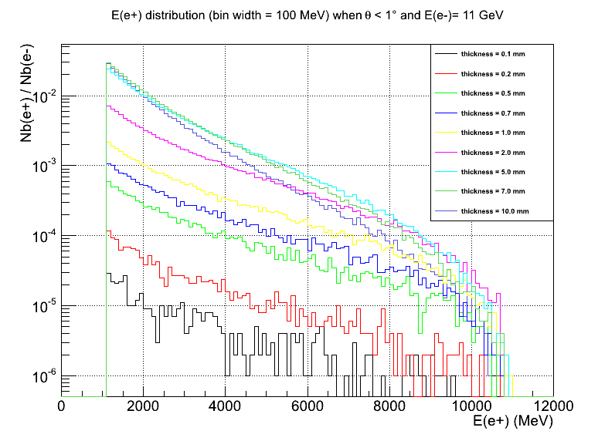
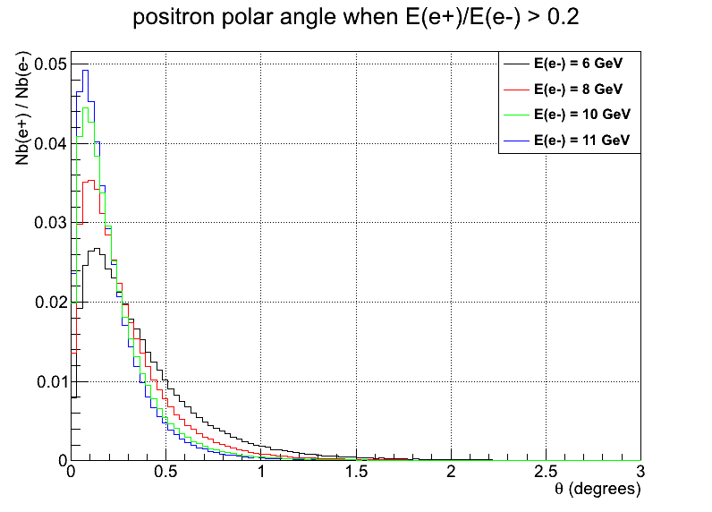
Polarized e⁺ @ CEBAF
Eric Voutier
Conceptual Simulations
M. Mazouz (2015)
Thickness : varying from 0.1 mm to 10 mm
Positrons
E(e⁺)
GEANT4 simulation of a generic first order production scheme in absence of magnetic collection of positrons, and with high energy polarized electrons.
10⁶ electrons (P_{b}=+1)
Tungsten target
θ
z-axis
No magnetic field
E(e⁻) varying 6-11 GeV
2.0
10 mm
0.7
0.2
0.1 mm
Loch Lomond, October 13-14, 2016

Slide 29
Polarized e⁺ @ CEBAF
Eric Voutier
e⁺ @ CLAS12
A new tunnel parallel to the Hall B ones is required,
long enough to allow for production and collection of positrons as well as to dump of the electron beam.
Loch Lomond, October 13-14, 2016

