Slide 1

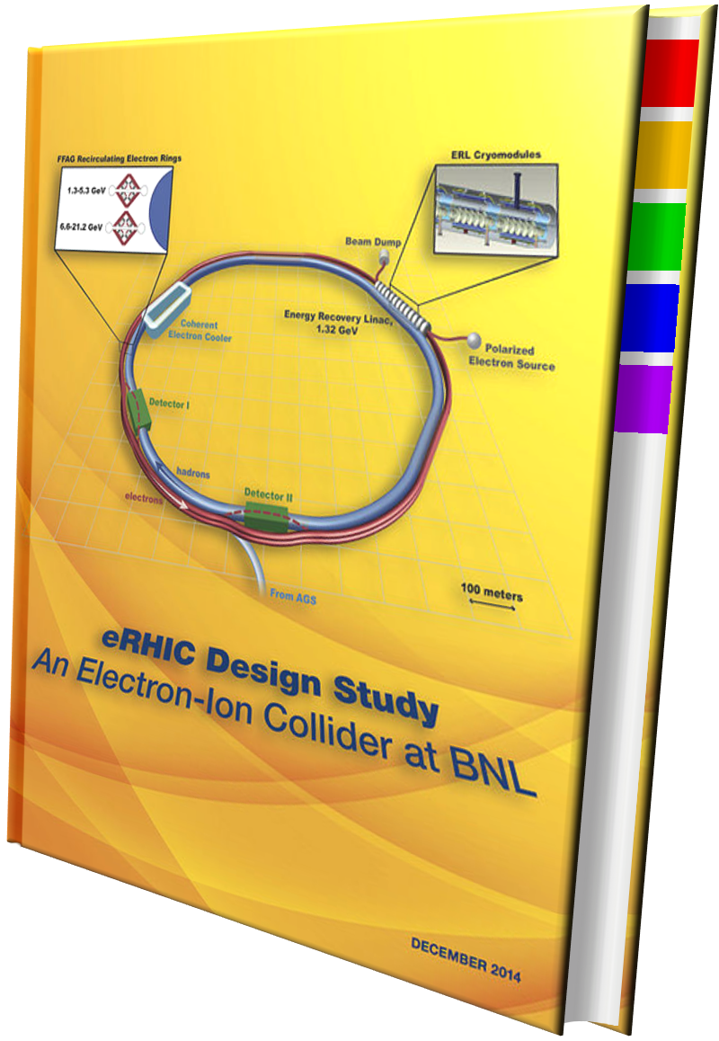
EIC@BNL - Energy Reach - Physics and Detectors
E.C. Aschenauer
arXiv: 1212.1701
arXiv:1409.1633

Slide 2
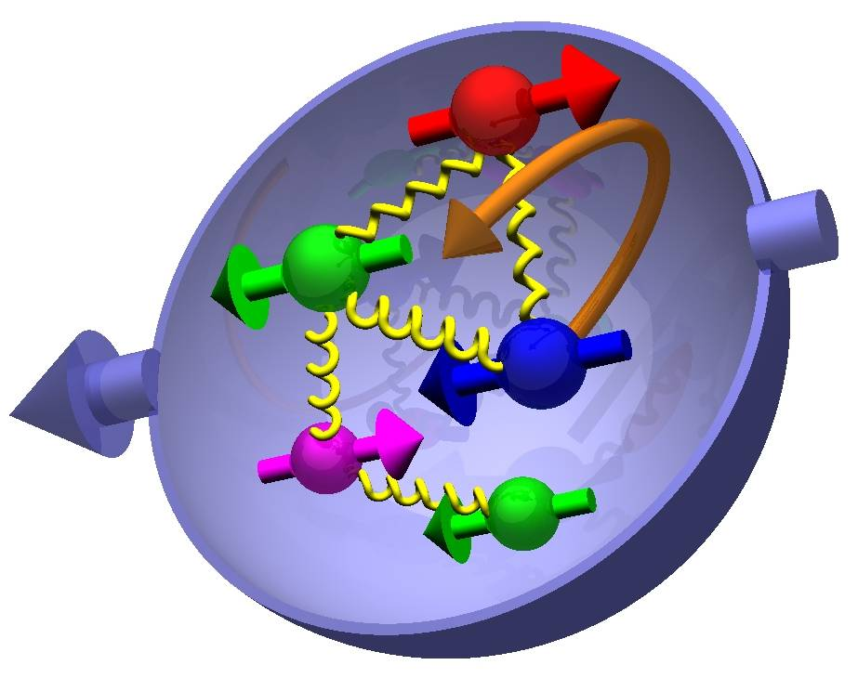

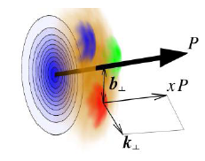
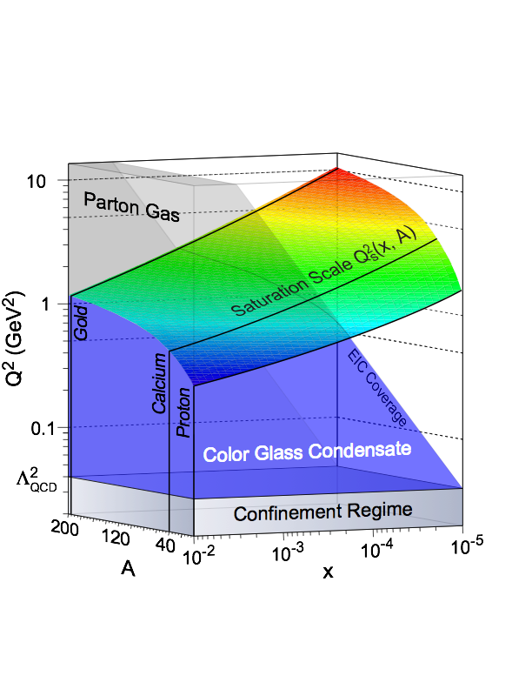
Most Compelling SCIENCE Questions
How are sea quarks and gluons and their spin distributed
in space and momentum inside the nucleon?
How are these quark and gluon distributions correlated with the
over all nucleon properties, such as spin direction?
What is the role of the motion of sea quarks and gluons
in building the nucleon spin?
How does the nuclear environment affect the distribution
of quarks and gluons and their interaction in nuclei?
How does the transverse spatial distribution of gluons compare to that in the nucleon?
How does matter respond to fast moving color charge passing through it?
Is this response different for light and heavy quarks?
γ*
h
e’
q
e
Where does the saturation of gluon densities set in?
Is there a simple boundary that separates the region from the more dilute quark gluon matter? If so how do the distributions
of quarks and gluons change as one crosses the boundary?
Does this saturation produce matter of universal properties in
the nucleon and all nuclei viewed at nearly the speed of light?

Slide 3
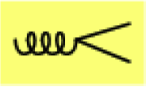
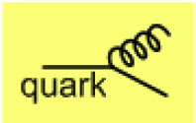
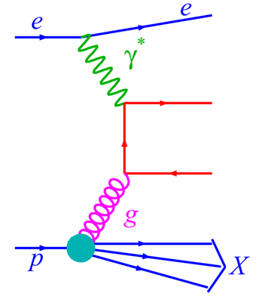
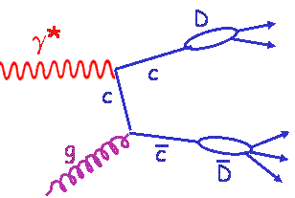
How to access gluons in DIS
small x
gluon extracted
from inclusive SF
through DGLAP
need to have at
fixed x more than
1-decade in Q²
large x
dF₂/dlnQ² ~ Pqg xg
Tag photon-gluon-fusion:
tag on charm
in the event
→ μ-vertex detector
q
high-p_{t} di-hadrons
di-jets
or

Slide 4
present vs EIC kinematic coverage
likewise for Q²
EIC extends x coverage
by ~2 decades

Slide 5
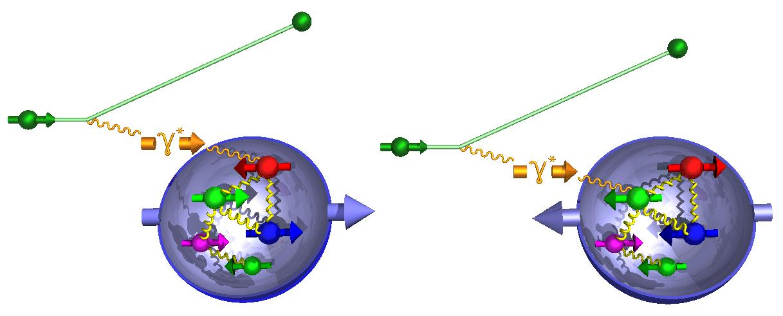
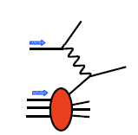
g₁^{p} the way to find the Spin
M.Stratmann, R. Sassot, ECA: arXiv:1206.6014 & 1509.06489
unseen precision and x-Q² coverage
cross section:
-
g₁ ~
pQCD scaling violations
world data

Slide 6
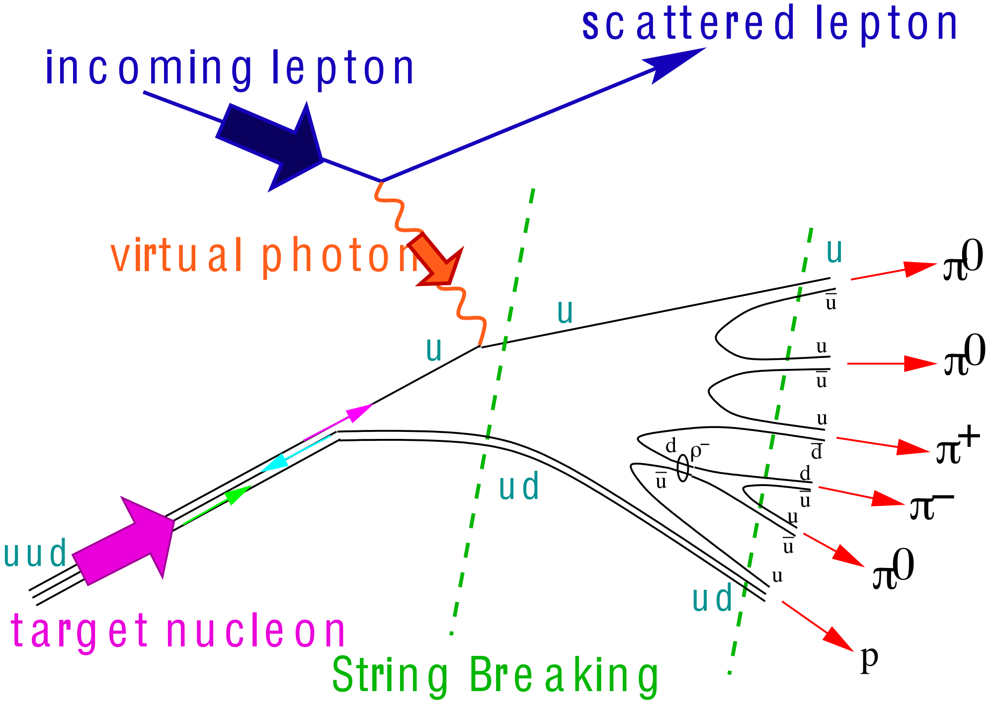
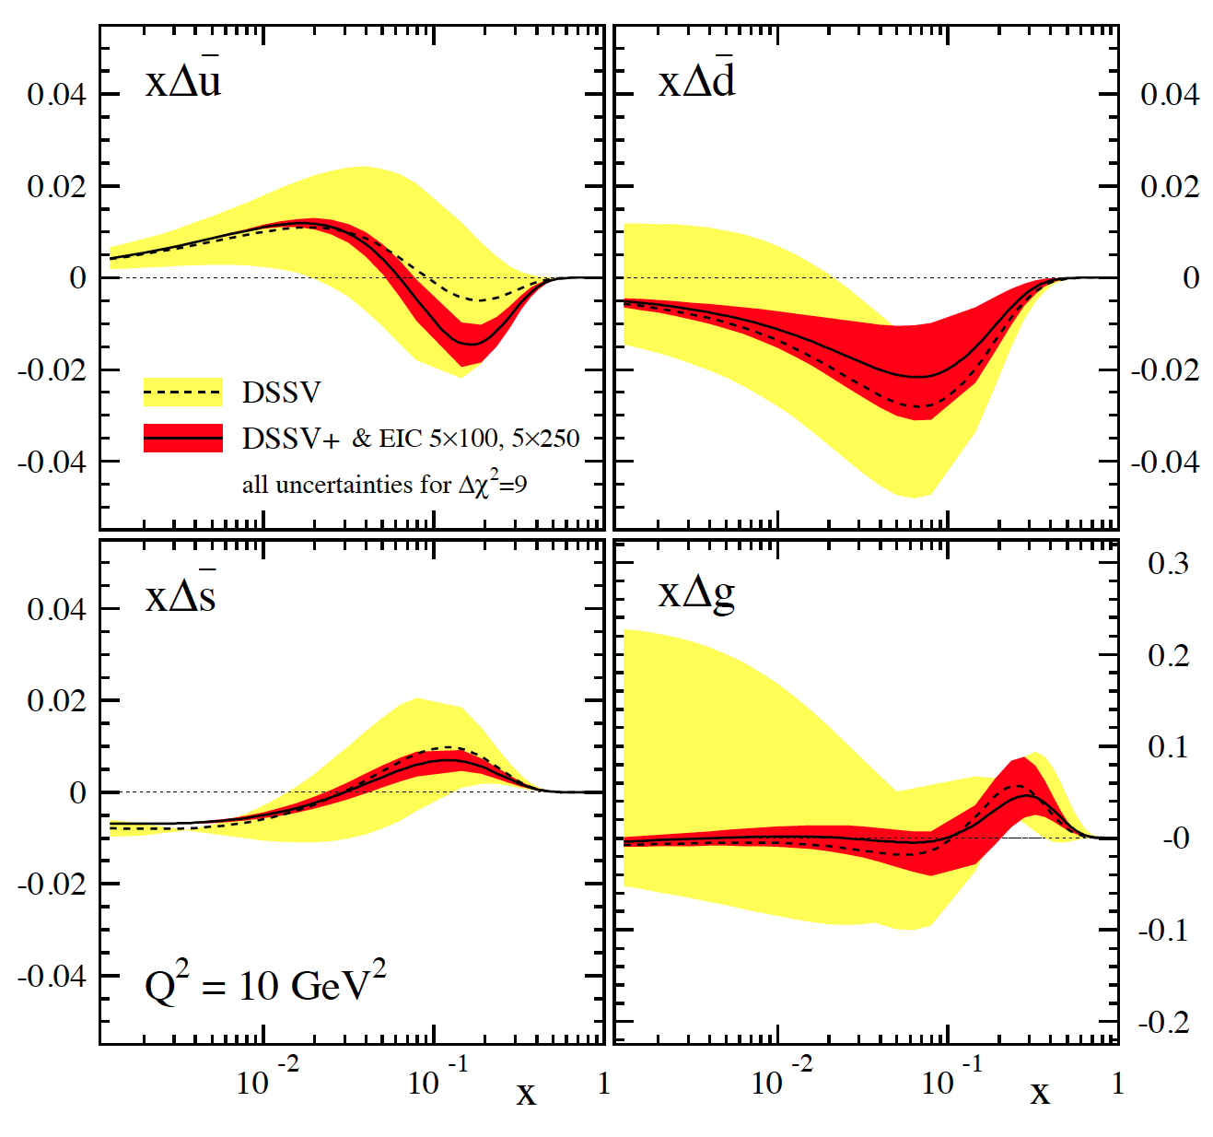
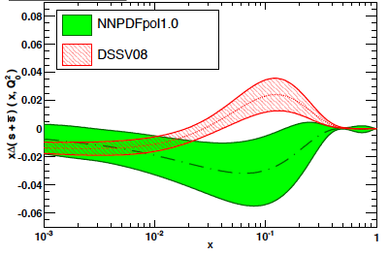
impact on helicity PDFs: Δq
DIS scaling violations crucial to constrain Δg
SIDIS data provide detailed flavor separation of quark sea
only data till x>10⁻³ included
∫Δq dx needs also the data
with √s = 140 GeV
→ same for ∫Δg dx
2008
To resolve the 3F-D controversy → SU(3)_{f} breaking
need data at low x to see we have knots or ? in the PDF
Strangeness:
Remarks/Caveats:
SIDIS analysis depends on s
→K fragmentation
DSSV global fit finds no tension
between DIS and SIDIS
NNPDF allows for 30% error on
3F-D=0.585±0.025
→ no big impact
how well do we know unpolarized s(x)?
lattice finds small strangeness
←→ large breaking of 3F-D relation
Bali et al. 1112.3354
from
SIDIS
K-data
SIDIS
data
1st moment
constrained
by 3F-D
indirectly
from
DIS-data

Slide 7
impact on helicity PDFs: Δg
possible slower
Δg(x,Q²) → 0 as x → 0
consistent with uncertainties
and first calculations based
on BFKL low-x approaches
by Bartels et al.
and Kovchegov et al.
∫dx (1/x)^{1.26 / 0.8}
low x-reach (x<10⁻³)
of EIC critical
dramatic reduction
of uncertainties:
BUT:
DSSV 2014
2008
Consequences
on
g₁(x,Q²)
&
∫dx Δg(x,Q²)

Slide 8

Where does the Spin of the proton hide
total
quark
spin
“Helicity sum rule:”
gluon
spin
angular
momentum
After EIC:
spin puzzle will be solved
1/2 -
-
orbital angular
momentum
Gluon
Quarks
=

Slide 9
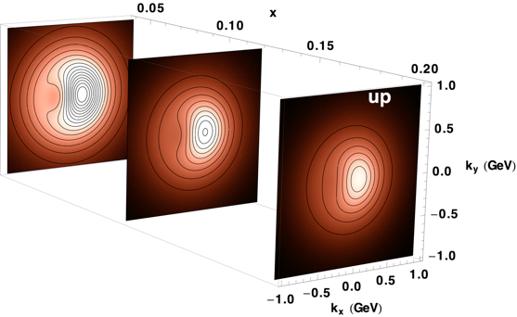
2+1 dimensional Imaging: Quarks & Gluons
Wigner function
W(x,b_{T},k_{T})
Momentum
space
Coordinate
space
∫d²b_{T}
∫ d²k_{T}
f(x,k_{T})
f(x,b_{T})
Quarks
Gluons
Spin-dependent 3D momentum space
images from semi-inclusive scattering
Spin-dependent 2+1D coordinate space images from exclusive scattering
Latest on TMDs look to
https://indico.cern.ch/event/570680/contributions/2309907/
attachments/1341724/2024252/eca.EIC.transverse.pptx

Slide 10
Deeply Virtual Compton Scattering at EIC
e’
γ
DVCS: Golden channel → theoretically clean
wide range of observables
(σ, A_{UT}, A_{LU}, A_{UL}, A_{C})
to disentangle different GPDs
e
γ_{L}*
(Q²)
x+ξ
x-ξ
~
~
p
H, H, E, E (x,ξ,t)
p’
t
large t
D. Mueller, K. KumerickiS. Fazio, and ECA arXiv:1304.0077
small t
Fourier
Transform

Slide 11
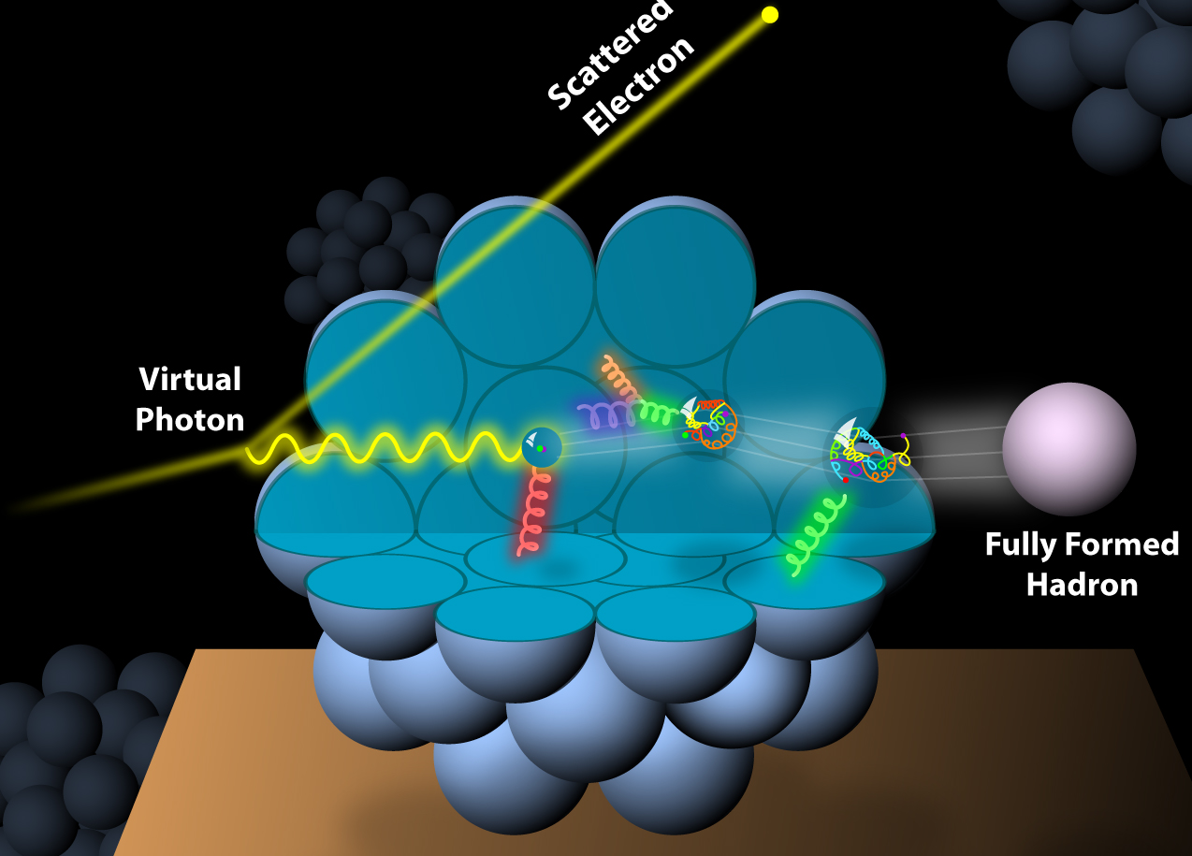
And What about nuclei
Incoming
Electron Beam

Slide 12
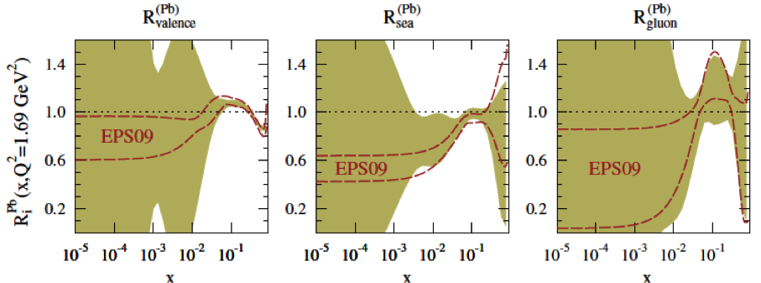
npdfs before and after EIC
Ratio g(x,Q²)_{pb} /g(x,Q²)_{p}
DGLAP:
predicts Q² but not A-dependence and x-dependence
Saturation models:
predict A-dependence and x-dependence but not Q²
→ Need: large Q² lever-arm for fixed x, A-scan
Ilkka Helenius DIS 2016 arXiv:1606.09003
x
LHC
RHIC
Measure different structure function in eA → constrain nPDF:
quark+anti-quark
momentum distributions
gluon momentum distribution
or tag on charm → F₂^{C}

Slide 13
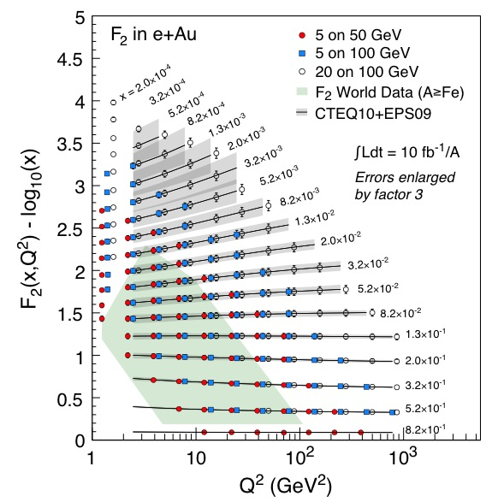
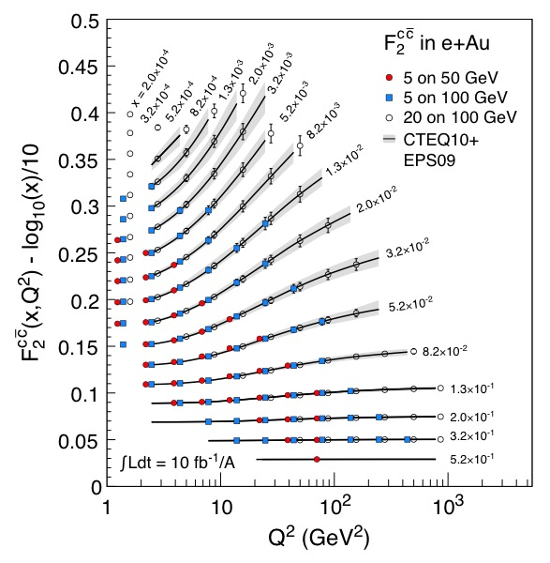
npdfs before and after EIC
√s_{eA}= 32 GeV
√s_{eA}= 45 GeV
√s_{eA}= 90 GeV
√s_{eA}= 32, 39, 45 GeV
√s_{eA}= 63,77, 90 GeV
√s_{eA}= 32 GeV
√s_{eA}= 45 GeV
√s_{eA}= 90 GeV
Identical precision can be reached for ep SF
to even higher Q² at high x
→ critical input for high mass searches at LHC

Slide 14
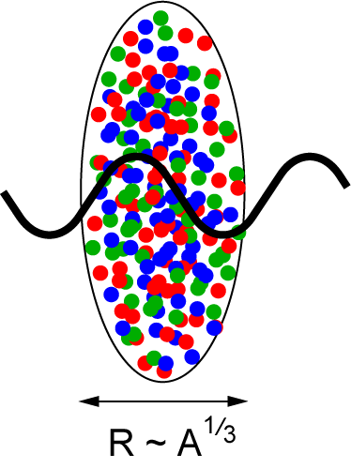
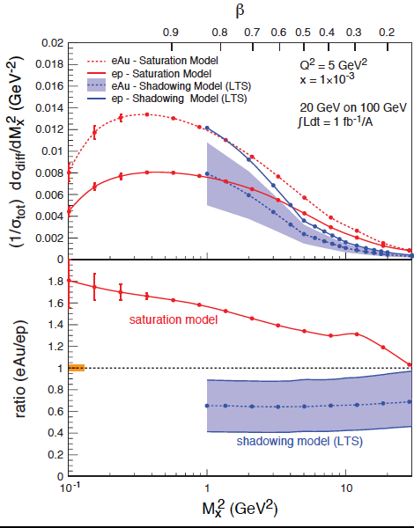
Saturation and EIC
Key Observables:
Di-hadron correlations:
√s_{eA}= 63 GeV
√s_{eA}= 90 GeV
L ~ (2m_{N} x)⁻¹ > 2 R_{A} ~ A^{1/3}
Probe interacts
coherently with all nucleons
Inclusive diffraction
Ca
Gold: 197 times smaller effective x !
→ The EIC will map the region of the transition from non-saturated
to saturated (CGC) regime
→ With it's flexible ion source we will be able to measure the
A-dependence of the saturation scale Q_{s}(x)
→ a fundamental landmark of QCD
p
Coherent and in-coherent VM-production:

Slide 15

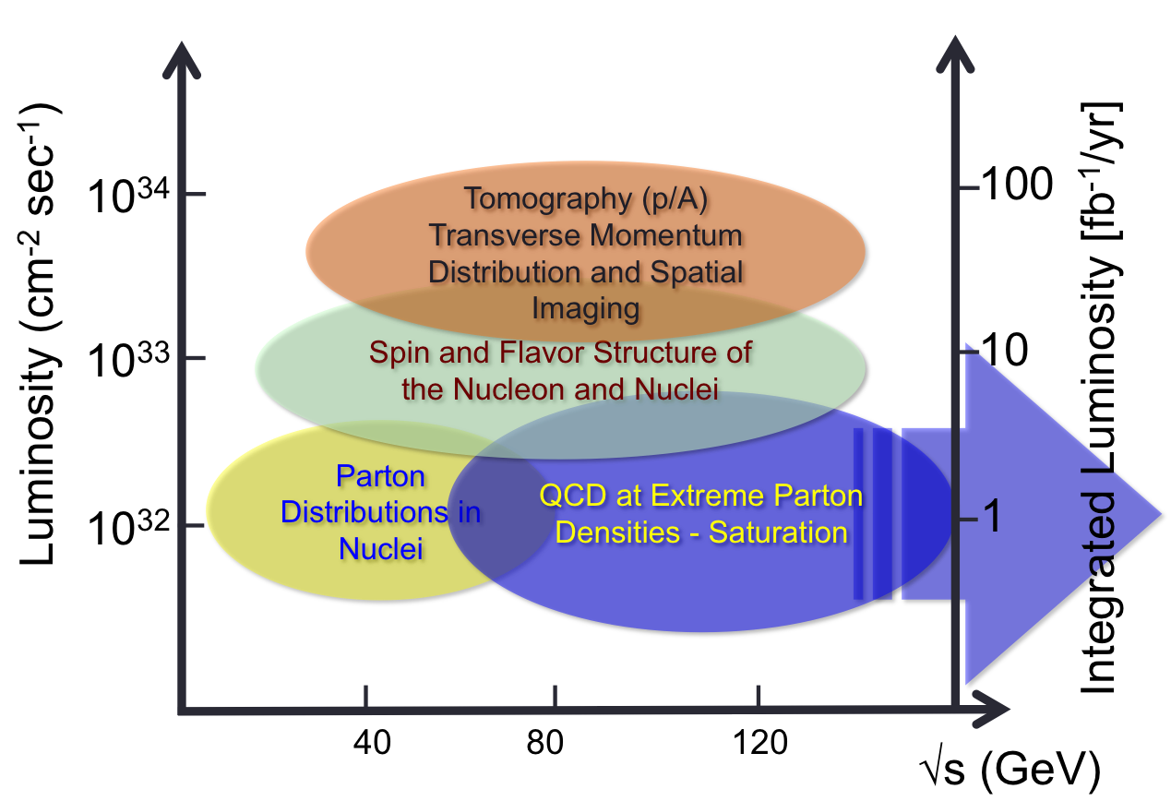
Global Requirements
Requirements from Physics:
High Luminosity > 10³³⁻³⁴ cm⁻²s⁻¹ and higher → nucleon/nuclei imaging
Flexible center of mass energy → wide kinematic reach
Electrons (0.8) and protons/light nuclei (0.7) highly polarized
→ study of spin structure
Wide range of nuclear beams (D to U) → high gluon densities
room for a wide acceptance detector with good PID (e/h & π, K, p)
large acceptance for protons from elastic reactions and neutrons from nuclear breakup
year =10⁷ sec

Slide 16

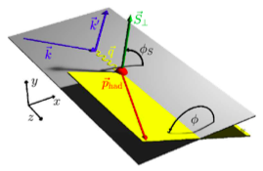
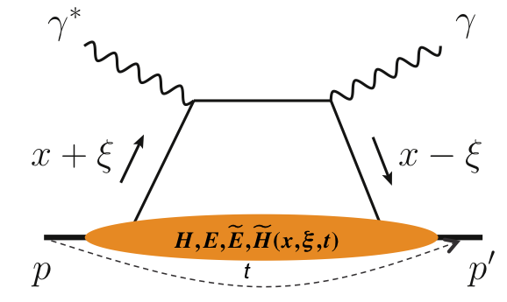
What is needed to realize EIC program
experimental program to address these questions:
prerequisites
inclusive and semi-inclusive DIS
all need √s_{ep} > 50 GeV
to access x < 10⁻³ where
sea quarks and gluons dominate
longitudinal motion of spinning quarks and gluons
machine & detector requirements
azimuthal asymmetries in DIS
L ≃ 10 fb⁻¹
adds their transverse momentum dependence
L ≃ 10 - 100 fb⁻¹
exclusive processes
multi-dimensional binning
→ x, Q², z, p_{T} (or t), Θ
to reach pT > 1 GeV
to reach |t| > 1 GeV²
adds their spatial distribution

Slide 17
Difference to RHIC and JLab
 | EIC | hadron-hadron colliders | fixed target experiments
Kinematics | very asymmetric beam energies → very boosted kinematics | symmetric beam energies → most activity at mid rapidity | totally asymmetric beam energies → all activity at very forward rapidities
Backgrounds | synchrotron radiation beam gas events | beam gas events | some synchrotron radiation Moeller/Bhabha leptons
Measurements | run many “experiments: at once | run many “experiments: at once | limited to single experiments at a time

Slide 18
Background Sources
electron beam:
Synchrotron radiation
  Backscattering
  Photo desorption
  → degradation of vacuum
Beam gas interactions
  Off momentum electrons
Higher order mode losses
  Local heating at injection and ramp (short bunches)
  degradation of vacuum
background due to de-excitation of beam if bunches are replaced
proton beam:
Low beam lifetime during
injection and ramping
Beam gas interactions, large
hadronic cross section
  Secondary interactions with
  aperture limitations, i.e. with
  magnets, beam pipe, masks
Need:
Careful design of interaction region, beam-pipe masks and photon beam dump
Excellent vacuum system
LR & RR
RR

Slide 19
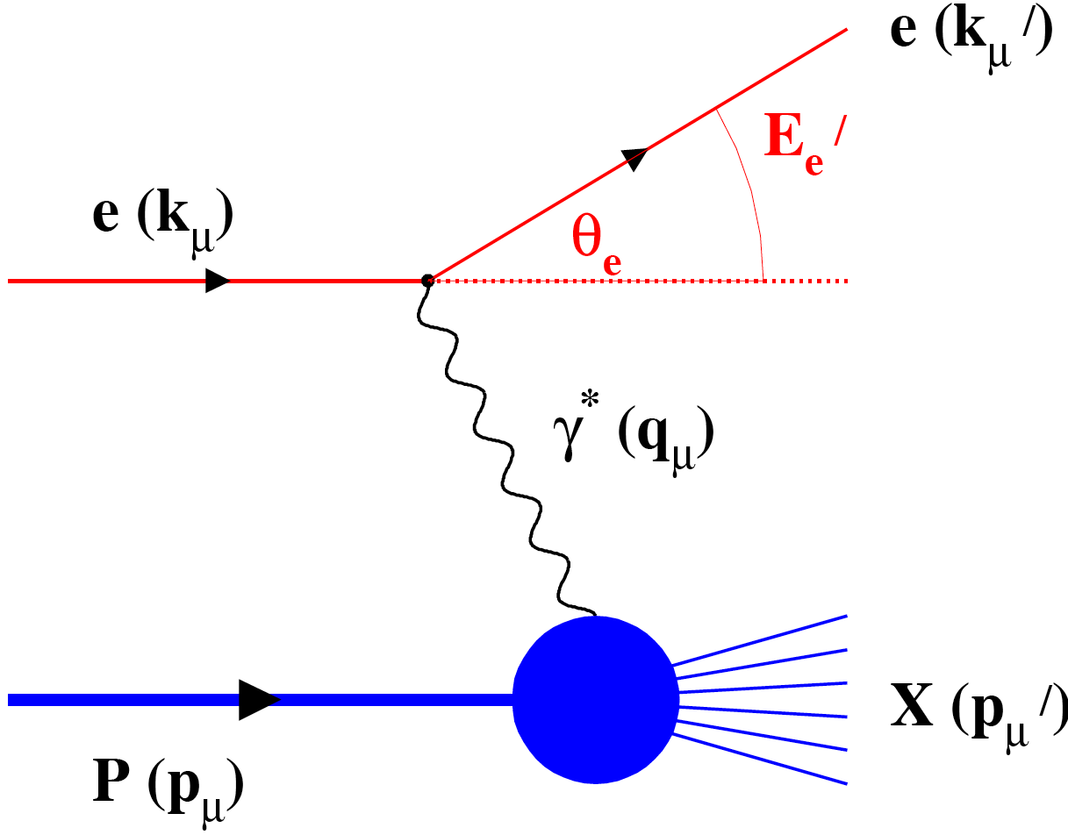
What is Needed to Realize this Program
Inclusive Reactions in ep/eA:
Physics: Structure Fcts.: g₁, F₂, F_{L}
scattered lepton → kinematics of event (x,Q²)
identify scattered lepton → excellent electron id
Momentum/energy and angular resolution of e’ critical

Slide 20
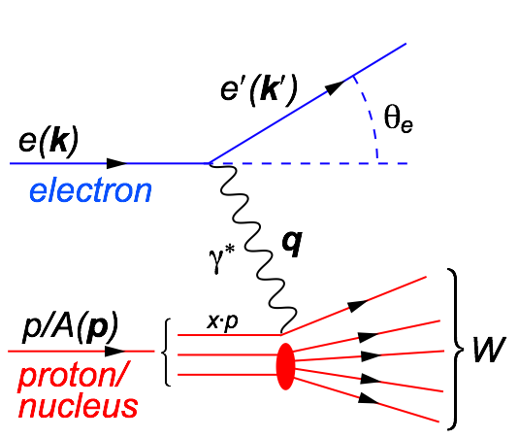
Deep Inelastic Scattering
Kinematics:
Measure of resolution power
Measure of inelasticity
Measure of momentum fraction of struck quark
low y-coverage: limited by E’_{e} resolution
y-coverage can be extended by beam
energy scan → costly $ & beam time
or use hadronic final state to reconstruct
event kinematics
CC events require the hadron method
Possible limitations in kinematic coverage:
high y limited by
internal radiative
corrections
can be suppressed by
requiring hadronic
activity
HERA
y>0.005

Slide 21
Particle Kinematics
−η
+η
lepton beam
hadron beam
scattered lepton:
low high
lepton beam energy
scattered lepton
more and more
at –η
low high
hadron beam energy
no influence on
scattered lepton
kinematics
main detector; -5 < η < 5
η <-5 : scattered lepton needs to be detected in dedicated low-Q² tagger
kinematic coverage in Q²-x-η critical for physics

Slide 22
Lepton PID requirements
Lepton-PID:
γ suppression:
the same η coverage for
tracking & Ecal
h⁻ suppression through E/p
η<-4: 1:1
-4<η<-1: 10:1 to 10³:1
−1<η <1: 10⁴:1

Slide 23
What is Needed to Realize this Program
Inclusive Reactions in ep/eA:
Physics: Structure Fcts.: g₁, F₂, F_{L}
scattered lepton → kinematics of event (x,Q²)
identify scattered lepton → excellent electron id
Momentum/energy and angular resolution of e’ critical
Semi-inclusive Reactions in ep/eA:
Physics: spin of the proton, FF, TMDs → flavor tagging through hadron type
→ Kaon asymmetries, cross sections → strangness PDFs
π±,K±,p± separation over a wide range |η|<3
→ covers entire kinematic region in p_{t} & z
→ Excellent particle ID
  → excellent p resolution at forward rapidities
TMDs: full Φ-coverage around γ*, wide p_{t} coverage
Excellent vertex resolution → Charm, Bottom separation

Slide 24
SIDIS: Pion Kinematics
Cuts: Q²>1 GeV, 0.01<y<0.95, z>0.1
low high
lepton beam energy
hadrons are
boosted
more and more
to –η
low high
hadron beam energy
hadron momentum
at fixed η
increases
Impact on hadron PID
no difference between π±, K±, p±

Slide 25
Hadron PID requirements
Hadron-PID:
technique dE/dx and RICH
π/K ratio 3-4
K/p ~ 1
-5 < η < 2:
0.1 GeV < p < 10 GeV
2 < η < 5:
0.1 GeV < p < 100 GeV
impact on RICH technology

Slide 26
Kinematic Coverage of Pions
Cuts: Q²>1 GeV², 0.01<y<0.95, p>1GeV
-3<η<3 covers entire kinematic region in p_{t} & z important for physics
no difference between π±, K±, p±

Slide 27
What is Needed to Realize this Program
Inclusive Reactions in ep/eA:
Physics: Structure Fcts.: g₁, F₂, F_{L}
scattered lepton → kinematics of event (x,Q²)
identify scattered lepton → excellent electron id
Momentum/energy and angular resolution of e’ critical
Semi-inclusive Reactions in ep/eA:
Physics: spin of the proton, FF, TMDs → flavor tagging through hadron type
→ Kaon asymmetries, cross sections → strangness PDFs
π±,K±,p± separation over a wide range |η|<3
→ covers entire kinematic region in p_{t} & z
→ Excellent particle ID
  → excellent p resolution at forward rapidities
TMDs: full Φ-coverage around γ*, wide p_{t} coverage
Excellent vertex resolution → Charm, Bottom separation
Exclusive Reactions in ep/eA:
Physics: GPDs, parton imaging in b_{T} through DVCS, excl. VM/PS prod.
Exclusivity → large rapidity coverage → rapidity gap events
↘ reconstruction of all particles in event
high resolution, wide coverage in t → b_{t} → Roman pots
eA: → acceptance for neutrons in Zero Degree Calorimeter
  veto nucleus breakup
  determine impact parameter of collision

Slide 28
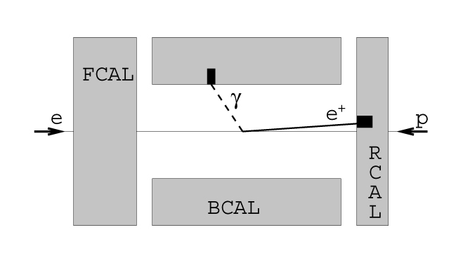
Exclusive Reactions: DVCS
DVCS – photon kinematics:
Cuts: Q²>1 GeV, 0.01<y<0.85
increasing Hadron Beam Energy:
influences max. photon energy at fixed η photons are boosted to negative rapidities (lepton direction)
γ
Δθ
e
ECal granularity: needs to be able to distinguish clusters down to Δθ=1º

Slide 29
Exclusive Reactions
two methods: to select events
proton/neutron tag method
Measurement of t
Free of p-diss background
Higher M_{X} range
to have high acceptance for
Roman Pots / ZDC challenging
→ IR design
Need for
Roman Pots (RP)
and
Zero Degree Calorimeter (ZDC)
detector acceptance: η>4.5
p’ acceptance critical:
t (~p_{t}²) reach influences b_{T} uncertainty
t_{min}~ 0.175 GeV² → 300 GeV² δF/F > 50%
Large Rapidiy Gap method
M_{X} system and e’ measured
Proton dissociation background
High acceptance in η for detector
Need for HCal
in the forward
region

Slide 30
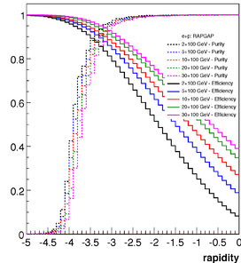
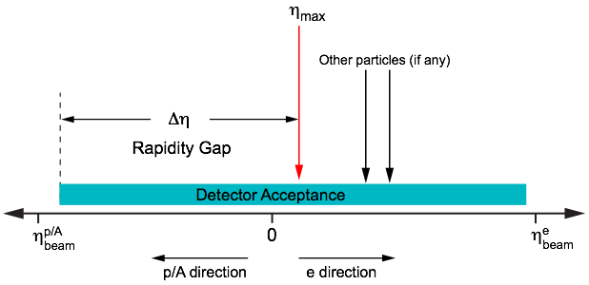
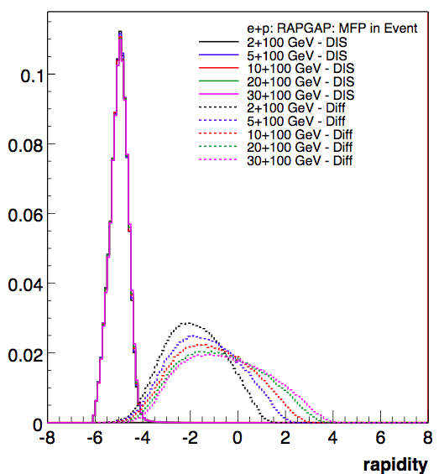
Large Rapidity Gap Method
  Identify Most Forward Going Particle (MFP)
    Works at HERA but at higher √s
    EIC smaller beam rapidities
σ_{dis}/σ_{diff} = 90:10
Diffractive ρ⁰ production at EIC:
η of MFP
DIS
Hermeticity requirement:
needs just detector to be present → -4 < η < 2
does not need momentum or PID
simulations: no show stopper for EIC √s
(can achieve <10% contamination, 90% efficiency)
Diffractive

Slide 31
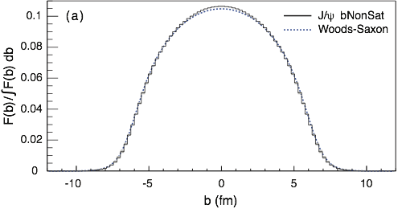
Why is Neutron Detection Critical
Measure spatial gluon distribution in nuclei
How: Diffractive vector meson production:
→ Momentum transfer t = |pAu-pAu′|² conjugate to bT
e + Au → e′ + Au′ + J/ψ, φ, ρ
suppress by
detect break-up
neutrons
PRC 87 (2013) 024913
Fourier Transform
Reconstruct the eA collision geometry:
for details see L. Zheng, ECA, J-H. Lee arXiv:1407.8055 Eur. Phys. J. A (2014) 50: 189
Notes:
spin-dependent gluon distribution

Slide 32
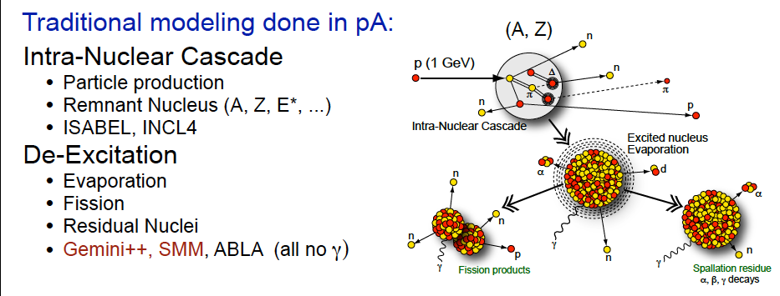
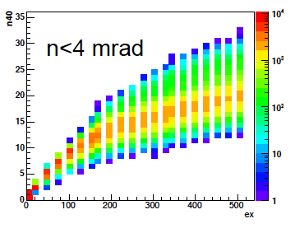
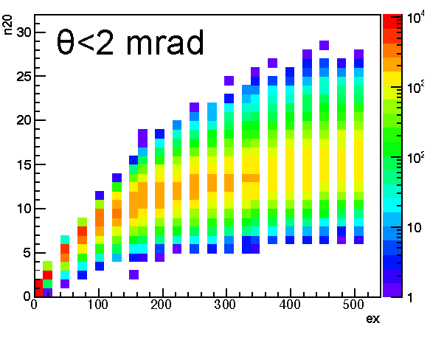
Modeled Nuclear breakup
Need a 4 mrad beam element free cone before
the zero degree calorimeter to detect the breakup neutrons
Au: 100 GeV
θ < 4 mrad
Au: 50 GeV
θ < 4 mrad
# Neutrons
# Neutrons
Excitation Energy
Excitation Energy

Slide 33
Requirements Summary
Rapidity Coverage:
tracking: -4 < η < 4
calorimetry: -5 < η < 5
π,K,p identification: -3 < η < 3
PID Requirements:
lepton / hadron separation strongly rapidity dependent
1:1 at η < -1 10:1 to 10³:1 at -4<η<-1 10⁴:1 at -1<η <1
π,K,p Identification:
π/(K,p) ratio ~3-4 → need high K efficiency and purity → positive ID
K/p ratio ~1
momentum-coverage:
-5 < η < 2: 0.1 GeV < p < 10 GeV
2 < η < 5: 0.1 GeV < p < 100 GeV
Momentum / Energy resolution:
RICH in f/b rapidity: δp/p < 1% p < 10 GeV 1<|η|<3
Combined Calorimeter and Momentum resolution:
in x-Q² bins > 60% for 0.01<y<0.95
Dual radiator RICH for 1<|η|<3

Slide 34
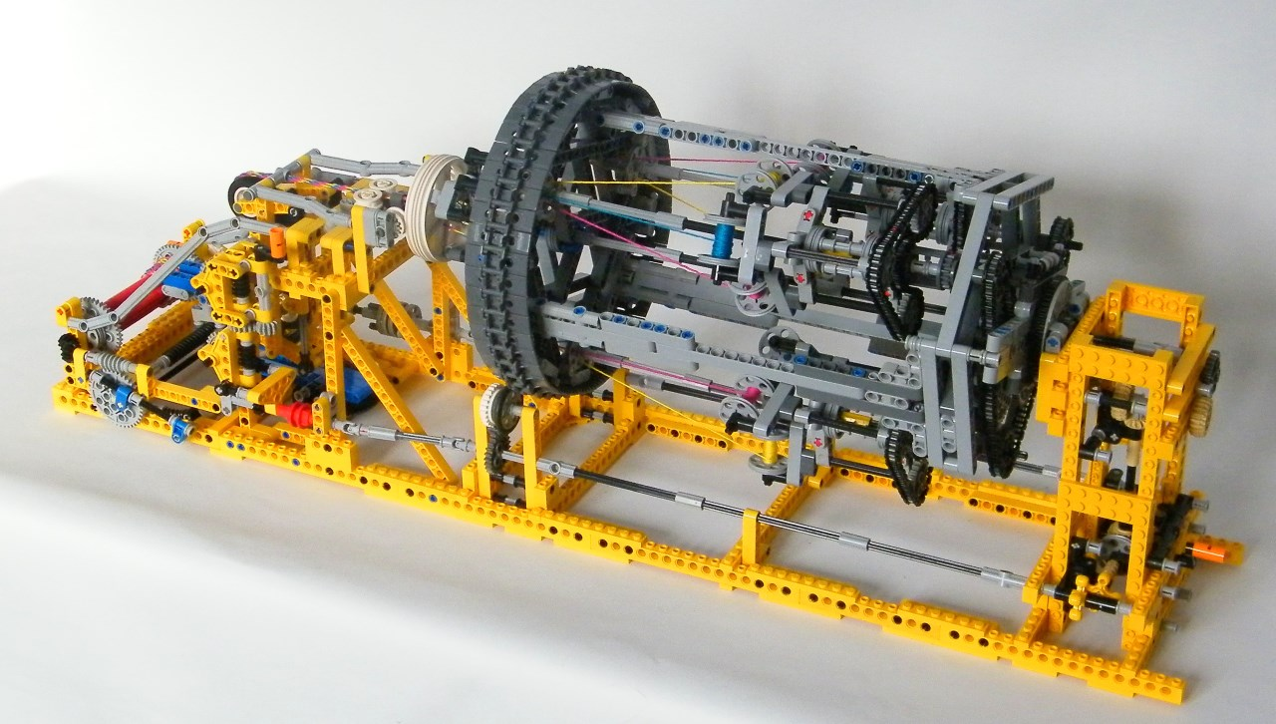
An EIC Detector
integrating all requirements

Slide 35
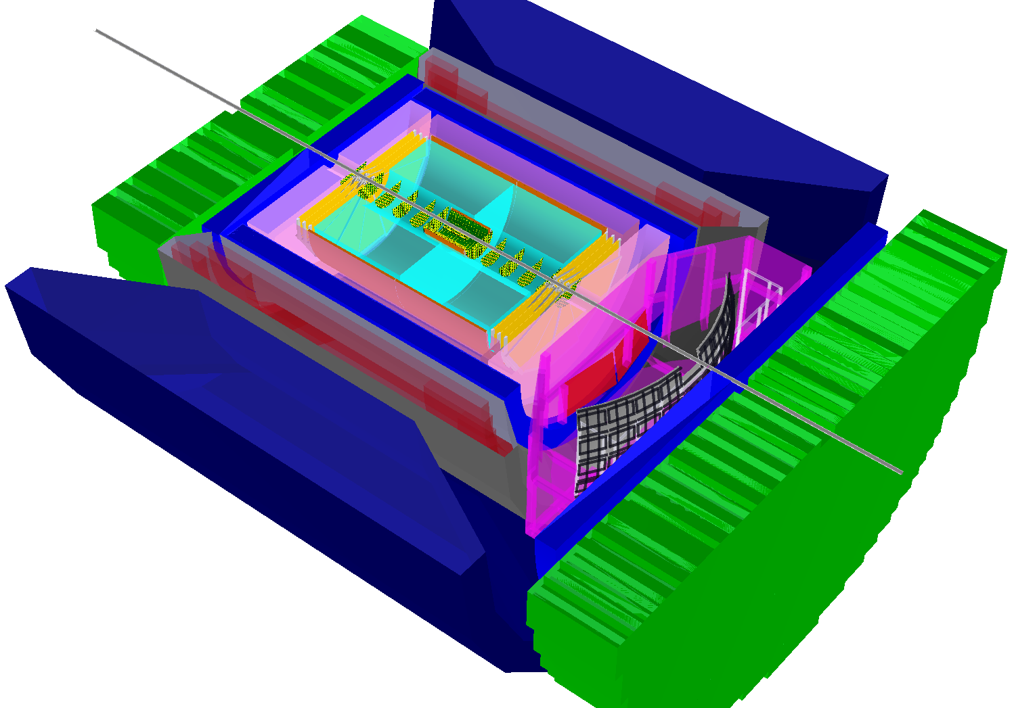
BeAST detector layout
-3.5<η<3.5: Tracking & e/m Calorimetry (hermetic coverage)
hadronic calorimeters
e/m calorimeters
RICH detectors
9.0m
Mainly based on detector ready to built technologies
or
as proposed in EIC-Detector R&D:
https://wiki.bnl.gov/conferences/index.php/EIC_R%25D
only minimal R&D required → cost reduction with improved performance
Hadron PID:
-1<η<1: proximity focusing
RICH + TPC: dE/dx
1<|η|<3: Dual-radiator RICH
Lepton-ID:
-3 <η< 3: e/p
1<|η|<3: in addition Hcal response
& γ suppression via tracking
|η|>3: ECal+Hcal response &
γ suppression via tracking
-4<η<4: Tracking (TPC+GEM+MAPS) MAPS: CMOS Monolithic Active Pixel Sensors
hadrons
electrons
silicon trackers
TPC
GEM trackers
3T solenoid coils

Slide 36
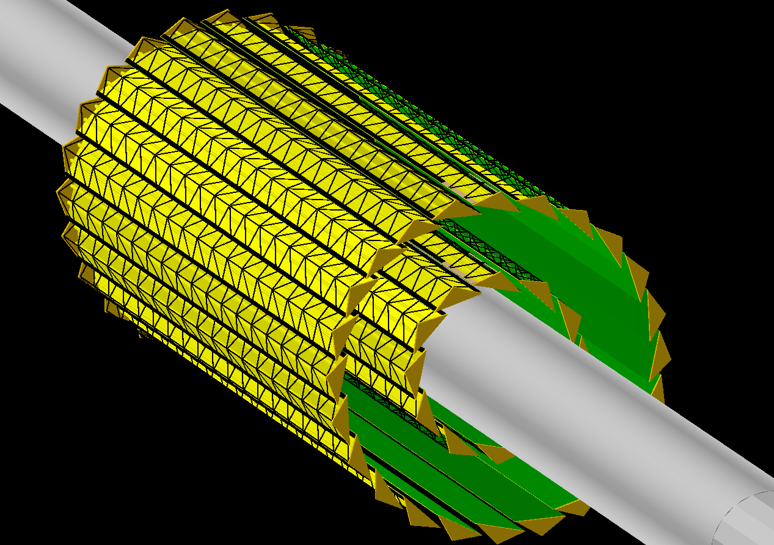
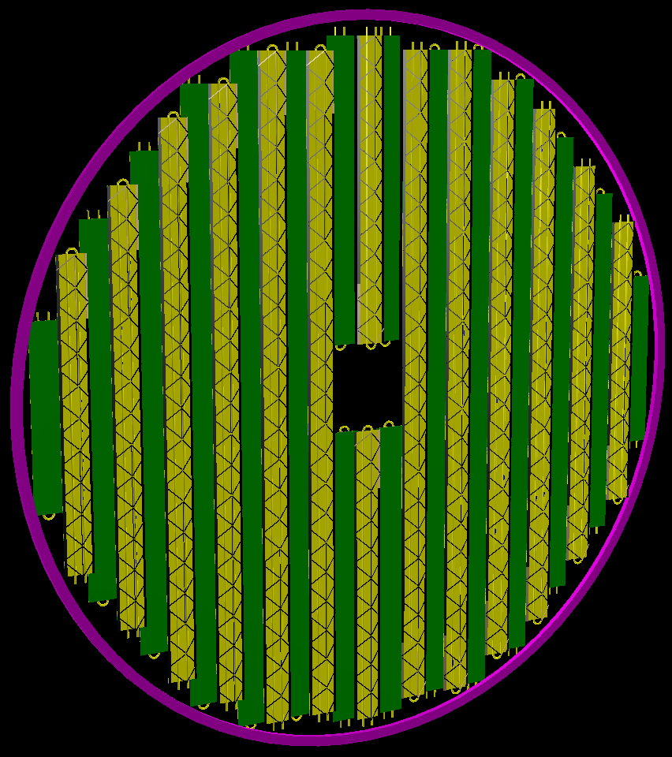
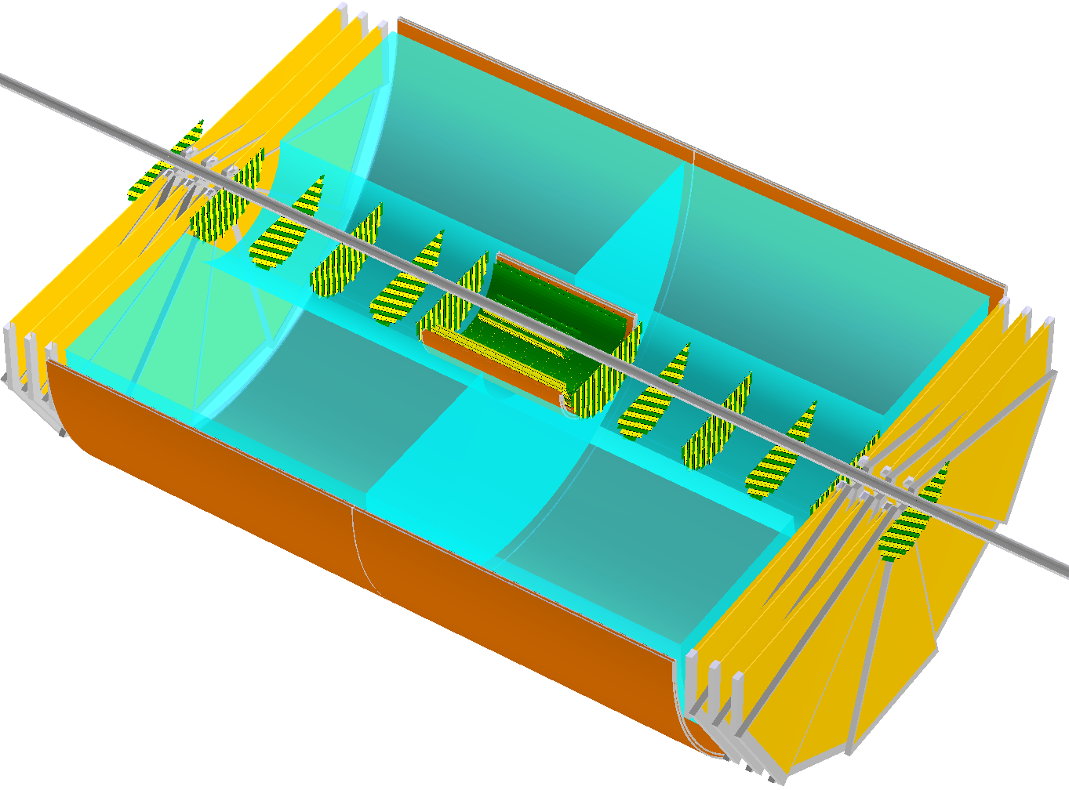
Tracking Detectors
TPC:
~2m long; gas volume radius [225..775] mm
1.2% X/X₀ IFC, 4.0% X/X₀ OFC; 15.0% X/X₀ end-caps
assume 5 mm long GEM pads and ~250 μm single point {rφ} resolution for the max. drift distance of ~1m
A gas mixture like T2K at ~250 V/cm (very small transverse dispersion in 3T field) will do the job
Configuration similar to ALICE ITS design should work just fine (and simulation environment is pretty much set up and ready for design optimization work)
2x2 barrel layers with high resolution MAPS
assume 20x20 μm² pixels and ~0.3% X₀ per layer
Two innermost layers
~180 mm
Forward/Backward Disks:
for now assume the same a la ALICE ITS building blocks (complete staves)
as in the vertex tracker
2x7 “discs” with [30 .. 180] mm radius
~2.0m
~360 mm
π⁺
Micromegas
Momentum resolution
H1 : 0.6%*P_{t} + 1.5%
ZEUS : 0.5%*P_{t} + 1.5%
GEM
High redundancy
Material budget ~5% rad.length
Pretty much “basic” components

Slide 37
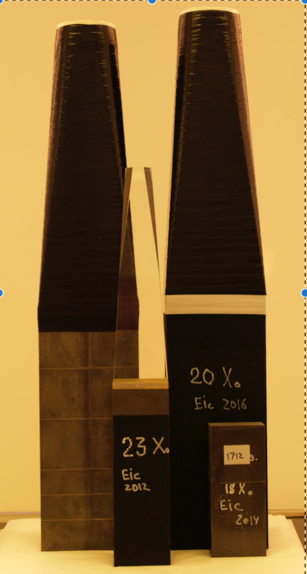
Electromagnetic Calorimeter
Very backward pseudo-rapidities (η < -2):
PWO crystals with ~2%/√E (or better) energy resolution
Pseudo-rapidity range -2 < η < 3.5:
Tungsten powder scintillating fiber technology with ~7-10%/√E energy resolution
Ongoing EIC R&D projects
e⁻ and γ energy measurement;
e/p electron ID
May’2016 test run in FNAL
H1 : (7..12)%/√E+1%
ZEUS : 18%/√E+1%
Present status (May’2016 test run)
Several configurations tested since 2012
Reach energy resolution level of ~{7%/√E + 1%} with the PMTs
See clear path towards getting similar level of performance with a compact readout

Slide 38
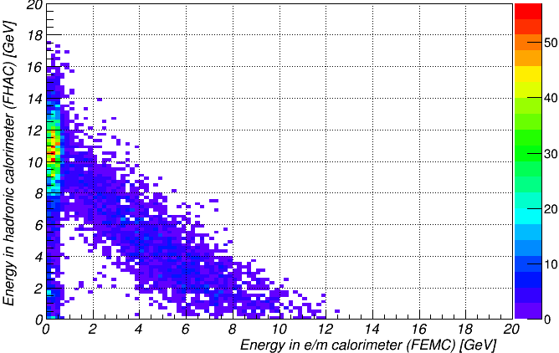
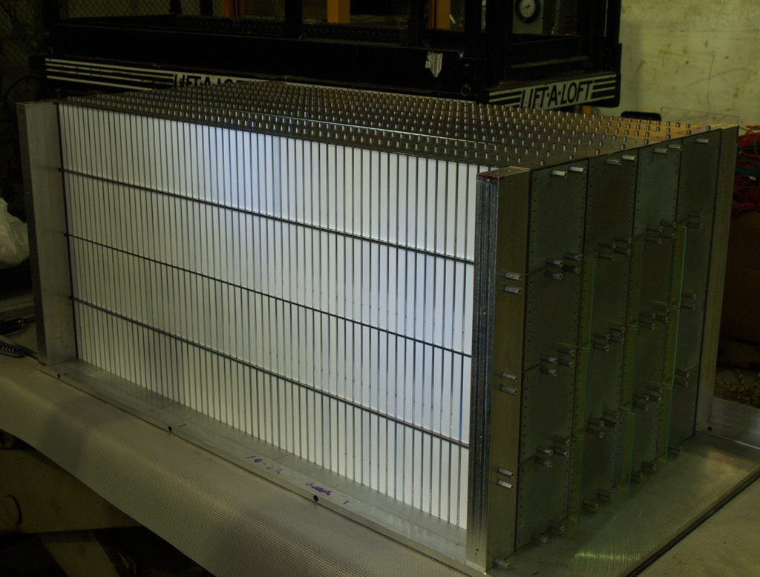

END-CAps; HadronIC calorimeter
Electron identification in electron-going direction;
jet physics in hadron-going direction
EIC R&D project
MC: 12 GeV pions: Hcal vs EmCal
Slope ~1.20 perfectly
matches measured data
Lead absorber scintillating plate sandwich technology
~50%/√E energy resolution looks fine
Adequate Monte-Carlo model exists in GEANT
Cost optimization and further R&D may be required (use steel plates instead of lead?)

Slide 39
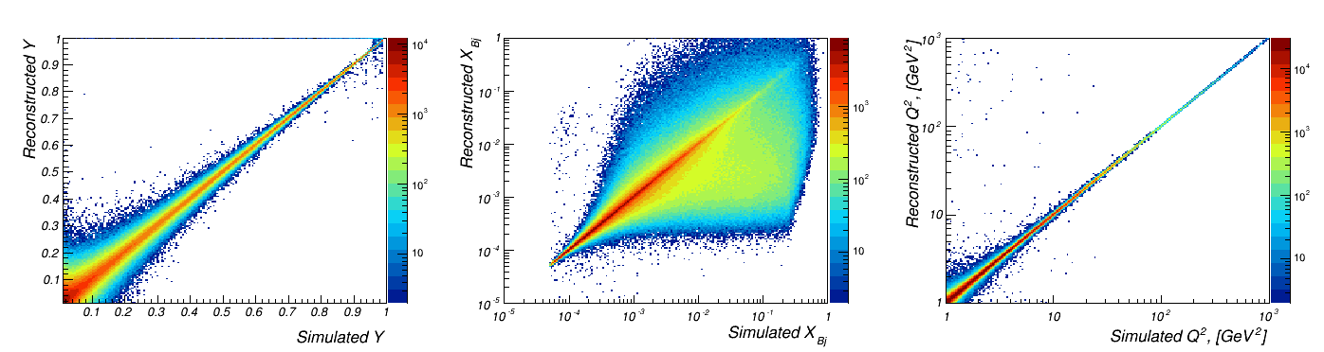
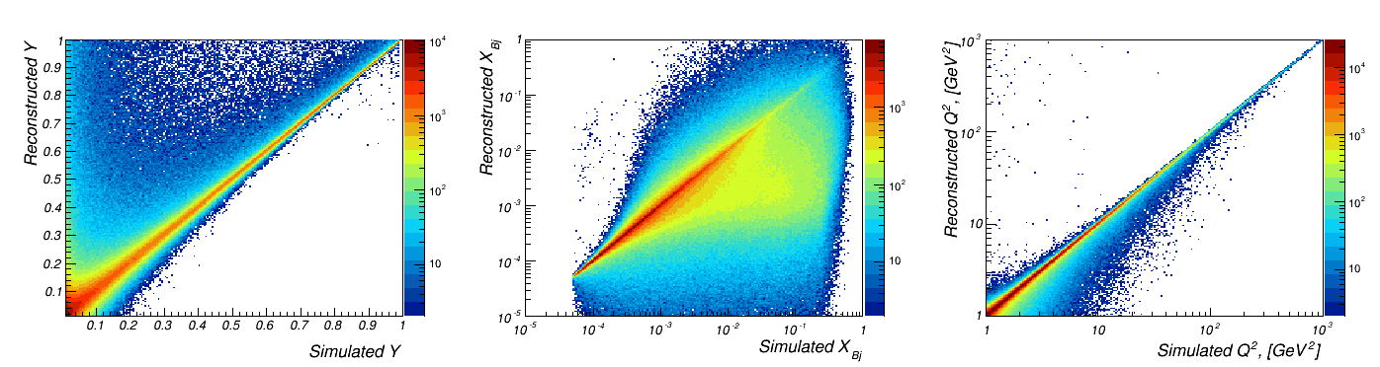
Tracking: smearing in kinematic variables
{PYTHIA 20x250 GeV, NO bremsstrahlung} -> {GEANT} -> {Kalman filter track fit}
same procedure; simulation WITH bremsstrahlung
Resolutions in electron method:
diverges for
y_{e}→0
depends on E’_{e}
diverges for
θ’_{e}→180º
depends on
E’_{e} and θ’_{ezz}
→ looks good despite poor resolution at low y and long bremsstrahlung tails

Slide 40
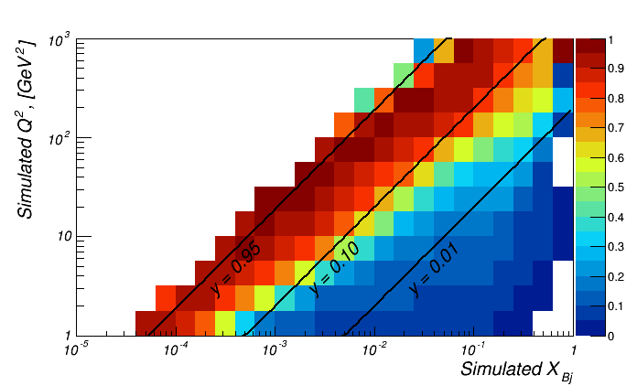
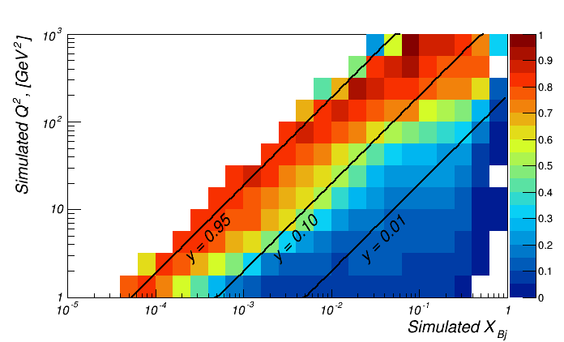
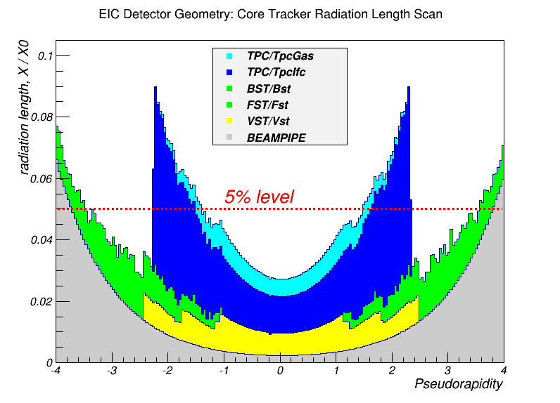
Tracking: “purity” in (x,Q²) kinematic bins
Describes migration between kinematic bins
Important to keep it close to 1.0 for successful unfolding
bremsstrahlung OFF
bremsstrahlung ON
  Migration from bin to bin influences
  bin size
  statistical precision:
  δN: given by events which are generated and reside
  in the same bin
Bremsstrahlung matters even for detector with ~5% X/X₀
“Straightforward” tracking can hardly
help at y<0.1
bremsstrahlung OFF
tracking + ECal
How can we improve further:
Try to account for bremsstrahlung photon
Combine Ecal and tracking info for lepton
Change Method: use hadronic final state information

Slide 41
πKp-ID: General Considerations
Rely on various types of Cerenkov detectors as the main device for p/K/p separation
EIC configuration is rather unique:
Potentially want to cover η range [-3.5 .. 3.5], all in a ~2-3T field of a compact solenoid:
Hard to use long (>1m or so) gas radiator in a (strongly non-homogeneous) fringe field
No way to shield the readout (so the options are very limited: GEMs, SiPMs, ..?)
Based on relative yields conclude that suppression factors around 1:100 or better are needed for specific momentum ranges at given h values
→ 3σ separation may be on a low end
Assume RICH can be supplemented by either TPC dE/dx (below ~1 GeV/c) or ToF (below ~1-2 GeV/c)

Slide 42
πKp-ID: General Considerations
SIDIS hadron momentum distributions: as high as ~50GeV/c, but plenty below 1 GeV/c
To which extent can we use results of the very successful “CF₄ + GEM RICH R&D”?
No need for momenta above 50 GeV/c
Once CF₄ is chosen as gas radiator, there is a glaring hole in Kaon ID below ~17 GeV/c
GEM readout inconsistent with aerogel-based dual radiator concept

Slide 43
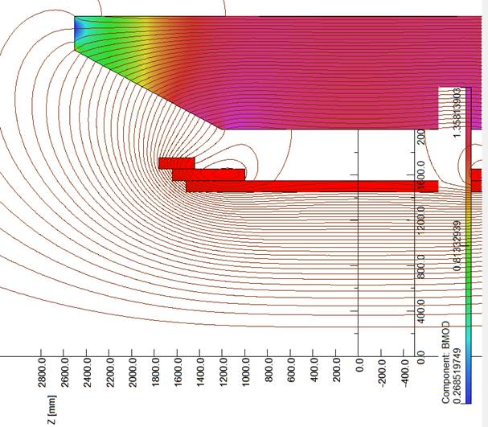
Gas RICH @ Forward Rapidities
Consider to use combination of solid (aerogel, C₆F₁₄?) and gas (C₄F₁₀?) radiators
Make sure one can minimize bending effects by special “alignment” of fringe field magnetic lines:
η = 1.0
Expected magnetic field effect: ~1mrad
is “bearable”
η = 1.5
RICH
location
TPC volume
η = 3.5
If needed, can we consider three radiators at once to cover full momentum range of roughly [<1 .. ~50] GeV/c?
C₆F₁₄
aerogel n=1.05
C₄F₁₀

Slide 44
Proximity Focusing RIch
Consider end-cap case in
proximity-focusing configuration:
NB: at 3T full track bending in aerogel volume is >5 mrad at 5 GeV/c!
3cm thick aerogel; 20cm expansion volume
<n₀> = 1.05
~5cm attenuation length
SiPM array readout; 5mm² “pixel” size
Assume on average 15 photons per ring at b ~ 1
Aerogel RICH R&D for Belle II upgrade
“Back-of-the-envelope” Monte-Carlo study:
Constant B_{z} ~ 3T
Asymmetric (f-dependent) attenuation
φ-dependent Cerenkov angle smearing in the field
SiPM quantum efficiency ε(λ) dependence
Refractive index n(λ) variation
Emission point uncertainty (thick radiator)
Finite readout board “pixel” size
Root TMVA-based output evaluation
… and magnetic field is again a minor effect
Require 95% kaon positive identification efficiency

Slide 45
Hadron PID requirement Summary
Lowest momentum in the whole h range: ALARA (but for sure <1 GeV/c)
Highest momentum:
Forward η: up to ~50 GeV/c (at least for h range [1.5 .. 3.5])
Central η: up to ~3-4 GeV/c (anything wrong with C₆F₁₄ in proximity focusing configuration?)
Backward η: up to ~5-6 GeV/c would suffice
At most few % of p->K misidentification probability at 90-95% K efficiency
Seemingly gas radiator RICH is limited to ~1m length in both BeAST and ePHENIX
dE/dx capability of GEM-based TPC below 1 GeV/c is of interest at
central η
Reliable complementary cheap ToF-based p/K/p separation below 1-2 GeV/c seems to be preferential compared to independent ultra-high timing PID up to ~3-4 GeV/c?

Slide 46
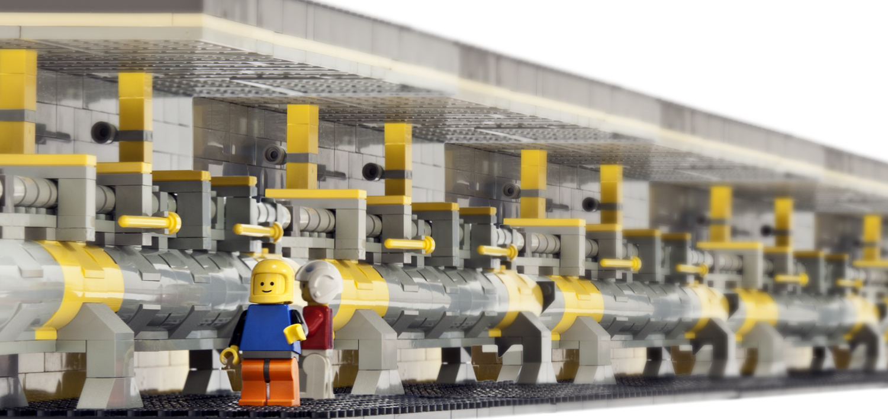
EIC:
Interaction Region
and
ancillary detector systems:
hadron and lepton polarimeters
luminosity detector
low Q² tagger
ZDC and Roman Pot systems
all needed from the beginning

Slide 47
Requirements from Physics on IR
Summarized at:
https://wiki.bnl.gov/eic/index.php/IR_Design_Requirements
Hadron Beam:
the detection of neutrons of nuclear break up in the outgoing hadron beam direction
→ location/acceptance of ZDC
the detection of the scattered protons from exclusive and diffractive reaction in the outgoing proton beam direction
the detection of the spectator protons from ³He and Deuterium
  → location/acceptance of RP;
space for hadron and local polarimetry
Lepton Beam:
minimize impact of detector magnetic field on lepton beam
  → synchrotron radiation
space for low Q² scattered lepton detection
space for the luminosity monitor in the outgoing lepton beam direction
space for lepton polarimetry
Important
EIC is a high luminosity machine 10³³⁻³⁴ cm⁻²s⁻¹
such controlling systematics becomes crucial
luminosity measurement
lepton and hadron polarization measurement

Slide 48
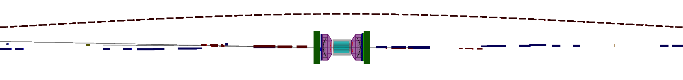
Auxiliary Detectors and the IR
hadrons electrons
-45 m
-35 m
-15 m
0 m
18 m
 | Hadron | Lepton
Polarization | > 0.7 | > 0.8
Bunch spin orientation | flexible from bunch to bunch | flexible from bunch to bunch
scattered neutron acc. | +/- 4 mrad
scattered proton acc. | +/- 5 mrad @ 250 GeV 0.18 < p_{t} (GeV) < 1.3
Machine free region | +/- 4.5 m for detector
Luminosity | > 10³³ cm⁻²s⁻¹
Luminosity monitor acc. |  | +/- 1-2 mrad δL/L < 1%
Relative Luminosity | L^{++/--}/L^{+-/-+} ~ 10⁻⁴ to 10⁻⁵
wide kinematic range | √s: 30 to 140 GeV
wide range of nuclei | p to Uranium

Slide 49
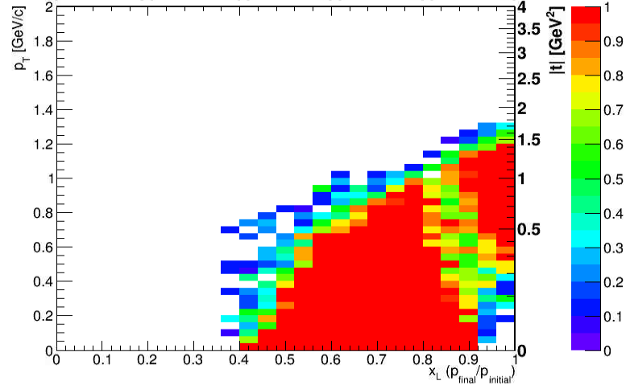
Auxiliary Detectors and the IR
hadrons electrons
generated flat in space
-45 m
-35 m
-15 m
0 m
18 m
Roman Pots
Sensors integrated into the vacuum system
Retractable to move into the beam after stable
Allows to move sensors as close to beam as possible
  Typically around 10sigma beam width
  Defined by beam optics (beta function) at the location of the roman pot
  Want small beta function with large dispersion to pull scattered protons out of the beam
Ongoing R&D with machine developers to give access
One station at ~20 m
MILOU 20x250 GeV DVCS sent
into simulation

Slide 50

Auxiliary Detectors and the IR
hadrons electrons
-45 m
-35 m
-15 m
0 m
18 m
Expected distributions from DPMJet simulation of neutron evaporation
ZDC
Need acceptance for outgoing neutrons
  Centrality determination in e+Au collisions
  Tagging for diffractive events

Slide 51



Auxiliary Detectors and the IR
hadrons electrons
-45 m
-35 m
-15 m
0 m
18 m
electron beam
Low Q²-Tagger
Acceptance for electrons from events with Q²<0.01 GeV²
Sits close to the beam line
pythia events
with electron reconstructed
in the tagger
51

Slide 52

Auxiliary Detectors and the IR
hadrons electrons
-45 m
-35 m
-15 m
0 m
18 m
Luminosity Monitor
Measure via Bethe-Heitler
  e+p -> e+p+gamma
Emission cone dominated by beam optics

Slide 53




Auxiliary Detectors and the IR
measure via single photons
cartoon schematic
hadrons electrons
-45 m
-35 m
-15 m
0 m
18 m
Electron Polarimetry
Measure via Compton Scattering
Shine laser on electron beam, flip helicity state and measure asymmetry in cross section
Focus here on measuring longitudinal component of spin, i.e. measure photon energy
Working on extracting the full polarization vector angle and magnitude by a 2D fit in angle and energy of photon
measure via electrons

Slide 54
EIC Hadron Polarimetry
Polarized hydrogen Jet Polarimeter (HJet)
  Source of absolute polarization (normalization for other polarimeters)
  Slow (low rates ⇒ needs looong time to get precise measurements)
Proton-Carbon Polarimeter (pC) @ RHIC and AGS
  Very fast ⇒ main polarization monitoring tool
  Measures polarization bunch profile and lifetime
  Needs to be normalized to HJet
Local Polarimeters at Experiments
  sits between spin rotators
  Critical to define spin direction at experiments
  can use the concept of pC
  asymmetry vanishes for longitudinal polarisation
All the equipment is used at RHIC to measure
polarization since many years
All of these systems are necessary for the hadron
beam polarization measurements and monitoring

Slide 55


RHIC Hadron Polarisation
Account for
beam polarization decay through fill → P(t)=P₀exp(-t/τ_{p})
growth of beam polarization profile R through fill
pCarbon
polarimeter
Collider
Experiments
x=x₀
Result:
Have achieved 6.5% uncertainty for DSA and 3.4 for SSA
→ will be challenging to reduce to 1-2%
polarised Deuterium and He-3 polarimetry will be challenging
to use CNI you need to make sure D and He-3 does not break up
correlation of
dP/dt to dR/dt
for all 2012 fills
at 250 GeV
Polarization lifetime has consequences for physics analysis
different physics triggers mix over fill
  → different <P>

Slide 56
Summary
Requirements for detector and IR clearly defined and documented
in different documents and actively maintained web-pages
To capitalize on the EIC physics potential as well as on its high luminosity a new uncompromised detector is needed from day one
Working hand-in-hand with machine groups to integrate the detector and its auxiliary ones into the machine and IR-design is mandatory
need large kinematic reach and integrated luminosity combined with large acceptance to do the full EIC physics program
Detector and IR design are constantly optimized
and will be adapted
to new physics measurements

Slide 57


Slide 58
Beam-gas interactions
First and foremost, need an excellent vacuum
Some rudimentary estimations which the proposal will refine
Assumptions of the vacuum and layout from other facilities (HERA, LHC)
Vacuum pressure | 10⁻⁹ mbar
Beampipe temperature | Room temperature
Average atomic weight of gas | 40 (Ar)
Molecular density (for 10 m pipe) | 2.65 x 10¹⁰ molecules/cm²
Luminosity (Linac-Ring) | 1.0 x 10³³ cm⁻²s⁻¹
Luminosity (Ring-Ring) | 1.4 x 10³³ cm⁻²s⁻¹
Bunch intensity (L-R) (e/p) | 0.17 / 2.0 x 10¹¹
Bunch intensity (R-R) (e/p) | 2.1 / 2.2 x 10¹¹
Beam Current (L-R) (e/p) | 26 / 277 mA
Beam Current (R-R) (e/p) | 935 / 990 mA
Bunch spacing (Linac-Ring) | 100 ns → 120 bunches
Bunch spacing (Ring-Ring) | ~30 ns → 360 bunches
Proton beam energy | 250 GeV
Ring-Ring and Linac-Ring similar:
probability 4 x 10⁻³
1 event every 241 bunch crossings
Need to analyze the effect of the following assumptions:
What is the realistic beam pipe temperature and how does it change around the IR?
What is the gas density profile
and detector acceptance for BG-events?
How does the different SR load influence the vacuum

Slide 59

Superconducting Magnet
Goal:
Implement in the same compact design:
homogeneous ~3T field in the TPC
hadron-track-aligned field in the RICH
Keep it simple (no dual solenoid configuration; no reversed current coils; no flux return through HCal; no warm coils between EmCal and HCal)
η = 1.0
η = 1.5
RICH
location
TPC volume
η = 3.5
Field variation in TPC volume
Central field | 3T
Current density | 23 A/mm²
Full current | 4.6 kA
Main coil radius | 1500 mm
Coil pack length | 3520 mm
Cryostat inner radius | 1350 mm
+/- 4% or so

Slide 60
Impact of reduced acceptance
Plots from
EIC WP:
eRHIC with 20x250 GeV²
and ∫L=10fb⁻¹
0.18 < p_{t} (GeV) < 1.3
0.03 < |t| (GeV²)< 1.6
Fourier
Transform
Plots with
reduced
lower
p_{t}-acceptance:
eRHIC with 20x250 GeV²
and ∫L=10fb⁻¹
0.44 < |p_{t}| (GeV) < 1.3
Plots with
reduced
high
p_{t}-acceptance:
eRHIC with 20x250 GeV²
and ∫L=10fb⁻¹
0.18 < |p_{t}| (GeV) < 0.8

Slide 61



Study: factor 10 reduced acceptance at low p_{t}
Acceptance: 0.18 < |P_{t}| (GeV) < 1.3
p_{T} > 0.3 GeV → 10 fb⁻¹
Fourier
Transform
p_{T} > 0.4 GeV → 10 fb⁻¹
Fourier
Transform
p_{T} > 0.5 GeV → 10 fb⁻¹
Fourier
Transform

Slide 62


Neutron flux
Low energy neutrons can be damaging to detectors
  Especially for SiPM readout, as currently this is planned to be used for several detectors
Need knowledge of the neutron dose to rule out detector technologies that are too radiation-soft
Propose to extend studies from STAR and focus on the EIC
  A. Kiselev has already ran some simulations on this
Use the EicRoot framework to model the detectors, machine lattice, and the surrounding experimental hall
Previous STAR study finds some discrepancy of measured neutron yield and that calculated from the simulation
  Authors attribute it to an incomplete description of the environment in the experimental hall and the mechanism of dissipation of thermal neutrons in the GEANT3 + GCALOR model
  only neutrons due to collisions simulated, no simulation of neutrons generated due to losses of protons / beam tails
  Our study can make improvements on these issues
BeAST detector placed in STAR hall
n/cm² / 1MHz PYTHIA 20x250 GeV ep-events
At most ~10¹⁰ n/cm² per year of running
at L=10³³ cm⁻²s⁻¹

Slide 63
Low Q2-Tagger
lepton beam energy
theta (rad)
scattered lepton
more and more
at –η
main detector: -4.5 < η < 4.5
η <-4.5 : scattered lepton needs to be detected in dedicated low-Q² tagger
kinematic coverage in Q²-x-η critical for physics
low Q² physics:
  (un)polarised photon structure
  constrain internal radiative corrections
  ……
Calorimeter with tracking planes
pythia events
with electron reconstructed in the tagger
for IR v2.1

Slide 64

Luminosity Measurement
Concept:
Use Bremsstrahlung ep → epγ as reference cross section
  different methods:
    Bethe Heitler, QED Compton, Pair Production
  Hera: reached 1-2% systematic uncertainty
Goals for Luminosity Measurement:
Integrated luminosity with precision δL/L< 1%
Measurement of relative luminosity: physics-asymmetry/10 → ~10⁻⁴ – 10⁻⁵
EIC challenges:
  with 10³³ cm⁻²s⁻¹ one gets on average
  23 bremsstrahlungs photons/bunch for proton beam
  → A-beam Z²-dependence
  this will challenge single photon measurement under 0º
zero degree photon calorimeter
high rate
measured energy proportional to # photons
subject to synchrotron radiation
additional pair spectrometer
low rate
The calorimeters are outside of the
primary synchrotron radiation fan
The spectrometer geometry
→ low energy cutoff in the photon spectrum,
→ depends on dipole field and calorimeter
transverse location

Slide 65


Luminosity monitor study
The expected angular distribution of Bremsstrahlung photons
  Bethe-Heitler calculation
  typical angle emission less than 0.03 mrad
  though there is a fairly long tail to the distribution
  what is the beam divergence contribution
  0.1 mrad for 20 GeV x 250 GeV
  σ_{θ} = angular beam divergence
  ε = (normalized) emittance
  = lorentz factor
  β* = beam optics parameter at IP
considering the added effect if the IP
moves a bit and is off center
both curves include crossing angle and angular
beam divergence and a flat z vertex spread of +/- 2.5cm
→ black has all events at (0,0) (x,y) vertex
→ red has events with (x,y) vertex distributed
flat with +/- 0.5 cm
Large contribution:
critical to be considered in the design

Slide 66

electron Polarimeter
Method: Compton backscattering
longitudinal polarization → Energy asymmetry
transverse polarization → position asymmetry
  segmented Calorimeter → to measure both components
572 nm pulsed laser
laser transport system
laser light polarization
measured continuously
HERA LPol:
achieved systematic uncertainty 1.4%
Considerations:
Measure Polarization as close to IP as possible
  → location should have bremsstrahlungs and synchrotron radiation contamination minimized
Polarimeter needs to measure both longitudinal and transverse component
  → important for systematics
Polarimeter technology needs to allow to have precise polarisation measurements
as function of all depolarizing effects,
  feedback to collider
  requires to integrate electron polarimeter fully into machine lattice

Slide 67

Some thoughts about rates
low ∫multiplicity; 4-10
√s = 30 -145 GeV
N_{ch}(ep)~N_{ch}(eA) < N_{ch}(pA)
15 GeV x 250 GeV
EIC
15 GeV x 250 GeV
Cross section:
Pythia σ_{ep}: 0.30 mb – 0.55 mb
Luminosity: 10³³ cm⁻² s⁻¹ = 10⁶ mb⁻¹ s⁻¹
Interaction rate:
0.3 MHz – 0.5 MHz

Slide 68
Impact on ∫Δg from systematic uncertainties
arXiv: 1206.6014
Dominant systematics:
Luminosity Measurement → Relative Luminosity
R needs to be controlled better then A_{LL}
~10⁻⁴ at low x
Absolut polarization measurements:
electron P_{e} and hadron P_{p}
Need also an excellent Luminosity measurement
relative
luminosity
Need systematics ≤ 2%

Slide 69


DIS Kinematics
Hadron method:
e-
p/A
0º 180º
+η
Measure of momentum fraction of struck quark
Measure of inelasticity
Measure of resolution power
-η
all plots for 15 GeV on 250 GeV
high important to
unfold measured quantities to Born level
electron method
hadron method:
DA method:

