Slide 1

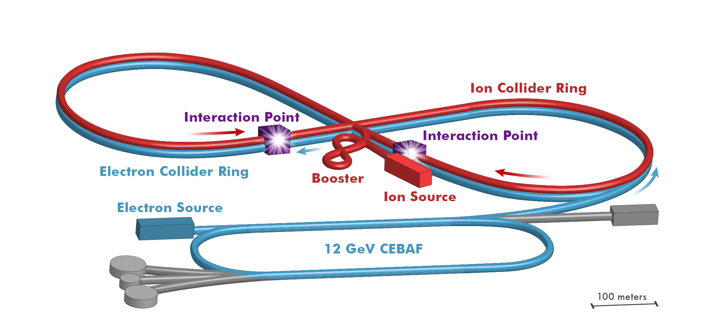

JLEIC: Physics and Guiding Concepts for Its Design
Rik Yoshida
Jefferson Lab
EIC Opportunities Meeting
Loch Lomond, 2016

Slide 2


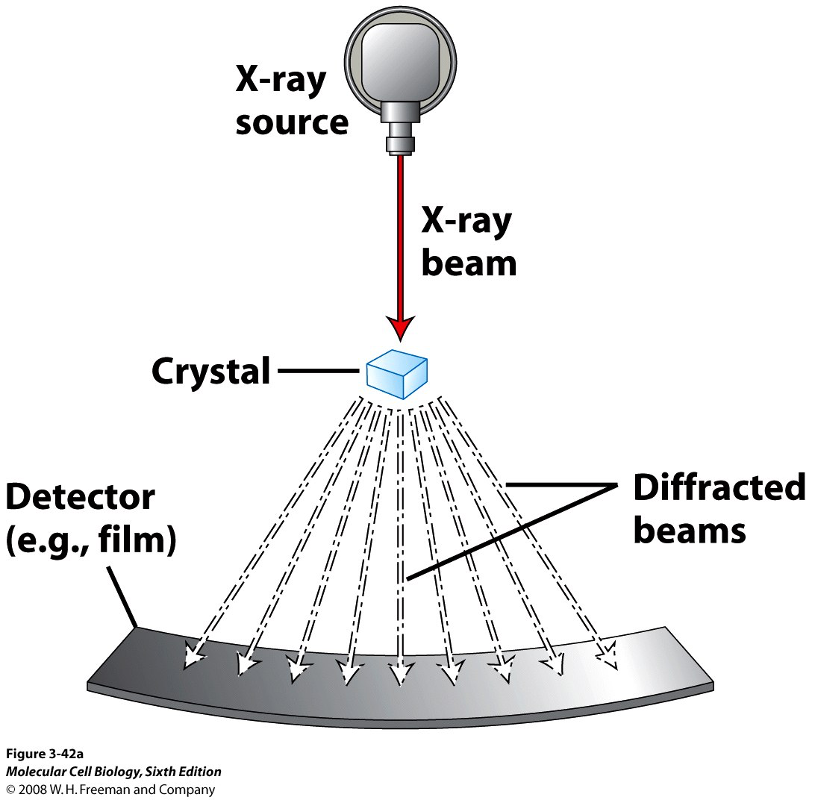
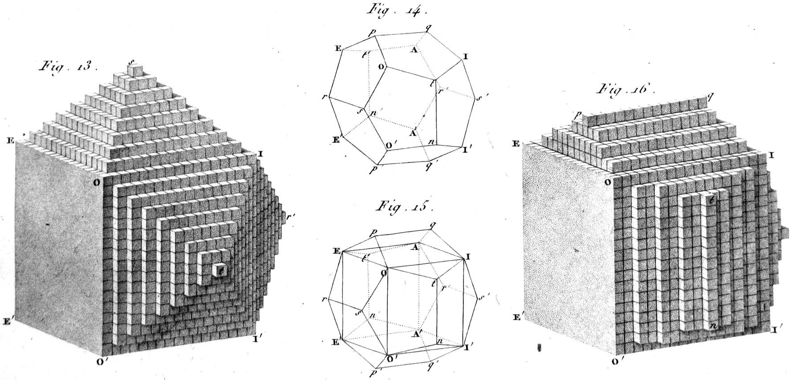
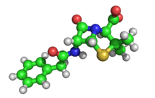
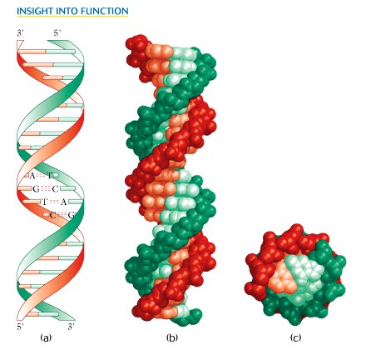
New Probes and New Science
Example: Structure of Atomic Matter
Advent of
X-ray Diff.
1912
Probe with the
right scale!
Crystal Structure: 1801
3D structure of penicillin: 1945
Precise understanding of structure leads to rich new sciences
Double Helix: 1953

Slide 3
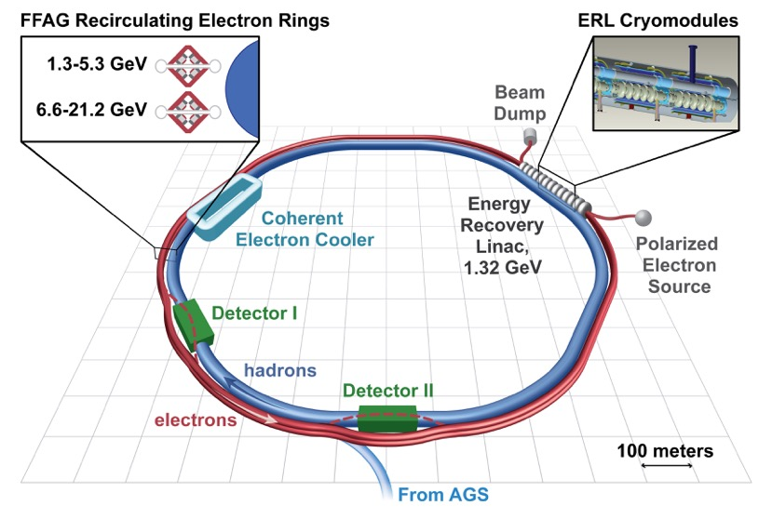
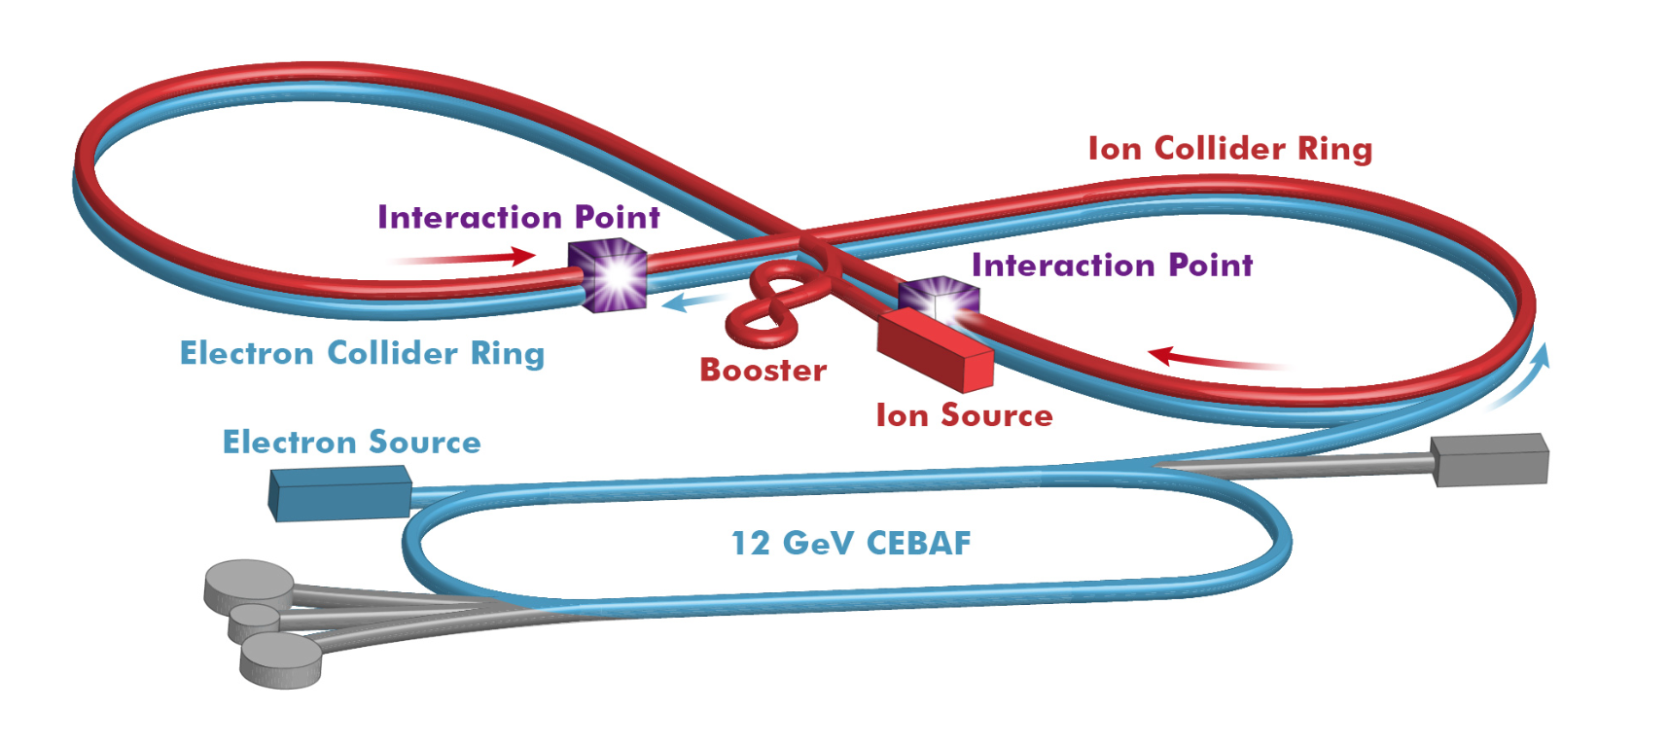
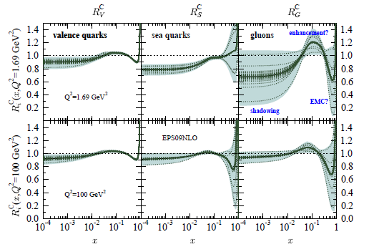
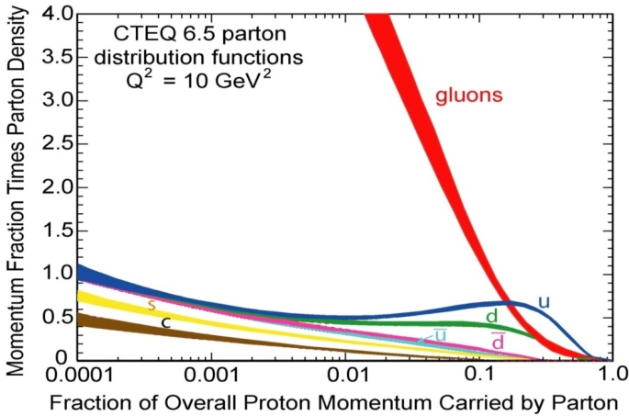
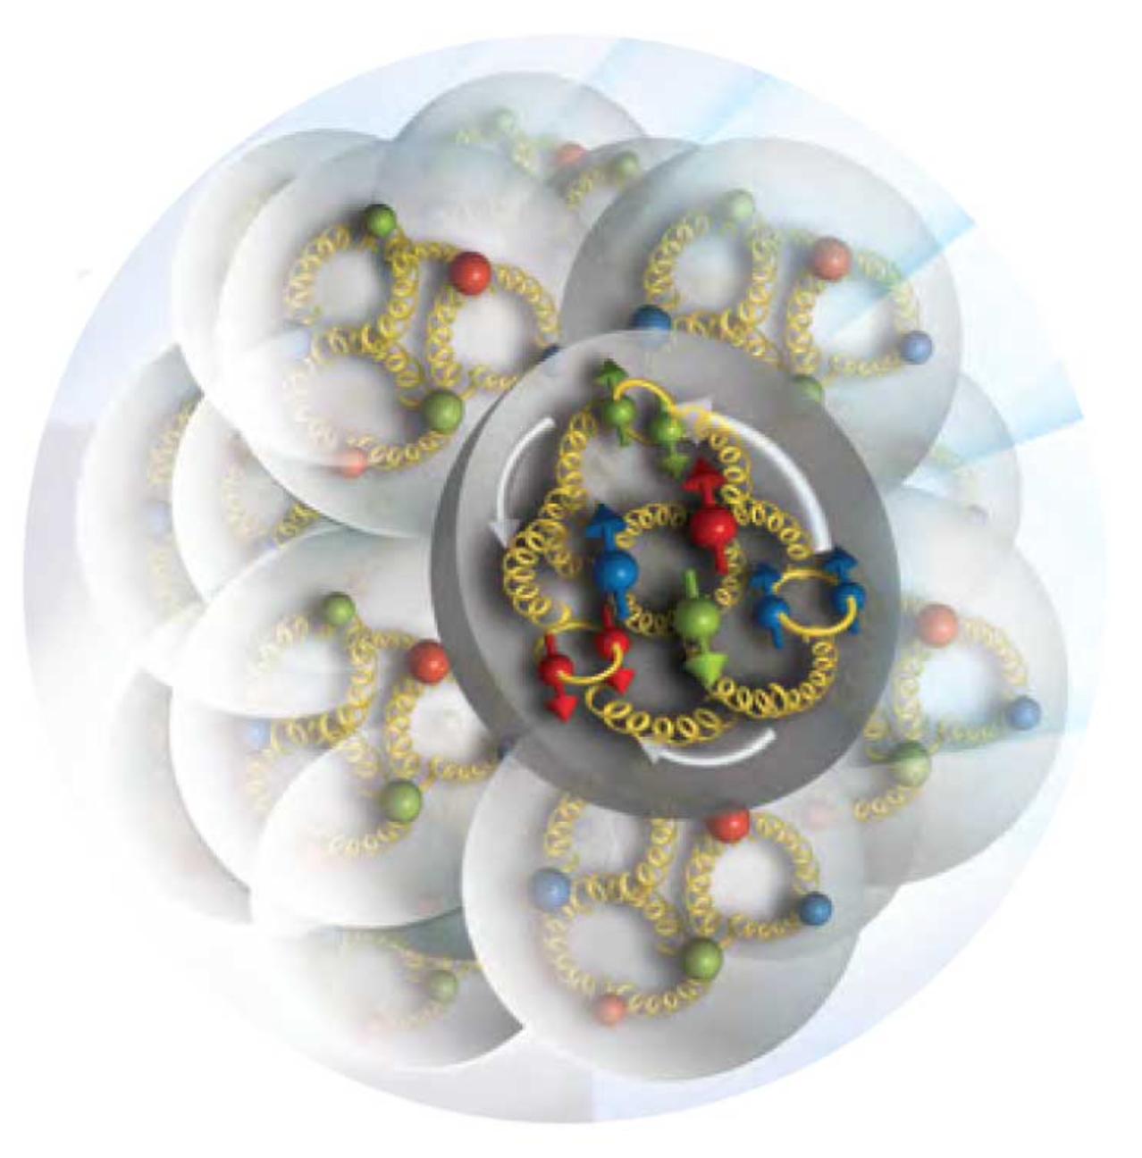
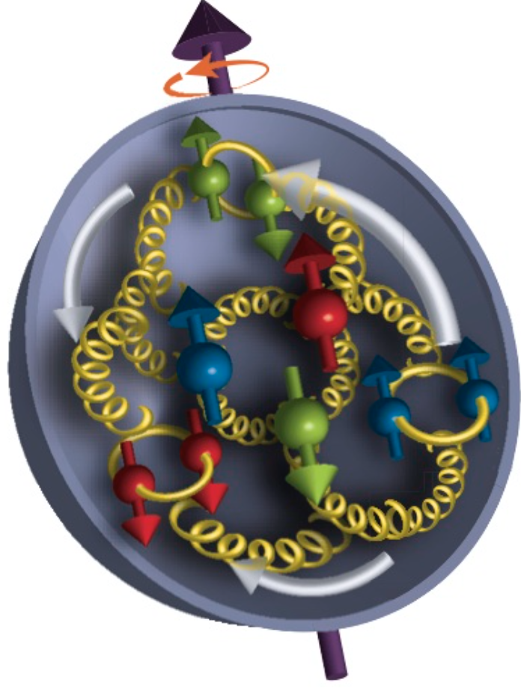
New Probe for Nuclear Science
2016
Probe with the
right scale!
Advent of EIC: ~2027
Precise understanding of structure and dynamics: dawn of new science

Slide 4
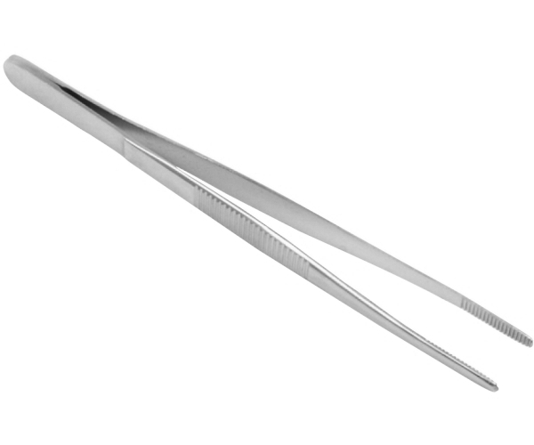
EIC Physics Program
Program aim: Revolutionize the understanding of nucleon and nuclear structure and associated dynamics. Explore new states of QCD.
small fraction of a fm
Program
Probe the nucleon in the many-body regime (down to x ≈ 0.005) at large Q²
Probe the nuclei in the N-N and multi-N interaction regime at large Q²
Extend our understanding of QCD (saturation, jets in cold nuclear matter)
Boring? Sounds like you’ve heard this for 30 years? No! Not Really!

Slide 5
Why EIC, Why Now?
Advance in theoretical understanding of perturbative quantum chromodynamics (pQCD) ➔
  Quantitative understanding of DIS processes to be measured has led to ➔
  Jefferson Lab 12 GeV program
Understanding of energies of a DIS collider and luminosities required for the full picture of nucleons and nuclei lead to ➔
Jefferson Lab Electron-Ion Collider (JLEIC) proposal:
  Use the understanding of high luminosity collider gained at b-factories
  Optimize the beam energies as well as interaction region + detector design for the measurements required.

Slide 6
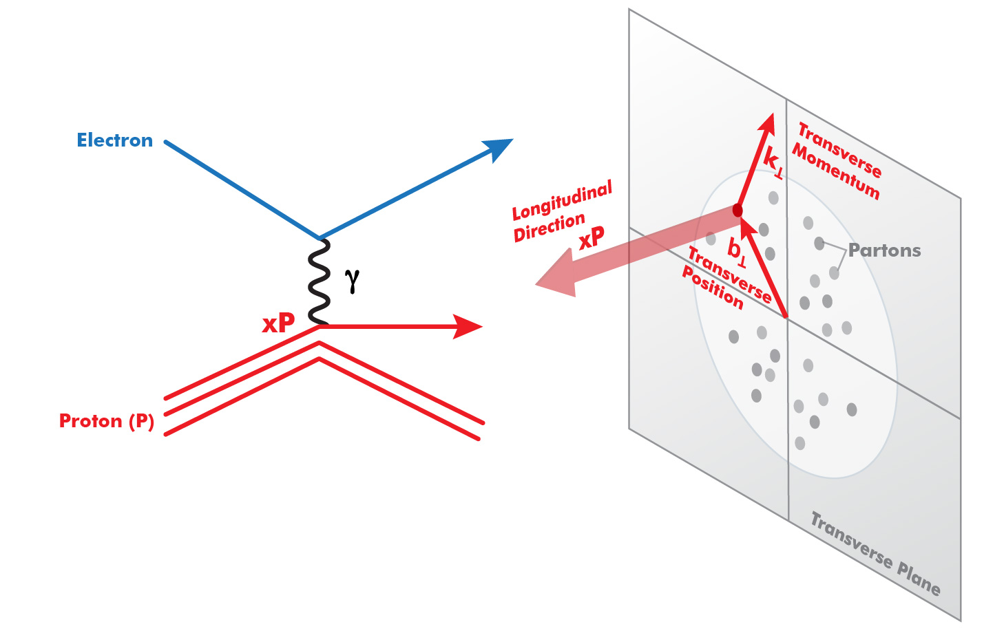
Progress in pQCD Theory (~1980-~2010)
(Q²)
Parton Distribution Functions:
Longitudinal only—
No way to interpret nucleon
partonic structure in rest frame
3D (Transverse) Structure
TMD’s, GPD’s—
Now we know what to measure to
understand partonic structure of nucleons
Jefferson Lab 12 GeV program based on this progress.
How do we get the complete picture:
origin of mass, spin, nuclear forces…? EIC !

Slide 7

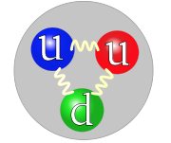
Understanding the Nucleon at the Next Level
Nucleon: A many-body system with challenging characteristics
Relativistic (M_{proton} >> M_{quark})
Strongly Coupled (QCD)
Quantum Mechanical (Superposition of configurations)
Measure in the Multi-Body regime:
- Region of quantum fluctuation + non-perturbative
effects → dynamical origin of mass, spin.
For the first time, get (almost?) all relevant
information about quark-gluon structure of the nucleon
Designing EIC → Designing the right probe
Resolution appropriate for quarks and gluons
Ability to project out relevant Q.M. configurations

Slide 8

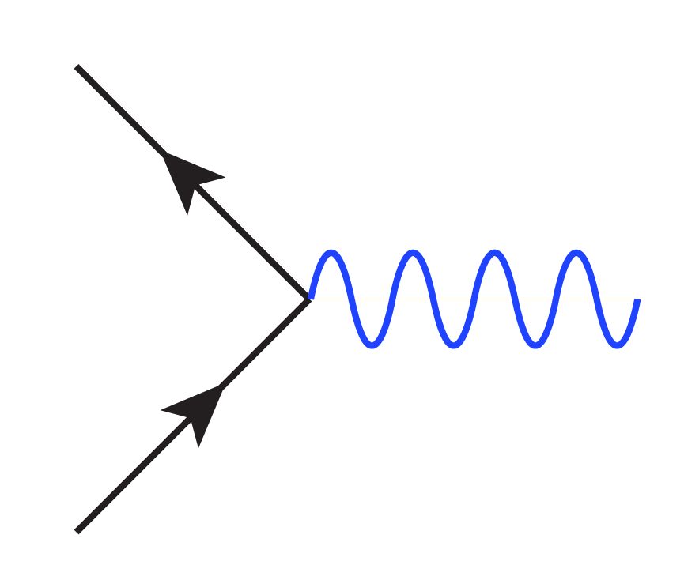
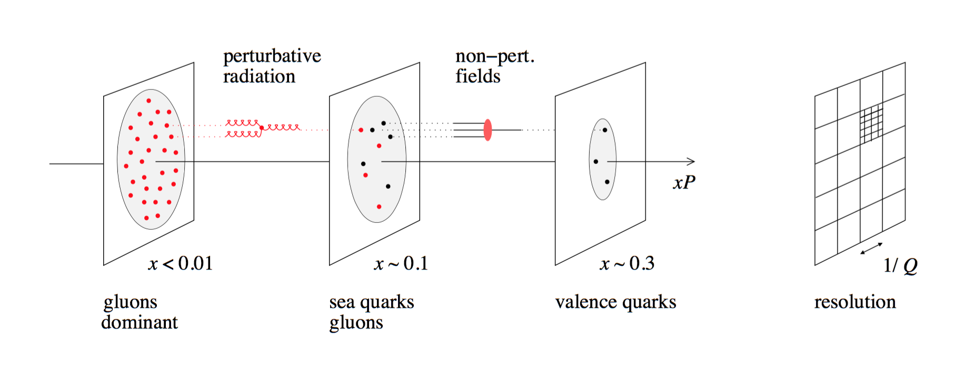
Parameters of the Probe
Q²
x
Ability to change x projects out
different configurations where
different dynamics dominate
Probe
Ability to change Q² changes the resolution scale
Q²= 400 GeV² => 1/Q = .01 fm

Slide 9
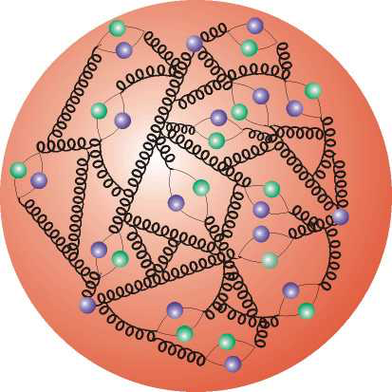
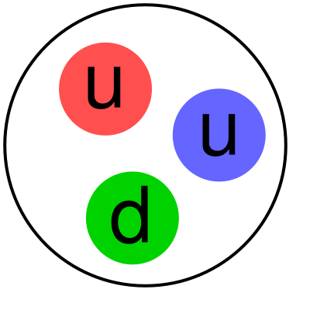
Where EIC Needs to be in x (nucleon)
Saturation
Regime:
Needs to be
Accessed via Ions
(see later)
Collective
Regime
Many-body
Regime
Few-body
Regime
10⁻⁴
10⁻³
10⁻²
10⁻¹
1
X (for proton)
QCD Radiation Dominated
(Studied at HERA)
Hadron Structure Dominated
Main interest for EIC Nucleon/Nuclear Program
Spin,TMD, GPD…

Slide 10
Where EIC needs to be in Q² (Q₁²)
X > 10⁻³,10⁻² to 1
Non-perturbative
Regime
Perturbative
Regime
Transition
Region
HERMES, COMPASS, JLAB 6 and 12
EIC
HERA high-x
Q²
10⁻¹
1
10
10²
10³
[GeV²]
Include non-perturbative, perturbative and transition regimes
Provide long evolution length and up to Q² of ~1000 GeV² (~.005 fm)
Overlap with existing measurements
Disentangle Pert./Non-pert., Leading Twist/Higher Twist

Slide 11
Understanding the Nuclei at the Next Level

Slide 12
Bjorken x and length scale
Correlation Length
in proton rest frame
100
10
1
fm
Corresponds to
Bjorken x
0.1
X
0.001
0.01
In the proton rest frame, QCD field (x < 0.1) extends far beyond the proton charge radius

Slide 13
Parameters of the Probe (Nuclei)
Q²
x
X > 0.1
Nuclear modification of nucleon. (“EMC effect”)
Probe
X ≈ 0.05
Nucleon-Nucleon Interaction
Probing the
nucleon interaction in the nuclei
(note this is different from correlation measurements)
X ≈< 0.005
Multi-nucleon interaction
(“shadowing” eventually saturation)
Note: the x range for nuclear exploration is similar to the nucleon exploration

Slide 14
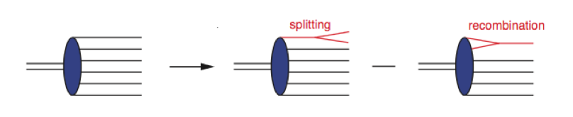
Beyond Nuclear Structure
Saturation
Eventually at low enough x
Cross-section will saturate
Equivalent to →
EIC will approach saturation in electron-Ion collisions

Slide 15
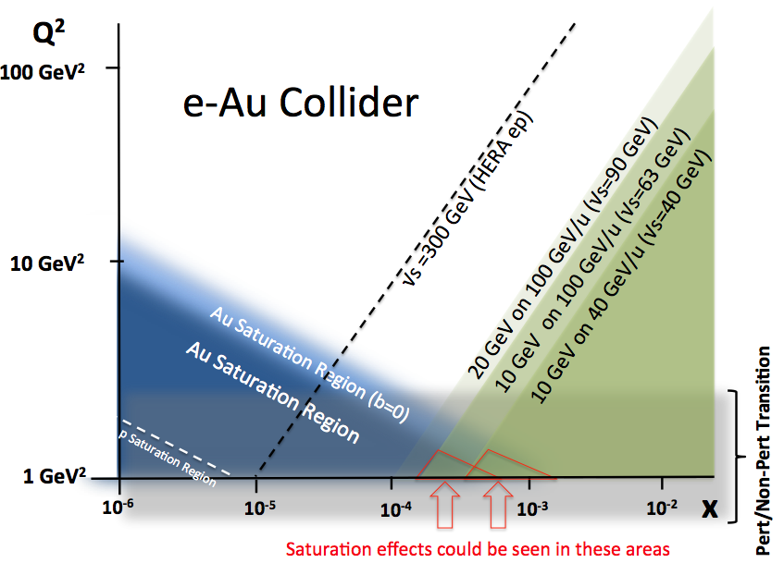
Saturation Regime and EIC
EIC kinematic reach for various scenarios
Two competing scales
Q_{s}(x) : Saturation Scale
Q₀ : Perturtative when Q > Q₀
Ideally, x such that Q_{s} >> Q₀
A
Centrality
EIC has two knobs to turn
Investigate the on-set of saturation
multi-nucleon coherence → saturation

Slide 16
Jets, Hadronization
ν = E-E’ = 100-200 GeV to keep jet within nucleus
√s = 32-45 GeV for y=0.1 (keeping jet in the central region of the detector)

Slide 17
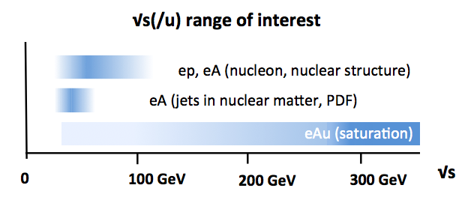
Designing The Right Probe: √s
What are the right parameters for the collider
for the EIC science program?
√s
~10 GeV electron
realizable
~100 GeV/u ion
Leaving Q₂/E_{proton} >10⁻³

Slide 18
Measuring k_{t} and b_{t}
60-100 GeV
Q² up to 1000 GeV²
Ion beamline
5-10 GeV
Electron beamline
P_{t} wrt beam
P_{t}/P_{beam} <~ 10⁻³
~100 MeV
~100 MeV
P_{t} wrt scattering plane.
+ particle ID

Slide 19
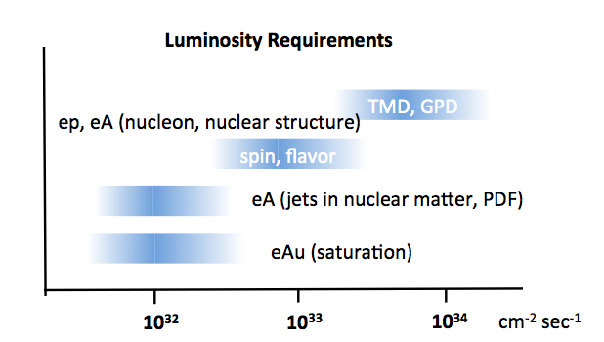
Luminosity Needed for Topics
HERA
Central mission of EIC (nuclear and nucleon structure) requires high
luminosity.

Slide 20
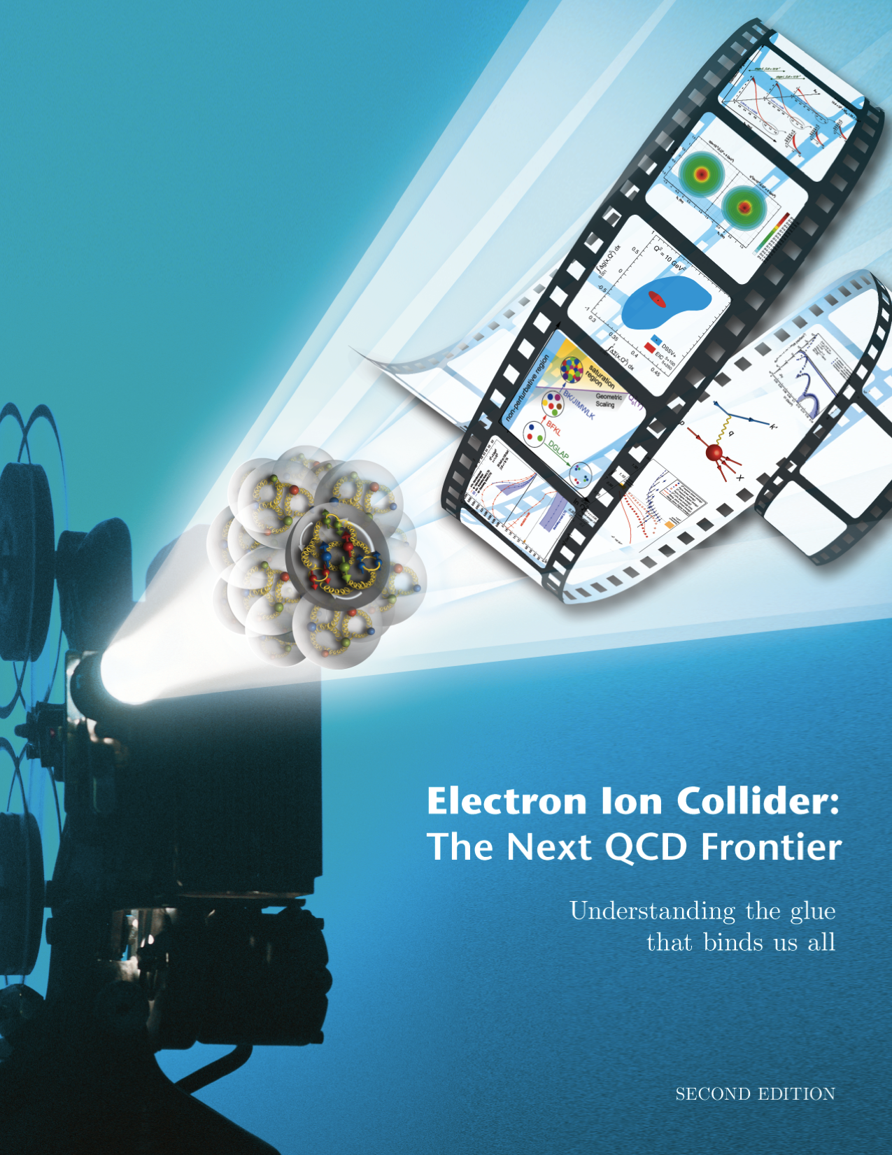
The Electron Ion Collider
For e-N collisions at the EIC:
Polarized beams: e, p, d/³He
e beam 3-10(20) GeV
Luminosity L_{ep} ~ 10³³⁻³⁴ cm⁻²sec⁻¹
  100-1000 times HERA
20-~100 (140) GeV Variable CoM
1212.1701.v3
A. Accardi et al
For e-A collisions at the EIC:
Wide range in nuclei
Luminosity per nucleon same as e-p
Variable center of mass energy
World’s first
Polarized electron-proton/light ion
and electron-Nucleus collider
Two proposals for realization of the science case -
both designs use DOE’s significant investments in infrastructure
Notes:
20

Slide 21
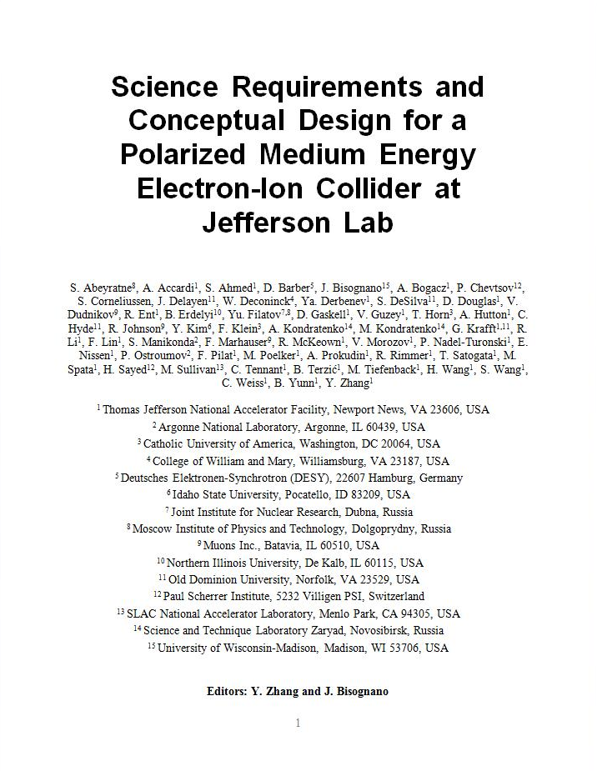
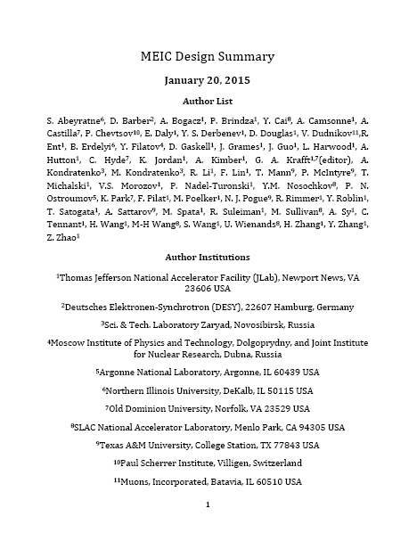
JLEIC Baseline Design
Features:
Collider ring circumference: ~2100 m
Electron collider ring and transfer lines : PEP-II magnets, RF (476 MHz) and vacuum chambers
Ion collider ring: super-ferric magnets (3T)
Booster ring: super-ferric magnets
SRF ion linac
Goals:
Balance of civil construction versus
magnet costs and risks
Aim overall for low technical risks
Collaborators:
ANL, LBNL, Fermilab, SLAC,
Texas A&M
Also DESY, Dubna
2012
2015
arXiv:1209.0757
arXiv:1504.07961
Low-risk luminosity ~ 5-10 × 10³³ cm⁻² s⁻¹
Notes:
Added collaborators

Slide 22
EIC Detector: What is Needed
Notes:
22

Slide 23
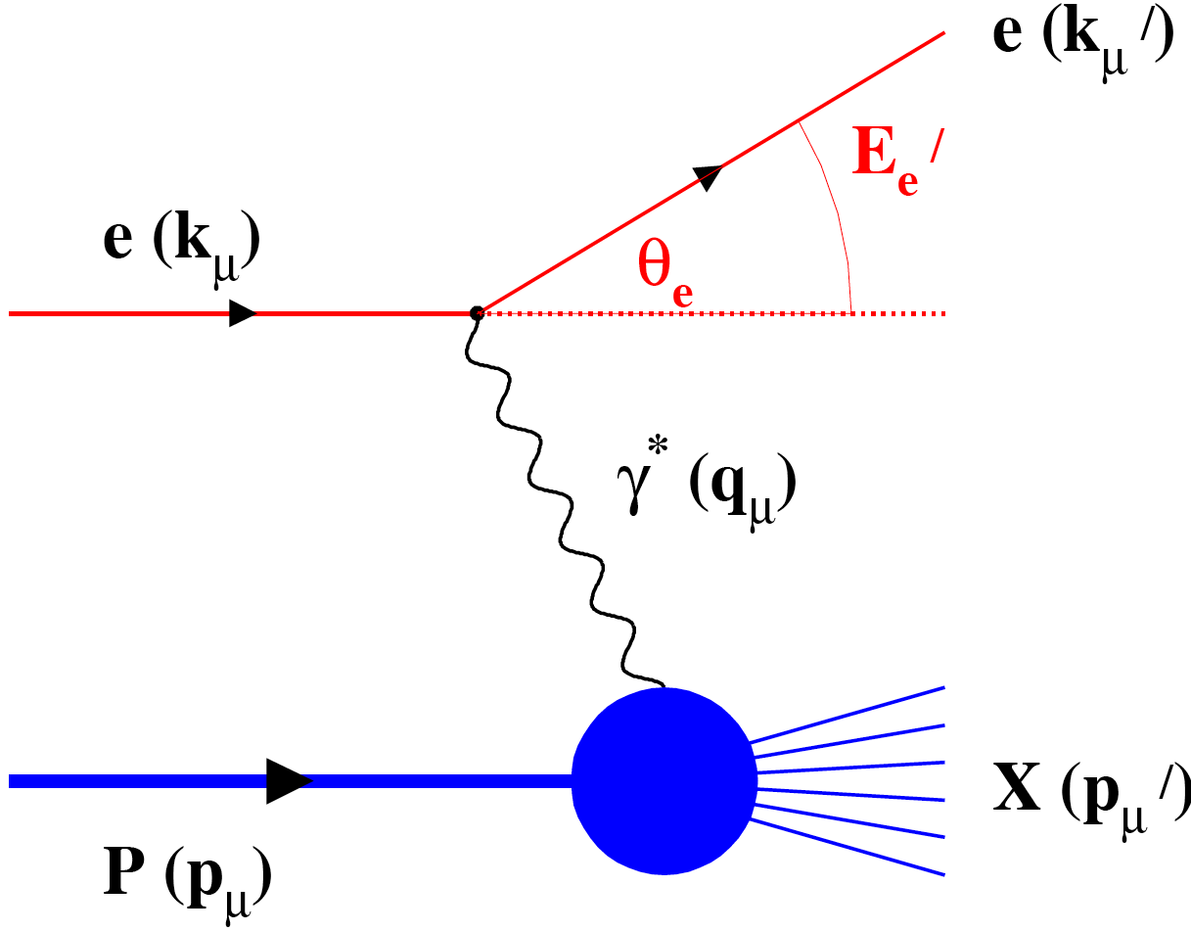
DIS and Final State Particles
Aim of EIC is nucleon and nuclear structure beyond the longitudinal description.
This makes the requirements for the machine and detector different from all previous colliders including HERA.
Ion beamline
E_{ion}
E_{electron}
Electron beamline
Need more than this
Need to access Q₂<<Q₁

Slide 24

Final State Particles in the Central Rapidity
Products of the hard
electron-quark collision
Scattered electron
Ion beamline
Photons
E_{ion}
E_{electron}
Electron beamline
Particles associated with struck parton
Transverse and flavor structure measurement of the nucleon and nuclei:
The particles associated with struck parton must have its species identified and measured (Q₂~Λ_{QCD}). Particle ID much more important than at HERA

Slide 25
Final State Particles in the Central Rapidity
Boosted towards ion beam
Ion beamline
E_{ion}
E_{electron}
Electron beamline
Boosted towards ion beam
Asymmetric collision energies will boost the final state particles in the ion beam direction: Detector requirements change as a function of rapidity

Slide 26
Particles Associated with the Initial Ion
For EIC, particles of the “target remnant” is
as important as the struck parton. e.g. Measure t~Q₂~Λ_{QCD}
Ion beamline
E_{ion}
E_{electron}
Electron beamline
Particles Associated with Initial Ion
Was not considered at HERA initially.
Close to the beamline
Not analyzed by central solenoid.
Aim for ~100% acceptance and good resolution at EIC.
Remember acceptance is equally
important as luminosity!

Slide 27
Particles Associated with the Initial Electron
Forward Electron area:
Tag photoproduction (Q²≈0)
Measure Luminosity
Measure electron polarization
Ion beamline
E_{ion}
E_{electron}
Electron beamline
Photons
beam electron (or low Q²)
Apply lessons from HERA, JLab and elsewhere

Slide 28
Final State Particles
The aim is to get ~100% acceptance
for all final state particles, and measure
them with good resolution.
Scattered electron
Ion beamline
Photons
Electron beamline
Photons
Particles Associated with Initial Ion
beam electron (or low Q²)
Particles associated with struck parton
Beam Elements
Central
Detector
Beam elements limit forward acceptance
Central Solenoid not effective for forward
Beam Elements

Slide 29
Interaction Region Concept
NOT TO SCALE!
Beam crossing angle creates
room for forward dipoles
Solenoid
Ion beamline
Electron beamline
Dipole (1 of 4)
50 mr
Dipole (1 of 3)
Dipoles analyze the forward particles
and create space for detectors in the forward direction

Slide 30
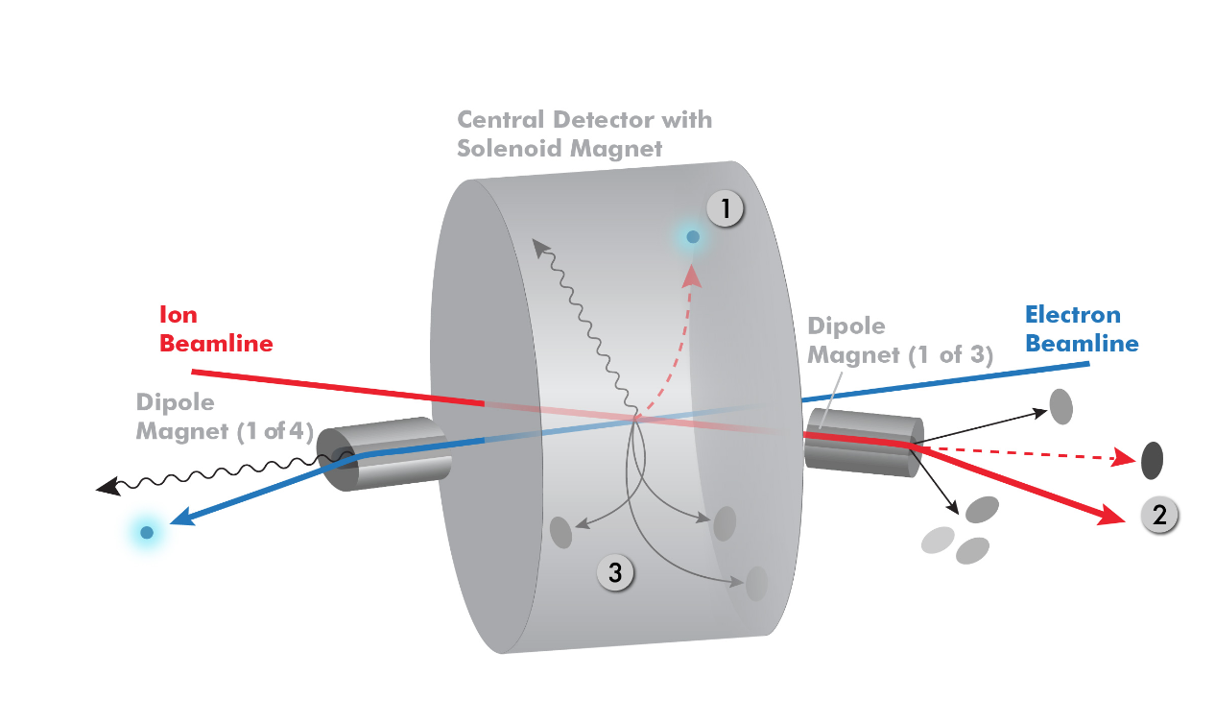
Interaction Region Concept
Possible to get ~100% acceptance for the whole event
Aim for total acceptance detector (and IR)

Slide 31
Electron-Beam Direction

Slide 32
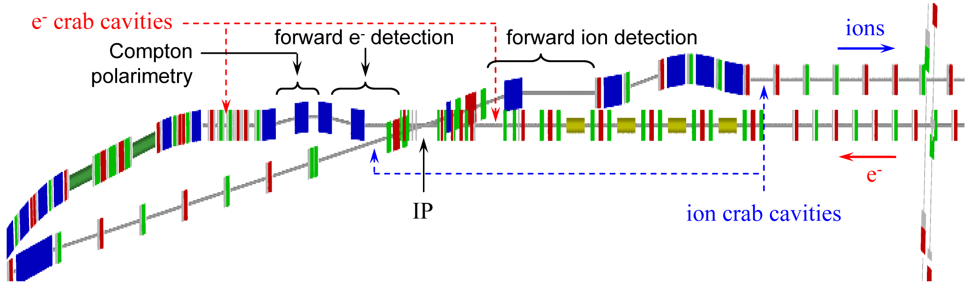
Chicane for Electron Forward Area
Extended detector: 80+ m

Slide 33
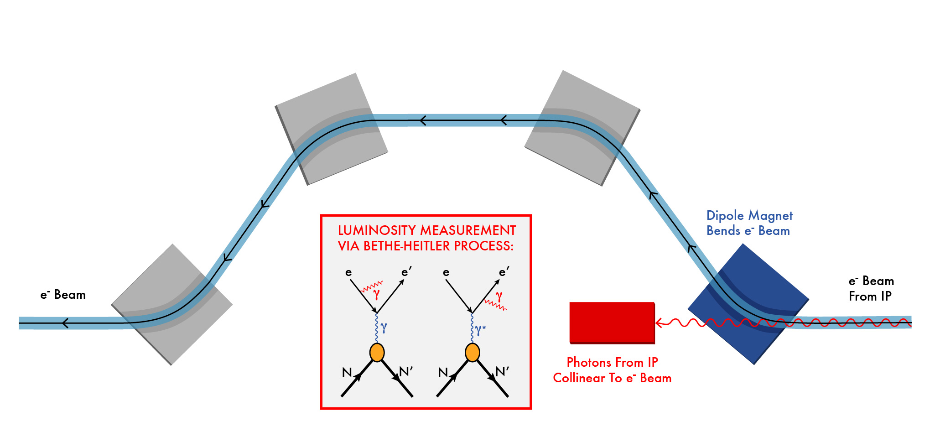
Luminosity Measurement
Use Bethe-Heitler process to monitor luminosity: same as HERA

Slide 34
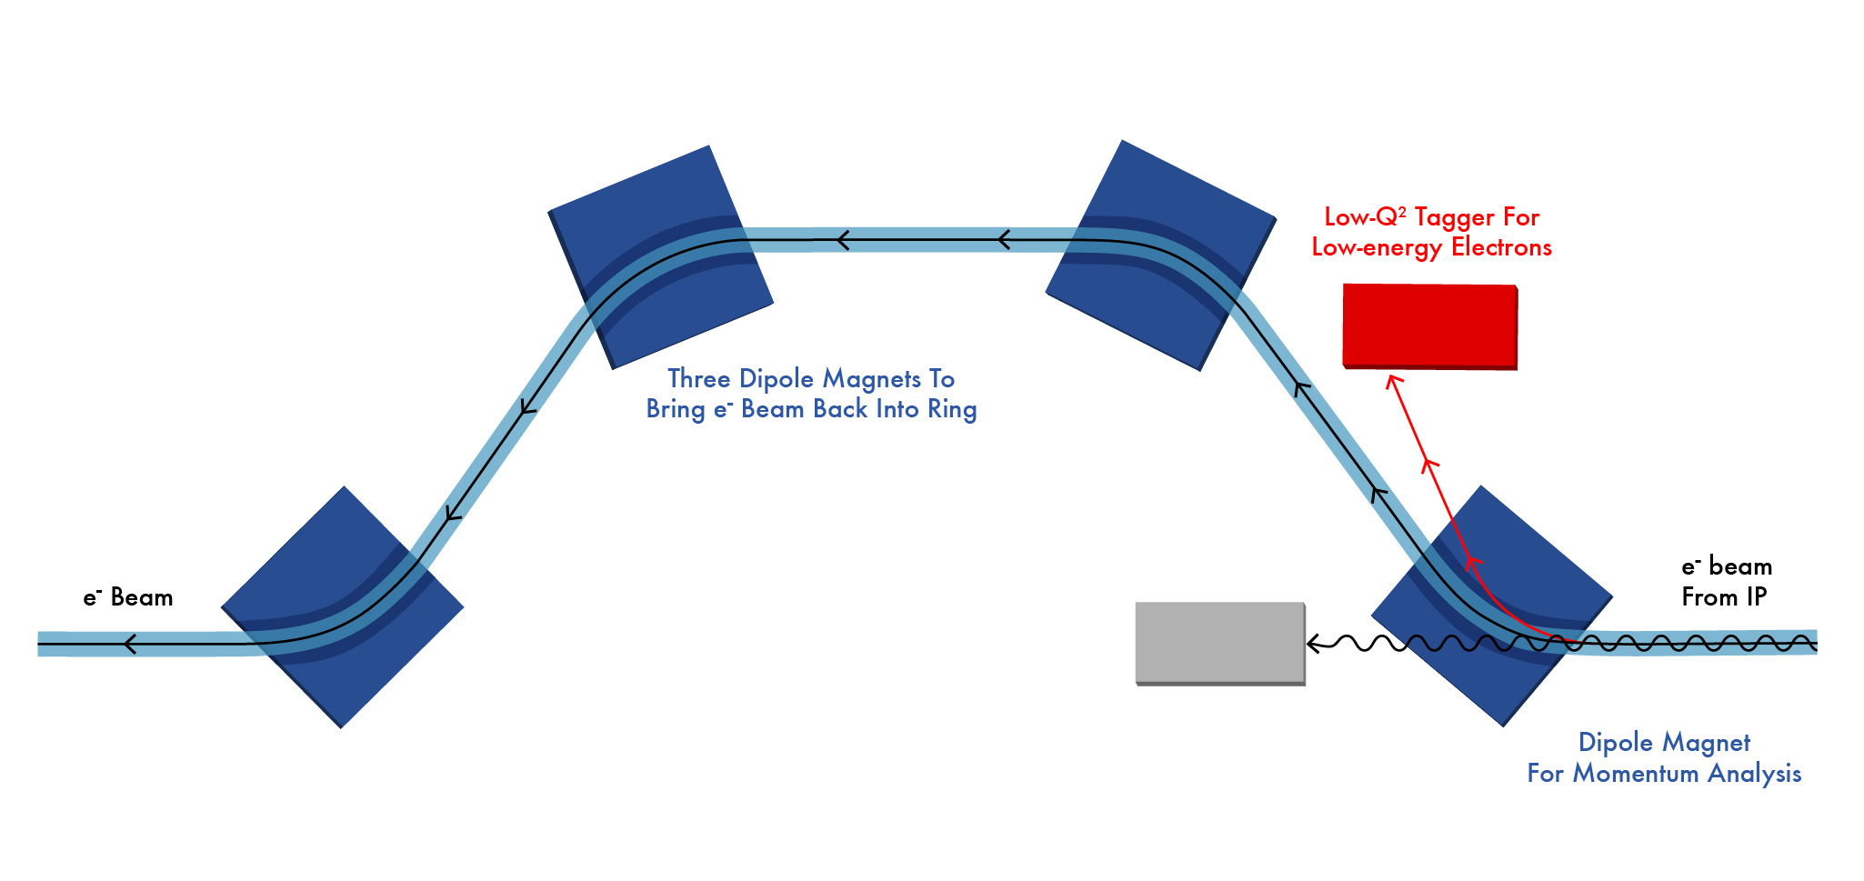
Low Q² Tagger

Slide 35
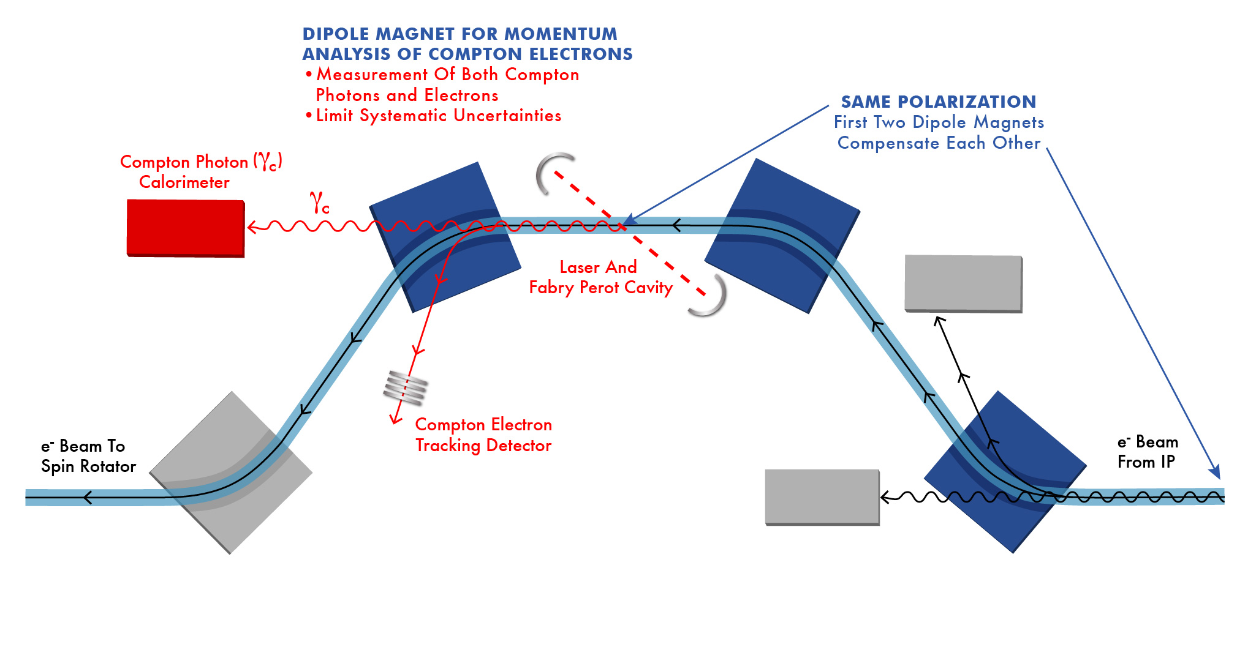
Polarization Measurement
Note the off-momentum electrons from IP does not enter the
Compton tracker for polarimetry.

Slide 36
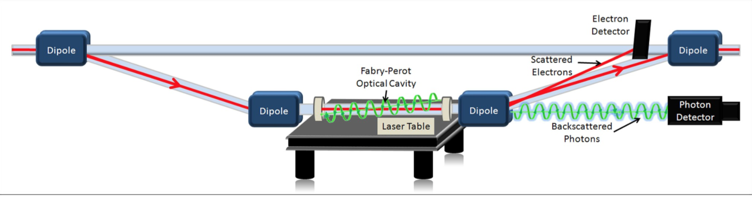
Compton Polarimetry
Existing Polarimeter in Hall C at JLab: Achieved 1% Precision

Slide 37
Ion-beam Direction

Slide 38
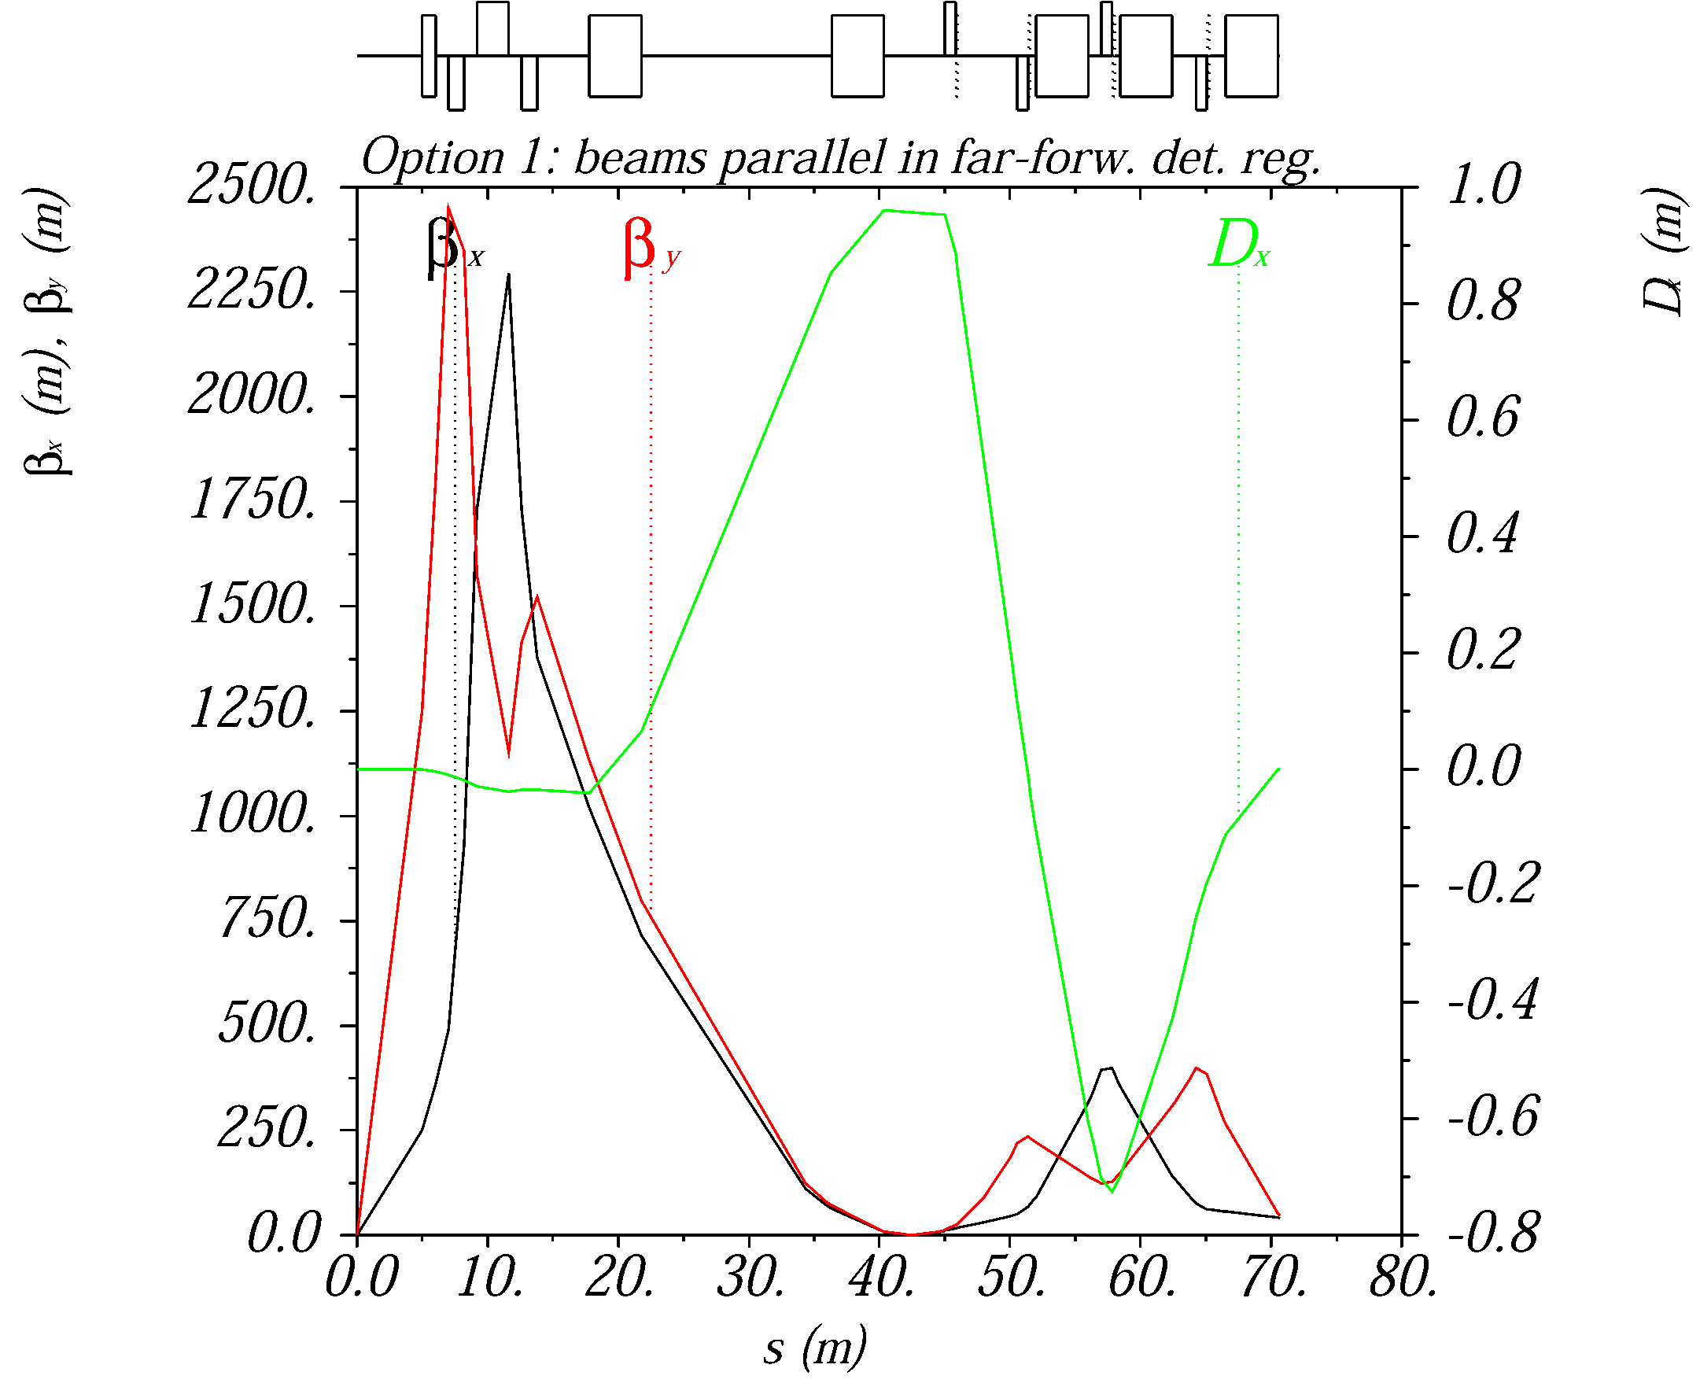
Ion optics for near-beam detection
Extended detector: 80+ m
A large dispersion at the detection point separates scattered (off-momentum) particles from the beam.
A second focus and small emittance (cooling) allows moving detectors closer to the beam
2nd focus on
Roman pots

Slide 39
EIC forward detection requirements
Good acceptance for recoil nucleons (rigidity close to beam)
  Diffractive processes on nucleon, coherent nuclear reactions
  Small beam size at detection point (to get close to the beam)
    Secondary focus on roman pots, small beam emmittance (cooling)
  Large dispersion (to separate scattered particles from the beam)
Good acceptance for fragments (rigidity different than beam)
  Tagging in light and heavy nuclei, nuclear diffraction
  Large magnet apertures (low gradients)
  Detection at several points along a long, aperture-free drift region
Good momentum- and angular resolution
  Free neutron structure through spectator tagging, imaging
  Both in roman pots and fixed detectors

Slide 40
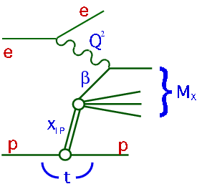
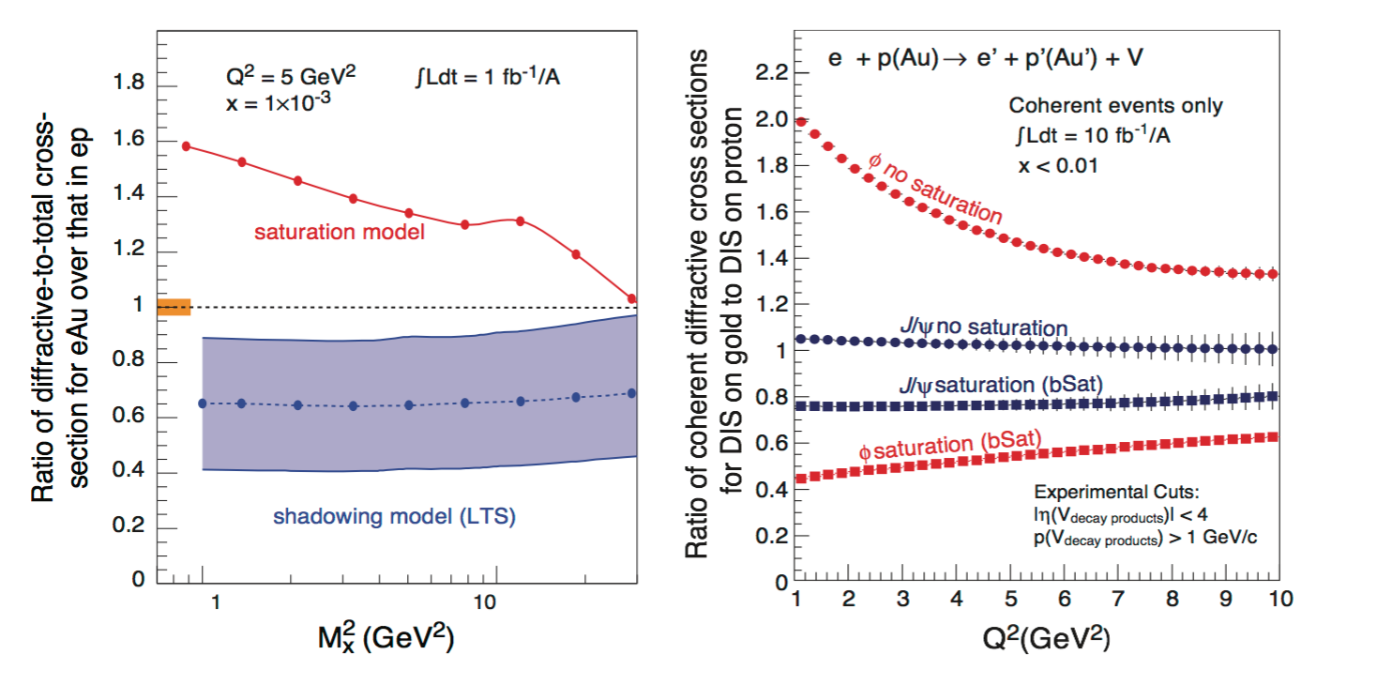
An Example: Diffractive DIS
Signature for Saturation (among other things)
Identify the scattered proton: distinguish from proton dissociation
Measure X_{L}= E_{p}’/E_{p}, and P_{t} (or t) (equiv. to measuring M_{x})

Slide 41
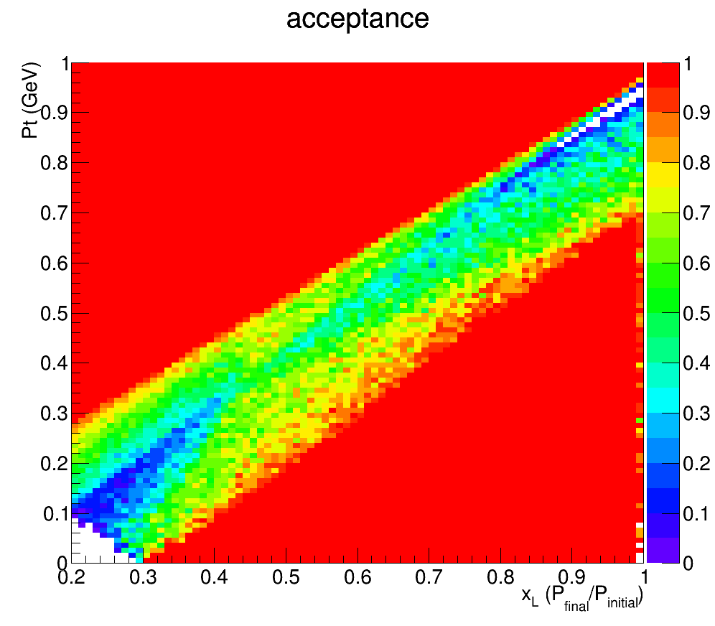
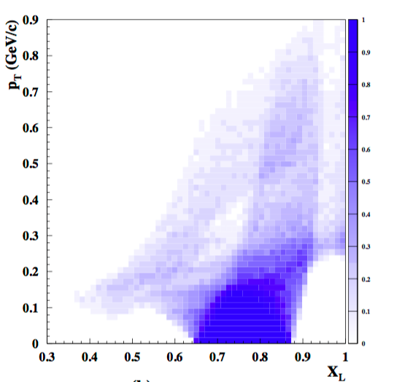
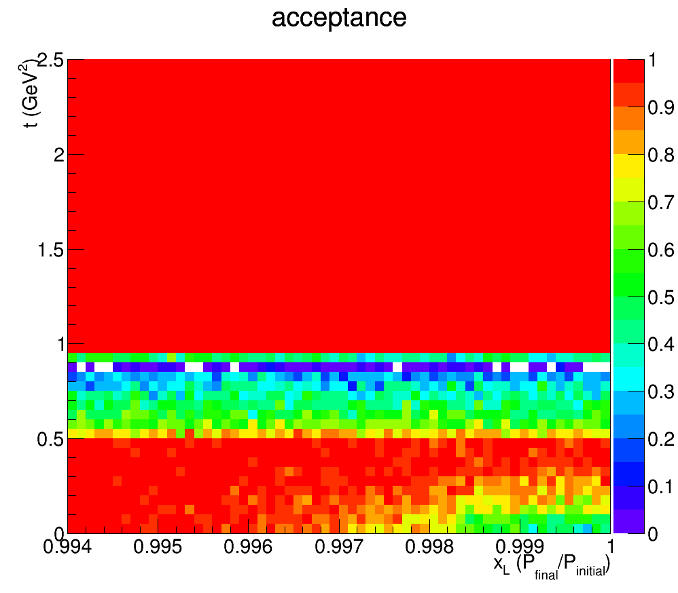
Acceptance for p’ in DDIS
JLEIC
ZEUS
Leading Proton Spectrometer
P_{t}
1
(GeV)
Region 1
Region 2 (Hi. Res)
0
0.2
1
X_{L}
t
2.5
(GeV²)
Acceptance in diffractive peak (X_{L}>~.98)
ZEUS: ~2%
JLEIC: ~100%
0.994
1
X_{L}

Slide 42
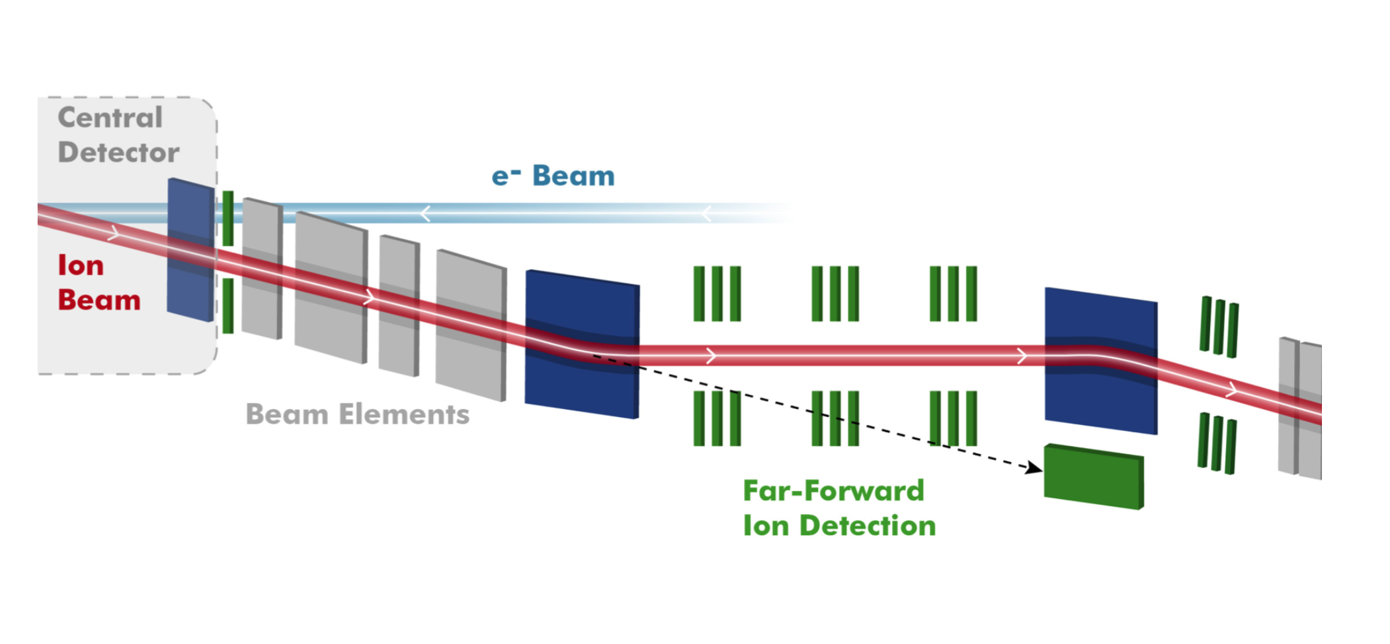
JLEIC Forward Ion Conceptual Layout
zero-degree
calorimeter
~40 meters

Slide 43
Bonus material
1212.1701.v3
A. Accardi et al
Beyond the
Whitepaper

Slide 44
High-x Physics
Last week, we had a one-day informal workshop on high-x (or non low-x) physics basically virtually:
https://www.jlab.org/indico/event/184/timetable/#20161004
It is clear from this short meeting that there are some very important
areas of high-x physics which Is within the reach of EIC.
We talked about:
Just measuring high-x pdf’s → what can be gained, and why is it interesting? (see below) *
Can we measure F_{L} at medium to high x? How interesting is that measurement? (Yes, Don’t know yet)*
What can we learn about higher twist effects? (Probably lots)
What can we learn about CSF? (Probably not much)
Can we measure pion and kaon structure? How interesting are they?
( Yes, and likely very interesting) *
* Follow-up work planned

Slide 45
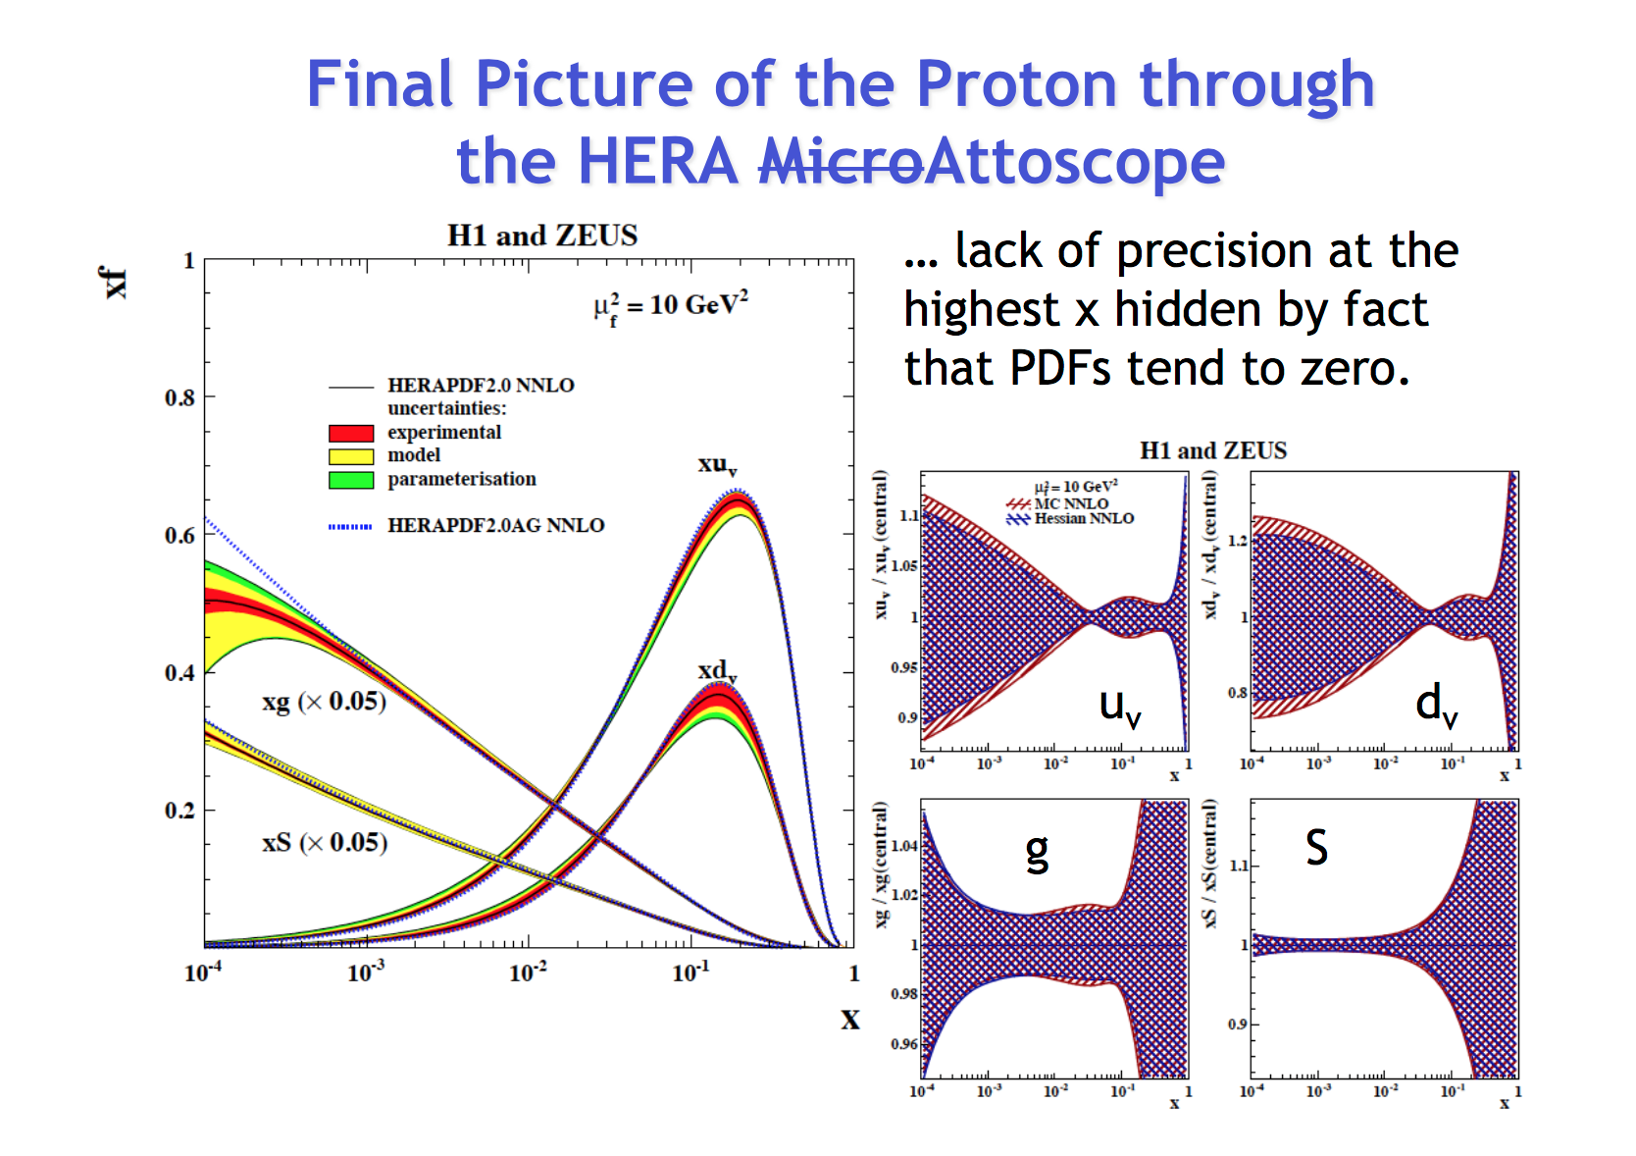
High-x Partons are poorly known
Paul Newman, Birmingham

Slide 46
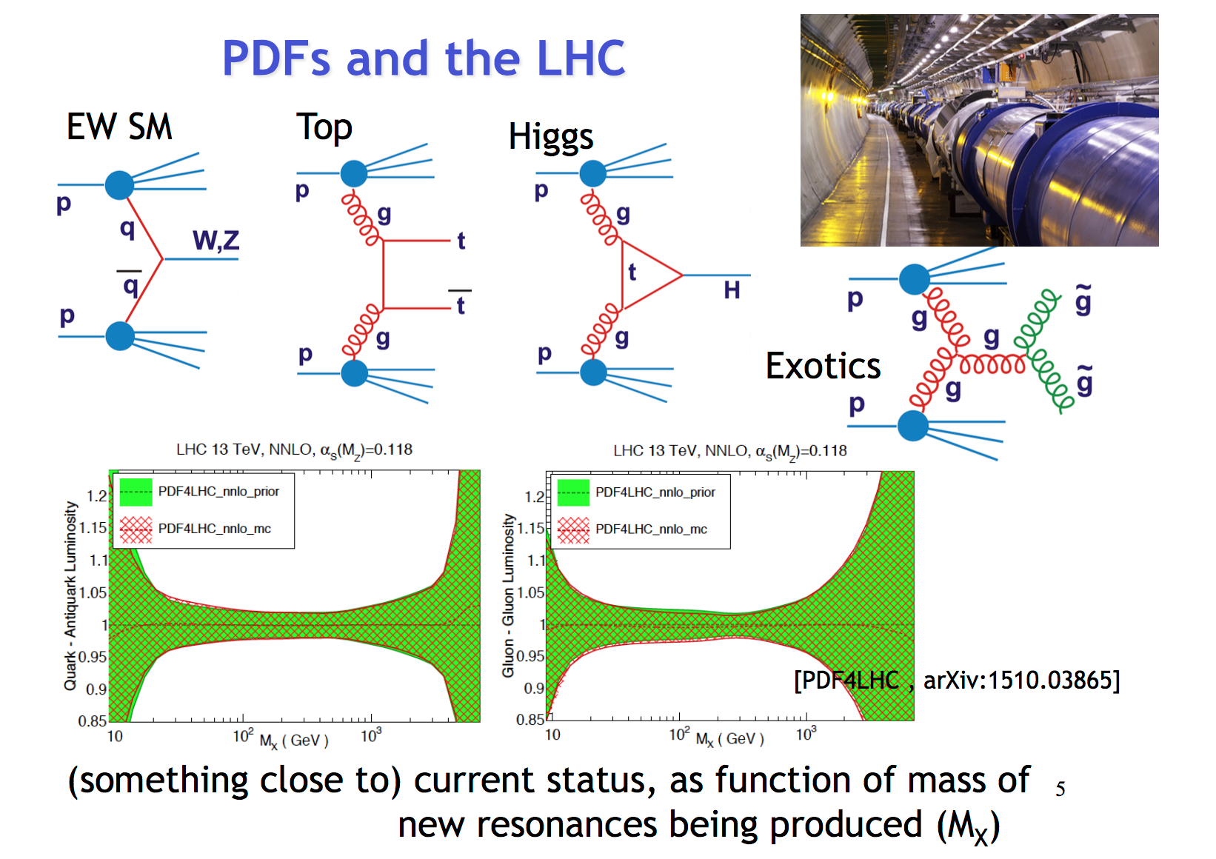
Leads to LHC “parton lumi” unc.
Paul Newman, Birmingham

Slide 47
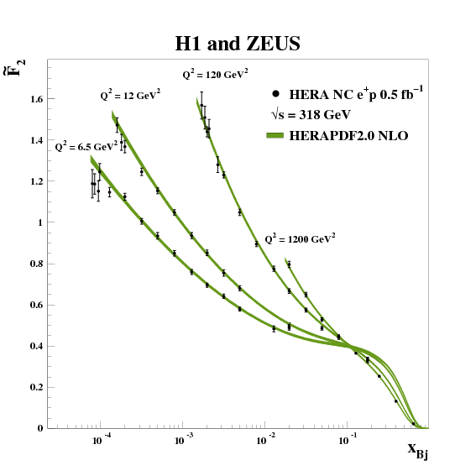
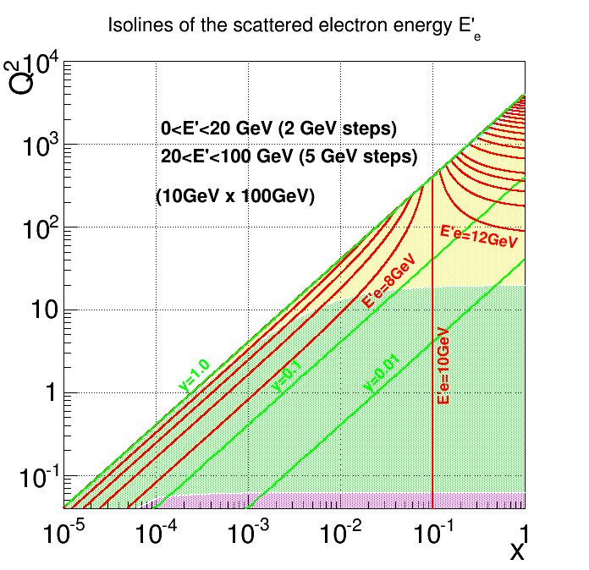
Could we measure it at EIC?
1/Q⁴
~(1-x)³
Best statistics at lower Q² (but must be “high enough”) ➔ Low y

Slide 48
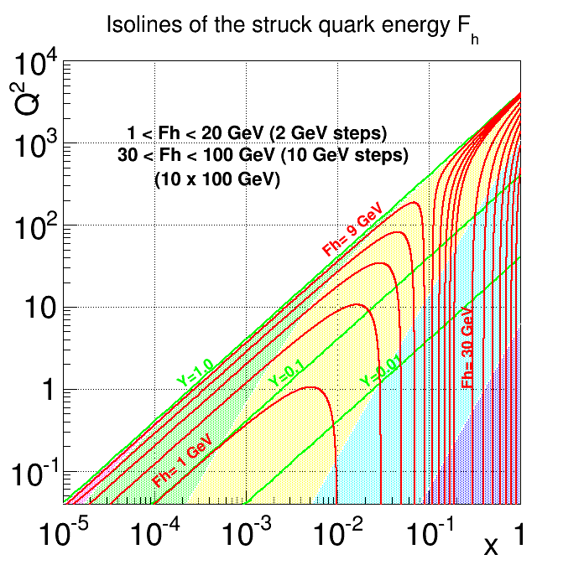
Resolutions

Slide 49
Resolutions
Say, Q² = 20 GeV², x= 0.7 (y=0.01)
if dE/E = 1%, then dx/x = 100%
if dF/F= 10% then dx/x = 10.1%
.. need jet energy resolution of ~85%/√F
Need to measure jet energies (forward calorimeters)?
How precisely?
Lower E_{p}?

Slide 50
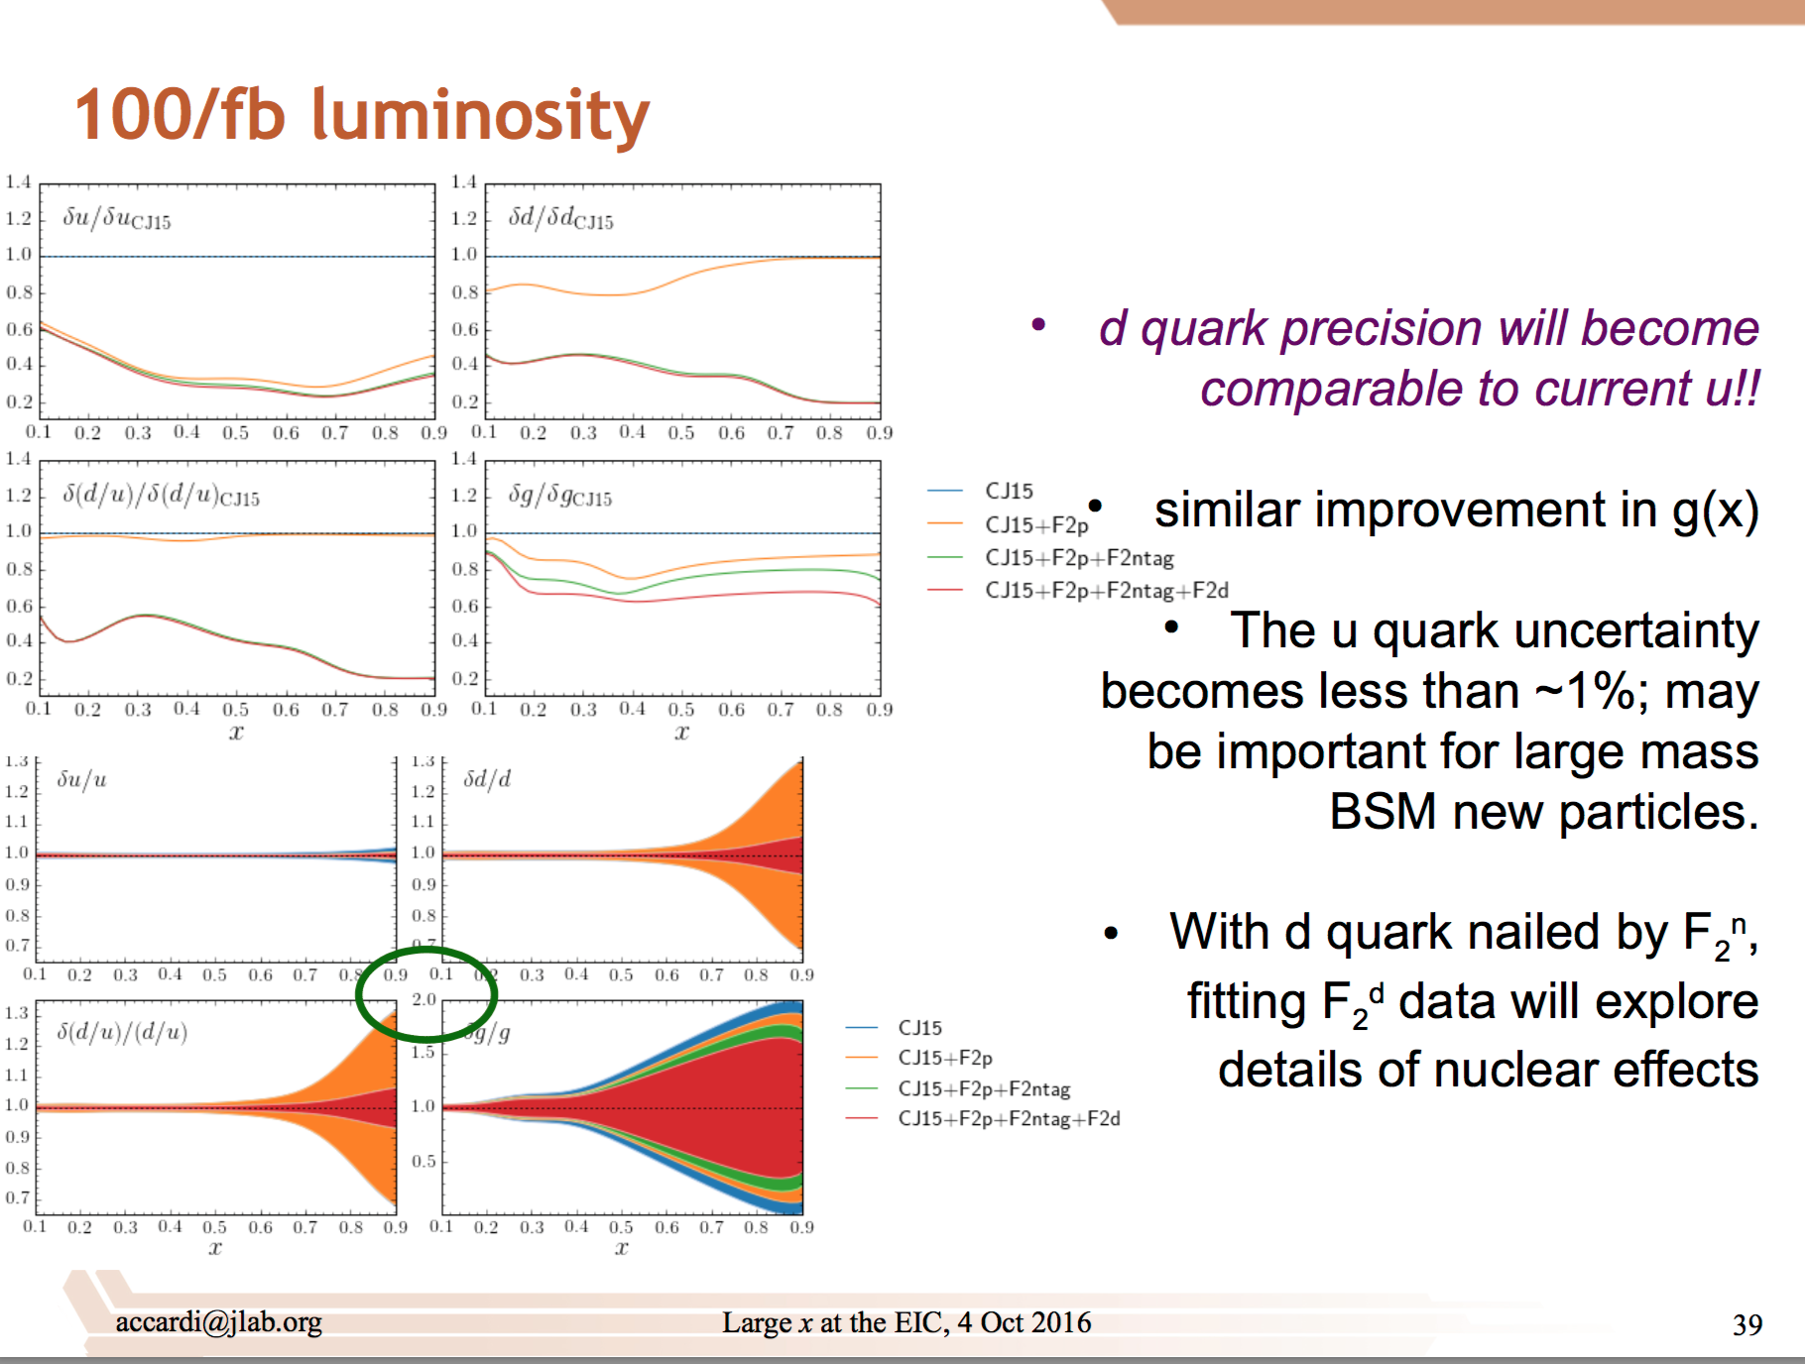
Can we measure this at EIC?
Alberto Accardi, Hampton

Slide 51
Questions you might ask..
What is the measurable range?
  What are the resolutions really needed?
  How low in the jet angle can we measure?
What is the relation between
  Luminosity available
  Acceptance
  Optimum beam energies (more than one?)
  Measurement technique
What is the right detector technology for this measurement?
Can we optimize for the high-x and also for other measurements at the EIC with the same detector?
EIC and HL-LHC will run concurrently according to current planning.
A program of high-energy, high-lumi pp discovery machine (HL-LHC)
running concurrently with a DIS machine (EIC) might make sense for LHC.
.. Of course this is an added benefit—not the main thrust of EIC
➔ LHC-EIC workshop? Other topics? Ultraperipheral scattering? Others?

Slide 52
Conclusion
EIC Program aim: Revolutionize the understanding of nucleon and nuclear structure and associated dynamics. Explore new states of QCD.
For the first time, EIC will enable us to study the nucleon and the nucleus at the scale of quarks and gluons, over (arguably) all of the kinematic range that are relevant for exploring the nuclear and nucleon structure and the associated QCD dynamics.
EIC detector is unlike any collider detector in it’s purpose and requirements: Leaves a lot of room for innovation.
There are further physics opportunities (also involving technical development) that need to be looked at.
A lot of opportunities for important and unique contributions from you!
Electron Ion Collider
Notes:
52

Slide 53
Backup

Slide 54
Central Detector

Slide 55
Final State Particles in the Central Detector
Products of the hard
electron-quark collision
Scattered electron
Took away radiated photon
for simplicity
E_{electron}
E_{ion}
Took away the (exaggerated)
beam crossing for simplicity
Particles associated with struck parton

Slide 56
Basic Kinematic Reconstruction
Q² → Measure of resolution
y → Measure of inelasticity
x → Measure of momentum fraction
of the struck quark in a proton
Q² = s x y
E’_{e}
θ_{e}
θ_{jet}
E’_{e,}θ_{e ,}E_{jet ,}θ_{jet} : any two of these, in principle, sufficient to reconstruct x and Q².
What are the detector
requirements?
E_{jet}

Slide 57
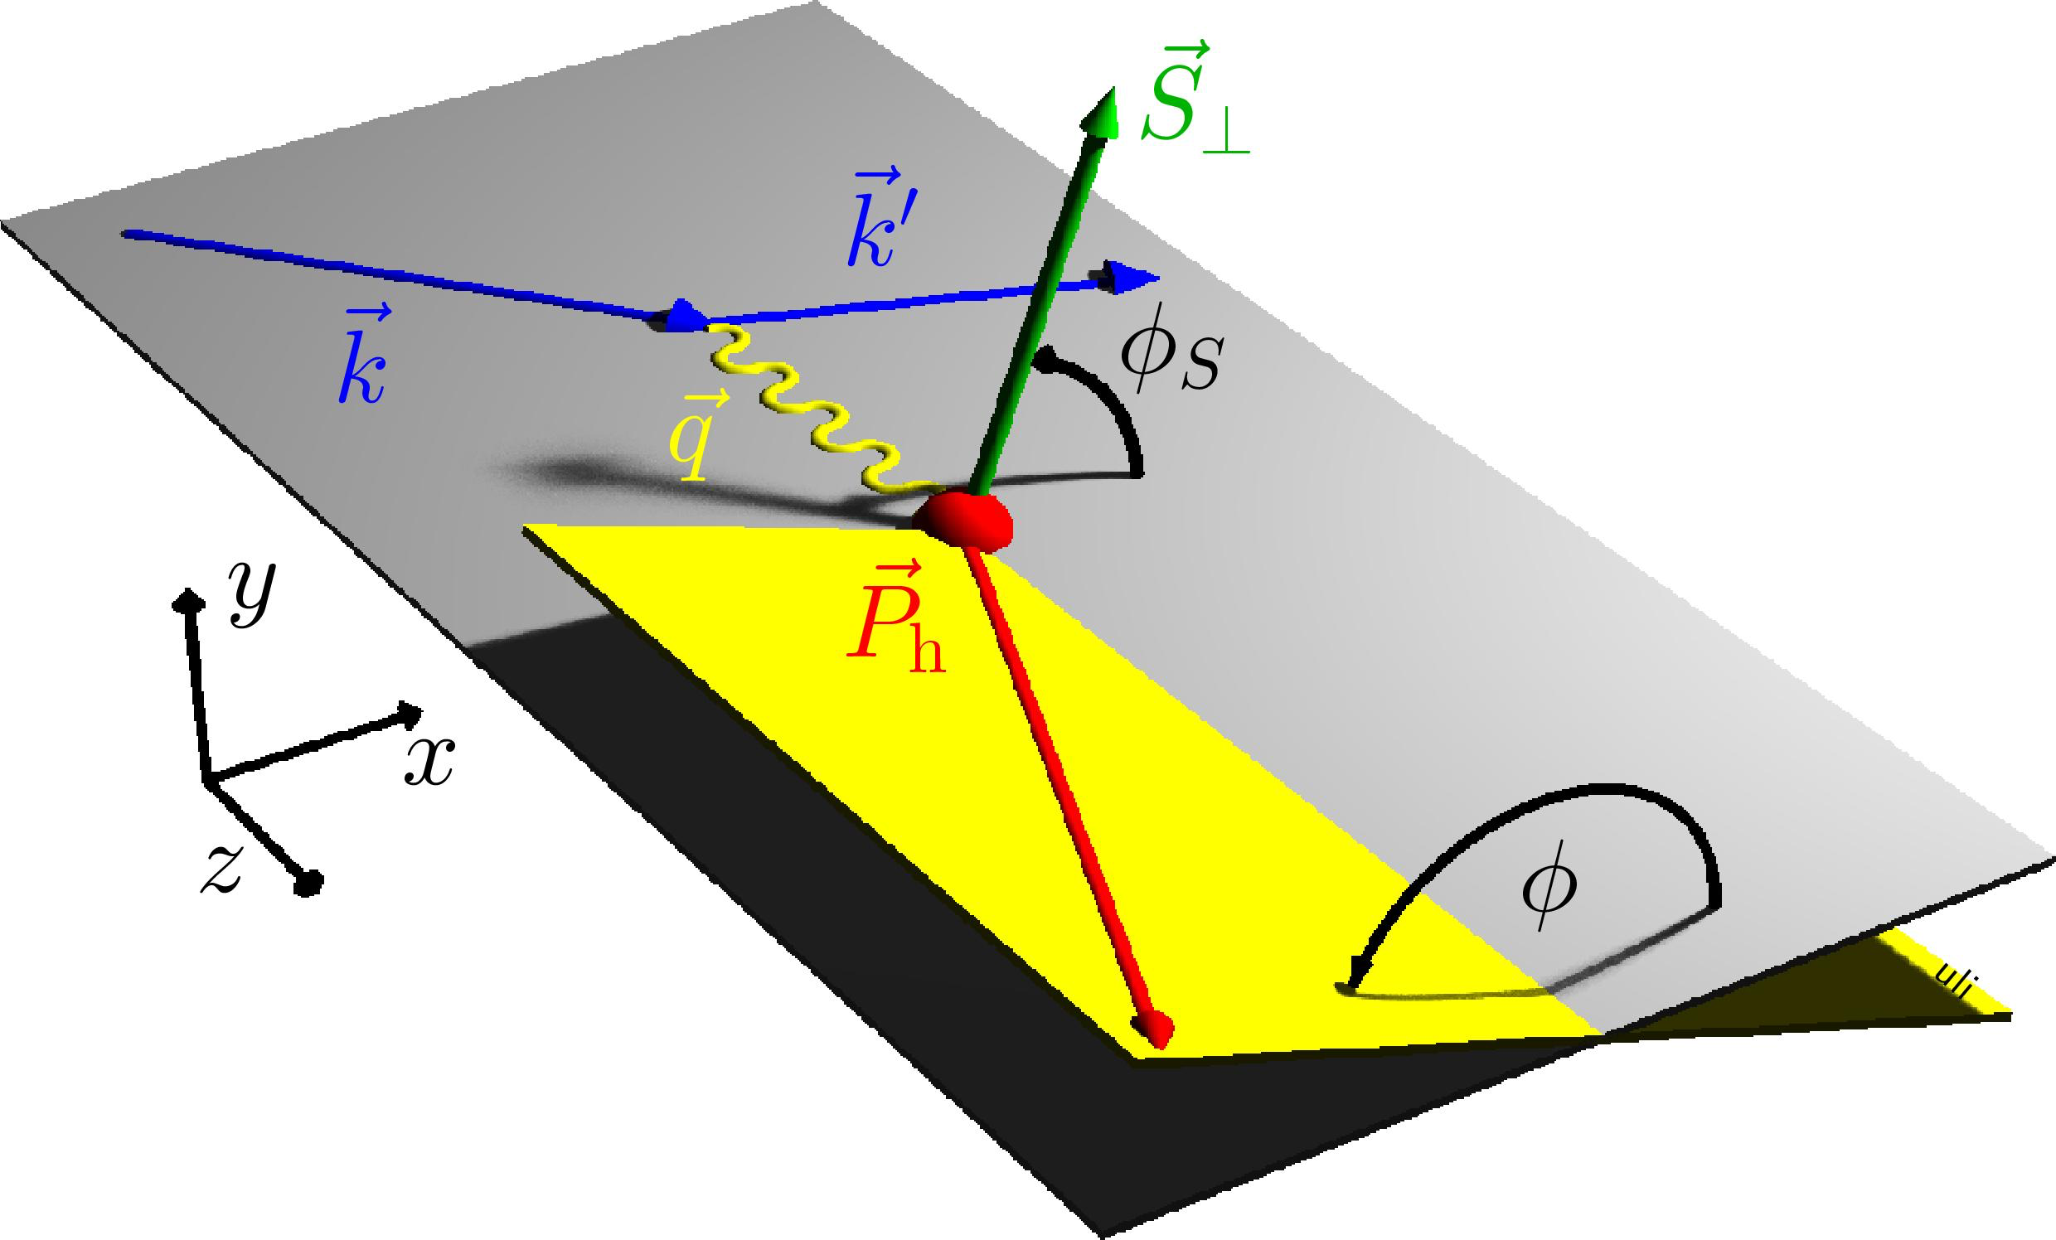
Reconstruction for Transvers Structure
Looking at out-of –plane component in the final state
Need to identify and measure
these particles
What are the detector
requirements?
Note: multiplicities are low (~20 for ep)
Cross-sec x Lumi < 0.01 x HLLHC
< 0.1 interaction/crossing

Slide 58
How Boosted is the Final State?
No Monte Carlo needed to Determine
Boosted towards ion beam
E_{electron}= 10 GeV
E_{ion}= 100 GeV
E’_{e,}θ_{e ,}E_{jet ,}θ_{jet} : any two of these, in principle, sufficient to reconstruct x and Q².
Given x and Q², E’_{e,}θ_{e ,}E_{jet ,}θ_{jet} are all
fixed

Slide 59
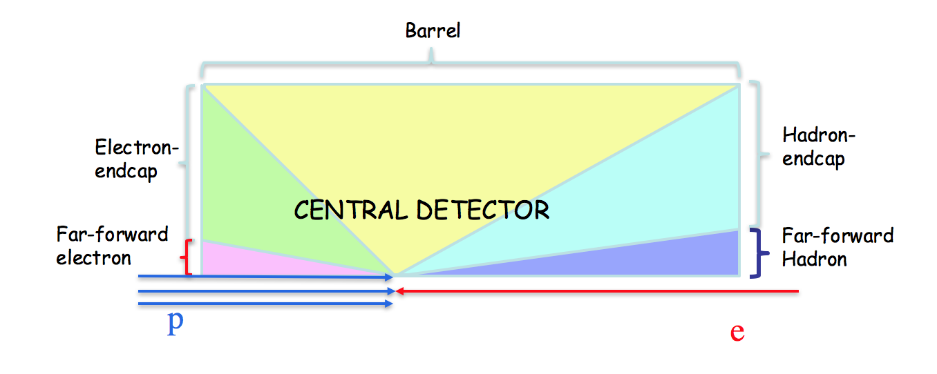
Electron Isoline Plot
Hadron Endcap
Barrel
Electron Endcap
Far-forward Electron
(out of central detector)

Slide 60
Quark(Jet) Isoline Plot
(E_{jet})
Barrel
Hadron Endcap
Far-forward Hadron
(Out of central detector)
Electron Endcap

Slide 61
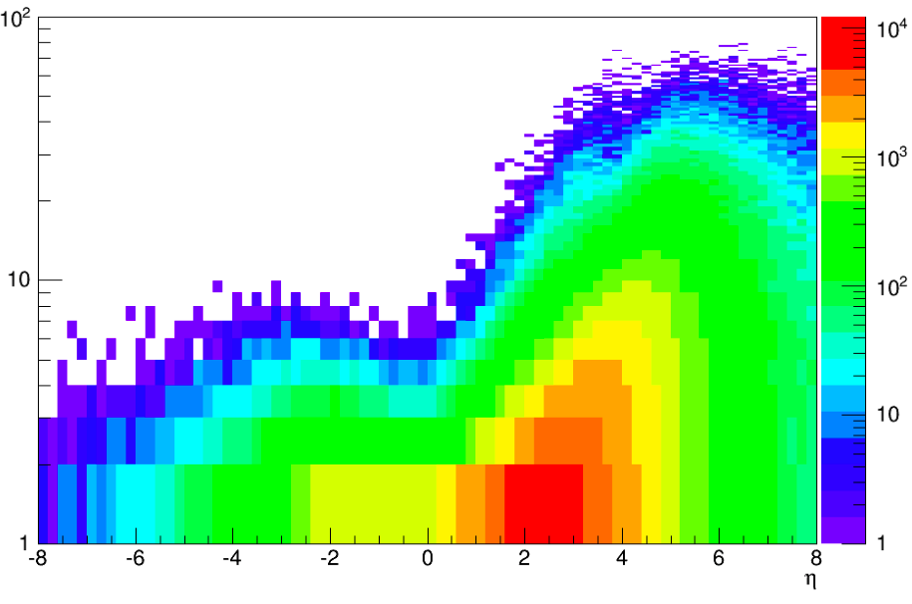
Particle Distribution
E-endcap
Barrel
H-endcap
E'e
<8 GeV
8-50 GeV
>50 GeV
Ejet
<10 GeV
~10-50 GeV
20-100 GeV
E,hadrons
<10 GeV
<15 GeV
~15-50 GeV
Pythia MC
occupancy
low
medium
high
π± Energy
100
10
GeV
η

Slide 62
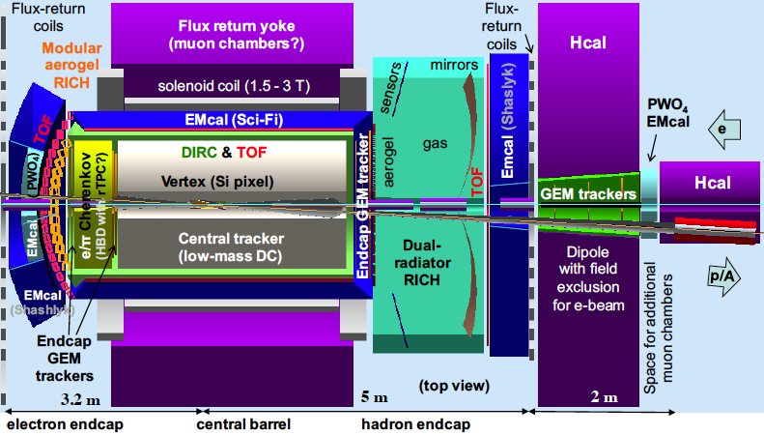
Current JLEIC Concept

