Slide 1
Plans and Ideas for
VR for Science at UCLA
Jay Hauser

Slide 2
Categories:
Development of existing apps
Possible new apps
Possible new directions
If not indicated otherwise, nobody is yet working on these

Slide 3
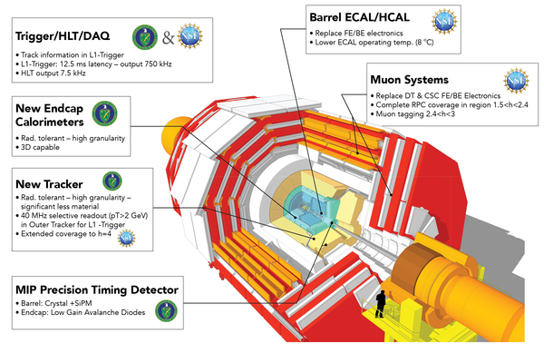
Development of existing apps
CMSVR and CEDVR for the massively upgraded detector being built right now, especially
  Novel picosecond timing detector!
  Novel endcap calorimeter with 3D energy plus timing

Slide 4
…Development of existing apps
VRFields
  Add ion and neutral atom traps used in AMO physics e.g. quantum computers
    Penning, Paul, MOT traps (underway)
  Make it an app accessible to a web browser in headset (underway)
  Use it as a guinea pig for trying to develop VR apps with strong use of AI tools (underway)

Slide 5
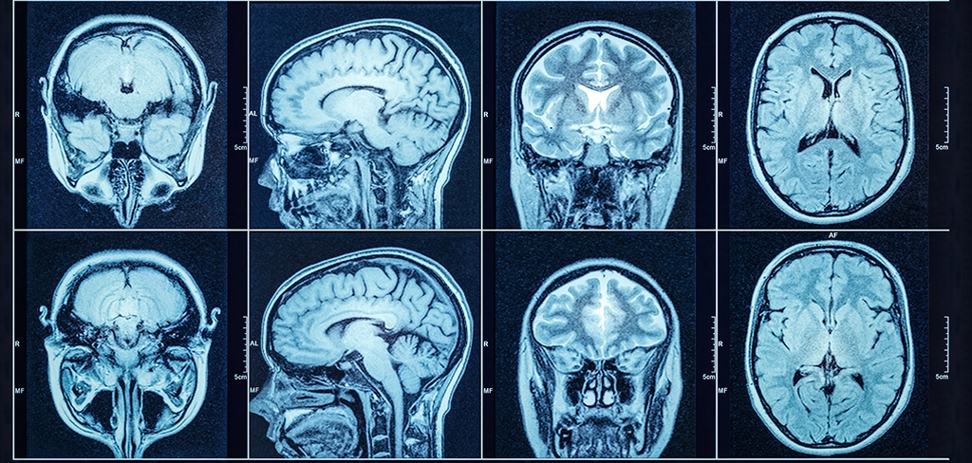
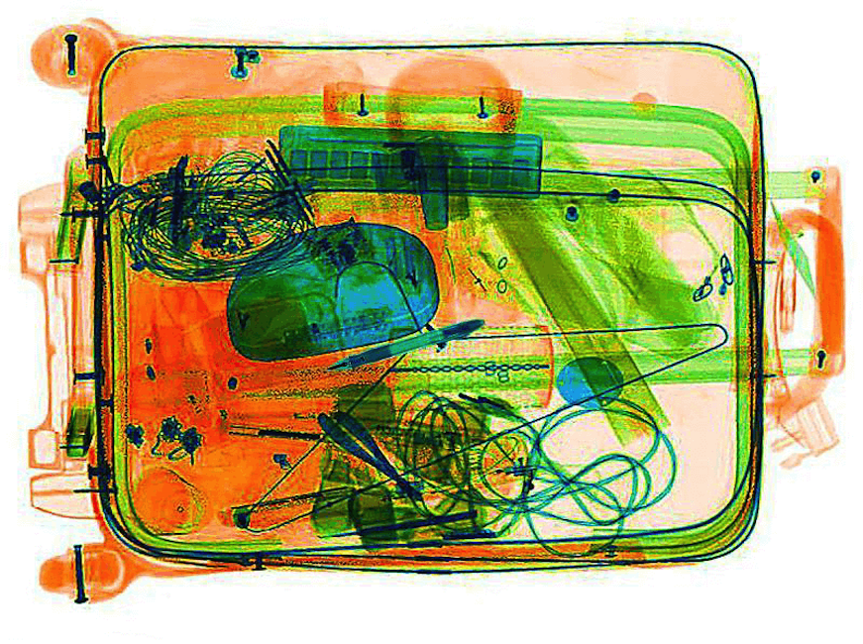
…Development of existing apps
ROOTVR
  Add new displays to take more advantage of VR capabilities, like contour plots/movies
  transparency variations for immersion into CAT scans, TSA luggage scans, …

Slide 6
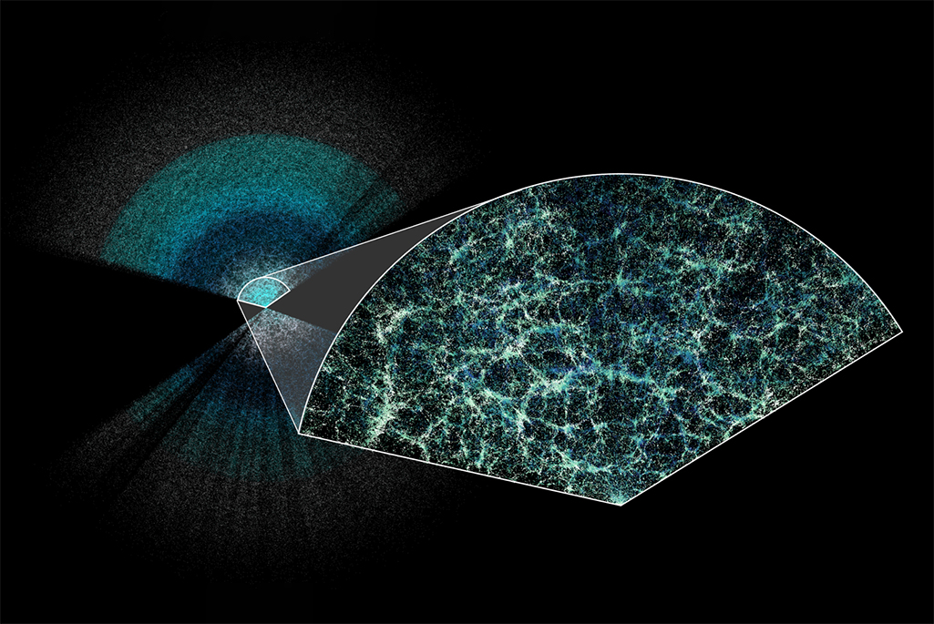

…Development of existing apps
ROOTVR
  Figure out how to display very large datasets (underway)
  Figure out how to make 3D and 4D data displays completely immersive (like simulated development of the early universe)
DESI 4-billion galaxy sky survey
The Millennium Simulation Project

Slide 7
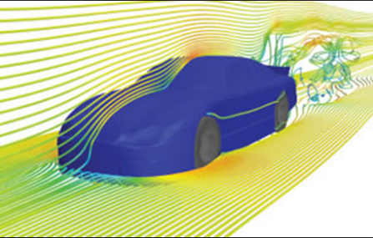
…Development of existing apps
ROOTVR
  Look for cool science data samples to plot, such as fluid flow or plasma

Slide 8
Development of existing apps…
“Publish” to Meta App Lab some of our additional apps that we will demo today:
  Dark matter detection in liquid Xenon (Nicholas)
  Proton decay in Super-K like detector (Trevor)
  Atomic orbitals (Andrew D)
Write up and submit articles for publication
  ☺ G4VR submitted
  CEDVR have a draft soon to submit
  Nothing yet for ROOTVR (of great interest to CERN scientists)
  Nothing yet for VR Fields (e.g. Physics Teacher)
  Nothing written yet for Hypercubes (math teacher journal??)

Slide 9
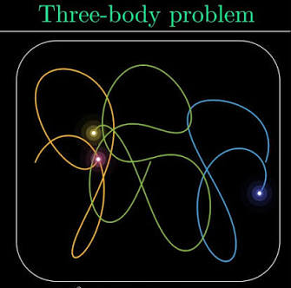
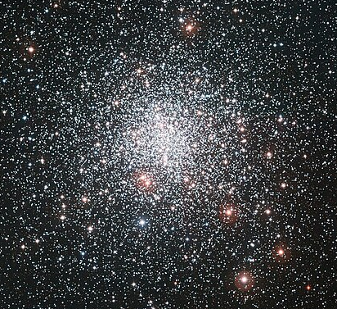
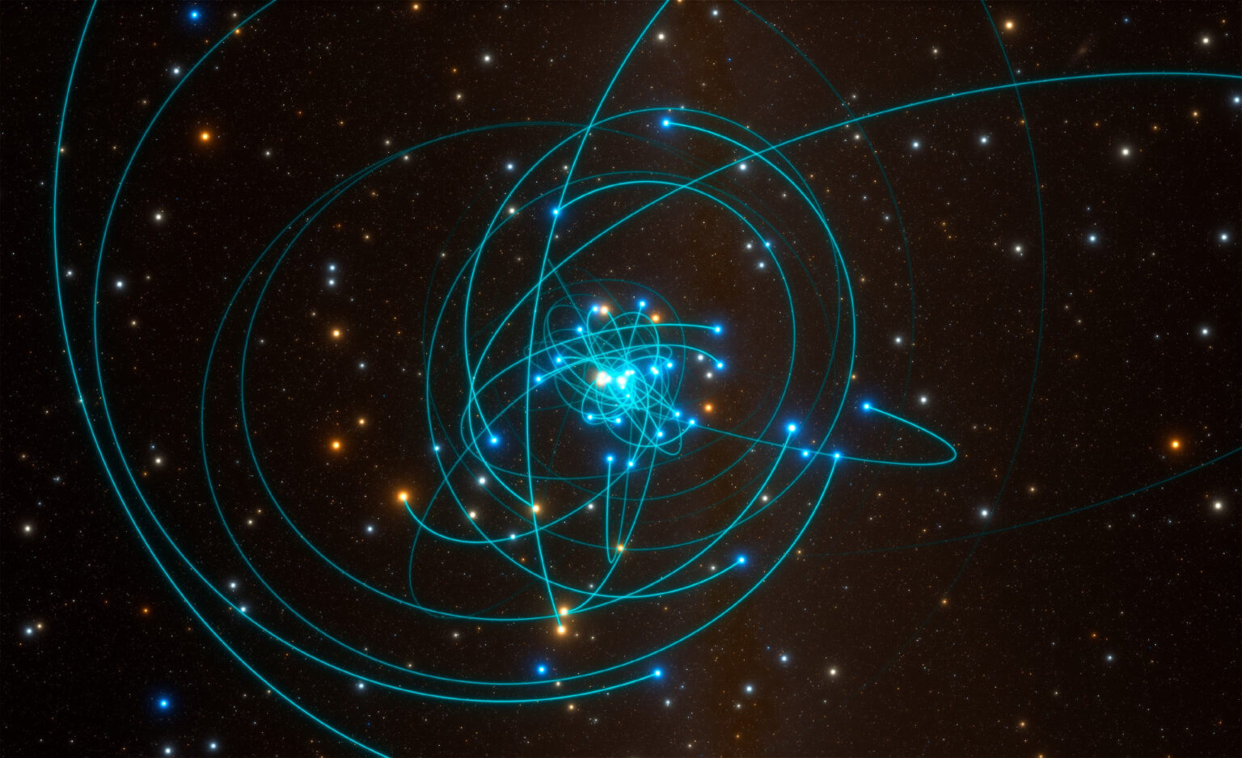
Possible new apps
Gravitational motion
  2-body → 3-body or more planetary system (underway)
  Self-gravitating galaxy, globular clusters
  The galactic center of the Milky Way and its massive black hole (Ghez 2020 Physics Nobel prize)
(very entertaining Netflix series)

Slide 10
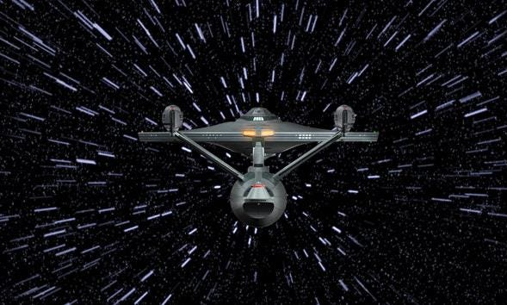
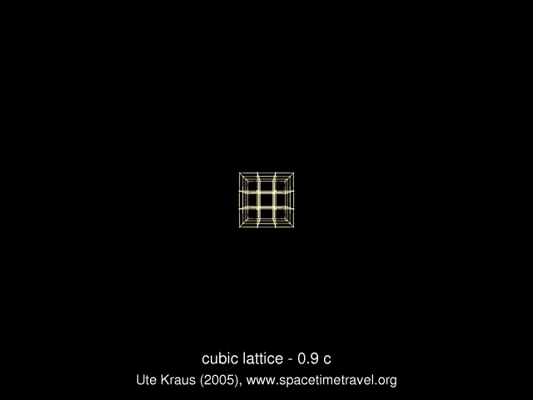
Possible new apps…
“Star Trek” type display of star fields as user speed increases relativistically.
  Not just blue shifts in front, red shifts in back, but distortions as well

Slide 11
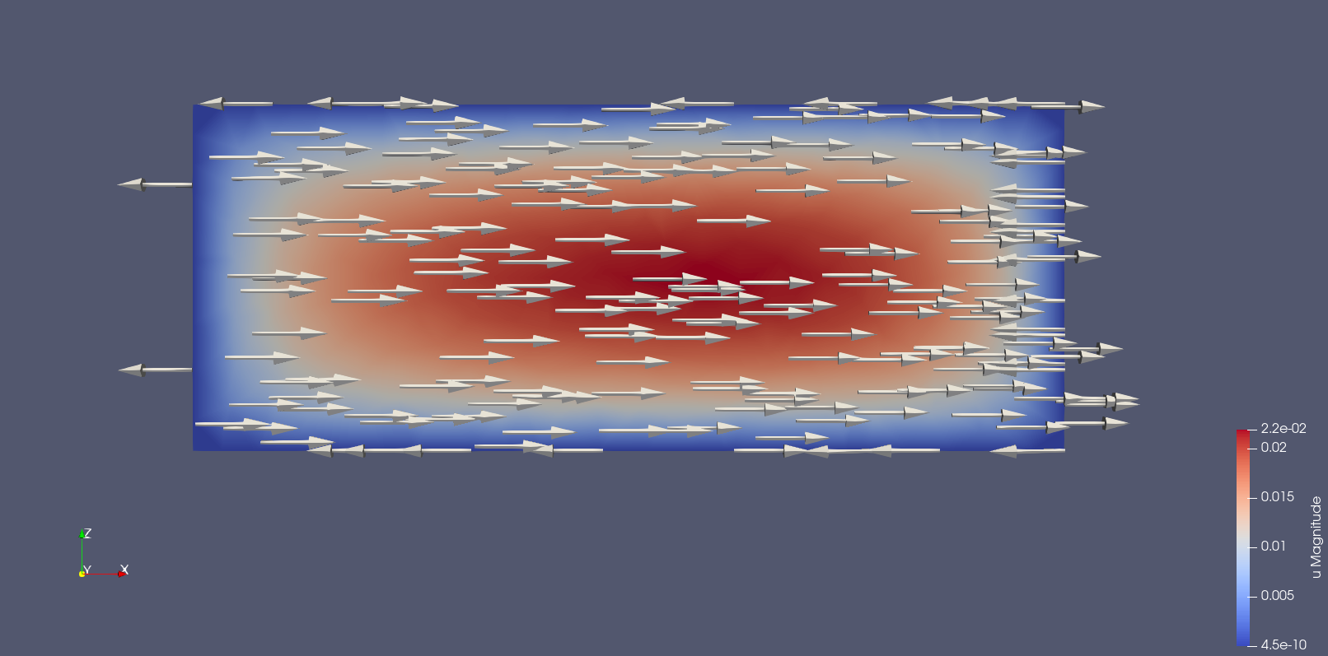
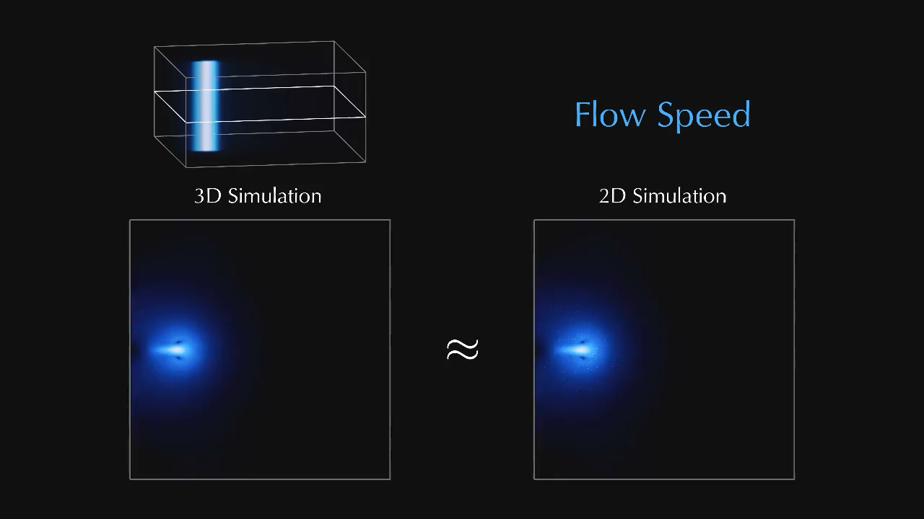
Possible new apps…
VR add-on to fluid flow with the open-source Fenics package.

Slide 12
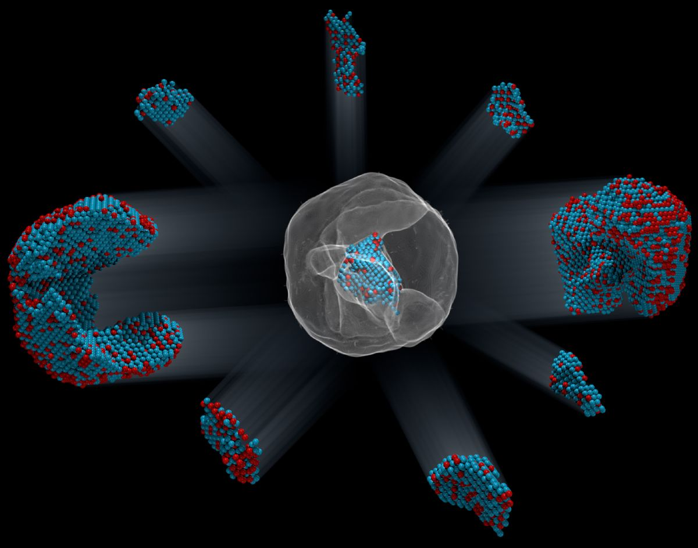
Possible new apps…
UCLA Miao group imaging of atoms using advanced lenseless diffraction
“Identification of the 3-D coordinates of 6,569 iron and 16,627 platinum atoms in an iron-platinum nanoparticle to correlate 3-D atomic arrangements with material properties at the single-atom level.”

Slide 13
Other possible new directions
Create VR add-ons to PyROOT (Python-based ROOT), mathplotlib, or other data analysis packages
Investigate higher-resolution, but expensive, headsets, such as Apple Vision Pro $3500, Samsung Galaxy XR $1800, or newer Augmented Reality (AR) headsets
Investigate “foveated streaming” with best resolution only where you are looking, for faster performance

Slide 14
Your ideas?

Slide 15
Thanks for coming here today
Enjoy the rest of the demos!

