Slide 1

Simulating Dark Matter Interactions and Visualizing with G4VR
Nicholas Farhadian

Slide 2
More About Me
Background
4th Physics and Applied Math double major
No GEANT4 experience OR particle physics knowledge before this project
My Project
Joined Physics VR group through UCLA REU in Summer 2025 and continued work through March 2026
Simulated interactions in Professor Kamaha’s Cali-X time projection chamber
Visualized simulation in VR using G4VR
Presented results at 2026 APS Global Physics Summit

Slide 3
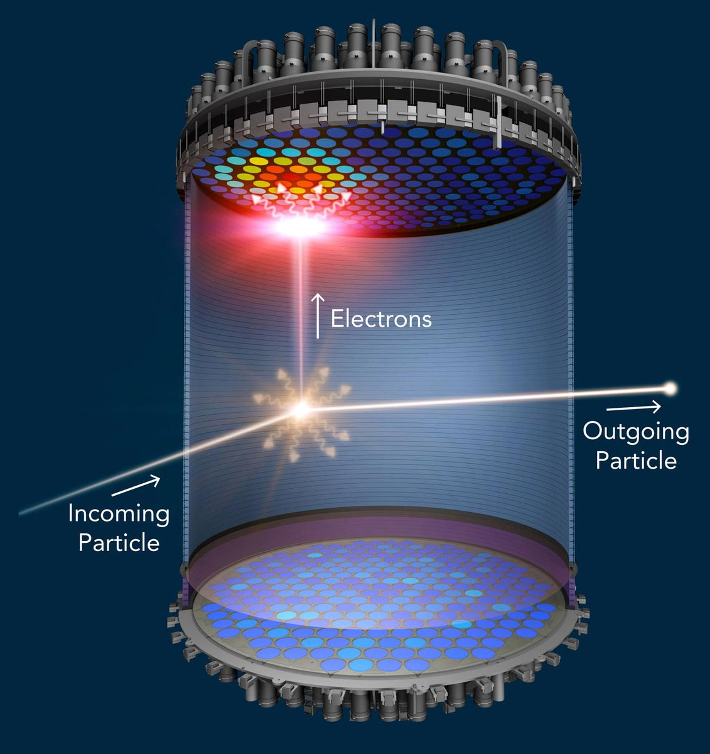
Dual Phase Liquid Xenon TPCs
Incident particle interacts with xenon nucleus → prompt scintillation (S1) → detected by photomultiplier tubes (PMTs)
  Alongside S1, interaction ionizes atoms, freeing electrons, travel upward due to electric field
Electrons reach the top → delayed scintillation (S2) via electroluminescence
Timing of S1 and S2 → z-position
PMT hit patterns → x- and y-position
Signal size ratio (S2/S1) → electronic (ER)/nuclear recoil (NR) discrimination
Working principle of a dual phase liquid xenon detector [1]

Slide 4
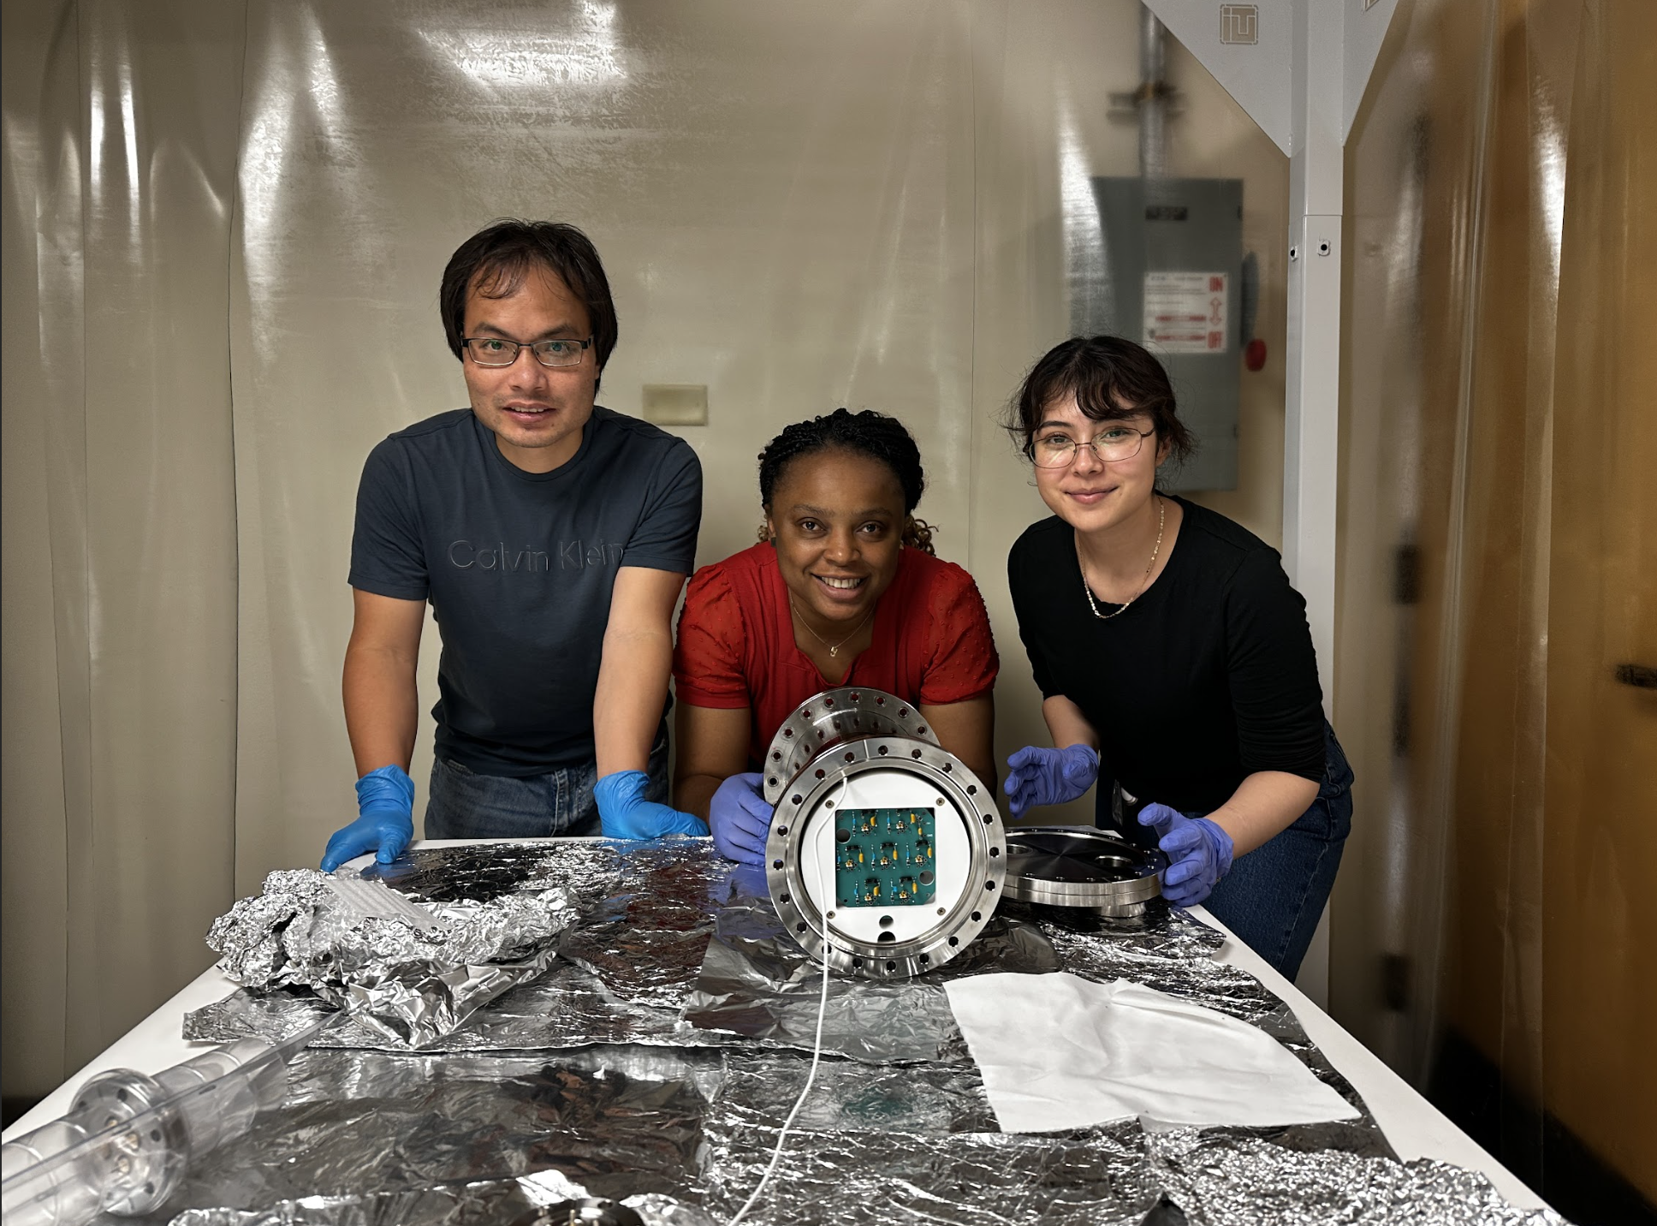
UCLA Cali-X TPC
Mini liquid xenon detector developed by Kamaha Lab at UCLA [2]
Prototype for large-scale xenon detectors (LZ [3], XLZD [4], etc.)
Used for thorough xenon microphysics calibration
7 rectangular PMTs on top array, 1 large round PMT on the bottom
Cali-X TPC fully assembled and inserted inside cryostat. Pictured: Professor Alvine Kamaha (center) with postdoc Dr. Dongqing Huang (left) and graduate student Samantha Contreras (right)

Slide 5
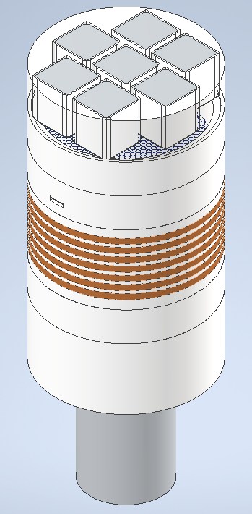
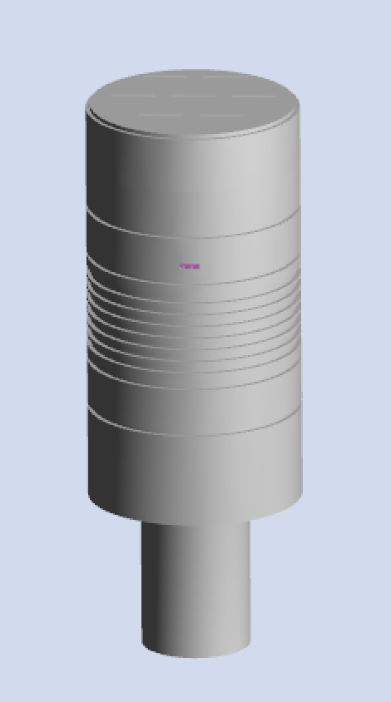
UCLA Cali-X TPC
E_{extraction}≈2.5 kV/cm
46.5 mm
E_{drift}≈100 V/cm
52 mm
Holds ~1.04 kg liquid xenon
CAD Drawing of Cali-X TPC [5]
My GEANT4 Simulation of Cali-X TPC

Slide 6


Simulating with GEANT4 and NEST
GEANT4 (GEometry ANd Tracking 4) [6-8] - C++ based platform that uses Monte Carlo methods to simulate interactions between particles
  Used for high-energy interactions and electric field
NEST (Noble Element Simulation Technique) [9-10] – used to model microphysics that lead to signal formation in noble liquid elements
  Use on its own or with GEANT4 to create S1 and S2 signals

Slide 7
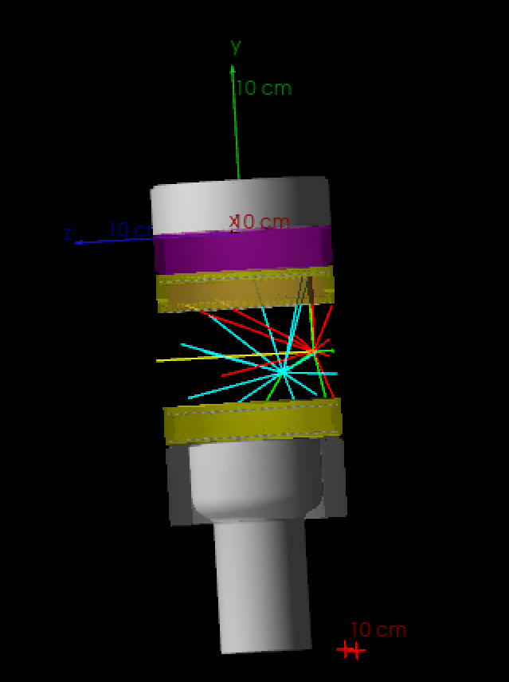
Designing the Simulation
Detector geometry: Convert CAD files to Geometry Description Markup Language (GDML) [11], native to GEANT4
Physics: Enable relevant physics, implement NEST, and create custom stepping algorithm for electrons
Data collection: Collect and export data from simulation runs for analysis
My simulation of a 2.45 MeV neutron incident on the TPC, producing drift electrons and scintillation photons

Slide 8

Virtual Reality Visualization with G4VR
G4VR [12]: visualization tool developed by fellow UCLA undergraduate Benjamin Jobilal that allows GEANT4 runs to be viewed in virtual reality
View tracks, energy depositions in specific volumes, and time evolution
G4XR saves scene geometry as a .glb file and each run as an individual .bin file
Data stored on local server and parsed by G4VR to produce scenes in VR headset

Slide 9
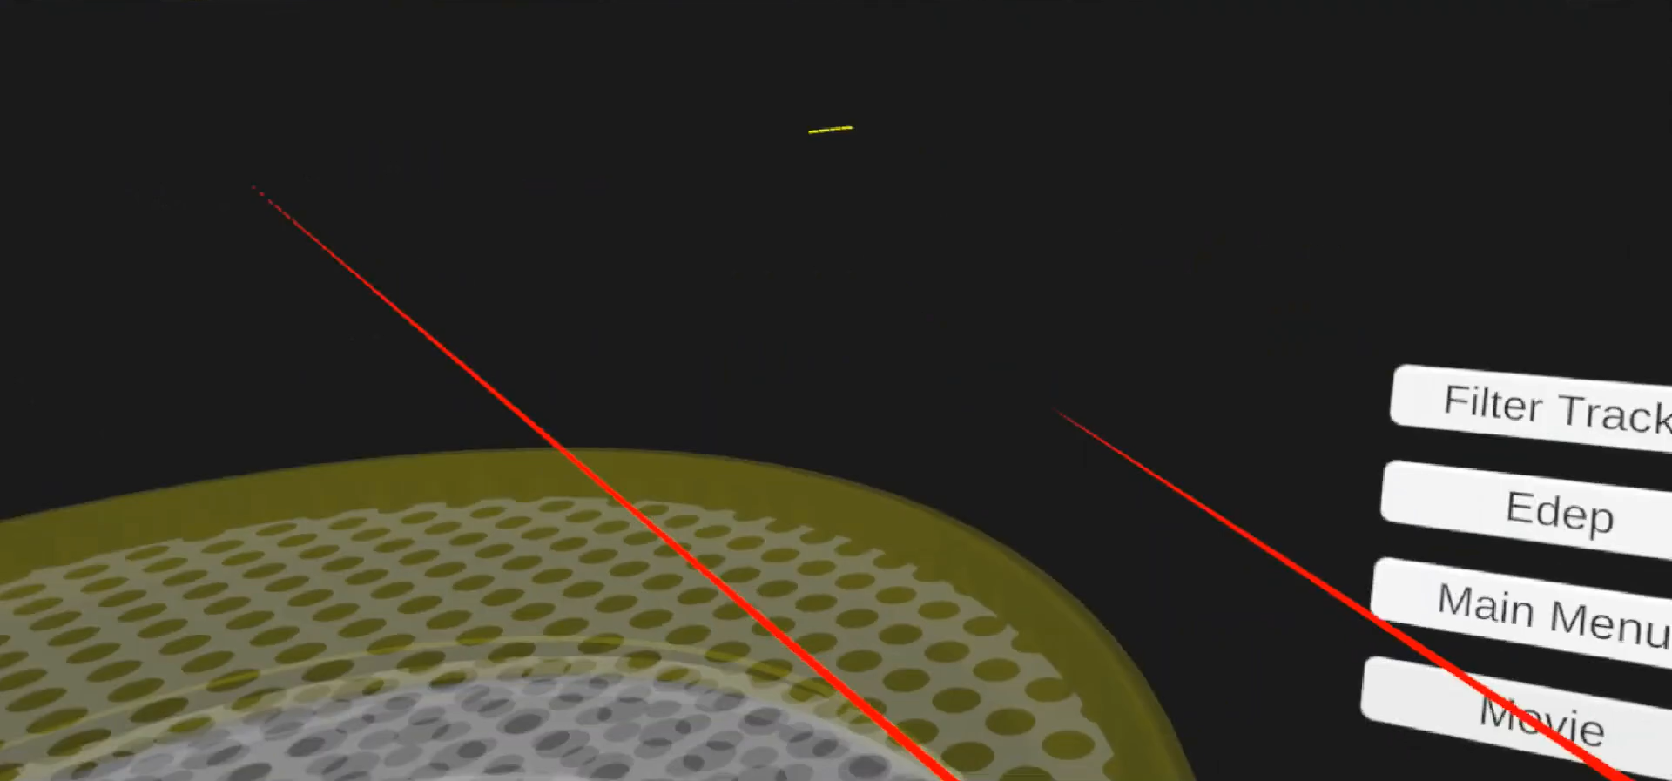
Example scintillation event in GEANT4 simulation from incident 2.45 MeV neutron viewed in virtual reality via G4VR

Slide 10
How to Get Involved
Reach out to professors
Use the tools at your disposal (Professors, AI, YouTube, etc.)
Be willing to learn and don’t be afraid to ask questions
Apply for scholarships/grants

Slide 12
References
[1] B. J. Mount et al. “LUX-ZEPLIN (LZ) Technical Design Report”. 2017. arXiv: 1703.09144 [physics.ins-det]. url: https://arxiv.org/abs/1703.09144.
[2] Kamaha Lab. (2026). University of California, Los Angeles. url: https://kamahalab.pa.ucla.edu/
[3] D.S. Akerib et al. “The LUX-ZEPLIN (LZ) experiment”. In: Nuclear Instruments and Methods in Physics Research Section A: Accelerators, Spectrometers, Detectors and Associated Equipment 953 (2020),p. 163047. issn: 0168-9002. doi: https://doi.org/10.1016/j.nima.2019.163047.
[4] J. Aalbers et al. “The XLZD Design Book: towards the next-generationliquid xenon observatory for dark matter and neutrino physics”. In: TheEuropean Physical Journal C 85.10 (Oct. 2025). issn: 1434-6052. doi:10.1140/epjc/s10052-025-14810-w. url: http://dx.doi.org/10.1140/epjc/s10052-025-14810-w.
[5] A. Kamaha. “CALIX Detector Design”. 2025.
[6] Geant4 - A Simulation Toolkit, S. Agostinelli et al., Nucl. Instrum. Meth. A 506 (2003) 250-303. https://www.sciencedirect.com/science/article/pii/S0168900203013688.
[7] Geant4 Developments and Applications, J. Allison et al., IEEE Trans. Nucl. Sci. 53 (2006) 270-278. https://ieeexplore.ieee.org/xpls/abs_all.jsp?isnumber=33833&arnumber=1610988&count=33&index=7.
[8] Recent Developments in Geant4, J. Allison et al., Nucl. Instrum. Meth. A 835 (2016) 186-225. https://www.sciencedirect.com/science/article/pii/S0168900216306957.
[9] M Szydagis et al. “NEST: a comprehensive model for scintillation yieldin liquid xenon”. In: Journal of Instrumentation 6.10 (Oct. 2011), P10002. doi: 10.1088/1748-0221/6/10/P10002. url: https://doi.org/10.1088/1748-0221/6/10/P10002.
[10] M. Szydagis et al. Noble Element Simulation Technique v2.0. Version v2.0.0. July 2018. doi: 10.5281/zenodo.1314669.
[11] Witold Pokorski et al. “Geometry Description Markup Language and its application-specific bindings” (2006). url: https://indi.to/q3NQR.
[12] B. Jobilal et al. “A virtual reality extension for the Geant4 toolkit” (2026). doi: https://doi.org/10.48550/arXiv.2609.08926

