Slide 1
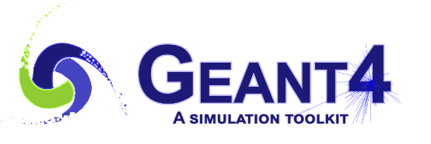

G4VR: A Virtual Reality Extension for Geant4
Benjamin Jobilal¹
Muhammad Ansar Iqbal², Jay Hauser¹
¹University of California Los Angeles, ²University of Wisconsin-Madison

Slide 2
Simulations are necessary in physics!
Let’s say you’re designing some experiment searching for some exotic particle
  Theorists will tell you the physics you need to know about the particle.
  Engineers will build the equipment you need to find this particle.
  Rich Swiss People will give you some money to get started.

Slide 3
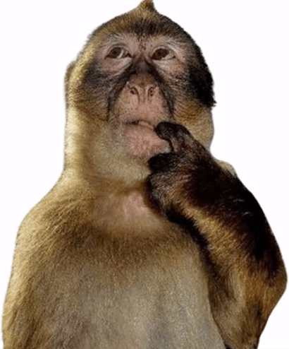
Simulations are necessary in physics!
Let’s say you’re designing some experiment searching for some exotic particle
  Theorists will tell you the physics you need to know about the particle.
  Engineers will build the equipment you need to find this particle.
  Rich Swiss People will give you some money to get started.
  Only one question: how do you know you’ll find it?

Slide 4
Simulations are necessary in physics!
Let’s say you’re designing some experiment searching for some exotic particle
  Theorists will tell you the physics you need to know about the particle.
  Engineers will build the equipment you need to find this particle.
  Rich Swiss People will give you some money to get started.
  Only one question: how do you know you’ll find it?
  Simulations!
  can tell you how much signal or background you get
  can tell if your design is efficient
  can help you understand your observations better, (and so on…)

Slide 5



Enter Geant4
Geant4 is one such simulation toolkit for simulating particle interactions in matter
  Ubiquitous in experimental physics, medical physics, etc. $→$ definitely worth learning about!
  Extensively used at CERN experiments.
  Bare workflow looks like:
Define Experiment
Shoot Particles at it
See What Happens
(Energy Dep., doses, etc.)

Slide 6
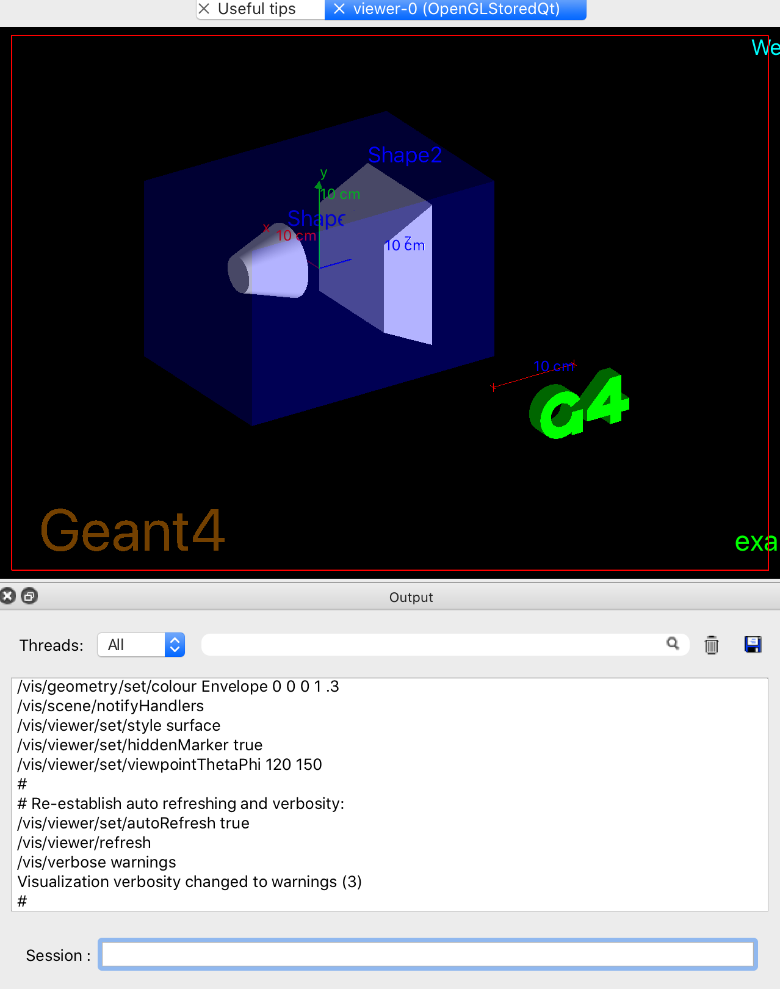
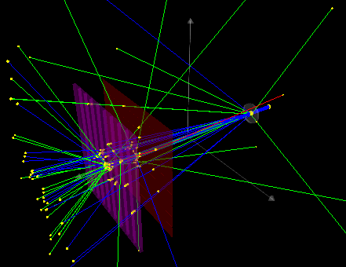
Enter Geant4

Slide 7

But Experiments are Complex…
“Nice! My seemingly innocent simulation has completed!”

Slide 8
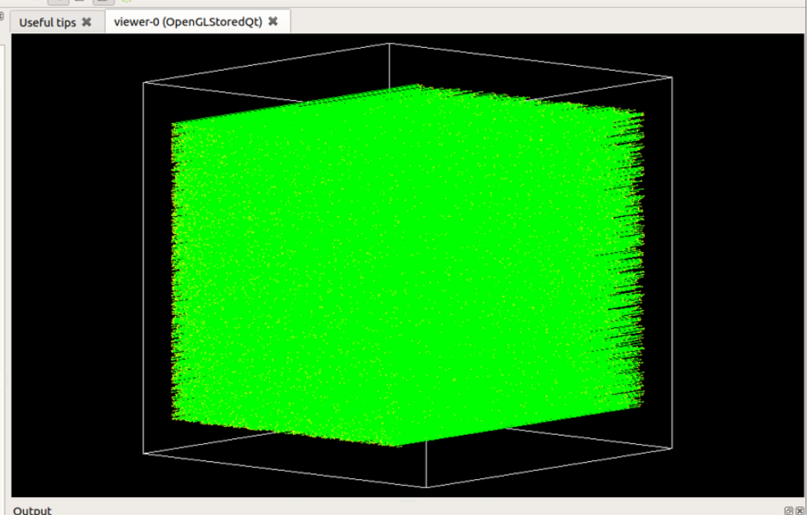
Experiments are Complex…
“Nice! My seemingly innocent simulation has completed!”
Erm…

Slide 9
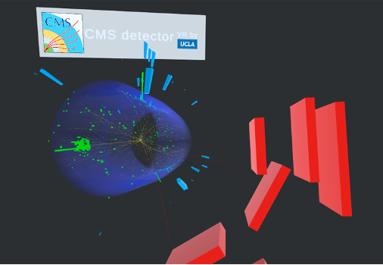
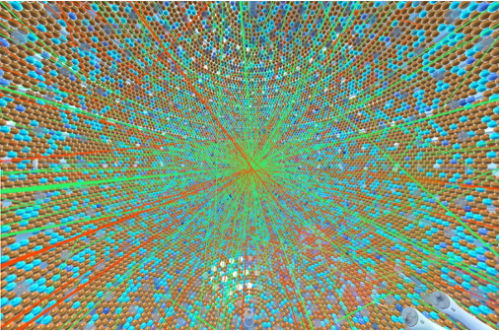
Enter Virtual Reality
You can now “insert” yourself into the event and see what unfolded!
  Allows deep immersion and understanding that is tricky otherwise
  VR event displays exist for JUNO and Belle II experiment simulations
  CED-VR for the CMS Experiment is developed by the UCLA VR Lab
CED-VR
JUNO

Slide 10

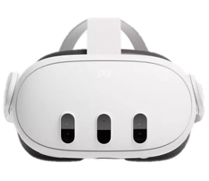

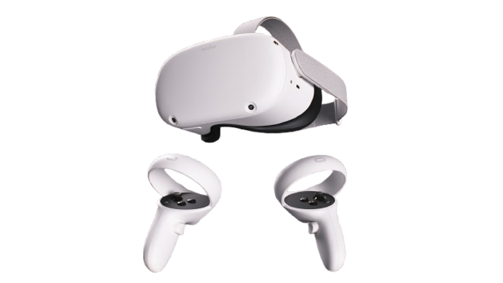

Enter Virtual Reality
For Geant4, we have developed G4VR - a VR app to visualize Geant4 simulations
VR Headset (Meta Quest 2+)
Running G4VR
$$\begin{matrix}L_{SM}= & -\frac{1}{4}F_{μν}^{a}F^{aμν} \\ & +i\overline{ψ}γ^{μ}D_{μ}ψ \\ & +(D_{μ}ϕ)^{†}(D^{μ}ϕ) \\ & -μ^{2}ϕ^{†}ϕ \\ & -λ(ϕ^{†}ϕ)^{2} \\ & -\left({\overline{ψ}}_{L}Yϕψ_{R}+h.c.\right)\end{matrix}$$
Right Controller
(locomotion/interaction)
Left Controller
(locomotion/interaction)
Geant4 Simulation

Slide 11
G4XR: The Xr Driver
How to communicate between Geant4 and G4VR…?
Introducing the G4Xr driver!
New visualization driver developed for Geant4.
Produces experiment geometries (GLB format) and track assets (binaries)
  One track asset per run $⟶$ aggregated events
Automatically sets up and pushes to a server that G4VR can find
  Runs on the local network from the user’s device
  User simply enters a URL in G4VR!
GLB, binaries
Retrieval
via provided URL
Geant4
Local Server
Created by G4Xr
G4VR

Slide 12
G4XR: The Xr Driver
GLB, binaries
Retrieval
via provided URL
Geant4
Local Server
Created by G4Xr
G4VR
Example Usage (Geant4 console)
/vis/open Xr # launch G4Xr instance
/run/beamOn 100 # run some events
Data Persistence (save to launch and view later w/o simulation)
/Xr/session “mysim” # persist and call the session “mysim”
/vis/open Xr # launch G4Xr instance
/run/beamOn 100 # run some events
Saves the assets locally to mysim.zip and provides a script to launch the server at a later time in G4VR

Slide 13
G4VR: Feature Overview
Track Features
Physical data from each step of each track
Edep
Determining energy depositions in different volumes
Time Evolution
Chronological event flow
Movies
30s visualization of the full event

Slide 14
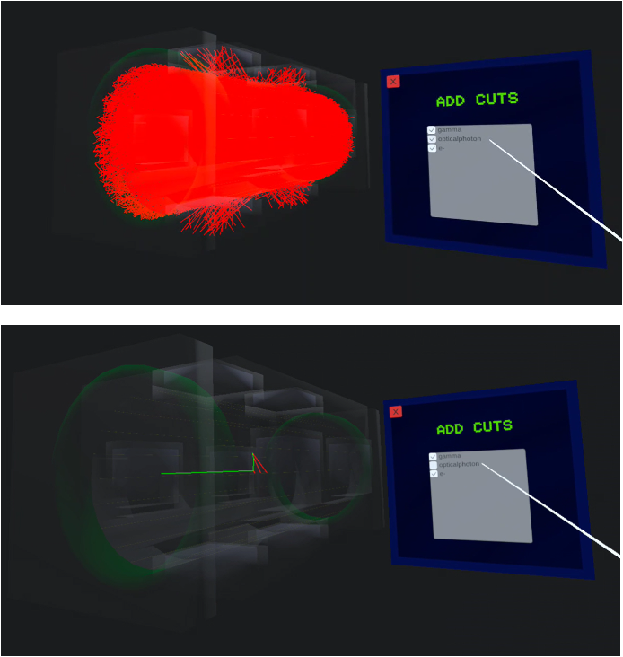
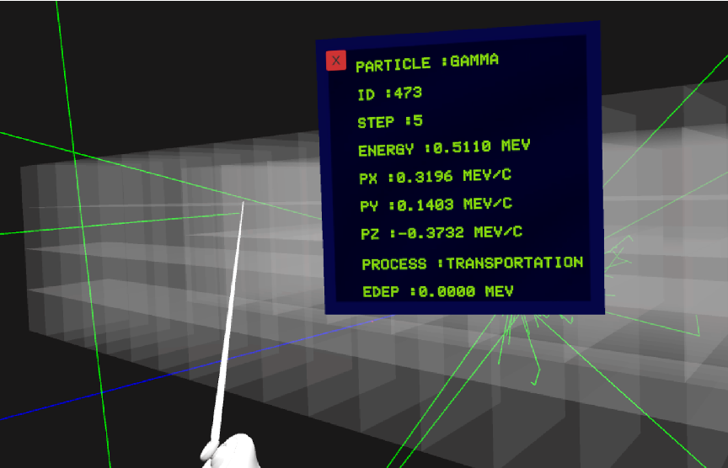

G4VR: Track Features
Use controllers to interact with tracks in the scene and access step-level information
Filter tracks by type ($e^{+},e^{-},p,n,π^{+},K^{-}$, etc.)
Remove optical photons
VR Controller to point and select

Slide 15
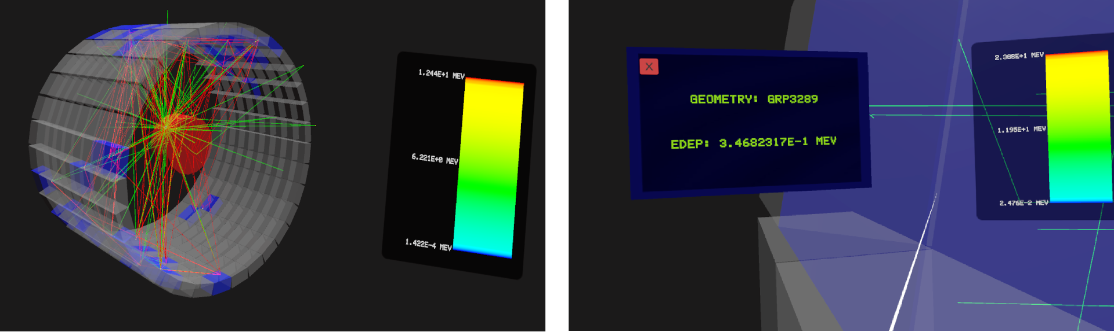

G4VR: Edep
Visualization of the energy deposited in each detector volume defined by the user.
Global energy scale for all edeps in all volumes
Interacting with volumes using the controller (white line) returns the edep value in it

Slide 16
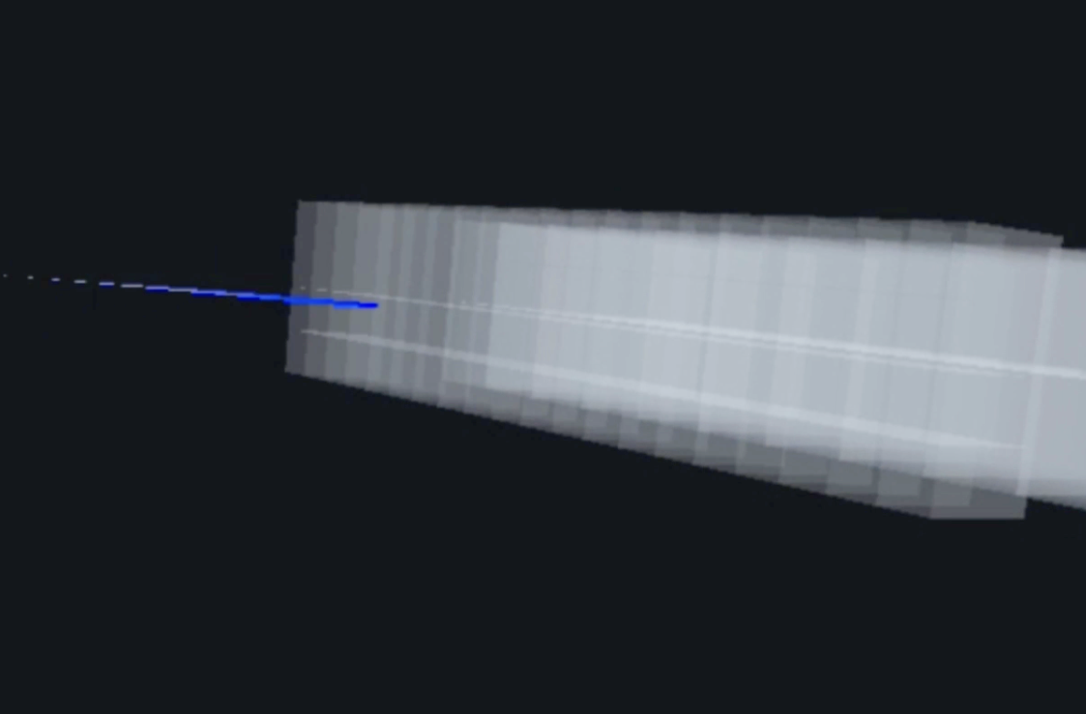

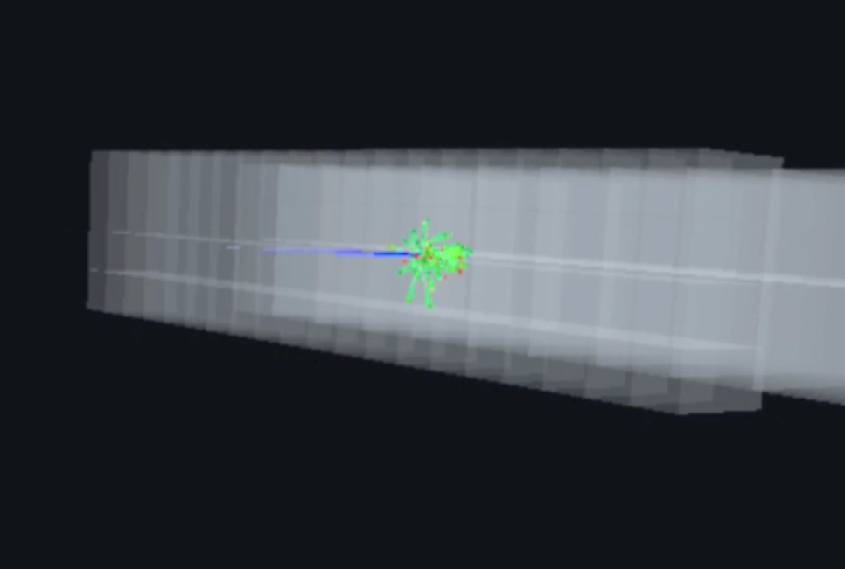
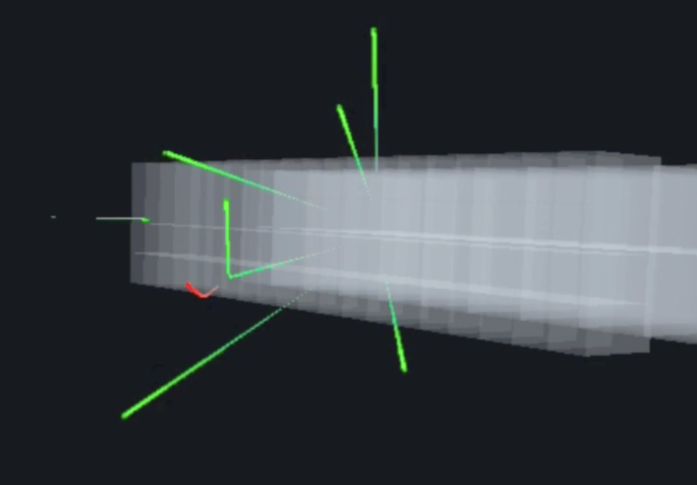

G4VR: Movie
Event scaled down to a 30s interval to show a quick overview of the run.
Example B5 in G4VR
Feature Inspired by Geant4 EXAMLE? Movies
An Example from Physino

Slide 17
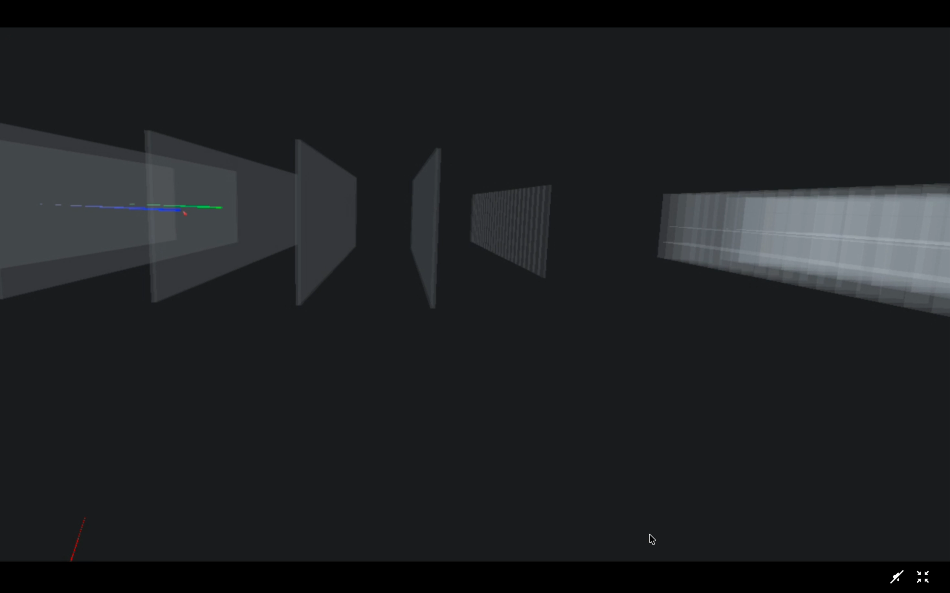
G4VR: Movie
Event scaled down to a 30s interval to show a quick overview of the run.

Slide 18
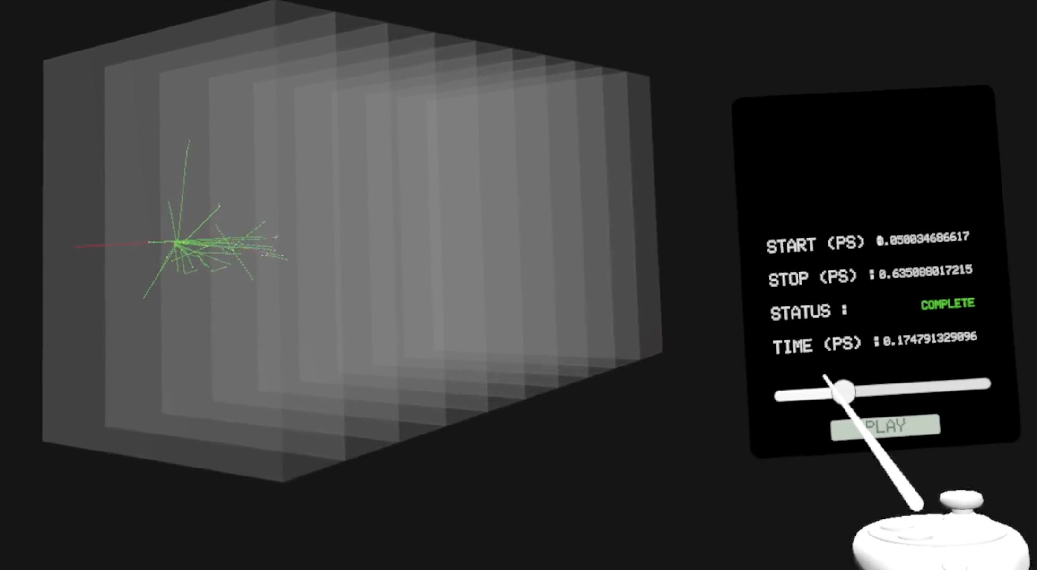
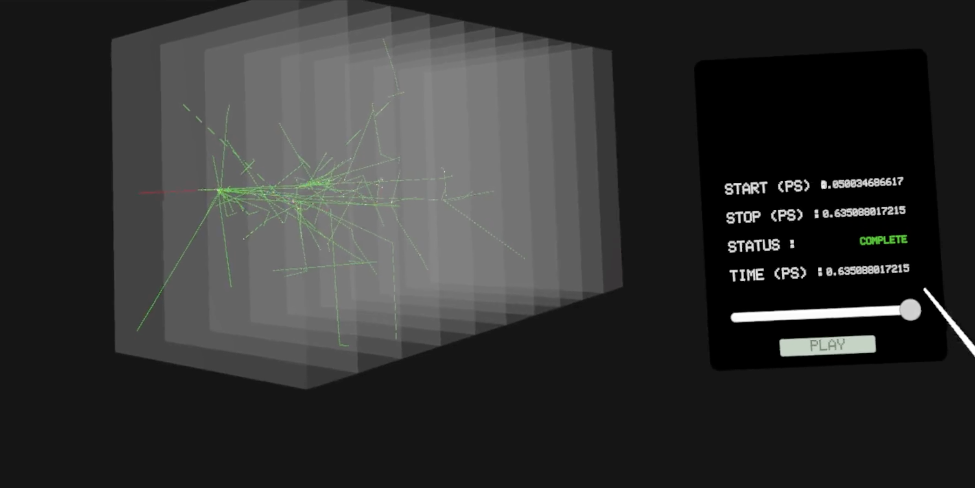
G4VR: Time Evolution
Similar to Movies, but only tracks appearing up to a certain time are displayed $⟶$ discretized compared to a movie.
Example B4a in G4VR

Slide 19
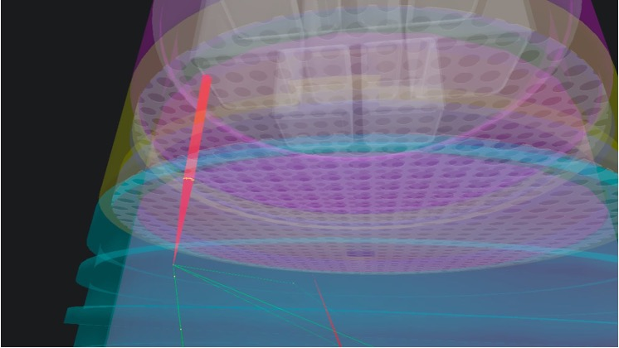
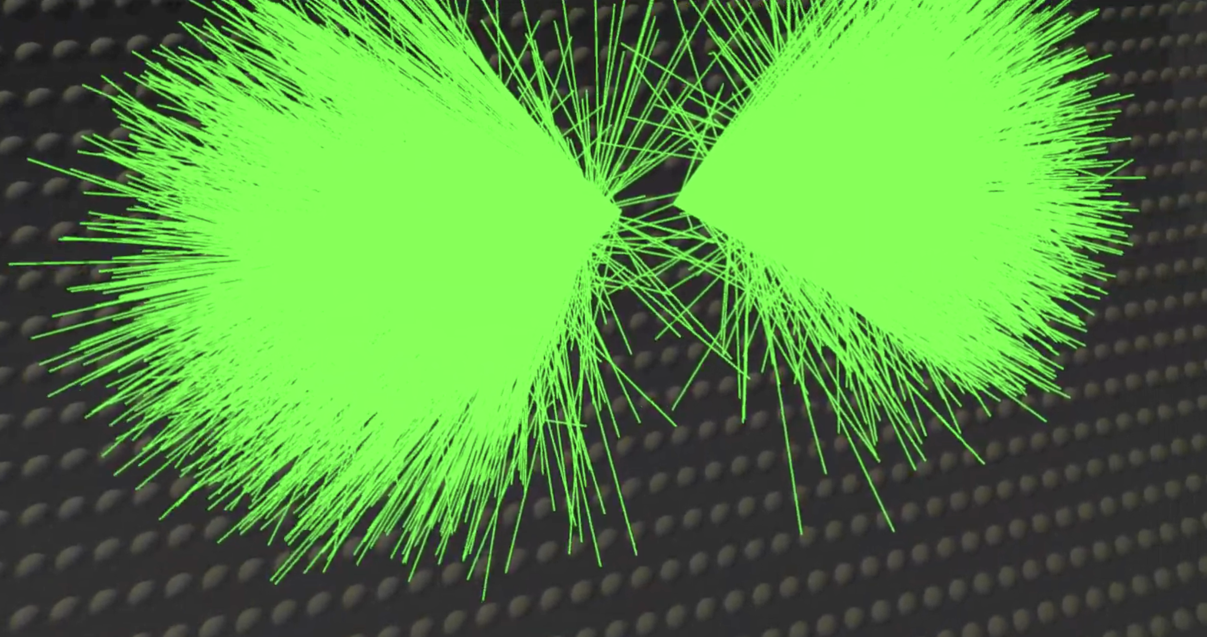
Applications
We have positive feedback!
CaliX LXe Time Projection Chamber (UCLA)
Picture on the left shows a scintillation signal and electrons drifting up.
G4VR useful in debugging the simulation from track-level data.
Proton Decay Simulation
(UCLA)
Simulation of proton decay in a Super-Kamiokande-like detector.
Picture on the right shows Cherenkov radiation as a result.

Slide 20
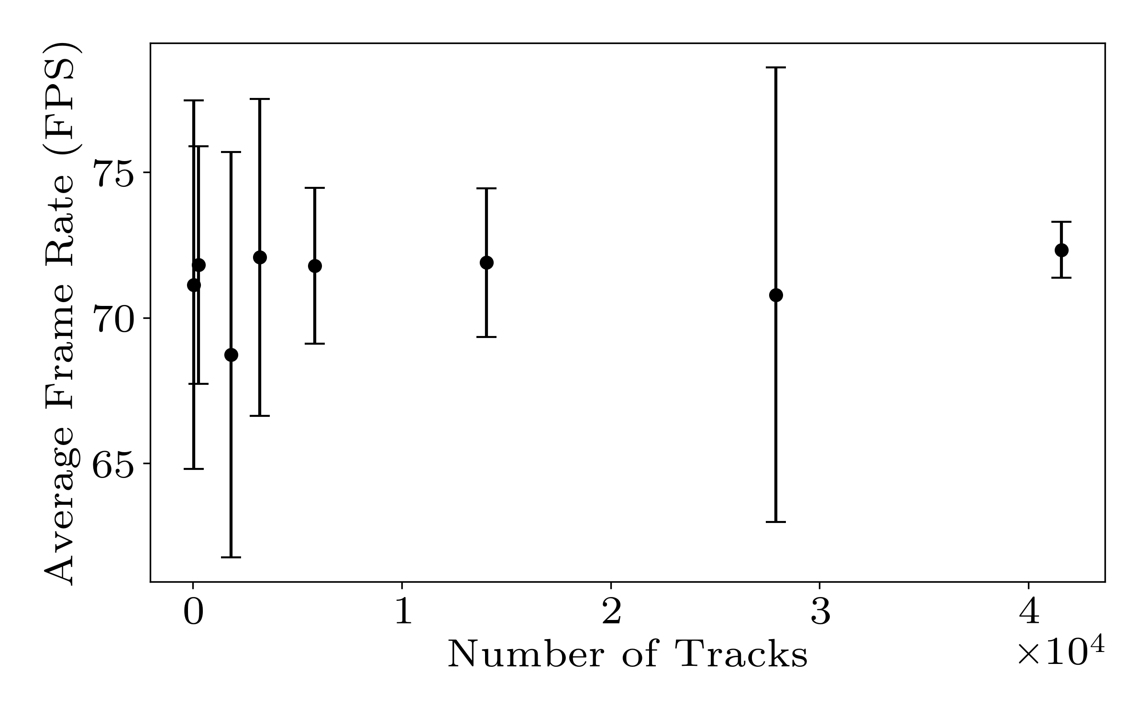
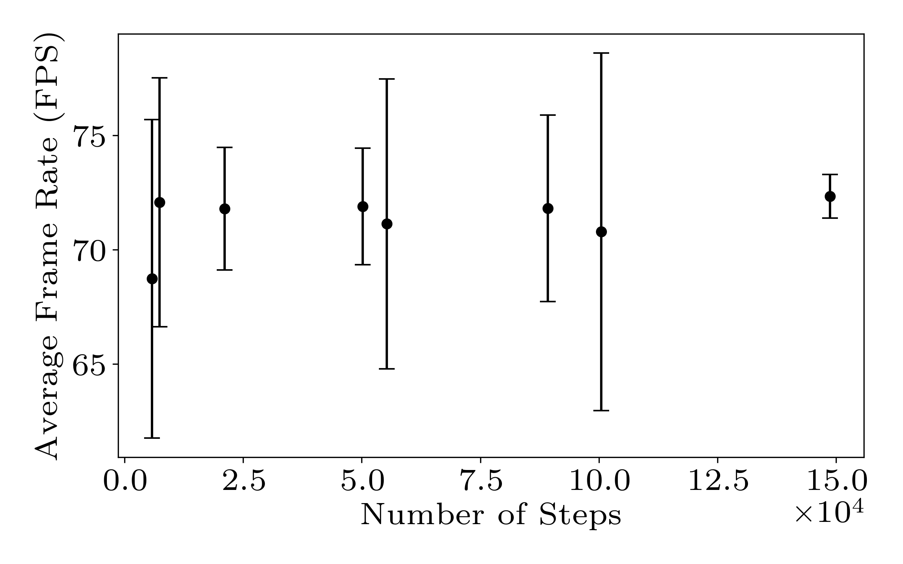
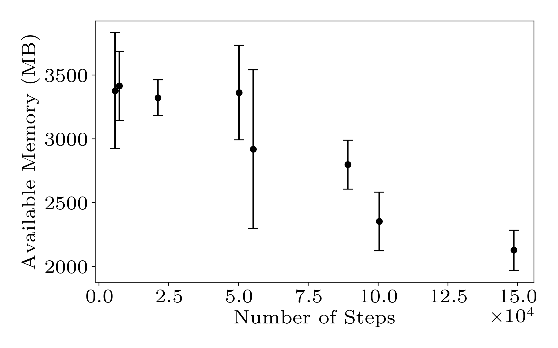
Meta Quest Performance Benchmarking
Performance consistently above 60 FPS (Meta Standard)
Switching to and from edep, movie mode can be heavy.
Load up time for very large events can vary from a few seconds to a minute.
No memory concerns up to 50k steps
Available headset memory quickly reduces with more steps
Not great!

Slide 21
Looking Forward
G4VR can be found on the UCLA Physics VR Lab page: https://vr.physics.ucla.edu/
  Three built-in Geant4 examples: B4a, B3a, B5. Easy to load and view in VR.
Driver available for install on GitHub: https://github.com/bjobilal/g4xr
  Currently binds to Geant4 v11.3.2
  Have asked vis team to make this an official Geant4 plugin!
arXiv:2609.08926 provides further details and usage instructions.

Slide 22
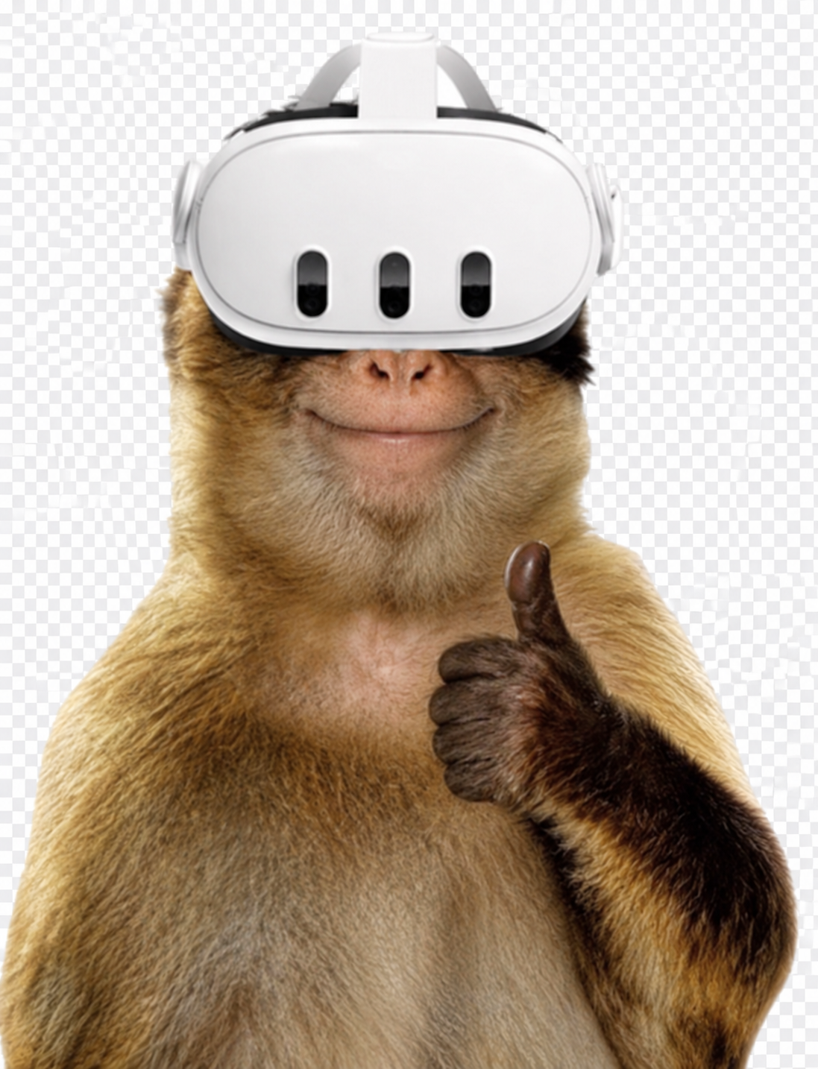
Thank You!

