Slide 1
2nd Virtual Reality for Science at UCLA Workshop
An introduction and overview
25-Oct-2026
Jay Hauser

Slide 2
Virtual Reality for Science – Why?
2D plots and pictures are universally used to convey complex information - almost all scientific journal articles contain them
Our binocular vision allows us to see information in the 3rd dimension, but this is not available on printed pages or computer screens
Virtual Reality (VR) headsets offer four huge advantages:
  360-degree viewing (actually 4π square steradians, since 4π is the area of the unit sphere)
  Binocular vision for the 3rd dimension
  The 4th dimension – time variation
  Going beyond “Youtube 360”, immersive applications allow you to move physically or with the aid of handsets within the virtual space, offering different perspectives – 3 additional dimensions?
VR thus offers the possibility of much better understanding of complex scientific phenomena

Slide 3
Virtual Reality for Science – Why NOW?
The hardware is ready and relatively inexpensive (~$600 for Quest 3)
Much software has been prepared for easy development
  Unity, Unreal engines
  Zuck helped – he thought it would make him many $billions
There is surprisingly little competition
  Hard to “sell” VR, given how little money has been made
  Visualization is individual, and most people don’t have headsets
  VR software isn’t something academics normally put on a list of publications
    Though our group is preparing several papers ABOUT our software
As a result, it is still early days for scientific VR visualization
  Plenty of low-hanging fruit to be picked

Slide 4
Virtual Reality for Science at UCLA
We started in 2022 with two VR visualizations for the CMS detector
  Protons hit protons at high energy in the Large Hadron Collider at the CERN laboratory, and particles come streaming out from the point of collisions. By studying the particles carefully, the Higgs particle was discovered in 2012. These days, CMS studies the Higgs particle in detail and looks for signatures of new physics
  CMSVR shows the particle detector apparatus, while CEDVR shows the data for one collision
The UCLA Physics VR lab has produced a range of applications
  See https://vr.physics.ucla.edu for the most mature apps
  Most of the work has been and will continue to be done by UCLA undergraduates
A few screenshots to give you a little flavor of the applications follow

Slide 5
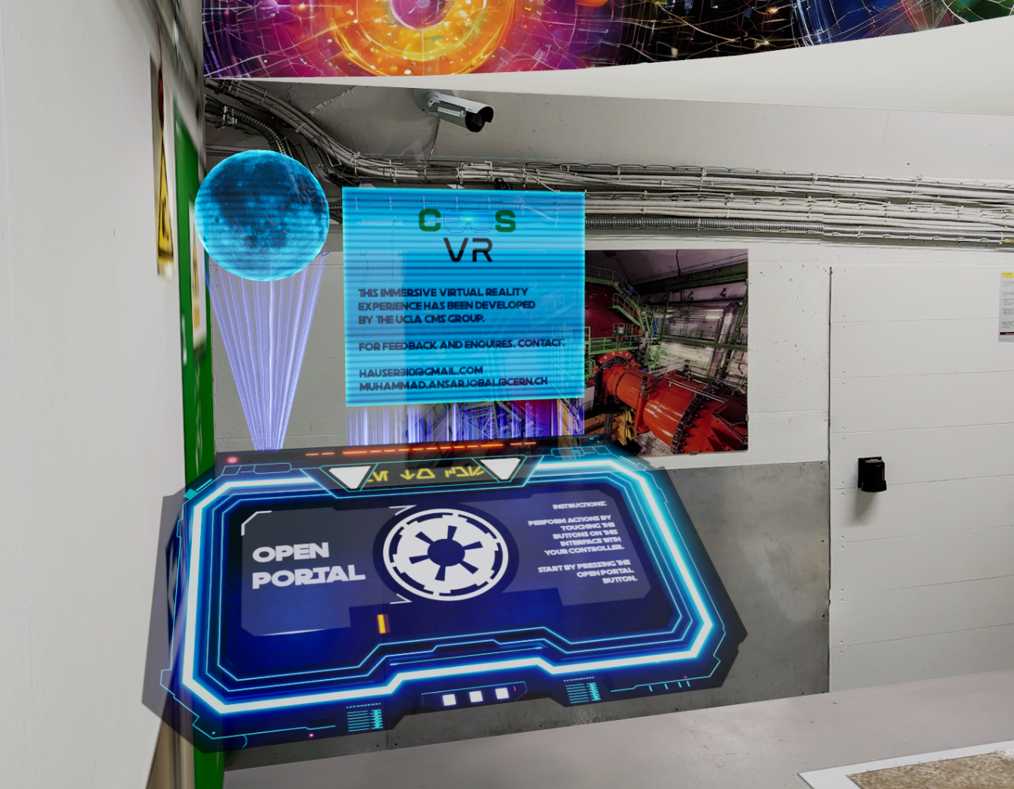
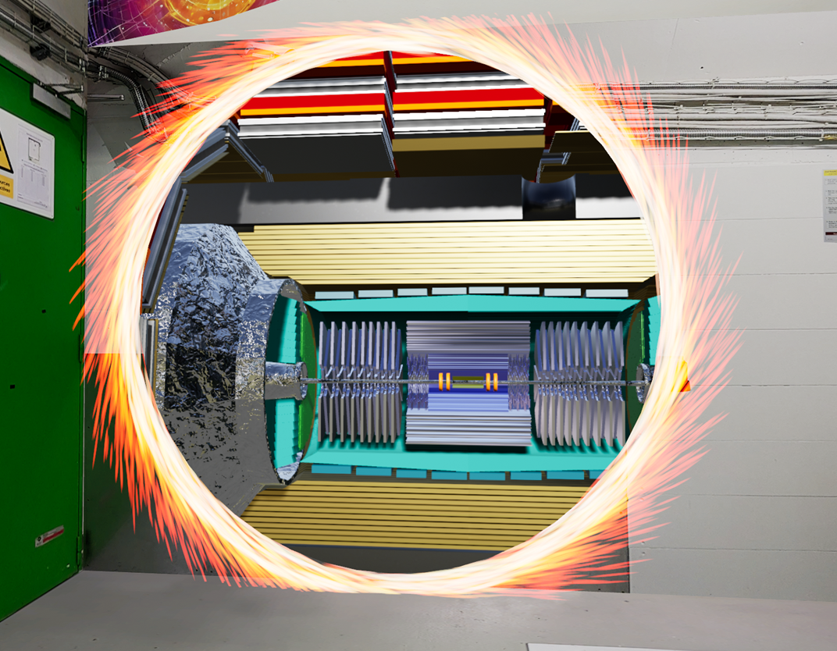
Open a portal to the CMS detector with CMS VR
Notes:
Add slide numbers

Slide 6
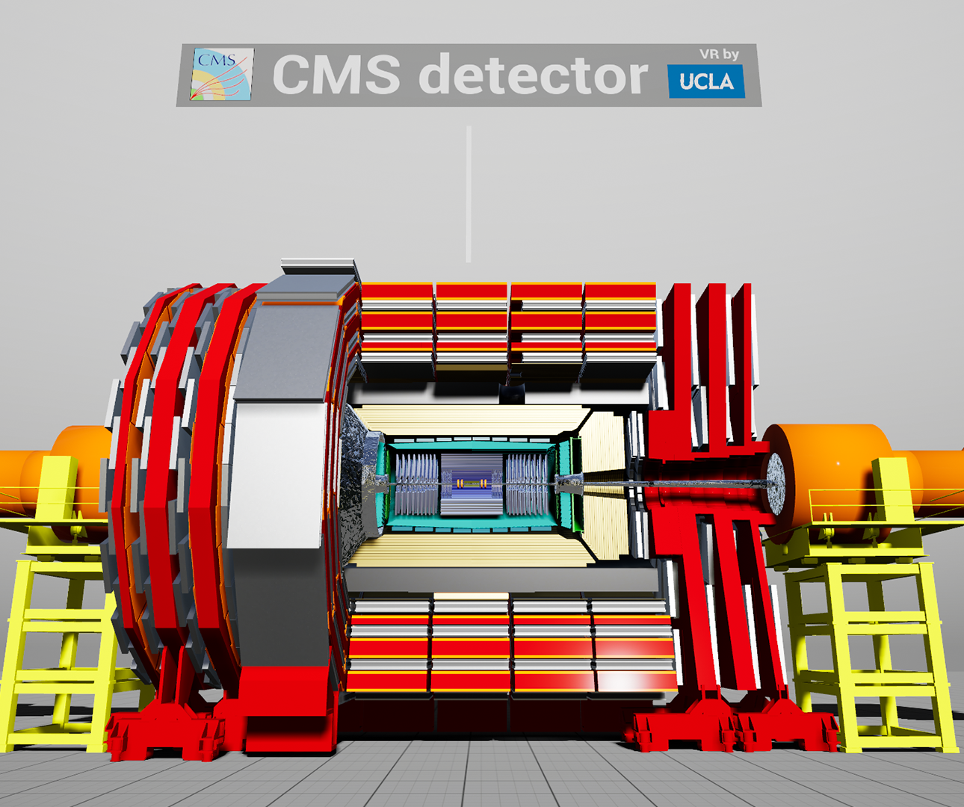
Notes:
Add slide numbers

Slide 7
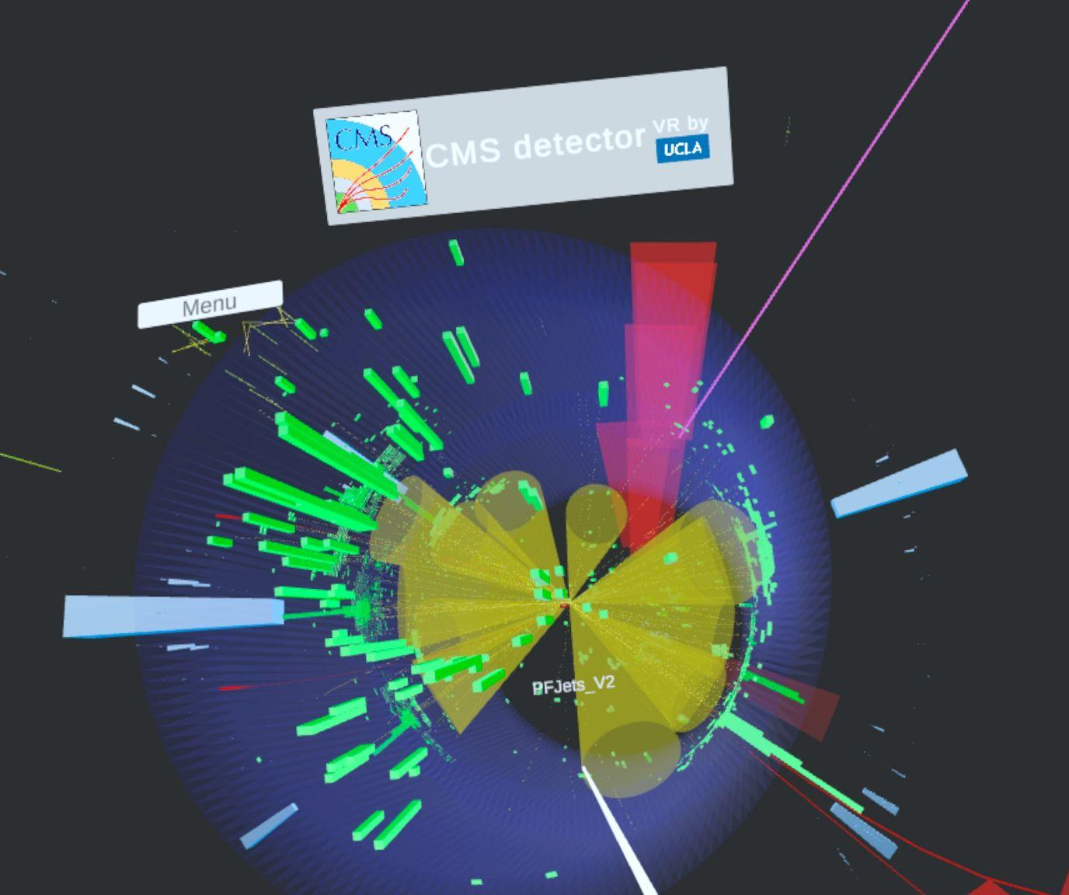
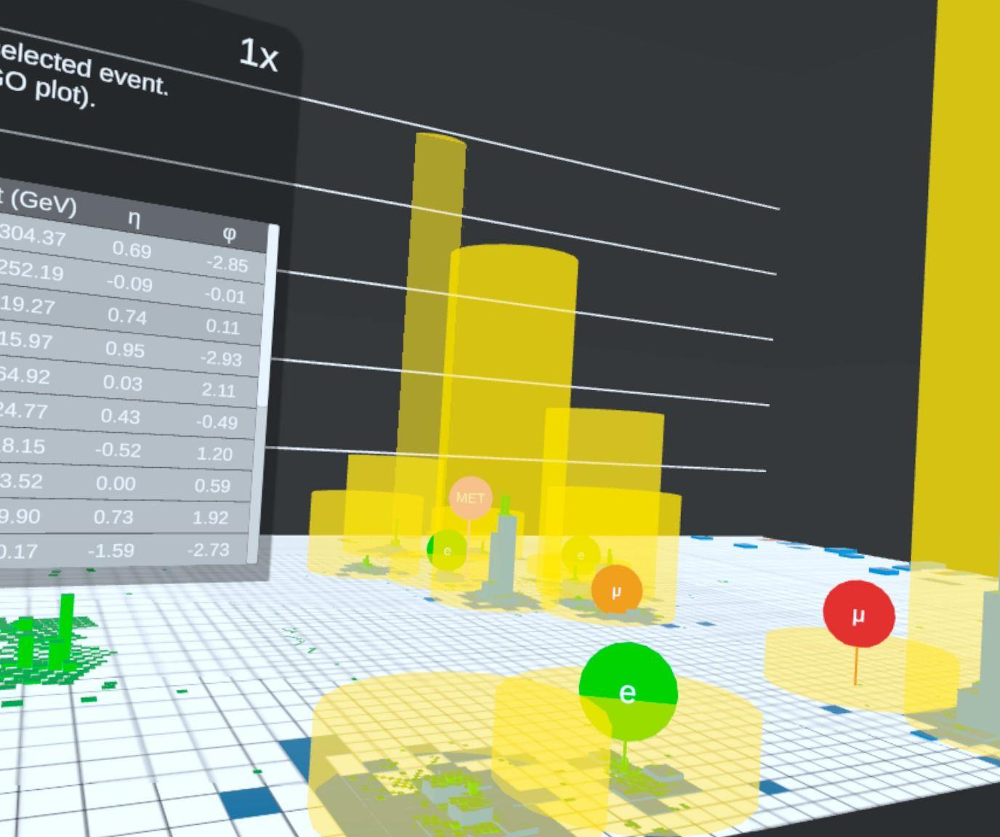
Explore LHC Data with CEDVR (Cms Event Display in VR)
Data in normal x-y-z space
“LEGO” plot for energies
Notes:
Add slide numbers

Slide 8
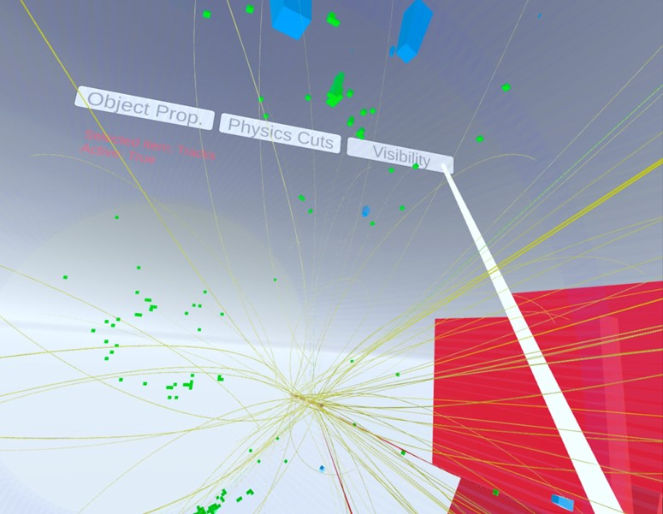
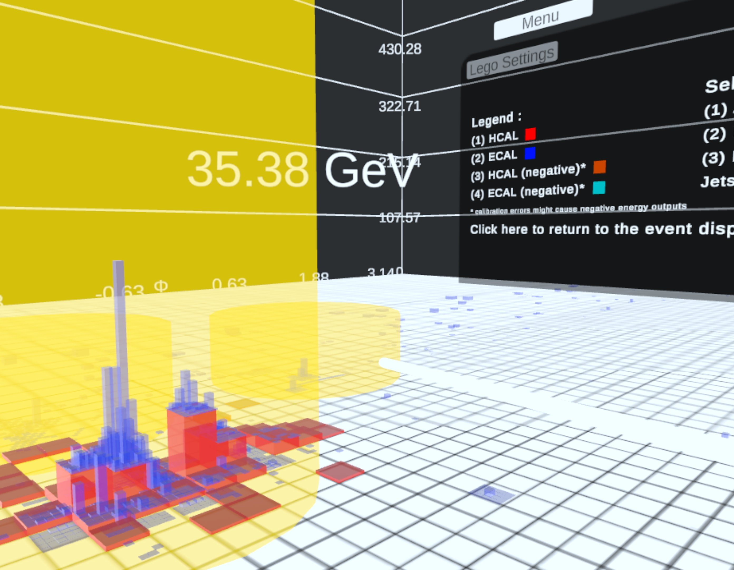
Explore LHC Data with CEDVR
Notes:
Add slide numbers

Slide 9
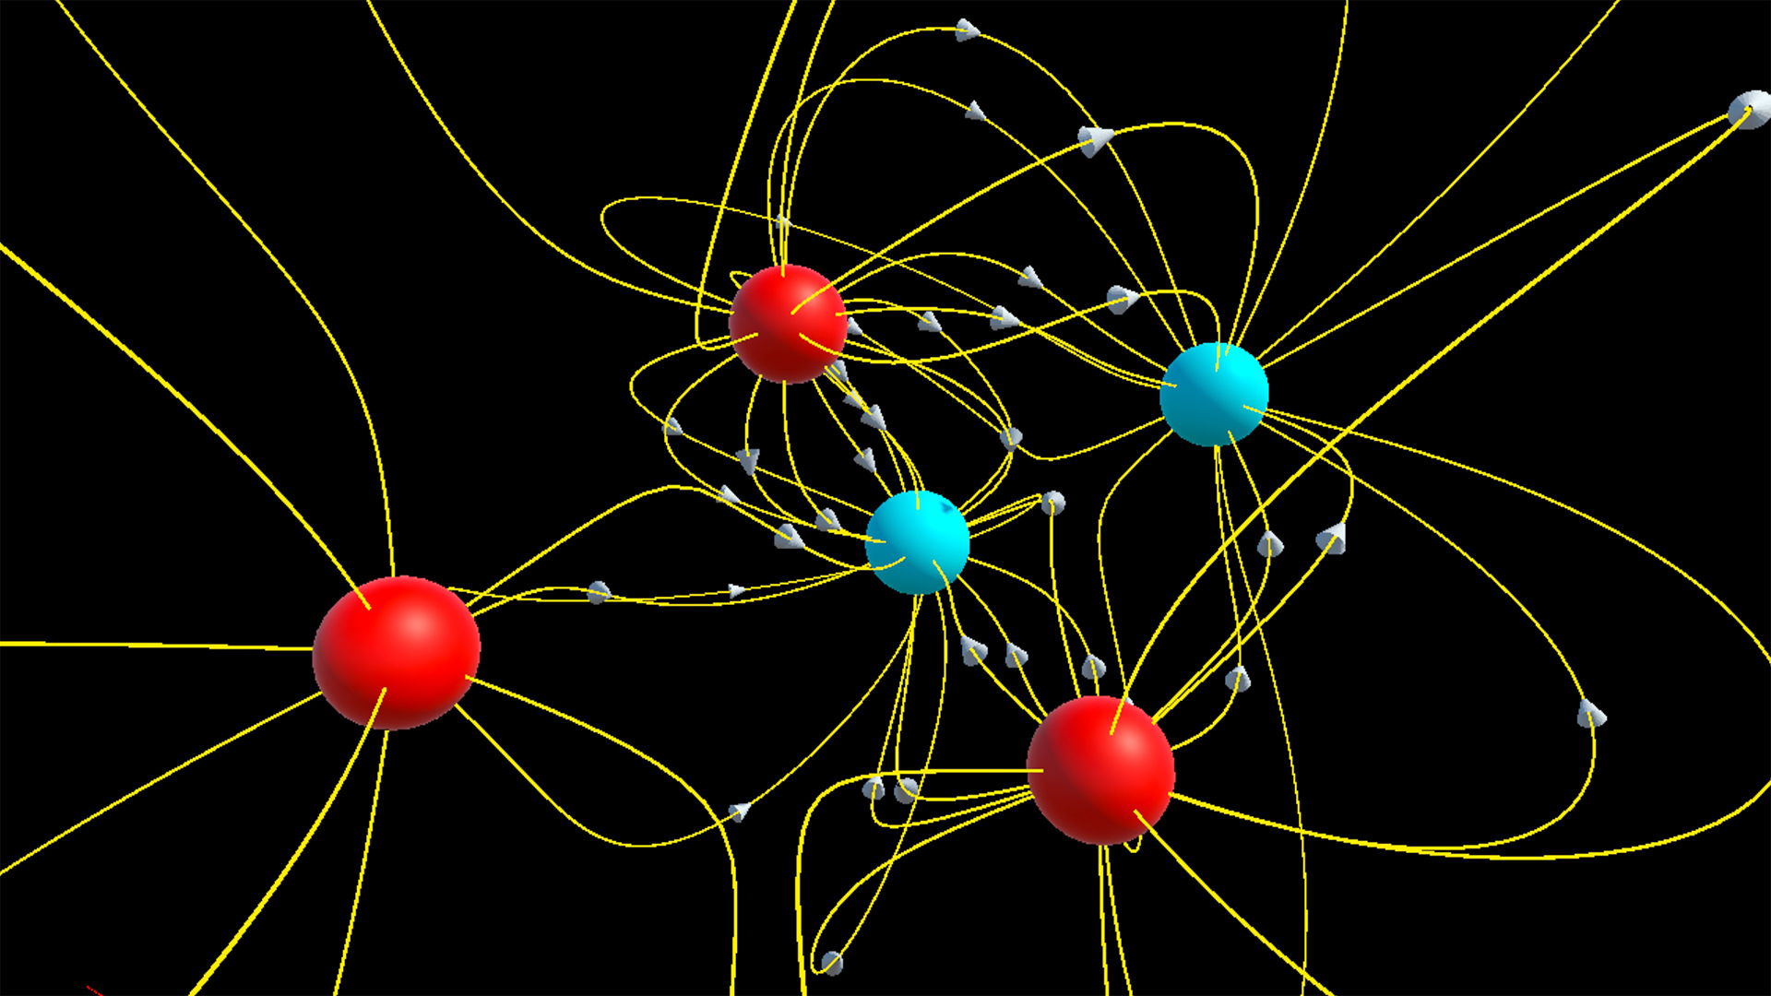
Electric field lines of point charges in VR Fields

Slide 10
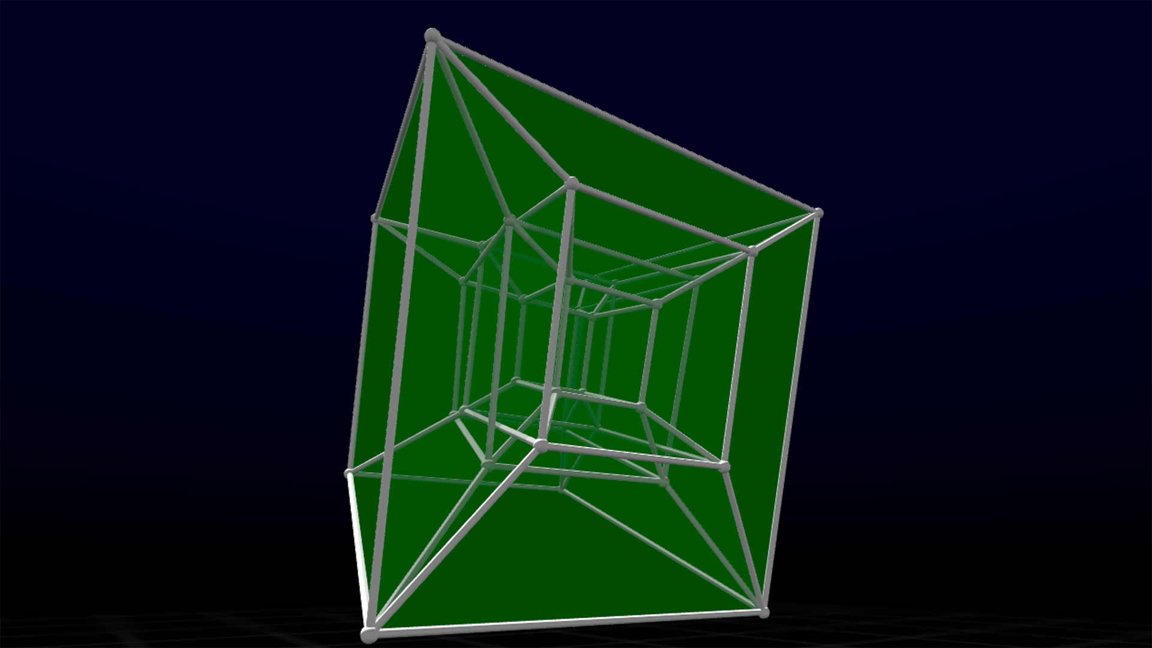
Hypercubes: rotate manually or automatically
(what is D?)

Slide 11
What are the purposes of this workshop?
For us developers:
  A good checkpoint – can we get everything running smoothly?
  Showing demos – user feedback from a semi-expert audience (you!)
  Ideas, stimulated by seeing each others demos and hearing your comments
For the general audience:
  Fun demos today!
  Interesting science and technology presentations and discussions
  Maybe you want to pursue some VR topic you hear about, or something else. My group is a community with a lot of experience that will provide feedback and support you in this.

Slide 12
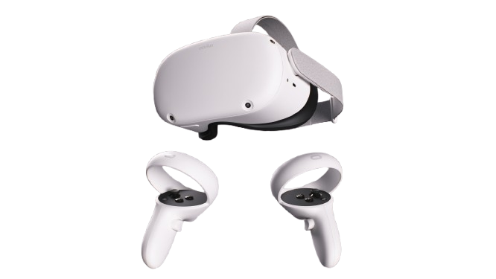
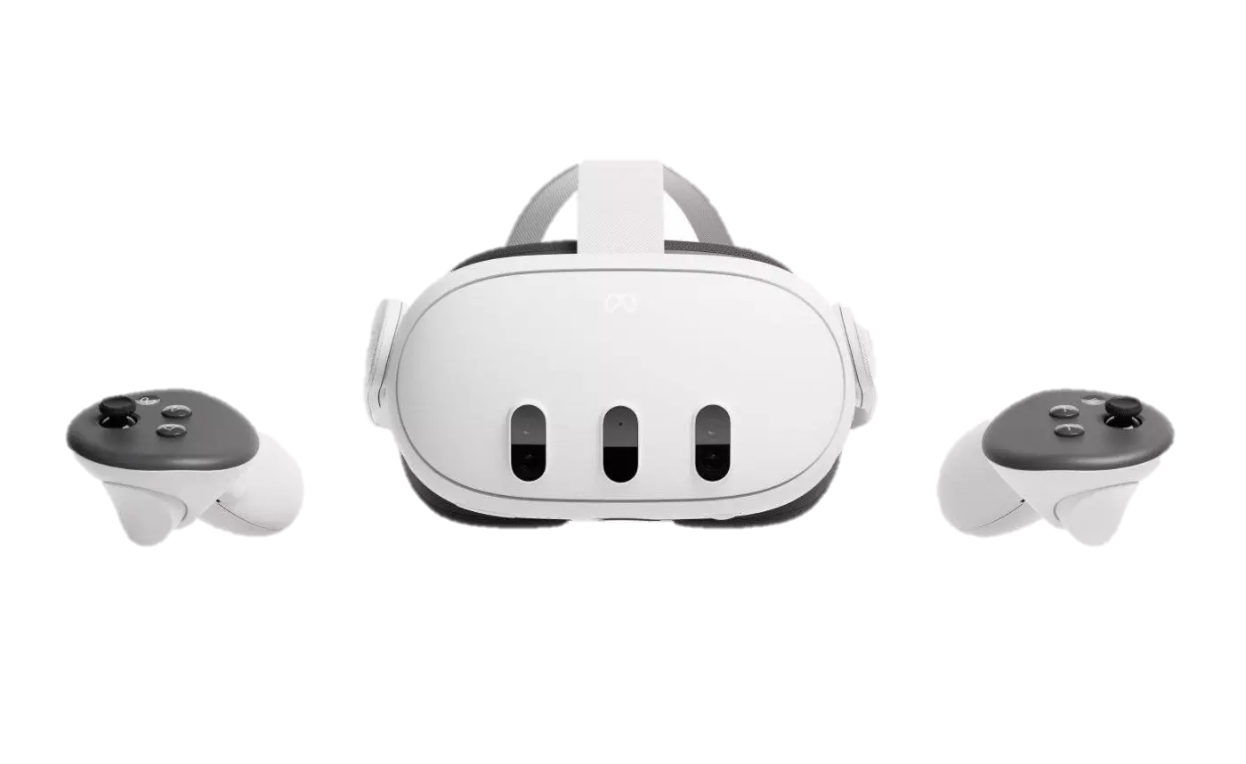
The VR Toolkit
We have developed VR apps (APKs) in Unity – a game development platform with VR features.
To use any APK, the user must have an Oculus headset (Quest 2+) and controllers.
Oculus Quest 3
Oculus Quest 2
Notes:
Add slide numbers

Slide 13
Demo sessions:
There are two ~hour-long demo sessions with 5 stations
We will use 2 stations in this room (left and right front), and 3 stations in the lobby (North, middle, and South)
Demo session #1 is 9:30-10:20 a.m.
  This room: VR Fields, ROOTVR
  PAB lobby: CEDVR, CMSVR, and VR Orbitals
Demo session #2 is 11:20-12:10 p.m. (or so, can run long)
  This room: Hypercubes, ROOTVR
  PAB lobby: Proton decay in Super-K, Dark Matter in liquid Xe, and G4VR
Notes:
Add slide numbers

Slide 14
Talks before demo session #1:
Exploring the CMS Detector and LHC Data with CMS VR and CEDVR (Ansar Iqbal, over Zoom from CERN in Geneva, Switzerland)
Interacting with E and B fields with VR Fields (Rin Fudemberg)
Quantum orbitals in VR (Andrew Douglas)
Scientific multidimensional data displays with ROOTVR (Aryan Mosavian-Pour)
Notes:
Add slide numbers

Slide 15
Talks before demo session #2:
Visualizing particle interactions with matter with G4VR (Benjamin Jobilal)
Simulating proton decay in a Super-K-like detector and visualizing it using G4VR (Trevor Waltersdorf)
Simulating dark matter interactions and visualizing with G4VR (Nicholas Farhadian)
Plans and ideas for future VR development at UCLA (Jay Hauser)
Notes:
Add slide numbers

