Slide 1
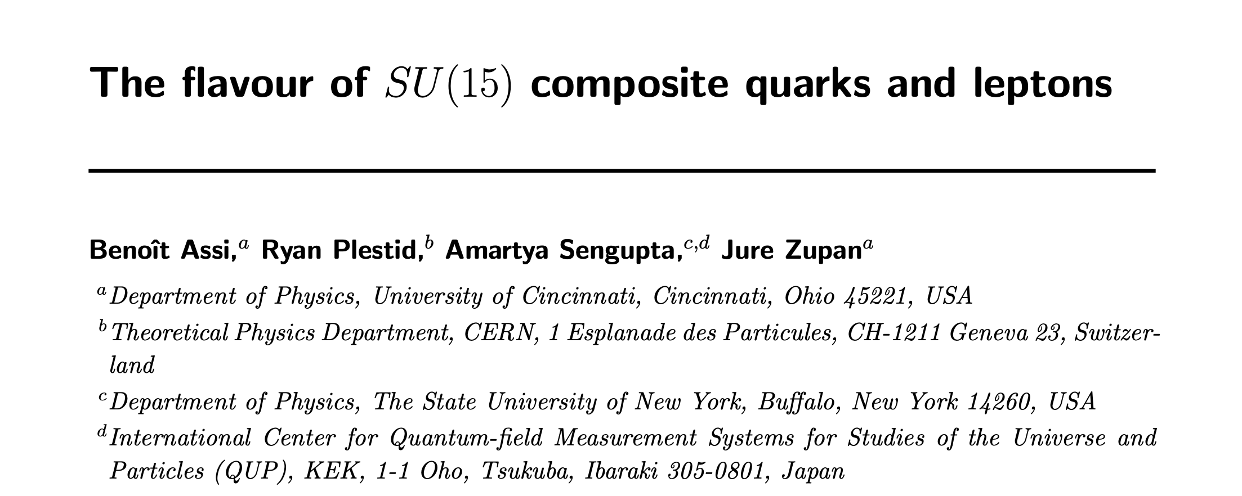





Flavour Probes of Composite Quarks and Leptons
arXiv: 2608.00166
AMARTYA SENGUPTA
Graduate Student - The University at Buffalo, SUNY, USA and Fermilab
COLLABOR AT ORS
BENOIT ASSI, RYAN PLESTID , JURE ZU PA N
HEP Theory Seminar | University of Minnesota Twin Cities, USA | September 25th 2026
1

Slide 2
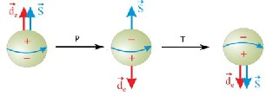
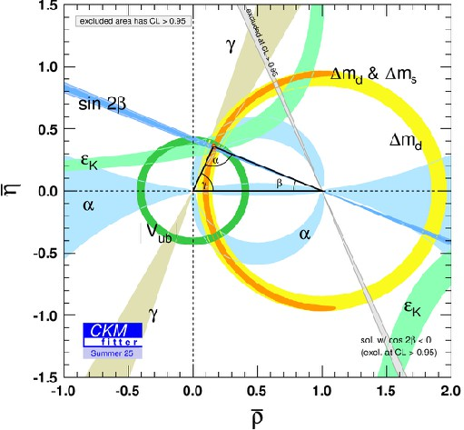
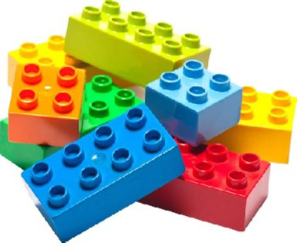
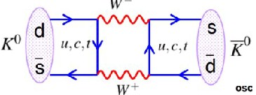


Outline Of Talk
C O M P O S I T E
Q U A R K S A N D L E P T O N S
Y U K A W A S
F L AV O U R P R O B E S
2

Slide 3


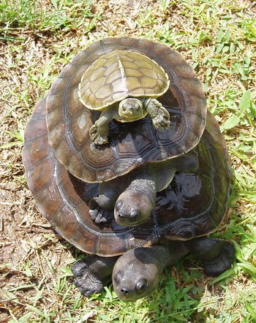
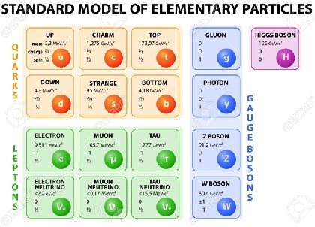


COMPOSITE DYNAMICS
WH AT S A PREON?
YUKA W A STRUCTURE
FITTING THE D ATA
FLAVOUR PHYSICS
PROBING COMPOSITENESS SCALES
3

Slide 4
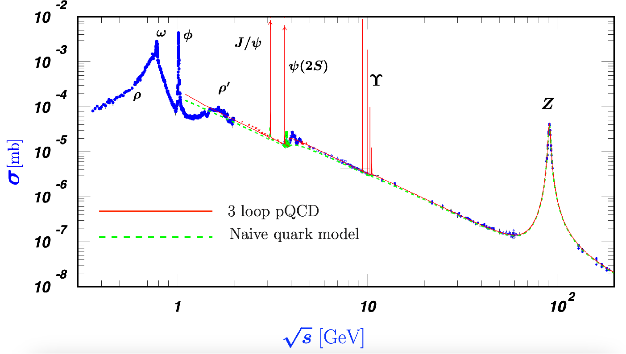


Are Leptons Composite?
Electrons point- like up to at least
~ 100 GeV.
LEP-data
4

Slide 5
Are Leptons Composite?
Particle | Mass | Inverse Radius
Atom | ~10 GeV | ~keV
Nucleus | ~10 GeV | ~100 MeV
Nucleons | ~ 1 GeV | ~ 1 GeV
Pions | ~ 100 MeV | ~300 MeV
Electron ? | ~ 1 MeV | > 1 TeV
Challenge.
Find models with
R⁻¹ ≫ m.
5

Slide 6
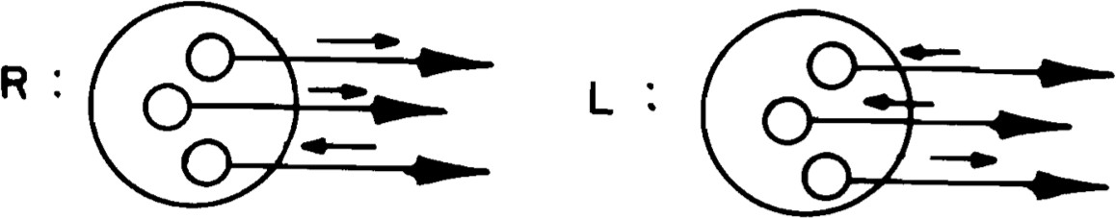
Massless Composite Fermions
Solution was found in 1980 (Dimopolous, Susskind, Raby).
Relies on confining chiral gauge theories.
Main tools: large-N & 't Hooft anomaly matching.
6

Slide 7
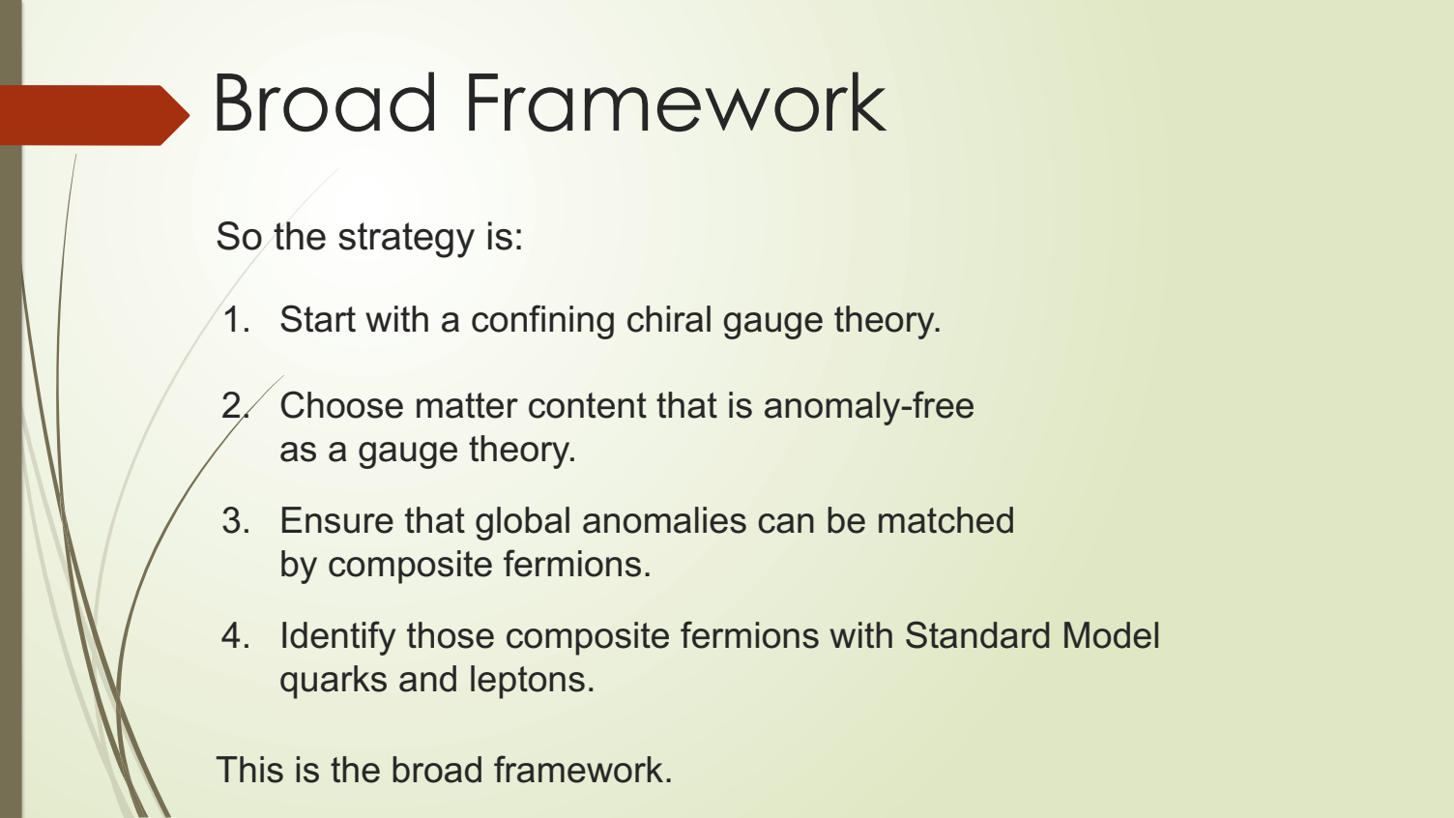

Slide 8

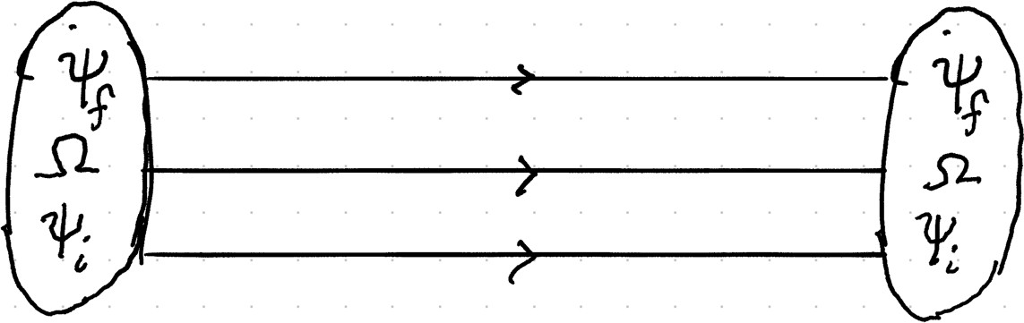
A Specific Class Of SU(N)
N + 4 fundamentals
1 conjugate symmetric
H E A LT H Y T H E O RY
Anomaly free.
't Hooft matching?
Large-N
8

Slide 9
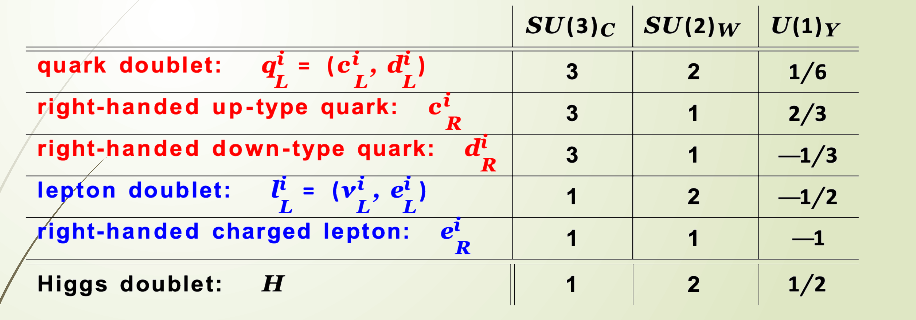
Standard Model
Fermion and scalar gauge charges:
i = 1, 2, 3 labels the fermion generations.
There are 2 × 3 + 3 + 3 + 2 + 1 = 15 fermions per generation.

Slide 10
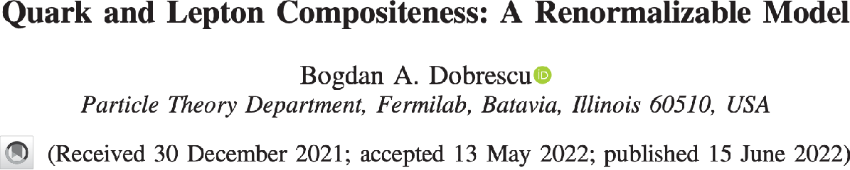

SU(15) Proposal
H E A LT H Y
P L A U S I B L E PAT H T O S M
Anomaly free.
't Hooft matching?
Large-N
10

Slide 11

Fermions As Pre-Baryons
SM-CHARGES
Field | Spin | SU(15)_{p} | SU(3)_{c} × SU(2)_{W} × U(1)_{Y}
ψ_{Q} | 1/2 |  | (3, 2, +1/6)
ψ_{U} | 1/2 |  | (3, 1, −2/3)
ψ_{D} | 1/2 |  | (3, 1, +1/3)
ψ_{L} | 1/2 |  | (1, 2, −1/2)
ψ_{E} | 1/2 |  | (1, 1, +1)
ψ₁, ψ₂, ψ₃, ψ₄ | 1/2 |  | (1, 1, 0)
Ω | 1/2 |  | (1, 1, 0)
Q
∼
(
ψ
Ω
ψ
)
i
Q
i
GAUGE
COUPLINGS
FLAVOUR
c
e
∼
(
ψ
Ω
ψ
)
i
E
i
STANDARD MODEL FERMIONS ARE
"PRE-BARYON" BOUND STATES
SM-SINGLETS
11
Notes:
Scientific content transcribed from the slide image supplied by the user. Orange border includes the SM charges of psi_Q, psi_U, psi_D, psi_L and psi_E. Blue border includes only the final two rows: psi_1 through psi_4, and Omega.

Slide 12
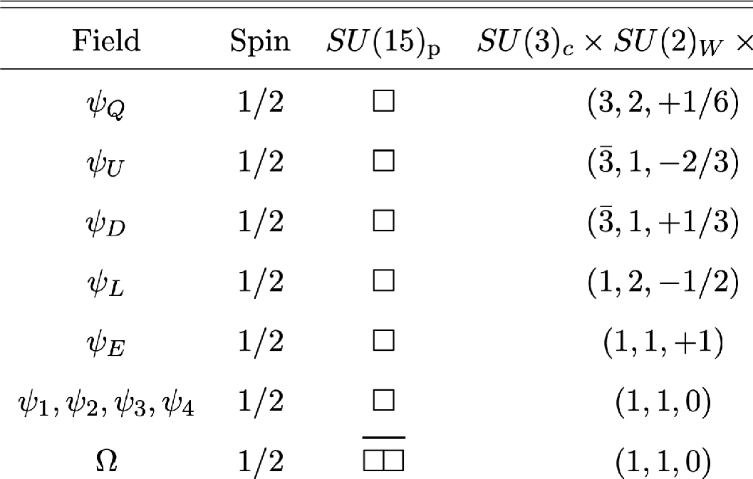
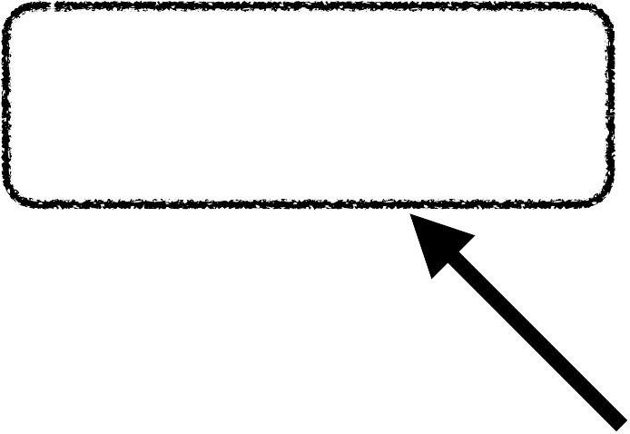
ConnectionTo Flavour
Spontaneous breaking.
SU(4)_{F} → SU(3)_{F}
R E Q U I R E D B Y
A N O M A LY C A N C E L L AT I O N
SU(4)_{F}
11

Slide 13
The Fourth Generation
Vevs will break SU(4)_{F} → SU(3).
There is only one SU(3) (as opposed to the SM's 5).
ϕ
(i)
~ ([QΩψ ] [
ψ Ωψ ])
1/6
i
D L
_{δ}i4
T H I S D E F IN E S T H E
3 - G E N E R AT I O N S O F T H E S M
⟨ϕ^{(i)} ⟩ ≡ φ
1/6
1/6

Slide 14
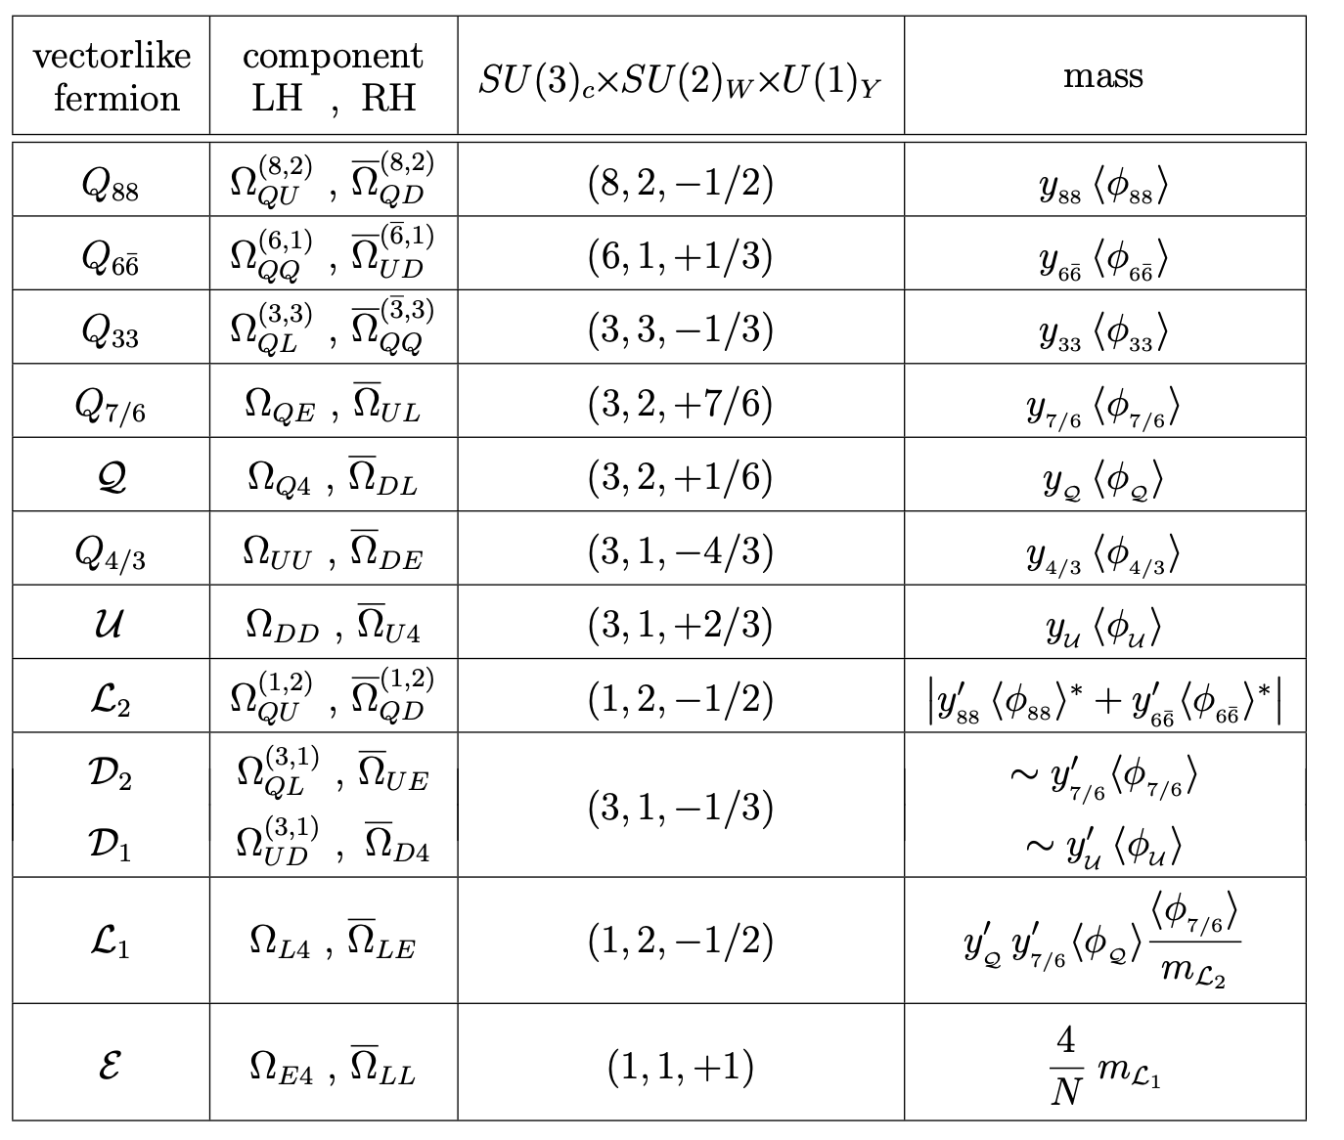
Vectorlike States
Vectorlike fermions arise from SU(4)_{𝐹} breaking, pairing the extra preonic direction into heavy states.
Their masses 𝑚_{𝑉𝐿} ~ y<ɸ> can range from a few hundred GeV to multi-TeV scales.

Slide 15
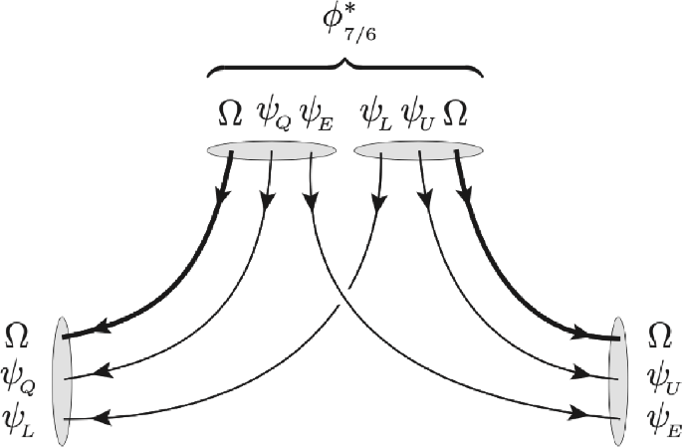
Flavour Breaking VeVs
Model has too many light fermions.
Need SSB to generate Dirac mass terms.
Masses depend on the scalar vevs.
  Creates heavy vector-likes.
  Potential collider signatures.
  Leaves just the 3-SM generations as light.

Slide 16
Flavour Breaking Spurions
Model must contain explicit SU(4)_{F} breaking.
Vev is naturally correlated with direction of explicit breaking.
ℒ ∼ λ^{ij}Aψ_{i}ψ_{j} + λ^{˜ij}A˜ψ_{i}ψ_{j}
    Minimum of two independent spurions for misaligned CKM.

Slide 17
The Higgs Sector
Light Higgs will require fine-tuning (we will live with it).
Attractive binding can produce vevs.
Constituents with QCD + large Yukawa couplings.
H
(34)
~ [QΩψ ] [ψ Ωψ ]
( )
u,d
3 U,D 4
We follow the original paper and assume a 3-4 (top+vector-like) composite Higgs sector (type-II 2HDM).

Slide 18
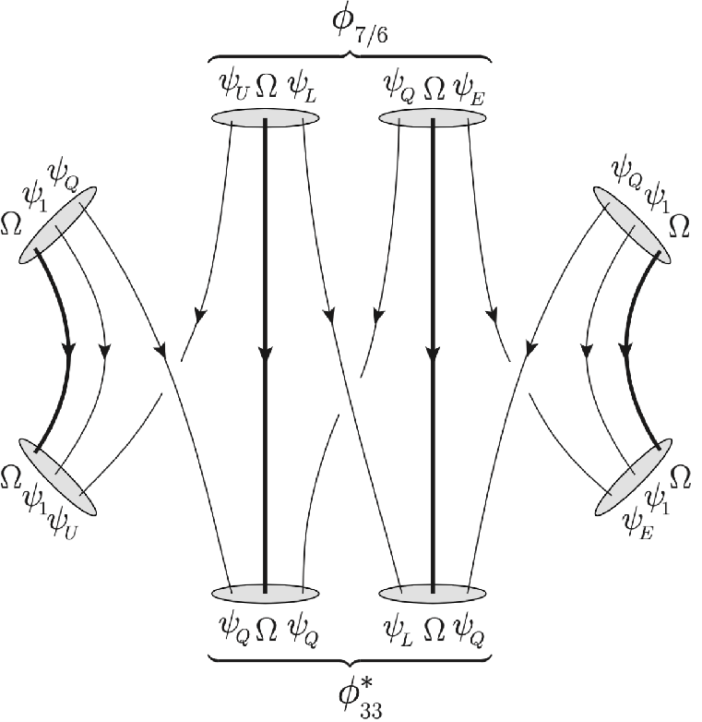
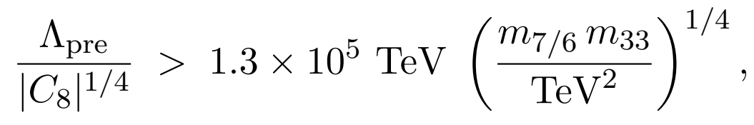
Proton Decay
ASSI, DOBRESCU (2022) ARXI V: 2211.02211
Vevs turn d = 8 scalar matching into d = 6 proton decay.
Controlled by vevs in the theory.
10⁵ TeV → Flavour!

Slide 19
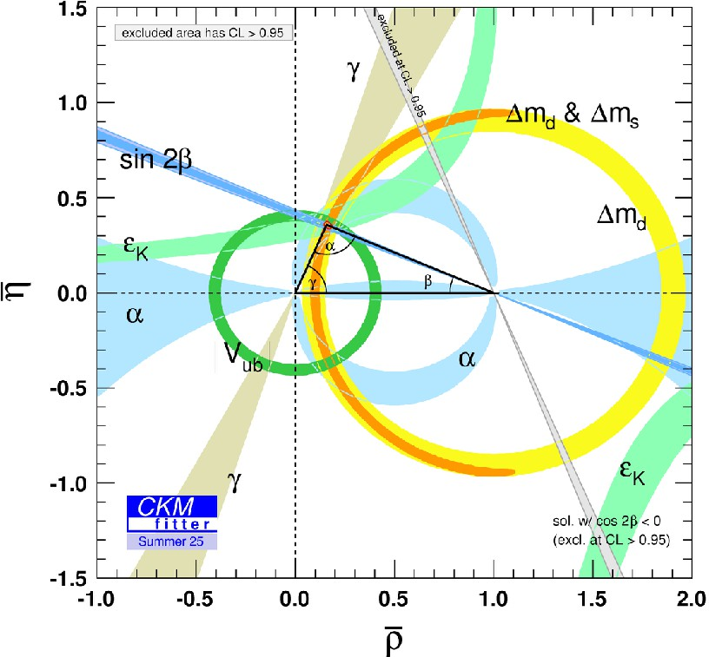
COMPOSITE DYNAMICS
WHATS A PREON?
YUKAWA STRUCTURES
FITTING THE DATA
FLAVOUR PHYSICS
PROBING COMPOSITENESS SCALE

Slide 20
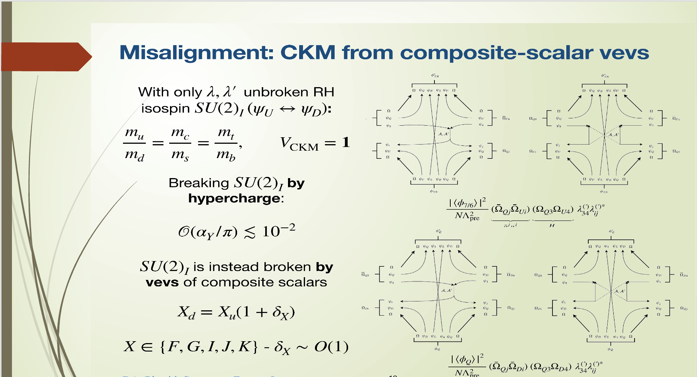



Slide 21
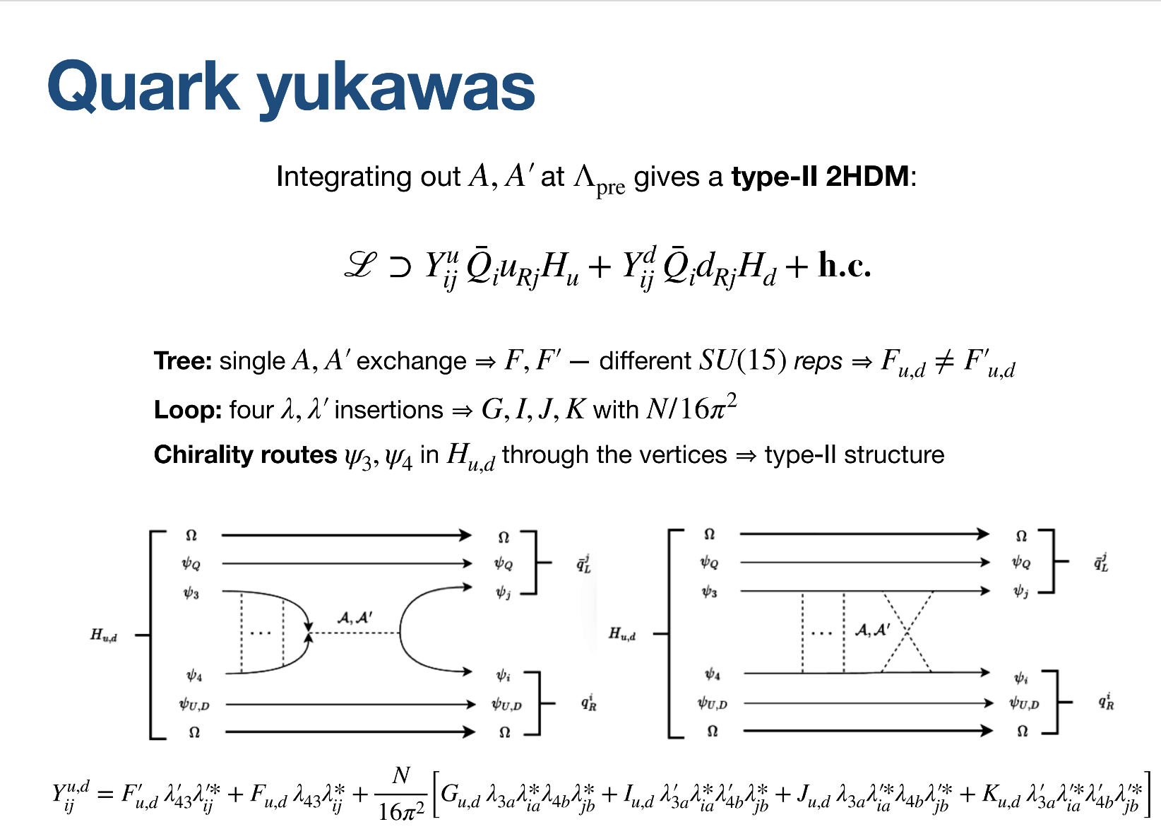
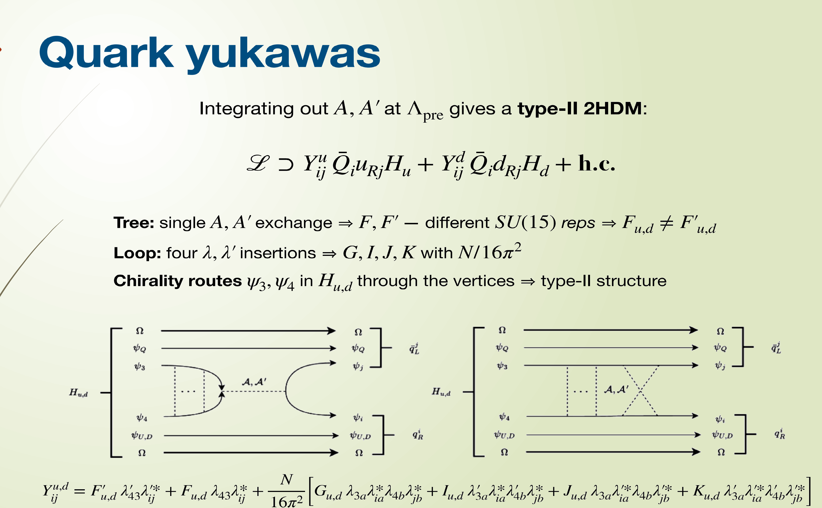

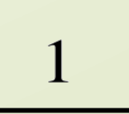

Slide 22
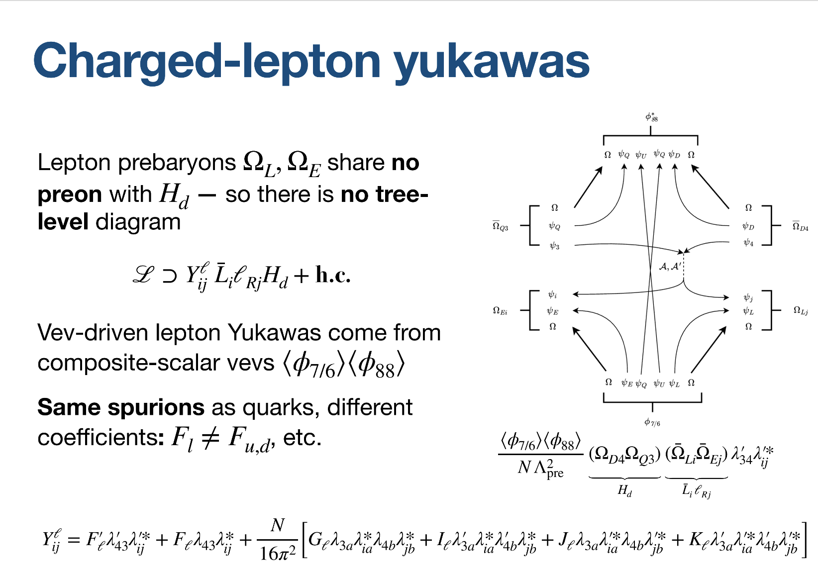
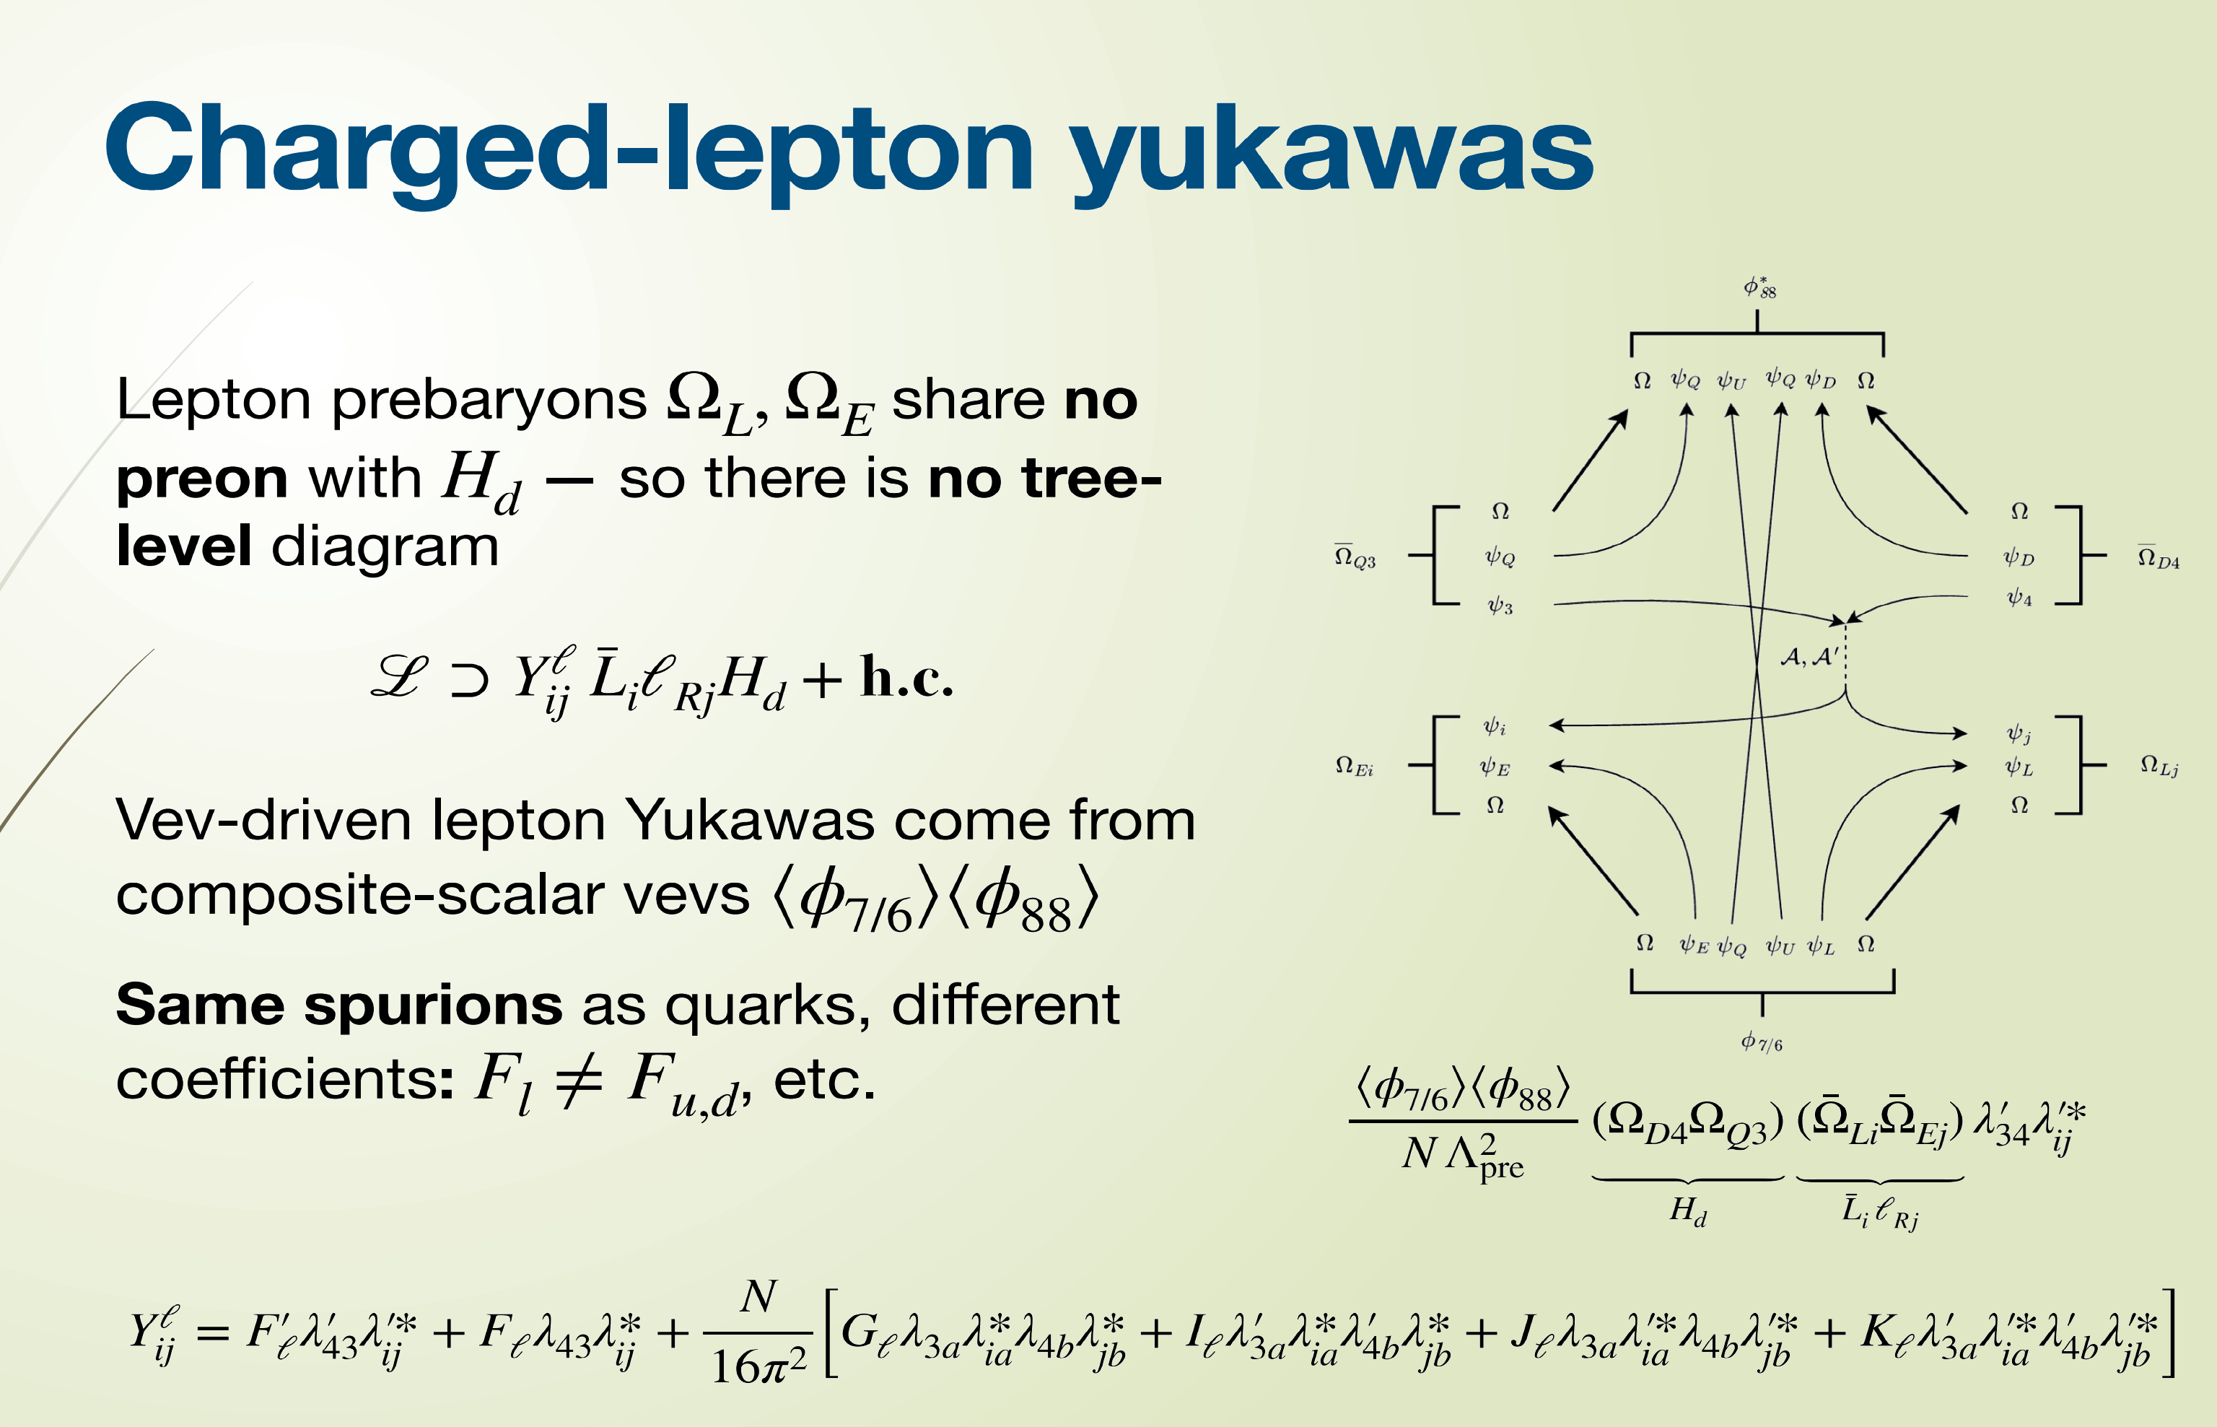
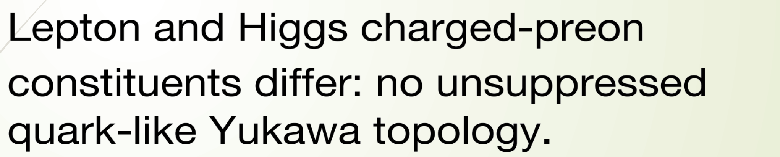
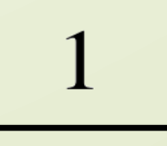

Slide 23
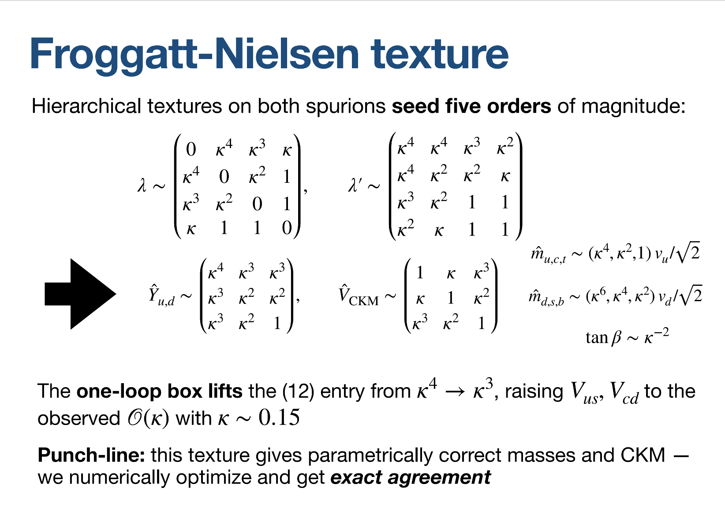
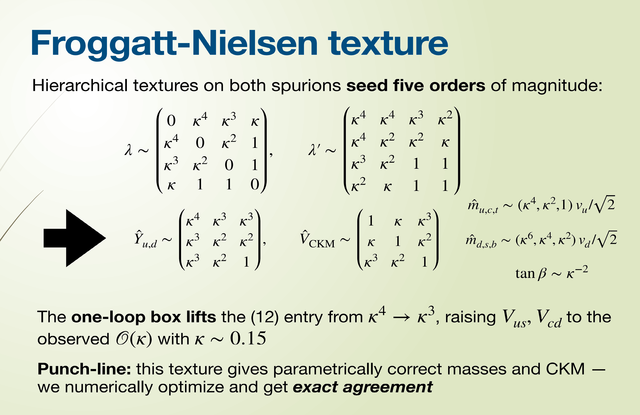

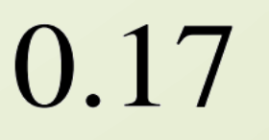

Slide 24
Finding Benchmarks
Demand X_{d} = X_{u}(1 + δ_{X}).
Float non-perturbative matrix elements
|X| ≲ 6
Vev-driven misalignment
|δ_{X}| ≤ 1
Numerical search minimizing loss function.
Yukawas → λ_{ij} , λ˜_{ij} → Flavour Pheno

Slide 25
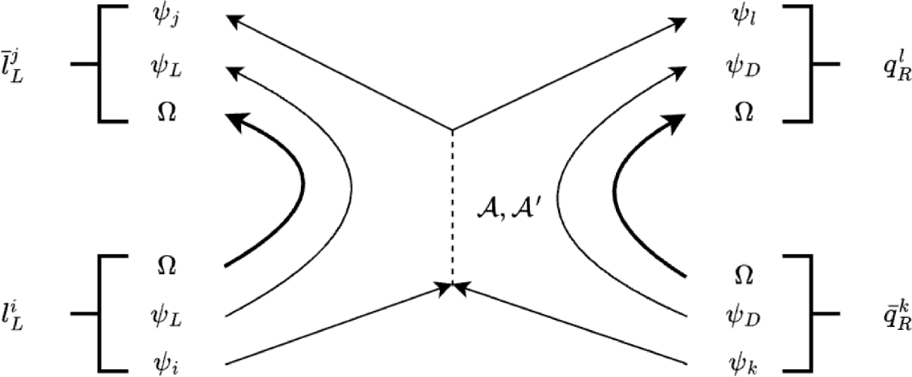



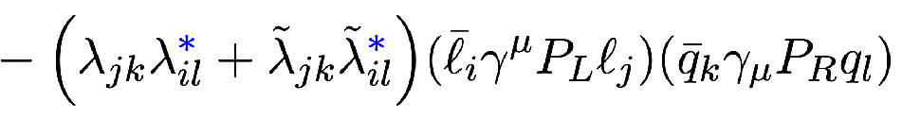
Correlated Flavour Pheno
RH
RO TATION
LH
RO TATION
U_{ℓ}
V_{q}
FITTED SPURIONS

Slide 26


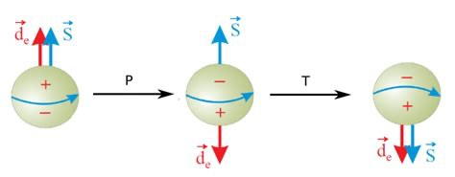
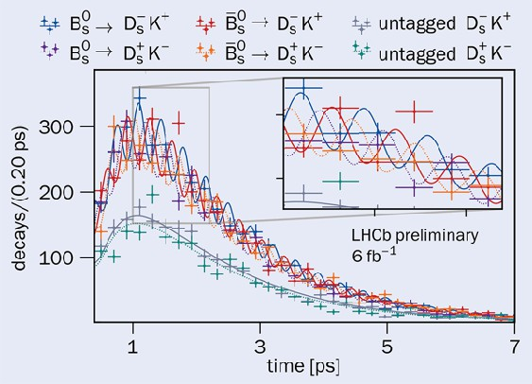
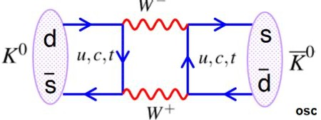

COMPOSITE DYNAMICS
WHATS A PREON?
YUKAWA STRUCTURE
FITTING THE D ATA
FLAVOUR PHYSICS
PROBING COMPOSITENESS SCALES

Slide 27
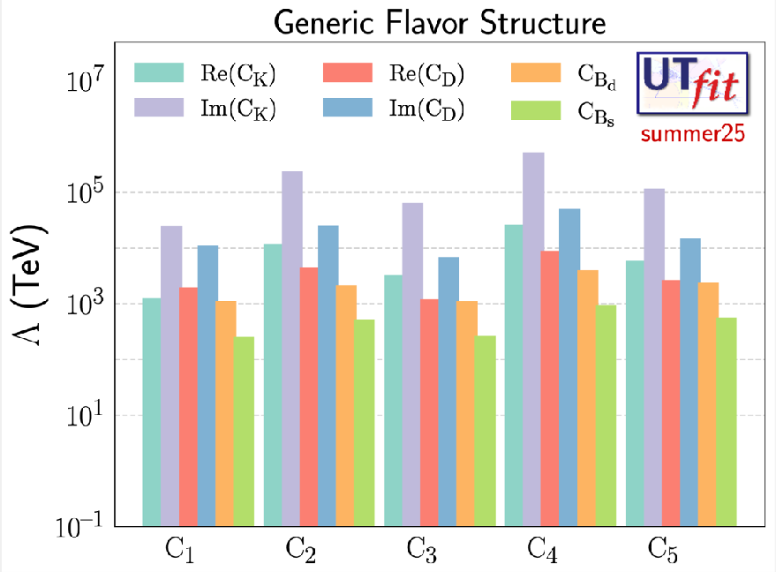
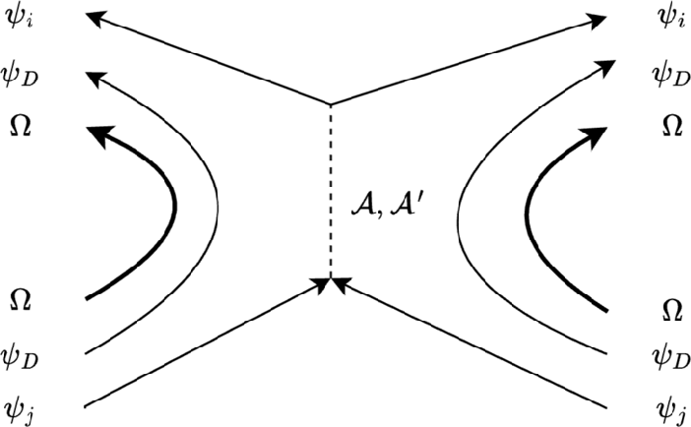
Example: Kaon Mixing
(s¯ªγ^{μ}d_{La})(s¯^{b} γ_{μ}d_{Rb})
L R

Slide 28
Example: Kaon Mixing
(s̄_{L}ª γ^{μ} d_{L}ª)(s̄_{R}^{b} γ_{μ} d_{R}^{b}) = −2(s̄_{R}^{b} d_{L}ª)(s̄_{L}ª d_{R}^{b})
Fierz
O₅

Slide 29

Example: Kaon Mixing
(s̄_{L}ª γ^{μ} d_{L}ª)(s̄_{R}^{b} γ_{μ} d_{R}^{b}) = −2(s̄_{R}^{b} d_{L}ª)(s̄_{L}ª d_{R}^{b})
Fierz
O₅
Λ_{pre} > 8.5 × 10³ TeV

Slide 30
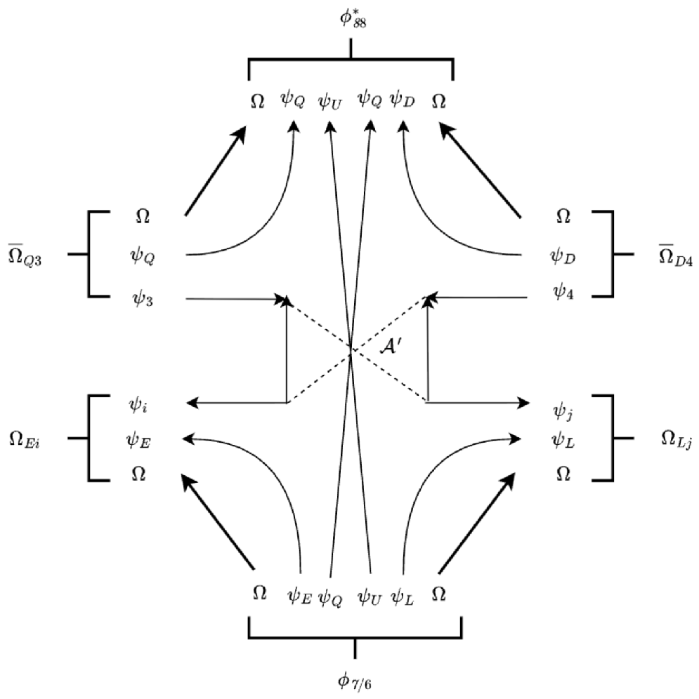

Example: μ → eγ^{(*)}
γ
Same structure as Yukawas.
Different matrix elements.
Misalignment allows transitions.

Slide 31
Example: μ → eγ^{(*)}
γ
Same structure as Yukawas.
Different matrix elements.
Misalignment allows transitions.
μ → eγ: Λ_{pre} > 900 TeV
Projected: 1100 TeV
μ → e conversion
Notes:
Misalignment

Slide 32
Example: Electron EDM
ℒ ∼ [c e¯_{L}σ_{μν}e_{R} + c* e¯_{R}σ_{μν}e_{L]} F^{μν}
−2e⟨H_{d}⟩
d_{e} =
Im[(U_{ℓ}† C_{ℓ}^{γ′} V_{ℓ})₁₁]
Λ_{pre}²
INDEPENDENT DIPOLE MATCHING

Slide 33
Example: Electron EDM
J I L A HfF⁺ 2 2 1 2 . 1 1 8 4 1
|d_{e}| < 4.1 × 10⁻³⁰ e cm ⇒ Λ_{pre} > 9.5 × 10³ TeV
−2e⟨H_{d}⟩
d_{e} =
Im[(U_{ℓ}† C_{ℓ}^{γ′} V_{ℓ})₁₁]
Λ_{pre}²
NO EXTRA UNIVERSAL LOOP FACTOR

Slide 34
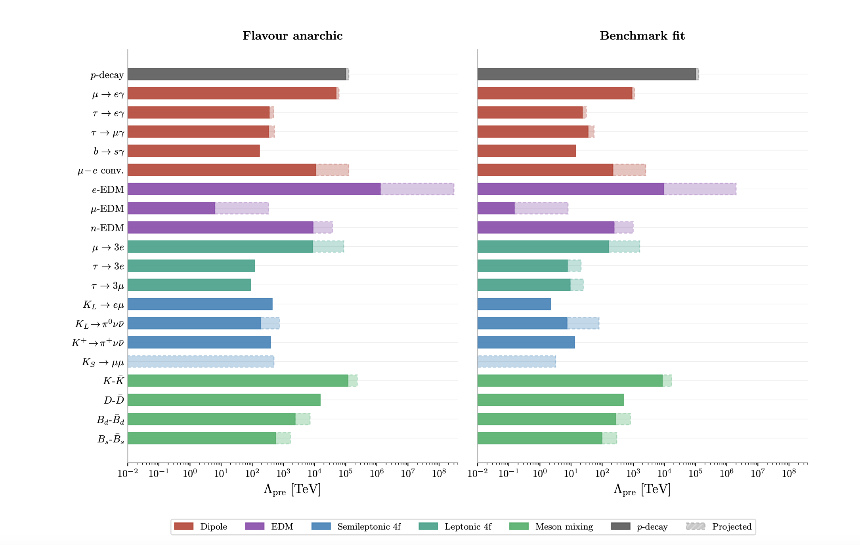
Larger Picture
BENCHMARK IS NOT UNIQUE
ACCOUNTS
FOR YUKA W AS

Slide 35

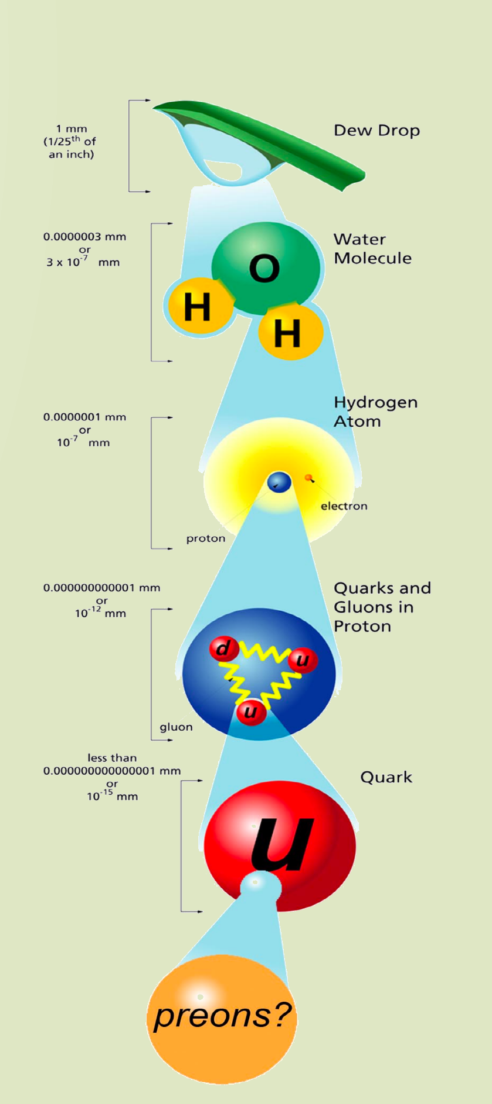
Conclusions and Outlook
Conclusions
A renormalizable framework for composite
quarks and leptons at high energies.
A viable flavour structure, with precision probes
that can compete with proton-decay searches.
Outlook
Derive neutrino masses and the PMNS matrix
within the composite flavour framework.
Study baryogenesis and other cosmological
applications in a follow-up study.
Notes:
Future directions are motivated by the SU(15) composite flavour framework in Assi, Plestid, Sengupta and Zupan, “The flavour of SU(15) composite quarks and leptons,” arXiv:2608.00166.

Slide 36

Thank You and Questions?
39
Notes:
The original sailing photograph and light green background are retained. The title placeholder is replaced with the requested wording: Thank You and Questions?

Slide 37



Anomaly Matching Works!
z_{Ω} = − 19/17z_{ψ}
SU(15)² ⊗ U(1)
285z³ + 120z³
171(2z
+ z )³
ψ
Ω
← U(1)³ →
gravity² ⊗ U(1)
ψ Ω
285z_{ψ} + 120z_{Ω} ←
→ 171(2z_{ψ} + z_{Ω})

Slide 38
Charge Conservation →Gauge Anomaly Cancellation
Gauge symmetries may be broken by quantum effects. Cure: sums over fermion triangle diagrams must vanish.
gauge boson
z _{zz}
z_{zz}
z_{zz}
gauge boson
fermions
z_{z} c
_{cc}c
_{cc}c
gauge boson
_{cc}c
c
Standard Model – anomalies cancel within each fermion generation:
[SU (3)c]² U (1)_{Y} : 2(1/6) + (—2/3) + (1/3) = 0
[U (1)_{Y} ]³: 3 ^{h}2(1/6)³ + (—2/3)³ + (1/3)^{3i} + 2(—1/2)³ + (+1)³ = 0
... (c_{L}, d_{L}) c_{R}^{c} d_{R}^{c} (ν_{L}, e_{L}) e_{R}^{c}
Anomaly cancellation constrains the full spectrum; it does not by itself require compositeness.

Slide 39
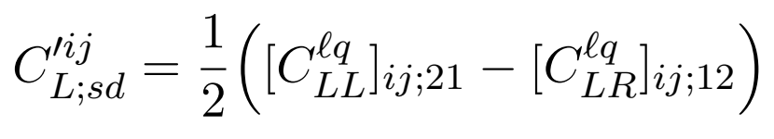
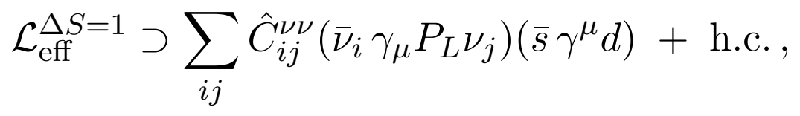
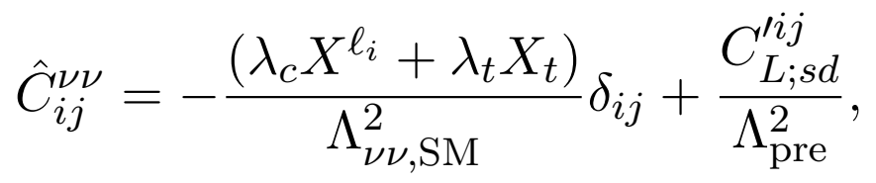
Example: K→ πνν
SM + NP; all neutrino flavours; single exchange + boxes
Λ_{pre} > 13 TeV (K⁺)
Λ_{pre} > 7.4 TeV (K_{L})
PAPER BENCHMARK

Slide 40
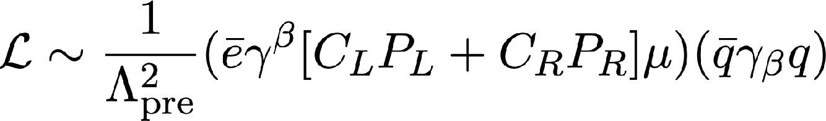
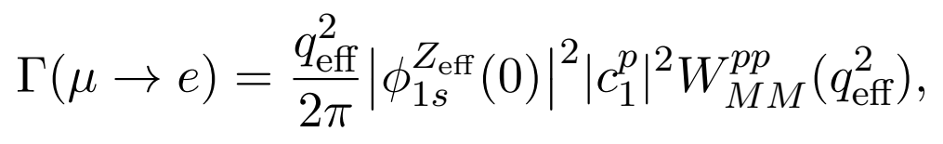
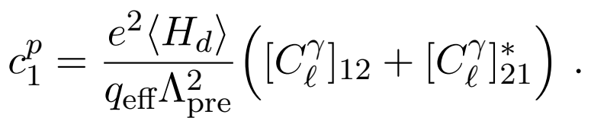
µ→e Conversion
Related:
Benchmark: dipole dominance
Subleading four-fermion contribution
Λ_{pre} > 220 TeV (Ti)
Al: 2500 TeV projected
PAPER BENCHMARK

Slide 41
