Slide 1
Status Degradation Study
29.09.2026
Collection of what has happend and what needs to still happen
Martin Weber

Slide 2
What was done
[ACL production introduction (mirror, glue, coating)]
Light feedthrough tests
Vacuum test
Sensor Setup (integration into influxBD and Grafana)
Light readout data acquisition
Darkbox light tightness test
Preliminary Argon flow tests
Darkbox test (SiPMs and pulser LEDs)

Slide 3
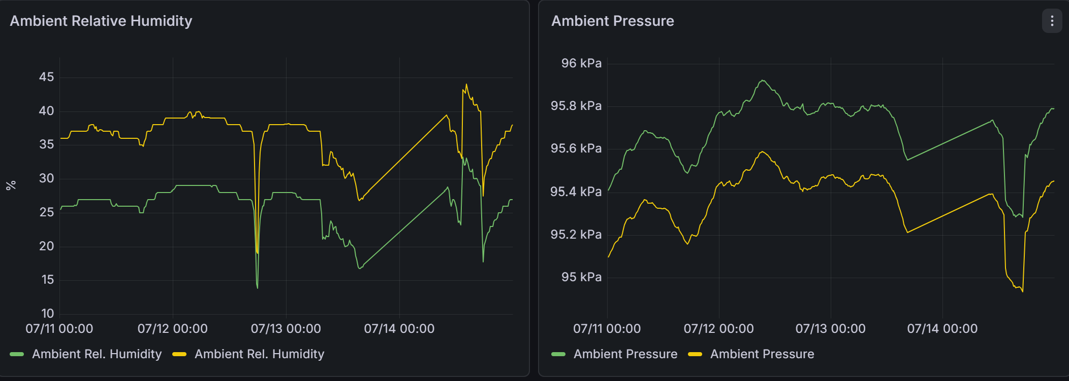
What I still want to do (experimentally)
Sensor Calibration (ongoing)
  Anticipate differences between ambient and Argon atmosphere.
  Incorporate calibration into Arduino code.
  Calculate partial water pressure and automate reading (Grafana, Influx?)

Slide 4
What I still want to do (experimentally)
In depth vacuum chamber test
  (Vacuum leak test: pull vacuum with sensors and let sit for a period of time)
  Quantified Argon leak test: pull vacuum, flush with Argon, adjust argon flow meter to keep humidity (temperature and pressure) stable. Quantify Argon usage

Slide 5
What I still want to do (experimentally)
First “degradation” test
  Two equally good Arclights, both into darkboxes, one in Argon the other in ambient.
  Leave in boxes with periodic measurements via in situ pulser LEDs (how long?)

Slide 6
What I still want to do (experimentally)
Full / partial scale degradation study
  4 or 5 similar Arclights, Degradation UV running, periodic measurements with in situ pulser LEDs, full 2D measurement after study
  Length? Most degradation happens at the beginning.

Slide 7
Thesis
Introduction into DUNE
SiPMs + Sensors
  Theory
  Calibration
Experimental Setup
  Idea, Build, Data acquisition, Tests
Degradation Study
  Experiment
  Analysis

Slide 8
Timeframe
Due date end November!!!

