Slide 1

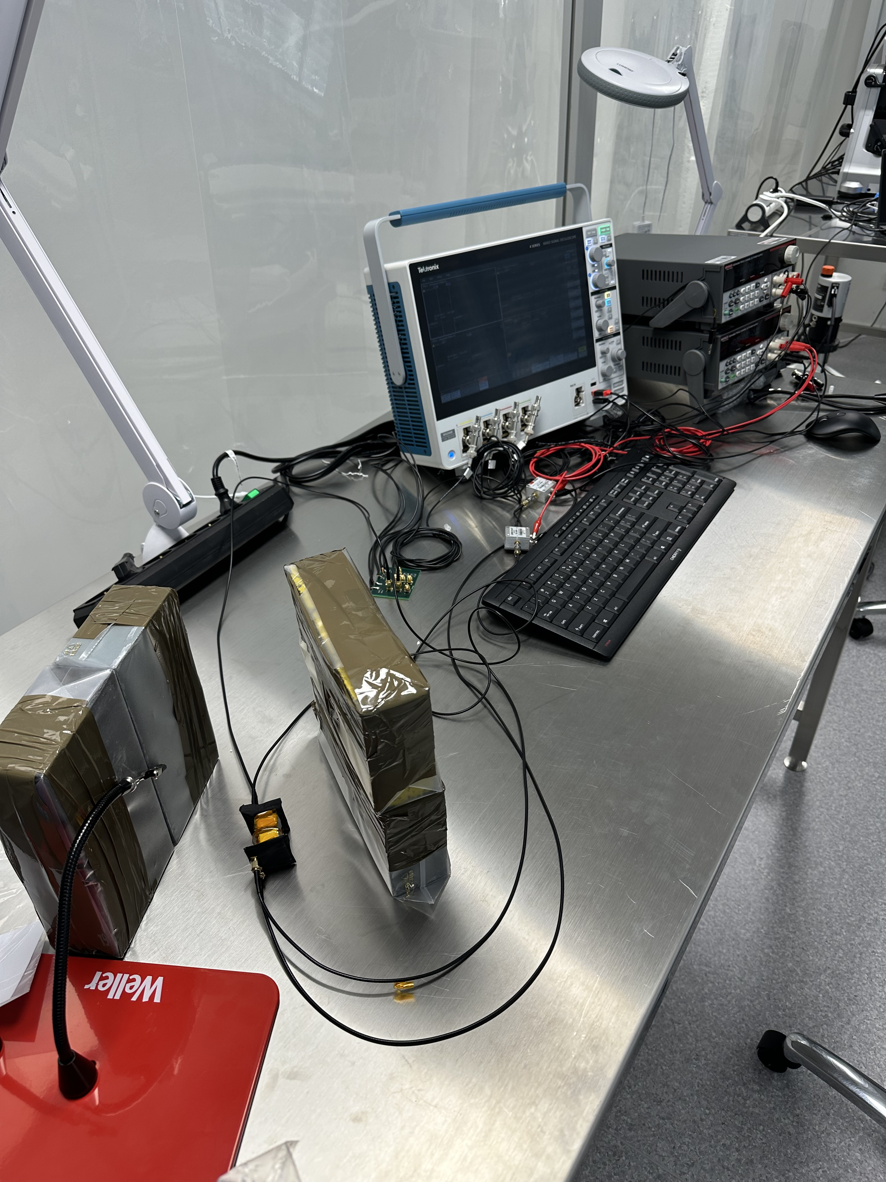
Study of the performance of polystyrene-based plastic scintillators
Bachelor Thesis Colloquium
Ira Schneider
29.09.2026, Hamburg
Experimental setup with two detectors and ¹³⁷Cs

Slide 2
Table of contents
Introduction
Background
Experimental Setup and Data Collection
Analysis and Results
Conclusion
Notes:
-first have-and
-then want to talk about
-in next section want to describe how
-finally

Slide 3
Introduction
Study of polystyrene-based plastic scintillators using a radioactive source
  Allow assembly of inexpensive detectors with a fast response time and high resolution
Characterization of the single-photon response
Study of the Compton edge position of ¹³⁷Cs
Study of signal correlations in two detectors
Notes:
-of interest
-three setups that I used to first, second, third
-find position with cs

Slide 4
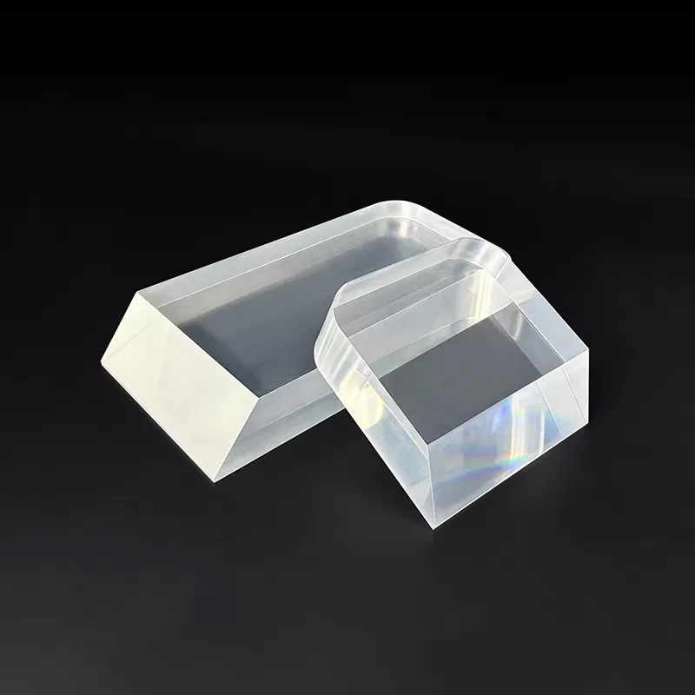
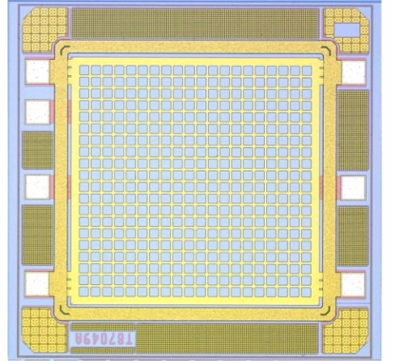
Background
2
Plastic scintillators from [1]
SiPM schematic from [2]

Slide 5
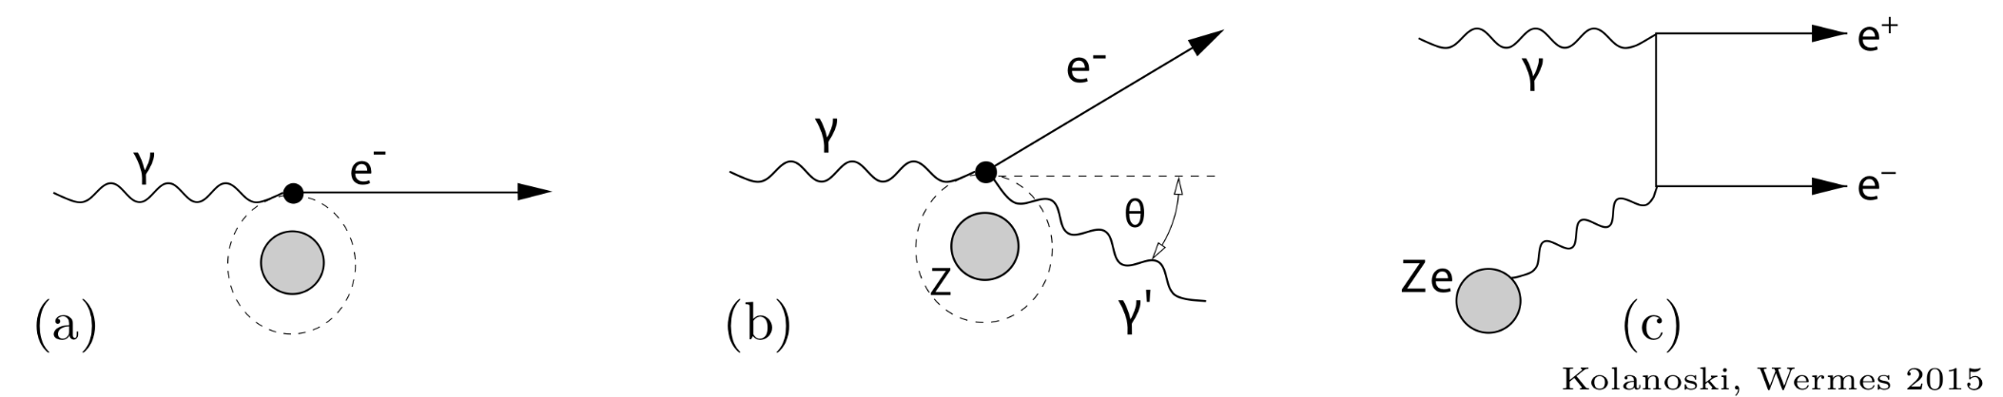
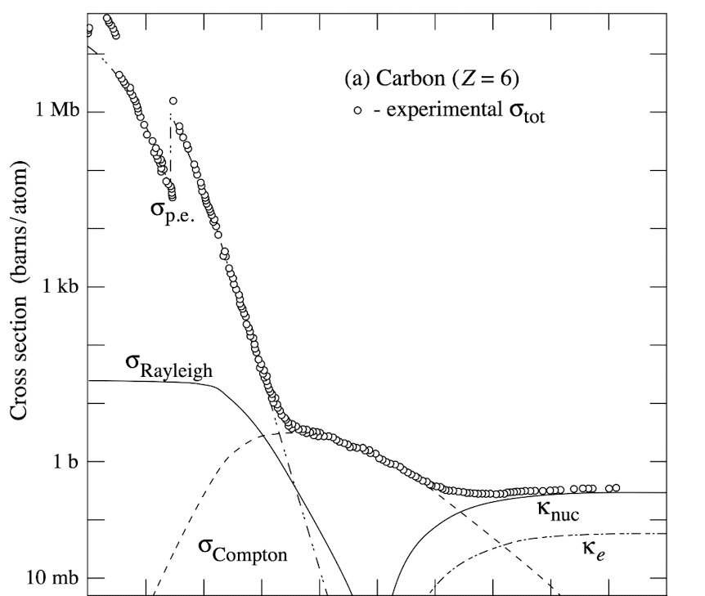
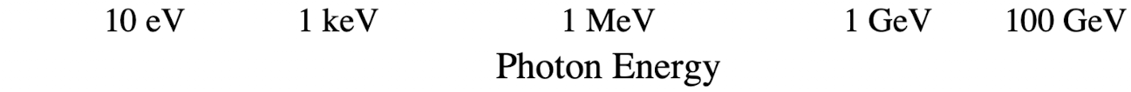
Photon Interaction with Matter
Photoelectric effect (a)
  Entire energy from photon transferred to electron
  Up to tens of keV
Compton scattering (b)
  Photon scatters off a practically free electron
  In the hundreds keV to few MeV range
Pair production (c)
  Photon converts into electron-positron pair
  In the MeV range, at minimum larger than two electron masses
Feynman diagrams from [3]
Cross section for Carbon Z=6 from [3]
Notes:
-there are three of more interest
-Typically becomes relevant in the range
-orbital, generally quasi free electrons
->occurs when photon energy significantly larger than binding energy

Slide 6
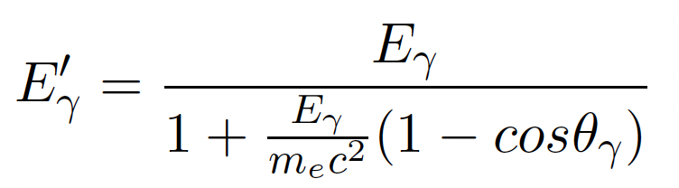
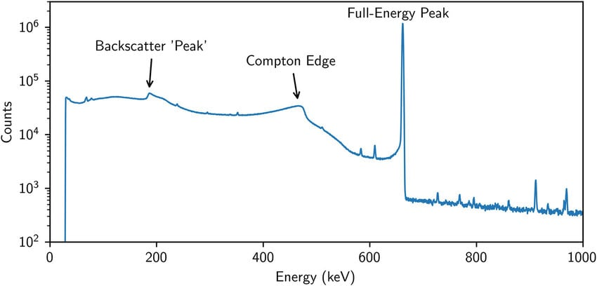
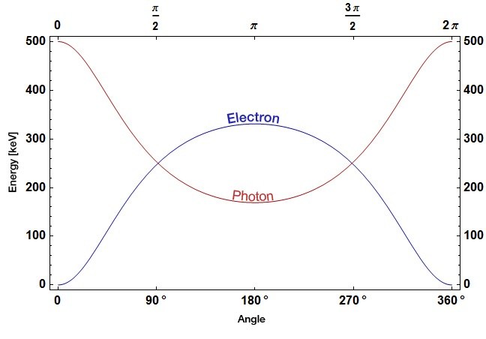
Compton Scattering
Energy after scattering depends on scattering angle:
Maximum energy deposition for a 180° scattering angle
  Causes Compton edge in the energy spectrum
Second order Compton edge: Photons scatter with a 180° angle twice
¹³⁷Cs spectrum from [4]
Energies of photon and electron after scattering from [5]
Notes:
-energy transfer during compton scattering depends on scattering angle
-CE of Cs: 477 keV
-full-energy peak: deposition of full gamma energy through photoelectric

Slide 7
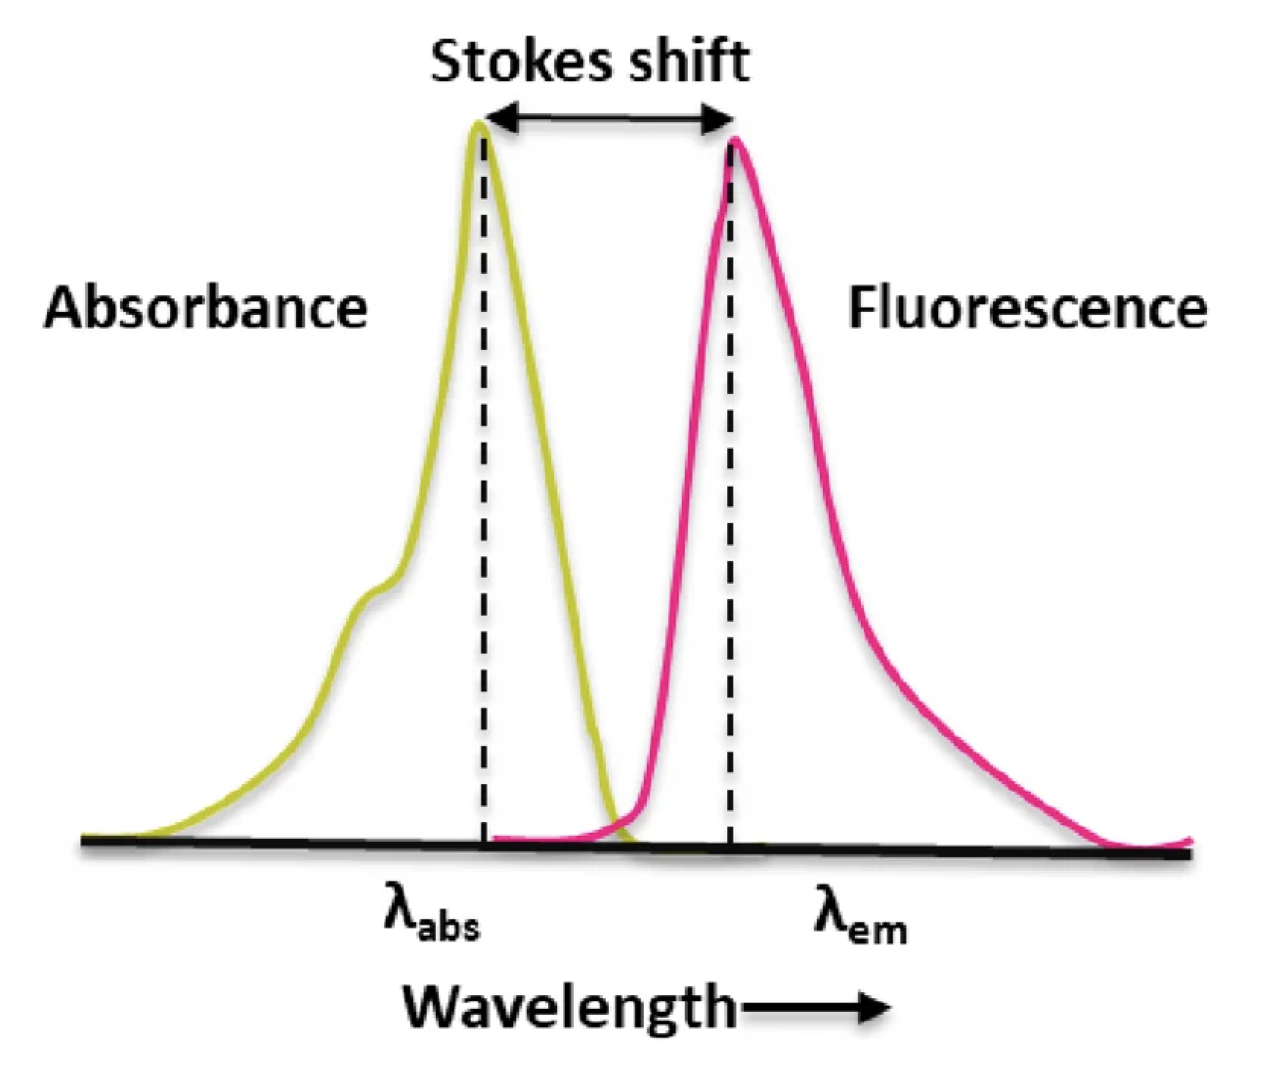
Scintillating Materials
Scintillation: Luminescence caused by ionising radiation
Example: charged particles/γ-rays cause excitation of molecules
  De-excitation by emitting photons
Reabsorption of emitted photons surpressed by Stokes shift
Plastic scintillators:
  Solvent , slow scintillator
  Additives, faster scintillation and wavelength shift
  Fast signals, inexpensive, wide variety forms
  Typical combination: PVT, p-terphenyl, POPOP
Stokes-shift from [6]
Notes:
-emitted photons, scintillation light
-stokes: energy difference between energy levels is smaller during emission, causes longer wavelength of photon
-PVT: polyvinyl toluene
-POPOP: 1,4-bis(5-phenyloxazol-2-yl) benzene, wavelength shifter
-typically fast decay time of 2-3 ns

Slide 8
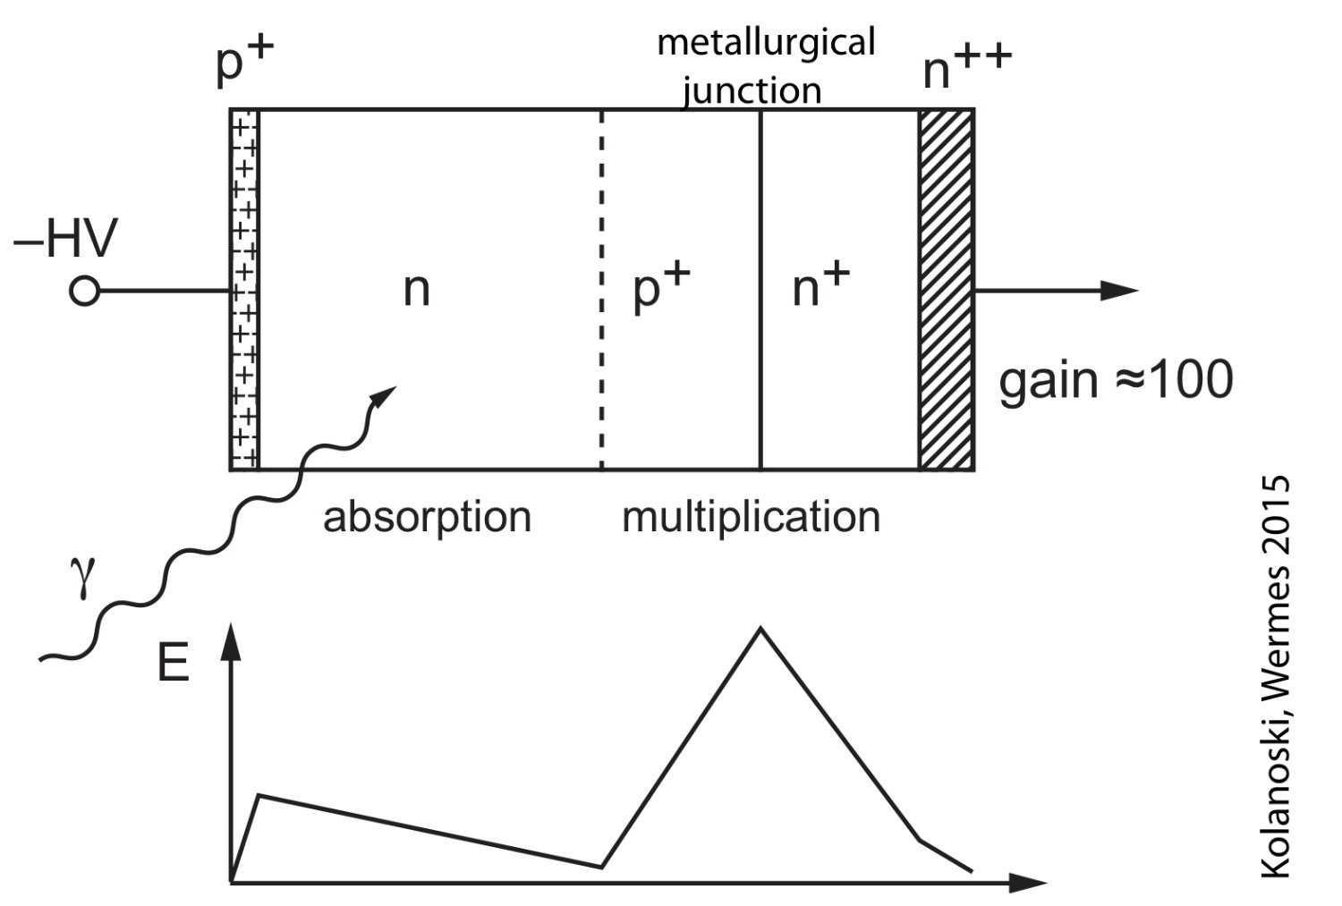
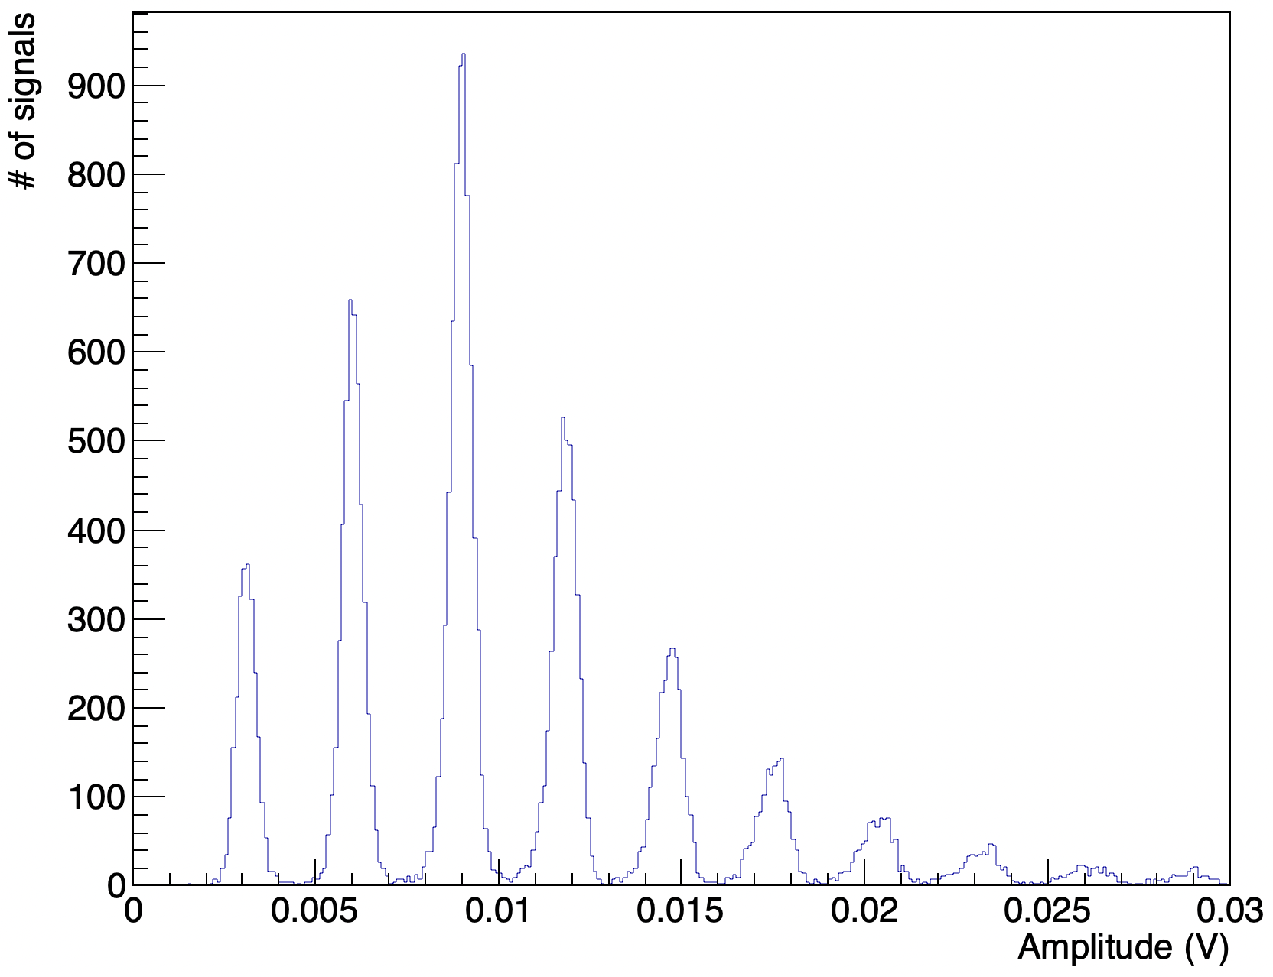
Silicon Photomultipliers
Array of Avalanche Photodiodes:
  Photon absorped and creates charge carriers
  Electrons are accelerated in electric field and create an avalanche through ionization
APDs operated in photon-counting mode:
  Operated at a voltage high enough for every photon to cause a self-sustaining avalanche
Single-photoelectron spectrum: separation and distance between peaks of the spectrum describe single-photon resolution
Schematic structure of an APD from [3]
SPE spectrum example
Notes:
-in SiPM APDs are operated in photon counting mode
-the amplitude distribution obtained by detecting very small quantities of light is SPE
->where first peak corresponds to
->the better these peaks are seperated, the better the single res of SiPM
-avalanche influences charge on electrode, causes it to detect electric charge
-self-sustaining: does not matter how many charge carriers initially created, APD emits a signal either way
->number of APDs that emit signal is proportional to detected photons
-pedestal: electronic noise, is for SiPM much larger than fluctuations during each avalanche (which influences actual pe peak width in addition to electronic noise)
->that’s why SNR can be used to determine single photon resolution

Slide 9
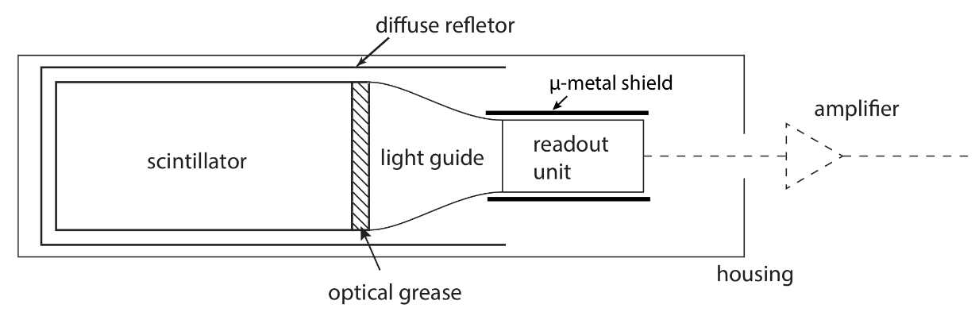
Detector Structure
Four main components:
  Scintillator: converts deposited energy into photons, wrapped in light-reflective material
  Light guide: reduces loss of photons for detectors with incompatible scintillator and Photodetector window geometries Or wavelength shifter: if photodetector cannot detect scintillation light wavelength
  Photodetector: converts photons into electrons, emits an electric signal
  Amplifier: in case of low output signals
Optical grease with similar refractive index to components for optical coupling and light-tight wrapping
Schematic structure of a scintillation detector from [5]
Notes:
-compare own
-geometry was compatible
-used amp

Slide 10
Experimental Setup and Data Collection
3

Slide 11
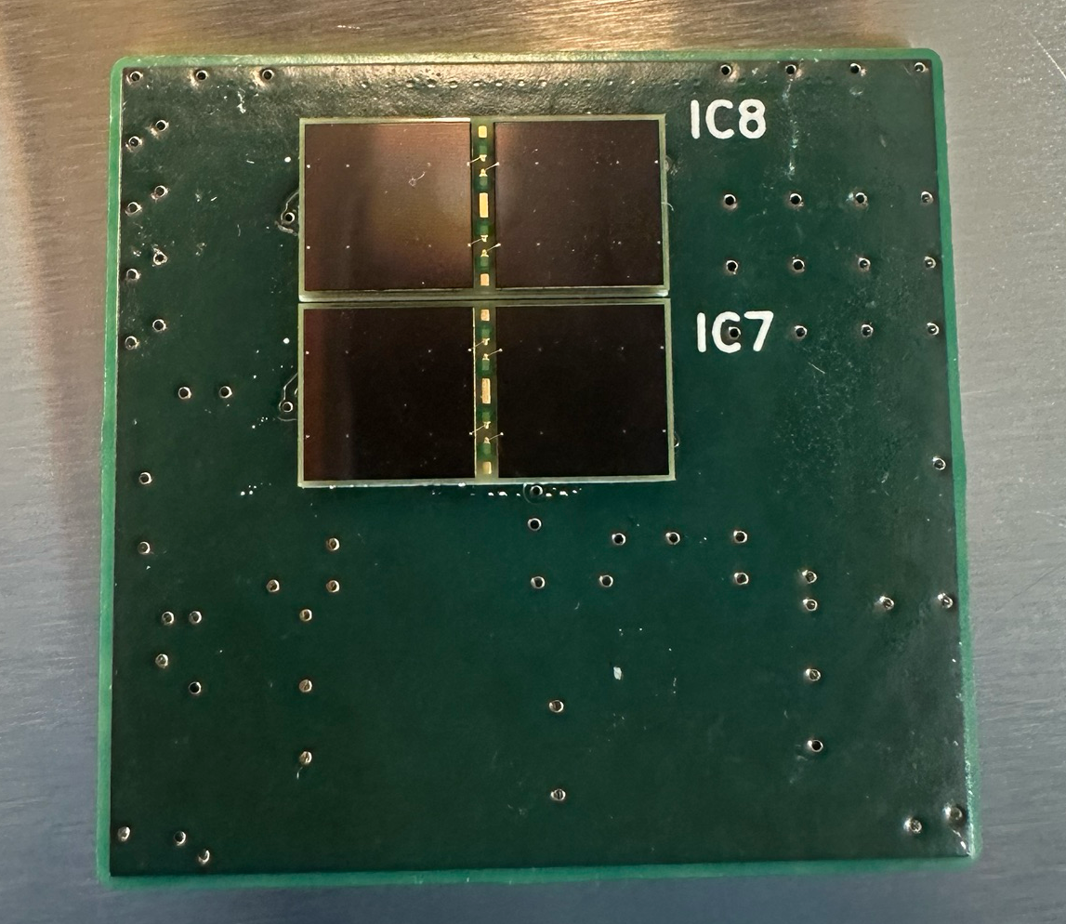
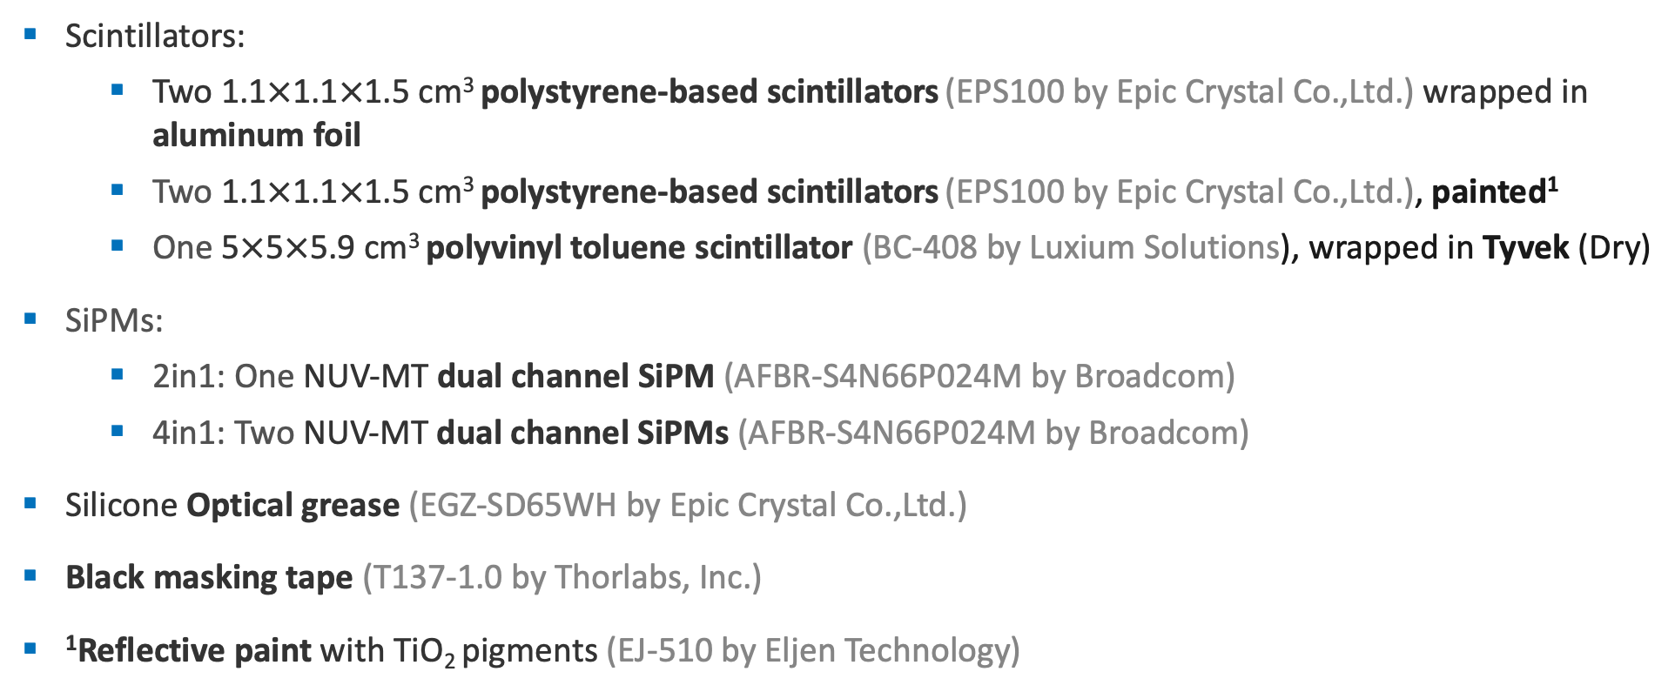
Detector information
Scintillators:
  Two 1.1$×$1.1$×$1.5 cm³ polystyrene-based scintillators (EPS100 by Epic Crystal Co.,Ltd.) wrapped in aluminum foil
  Two 1.1$×$1.1$×$1.5 cm³ polystyrene-based scintillators (EPS100 by Epic Crystal Co.,Ltd.), painted¹
  One 5$×$5$×$5.9 cm³ polyvinyl toluene scintillator (BC-408 by Luxium Solutions), wrapped in Tyvek (Dry)
SiPMs:
  2in1: One NUV-MT dual channel SiPM (AFBR-S4N66P024M by Broadcom)
  4in1: Two NUV-MT dual channel SiPMs (AFBR-S4N66P024M by Broadcom)
Silicone Optical grease (EGZ-SD65WH by Epic Crystal Co.,Ltd.)
Black masking tape (T137-1.0 by Thorlabs, Inc.)
¹Reflective paint with TiO₂ pigments (EJ-510 by Eljen Technology)
4in1 SiPM
Notes:
-five scint
-five sipm
-ps: 423
-pvt:425 nm
-sipm: peak at 420 nm
-two with reflective paint
-one with tyvek dry 90% reflection

Slide 12
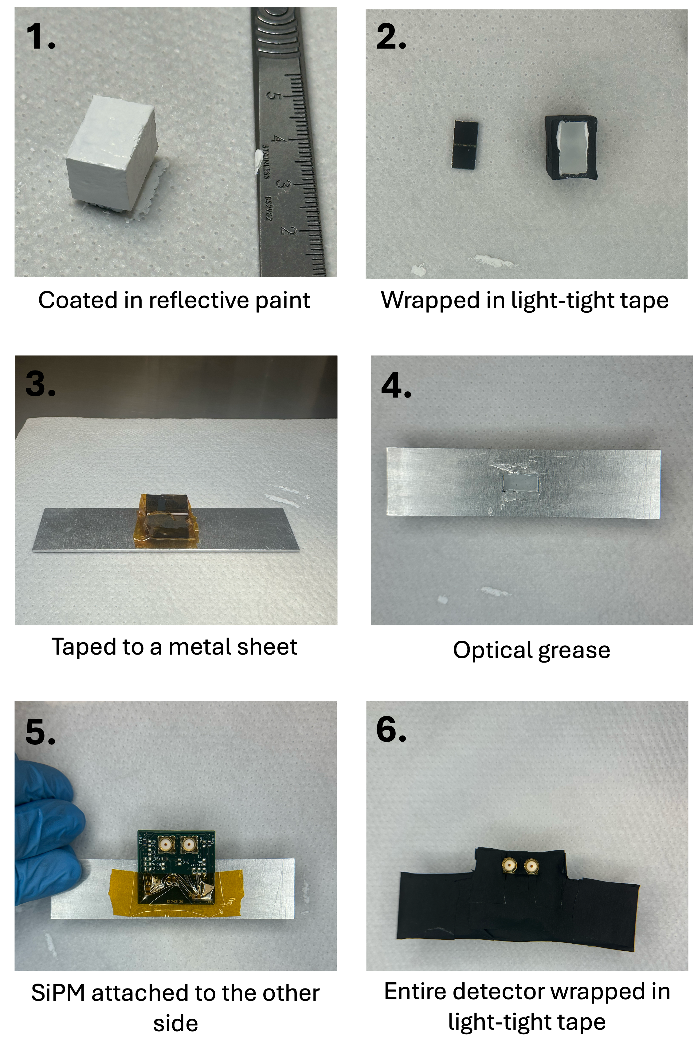
Detector Assembly
Three types of detector structure:
Two OD:
  PS scintillator wrapped in aluminum foil, attached to five sides
  One 2in1 SiPM
Two ND:
  PS scintillator painted with reflective paint with TiO₂ pigments
  One 2in1 SiPM
One BD: PVT scintillator wrapped in Tyvek (Dry)
  One 4in1 SiPM
Notes:
-using five scint and SiPMs: assembled five det
-OD: , ND:, BD: only one with 4in1
-first step for new was
-next step and all following the same for all

Slide 13
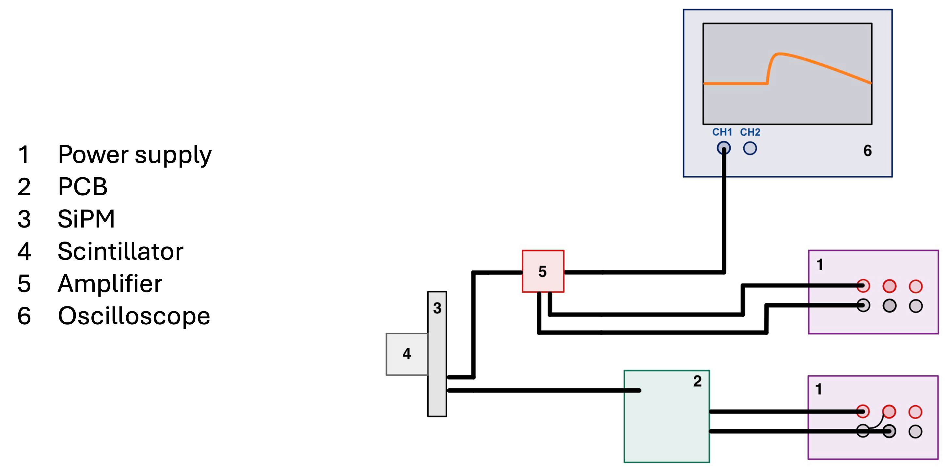
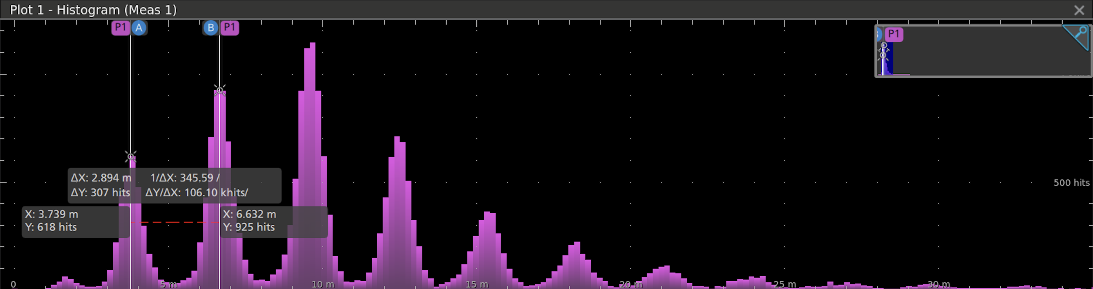
Single Photo-Electron Spectrum
SPE spectrum as shown by the oscilloscope
Notes:
-first one: to study single photon response by looking at SPE
-read out on the osc
-see example of SPE spectr as shown on osc screen
-%ND2 with different amp because others were in athens

Slide 14
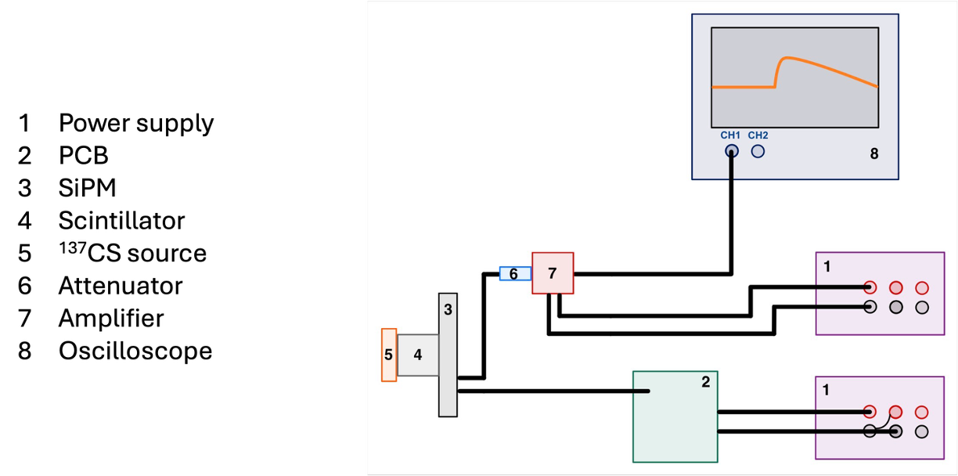
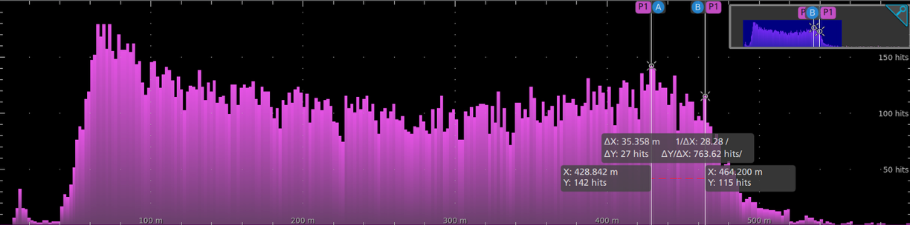
Uncorrelated Signals
Oscilloscope screen for uncorrelated data measurement
Notes:
-for study of CE position or to measure what I call uncorr
-now detectin high energy gamma
-att as not to saturate
-ATTENUATOR 20dB except BD
-ND2 with different amp because others were in athens

Slide 15
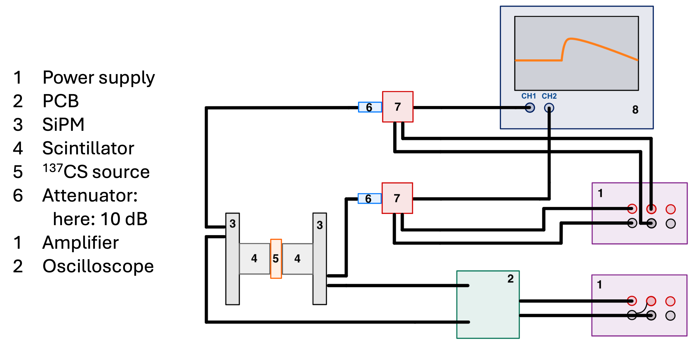
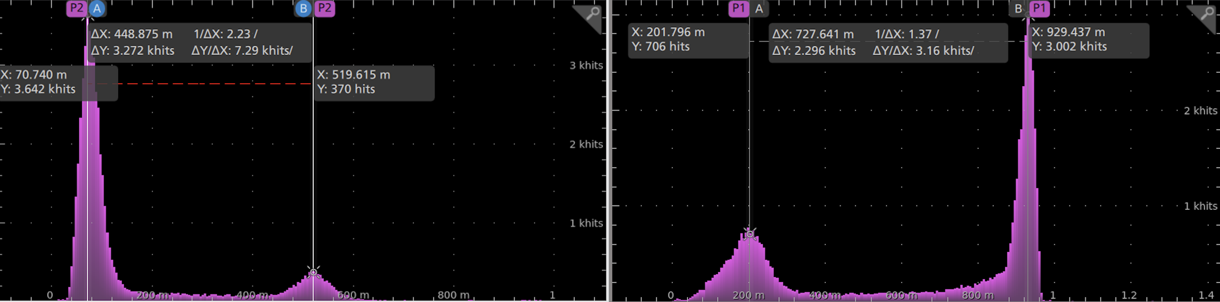
Correlated Signals
The output of two channels as seen on the oscilloscope
Notes:
-shows amp distr of signals det with two det, explained later on
-wanted to detect gamma hitting one and then second
->close together: arrive almost simultaneous
-ATT 10 dB NOT AMP
-ND2 with different amp because others were in athens

Slide 16
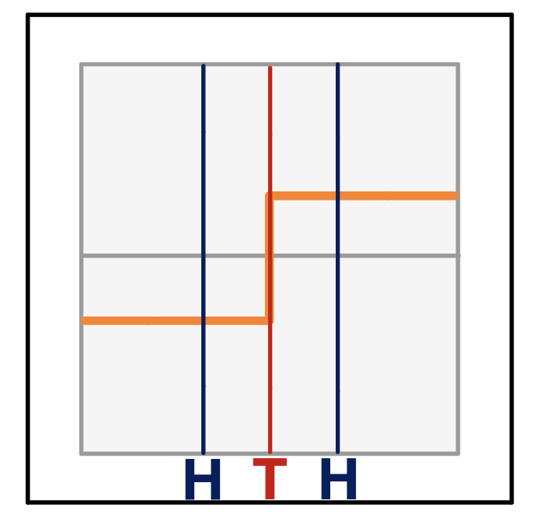
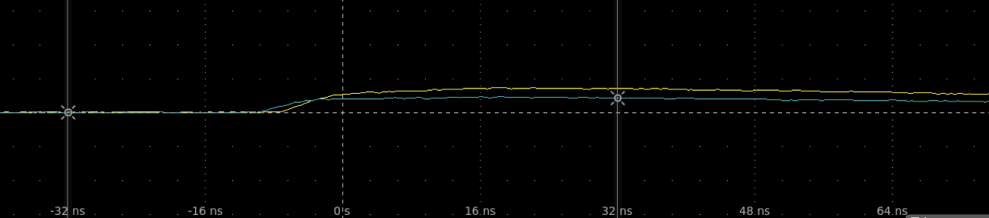
Trigger Logic
Trigger on one channel
Hold for ±4 ns
Event is kept if the other channel also produces a signal in the ±4 ns window
Waveforms from two detectors as shown on the Oscilloscope
Notes:
-Setup and Hold
-where one detector chose as trigger
-set window
-det1 triggered, if signal prod det: det2 needs at most ±4
-see pic: means all events contain 2 signals close
-only two combinations: ODs and ND1-OD1
->OD once with trig on ch1, once on ch2 for OD
-trigger on one channel, ->when I later say trigger on OD so and so

Slide 17
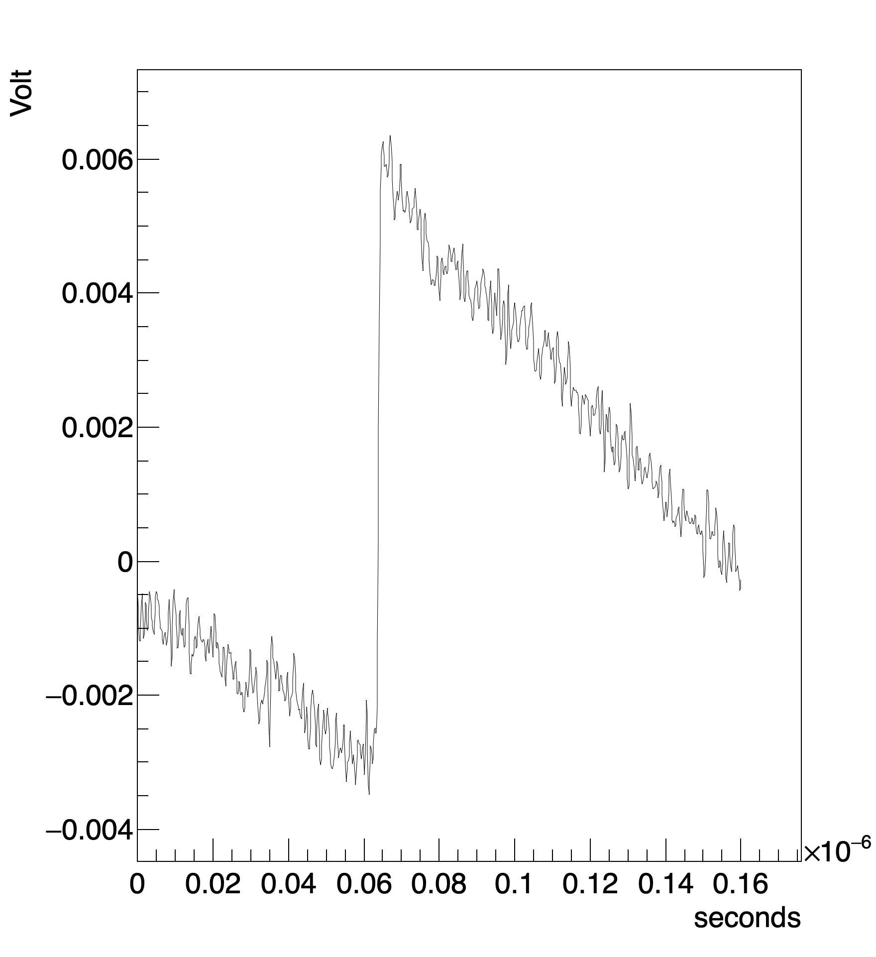
Data Analysis and Results
4
Example waveform SPE spectrum – OD1
Notes:
-here see signal/wfm det with no source for single-photon response characterization

Slide 18
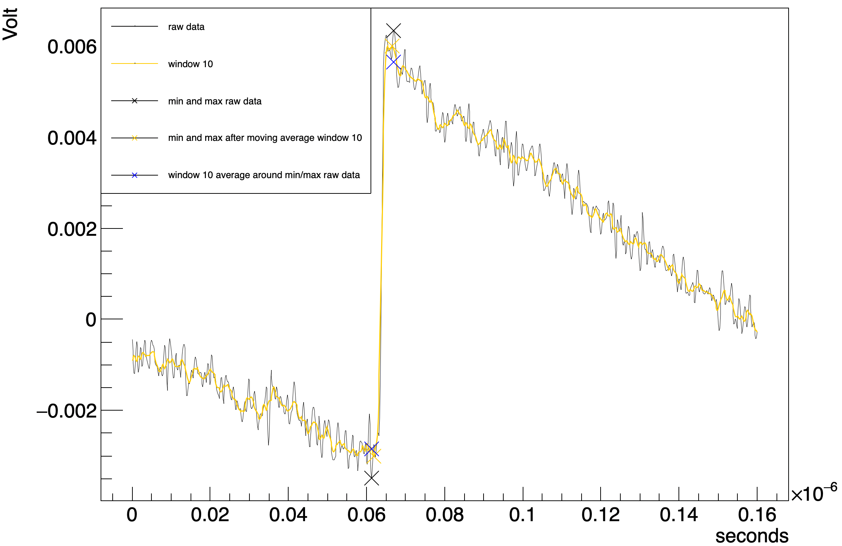
Analysis
Input: binary waveform output file from Oscilloscope
Method 1:
  Smooth waveform with a moving average filter
  Find amplitudes
Method 2:
  Find amplitudes
  Calculate average of the amplitudes within a window
Example waveform of the SPE spectrum – OD1
Notes:
-needed for analysis amp of wfm
-tried two methods for that
-bit of noise: to counteract first method was
-second find min max of og wfm
-then calc their average within a window

Slide 19
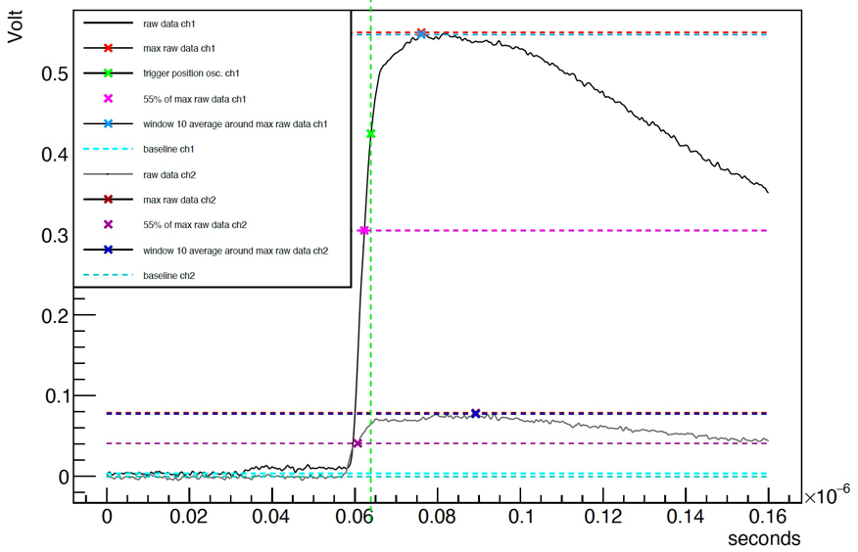
Example waveform from the Correlated signals
Two waveforms from two channels
Find trigger times at e.g. 55% of the total amplitude
Baseline in light blue
Example waveforms: OD1-OD2, trigger on OD1
Notes:
-pink markers show position of 55% of amplitude
->kept time indeces of these markers as signal trigger time
->used for analysis of the signal timing, show at the end

Slide 20
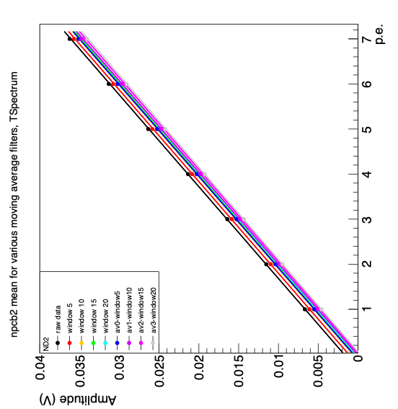
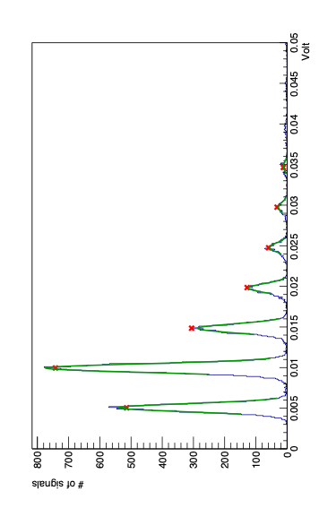

SPE Spectrum
Find peaks
Gaussian fit around each peak
Gaussian statistics kept in a CSV file
Calibration line for the conversion from amplitude to photoelectrons – ND2
SPE spectrum NPCB2
Notes:
-distr of amps of signals detected w/o source: SPE spectrum
-which is fitted with gaussian func
-using mean of gaus->find relation between number of pe and amp
To convert signal amp to pe
-also used these results to chose method
-no det pe should correspond to no signal = 0V
->chose method for which lin fit hat y-intercept closest to 0

Slide 21
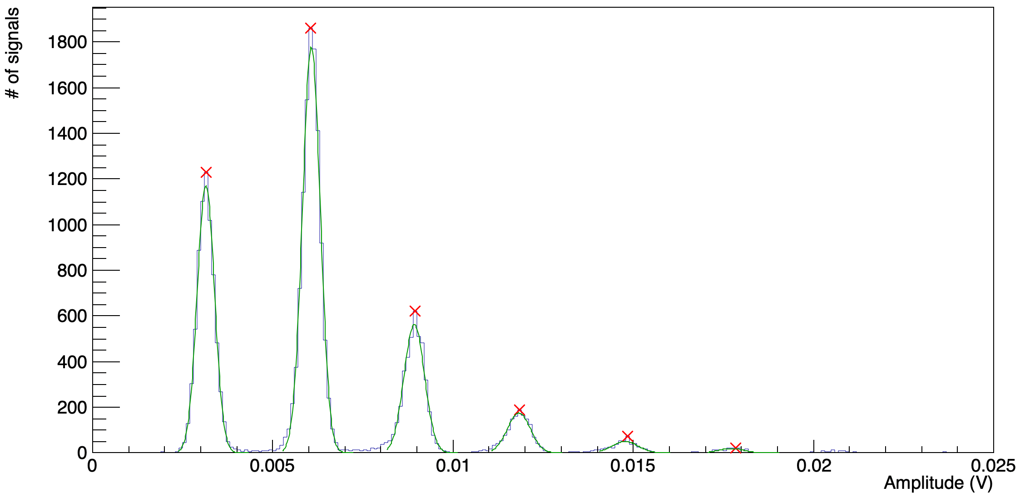
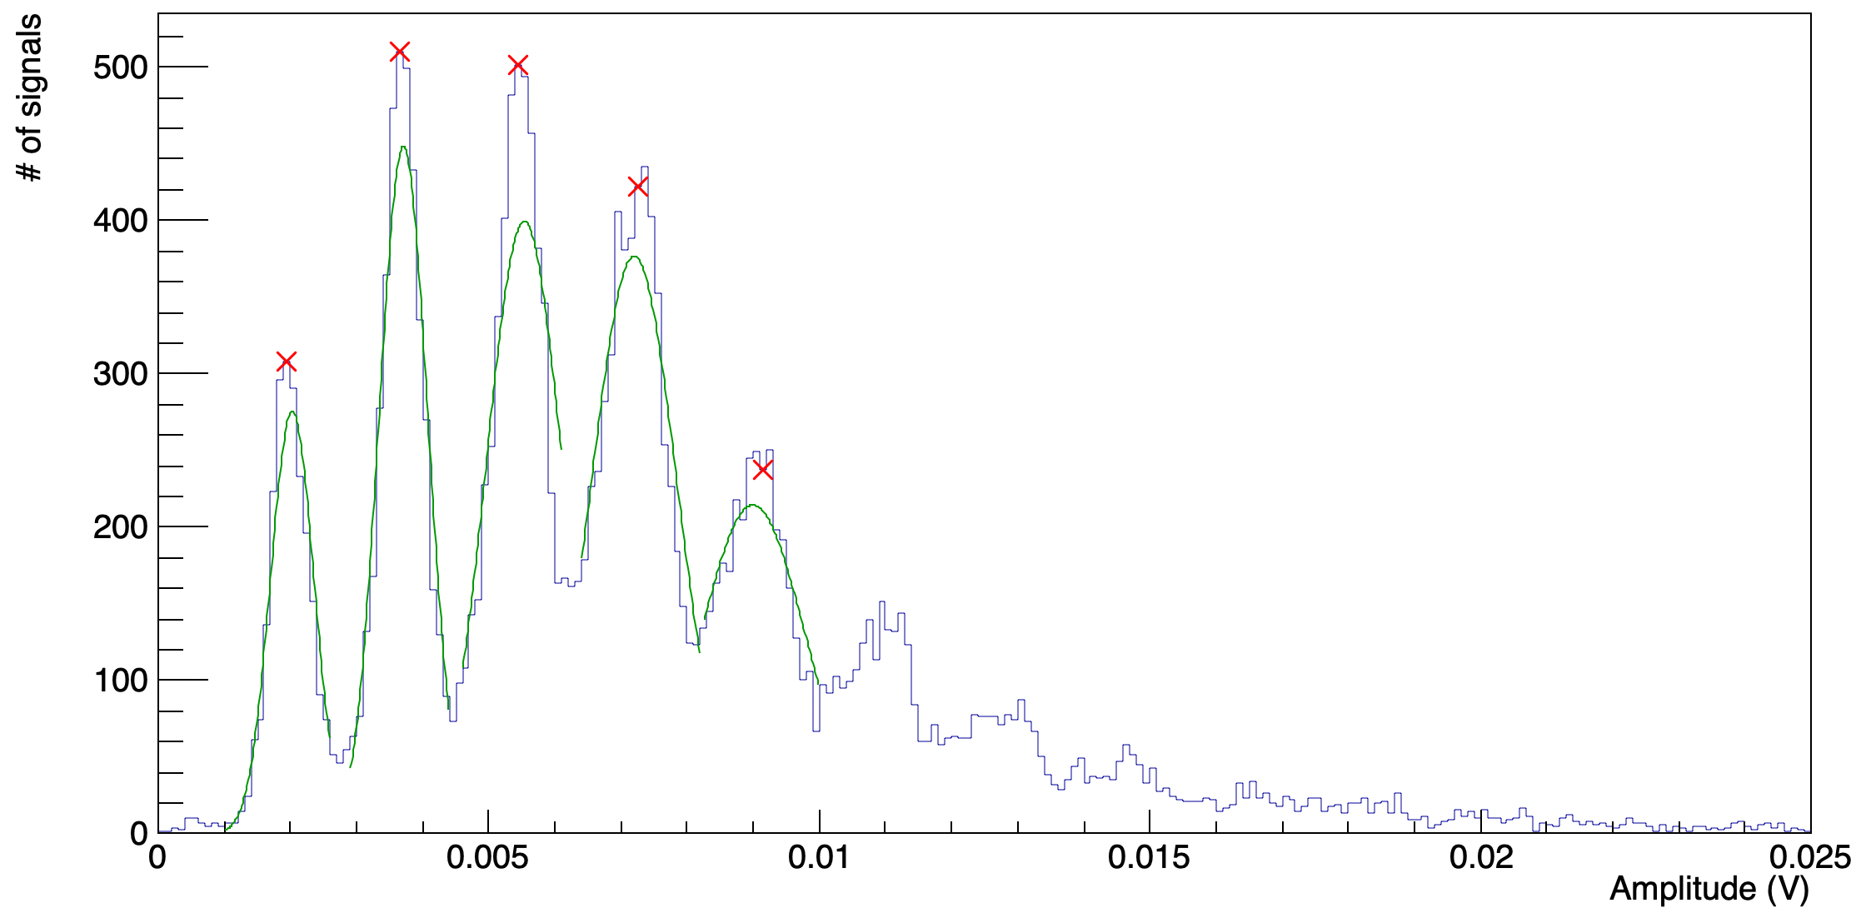
SPE Spectrum
Single-photon resolution: well separated discrete peaks of the SPE Spectrum
BD: uses 4in1 SiPM instead of 2in1 SiPM
  Worsens single-photon resolution
SPE spectrum OD1
SPE spectrum BD
Notes:
-gen looking at spe spectra showed that
-BD: 4in1 sums output from four instead of only 2, seems to worsen resolution, previous measurements of SPE with 4in1 used amp, therefore seemed to have better resolution
->signal of one photon does not have higher amplitude, but noise is summed
-ND2: at 5 and 10 mV
-OD and ND1 spectra very similar

Slide 22
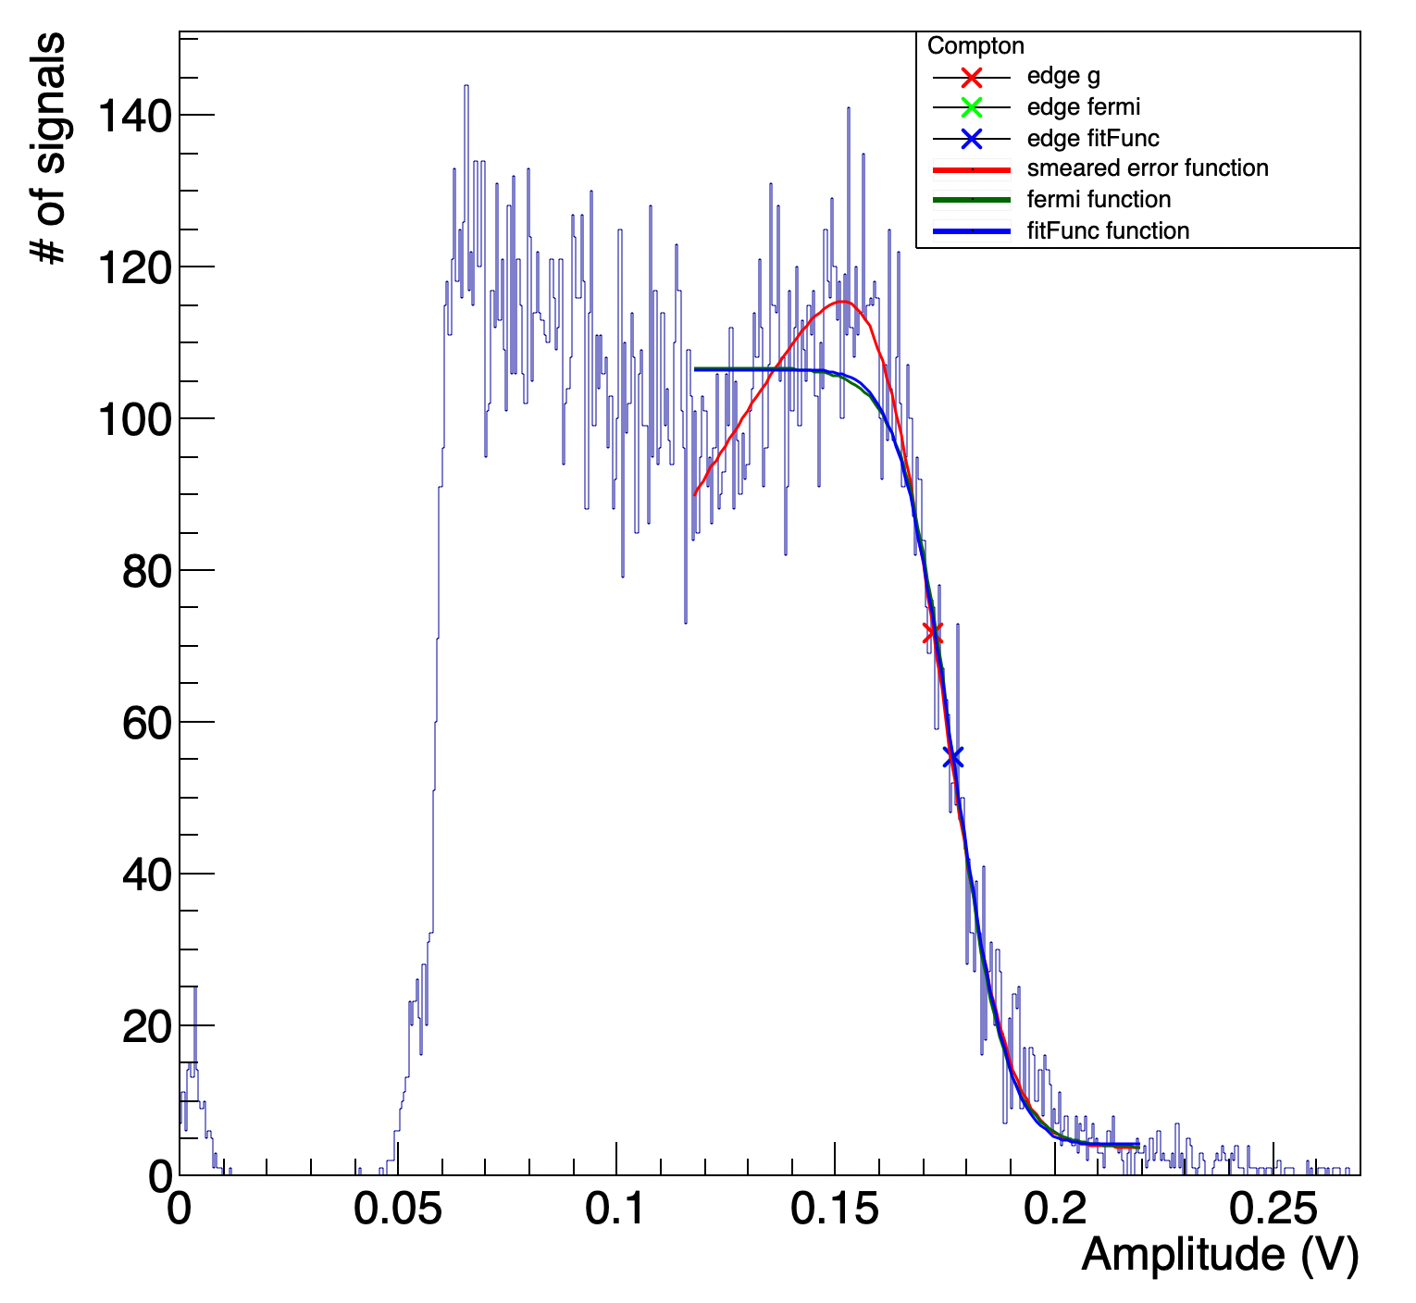
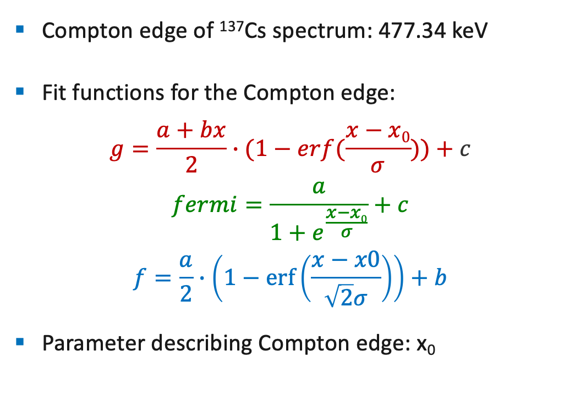
Uncorrelated Signals
Compton edge of ¹³⁷Cs spectrum: 477.34 keV
Fit functions for the Compton edge:
$$g=\frac{a+bx}{2}∙(1−erf(\frac{x−x0}{σ}))+c$$
$$fermi=\frac{a}{1+e^{\frac{x−x0}{σ}}}+c$$
$$f=\frac{a}{2}∙\left(1−\operatorname{erf}\left(\frac{x−x0}{\sqrt{2}σ}\right)\right)+b$$
Parameter describing Compton edge: x₀
OD1 Compton spectrum
Notes:
-analys of signals obtained with one det and source leads to amp distr of uncorr signals is compton spectrum
With averaged10 found histogram,
Erf(x)= 2/sqrt(pi) \int_0^x e^(-t^2) dt
-g: a-y at left edge , b-slope before edge , sigma–half width , c-background, x0-steepest decent
-fermi: a-amplitude, c-background, sigma-width of transition,
-f: a-amplitude, b-background, sigma-width of transition

Slide 23
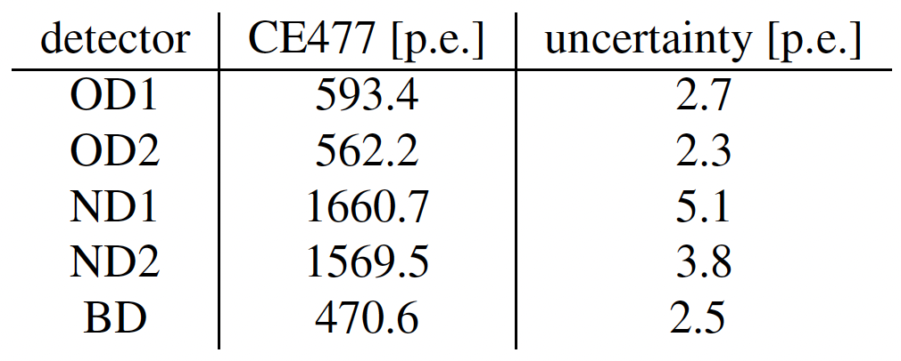
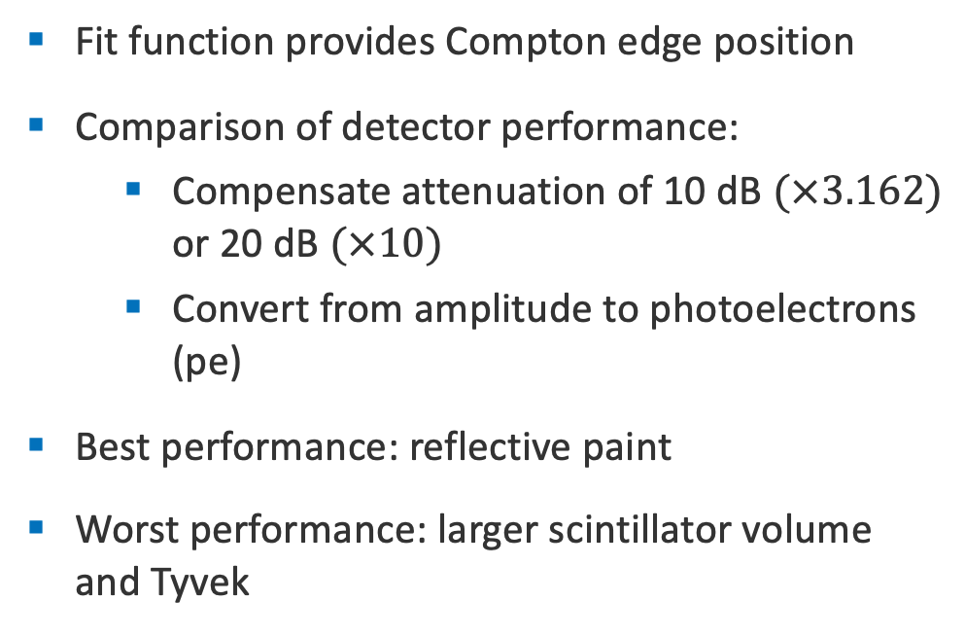
Uncorrelated Signals – Compton Edge Study
Fit function provides Compton edge position
Comparison of detector performance:
  Compensate attenuation of 10 dB $(×3.162)$ or 20 dB $(×10)$
  Convert from amplitude to photoelectrons (pe)
Best performance: reflective paint
Worst performance: larger scintillator volume and Tyvek
The number of detected photoelectrons corresponding to 477.34 keV
Notes:
-CE position found with fit converted into no of p.e.
-as can see: deposition of 477 keV leads to approx triple
-larger vol of scint used for BD appears to lead to fewer detected
->dont know influence of pvt and tyvek
-after analysis of SPE: only present averaged 10
-gamma ray depositing 477.34keV leads to almost triple the detected photoelectrons for NPCB compared to OPCB
->only difference: paint vs alu
->ND1 vs ND2: 4 layers vs 2 layers

Slide 24
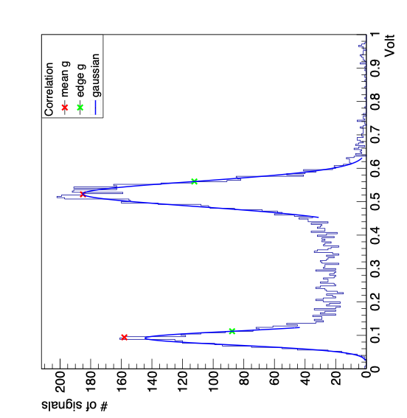
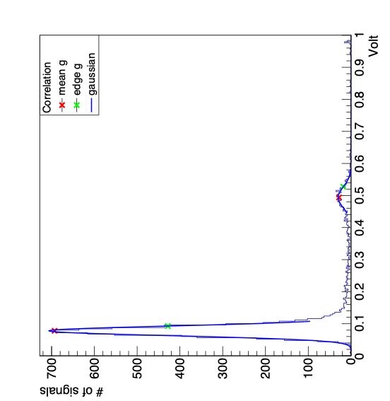
Correlated Signals
Expected:
Second order Compton edge of ¹³⁷Cs spectrum: 77.25 keV (CE77)
  Amplitude distributions showing two peaks of the same height
  Both channels produce identical distributions for the same measurement
Channel one Amplitudes
Channel two Amplitudes
Output of two channels from the same data run OD1-OD2, trigger on OD1
Notes:
-exp identic amp distr from both det, showing to peaks: one corresponding to CE at 477 and one to second order CE at 77
-since two detectors, meaning two channels: one histogram per channel/detector
-expect two peaks bc now have two detectors: Ce477 and CE77, gamma does 180 at first detector and another 180 at second
-> as said for uncorr: CE477 at 477.34
->means second order must be at 77.25
-gaussian fit, peak und peak plus sigma
->peak plus sigma for CE477 because closer to where uncorr edge was taken
->unsure if is case for CE77,

Slide 25
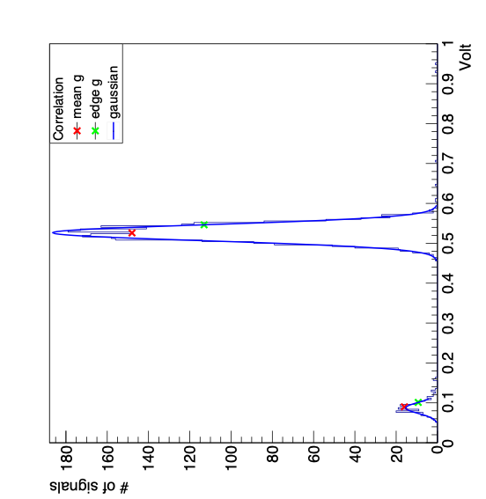
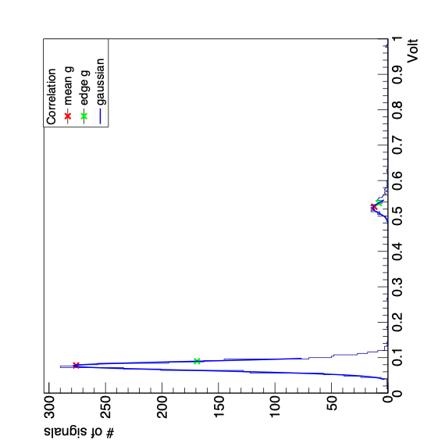
Correlated Signals
Selection criteria for signals within one event:
  Expected total energy a γ-ray deposits in both detectors
  477 keV + 77 keV = 554 keV
  Expected energy difference between the signals of the two detectors
  477 - 77 = 400 keV
  Margin of error: 15%
Output of two channels from the same data run OD1-OD2, trigger on OD1
Energy difference selection criterion
Ratio: 77.25 keV/477.34 keV = 16.2%
Notes:
-since signals of one event caused by same gamma:
-tot e deposit by gamma during two interact with det should
-e diff between e deposited in two det should be
-amp distr using signals that fulfill a criterion leads to distributions such as
-still not ident, but symm
->could be explained by non-iso
-peaks once again fitted with gaussian func
-results can be interpreted by comparing to expected ratio of the CEs
-explain anisotropic as theory for asymmetry
->same number of low amp ch1 as high amp ch2, vice versa
->not overly precise bc values in keV definitely not the same amp for every detector
-apart from that: know that expected ratio of CE77 to CE477,

Slide 26
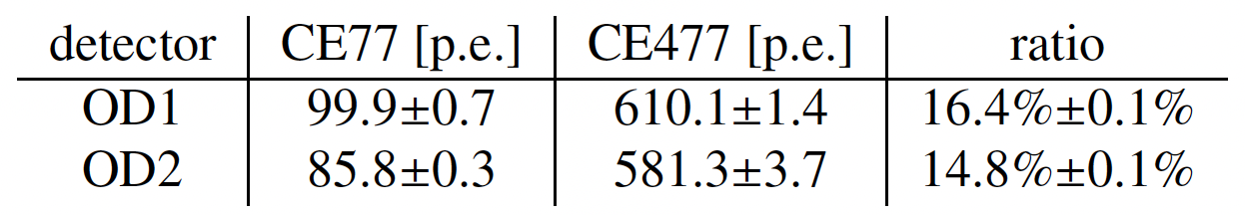
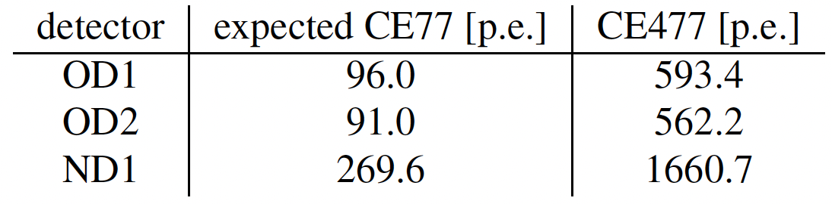
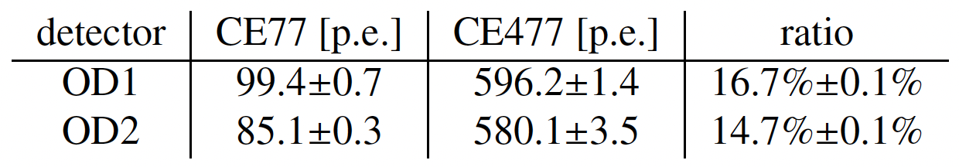
Correlated Signals
OD1-OD2 setup, trigger on OD1:
OD1-OD2 setup, trigger on OD2:
Differences negligible: the choice of trigger channel does not affect the measurement
Expected values for Ce77 and CE477 in p.e.
Notes:
-comparing results from setup with two old, trig on 1, to setup again with old, but trig 2 shows:
-unfortunately, one amp was saturated during measurement with ND-OD, thats why not showing
-corner: reminder of where CE477 is expected based on uncorr with only one detector
-know what 477 keV translates to terms of signal amplitude
->can calculate expected CE77 amplitude for each detector

Slide 27
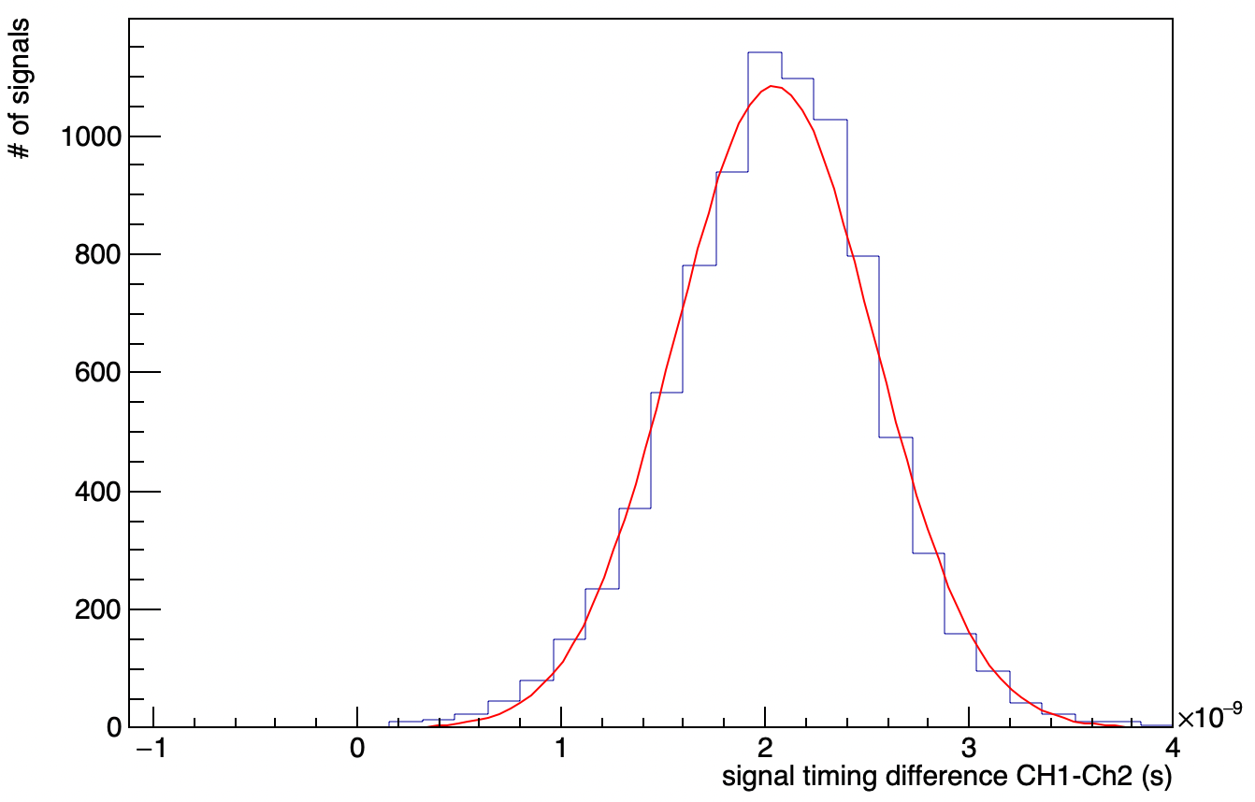
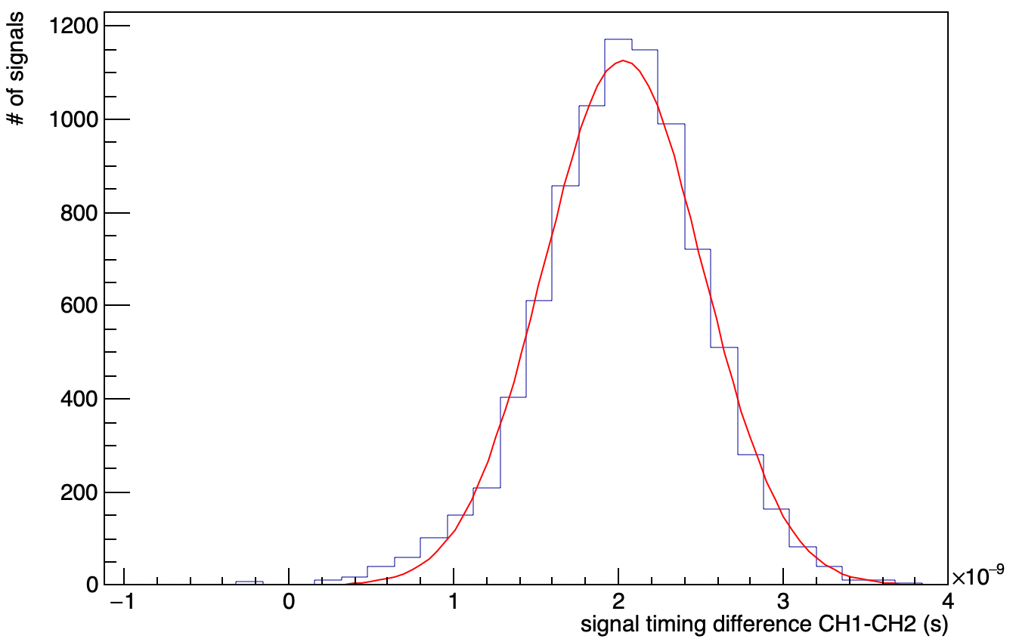
Correlated Signals: Signal Timing Difference
Estimated signal timing at 55% of the amplitude
Expected signal timing difference between two detectors: centered around 0 ns
Hypothesis: different cable lengths
Trigger on channel one
Trigger on channel two
Notes:
-as mentioned used time indeces of 55% of amp markers as signal trigger time
-difference of the two signal triger times in each event leads to distr
-on the left: trig on OD1, right: trig on OD2
-left: mean=2.046±0.0054ns, sigma=0.49±0.0045ns
-right: mean=2.028±0.0053ns, sigma=0.4829±0.0044ns
-see wfm from beginning: two signals per event
->take signal timing of each find difference of signal timing for each event
=>create hist containg all the differences
-wanted to see if trigger influences timing of two signals, difference of 2 ns
-mentioned in exp setup: one channel chosen to be triggered on
->two setups identical except for which channel is triggered on
-could check cable length hypo with 50 ohm splitter and one detector

Slide 28
Conclusion
One 2in1 (dual-channel) SiPM delivers a better single-photon resolution than a 4in1 SiPM
Detector performance improves for scintillators covered in reflective paint: three times the photoelectrons compared to aluminum foil
Lower collection efficiency with the larger scintillator
Correlated data produced spectra that showed the Compton edge as well as the second order Compton edge
  Experimental setup was successfully used to detect γ-rays interacting with two detectors sequentially
Setup-And-Hold trigger channel does not influence the signal timing and measurement
Notes:
-painting scint instead of wrapping in alu leads to
-larger scint vol leads to fewer det pe, meaning leads to worse performance
-were able to detect correlated signals with two detectors
-choice of det/channel that was trig on did have signif influence on results
-expected lower collection eff bc ratio volume scint to size opt window different: volume larger in comparison
->also larger volume more reabsorption

Slide 29

Thank you for listening!
Questions?

Slide 30
References
[1] Epic Crystal Co., Ltd. Plastic scintillator. https://www.epic-crystal.com/scintillation-crystals/plastic-scintillator.html, 2023, accessed: 20.09.2026.
[2] Silizium Photomultiplier (SiPM) - Fraunhofer IMS. https://www.ims.fraunhofer.de/de/Kernkompetenz/Technology/Bildsensoren/Silizium-Photomultiplier.html, accessed:24.08.2026.
[3] H. Kolanoski and N. Wermes. Particle detectors. Oxford University Press New York, 2022.
[4] W. H. Geist, P. A. Santi, and M. T. Swinhoe. Nondestructive Assay of Nuclear Materials for Safeguards and Security. Springer Nature, 2 edition, 2024.
[5] N. Rashid. Gamma ray spectroscopy of Co-60 radioactive source. 2018.
[6] Wafa Mazi. Near-infrared fluorescent probes for sensitive determination of lysosomal mitochon-drial ph in live cells. 01 2019.
W. R. Leo. Techniques for Nuclear and Particle Physics Experiments. Springer Berlin Heidelberg, 2 edition, 1994. https://link.springer.com/book/10.1007/978-3-642-57920-2

Slide 31
References - Data Sheets
Luxium Solutions, LLC. BC-400, BC-404, BC-408, BC-412, BC-416: Premium Plastic Scintillators. Luxium Solutions, LLC, 2023. https://luxiumsolutions.com/sites/default/files/2023-08/146337_Luxium_SGC%20BC400%20404%20408%20412%20416_FIN.pdf, accessed:20.09.2026.
Plastic scintillator, 2023. https://www.epic-crystal.com/data/upload/20260206/69855ae234086.pdf, accessed: 01.09.2026.
Broadcom Inc. AFBR-S4N66P024M: 2x1 NUV-MT Silicon Photomultiplier Array. Broadcom Inc., 2025. https://docs.broadcom.com/doc/AFBR-S4N66P024M-DS, accessed: 16.09.2026.
Epic Crystal. EGZ-SD65WH: Optical Grease. Epic Crystal, 2023. https://www.epic-crystal.com/data/upload/20231019/6530e9e1d813b.pdf, accessed: 17.09.2026.

Slide 32
References - Data Sheets
Eljen Technology. EJ-510: Reflective Paint. Eljen Technology, 2021. https://eljentechnology.com/images/products/data_sheets/EJ-510.pdf, accessed: 18.09.2026.
Mini-Circuits. ZFL-1000+: Coaxial Amplifier. Mini-Circuits, 2019. https://www.minicircuits.com/pdfs/ZFL-1000.pdf, accessed: 17.09.2026.
Mini-Circuits. ZFL-1000LN+: Low Noise Amplifier. Mini-Circuits, 2019. https://www.minicircuits.com/pdfs/ZFL-1000LN%2B.pdf, accessed: 17.09.2026.
Thorlabs. Black Masking Tape: T137-1.0. https://www.thorlabs.com/tape?tabName=Overview, accessed: 17.09.2026.

Slide 33
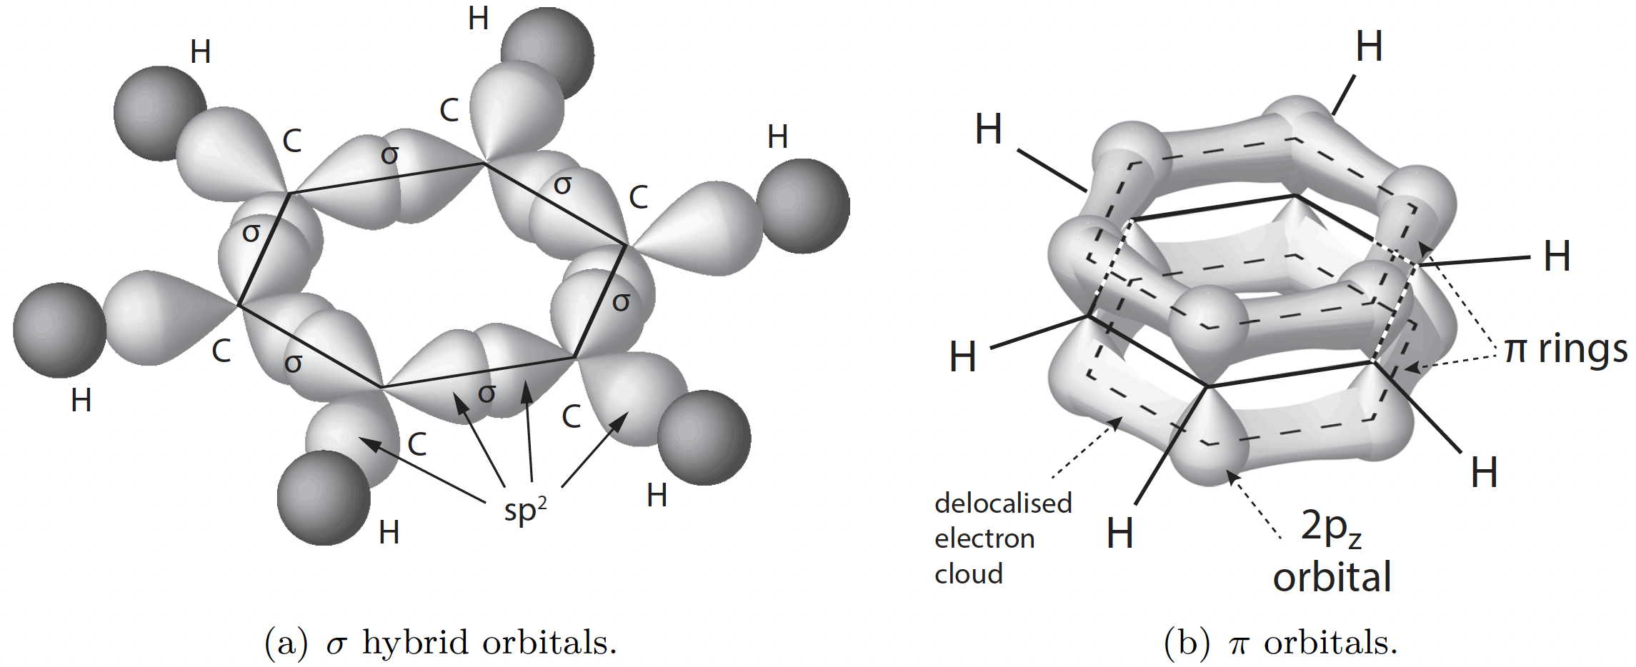
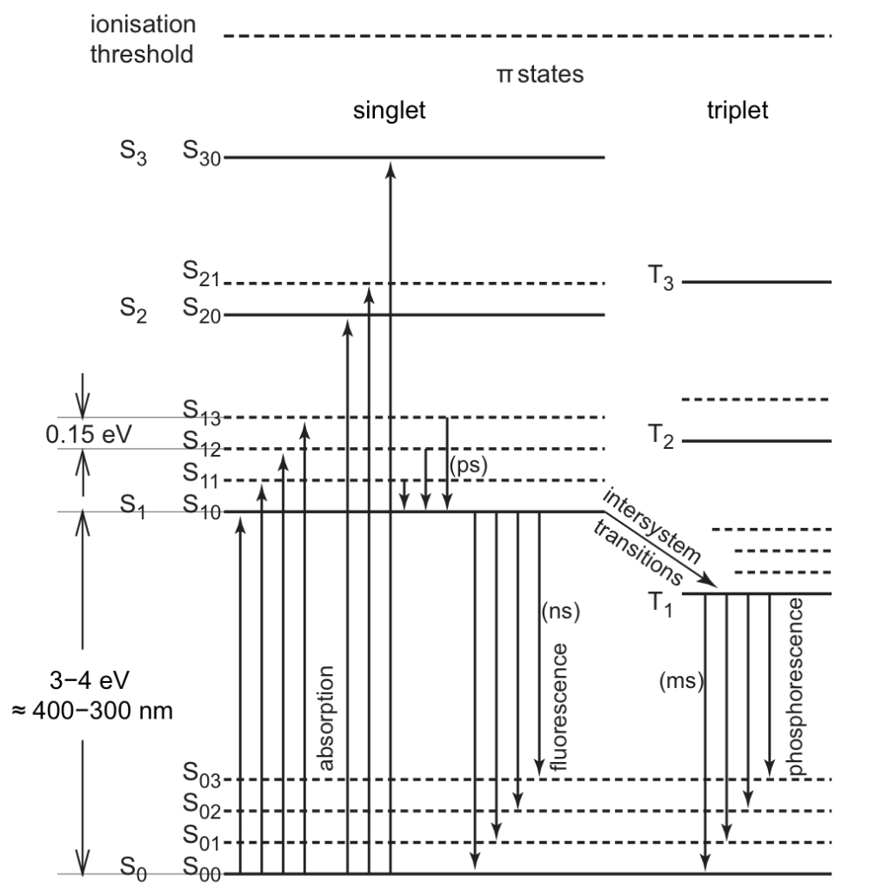
Carbon in benzene (C₆H₆)
Typical energy levels of π electrons in organic molecules from [3]
Notes:
-scint mechanism determined by carbon atom structure (1s² ,2s²,2p²) in compounds: (1s² ,2s²,2p³) ->luminescent transitions in sp2 (three sp hybrid slightly higher than s, one p) or sp hybridization, one p unchanged (pi) more weakly bound
-excitation of pi in singlet state: prompt fluorescence
-ionisation of pi electrons, recombination: population of triplet state(more strongly bound than S, antisymm spin, smaller radiusphos)
-excitation of other electrons: dissipates thermally
-ionisation other electrons: radiation damage
-prompt fluo:from S exc to S0i
-delayed: T occup., more energy deposited, back to S

Slide 34
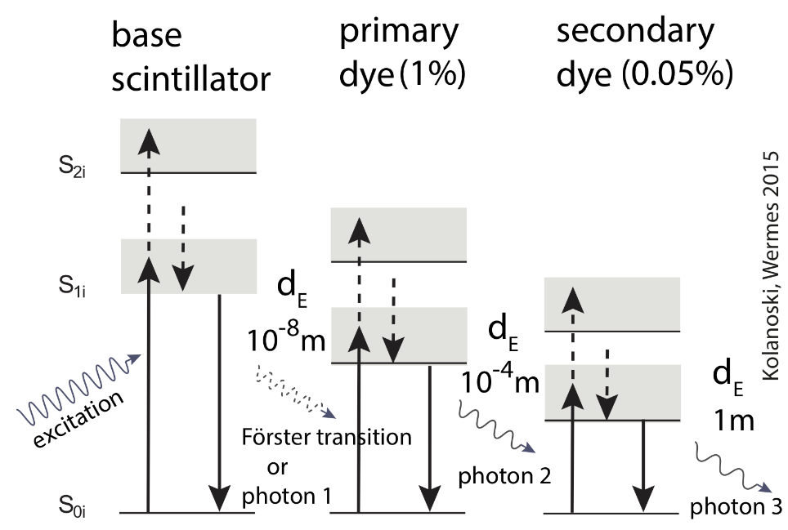
Plastic Scintillators
Matrix, base
  Often already a scintillator, slow and small light yield
  Excitons created, transferred to first fluophore, usually by FRET
First fluophore
  Higher yield and shorter rise time
  radiative transfer to second fluor
Second fluophore:
  larger emission wavelength but less local
Notes:
-Förster transition: radiationless dipole-dipole resonance interaction
->very sensitive to distance between molecules
->Donor causes oscillation of acceptor/ virtual photon exchange
->emission and absorption spectrum overlap
-d_E: distance between centers
-light yield: photons per deposited energy

Slide 35
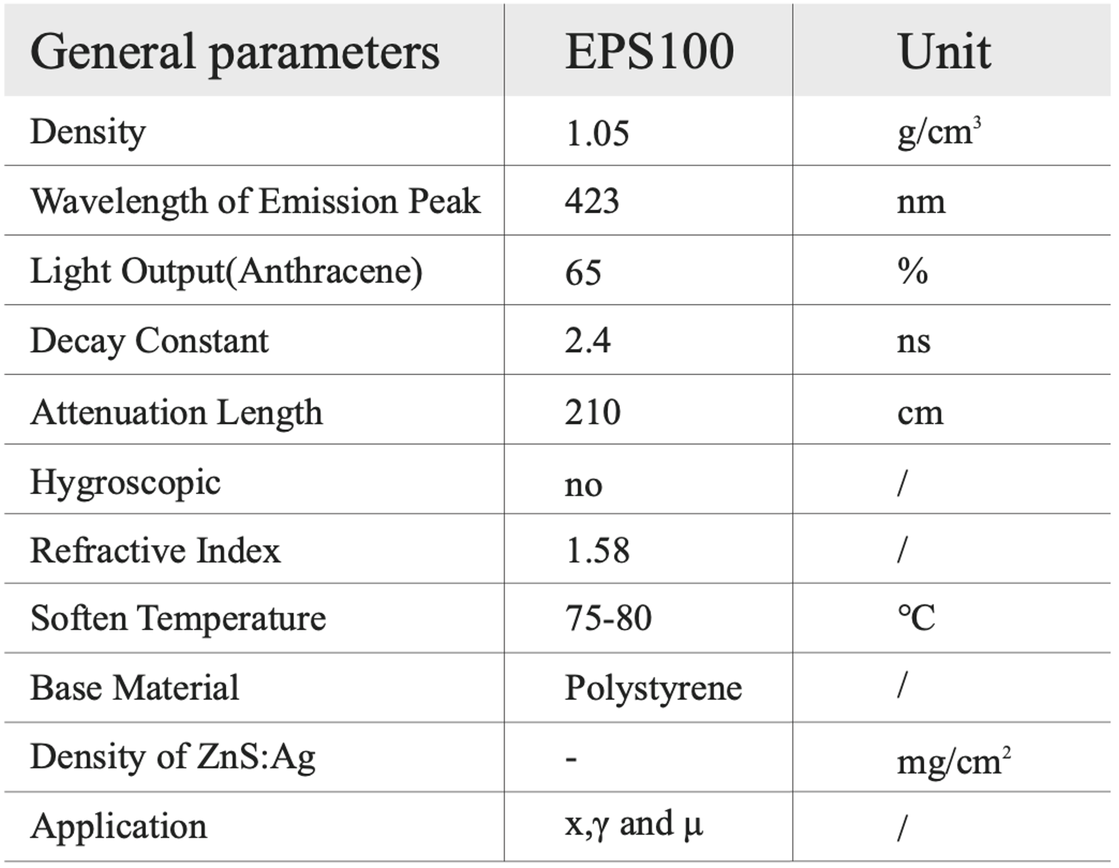
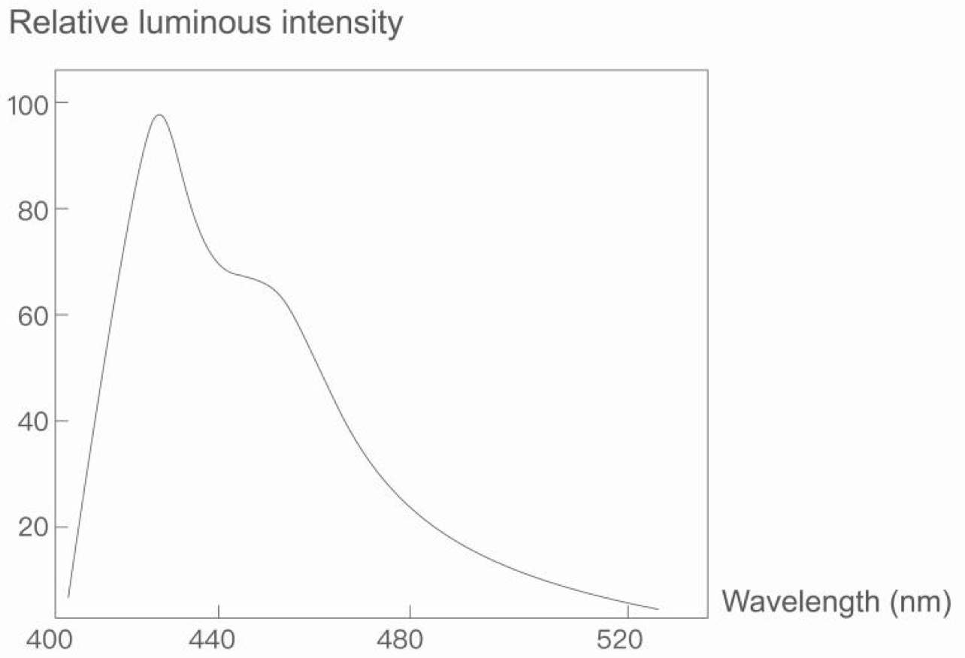
Data Sheets – Small Scintillators

Slide 36
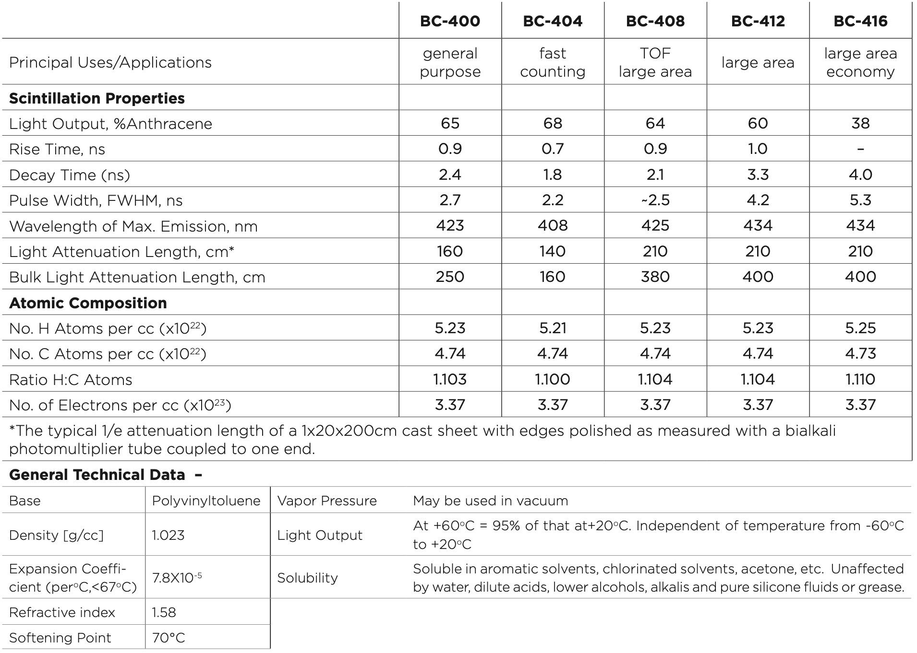

Data Sheets – Large Scintillator

Slide 37





Data Sheets – SiPMs
Notes:
-Photo Detection Efficiency

Slide 38


Data Sheets – Reflective Paint

Slide 39


Data Sheets
Optical Grease
Black Masking Tape

Slide 40


Data Sheets - Amplifiers
ZFL-1000+
ZFL-1000LN+

Slide 41

SPE Sepctrum OD1

Slide 42

SPE Sepctrum OD2

Slide 43

SPE Sepctrum ND1

Slide 44

SPE Sepctrum ND2

Slide 45

SPE Sepctrum BD

Slide 46

Compton Sepctrum OD1

Slide 47

Compton Sepctrum OD2

Slide 48

Compton Sepctrum ND1

Slide 49

Compton Sepctrum ND2 – No Threshold

Slide 50

Compton Sepctrum ND2 – 32 mV Threshold

Slide 51

Compton Sepctrum BD – 20 dB

Slide 52

Compton Sepctrum BD – 10 dB

Slide 53


Single Photo-Electron Spectrum
Uncorrelated Signals
Correlated Signals
Notes:
-NPCB2 with different amp because others were in athens
-Corr: only two combinations: OPCBs and NPCB1-OPCB1
->OPCB: once with trig on ch1, once on ch2 for OPCB

Slide 54

Screemshot of the Oscilloscope from a measurement with two detectors OD1-OD2, trigger on OD1

Slide 55

Screemshot of the Oscilloscope from a measurement with two detectors OD1-OD2, trigger on OD2

Slide 56

Screemshot of the Oscilloscope from a measurement with two detectors ND1-OD1, trigger on ND1

Slide 57

OD1 SPE Spectrum
Linear y-scale Amplitude distribution
Logarithmic y-scale Amplitude distribution

Slide 58

OD2 SPE Spectrum
Linear y-scale Amplitude distribution
Logarithmic y-scale Amplitude distribution

Slide 59

ND1 SPE Spectrum
Linear y-scale Amplitude distribution
Logarithmic y-scale Amplitude distribution

Slide 60

ND2 SPE Spectrum
Linear y-scale Amplitude distribution
Logarithmic y-scale Amplitude distribution

Slide 61

BD SPE Spectrum
Linear y-scale Amplitude distribution
Logarithmic y-scale Amplitude distribution

Slide 62

Calibration Curves
OD1: $(−0.022±0.004) mV+N_{pe}∙(2.905±0.002) \frac{mV}{pe}=A$
OD2: $(0.034±0.004) mV+N_{pe}∙(2.868±0.002) \frac{mV}{pe}=A$
ND1: $(−0.056±0.006) mV+N_{pe}∙(2.880±0.002) \frac{mV}{pe}=A$
ND2: $(0.109±0.009) mV+N_{pe}∙(4.923±0.004) \frac{mV}{pe}=A$
BD: $(0.013±0.011) mV+N_{pe}∙(1.729±0.004) \frac{mV}{pe}=A$

Slide 63

OD1 Compton Spectrum

Slide 64

OD2 Compton Spectrum

Slide 65

ND1 Compton Spectrum

Slide 66

ND2 Compton Spectrum

Slide 67

BD Compton Spectrum

Slide 68

OD1-OD2 setup, trigger on OD1 – total energy selection criterion
OPCB1 signal amplitudes
OPCB2 signal amplitudes

Slide 69


OD1-OD2 setup, trigger on OD2
OPCB1 signal amplitudes
OPCB2 signal amplitudes
Notes:
OPCB_CH2 left: Ch1, right: ch2 no selection

Slide 70

OD1-OD2 setup, trigger on OD2 – total energy selection criterion
OPCB1 signal amplitudes
OPCB2 signal amplitudes

Slide 71

OD1-OD2 setup, trigger on OD2 –energy difference selection criterion
OPCB1 signal amplitudes
OPCB2 signal amplitudes

Slide 72




Correlated Signals
ND1-OD1 setup, trigger on ND1
Expected signal amplitude corresponding to 477.34 keV with 10 dB attenuation: 1542.9 mV
Dynamic range of the amplifier: 800 mV
  Amplifier was saturated for high energy signals from ND1
Amplitude distribution of NPCB1
Notes:
-hist: saturated signals
-appendix

Slide 73

ND1-OD1 setup, trigger on NPCB1
NPCB1 signal amplitudes
OPCB1 signal amplitudes
Notes:
NPCB left: Ch1, right: ch2 no selection

Slide 74

Signal Timing Difference – Selection Criterion
OD1-OD2, trigger on OD1
OD1-OD2, trigger on OPCB2
=>only from events fullfilling the energy difference selection criterion

Slide 75



Data in mV
Uncorrelated data
Correlated data
Coversion energy to amplitude

Slide 76



Additional Results Correlated Data
Results in mV
Results in p.e.
Expected Values in p.e.

Slide 77


Simulation of the Experimental Setup using Geant 4
Modified version of a simulation provided by the research group
So far:
  One polystyrene-based scintillator, five sides wrapped in reflective material
  Same size as the real small scintillators
  661.66 keV γ-ray beam
  Energy of γ-ray escaping the scintillator recorded
  Very slow
Notes:
-appendix
-used for neutron scattering, majority of program not needed for this simulation
-time restraint, not more than that

