Slide 1



Design and construction of RPC detectors
G. Aielli

Slide 2
RPC technical challenges vs. construction

Slide 3
Features challenges and limits of RPCs
RPCs are fast and time sharp
  Been used for many applications where timing is crucial
“Easy” and “Cheap”
  So they are often built in very large modules
  As thin as possible gas gaps for better timing
Most wanted: large-size, thin, fast signal devices,
…and yes, with very sensitive electronics…
Competing requirements challenge:
  mechanical:
    Uniformity of gas change, rigidity, planarity, surface roughness and large surface
  Electronic:
    External and self-induced noise, reflections, sensitivity of electronics to all that
We will touch those points in the next slides

Slide 4

Resistive Plate Chamber
One of the primary features of the RPC is the resistive electrodes
Requirements:
  Uniformity: a continuous piece of material industrially produced
  a volume resistivity ranging in between 10^8 - 10^12 Ohm cm
  Relative Dielectric constant around 5-7
  The resistivity should be stable in the detector lifetime → carriers non depleted
  A continuous resistive layer is needed to localize the discharge, but it limits the rate capability: in presence of a uniform background, the voltage drop is $∆V=IR= \left\langle Q\right\rangle \left(pC\right)∙f\left(Hz\right)∙ρ\left(Ohm cm\right)∗d/S\left({cm}^{−1}\right)$
  Having d=1 mm of electrode thickness and $ρ={10}^{10}\left(Ohm cm\right)$, a current of 10 μA given by a 1 MHz/m^2 of MIPS producing in average 10 pC of avalanche charge, would produce a field of 1 V/mm in the electrode
  To be compared to the typical applied field of about 5000 V/mm
The field in the electrode should be “small” to have most of the field on the gas. Vice versa this limits the rate capability (through the voltage drop) and the longevity by deplating the electrode
i
ΔV=i*R
V
V-2ΔV
ΔV=i*R

Slide 5
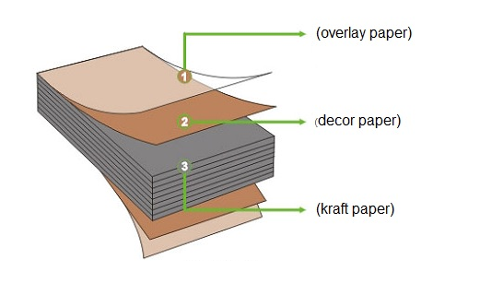
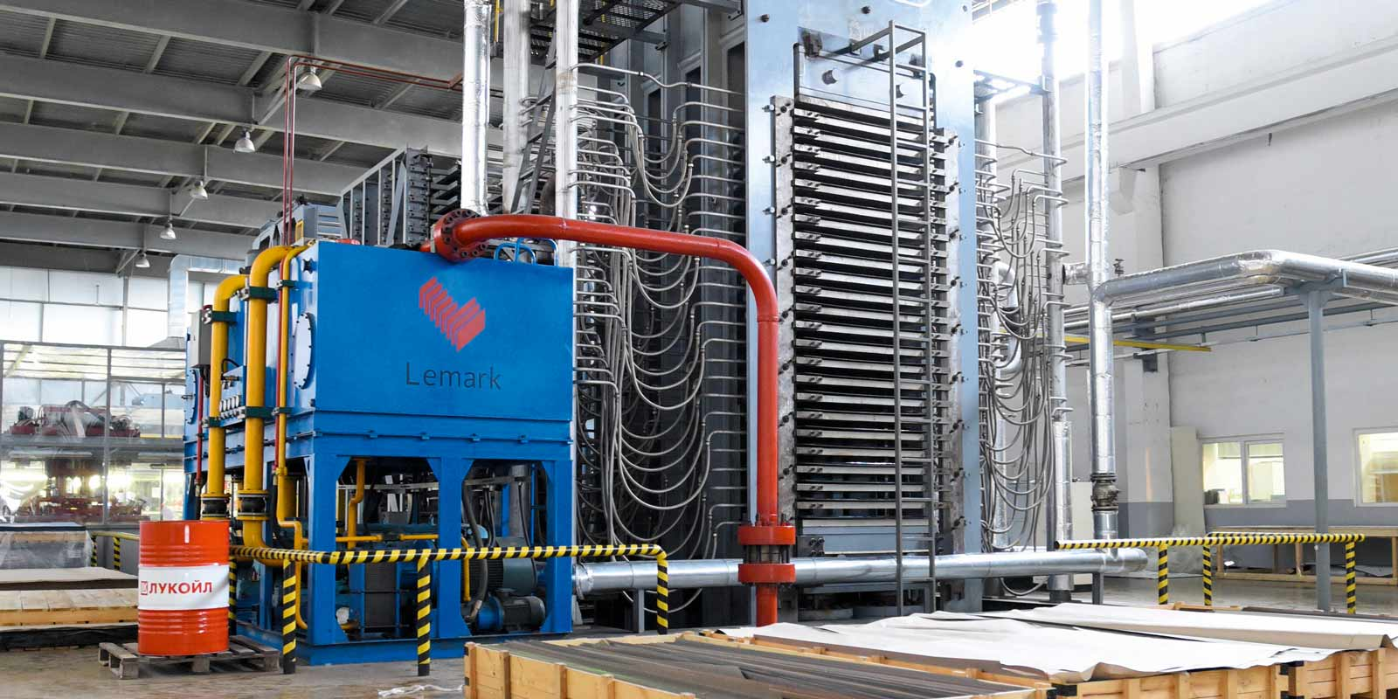
Resistive Plate Construction
Such resistivity range is not common for large plates of materials. Most commonly used material:
  High Pressure Laminate ranging between 10^9 and 10^12 Ohm cm
    Low cost per unit surface
    High mechanical stability
    Carriers are water ions (internal water concentration goes in equilibrium with the environment)
    The plate is in between 1 and 2 mm
  It is produced by pressing together at high temperature a core of several layers of kraft paper impregnated with phenolic resin, finished externally with melamine impregnated paper.
  The hot press produces the resin polymerization
  The melamine provides a harder surface and carries most of the resistivity

Slide 6
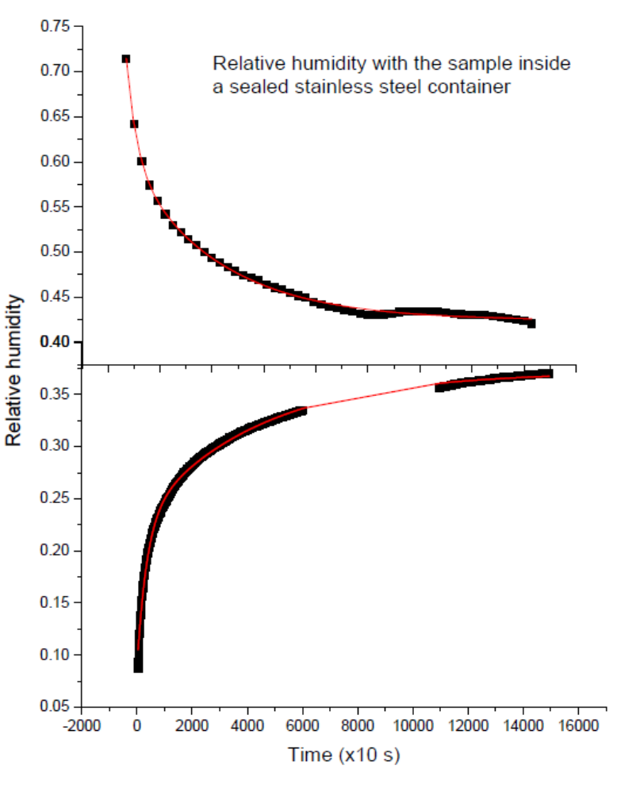
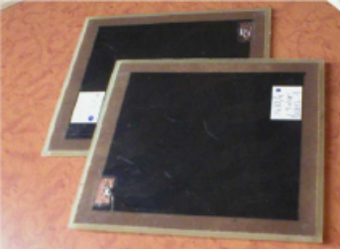
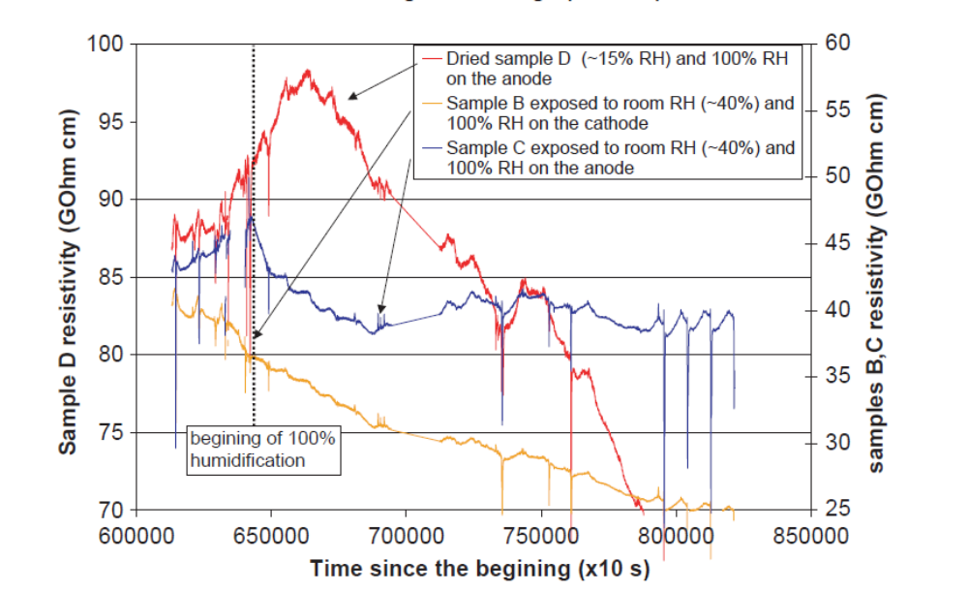
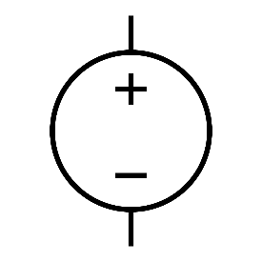
Resistive Plate Endurance
HPL is hygroscopic
It behaves as porous water container setting surrounding environment to an equilibrium point around 40% RH
HPL electrical conduction is mediated by water ions
A constant availability of water molecules at the electrode anodic face, guarantees a stable conductivity
To expose the anode side of each RPC electrode, both environment and gas must be kept at constant RH (around 40%)
RH=40%
RH=40%

Slide 7
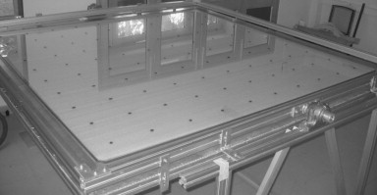
Resistive Plate Construction
The other commonly used material is glass
Soda-lime glass: The typical resistivity is 10¹² Ω⋅
  This is the most commonly used type of glass in RPC detectors.
  It provides a good combination of:
    Surface resistivity uniformity, which is crucial for the consistent operation of the chamber.
    Mechanical stability, to maintain the flatness of the plates.
  It is relatively inexpensive and easy to process.
Drawbacks are the weight, fragility, and high resistivity, making it suitable for cosmic rays experiments.
Must be operated with a dry gas if in presence of fluorinated gases, since glass is very sensitive to HF
Advantage: more rigid and higher mechanical precision than HPL → suitable for very thin electrodes
It is the election material for the micro-multi gap RPCs where the electrode thickness is of the order of 0.2 mm

Slide 8
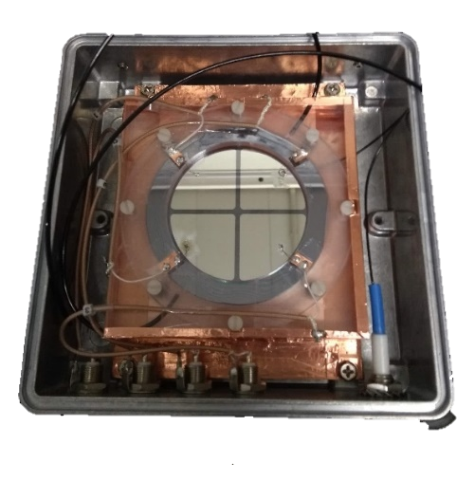
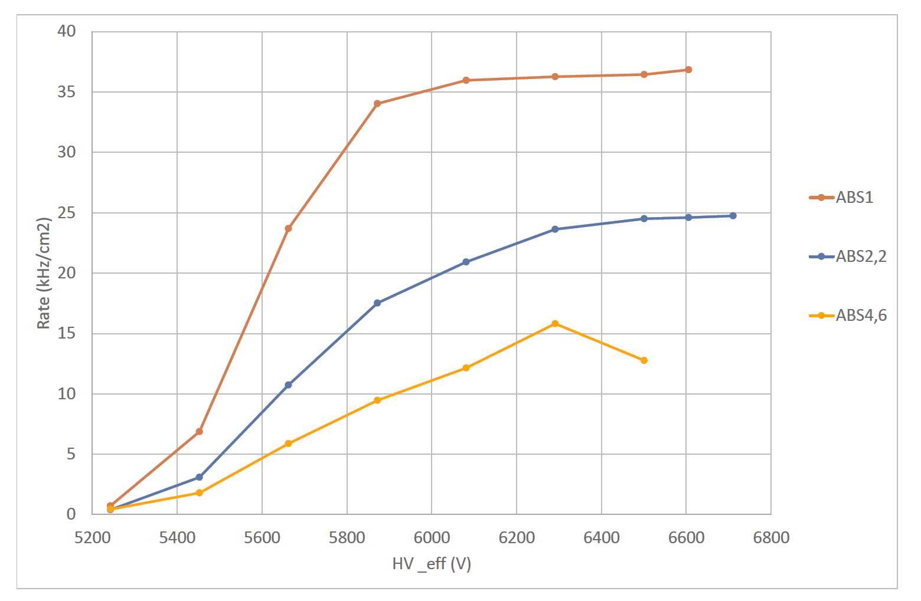
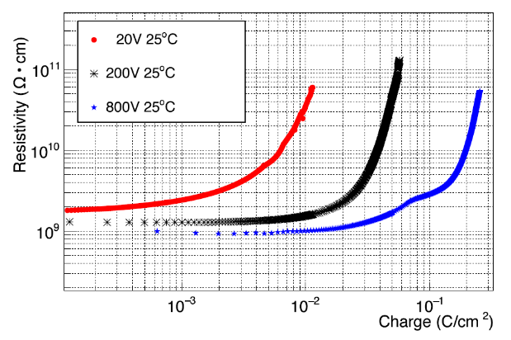
Resistive Plate alternatives
MRPC →extreme exploitation of the detector geometry to extract the most of <Q>
  E.g. ALICE: 10 gas gaps of 0.25mm with 0.4 mm electrodes
Main limitation → thin float glass limited to < 1 kHz/cm² due to ρ~10¹² Ω/cm.
New materials with low resistivity (down to 10⁹⁻¹⁰ Ω/cm) →(ceramics, plastics, glass,…) (10.1016/j.nima.2006.12.027, 10.1016/j.nima.2010.08.076, 10.1016/j.nima.2020.163483, 10.1088/1748-0221/14/09/C09007, http://cds.cern.ch/record/2319919
A new device: single gap semi-conductor RPC
[electronic carriers can not be depleted]
  Counting rate > 40 kHz/cm²
  0.6 mm GaAs electrodes
  Resistivity 1.4×10^8 Ωcm
  1 MHz/cm² seems possible
  Active area 6.25 cm²
  10.1088/1748-0221/15/12/C12004
  Carrier depletion effects → R&D needed
  material non-homogeneities for large sizes
  Thinning electrodes still possible.
  Forced (no diffusion) gas distribution
Large margin achievable by lowering < Q >
Seamlessly achieved 40 kHz
FFC TARGET → improve by a further order of magnitude by lowering R

Slide 9
Resistive Plate Chamber - surface
The other characterizing feature is the uniform and strong electric field → plate configuration.
The advantage is the production of a signal without delay and the naturally achieved 3D+t localization of the hit with high space-time resolution, on large surfaces.
The disadvantage is that it is difficult to maintain such a configuration in a stable way, due to the spontaneous electron emission from the electrode surface, by edge effect (cold electron extraction)
The resistive plate prevents the lateral propagation of the discharge, but the spontaneous discharges may overwhelm the detector response
  This is affecting in particular HPL electrodes → the surface finishing is determined mechanically determined by the press iron plate finishing. Moreover, HPL is a multilayer polymer. The expected local roughness distribution is wide, with an average of the order of 1 μm
  Glass is a liquid so naturally smooth (roughness from 10 to 100 nm)
  silicon is a crystal cut along a specific layer (roughness of the order of a few nm)

Slide 10
Resistive Plate Chamber – HPL case
HPL was the first material used for RPCs
A very special procedure has been invented to have a glass-like finishing
Varnishing the internal surface with a few μm layer of linseed oil
  Linseed oil was the “secret” of the Flemish painters in the XVI century…
  Upon polymerization, linseed oil forms a hard and glossy surface, and its resistivity is similar to the one of HPL
  Oiling is applied by slowly filling and emptying gas volumes vertically held, with a mixture of linseed oil and heptane, and subsequently stimulating the polymerization (oxygen driven) by flushing the gas volumes with clean air.
  The polymerization lasts a few days and is performed at T> 30 °C

Slide 11
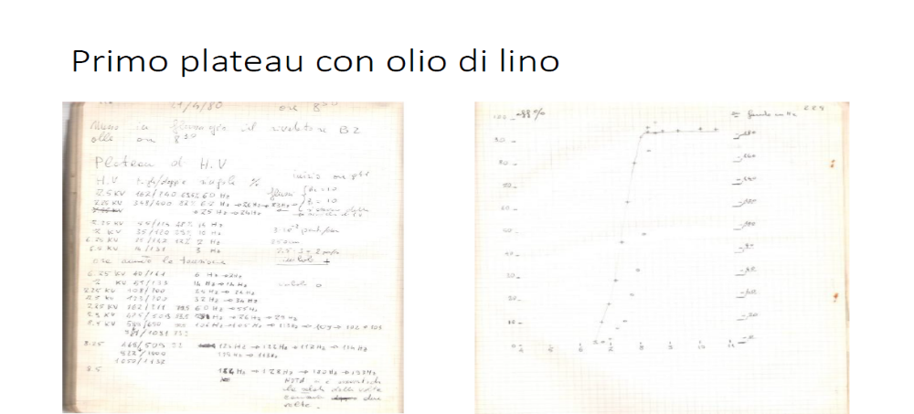
First plateau using linseed oil (by R. Cardarelli)

Slide 12
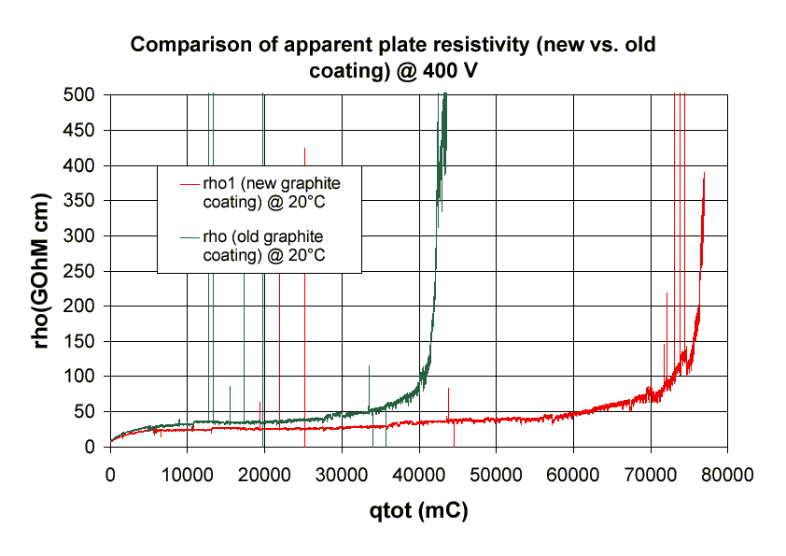

Resistive Plate – ohmic contact
The external face of the electrodes are treated with a graphite layer with a surface resistivity << of the HPL one
This represents an ohmic contact and has the function of distributing the electric potential uniformly on the surface
Its surface resistivity is of the order of 100 kOhm/$⎕$
  Typical τ=RC=10 pF*100 kOhm = 10⁻⁶ s
  Sufficiently slow to be transparent to the prompt avalanche signal ($τ≈1ns)$
The graphite contact is progressively damaged by the electro-chemical reactions, using a thick layer, we demonstrate that the system can withstand the full ATLS program
Choice of the graphite: it is possible to obtain the same resistance per square with different amounts of graphite per unit surface, by adding a resin as a filler in between the graphite grains. Such a thicker structure is more resilient to chemical damage

Slide 13
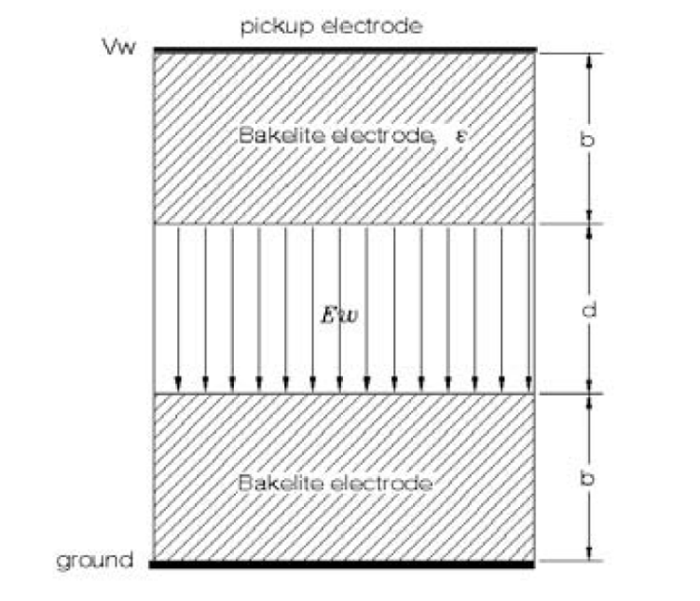
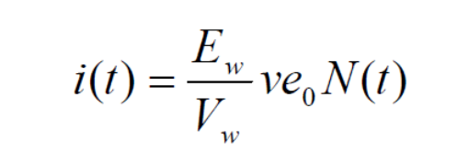

Resistive Plate – electrode thickness
The electrode thickness should be idealistically as thin as possible since the signal induction is given by the weighting field through the Ramo theorem as:
Where $\frac{E_{w}}{V_{w}}=\frac{1}{\frac{2b}{ε}+d}$
Since ε is about 7 the electrode thickness contribution is reduced:
Example: b=1mm d=2mm → 77% we have a reduction of 23% for the signal with respect to a zero thickness electrode
On the other side a too thin electrode becomes mechanically unstable due to the electrical force in between the electrodes
Practical ranges are in between 1.4 and 2 mm

Slide 14
Discussion on the mechanical stability
When the electric field is on the plates are attracted by electrostatic force
Elements to consider:
  Material rigidity
  Material thickness
  Distance and size of the spacers
  Fixing of plate and spacer
  Intensity of the field
The residual gas gap is smaller
  In extreme cases it may trigger a pull-in effect due to the increase of E
  The design should be such to make this effect negligible
V+
V-

Slide 15
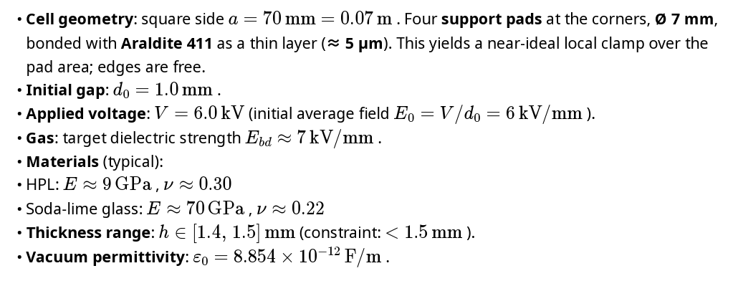
An example
E is the Young modulus
ν is the Poisson coefficient
a
Typical literature value are used
For a more predictive calculation one should measure the material rigidity E directly

Slide 16
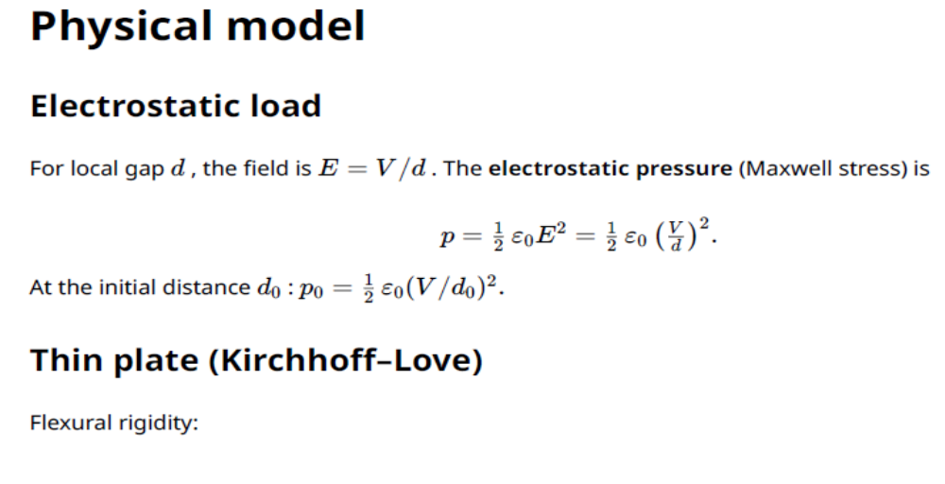
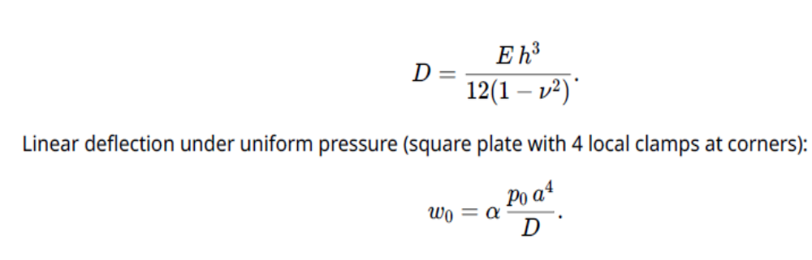
Physical model
For more accurate results, one should measure directly D on a realistic mock-up
By using different loads it is also possible to verify the linear deflection law
Notice that the deflection grows with the 4th power of a and decrease with the 3rd power of h
Implication on the spacers grid density

Slide 17
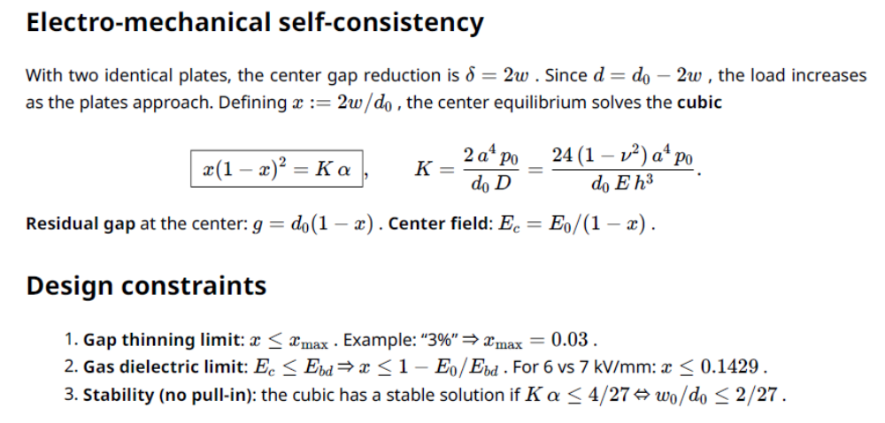
Physical model - extrapolation
One can play with the model to find the most desired optimization
Changing a, h in particular and making statistical consideration on the stability of the expected values for D

Slide 18
Mechanical stability – overpressure
The internal pressure of the gas
  static pressure of the gas column (2.3 mbar/m for TFE
  Dynamic pressure due to the gas flow
A small but continuous stress for the time life of the experiment
Neutralized by applying an external force to prevent spacer detachment
The force is applied just on the internal spacers, trough external thin spacers preventing the contact with the gas gap
If the gas is “light” and the flow is “low” the design of the mechanical frame can be greatly simplified
Rigid external structure
Gas gap
Rigid external structure

Slide 19
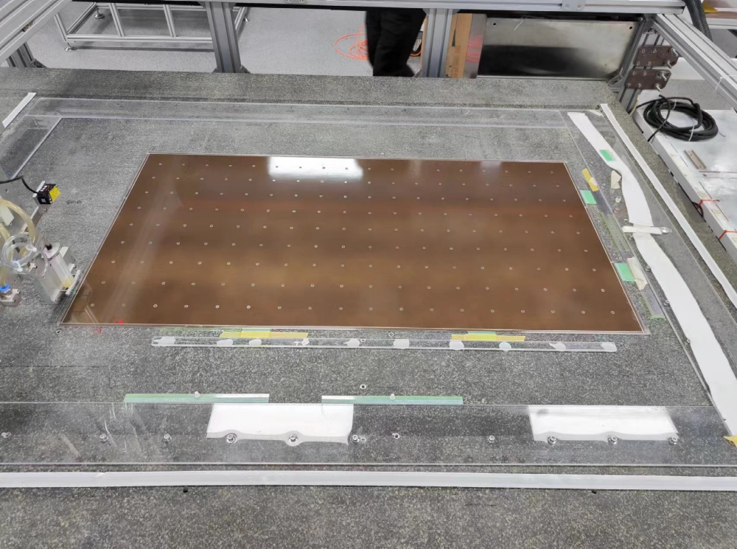

Resistive Plate Chamber gas gap
We consider a chamber as a closed and defined gas volume
The electrodes are kept at constant distance by a set of spacers placed at a distance such that the catenary profile in between 2 spacers is <<< of the gas gap
Having a more or less thin gas gap has pros and cons
Pro:
  higher time resolution
  Lower applied voltage
  The same charge, produces a higher saturation of the field
  Higher space resolution
Cons:
  Less statistics of primaries → the bottom line is $P\left(0\right)=e^{−\frac{d}{λ}}≤Eff$ where λ is the ionization mean free path
  Higher mechanical sensitivity
  Higher FE amplifier performance

Slide 20
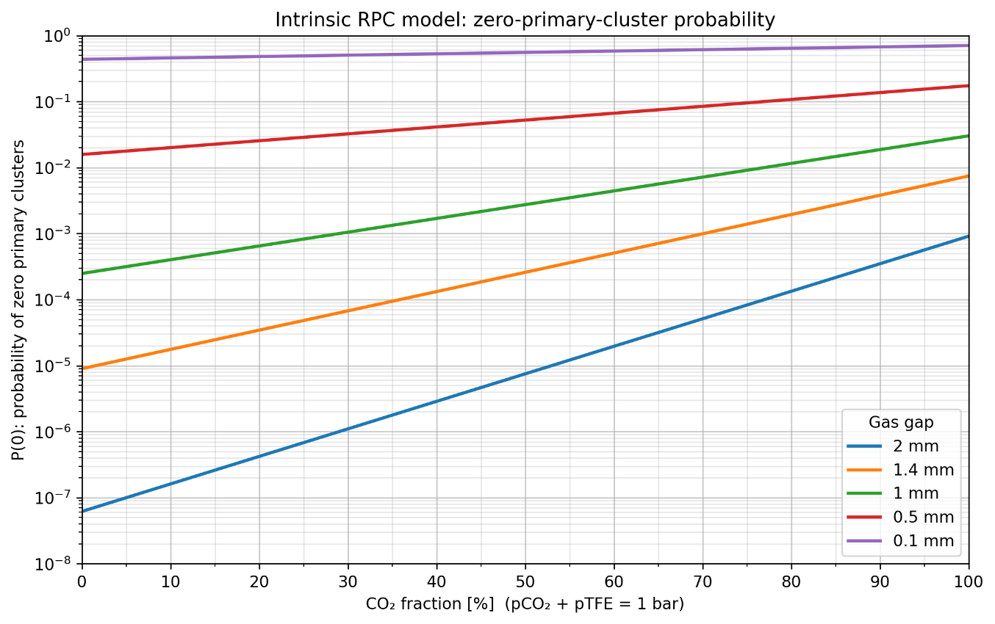
Primary Poisson probability and the useful gas gap
The total gaseous target sets P(0); only ionizations inside the useful region can generate a detectable avalanche.
PRIMARY-CLUSTER POISSON LIMIT
USEFUL GAP
Useful gap
gas gap
Useful gap
gas gap
The useful gap is empirical: it is the region where an ionization can develop into an avalanche large enough to be detected.
P(0) depends mainly on the total gaseous target: the gap thickness and the mixture density.
Consequence: Poisson P(0) is smaller than the observed inefficiency because not every primary ionization lies inside the useful gap.

Slide 21
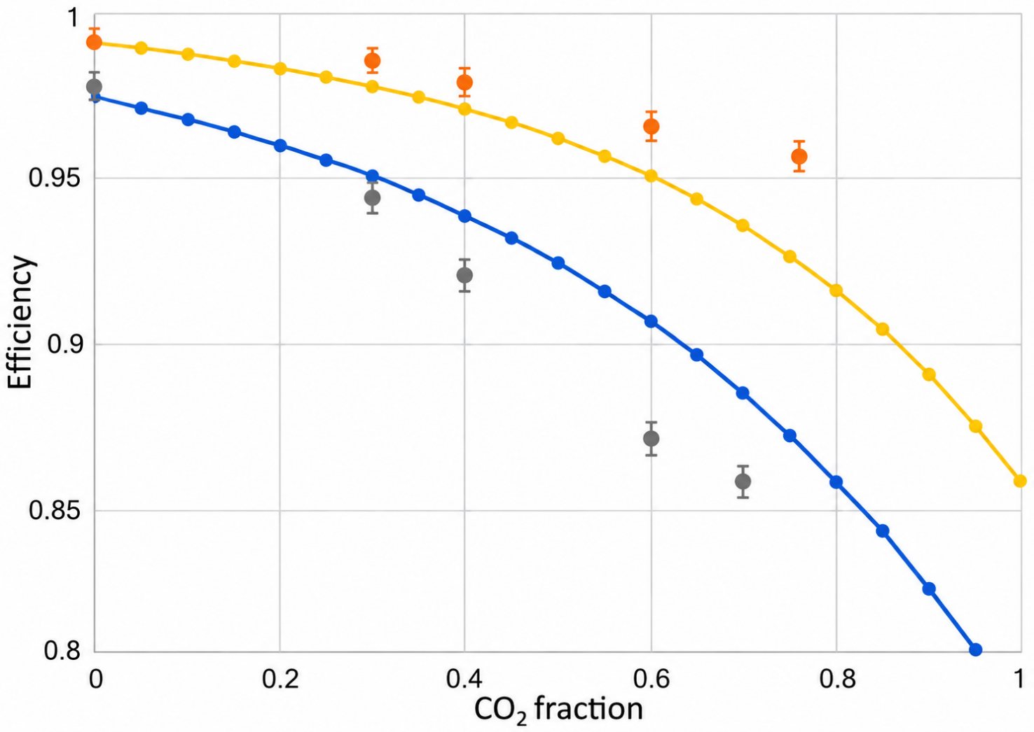
Effective maximum efficiency and constrained Poisson
1. Effective maximum efficiency
An empirical working value rather than a rigorous limit. Efficiency may still increase with HV, but at increasing operating cost.
2. Constrained Poisson prediction
The Poisson maximum from primary-cluster statistics versus gas composition, normalized to the Standard-mixture measured efficiency and assuming 100% acceptance.
3. Direct comparison
The Poisson curve follows the decrease approximately, but shows a growing quantitative difference and a different functional shape.
Equation placeholder: constrained Poisson normalization
Takeaway: the primary Poisson constraint is a baseline; detector-dependent response is required to describe the measured effective plateau.

Slide 22
Front-end electronics sensitivity test
TEST CONFIGURATION
Chamber: ATLAS-like layout [*]
Geometry: 2 mm gas-gap doublet with one test chamber and one monitoring chamber
Test readout: vertical strips equipped with ATLAS electronics
Reference readout: horizontal strips equipped with a high-sensitivity analog preamplifier, the baseline for the Phase-1 and Phase-2 upgrades
GIF++ EXPOSURE AND MEASUREMENTS
Beam and source exposure
Efficiency under irradiation
V–A curve
EXAMPLE GAS MIXTURE
0% R134a 88% CO₂ 10% i-C₄H₁₀ 2% R1233zd
Flammable and freon-free. Example only, not (yet) an official proposal.
OBJECTIVE Compare the two amplifiers event by event on the same avalanche signal.
Both electronics record each avalanche simultaneously.
[*] INSPIRE-HEP 2955768

Slide 23
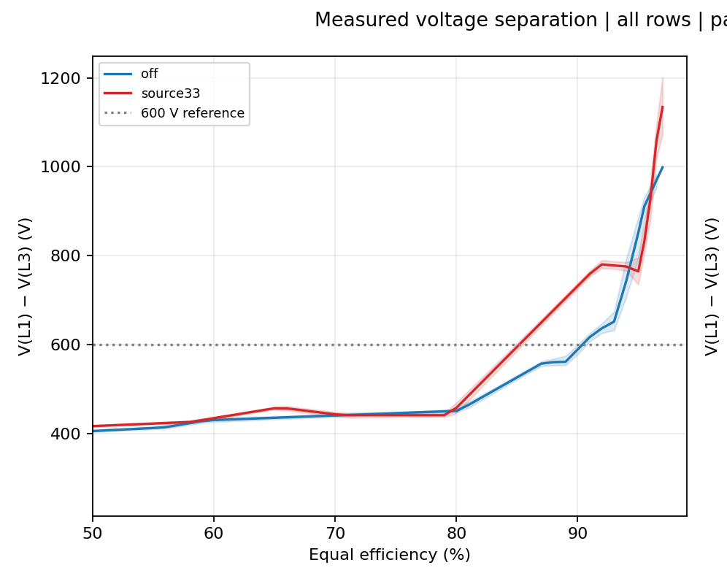
Voltage separation new vs. standard FE
Preliminary
DOI:10.5281/zenodo.22809853
800 V
We observe that
this freon free mixture, is unsuitable for a standard ATLAS chamber working at Efficiency > 90%
The sensitivity of the new electronics allows to catch very small signals lowering by more of 600V the working point → the mixture becomes fully workable in saturated avalanche regime

Slide 24
Efficiency and Fake tracks rejection
Balance of Efficiency and fake rejection:
  OR of layers boosts the efficiency and noise
  AND of layers boosts the fake rejection at expense of efficiency
  Majority (2oo3 3oo4) achieve both at expense of cost and bulkiness
The physics target influences the performance goals:
  Muon spectrometers are sensitive to single muons and rely on at most one hit per layer
  Vertex detectors can rely no at least 2 tracks, the signal is intrinsically much stronger
d
d
Fake vertex
Fake vertex
d
d

Slide 25
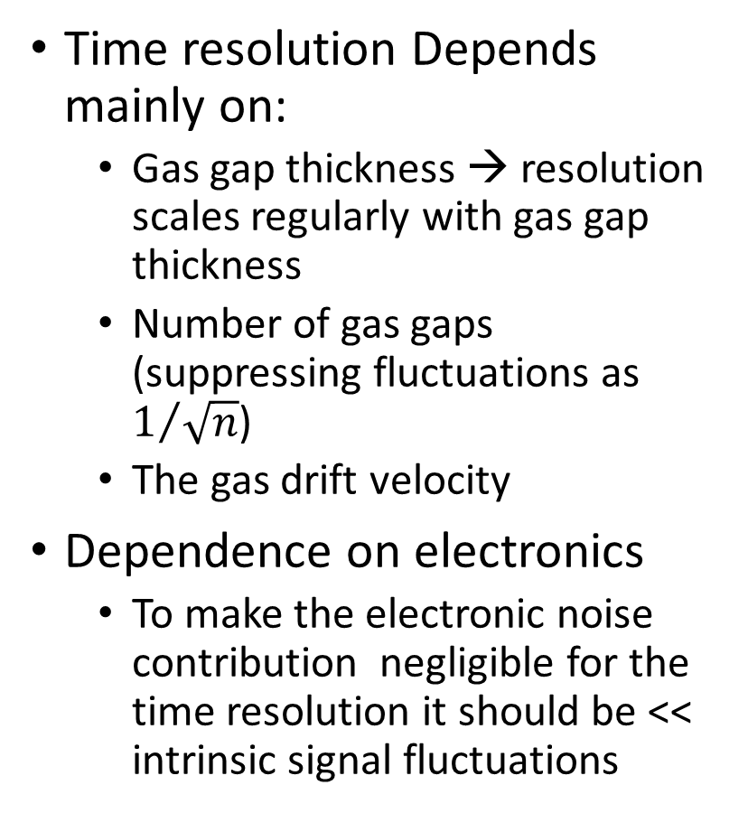
RPC design – time resolution
Time resolution taken for single gas gap and scaled for the number of gas gaps
Standard mixture
The yellow line il for total gas gap = 2 mm
Time resolution Depends mainly on:
  Gas gap thickness → resolution scales regularly with gas gap thickness
  Number of gas gaps (suppressing fluctuations as $1/{\sqrt{n}}$)
  The gas drift velocity
Dependence on electronics
  To make the electronic noise contribution negligible for the time resolution it should be << intrinsic signal fluctuations

Slide 26
RPC design – time resolution
Time resolution taken for single gas gap and scaled for the number of gas gaps
Standard mixture
The yellow line il for total gas gap = 2 mm
Overall performance
Target: > 2mm
Time res.: > 0.5 ns
Possible solutions:
Triplet with 1.5 mm < gas gap < 1.7 mm
  Double hit → 0.5 ns
  Triple hit → 0.4 ns
Doublet with gas gap = 2 mm
  R&D needed to improve single gas gap time resolution to 0.7 ns
  Single hit → negligible fraction
  Double hit → 0.5 ns
Doublet with a 1+1mm bi-gap
  Single hit → 0.2 ns
  Double hit → 0.13 ns

Slide 27
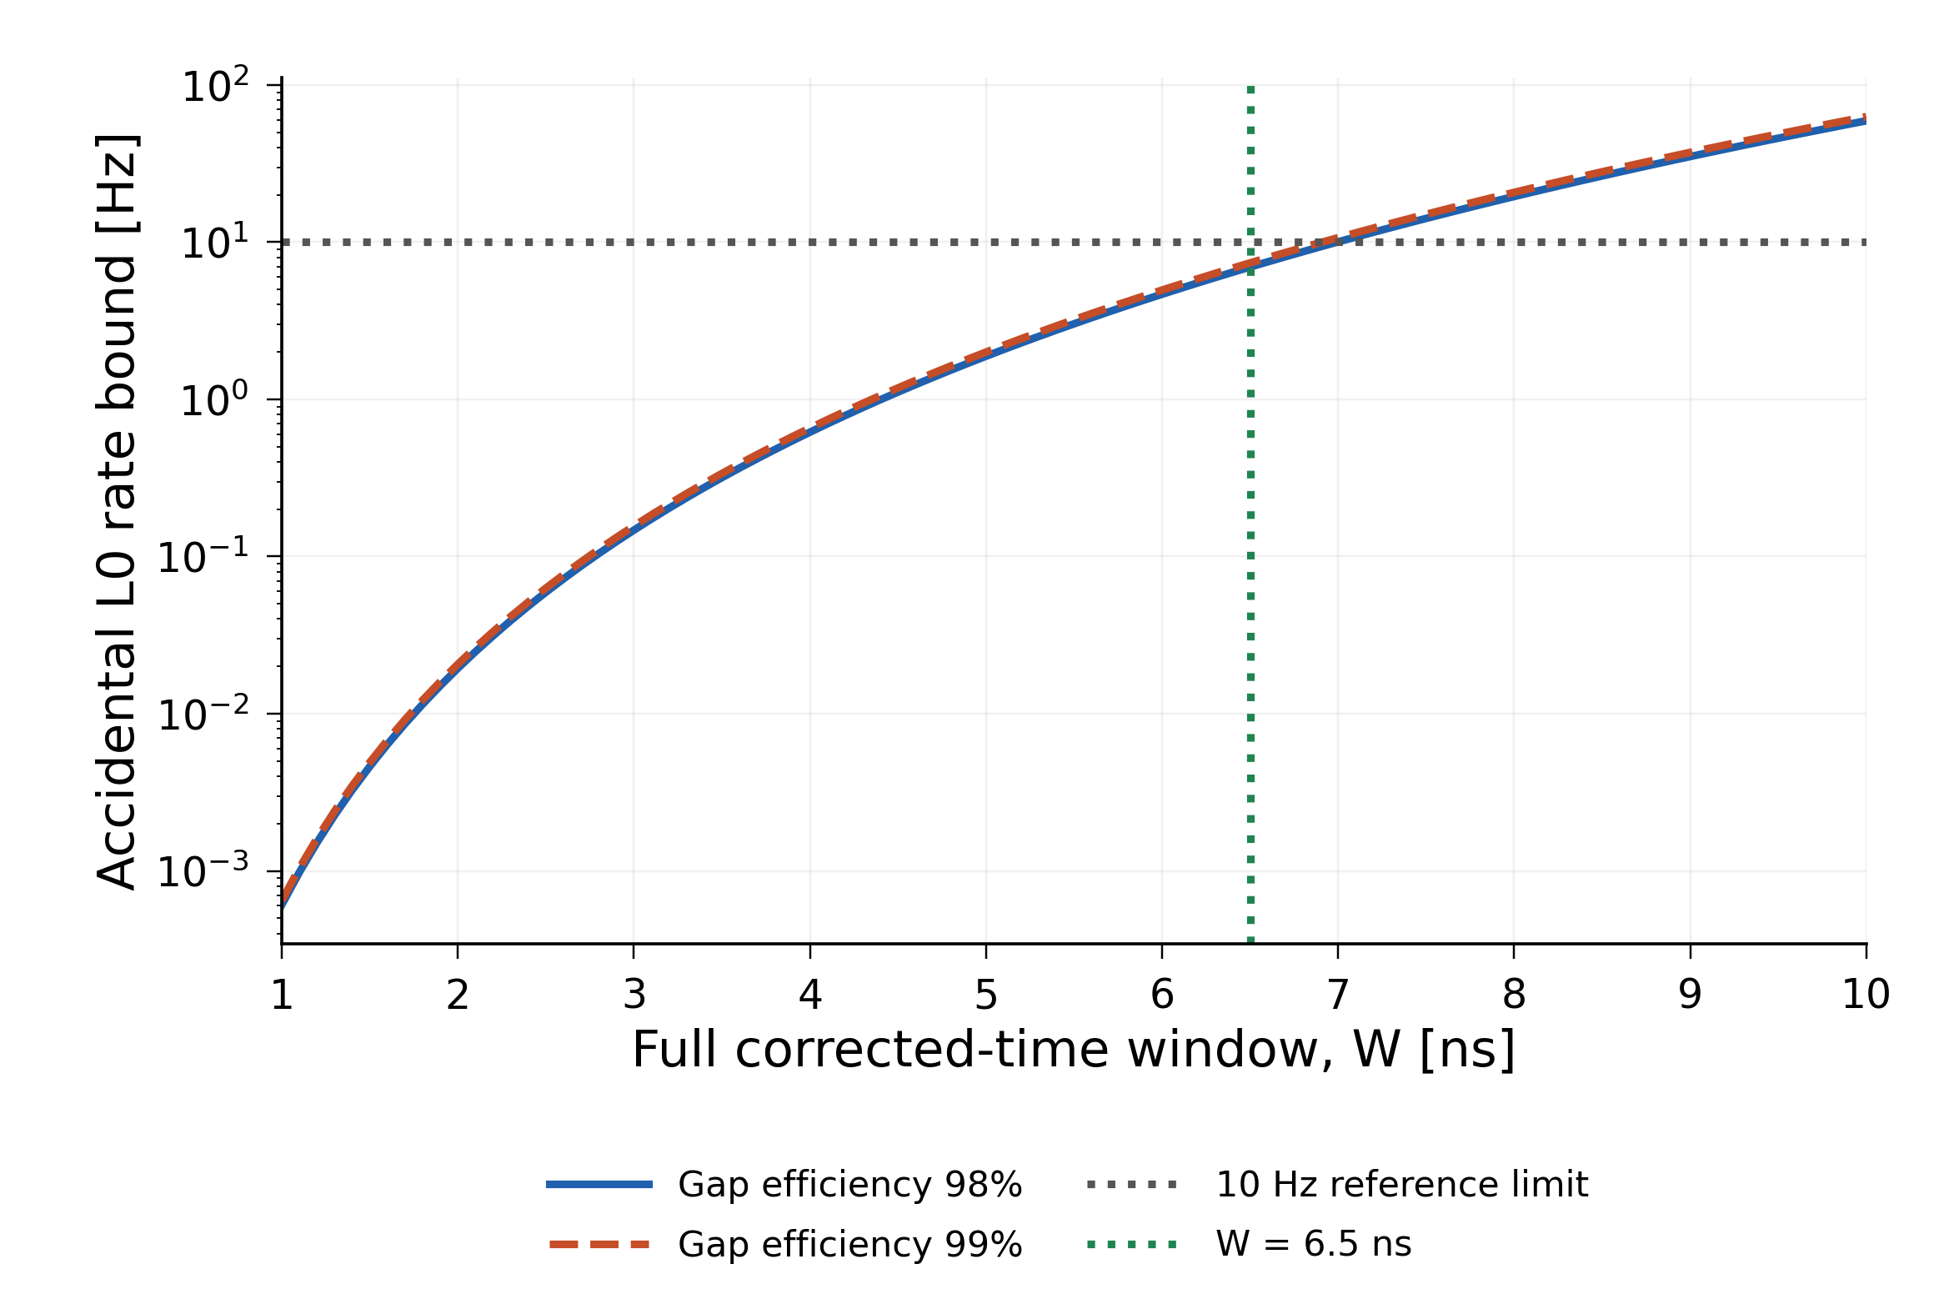
Six-hit RPC trigger: window dependence
1600 m² detector · stations at 25 and 26 m · adjacent gaps separated by 2 cm
At least six local hits are required across four gaps, with at most two contributions per gap. Rates sum 36 adjacent-pad combinations over the detector. For sparse occupancy, the accidental bound scales approximately as W⁵; exact Poisson values are plotted. W is a full sliding width after nominal light-flight offsets. Independent Poisson hits: 100 ε Hz/cm² per gap. No ATLAS selections are applied.
Notes:
At least six local hits are required across four gaps, with at most two contributions per gap. Rates sum 36 adjacent-pad combinations over the detector. For sparse occupancy, the accidental bound scales approximately as W⁵; exact Poisson values are plotted. W is a full sliding width after nominal light-flight offsets. Independent Poisson hits: 100 ε Hz/cm² per gap. No ATLAS selections are applied.
Source figure: 11_six_hit_l0_window.png. The plotted curves and numerical inputs are unchanged.

Slide 28
Next RPC design recipe
Select target efficiency → 99%
Select desired amount of CO2 → > 90%
Determine the total gas thickness needed per efficient unit → 2mm
Select the target Time resolution:
  1 ns → single 2 mm gas gap → simple robust and low cost
  400 ps → 1.4+1.4mm bi-gap --> CMS phase2 established resolution to be verified
  200 ps → 1+1mm bi-gap --> ATLAS phase2 established resolution to be verified
  80 ps → 2 x 0.5x0.5 mm bi-gap → critical R&D is necessary
2mm
2X1
0.5x4

Slide 29
Resistive Plate Chamber vs. amplifier
State of the art FE →
noise = 4000 e- RMS
Two parameters are important to determine the maximum rate capability:
  FE threshold
  Asymmetry of the charge distribution
  A perfectly saturated avalanche would produce a gaussian distribution
Threshold on the injected signal →
20000 e- RMS
Assuming to lose a factor 40 on the induction →
avalanche geometry x Ramo x readout strip
Gas gap optimization parameters:
As small as possible to achieve saturation with proportionally fewer electrons → 0.1 mm
Deep saturation also increases the induction efficiency
Below 1 mm gas gap P(0) is not negligible, and part of the advantage is lost due to the necessity of amplifying very unfavorable primary electrons (placed close to the anode) by increasing the electric field
Therefore, the MRPC use many tiny gas gaps
8*10^5 electrons for the minimum detectable signal
Rough assumptions on charge distribution for saturated avalanches
mode ≈ average ≈ 3 x minimum
Max ≈ 15 x minimum
Ideal case~ 0.4 pC
7.5 times better of the single gap state of the art (3 pC real case)
Worsening of FE performance proportionally reflects on <Q>
Correlation between narrower gas gap and FE threshold

Slide 30
Resistive Plate Chamber S/N
The RPC is typically a very large structure ( a few m^2)
A signal or a disturbance takes a few tens of ns to travel end to end
The amplifier and discriminator produce typically a fast transient resulting an in very high instantaneous current injected on the ground. This under any aspect is seen as a signal if the ground scheme is not able to dissipate or compensate it
There are the following types of noise:
  Self-induced current coupled noise (diaphonicity), the one above
  External noise coming from the environment, this can be dominant if the faraday cage is not strong enough
  Intrinsic electronic noise, of the order od a few hundred to a few thousand of electrons
  The first 2 are generally dominant unless the grounding is able to suppress them
Different RPC layout brought to different operative thresholds:
Legacy ATLAS – 20 fC one 2 mm gas gap
Legacy CMS – 40 fC two 2 mm gas gaps
Upgrade ATLAS 5 fC one 1 mm gas gap
Upgrade CMS 40 fC two 1.4 mm gas gaps

Slide 31
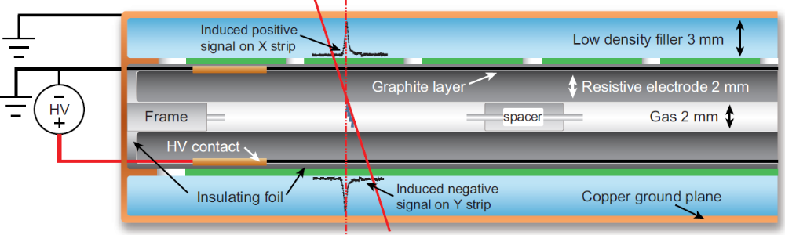
The RPC chamber: a stripline having the detector as dielectric
At the very origin of RPCs this was the driving concept for exploiting RPCs timing performance (R. Cardarelli private communication)
A large timing detector couldn’t be nothing but a fully matched stripline where the RPC is an “active” dielectric generating the signal internally
The strip line was meant to propagate without distortion the signal to the FE electronics, also matched to the line

Slide 32
Consideration on Ageing
Current it is used as a proxy for ageing effects but the same current may have very different effects

Slide 33

Ageing Test with 30% CO₂ + 0.5 % SF6
Results:
The ohmic current remains excellent and stable over time.
The electrode resistance was initially high, then increased by approximately 25% after the first exposure to radiation, and has remained stable since.
Target →Full HL-LHC program corresponds to ~ 3000 fb⁻¹
Approximately 42% of this target has been reached, corresponding to about 1250 ${fb}^{−1}$

Slide 34

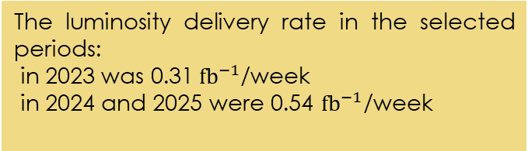
Comparison of STD & New RPC Gas Mixtures in ATLAS Cavern
Calibration current ): Current measured at the operating voltage without beam-induced background. For a stable detector, it should remain constant with accumulated charge
I_{calib} growth rate ≈ 0 → no current increase with accumulated charge
Results:
The mixtures with reduced fluorinated-gas content show distributions more concentrated around zero
→ smaller increase in the rate of I_{calib}.
Halving the SF₆ fraction further reduces $I_{calib}$, due to lower dark-current contribution.
The luminosity delivery rate in the selected periods:
in 2023 was 0.31${ fb}^{−1}$/week
in 2024 and 2025 were 0.54 ${fb}^{−1}$/week
Notes:
İn 2023 you dont have a stable flat top, the run is going down immedşately the integrated lumi is less, moreover the period of the lumi is much higher in 2025 so we tried to normalise it by a constant.

Slide 35
RPC Strength vs. weakness diagram
Continuous resistive electrode structure
Gaseous target and multiplication coincide
Cluster number and depth
Cluster size fluctuations
Multiplication fluctuations
Simple and robust construction
prompt avalanche → high time resolution and efficiency
Very wide avalanche charge range and high <Q>
Spark free
The Gain is a free parameter in RPCs which can be used to match the primary ionization of even just one electron with the
High operating current
transition to streamer
limitation to rate capability
Low cost
Easy to scale single module dimension to a few m^2 at constant unit cost and complexity
Implications:
challenging electronics
“low” resistivity electrodes
electronegative gases
Thin multi-gaps

Slide 36
RPC construction sites

Slide 37
Summary of the gas gaps production sites
Classic RPCs – main sites (known to me)
GTE (Colli – FR) it is the historical site where most of the classic RPCs have been built (ATLAS-CMS-ARGO-OPERA-BaBar etc)
Production in Korea for CMS (see next slides)
Production at MPI for ATLAS (new entry)
Production at USTC (new entry)
MRPCs
Smaller productions – lab driven

Slide 38
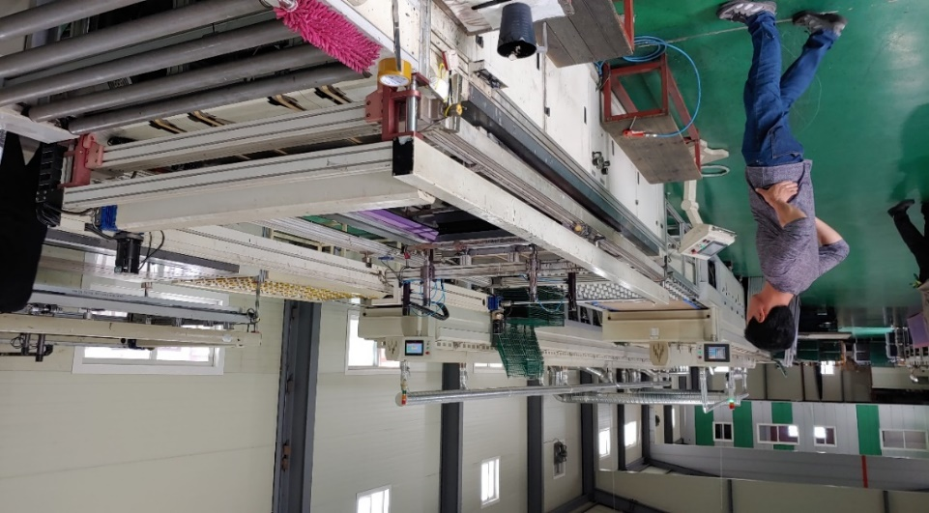
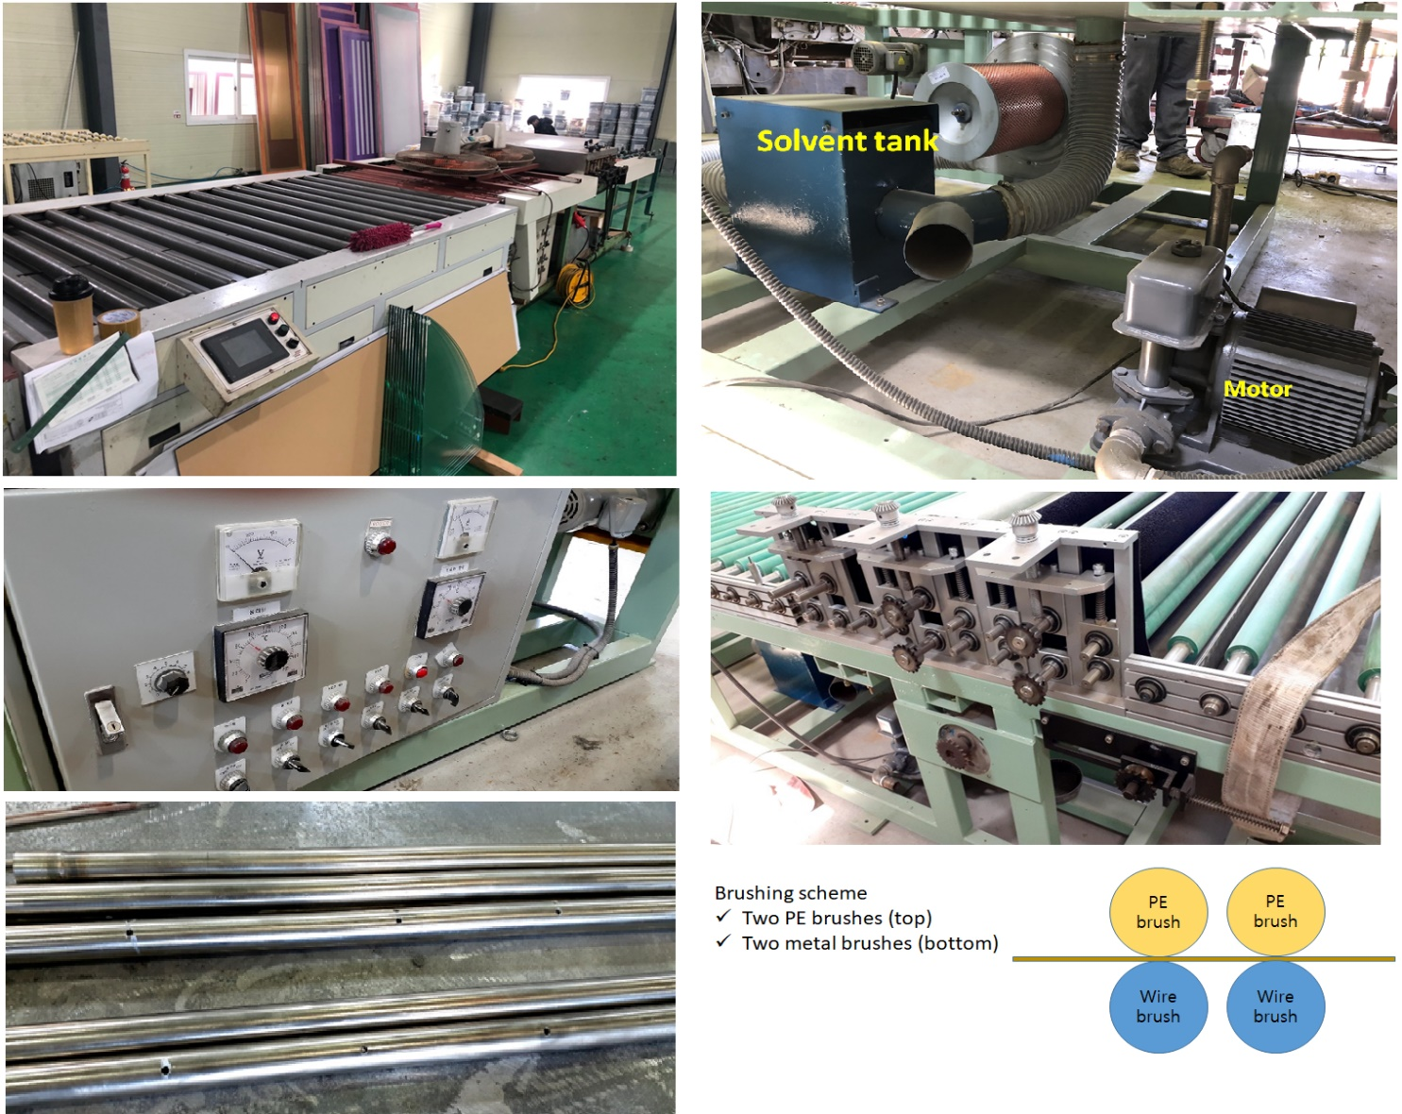
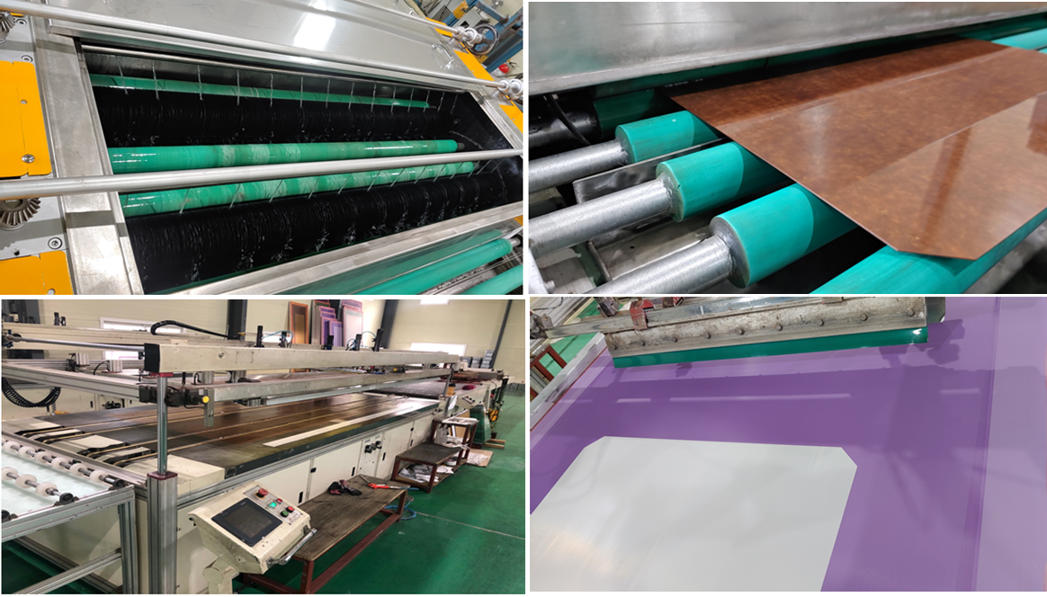
Outsourcing to private companies
Graphite printing facility
More uniform surface resistivity ranging from 300 to 700 kΩ/sq
Brushing and washing with MEK for HPL

Slide 39
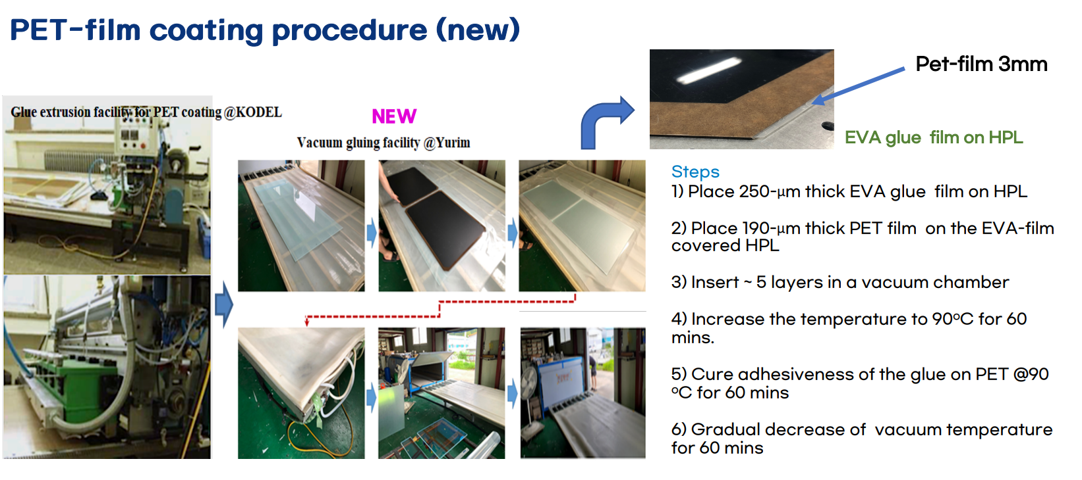
Outsourcing to private companies

Slide 40
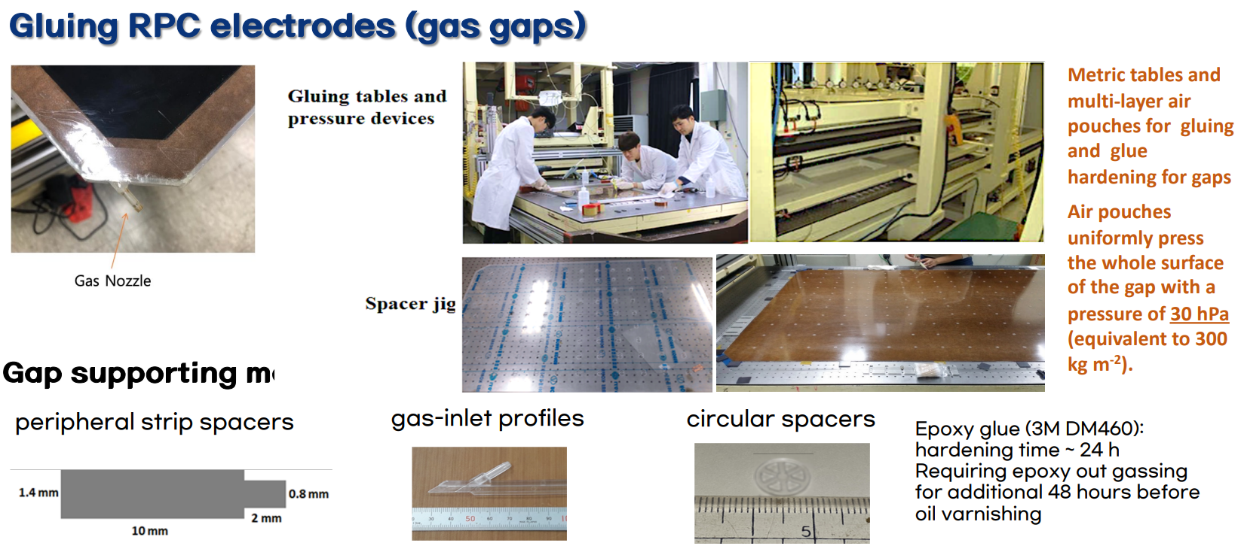
At KODEL
Minho Kang at KPS meeting on April 2020

Slide 41
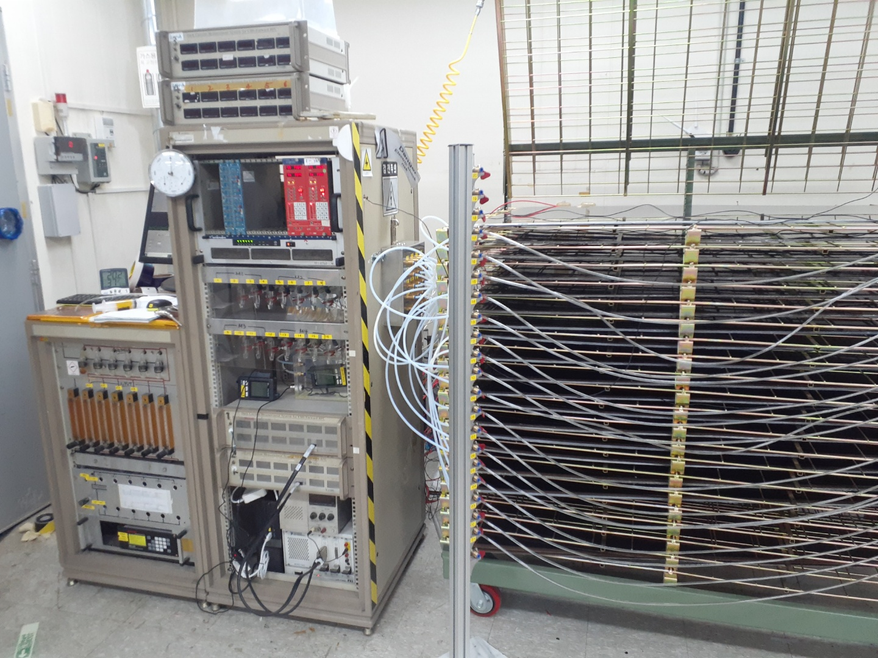
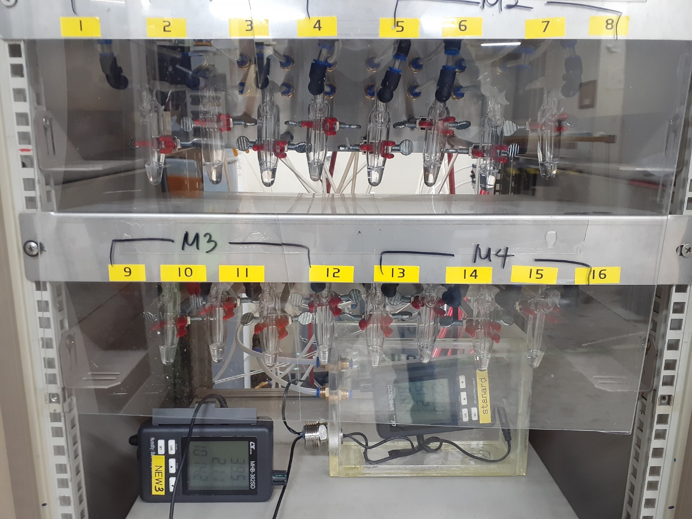
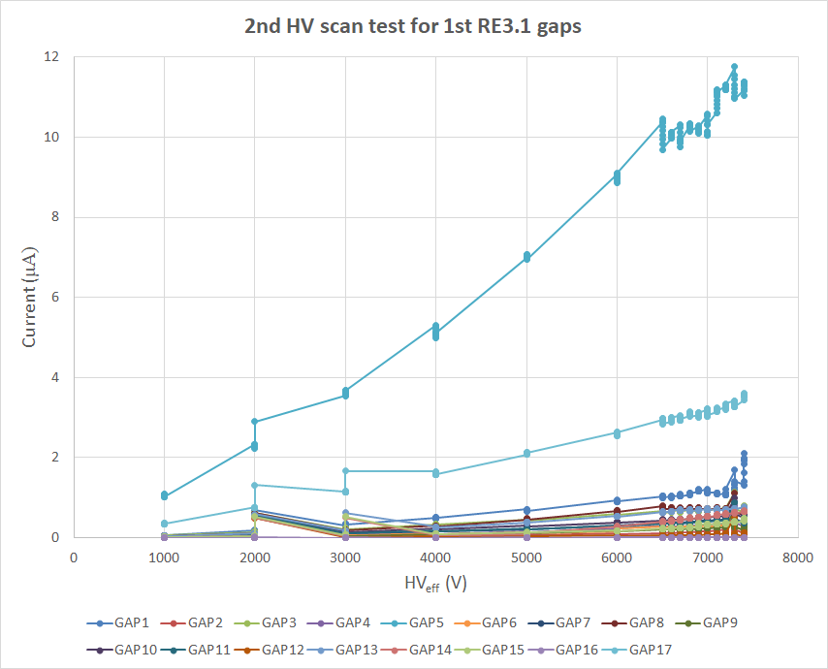
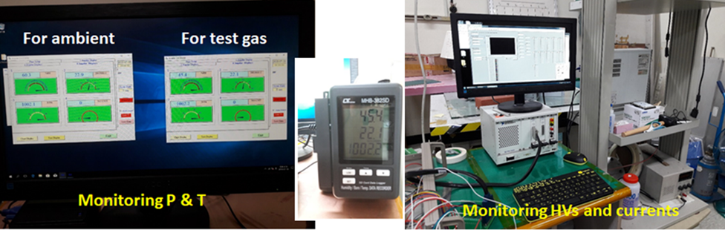
At KODEL
QC2 step2: three-step HV tests
1st HV scan test
Long-term test for 120 hours
2nd HV scan test
Operational gas = 95.2% TFE + 4.5% isobutene + 0.3 SF₆ with Gas humidity = 40%
Requirements:
For Ohmic current: current limit = 0.5 μA @5.0 kV
For operation: current limit = 2 μA at effective HV (7.5 kV)
QC data for HV tests: csv excel format for currents, P, T, H (gas & ambient)
2nd HV scan test for 1st RE3.1 gaps
Two gaps are rejected

Slide 42



MPI: qualification of 2 industrial producers
The 2 producers are followed up directly by MPI personnel and based on the same design and equivalent procedure been implemented by INFN at GTE
PHASE-0: Optimization of the production steps in interaction with companies
PHASE-1: Qualification of companies with test-sample prototypes
PHASE-2: Qualification of companies with both small- and real-scale prototypes
The series production is planned to start for September 2024
Website: https://www.mirion.com/
we are HERE!
Website: https://www.ptsmaschinenbau.com/
Certification plan
Small- and real-scale RPCs will undergo long-term irradiation for half a year in the CERN GIF++
Small and real scale prototypes per each company + dummies for oiling QC
Small scale RPC are produced and just started irradiation at GIF++
Real scale prototypes are under construction

Slide 43
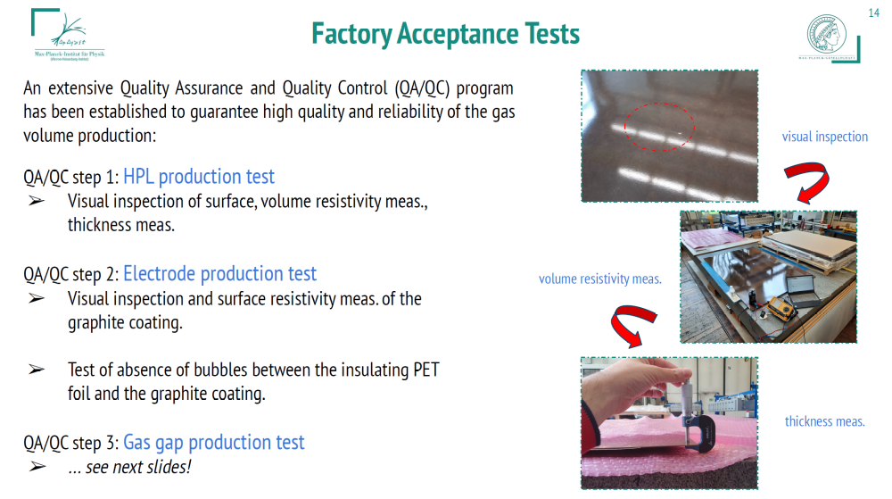
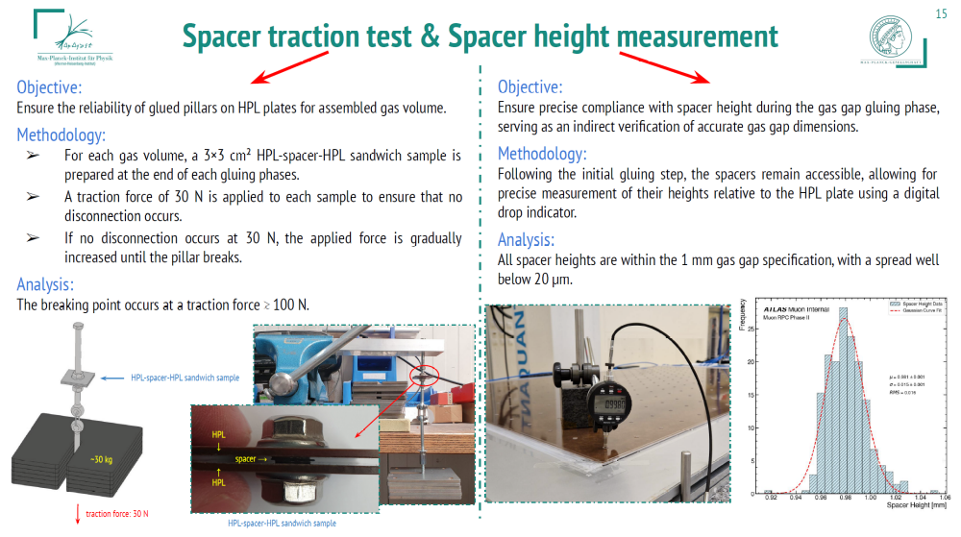
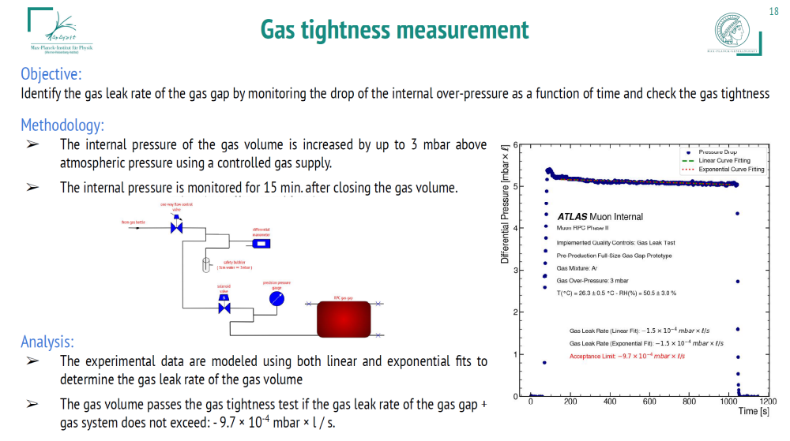
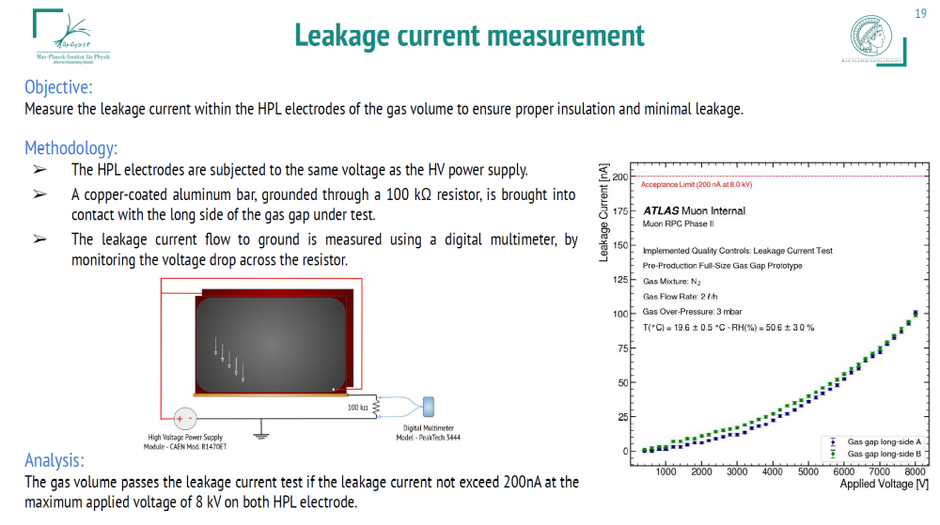

Slide 44
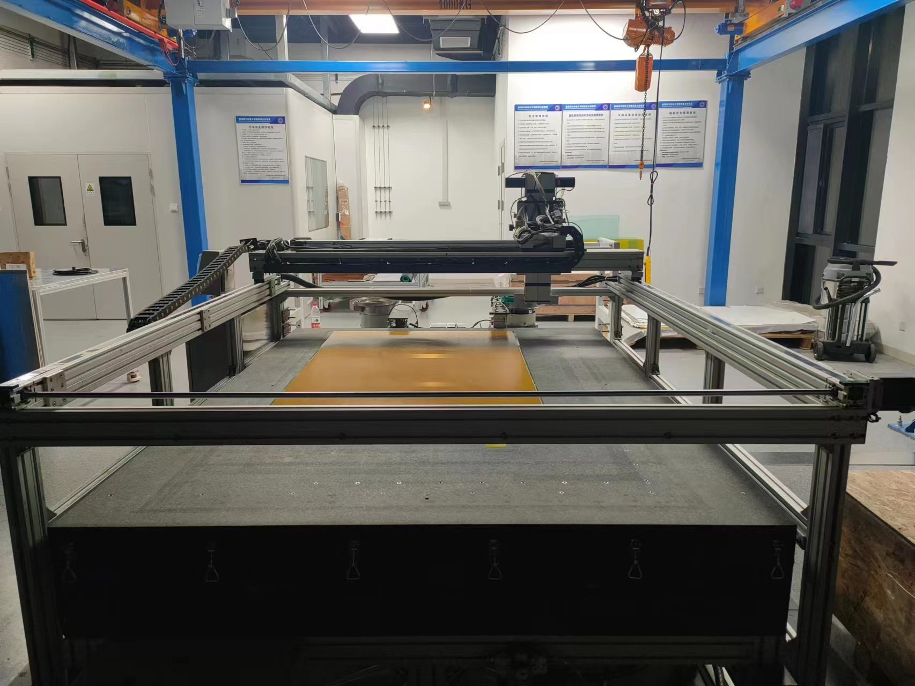
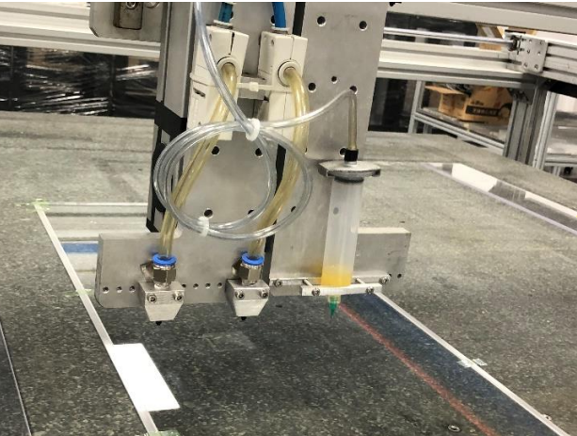
The platform of gas gap production at USTC
A marble table as base:
2.5m×1.8m
A head stock supported by a
gantry moving in 2-dimentional
9 holes among the table
are connected to the
vacuum system.
Spacer pickers
Glue syringe

Slide 45
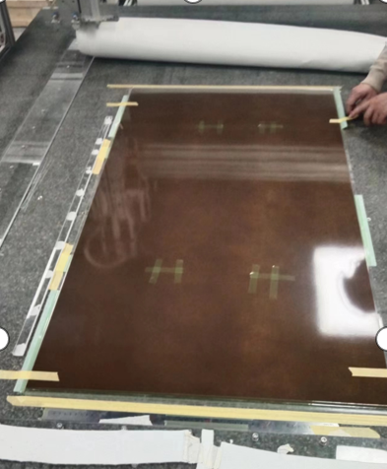
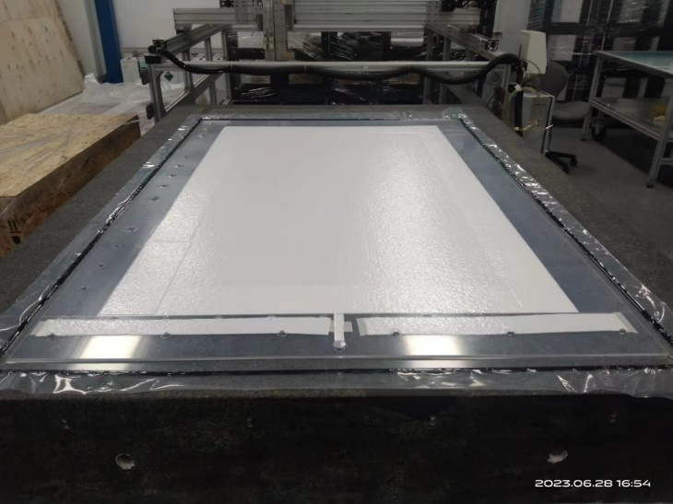
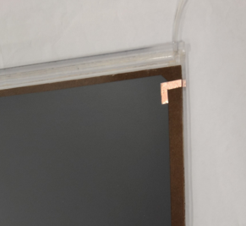
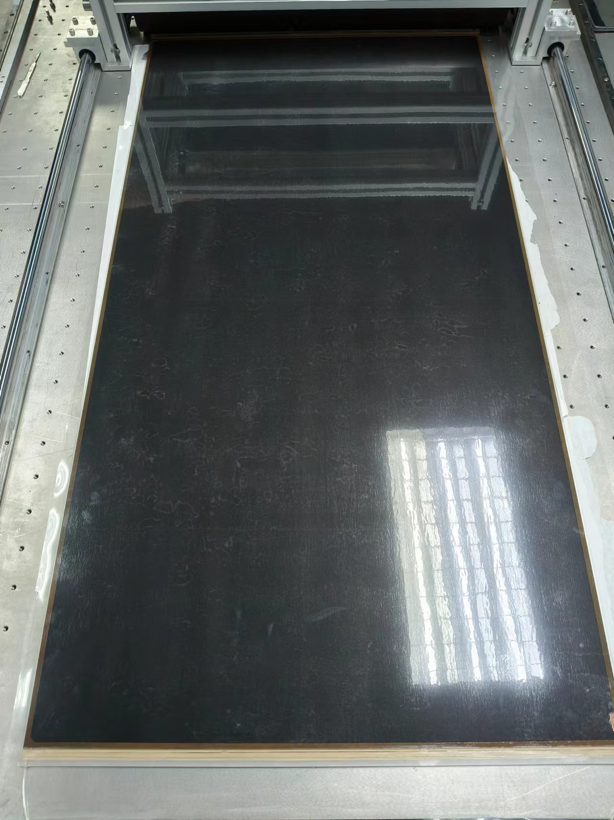
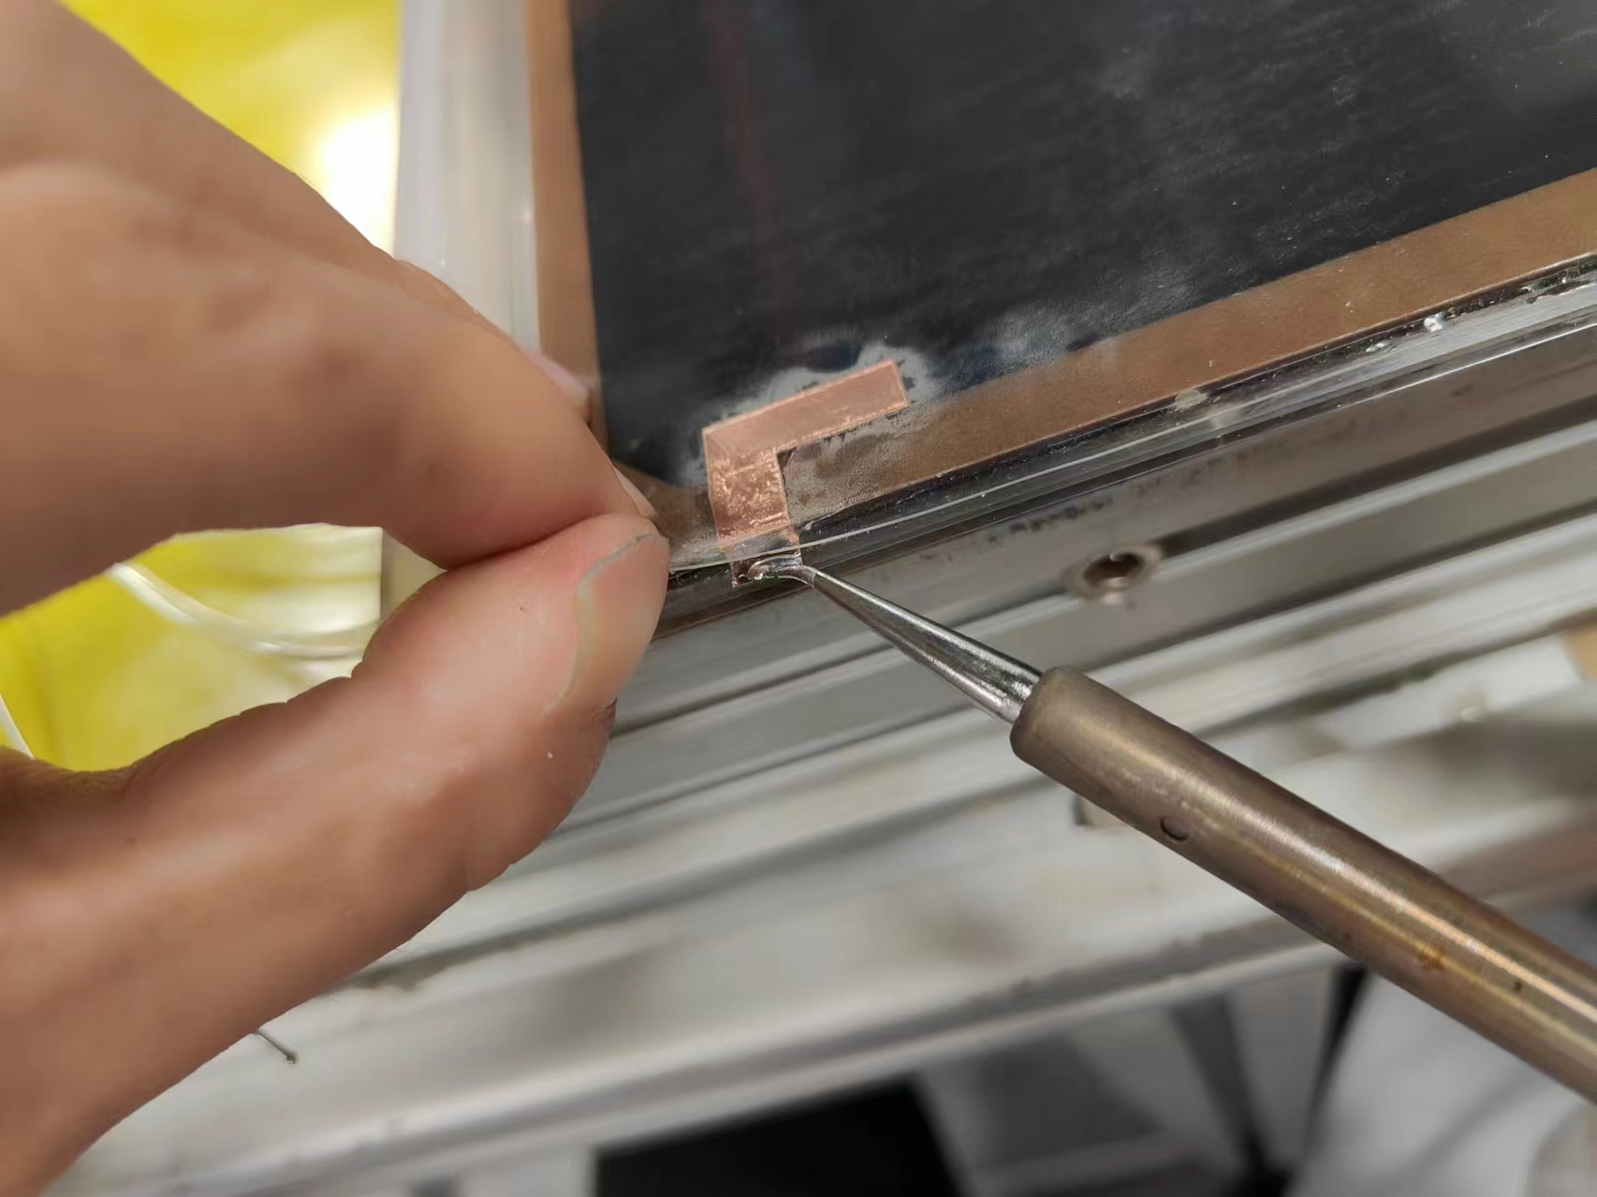
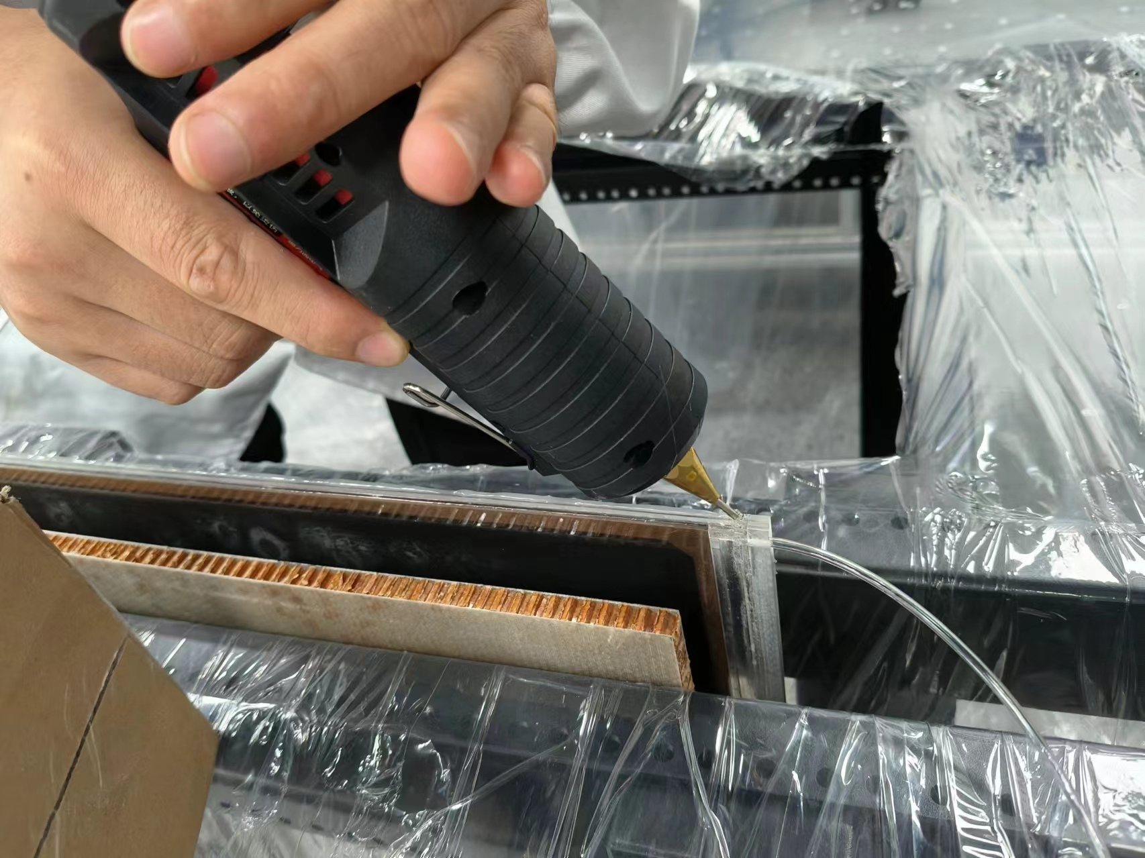
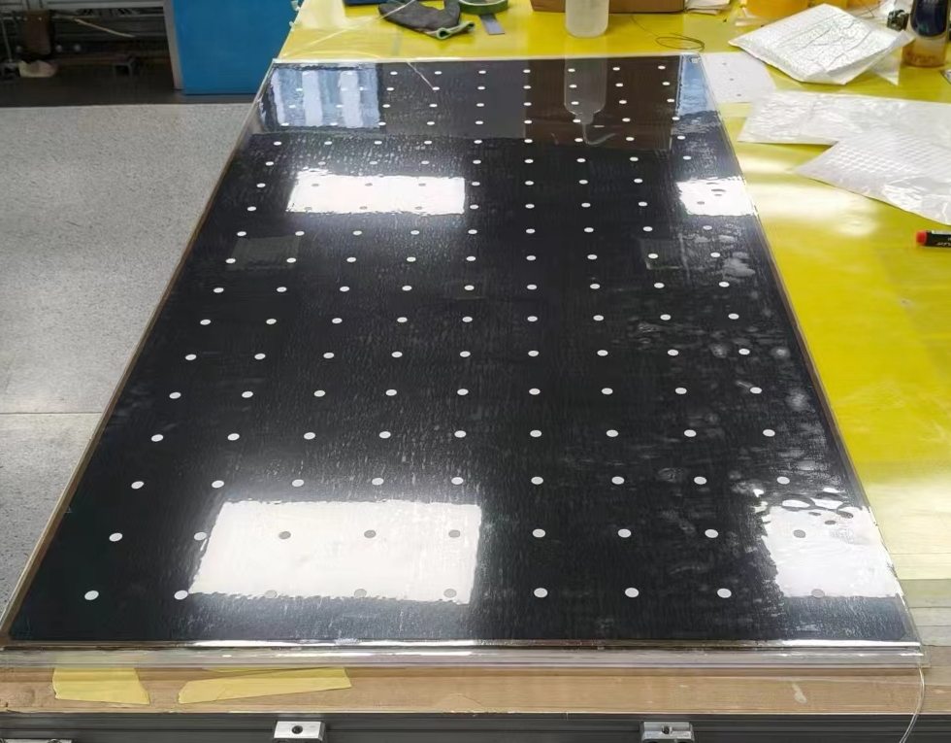
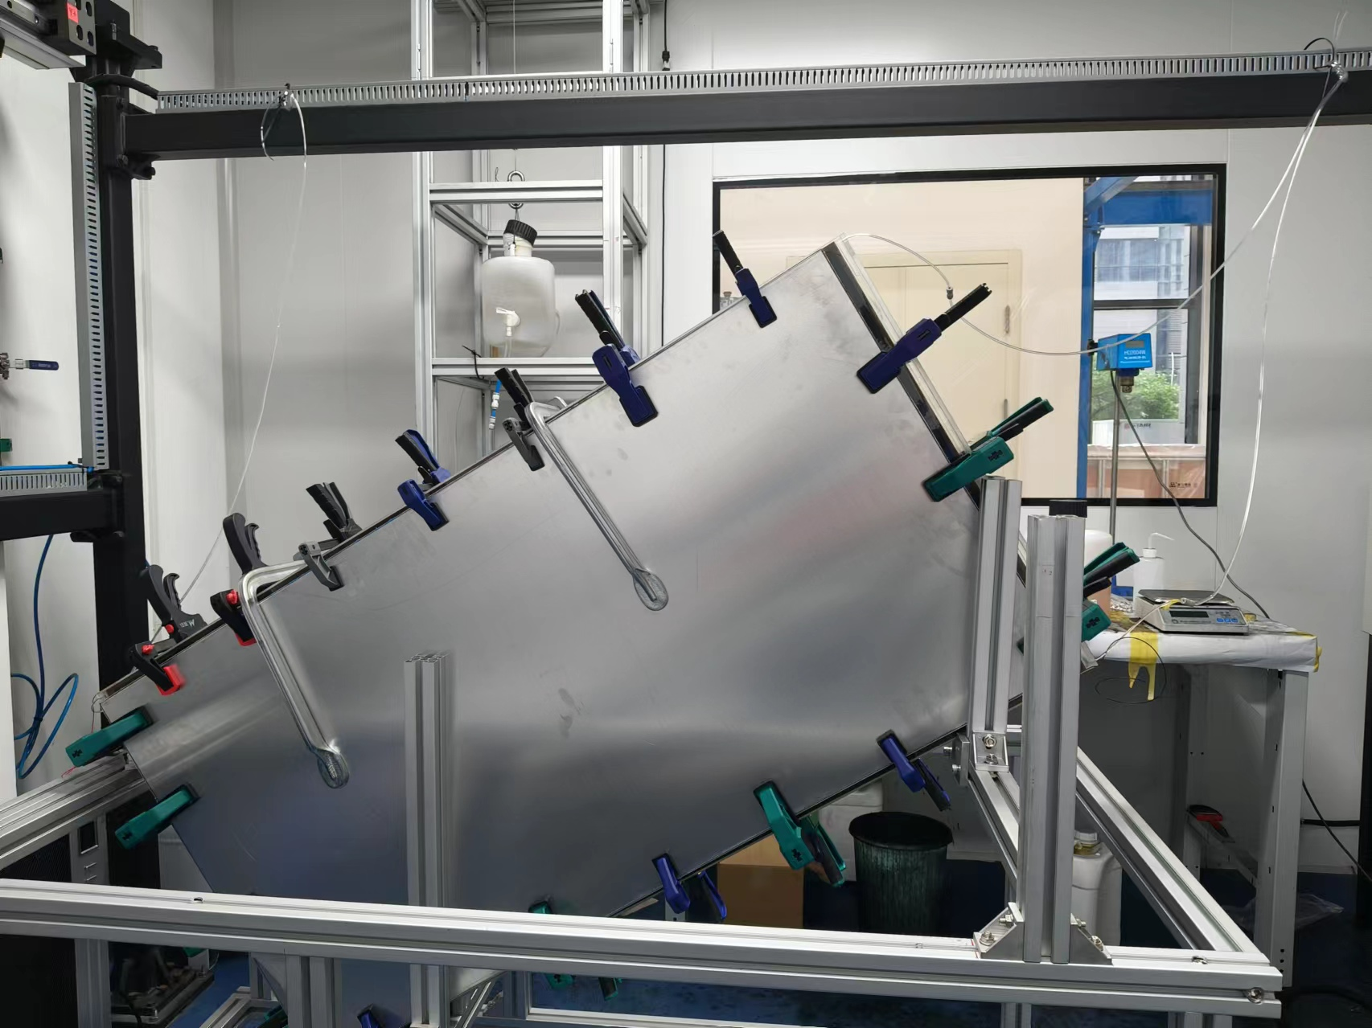
Production steps

Slide 46
Backup

Slide 47
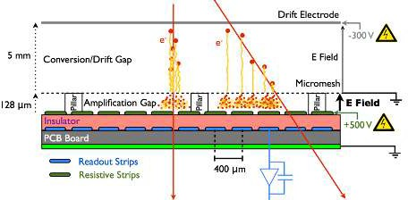



Space resolution principles
MPGD
Space resolution is driven by 2 factors
  Intrinsic localization of the event
  Precision of the chamber geometry
RPCs
Wire chamber
$$E≈\frac{1}{r}$$
Tubes and MWPC exploit the R-t relation of the ions drifting in the gas and rely on their metallic bulks which can be easily machined to offer a precise reference frame. Can obtain high precision with low channel density
RPCs and MPGD exploit electrostatic induction of the moving charges to calculate the charge centroid. The resolution is driven by the readout system segmentation and mechanical precision preserving it on large multi-layer chambers made of composite materials. Can obtain high precision with high channel density

Slide 48


The Physical model

Slide 49

Yet another method: strip drift time
Challenging readout for future colliders
$$∆x_{1}=v/{\sqrt{2}}∆t$$
t1
x1
t0
Fast leading signals for thin gas gaps
New generation of inexpensive ~ 1ps TDCs
Propagation speed 15 cm/ns
100 μm precision is the target
Can be replicated in 2D
Accurate reconstruction of multiple tracks
x2
t2
G. Aielli et al 2017 JINST 12 C01057

Slide 50



Space resolution performance
RPCs and MPGDs
ATLAS MMGAS
  resolution ~ 100μm with 0.4 mm strips
The drift gap is large → impact angle worsen resolution corrections needed (micro-TCP method)
Affected by the B field
A lot of care needed in construction
Proof of principle on a small MRPC
  resolution ~ 50μm with 4 mm strips
  RPC less sensitive to the angle → smaller gas gaps and a single dominant cluster
1m2 1mm gas gap ATLAS prototype reaching 1mm space resolution with 2.7cm strip pitch! Up to 10 kHz/cm^2 at GIF++
Space resolution is not a classic RPCs performance, though physics is not preventing it...
MMGAS
MRPC
Planar technologies need further R&D for a simple and reliable structures to emulate DTs
Atlas upgrade prototype
Space resolution

Slide 51


Time resolution principles
Time resolution is driven by
  Avalanche statistical fluctuations
  Drift time (velocity x gap size)
  Electronics noise
Wire chamber
MPGD
$$E≈\frac{1}{r}$$
MWPC and MPGD work on similar principles: the separation of the drift and multiplication introduces irreducible uncertainty on the time resolution, dependent on the drift width
RPCs and MRPCs drift and multiplication space coincide. The multi-micro gap RPC segments the gas gap to further reduce the drift time

Slide 52




RPC time resolution
Time resolution is one of the main RPC features
Golden standards: MRPCs ~50 ps -- RPCs ~500 ps
complex physics behind: cluster statistics, multiplication dynamics, electronic noise
Empirically smaller gas gaps → higher resolution
  Smaller gas gaps can be operated at higher electric field and have a faster multiplication dynamics compressing noise fluctuations
As one learn from other detectors the electronics noise plays a role
ATLAS Upgrade 5 pC → 4 $f$C FE th. → 4x10³ e-
ATLAS Upgrade 6 pC → 40 $f$C FE th. → 4x10⁴ e-
ATLAS and CMS 30 pC 50 $f$C FE th. → 5x10⁴ e-
Challenge: resolution beyond 50 ps
with more and thinner gas gaps, e.g, 20 ps with 24, 0.16 mm gaps [10.1016/j.nima.2008.06.013]
Thinner electrodes → higher signal
Low noise high resolution FEE (picoTDC) https://kt.cern/technologies/picotdc
Innovative approach →
going beyond the gas gap width law
extract hidden information beyond discr. and slew correction
Promising the use of DNN to filter the complex avalanche dynamics → 16 ps achieved! [arXiv:2005.03903v1 [physics.ins-det] 8 May 2020]

Slide 53



Drift based detectors time resolution
Atlas MMGAS
DT drift spectrum is by construction unsuitable for timing as a long drift time is used for high space accuracy
ATLAS Thin gap chambers → 6-7 ns
Typical Micromegas, GEM, μRWELL 10 ns
A proposal to get rid of the drift variations is to hybridize a MMGAS with a photo-cathode and a Cherenkov radiator. Resolution ~ 50 ps driven just by the single avalanche process, like in MRPC
Atlas sMDT
Drift detectors and limited in time resolution and an optimal strategy is combining a drift detector with an RPC to have a combined performance.
MPGD have a barely sufficient resolution for identifying the BC at 25 ns but it can be improved by using multiple layers for the 5ns scenario
The idea to combine a Cherenkov and a MMGAS can provide a good timing in the very high rate regions (why not an RPC?)

Slide 54
Present limits – rate and longevity
Rate capability [RPCs and MPGDs]
Electrode resistivity to prevent discharges in RPCs and MPGDs but limits rate capability:
  ΔV = <Q> x freq. x R
<Q> is very favorable in MPGDs
Longevity: Bulk materials insensitive to radiation, but
  radicals produced in RPC avalanches affect the electrodes
  High ionization may induce discharges in MPGDs progressively damaging the detector
Rate capability(drift chambers)
Limited by the space-charge effect
Effect reduced with R^3 → R=1/2 → rate = 8x (drift time x cross section)
Longevity: Bulk materials insensitive to radiation, but
  Gas purity is very important to avoid ageing
  no discharges possible (geometrical quenching)
  No observed ageing in such conditions
Reduction of <Q> improves rate capability and longevity at the same time
  by improving the S/N on the FE electronics
  by improving the signal collection efficiency
Lowering R improves rate capability only
  Lower resistivity materials
  Thinner electrodes
Achieving high rate by brute force reduction of R (without reducing at the same time the E field) may lead to instable detectors
Keeping the gas clean is the key to preserve the electrode longevity

Slide 55


High rate for single gap RPCs
limited by Ramo theorem (~1/20 of <Q> is usable)
low resistivity electrodes made of HPL (~10¹⁰ Ω cm)
SiGe FE tech. with 4k e- noise to reduce <Q>
Reaching up to 10 kHz/cm² in production chambers
Suitable for safe operation with eco-gas mixture
Up to~10 kHz/cm²
FFC full TARGET → improve by a further order of magnitude by increasing S/N and lowering R:
Last generation SiGe etero-junction technologies (fT 0.7 THz) announce a further x 10 leap in the FE → 500 e- noise reduction
A new device: single gap semi-conductor RPC
[electronic carriers can not be depleted]
  0.6 mm GaAs electrodes
  Resistivity 1.4×10^8 Ωcm
  Tested up to > 40 kHz/cm²
  > 1 MHz/cm² is possible
  Active area 6.25 cm²
  10.1088/1748-0221/15/12/C12004
LHC → 30pC
For further exploiting the electronics:
Faster avalanche
Very efficient grounding
1mm gas gap
HL-LHC → 5pC
FFC → 1-2 pC

Slide 56


Slide 57


Slide 58

BIS singlets assembly (Training @ BB5)

